Slide 1


Troubleshooting and Repairing Onsite & Decentralized Systems
Ben Kele, Tim Woods, & Andrew Kele

Slide 2
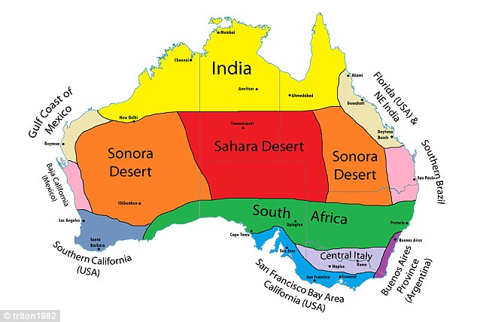
Climate Map of Australia

Slide 3
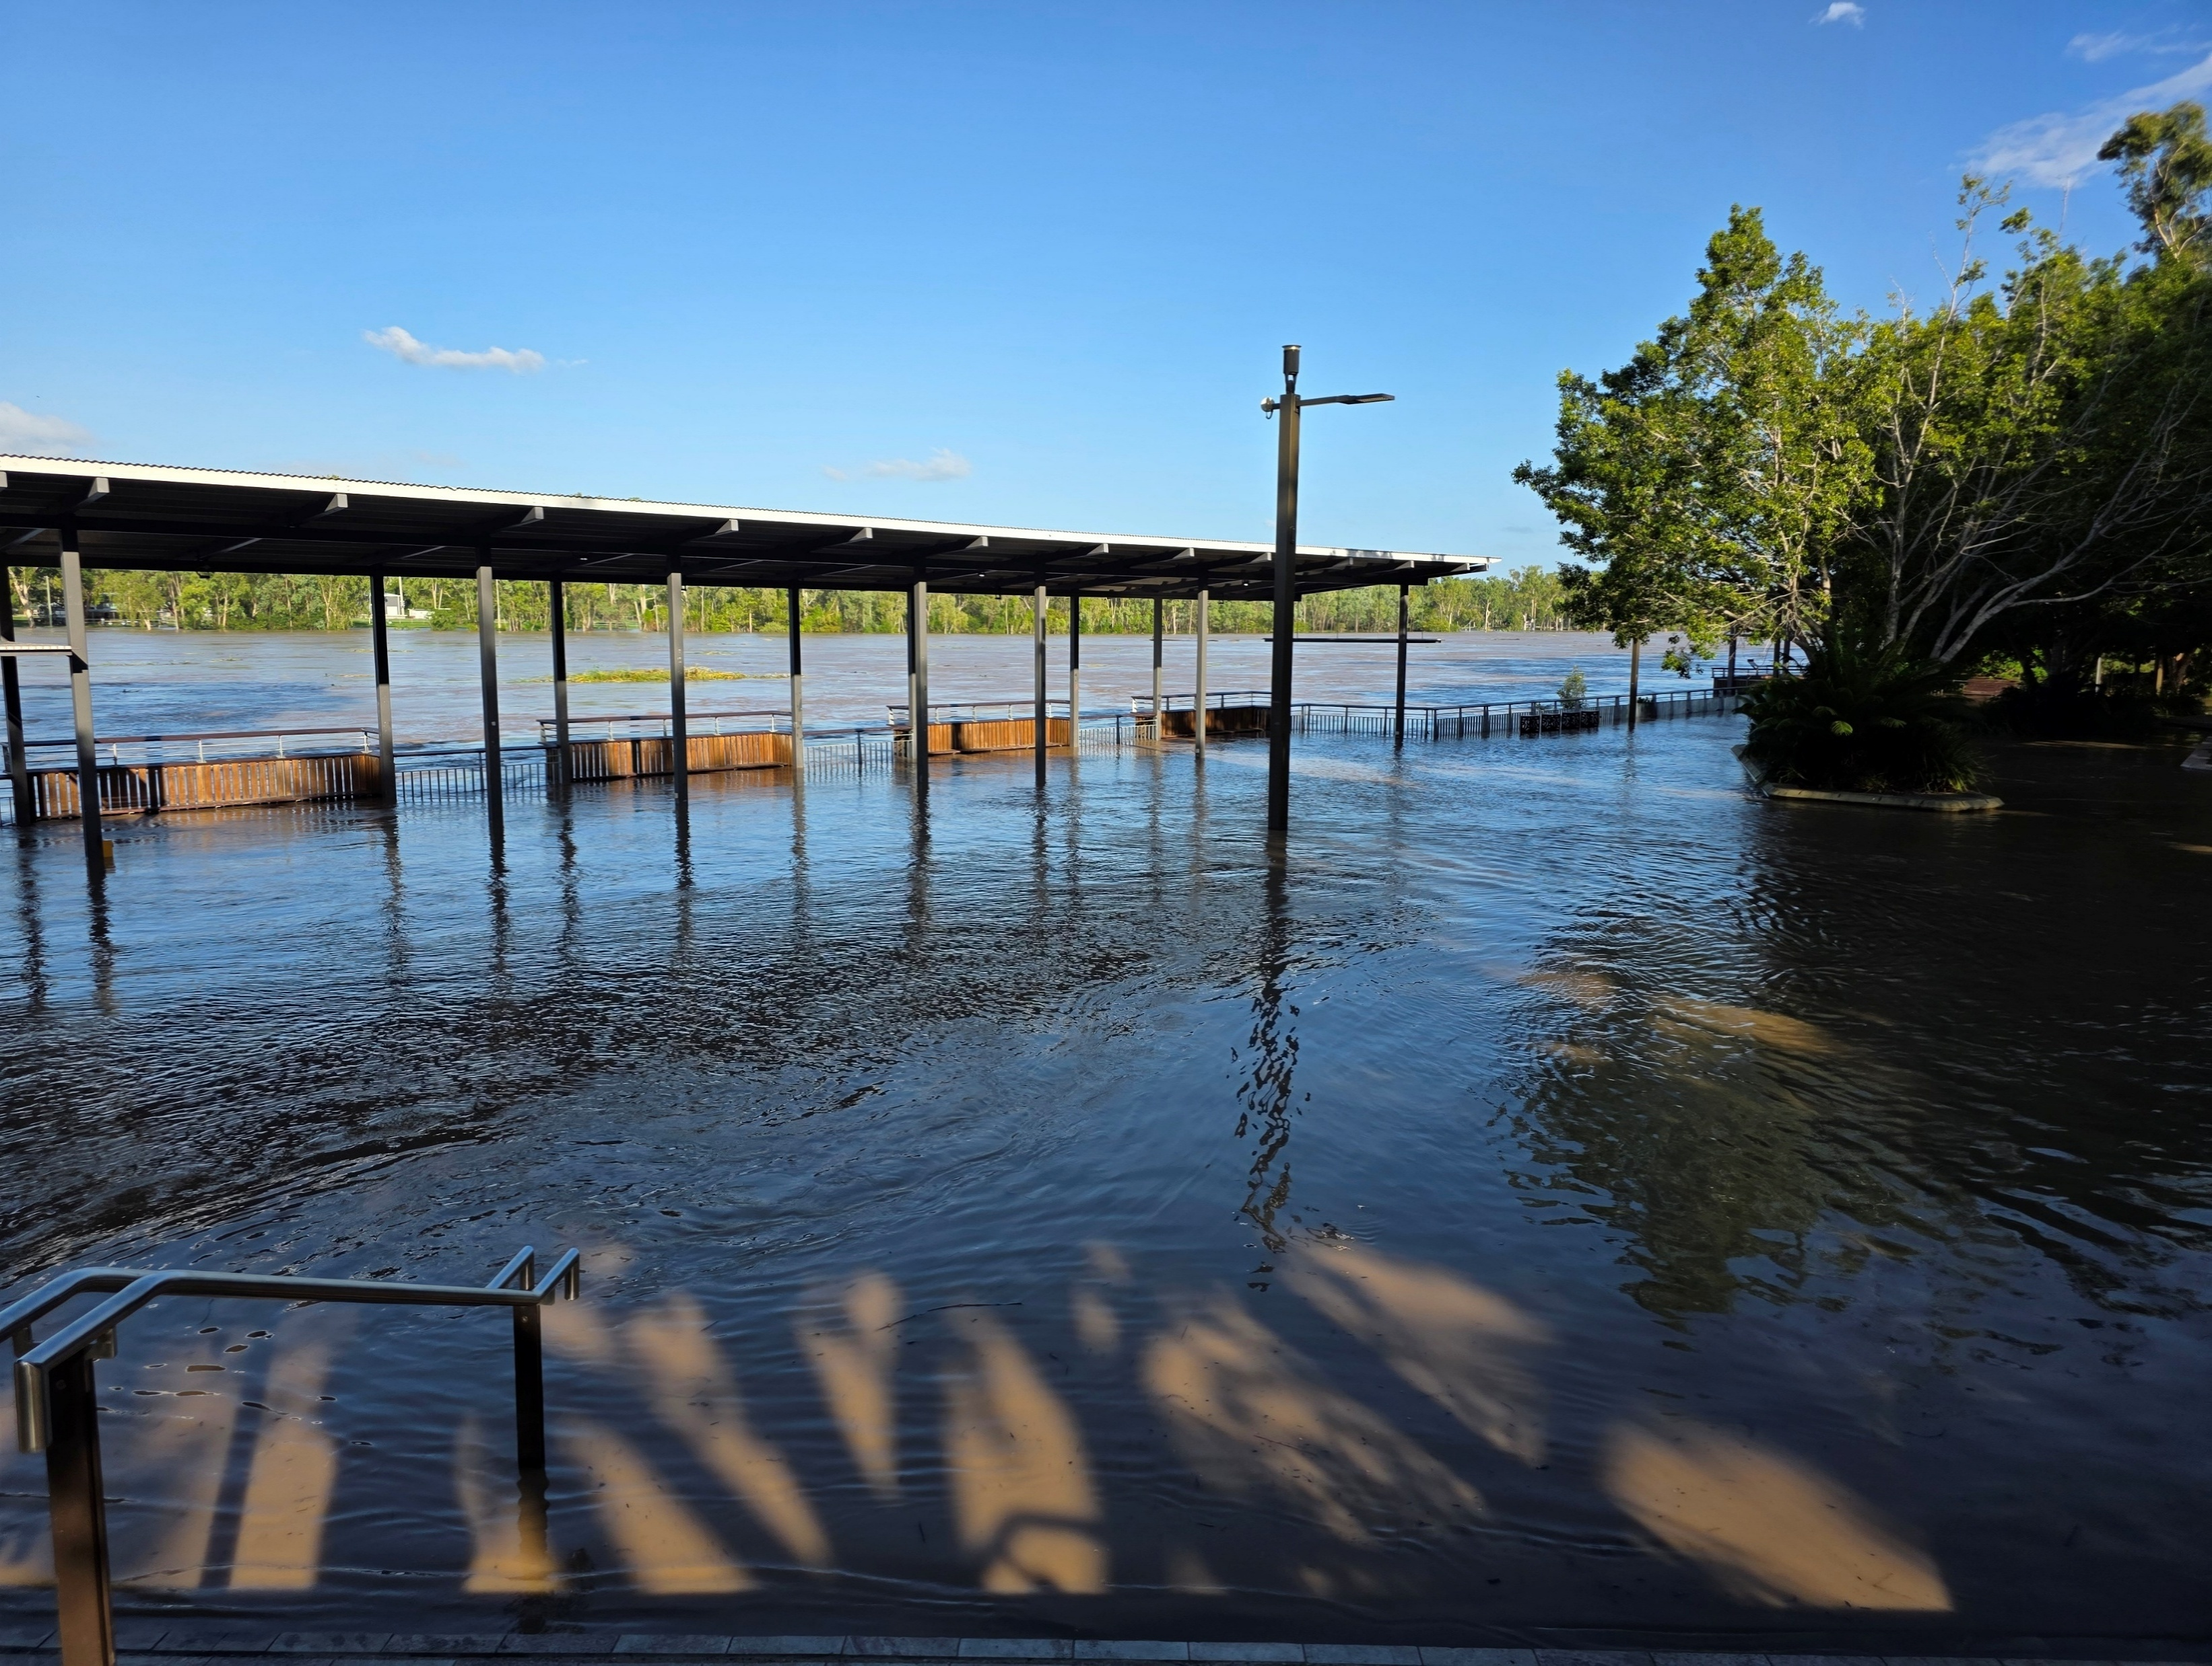
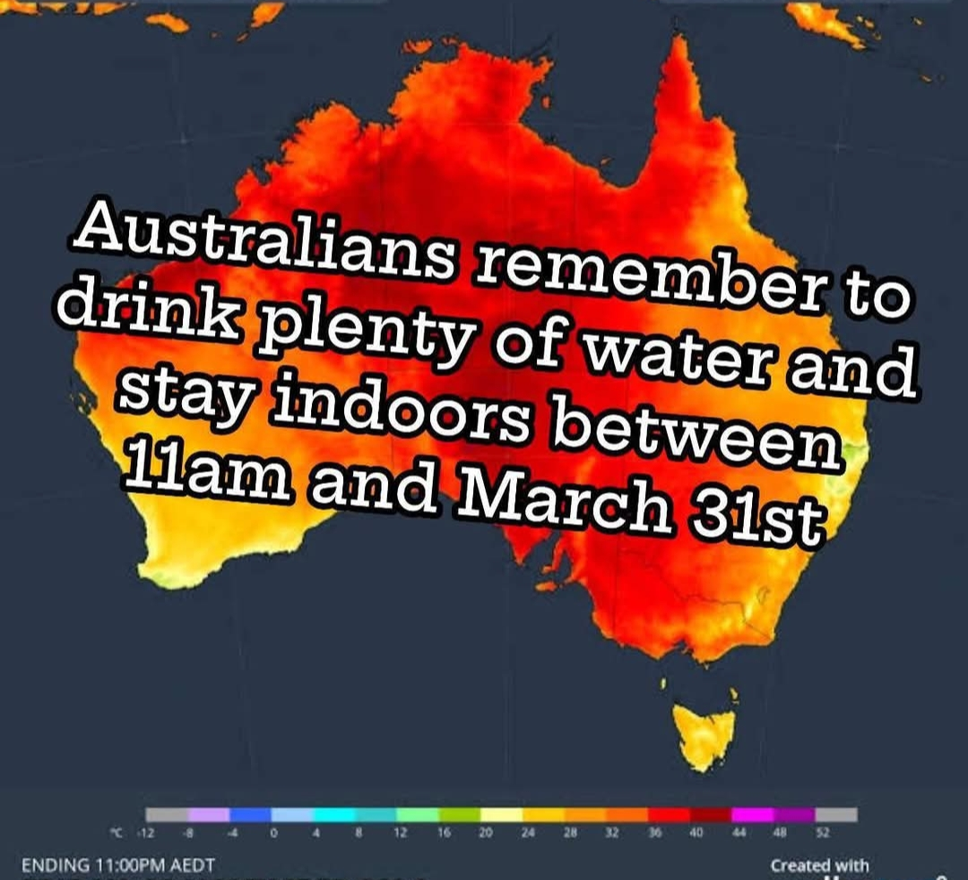
Summer In Australia

Slide 4
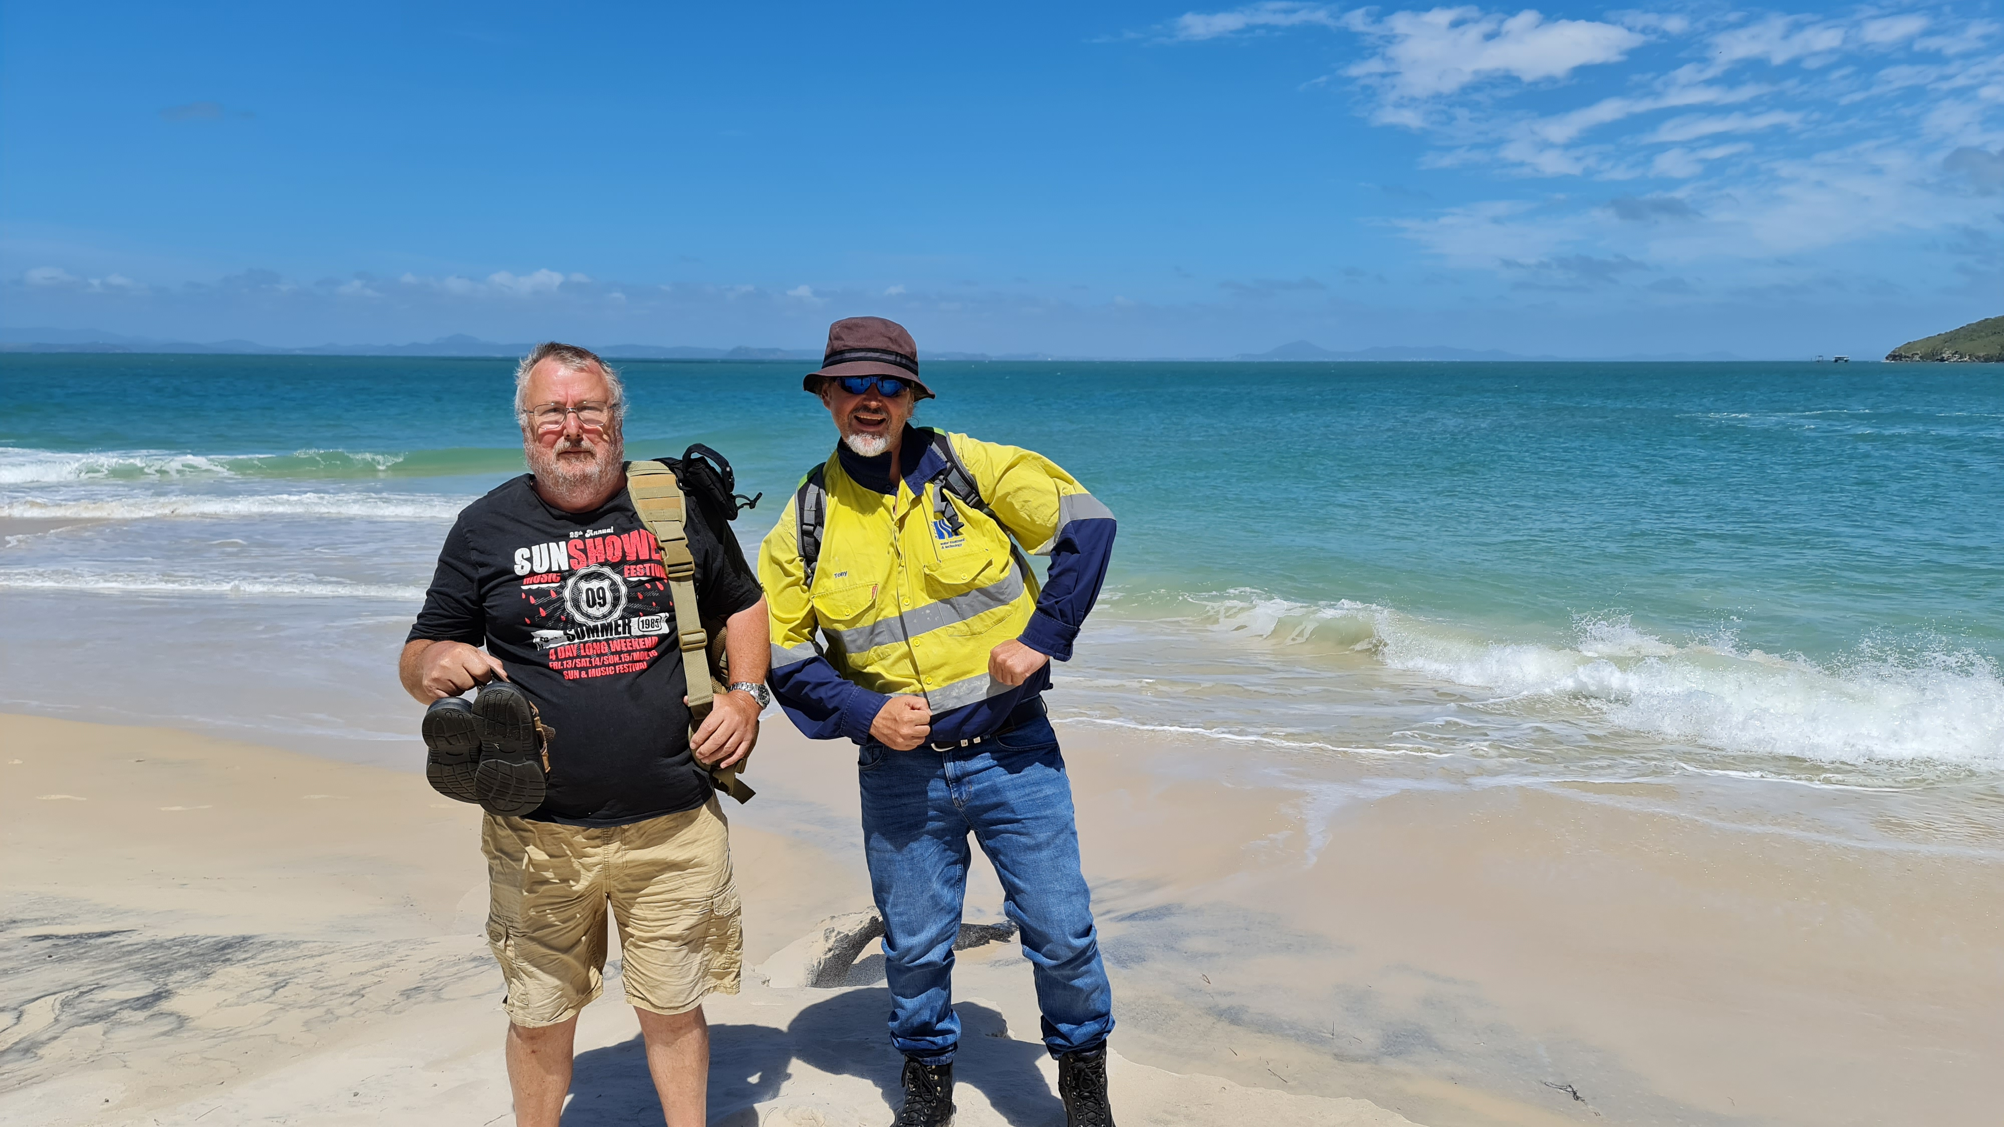
Australian On-Site & Decentralized Sites

Slide 5
How is Failure Defined?
On-site and Decentralized systems fail (frequently)
Different stakeholders may have varying definitions of failure (in regards to importance to them)
Owners
Odor, noise, cost of operation, surface pooling, etc
Regulators
Water Quality, environmental impact, etc
Manufacturers and Installers
Frequency of call-outs, false alarms, etc
Failure can be caused by many factors

Slide 6
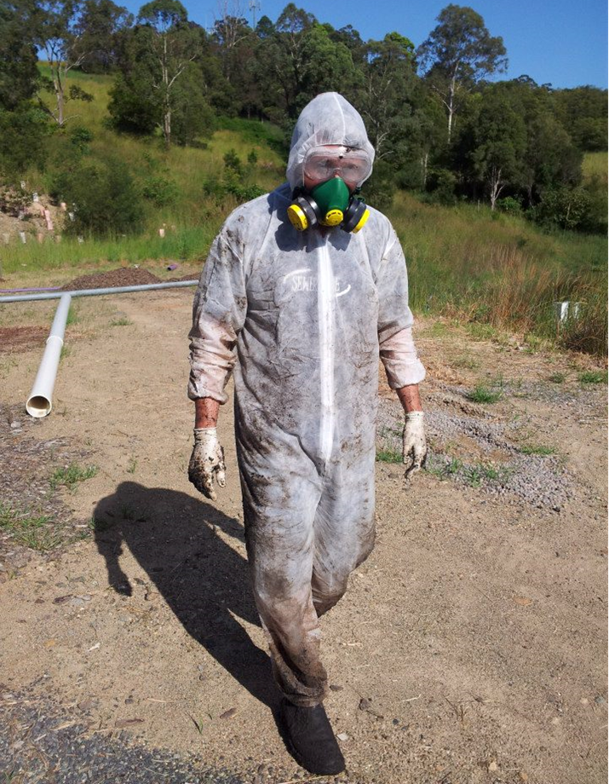
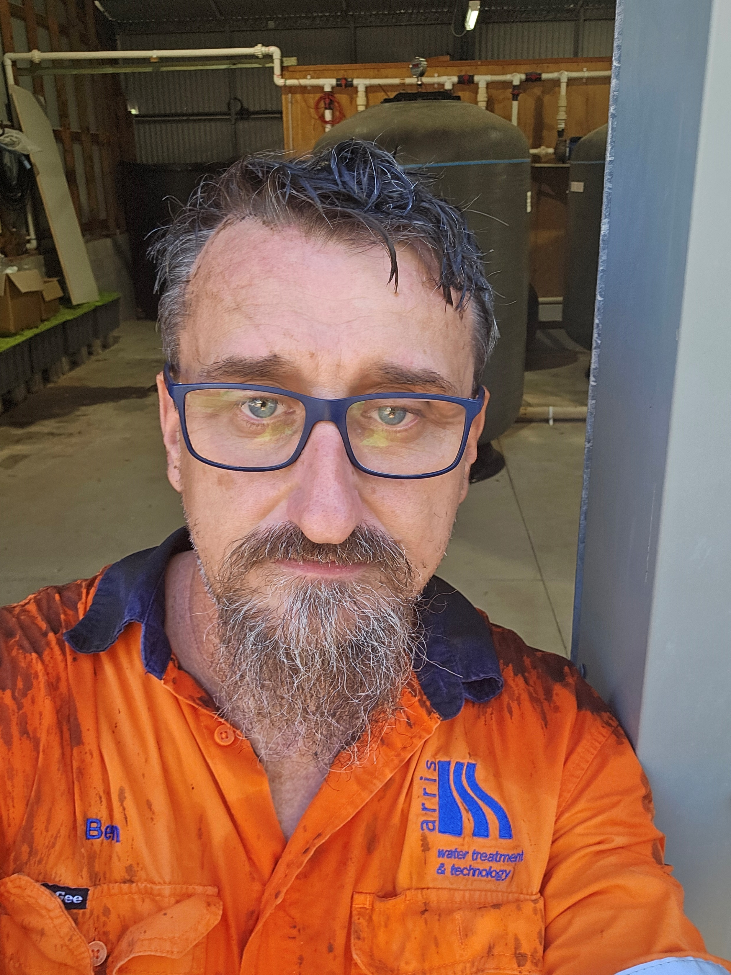
How do you Define Failure?

Slide 7
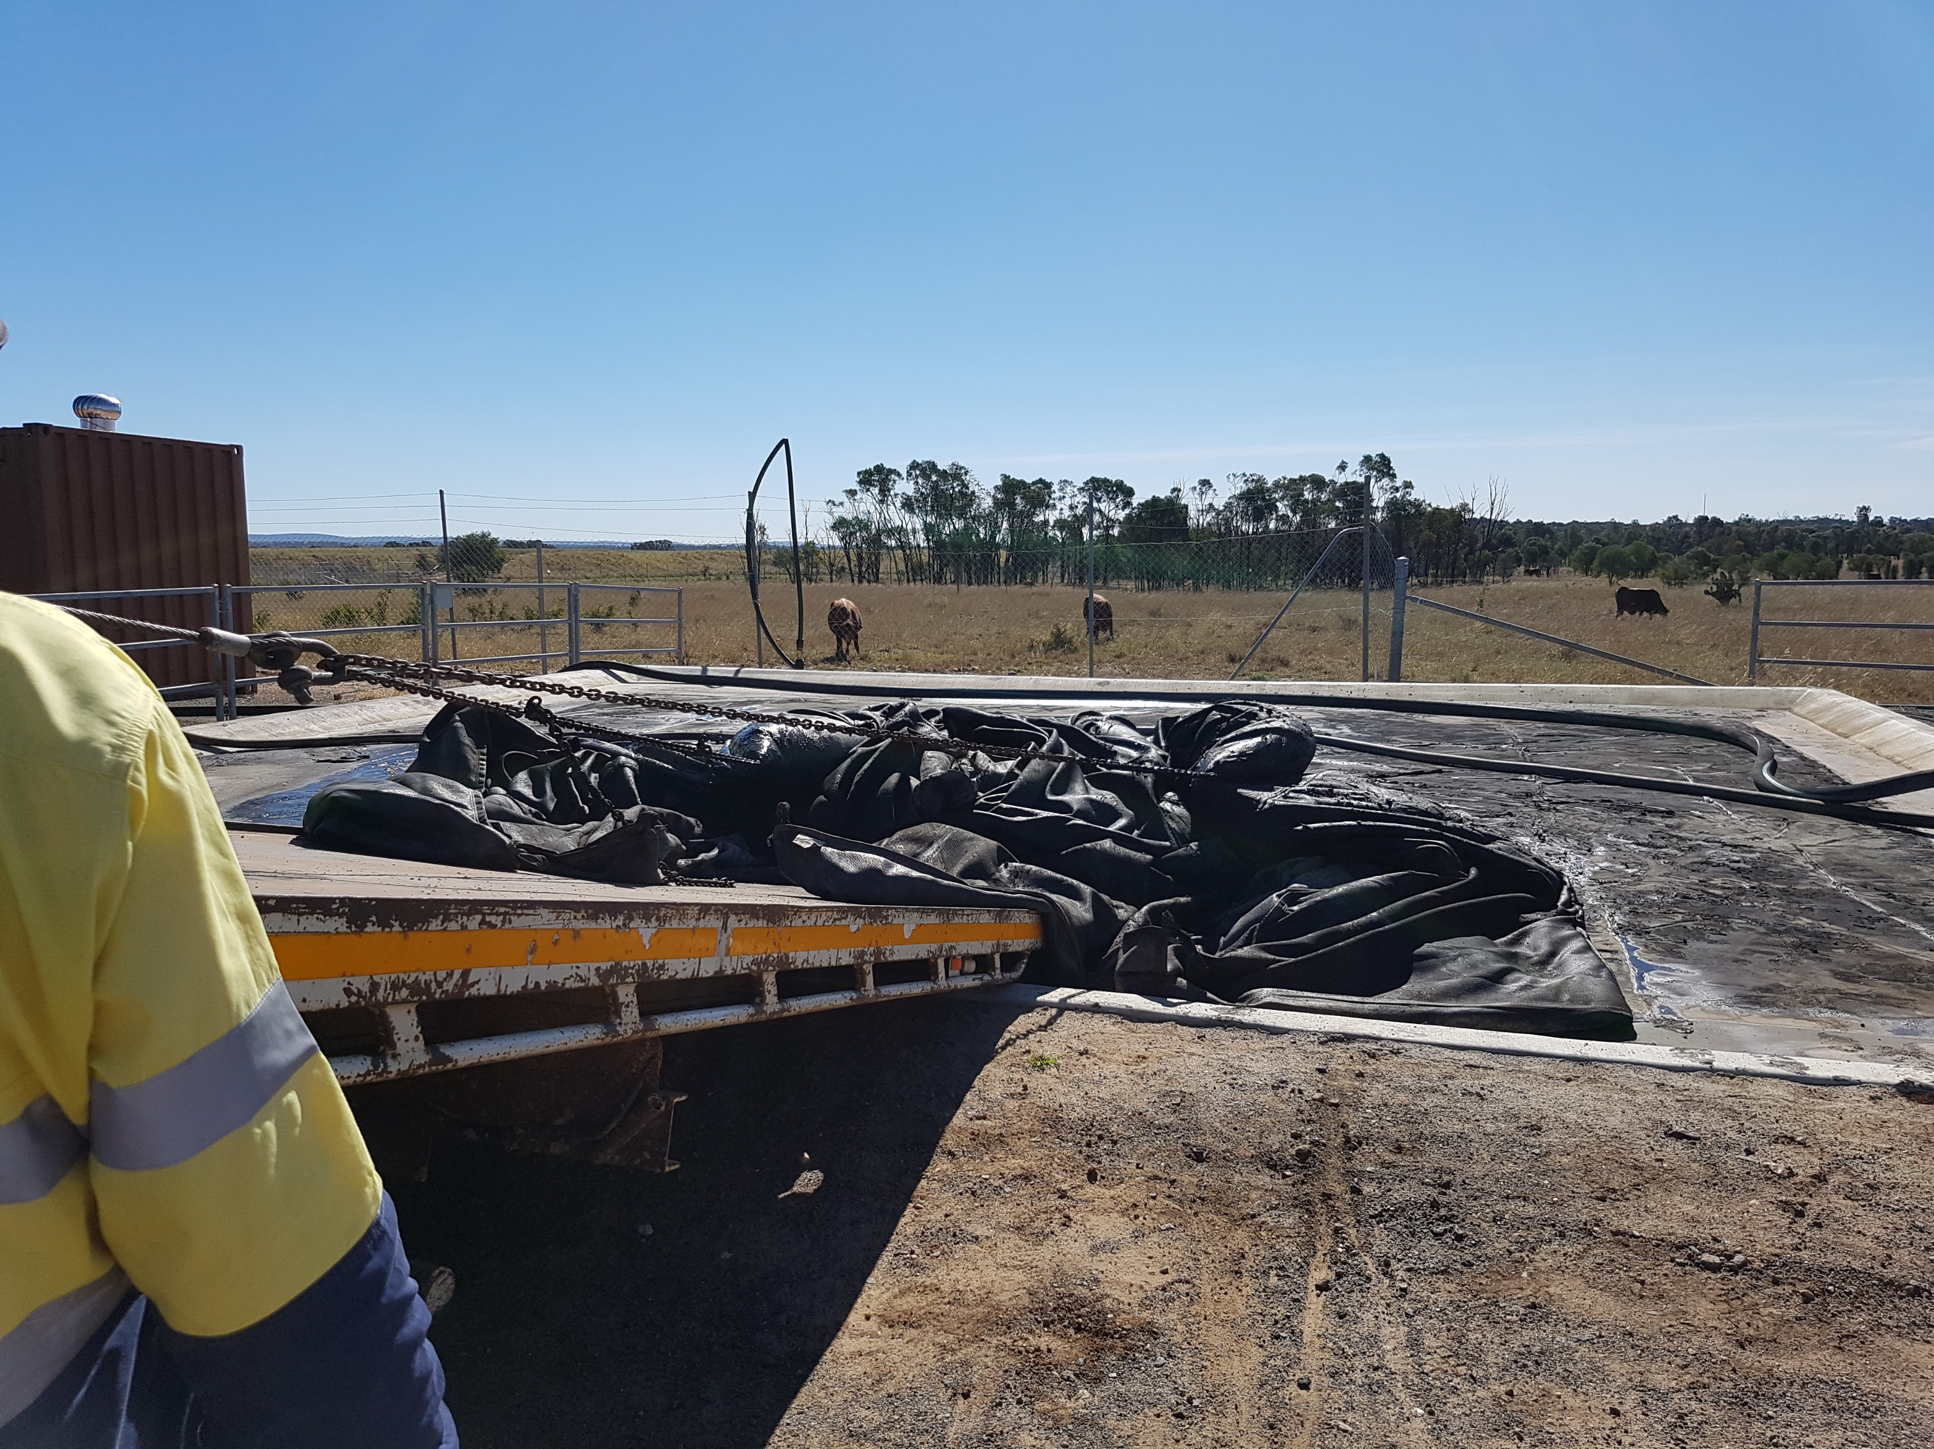
People…

Slide 8
What Causes Failure
Original design
Site inspection
Information from the client
System selection
Fit-for-purpose
Lack of ongoing maintenance
Institutional knowledge disappears…
System has reached the end of its working life
Changes in the site over time

Slide 9
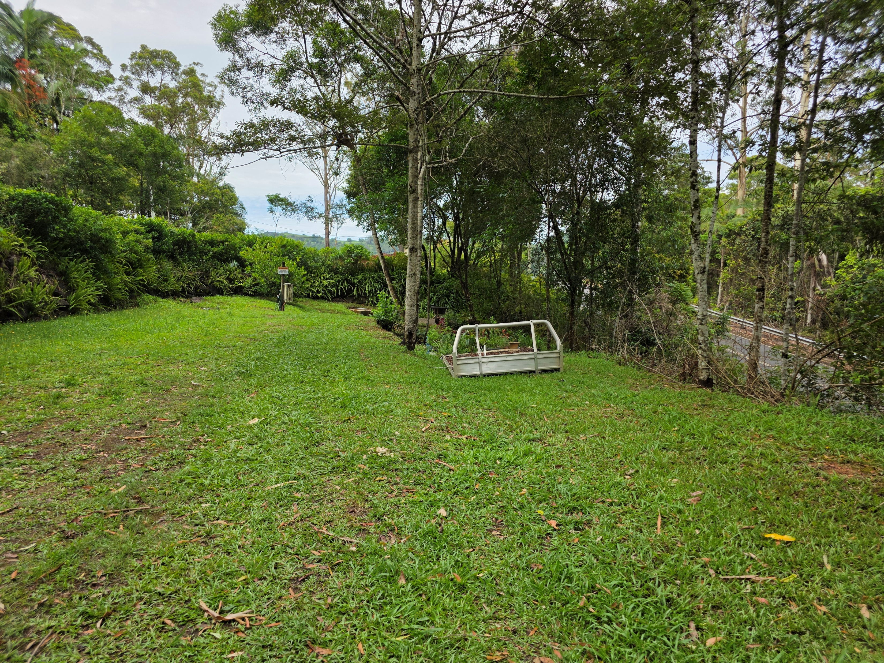
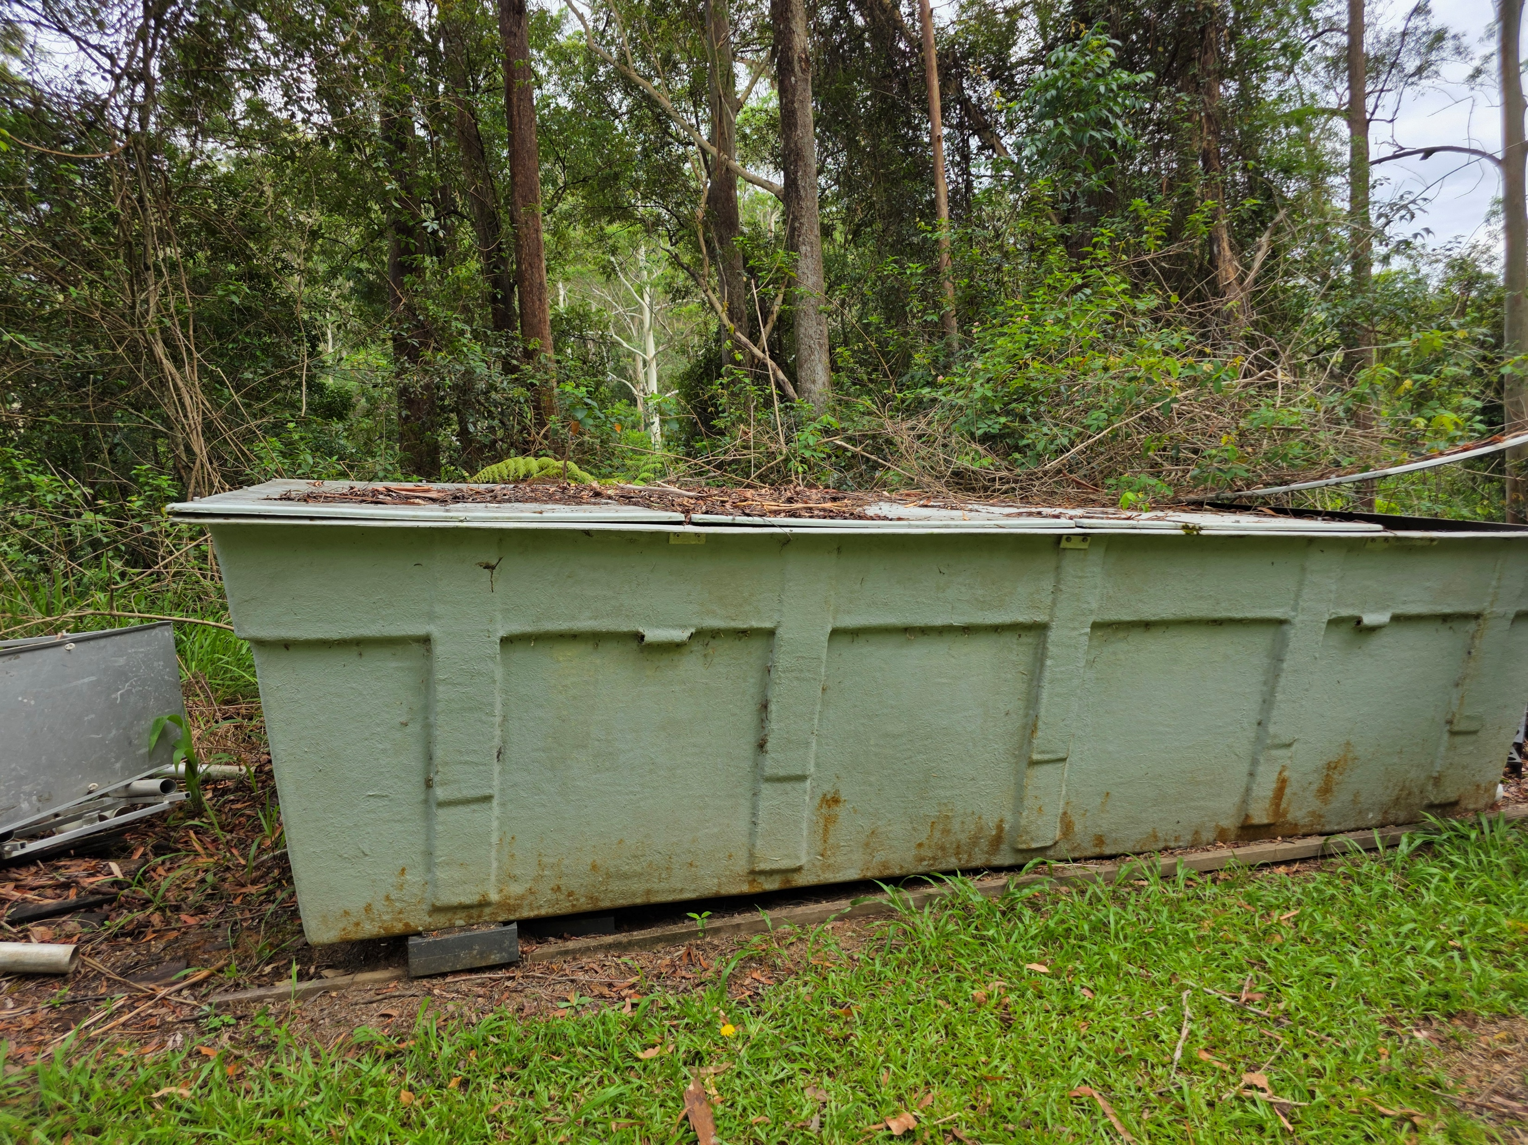
Failure Can be Slow

Slide 10
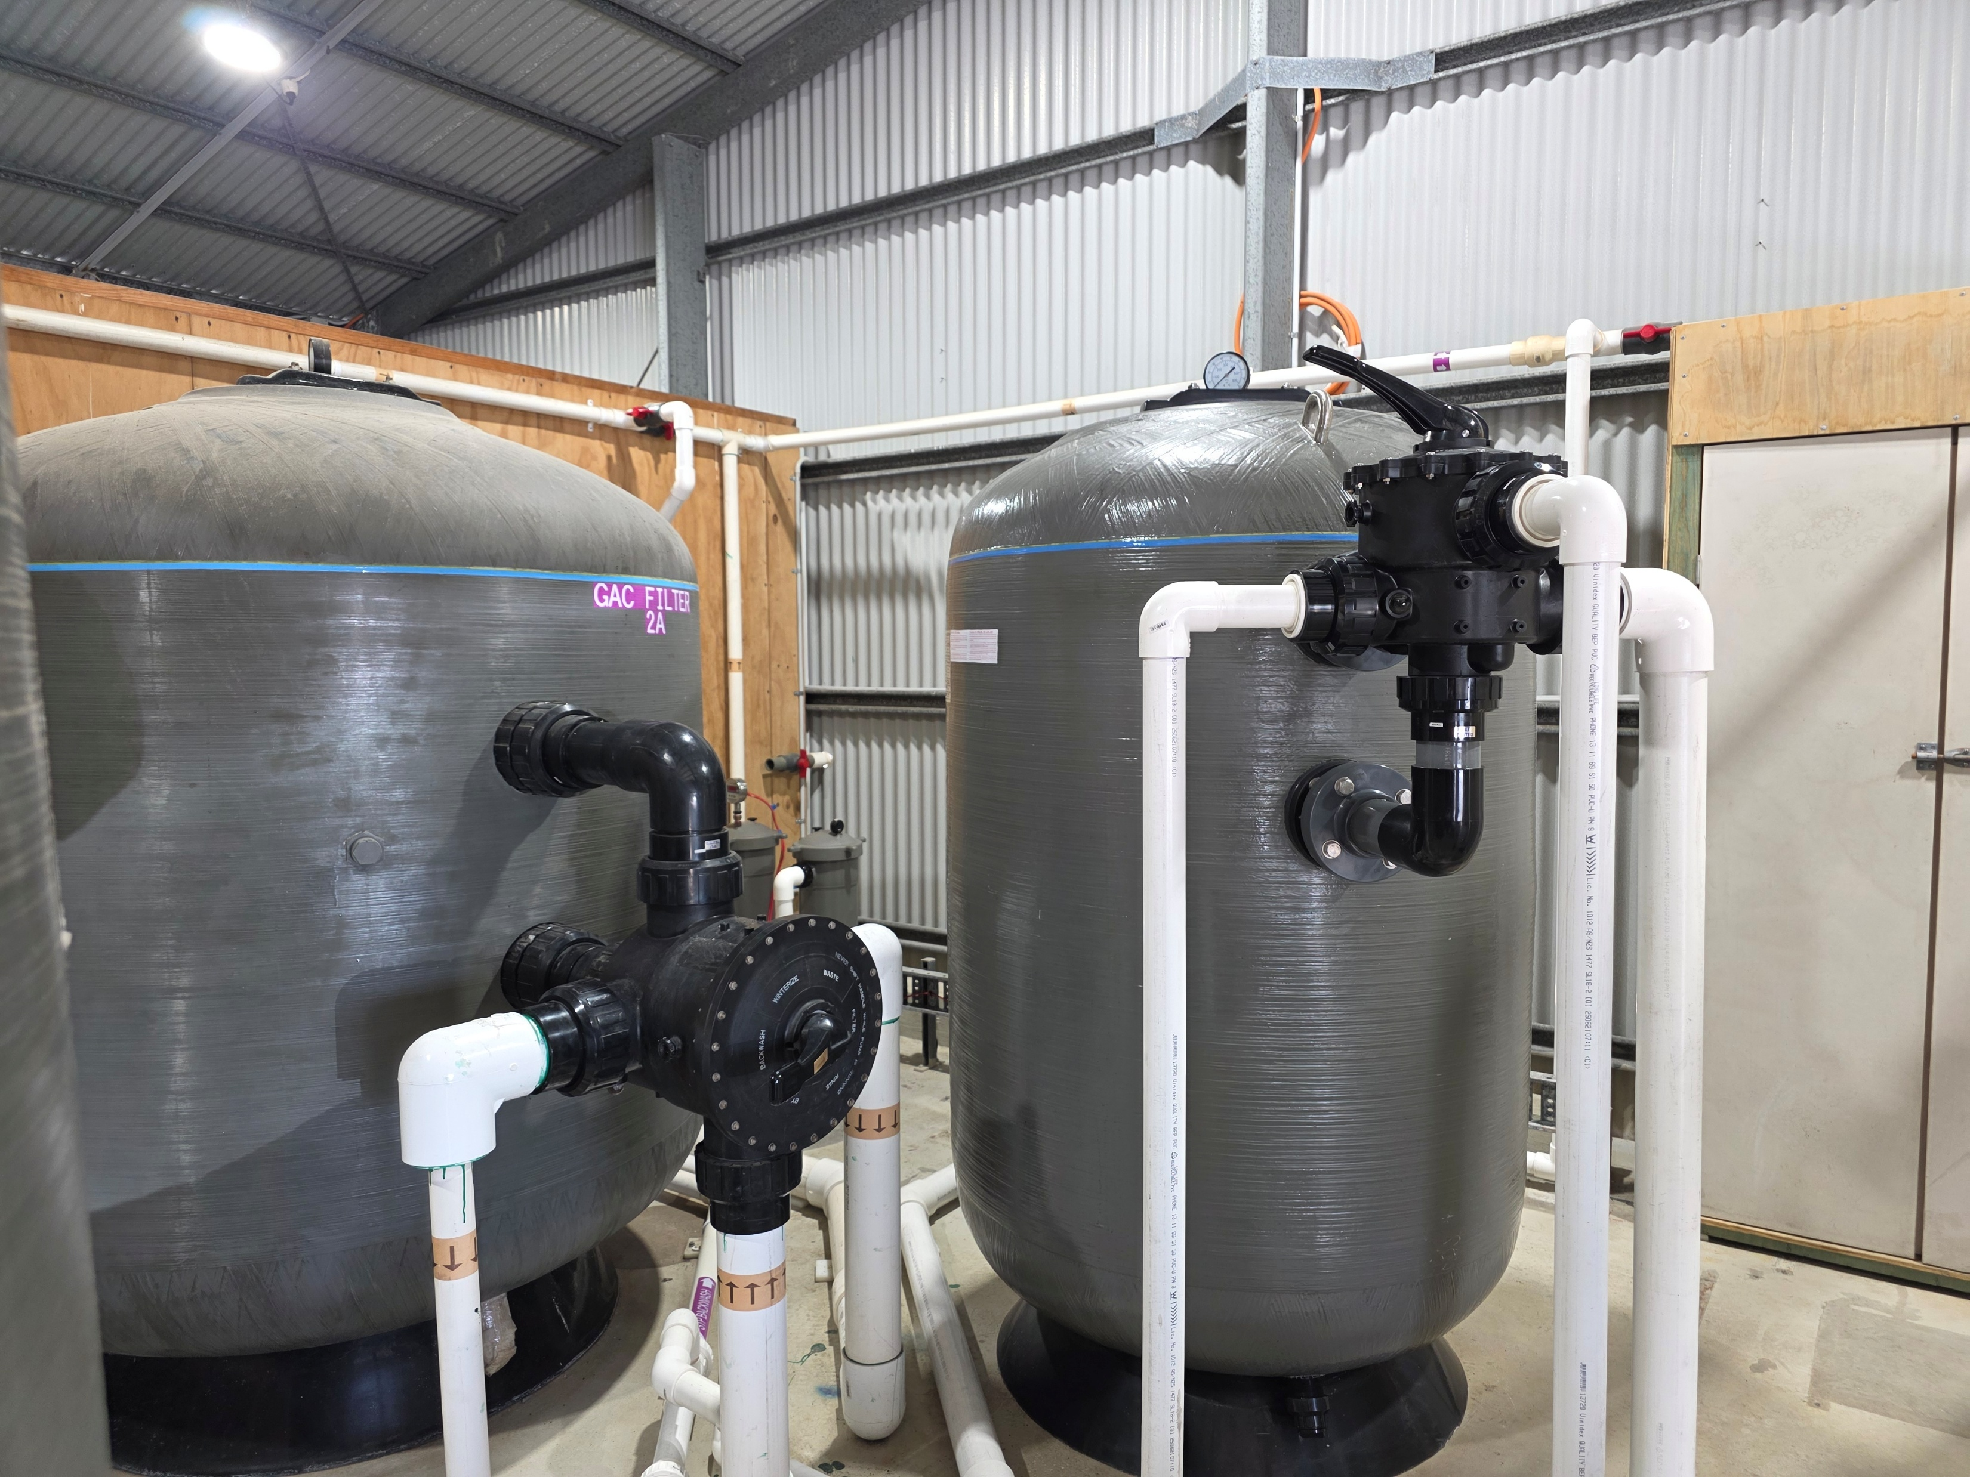
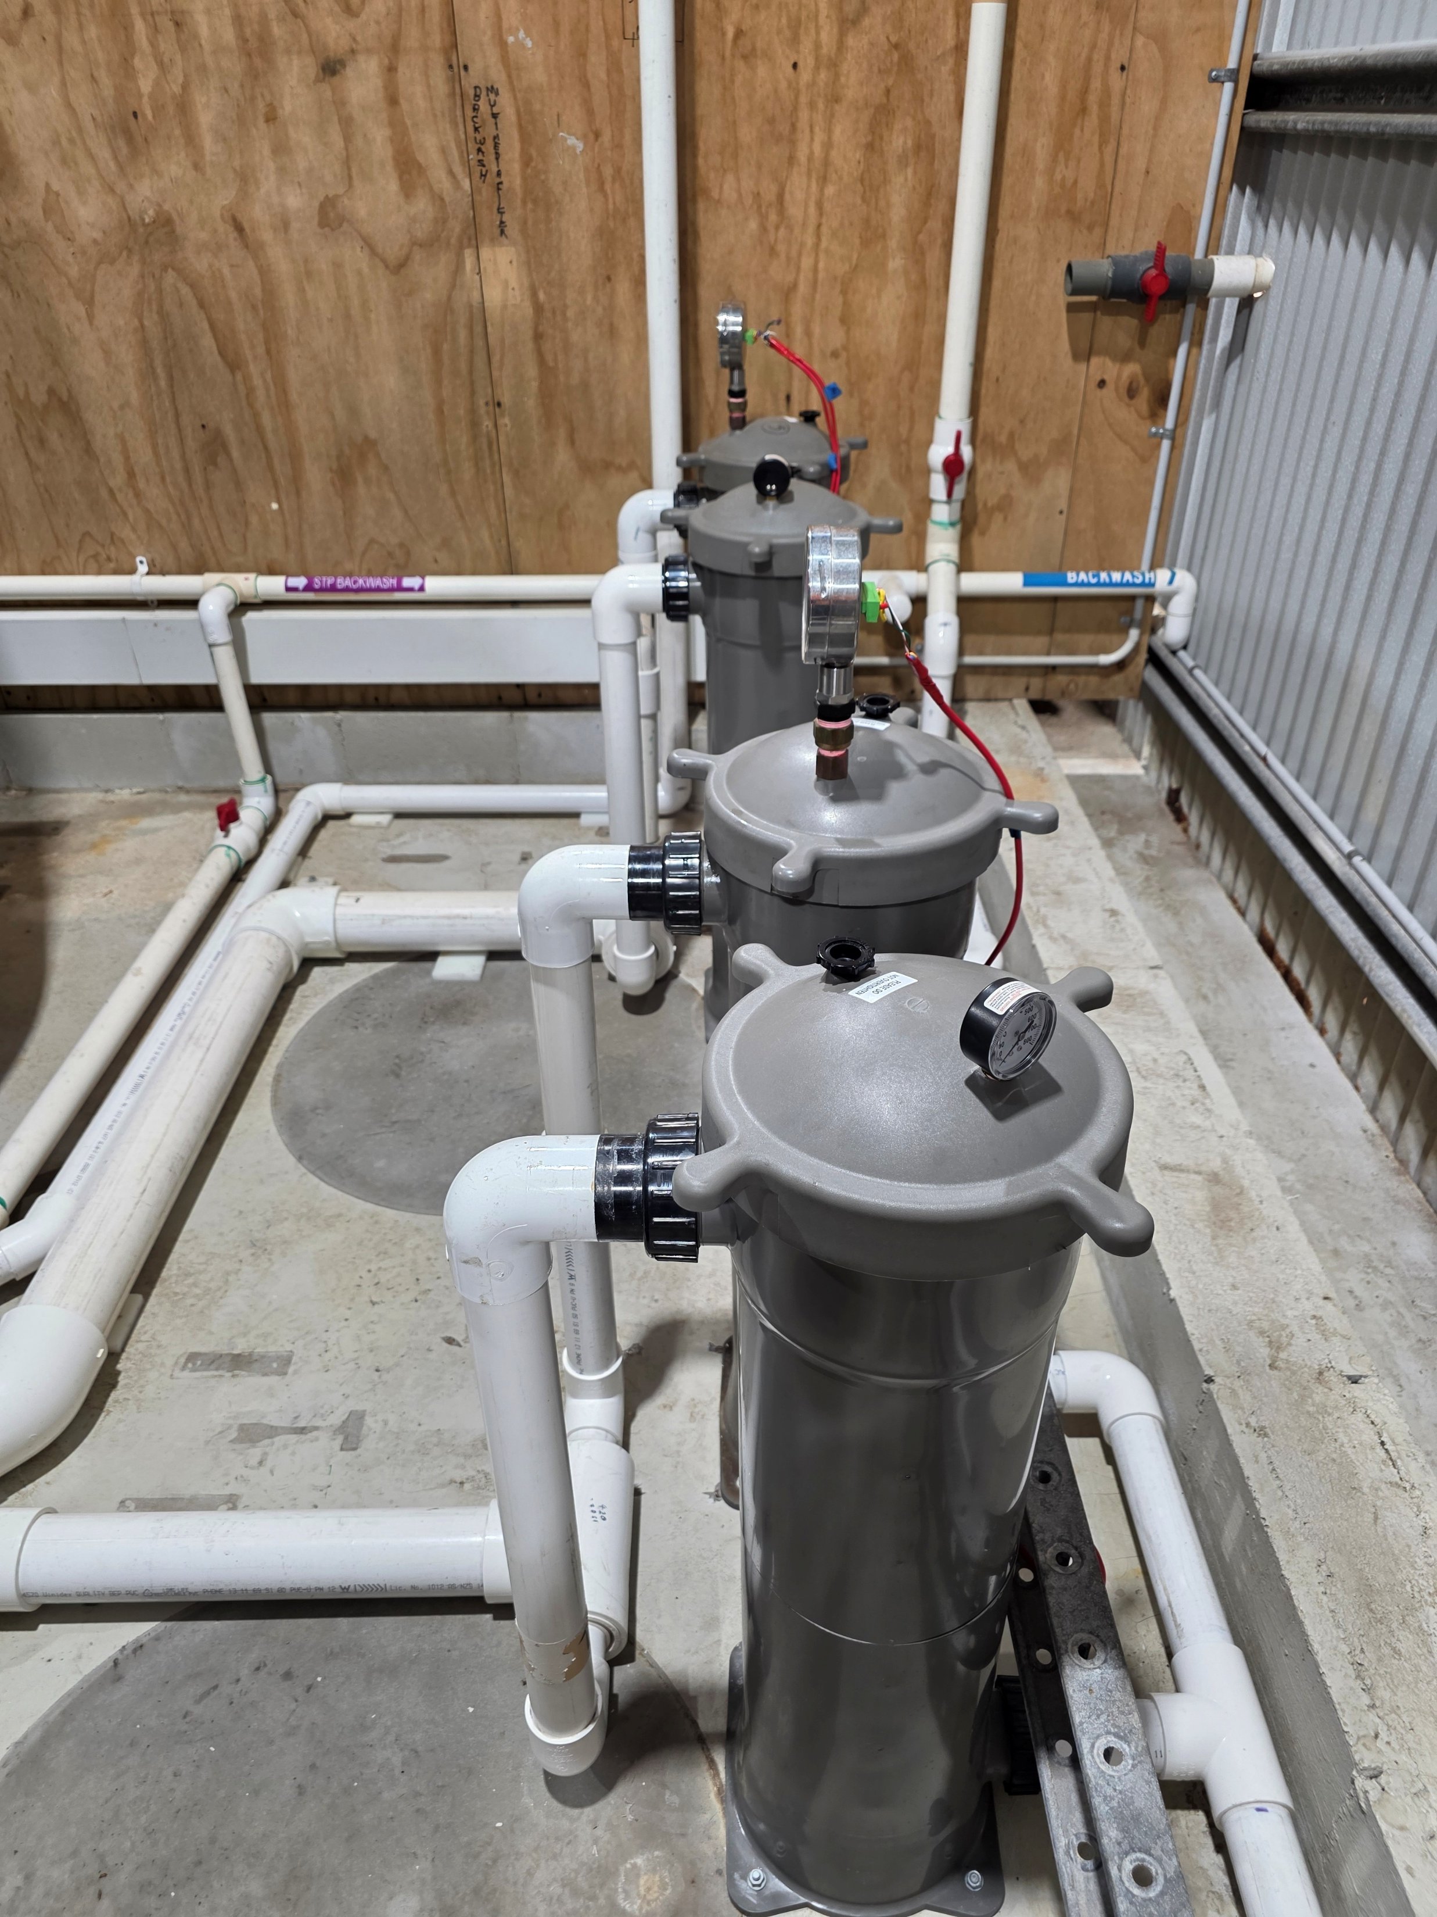
Failure Can Be Putting Up With OK Performance

Slide 11
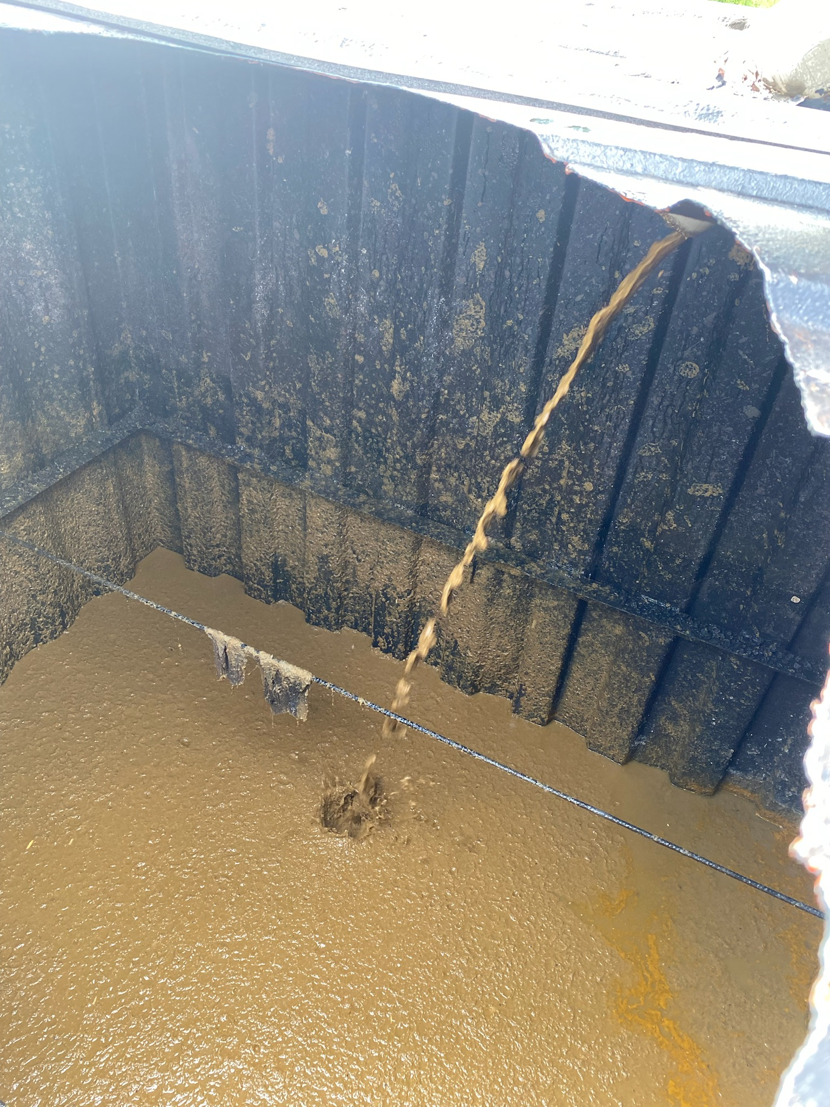
Common Design Failures
Design
Wastewater volume
Inflow wastewater quality
Inflow wastewater generation patterns
Soil at site
Domestic/Commercial/Industrial
NSF testing process
Treatment system selection

Slide 12
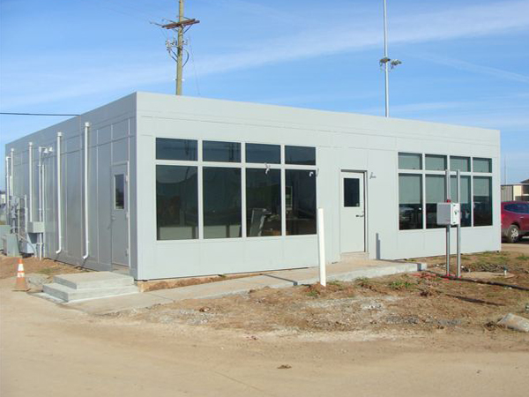
Ben’s Child Care Centre
Kids Not Picked Up on Time will be Taught to Swear

Slide 13
Ben’s Tavern
You Can’t Drink All Day if You Don’t Start in the Morning

Slide 14
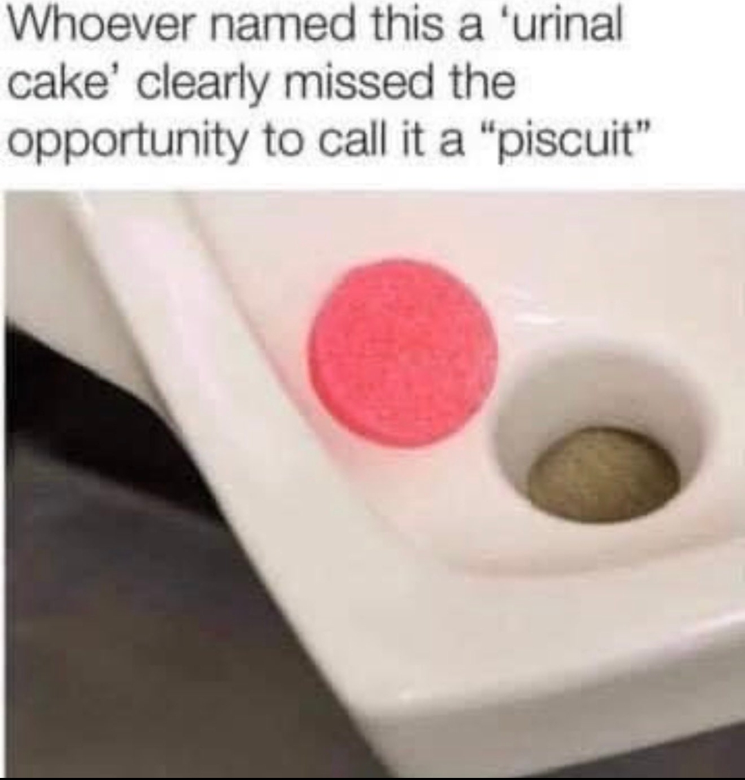

Slide 15
Ben’s Gym
No, You Don’t Look Good in Lycra

Slide 16
Ben’s Kebab Shop
Why Have Ab’s When You Can Have Kebabs

Slide 17
Varying Inflow Water Quality
Child Care Centres
Nappies, wet wipes, higher proportions of urine, typically not open at night
Tavern’s
Higher proportions of urine, disinfectants, maybe a commercial kitchen (oil & grease), increased phosphorus concentration (spirits), open from late morning to late at night
Gyms
Dilute wastewater from showers and often open 24 hours
Kebab Shop (fast food)
Takeaway different wastewater from dine-in
Oils & grease much higher; even with good quality greasetrap

Slide 18
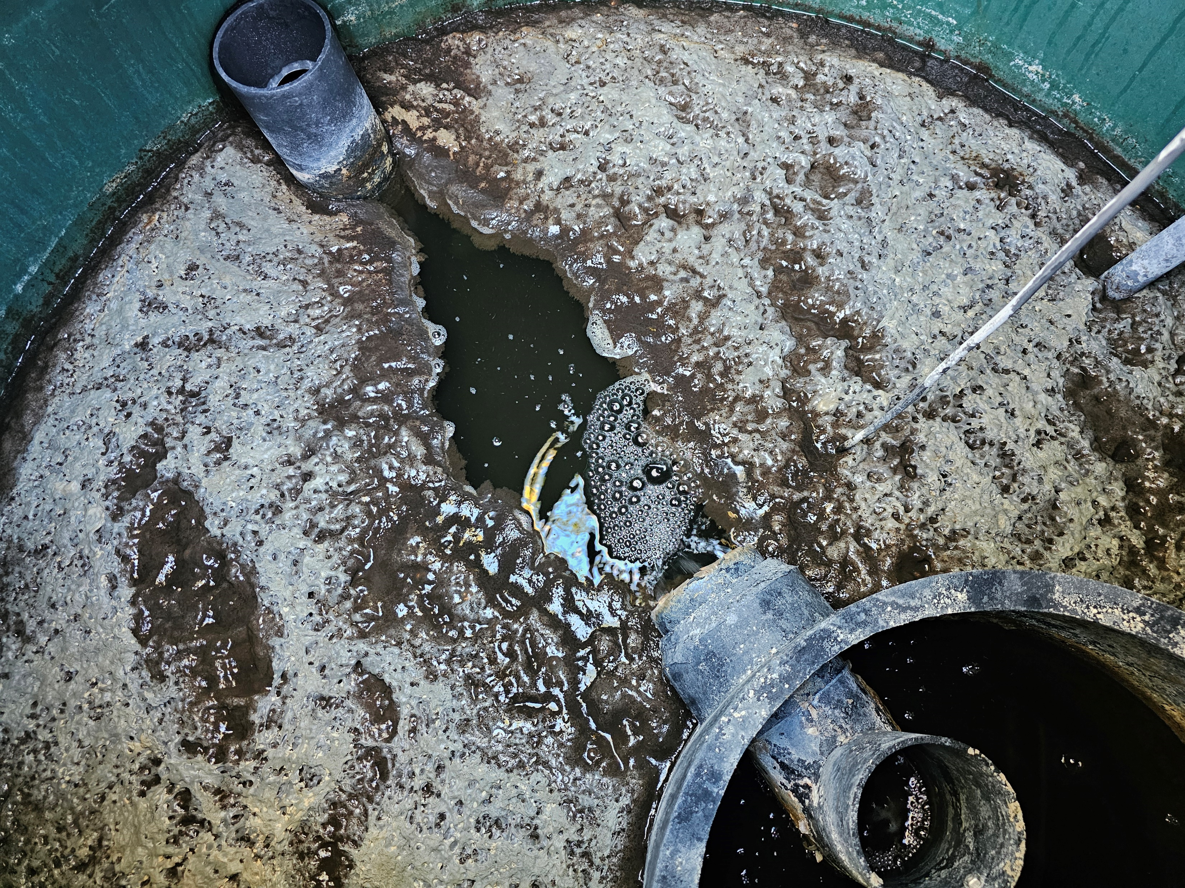
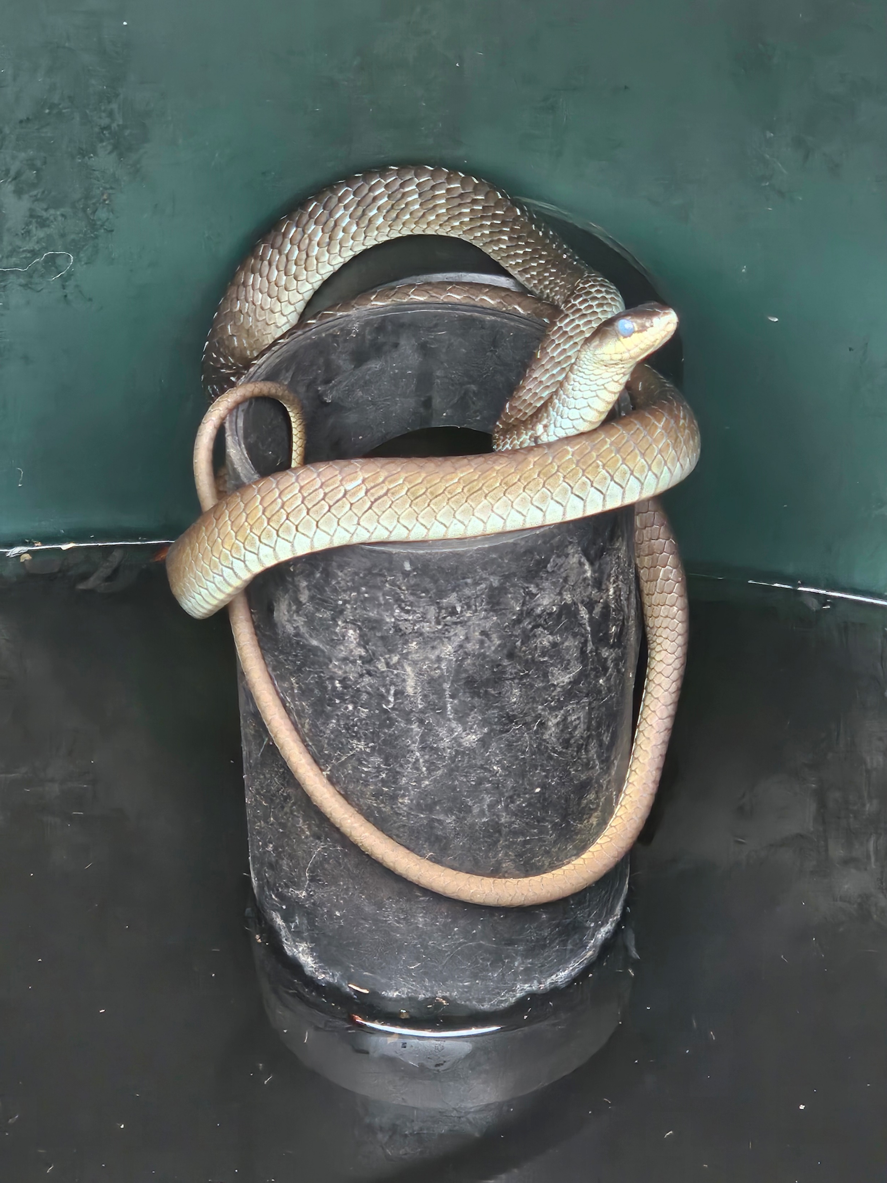
Unusual Water Quality Issues

Slide 19
Installation issues
Site investigations
Soil tests
Set back distances
Training on installation crews
Skills shortages
Weather during installation
Coordination of trades plumbers & electricians
Changes made by the client during the project delivery
Real Estate agents…

Slide 20
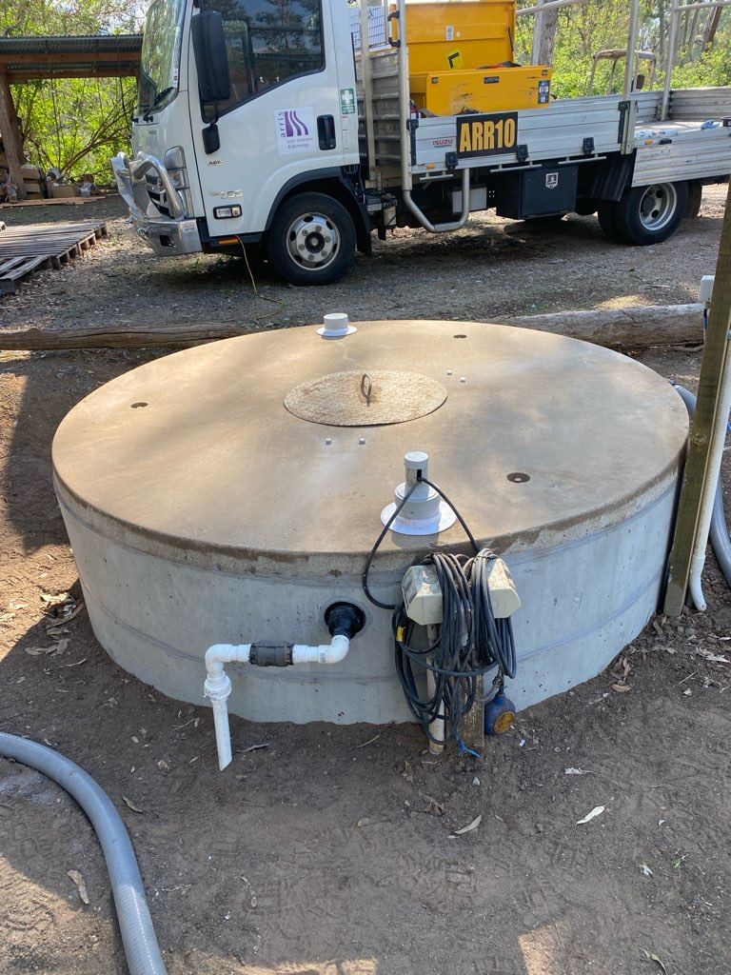
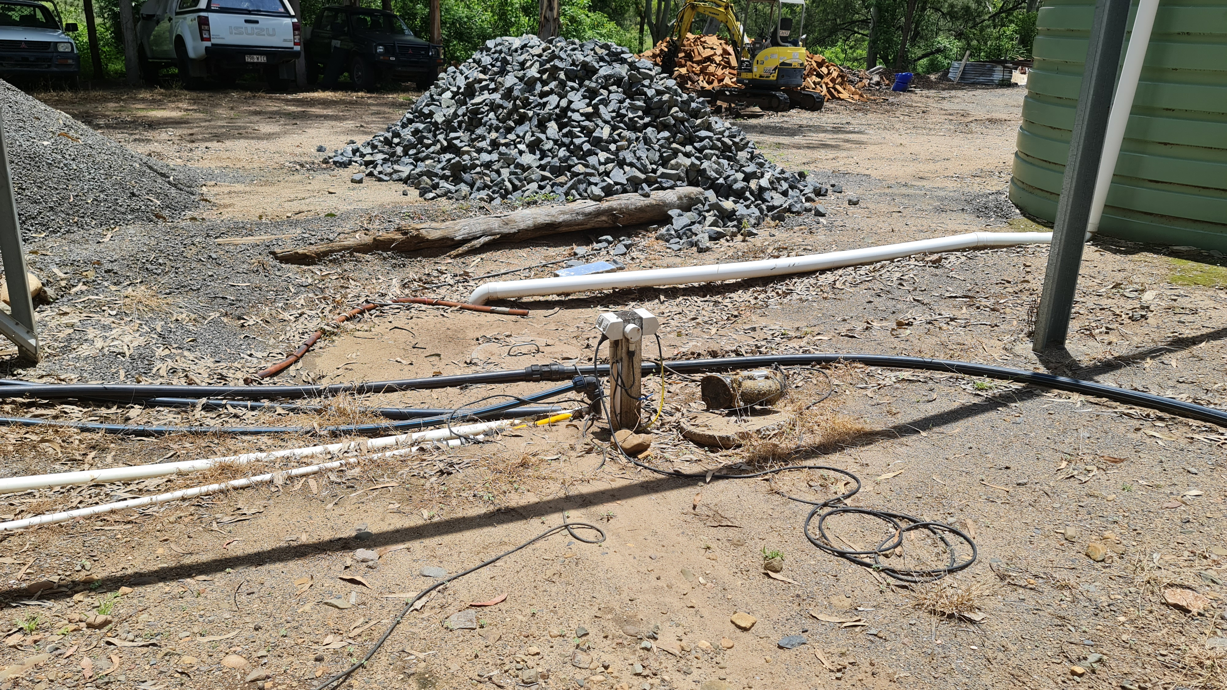
Infiltration Issues

Slide 21
Soil Testing
Foundation/Structural soil tests are not suitable for on-site wastewater analysis
Needs a sodicity analysis
Exchangeable % of sodium (ESP)
Cation exchange capacity (CEC)
Organic carbon is also useful
For nutrient leaching
Phosphorus absorption
% clay
Soil texture (sand)
Risk of nitrogen movement
An understanding of salinity and the sodicity of the water being applied
Distribution of the treated water needs to be even

Slide 22
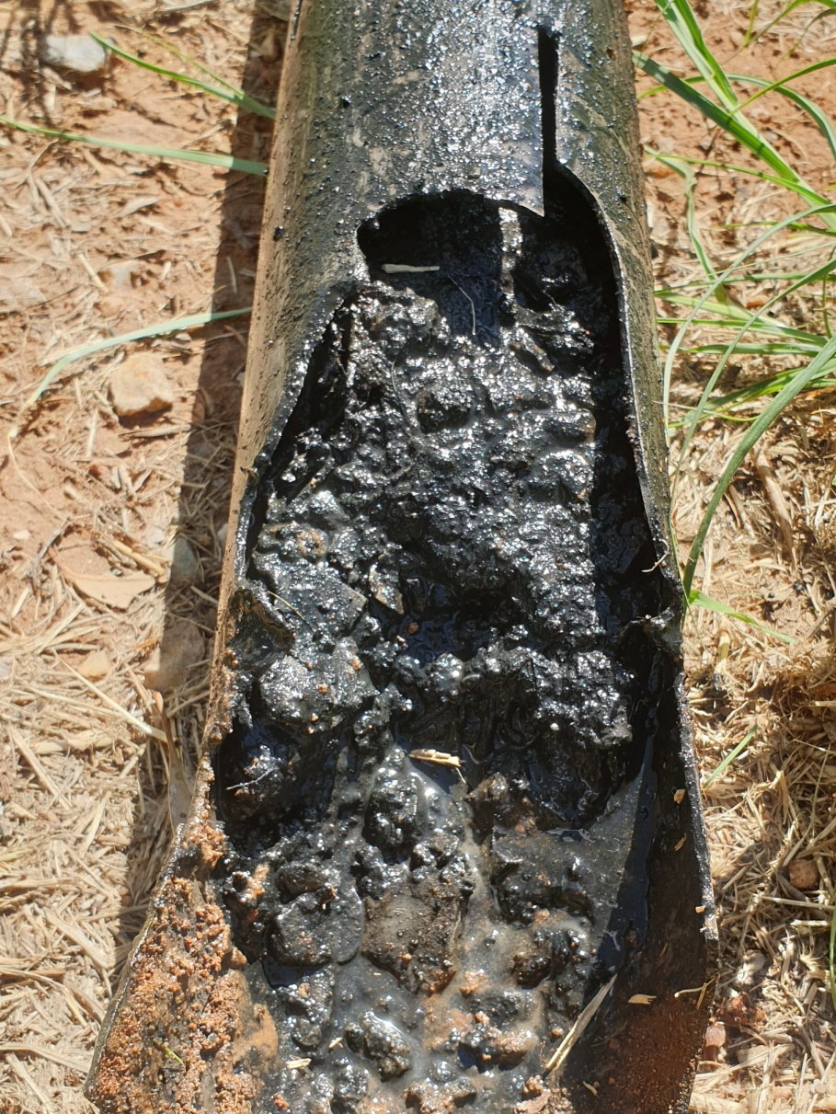
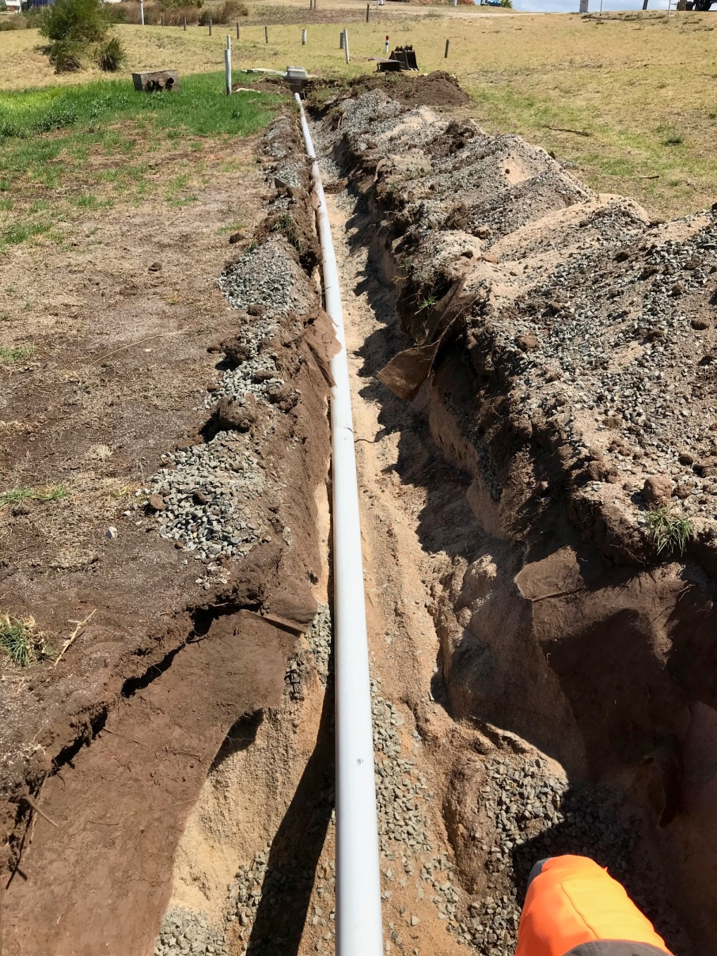
Distribution Issues

Slide 23
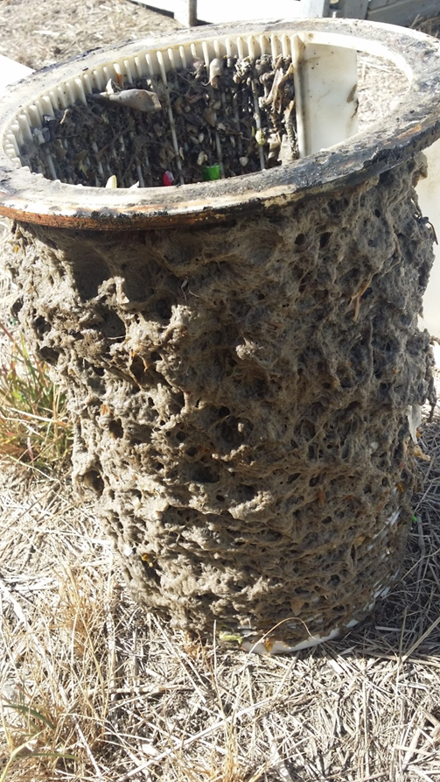
Operation and Maintenance
Lack of maintenance
Major competitor is people doing nothing
No such thing as maintenance free
Education of stakeholders
Many people don’t understand that maintenance is required
Training staff
Skill shortages
USA doing much better than Australia in this area
Establishing a common-sense budget for ongoing maintenance

Slide 24
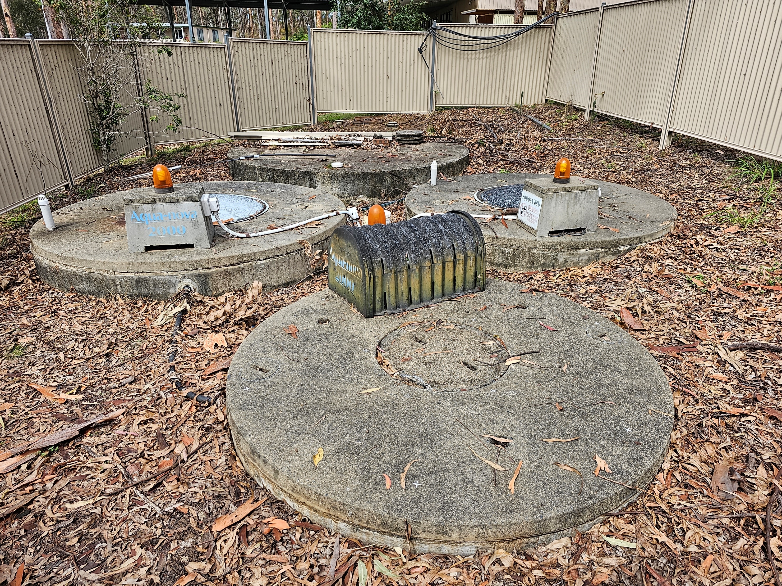
Operation and Maintenance

Slide 25
Trouble-Shooting a Failure
Some failures are more easy to work out than others
Pump failures
Pipe ruptures (above ground or in tank)
Electrical faults (breakers, etc)
Broken aerators
Some are harder to track down
Clogged or always open non-return/check valves
Splits in air lines under the water
Buried pipe rupture/s
Intermittent faults
Alarm failures
Issues with floats/level sensors
Some are very difficult
Treated water quality
Dispersal field failures

Slide 26
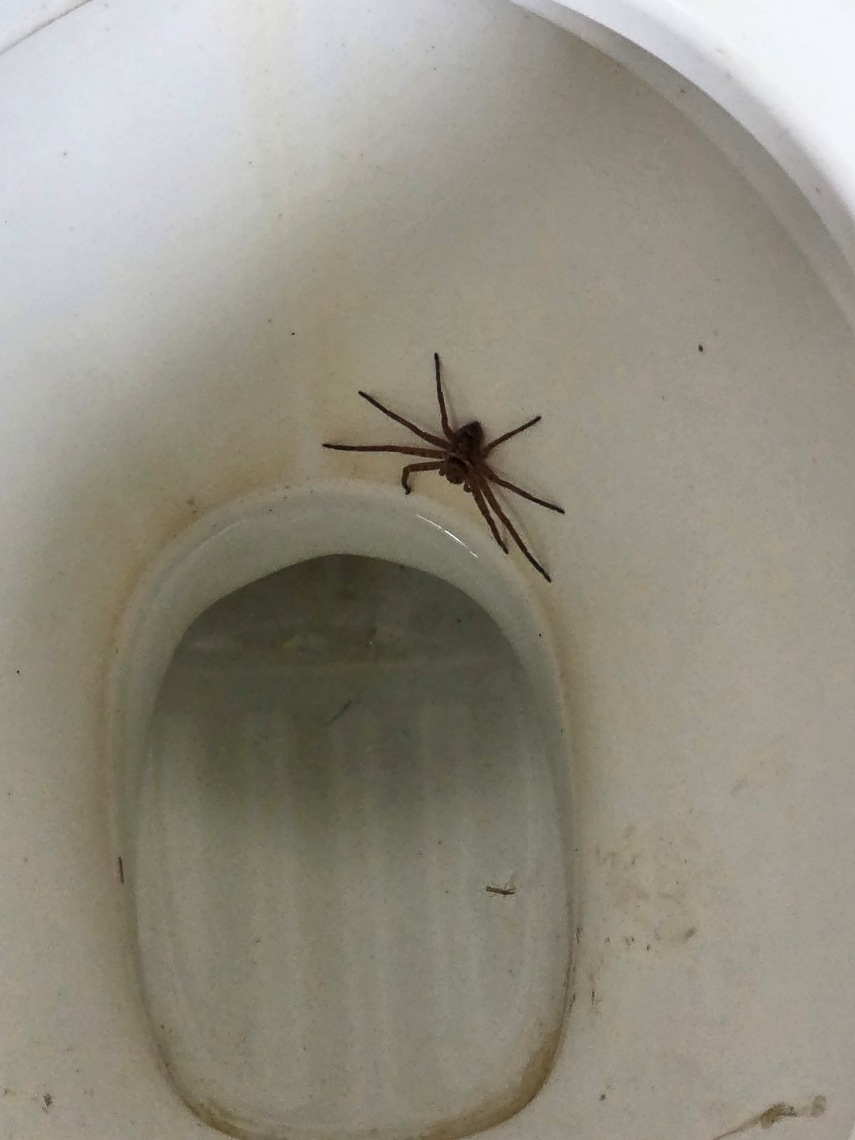
Water Quality Issues
These can be hard to trouble shoot
We don’t often test for the things that can cause issues with water quality
For example a high BOD5 or nitrogen result requires additional testing to diagnose the problem
Total organic carbon test is often required
Dissolved oxygen
Sometimes a sulphur test
Beneficial microorganism count can be helpful
Non-fastidious heterotrophic bacteria
Water quality issues can be caused by strange things; such as 2-in-1 shampoo and conditioner

Slide 27
Water Quality Issues
Standard tests
pH, salinity (EC or TDS), BOD5, nitrogen, phosphorus, total suspended solids, fecal coliforms, etc are useful but quite often miss what is causing a treatment problem in a on-site or decentralized system
Diagnostic tests may include
The different types of nitrogen (ammonia, nitrite, nitrate, etc)
Chemical oxygen demand and total organic carbon
Sulphur (essential nutrient for many beneficial microbes)
Heavy metals
Comparison of the different salts; sodium, potassium, calcium & magneisum
A wider microorganisms analysis
Water quality problems can occur because something is in too low a concentration or too high a concentration
Outside the typical range
Total organic carbon is an example

Slide 28
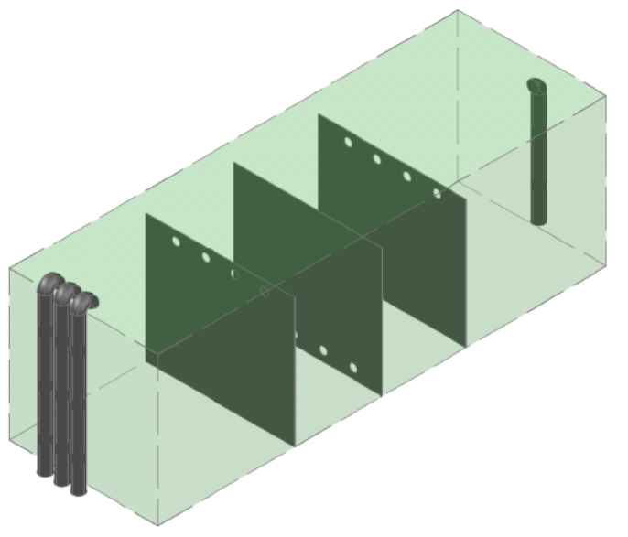
Water Quality Issues
Hydraulic retention time
Short circuits are a frequent cause of failure
Just because a tank has a certain volume doesn’t mean that the water will be in that space for a specific length of time
Dye tests can be very useful
Determine the actual residence time
Peak flows are easy to underestimate
Installing a larger tank right from the start can prevent problems from occurring later

Slide 29
Repairs
A lot of people just suggest replacement rather than repairing or adjusting an existing system
Sometimes replacement is the right answer
You can learn a great deal by troubleshooting and repairing systems
This can improve your designs
You can also get very frustrated…
Understanding what has gone wrong and why is key to fixing the problem
Many of my trouble-shooting projects have started by fixing ‘dodgy’ repairs that misdiagnosed the original problem

Slide 30
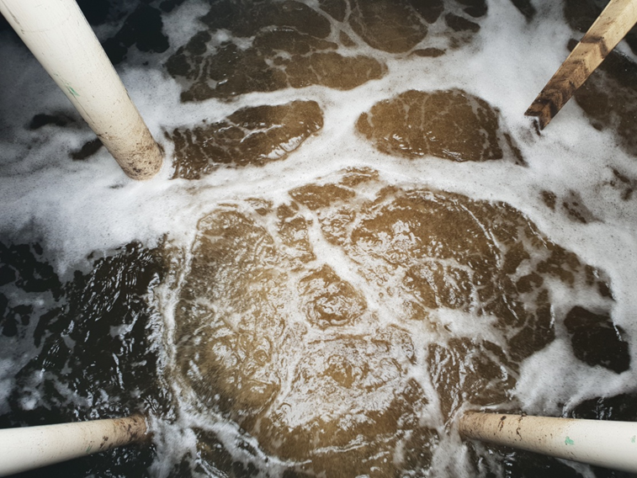
Repairs: Aeration
Volume of air
Surface area of air
Temperature of air
Oxygen transfer rate
Closely tied to the health of beneficial microorganisms
Can be too much in case of nitrogen transformation
Reducing air volume for energy efficiency can be a false saving

Slide 31
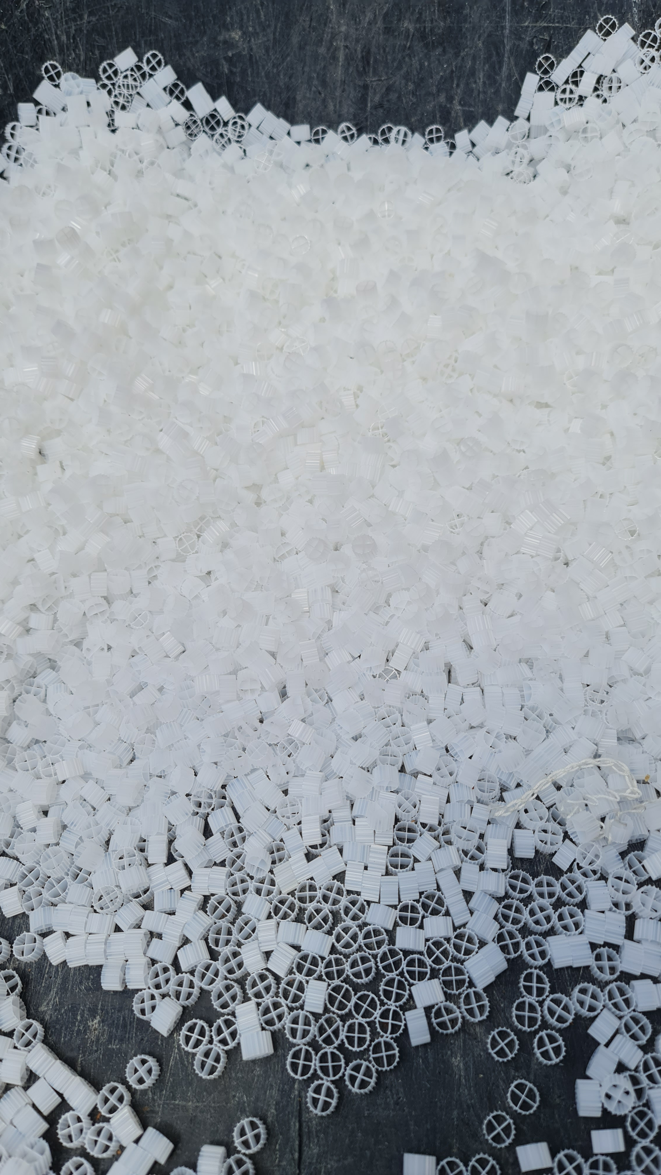
Beneficial Bacteria
Beneficial bacteria
Growth media
Retention time
Different oxygen conditions
Harmful chemicals
Environmental conditions
Temperature
Naturally present
Can be purchased as an additive
Plenty of chemicals can impede their performance and impact on water quality
Don’t like intermittent flows

Slide 32
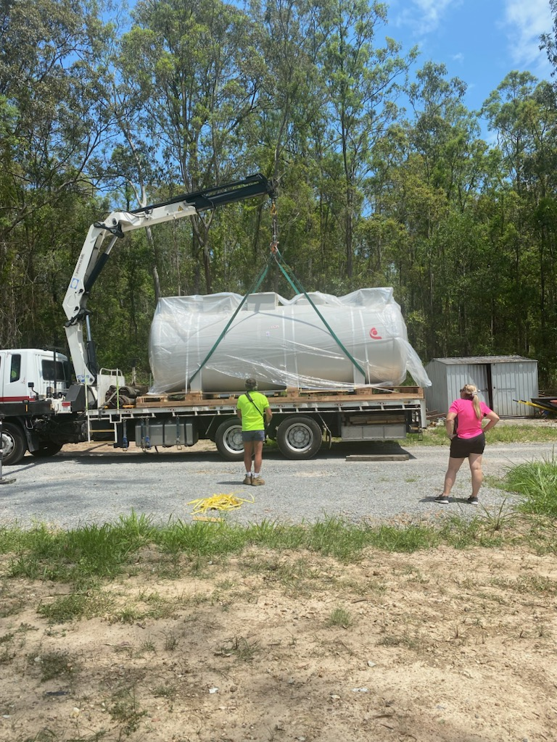
Hydraulic Retention Time
An undersized system is always undersized
But some systems can be too big as well
Not enough food for the system to work as designed
Biological systems typically need the longer periods of time
Some tanks can have baffles retro-fitted
Changes in pipework can also help with retention time

Slide 33
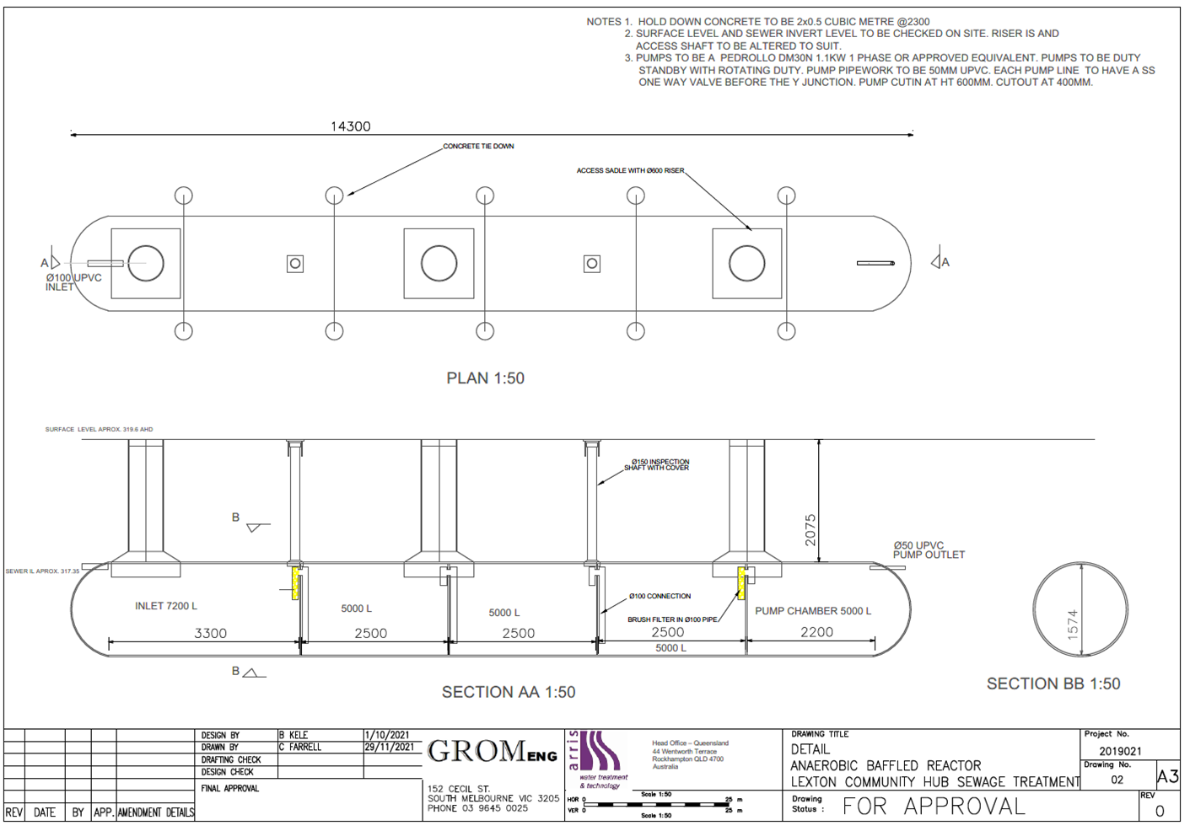
Hydraulic Retention Time

Slide 34
Soil Repair
Dispersal area or part of the treatment system?
Such as irrigation versus mounds
Application rate
Even distribution
Intermittent dosing (sequencing valve)
Pump controller with small doses; rather than floats which send a relatively large volume of the tank
Basic good gardening advice
Gypsum and organic carbon (compost)
This can be counter-intuitive, as compost has a high BOD5/COD
Difference between applying to soil and disposing to water
Gypsum repairs soil from the adverse impacts of sodicity

Slide 35
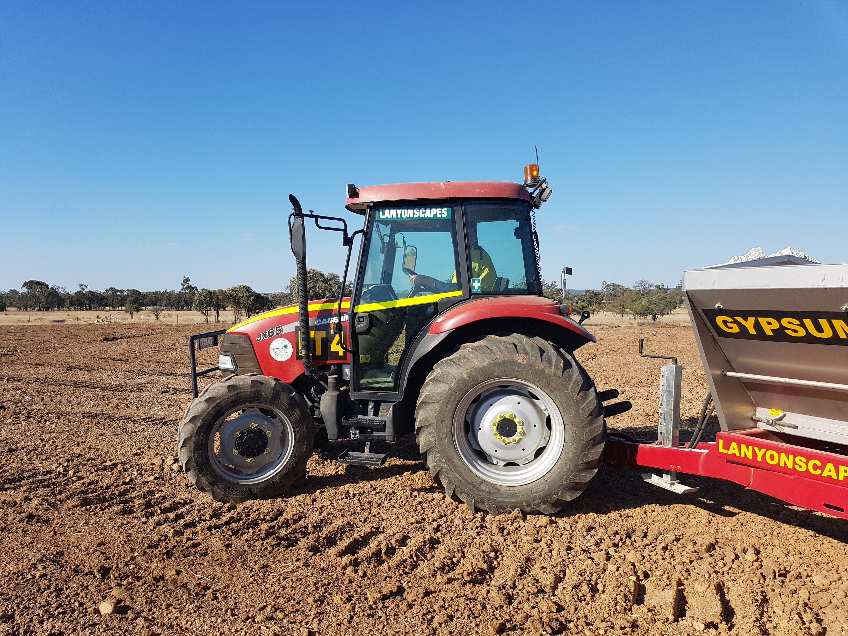
Soil Repair

Slide 36
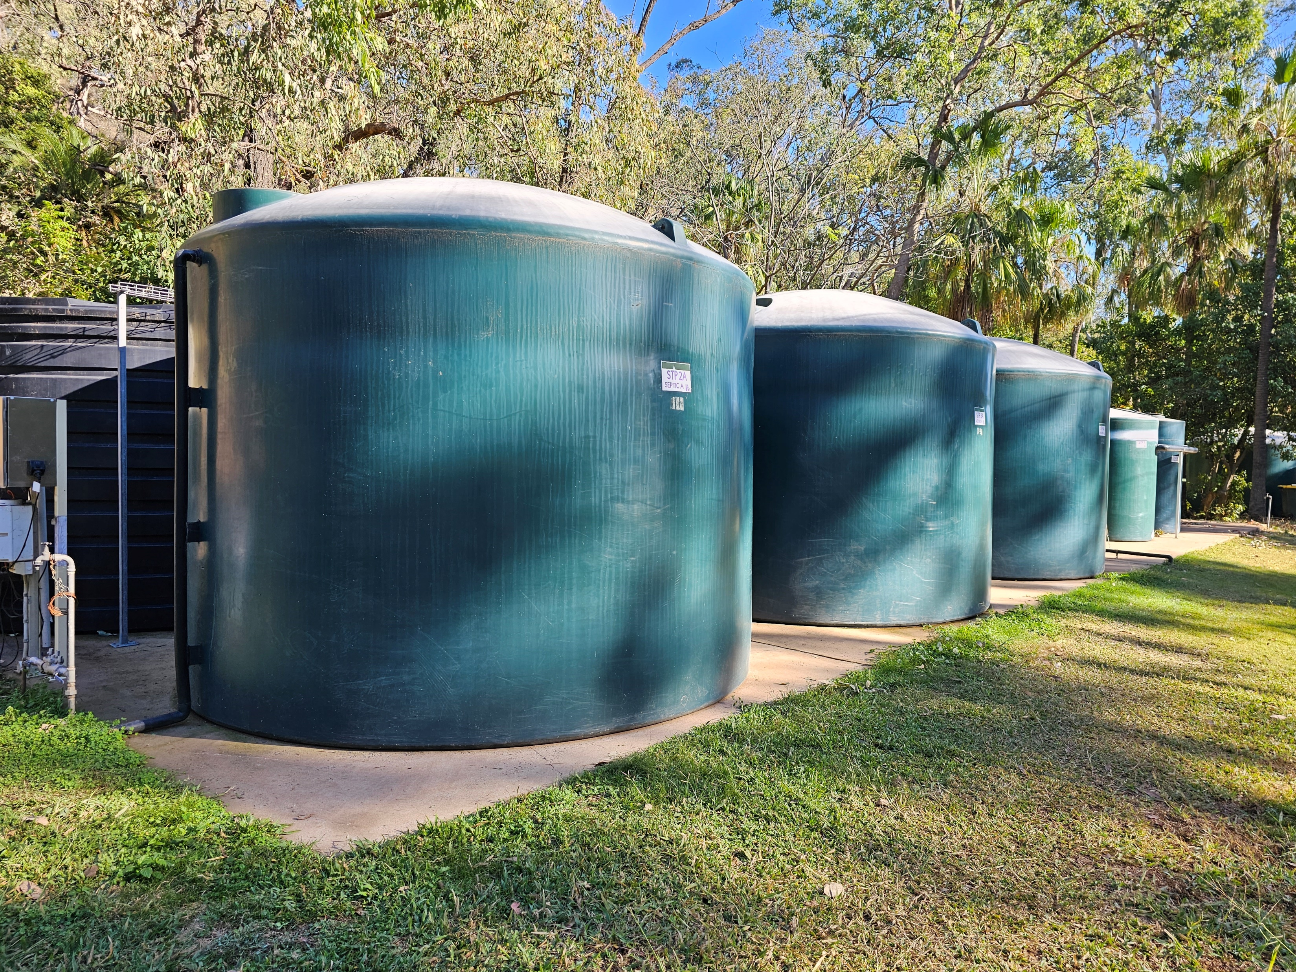
Case Study

Slide 37
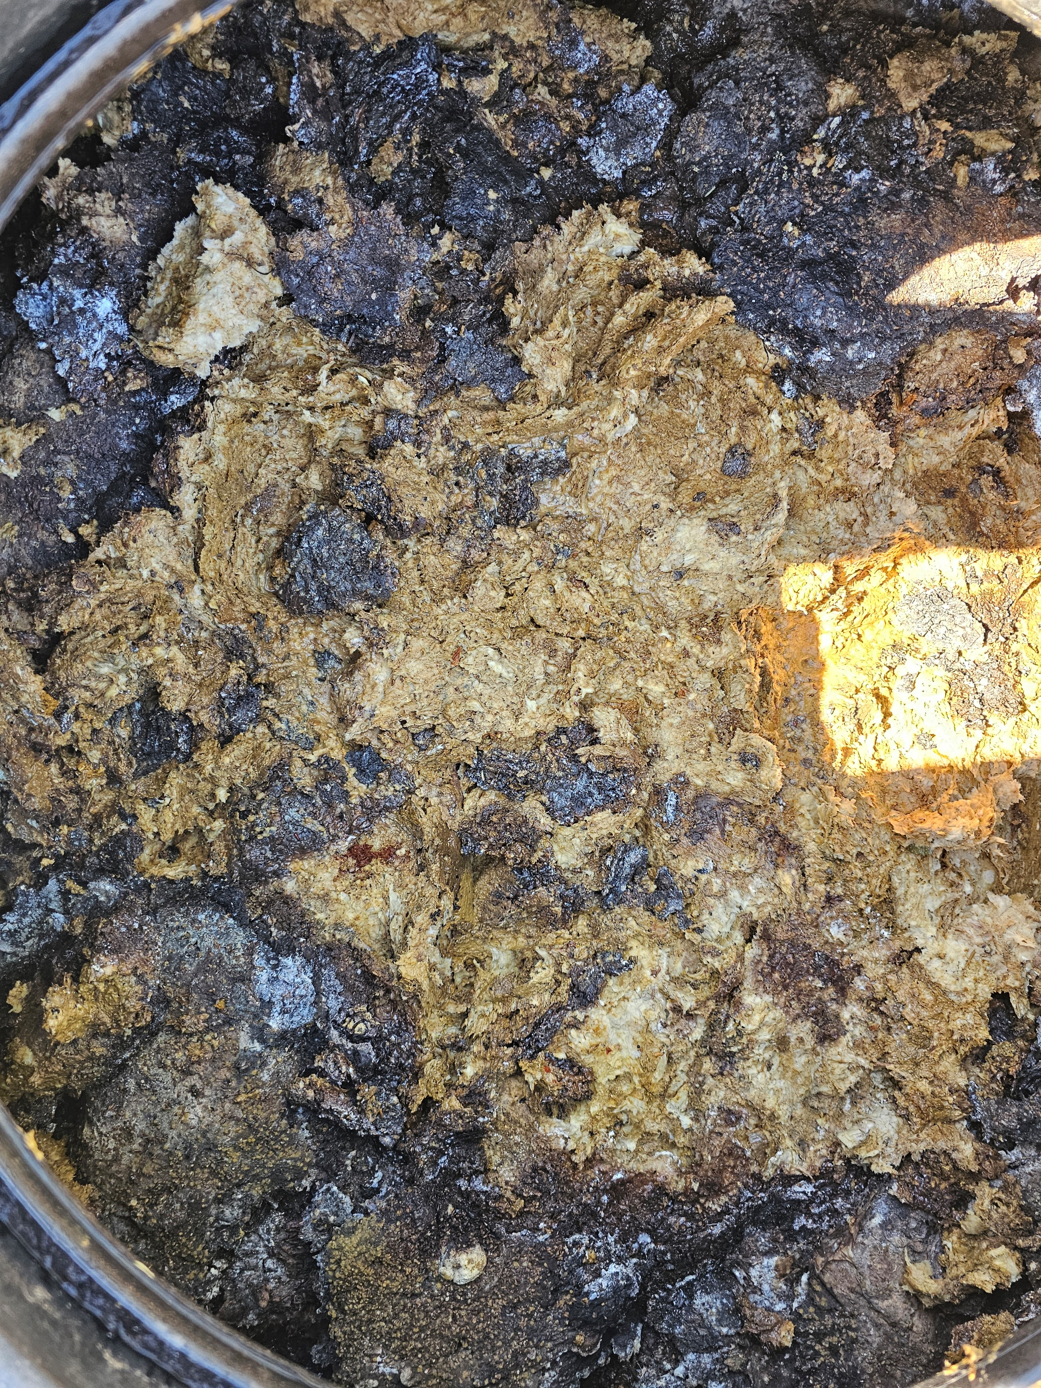
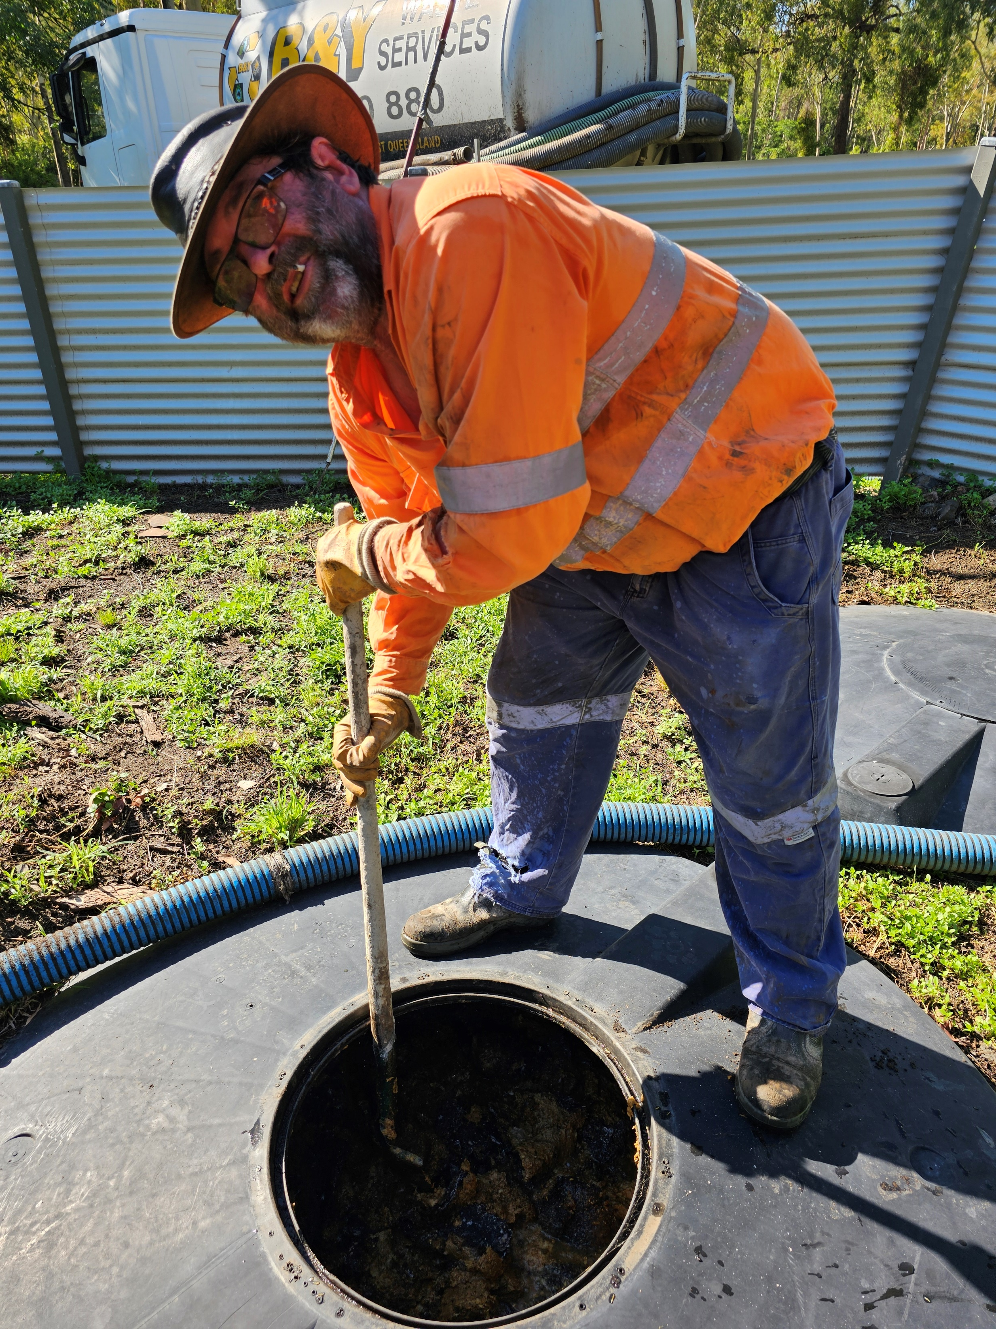
Case Study

Slide 38
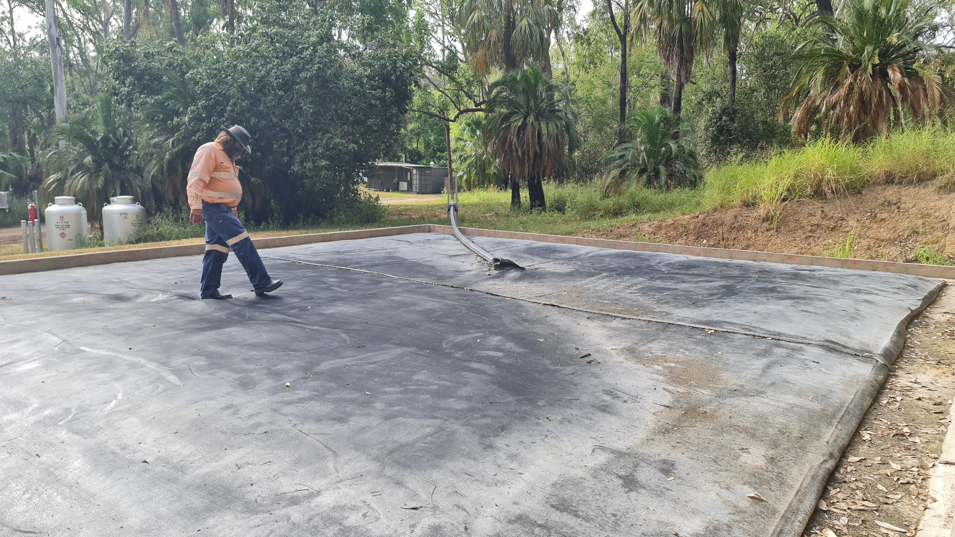
Case Study

Slide 39
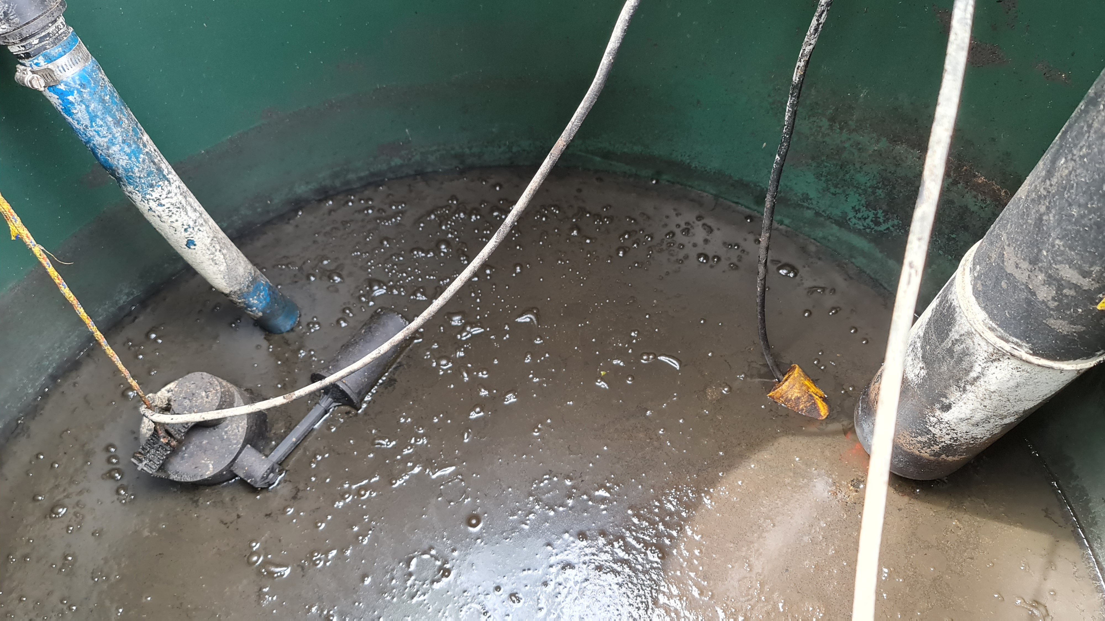
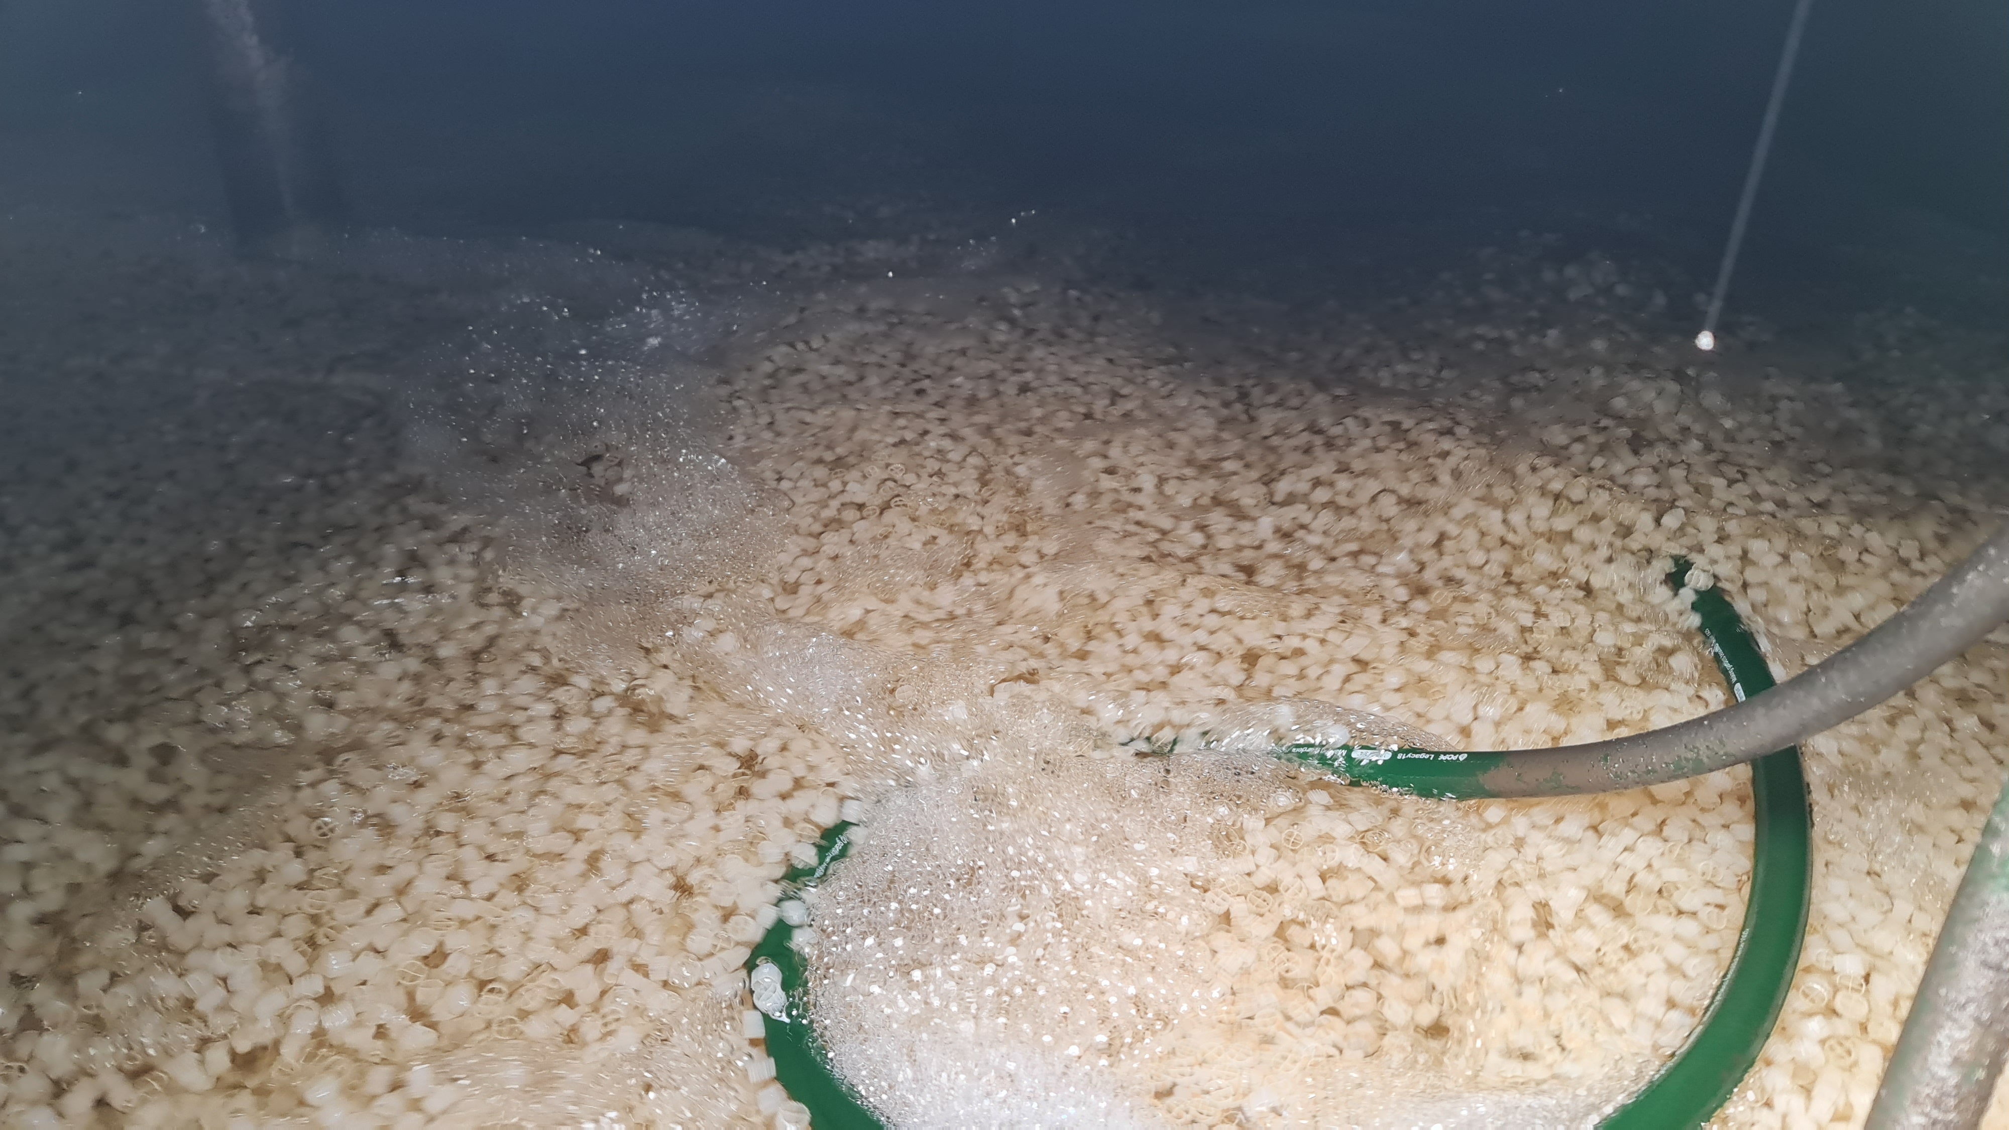
Case Study

Slide 40
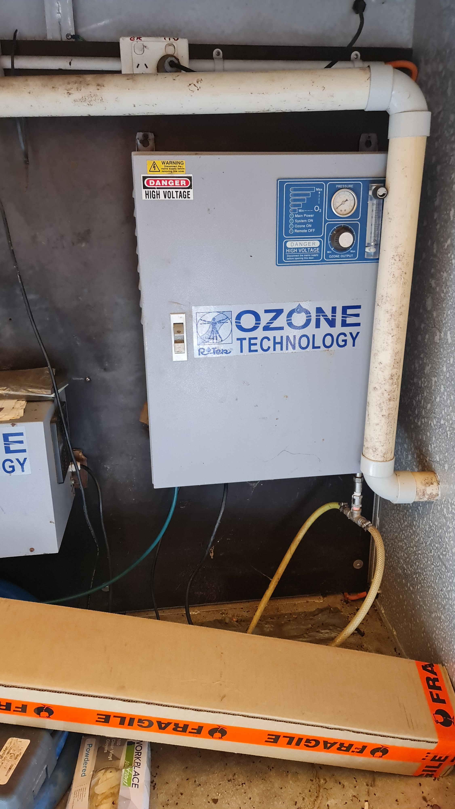
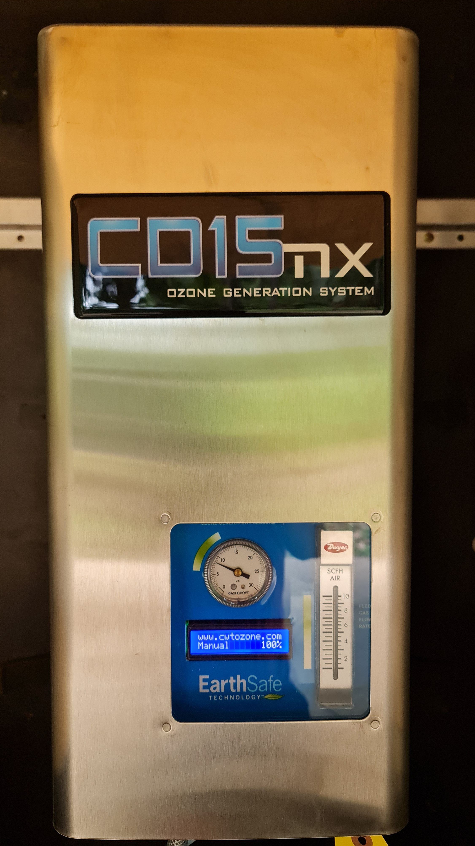
Case Study

Slide 41
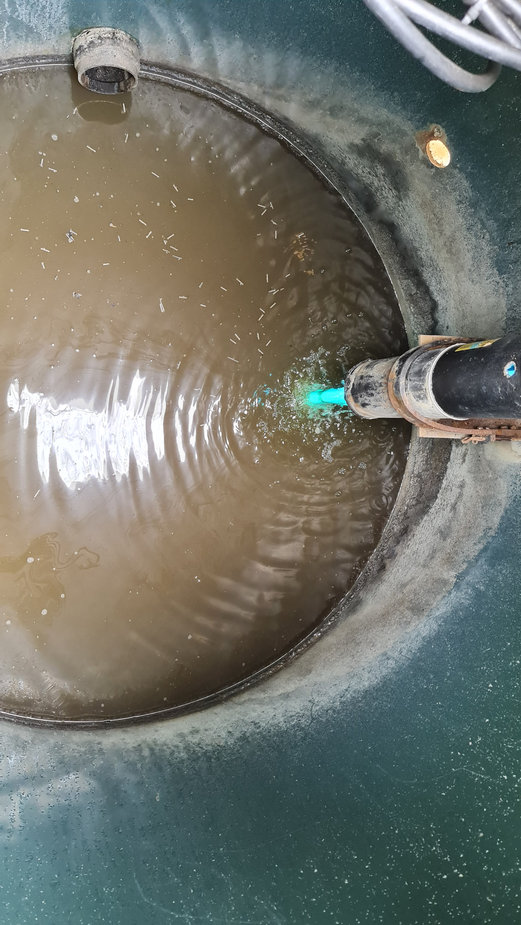
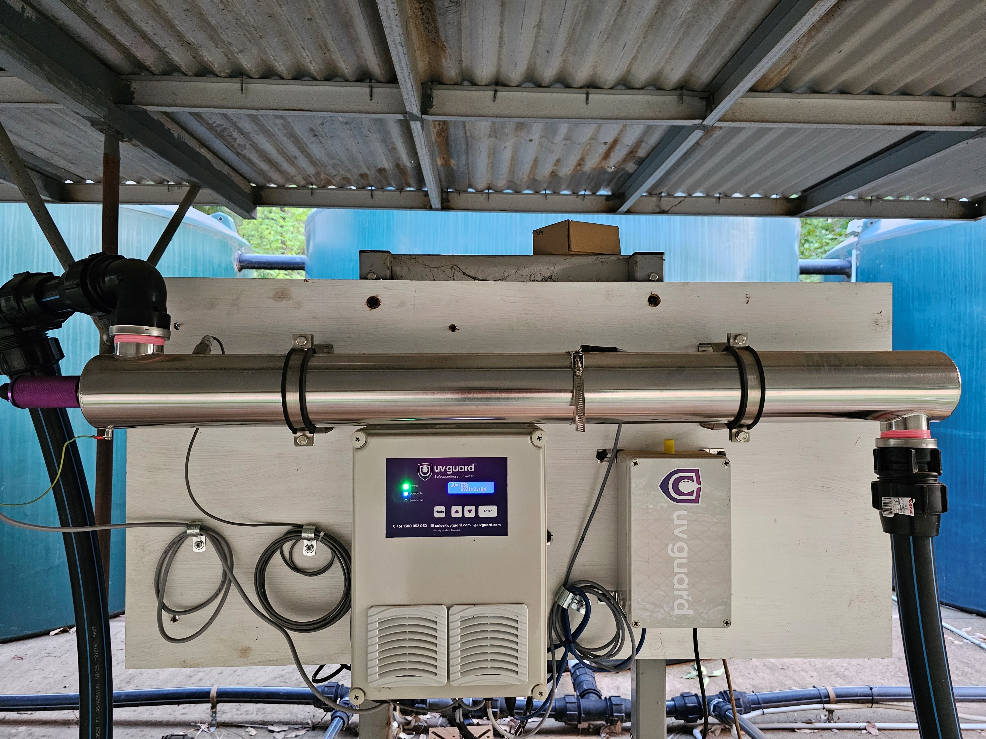
Case Study

Slide 42
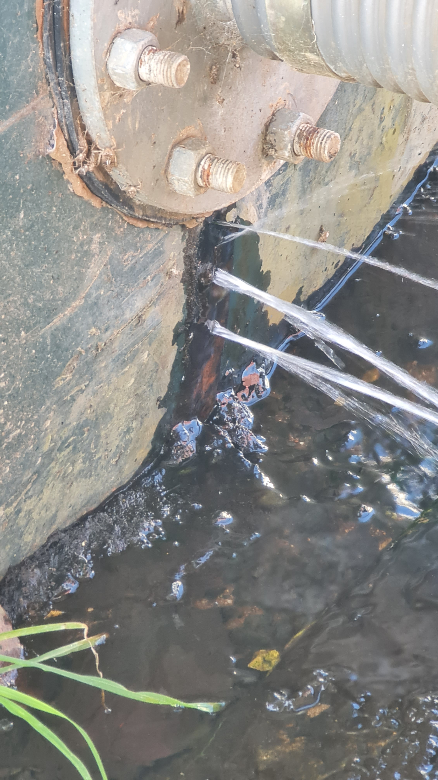
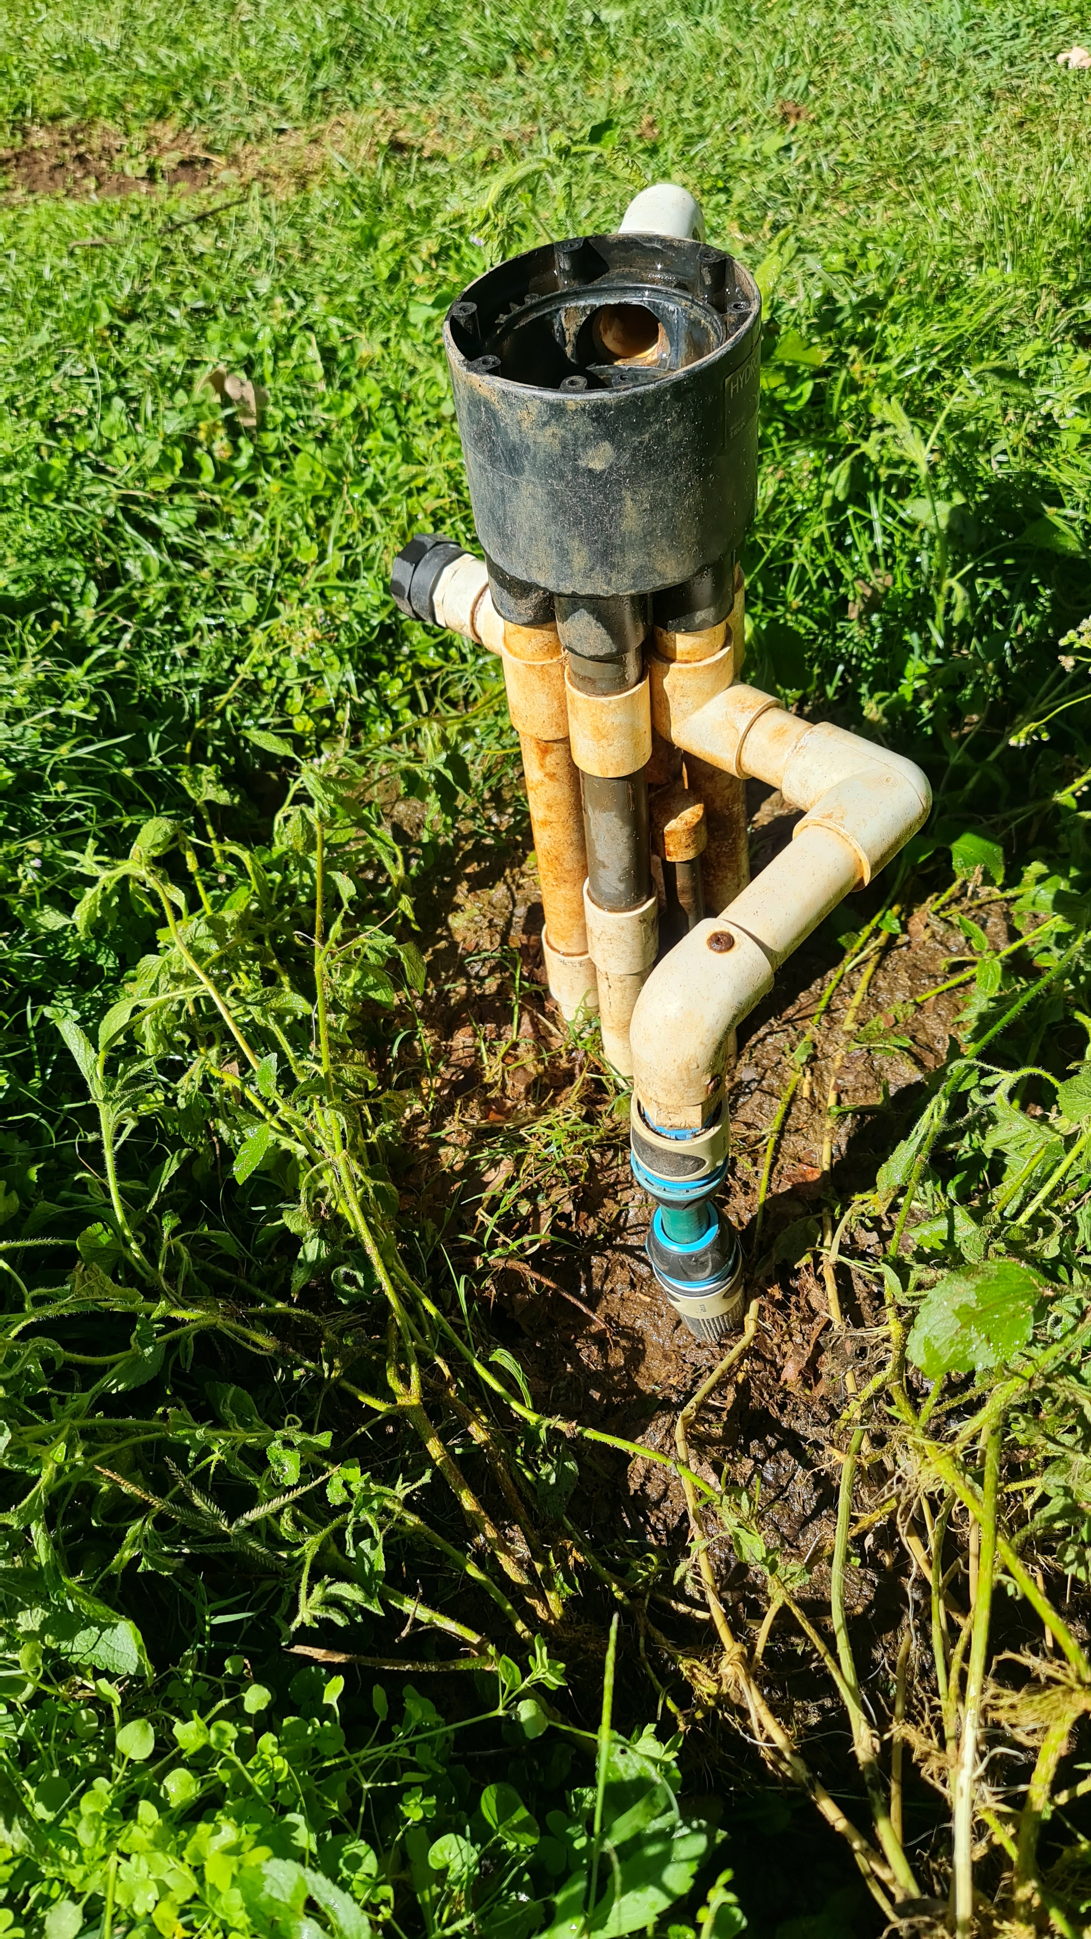
Case Study

Slide 43
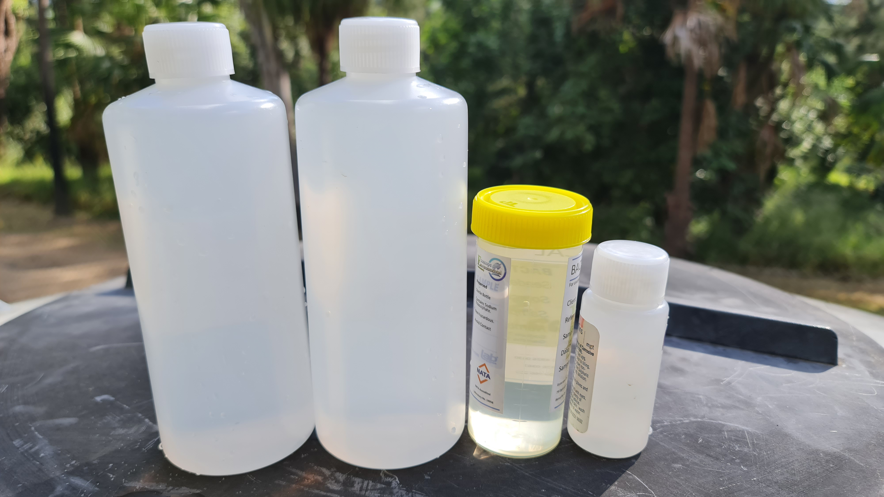
What Can Be Achieved?

Slide 44
Conclusion
You can learn a great deal about how wastewater treatment systems operate by trouble-shooting and repairing existing installations
You may need a different set of diagnostic tests to work out what is going wrong, than your standard water quality tests
You need to look back to how the system was originally designed, how it was installed, and how it is has been operated and maintained, to fully understand which is going on at the site.
People have different definitions of failure
Not everything can be repaired; sometimes starting again is the right answer
Learning from other peoples mistakes can be less stressful than learning from your own…

