Slide 1
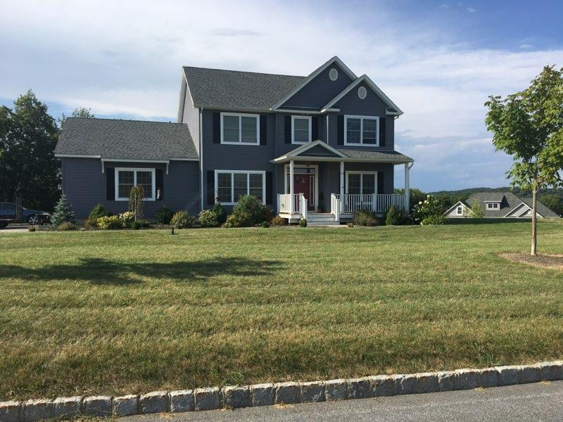
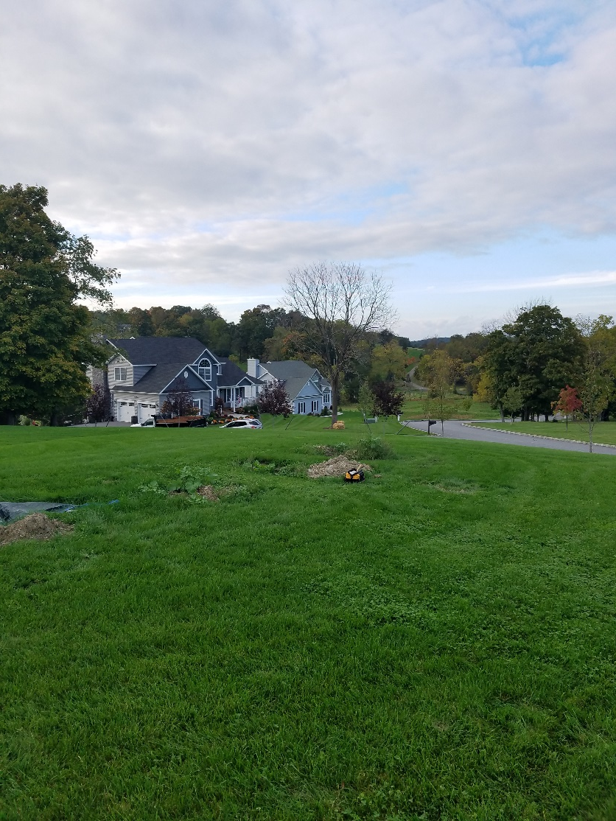
System Failure or Distress?
Troubleshooting Soil Treatment Areas (STA)

Slide 2
Overview
Distress Vs Failure - Troubleshooting
Before Arriving on Site
What Happens once on Site
Follow-Up
Site Walk Through

Slide 3
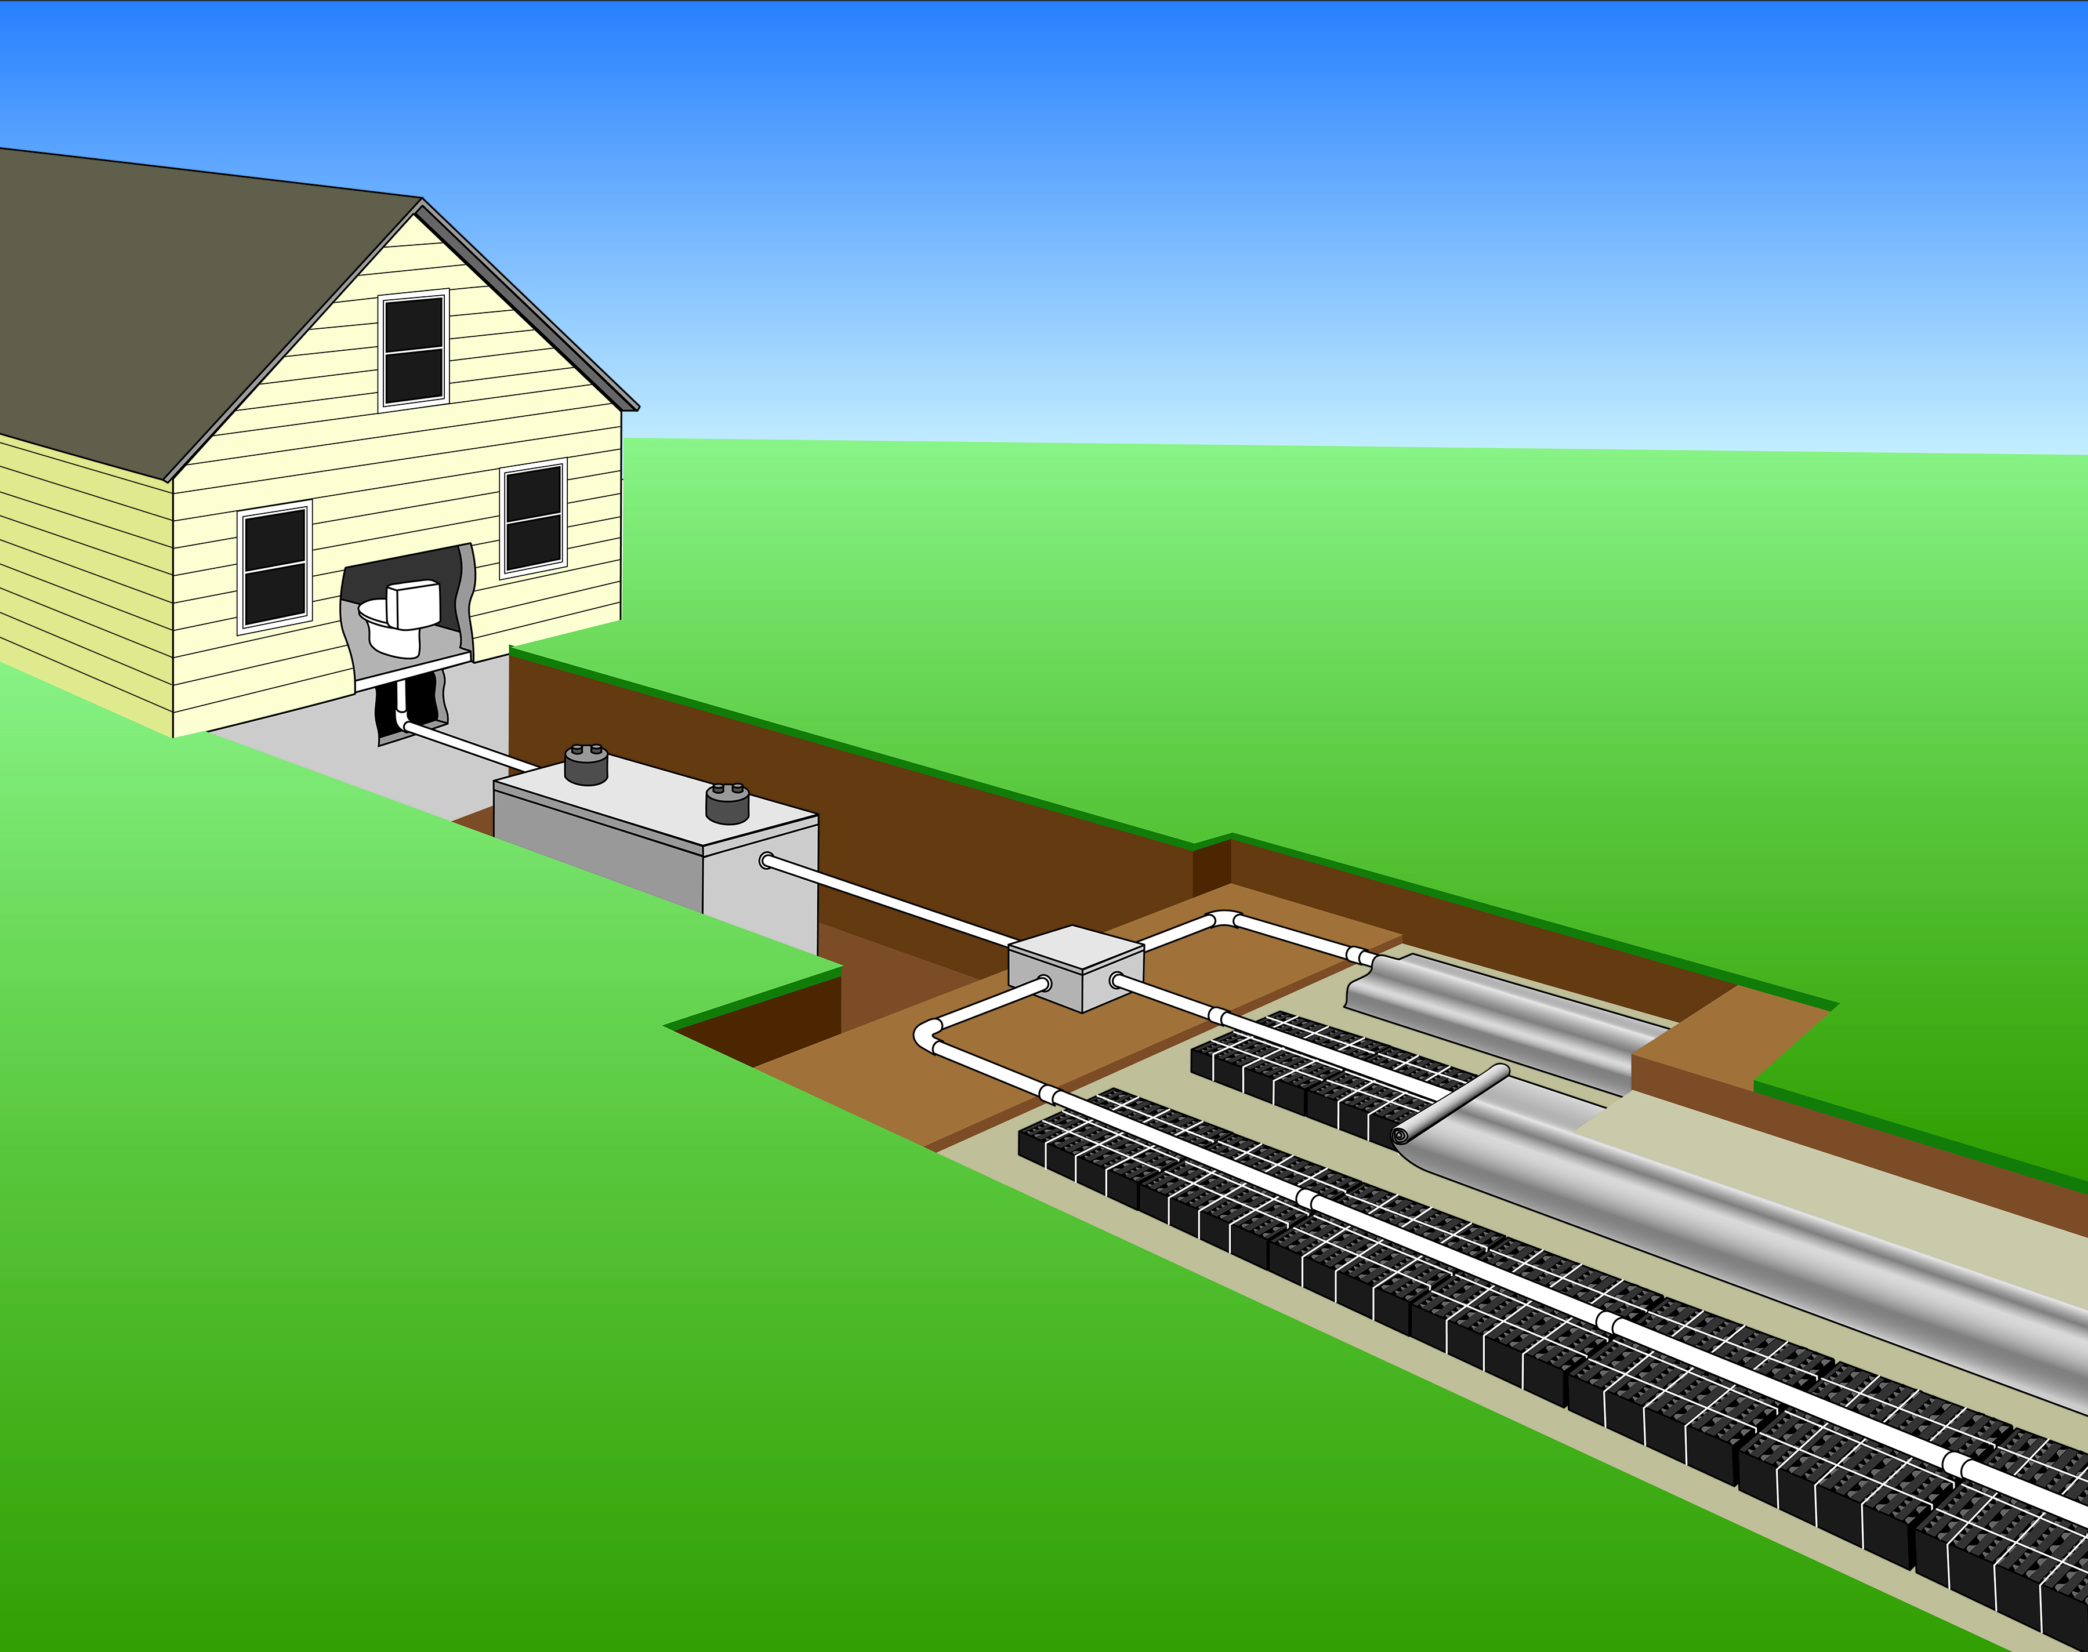
STA refresher
Soil Treatment Area (STA):
Where effluent is applied to soil for final treatment & dispersal (trenches, beds, mounds)
Key functions
Final treatment stage of wastewater
Reduction of solids: nutrients/organics & pathogens
Dispersal of wastewater
Protect groundwater/surface water & public health
Typical gravity system (for reference)
Notes:
[Sources] - https://web.uri.edu/owt/homeowners/understanding-septic-systems/ (diagram) - https://doh.wa.gov/community-and-environment/wastewater-management/septic-system/signs-failure (general description of failures)

Slide 4

Failure
Define “Failure”
Each state defines it differently:
MA – Title V: if the system fails the inspection (at time of sale)
WA – a system or component that threatens public health by inadequately treating sewage or creating potential contact between sewage and the public
NH – a condition where a system does not properly contain or treat sewage, or if the disposal area is located within the seasonal high groundwater table
MI – notable for being the only state without a uniform statewide septic code, meaning "failure" is defined entirely at the local or county level rather than by the state
How does your state define a failed system?

Slide 5
Distress
System in Distress
No state uses this term:
MA – Title V: “Marginal” systems – excessive pumping and/or biomat indications
MN – Failure: “Imminent Threat” but “Failure to Protect Groundwater” is essentially a system in distress
PA – “System in Trouble” – slow drains, spongy soil, pump alarms
RI – “Functional with Concerns”
TX – “Trouble” or “Nuisance” - Ponding
OR – “Likely to Create a Hazard” and uses this standard as a test: “ground too soft to mow over the drainfield”

Slide 6

Distress
System in Distress:
A system exhibiting early-stage malfunctions that, if left unaddressed, will result in a failure but can be repaired, with the reasonable expectation of remaining in compliance for an extended period of time.
A non-compliant system that can be repaired.
Should a distressed system be repaired or just replaced?
Notes:
Should a distressed system be repaired or just replaced?
Old systems are just going to break eventually, just replace it.
Once the soils are damaged, they cannot be remediated
Fixes just allow the system to limp along before totally failing.

Slide 7
Distress vs Failure
Distress: early warning signs Failure: public health/groundwater hazard
SYSTEM IN DISTRESS
SYSTEM FAILURE
Indicators:
Indicators:
Damp or Spongy Soil over Drainfield
Liquid Breakout over the System (Septic Tank to Field)
Foul Odors
Alarms (high water)
Gurgling Drains
Frequent Pumping
Lush grass/vegetation
Back-up into structure
Maintenance/Inspection findings
Each State has unique definition of system failure
Basic: Breaking out on the surface, or backing into the home
Advanced: threatens public health or creates potential for direct or indirect contact between sewage and public
Should a distressed system be repaired or just replaced?
Notes:
Should a distressed system be repaired or just replaced?
Old systems are just going to break eventually, just replace it.
Once the soils are damaged, they cannot be remediated
Fixes just allow the system to limp along before totally failing.

Slide 8
Distress vs Failure
Observation | Questions to Document
Damp or Spongy Soil over STA | Localized? Persistent?
Breakout/Ponding over System (septic tank to STA) | Localized? Persistent? Timing?
Foul Odors | Location? Timing?
Alarms (high water) | Repeated? Timing?
Slow/Gurgling Drains | Persistent? Location?
Lush Vegetation | Odor? Location? Weather?
Greening over STA | Location? Patchy?
Back-up into Structure | Repeated? Timing?
Notes:
Damp or Spongy Soil over STA: Distress: using to much H2O, leak? Stormwater intrusion, poor grading, is it over the entire system or one lateral? Unequal distribution…
Breakout/Ponding: Distress: Broken pipe? Stormwater intrusion, poor grading.
Foul Odors: Distress: broken pipe, venting issues,
High water alarms: Distress: floats going bad, Faulty wiring, bad pump, pressure orifices clogged
Slow/Gurgling drains: Clogged pipes, bad plumbing, clogged effluent filter
Lush Vegetation/Lush Vegetation indicates a water source, likely damp/spongy soil and/or ponding.
Greening: Greening is NOT always bad, shallow systems will be greener over drainfields. Distress: over part of field but not the rest? NOT always bad either. Greening CAN indicate somethings up, but not always.
Backup into Structure: Distress: clogged pipes, clogged effluent filter, damaged D-Box, roots, etc.

Slide 9

Distress vs Failure
TROUBLESHOOTING
Without clearly identifying the problem; it's impossible to know if the system can be returned to compliance
How often do you give good news?

Slide 10
Before Arrival
1) It Starts with a Call
2) Gather & Analyze Site Information
3) Send Out Invitations
4) Get Your Materials Ready

Slide 11

It Starts with a Call
When does the problem occur? Seasonal… Weekends… Always…
How long have they noticed the problem?
How long have they been in the home?
How many occupants?
Any changes in water usage habits?
Gather basic home & system details, maintenance, & problem timeline
- Bedrooms - Garbage Grinder - Date Installed
- Occupants (kids/adults) - Large/Oversized Tubs - First noticed problems
- Home Business - Lawn Irrigation - Date tank was last pumped
What additional questions would you add to this list?
Notes:
Homeowners Generally do not know this info
Follow up with an email with these same questions and requests for documents

Slide 12
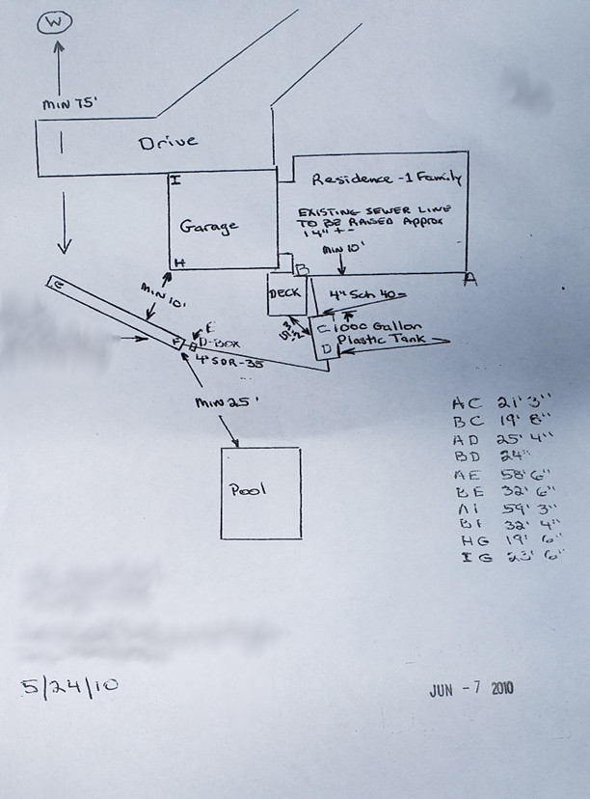
Gather Site Information
Gather information on the site
Do your homework
Plans
Permits
As-built
Google Earth
Water Usage (if available)
O&M Records
Available Pictures
What else could help?

Slide 13
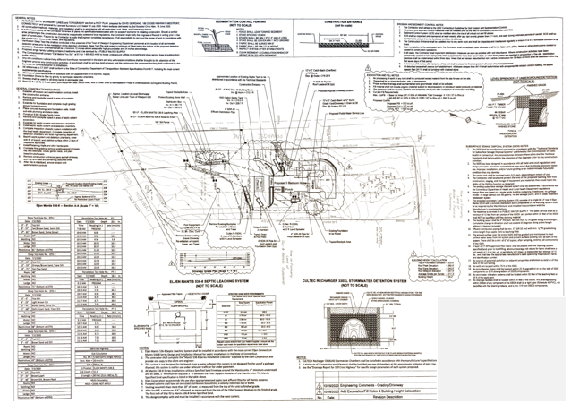
Gather Site Information – Homework Analyze: Septic Plans
Analyze the information
Compare known vs unknown
Start a list of questions
Septic Plans:
Sized appropriately?
Soil information
Date Planned vs Installed
Note any conflicting info
Notes:
Start a list of questions: Things that do not make sense or sound suspicious. As the investigation progresses many questions will be crossed off the list, the ones that remain unanswered generally lead to where we dig further.
Septic Plans (Current & any previous plans on record)
Soil/perc test results
Drainage (stormwater, water-softener/pool discharge)
Grey water systems

Slide 14
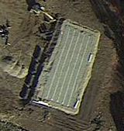
Gather Site Information – Homework Analyze: As-Built & Google Earth
Analyze the information
Compare known vs unknown
Add to list of questions
As-built:
Does it match the septic plans?
Sized Appropriately?
Correct products used as per plans?
Google Earth:
History & Site Details
Changes over time
Notes:
As-built – can clarify the situation or make it worse
Google Earth:
- Can be used to verify parts of As-Built
Grass coloring over time
Site History – Construction, significant landscaping changes,
Everyone in the neighborhood has mounded systems but this house…

Slide 15

Gather Site Information – Homework Analyze: Water & O&M Records
Analyze the information
Compare known vs unknown
Add to list of questions
Water Use
City Water bill
Well
Counter/meter?
Alternative options to estimate water use?
O&M Records
Pumping/maintenance records
Notes:
City Water: compare actual water use with design flow – Consider lawn irrigation and other non-septic water uses
Well water: alternative methods of estimating water use:
dosing counters/pump counters. (can install counter <$100)
Pump septic tank and inspect daily to determine how long takes to refill.
O&M records often ONLY source for some relevant info: weird things flushed, missing effluent filters, previous emergencies/events. Differences between previous and current owners. Total lack of maintenance despite owners assertions.

Slide 16
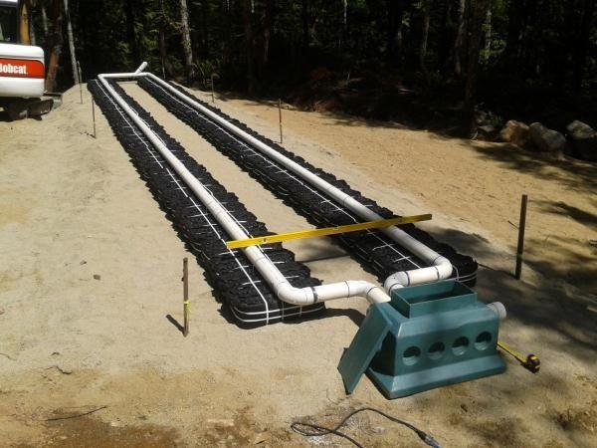
Gather Site Information – Homework Analyze: Pictures
Analyze the information
Compare known vs unknown
Add to list of questions
Pictures - Worth 1000 words
Weather/date of installation
Who else was on-site
Products/materials used
Configuration & locations
Indication of level of profession
Notes:
Sources of photos: Homeowner, installers/designers, Health Officials
Some states/districts HD require photos of installations – good practice
Photos can indicate:
Weather during installation (snow, rain, dry)
Who else was on site
Specific products/materials used
Configurations & locations
Indication of level of profession

Slide 17

Gather Site Information – Homework Analyze: List of Questions
Analyze the information
Compare known vs unknown
List of Questions:
Try not to make assumptions at this point
List concerns:
Differences b/w Plans & As-Built
Soil analysis
Depth to limiting layers unusual?
Anything suspicious – add to the list
List helps develop plan on-site
Notes:
List of Questions:
Try not to make assumptions: Just because the plans and as-built show an effluent filter does not mean its still there.
Make note of any anomalies: dept to bedrock or groundwater on this site vs others in the area
Differences b/w plans and as-built – were different products/pumps used vs what the plans called for?
Anything suspicious – add it to the list of questions

Slide 18

Send Out Invitations
Local Regulator
Contractor
Engineer
Builder
Homeowner usually is not a help
Notes:
- Being diplomatic here is important, everyone has their own incentives – This group is NOT going to show up looking like this picture
Often fingers have already been pointed, and accusations/insults have been thrown – some parties its best not to invite…
Homeowners on-site usually require a handler (someone solely there just to explain what is going on and what the discussion is about)
Interview the Homeowner separately if possible
Photo: Who doe each of these cartoons represent? – The installer is on the right, checking out the Health Inspector, the guy with the saw is the homeowner ready to DIY a fix right?

Slide 19
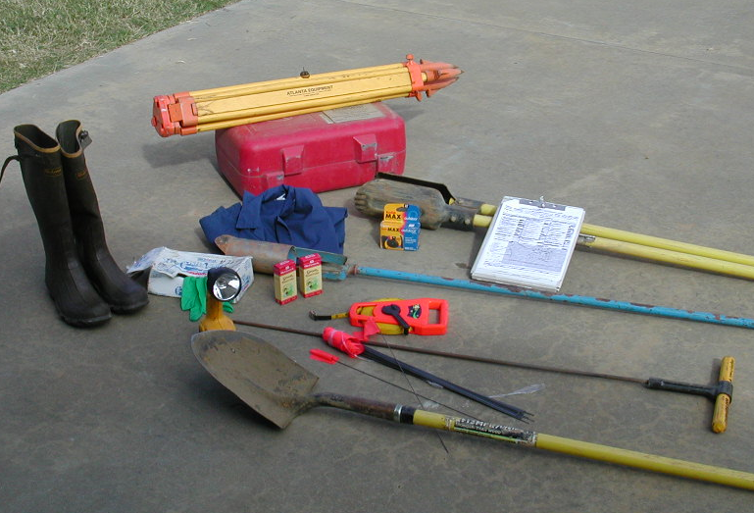
Get Your Materials Ready
Probe
Auger
Tape Measure
Gloves
Camera
Shovel
Marking Paint
Snake Camera
Flashlight
Laser Level
Sampling Equipment
Bottles
Cooler
Bags
Notes:
Sampling Equipment: method of getting effluent samples, Sludge Judge,
When taking effluent samples: Order bottles/supplies from lab & get ICE
Borrow your buddy's cooler, don’t use your own!
I also bring change of shoes, soap and water, Mosquito & Wasp spray
Long hook for removing deep septic tank covers

Slide 20
What Happens once on Site
1) Identify the Location of the System
2) Identify the Location of the Issue(s)
3) Start the Investigation
4) Document your Activities
5) Diagnostics/Testing & Way Forward
Notes:
Having a plan once you arrive on site will keep you from missing things. This is a good plan: modify as needed.
Interviewing the Homeowner and asking for a tour can be helpful, especially if investigating the system alone. (can save a LOT of time/digging)

Slide 21

Sage like Advice
Notes:
Where the fun begins right? Gazing into someone's septic tank always feels like I sneaked a look into their personal journal or underwear drawer. Like it’s their deep dark most private secrets.

Slide 22
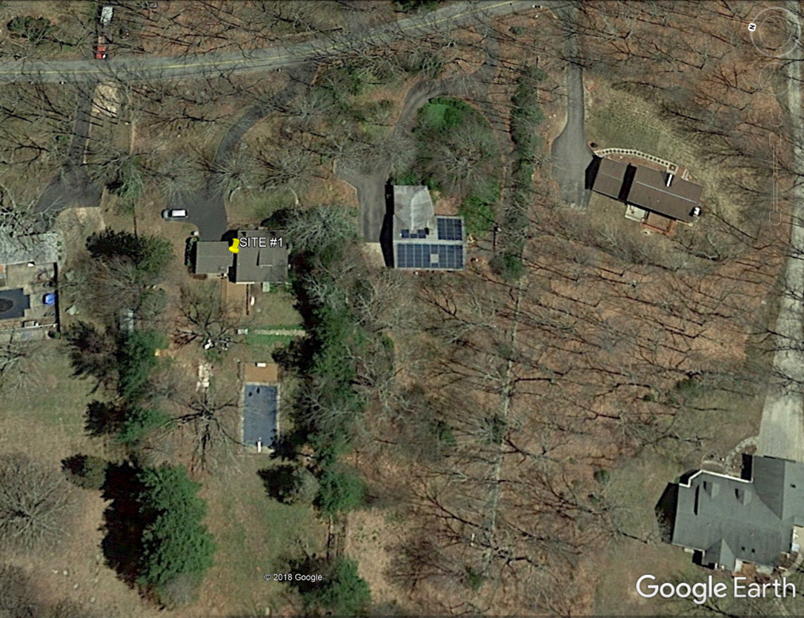
1. Identify the Location of the System
Notes:
*I avoid the Problem area as it can give tunnel vision. If all time/attention is on the symptom, we can easily overlook the cause accidently. *
What differences do you see with the as-built and google earth? Driveway, Pool location,
Google Earth – copy & paste a picture from above into word doc
Copy & paste picture of as-built into word – Windows/Shift/S to clip picture – Click on picture – Picture format – transparency – resize and overlay onto google earth picture
May or may-not be helpful

Slide 23
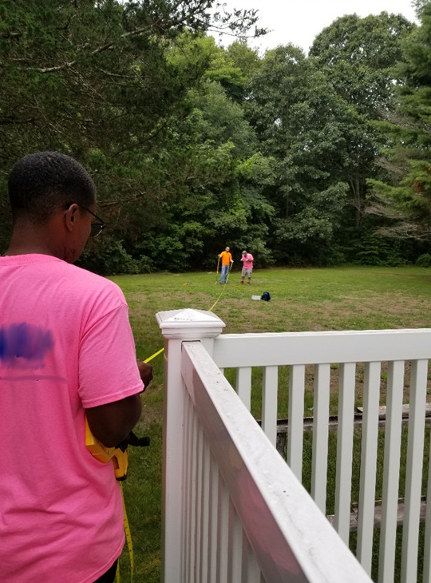
1. Identify the Location of the System
Consult as-built
Locate system
Notes:
Mark out spots on As-built using paint/flags
Septic Tanks, Pump chambers, D-Box, Field, Inspection Ports, Vents, Etc.
Keep eye out for other clues: soggy areas, greener grass, lush vegetation, lack of snow cover,

Slide 24
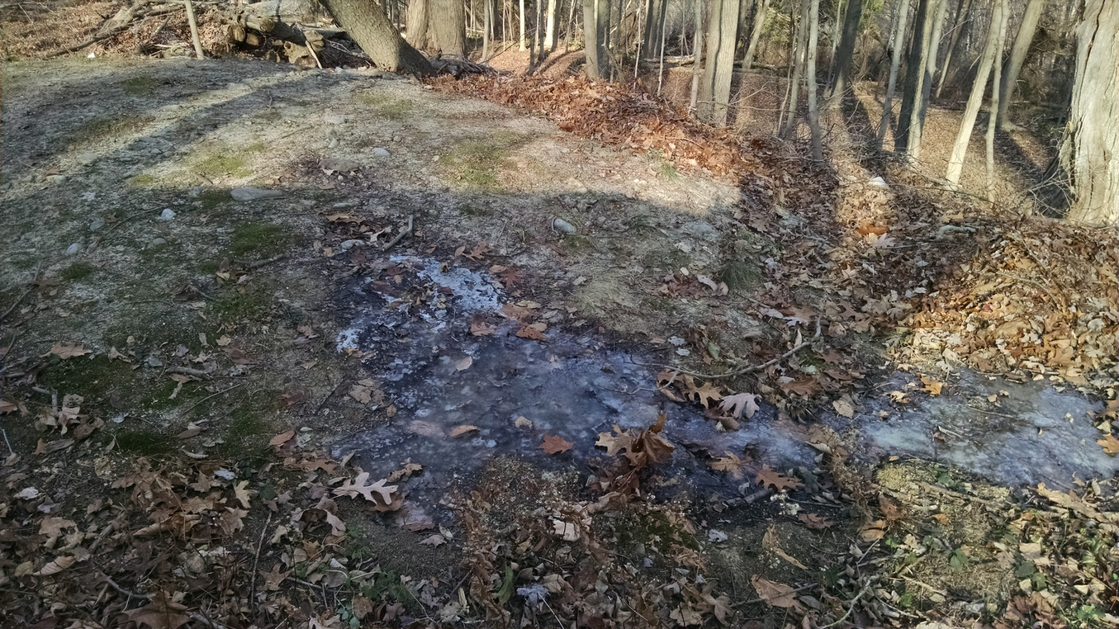
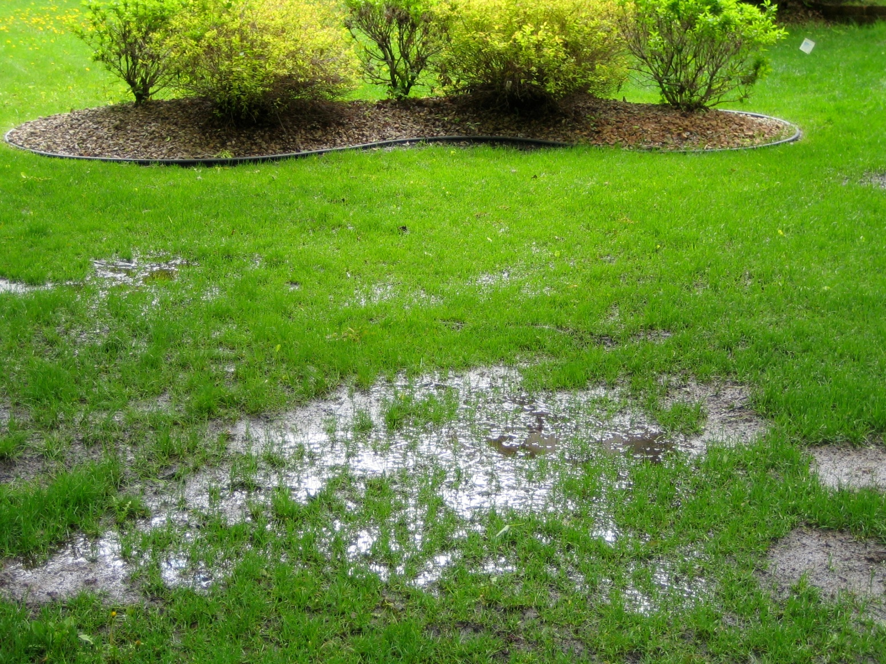
2. Identify the Location of the Issue
Notes:
Document, Document, Document. Take pictures, don’t get tunnel vision.

Slide 25
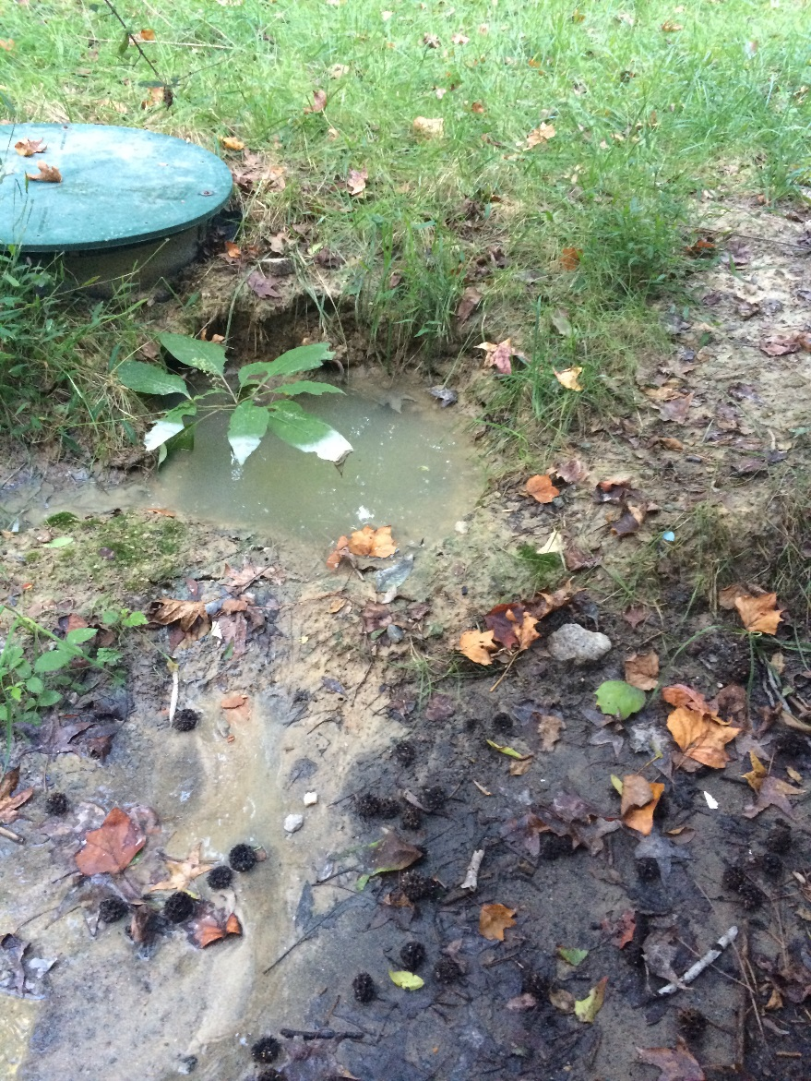
2. Identify the Location of the Issue
Pointed out by the homeowner
Their observations, timeline, how often, etc.
Obvious problems
Notes:
Once we see the obvious problems, why is important to keep looking?

Slide 26

3. Start the Investigation
Have a Plan:
Start from the home
Septic & Pump Tanks
Distribution Boxes
Field/STA
How do we implement our list of questions?
Notes:
You will miss important clues by skipping ahead and end up wasting time

Slide 27

3. Start the Investigation
Start from the home
Check for leaky fixtures:
observing the inlet of septic tank
Dye toilet reservoir tank
Check cleanouts
Venting issues
Notes:
Inside home: Toilet dye leak tests are easy to do, also gives opportunity to see if fixtures are leaking/dripping, extra bathroom/kitchen not aware of – *6 industrial washing machines*
Drains are slow or gurgling, ask to see them too.
Backing up into home, ask to see location
Ask to shut off all water use during investigation – will help identify leaky fixtures at septic tank/D-Box
Cleanouts – are they backed up or clear?
Venting: How to test? Smoke test

Slide 28
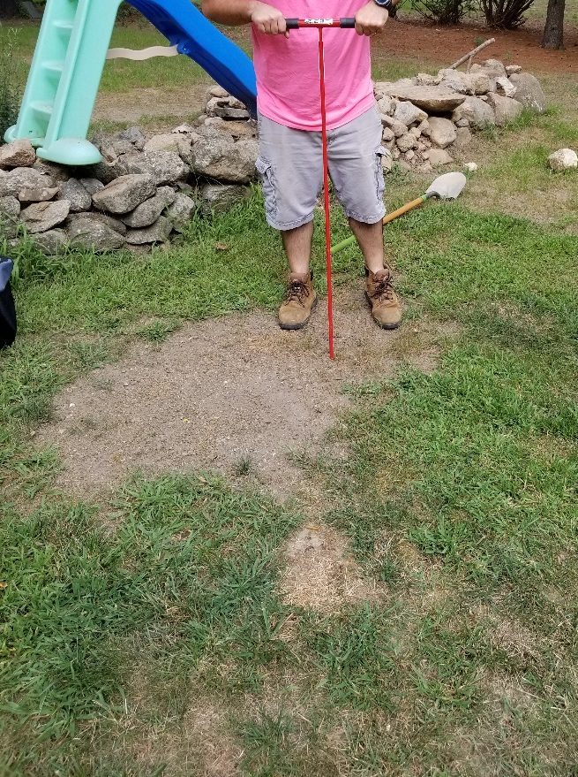
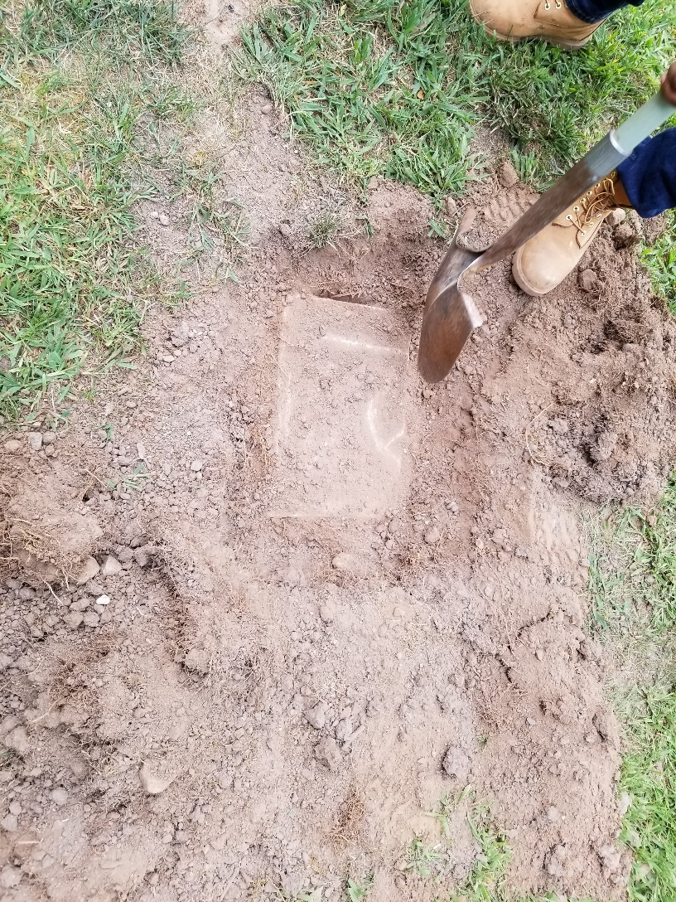
3. Start the Investigation
Probe area
Septic Tank & D-box

Slide 29
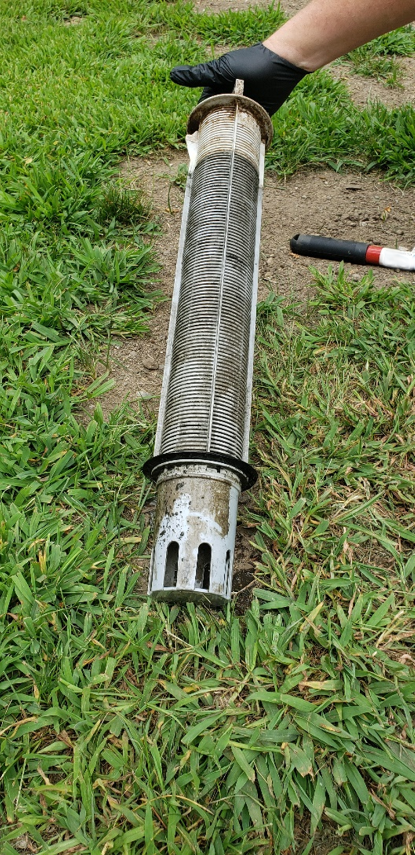
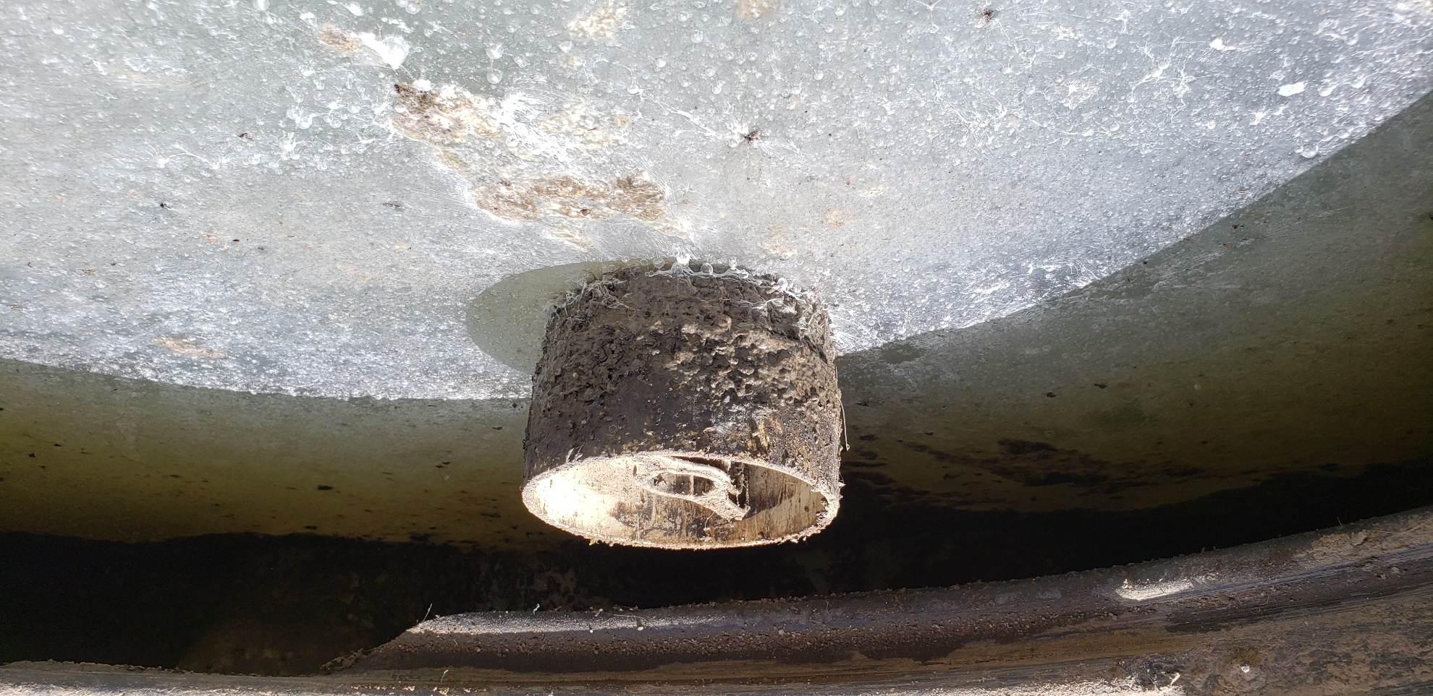
3. Start the Investigation
Septic Tank Condition
Effluent Filter
Notes:
Septic Tank:
Uncover both inlet & outlet: Note the condition, crust level, color, etc.

Slide 30
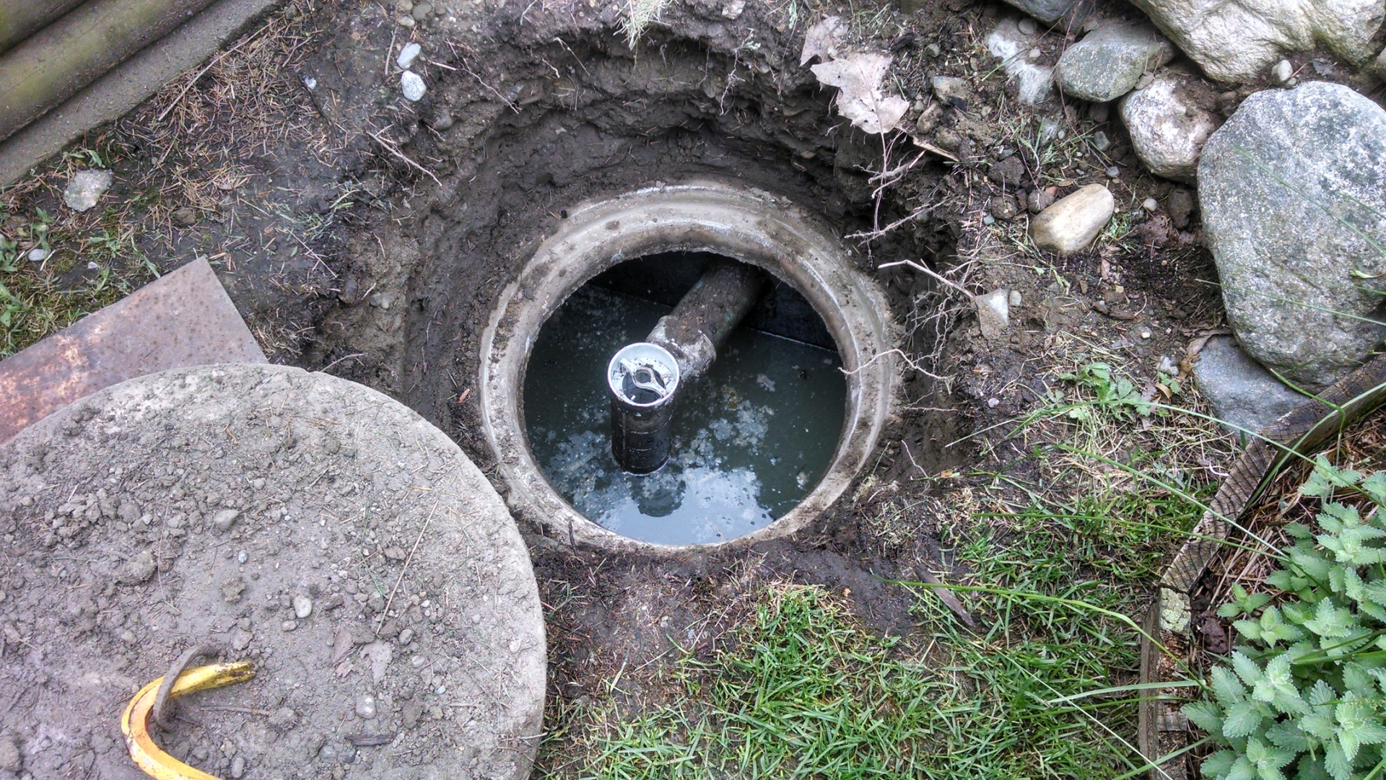
3. Start the Investigation
Septic Tank:
Inspect Lids & Risers
Inspect Baffles & Tees
Check Effluent Filter
Check liquid level
Check for surface intrusion
Pull Lab Samples
Notes:
Septic Tank
Inspect Inlet & Outlet side - Take pictures - Looking for clues: Heavy solid buildup – solids in outlet side, evidence of “high-tide” events
Effluent Filter Condition: Remove and inspect – if water level goes down after removal: Clean Effluent Filter – Maintenance required/change schedule. If Effluent Filter is perfectly clean: what's wrong?

Slide 31
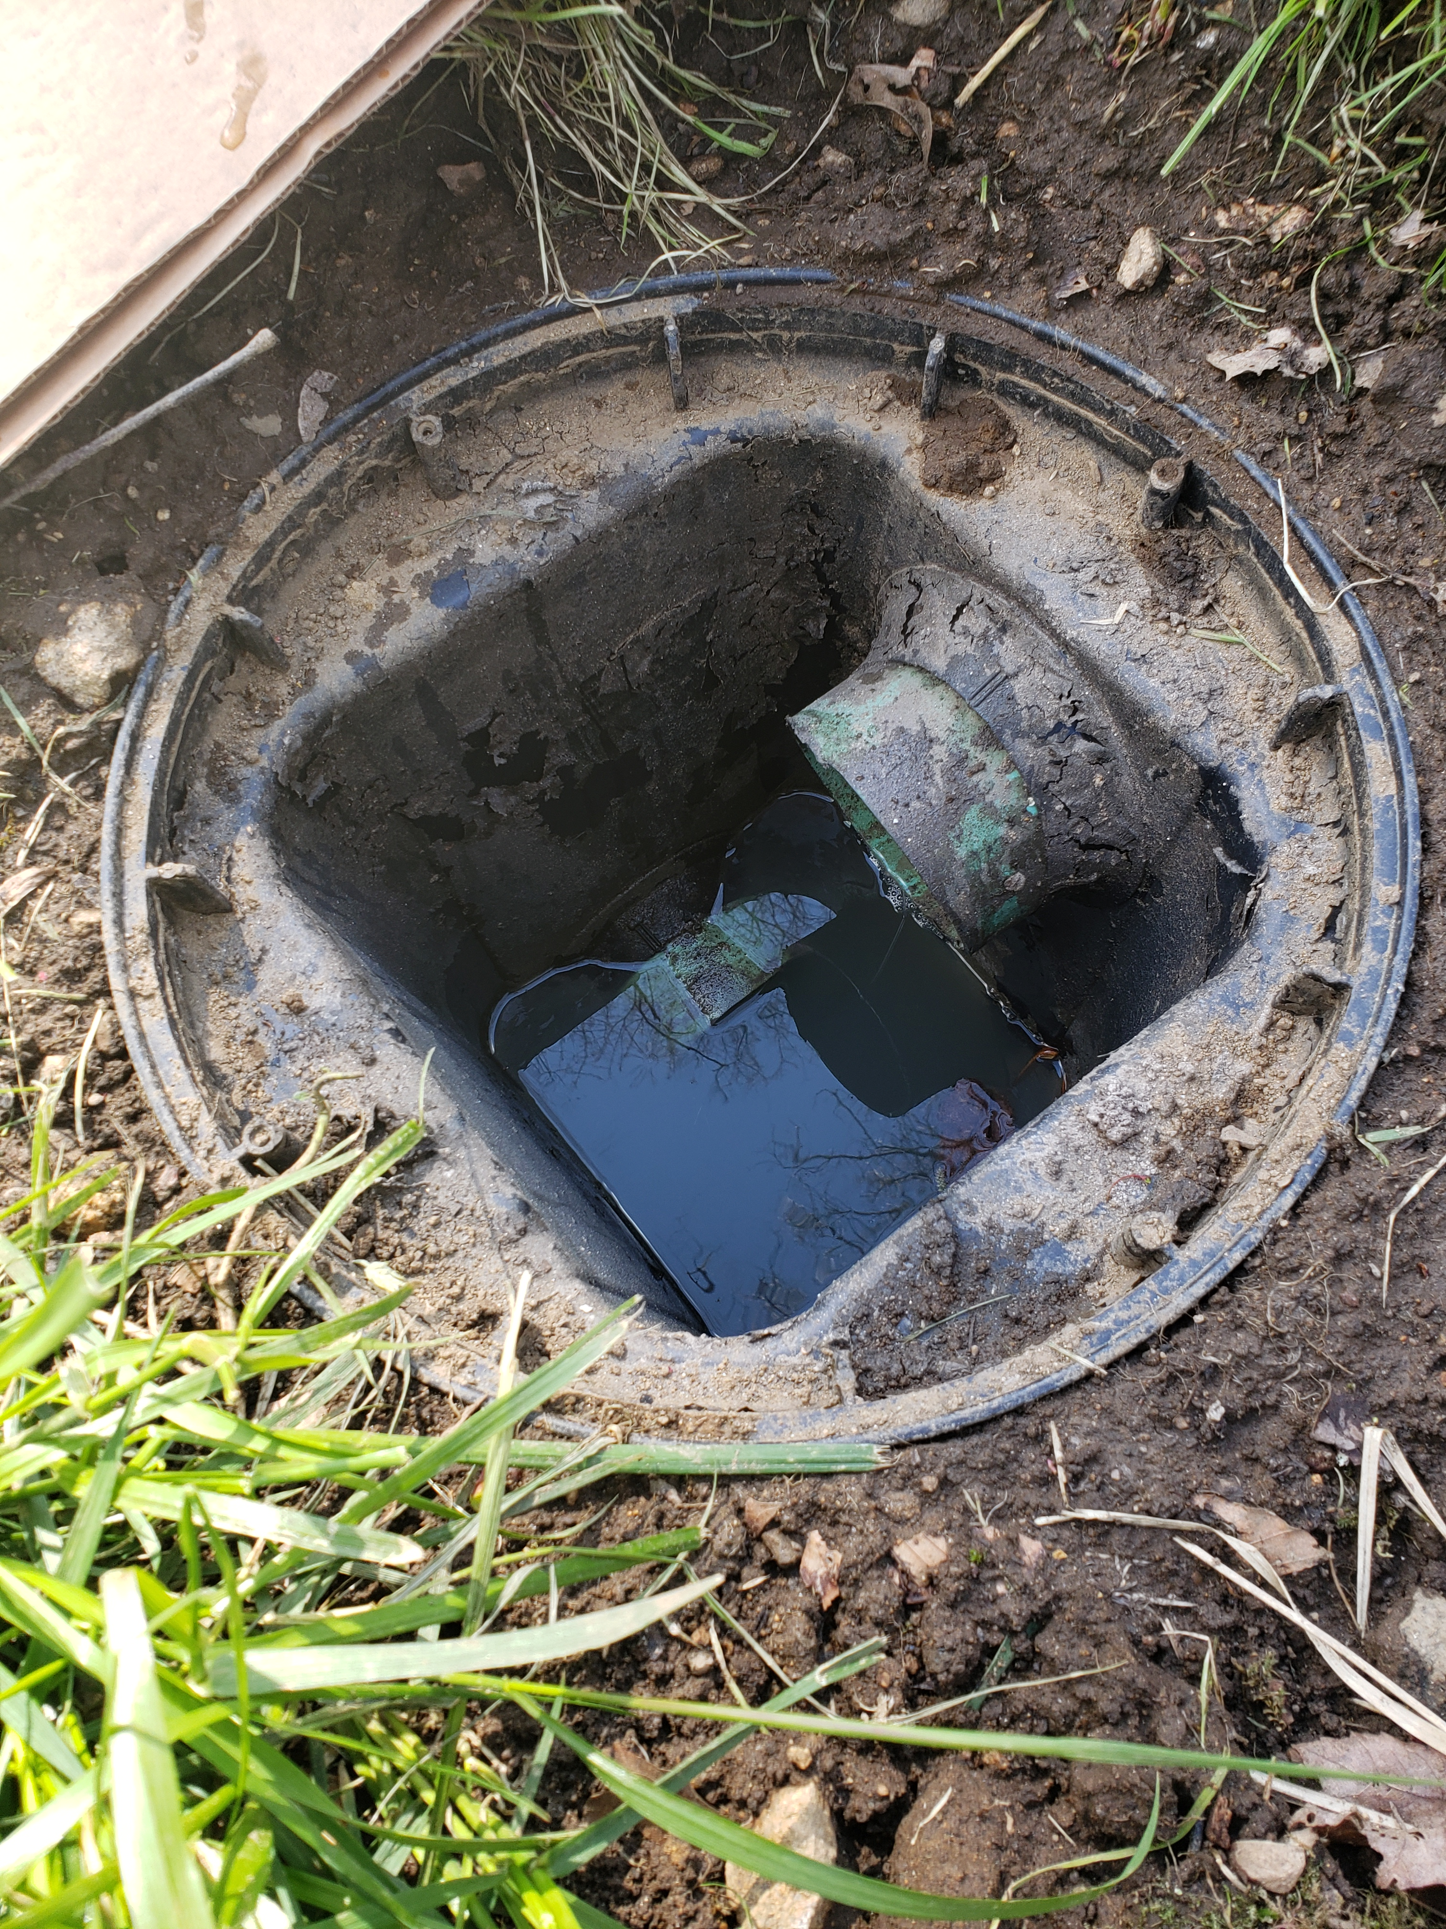
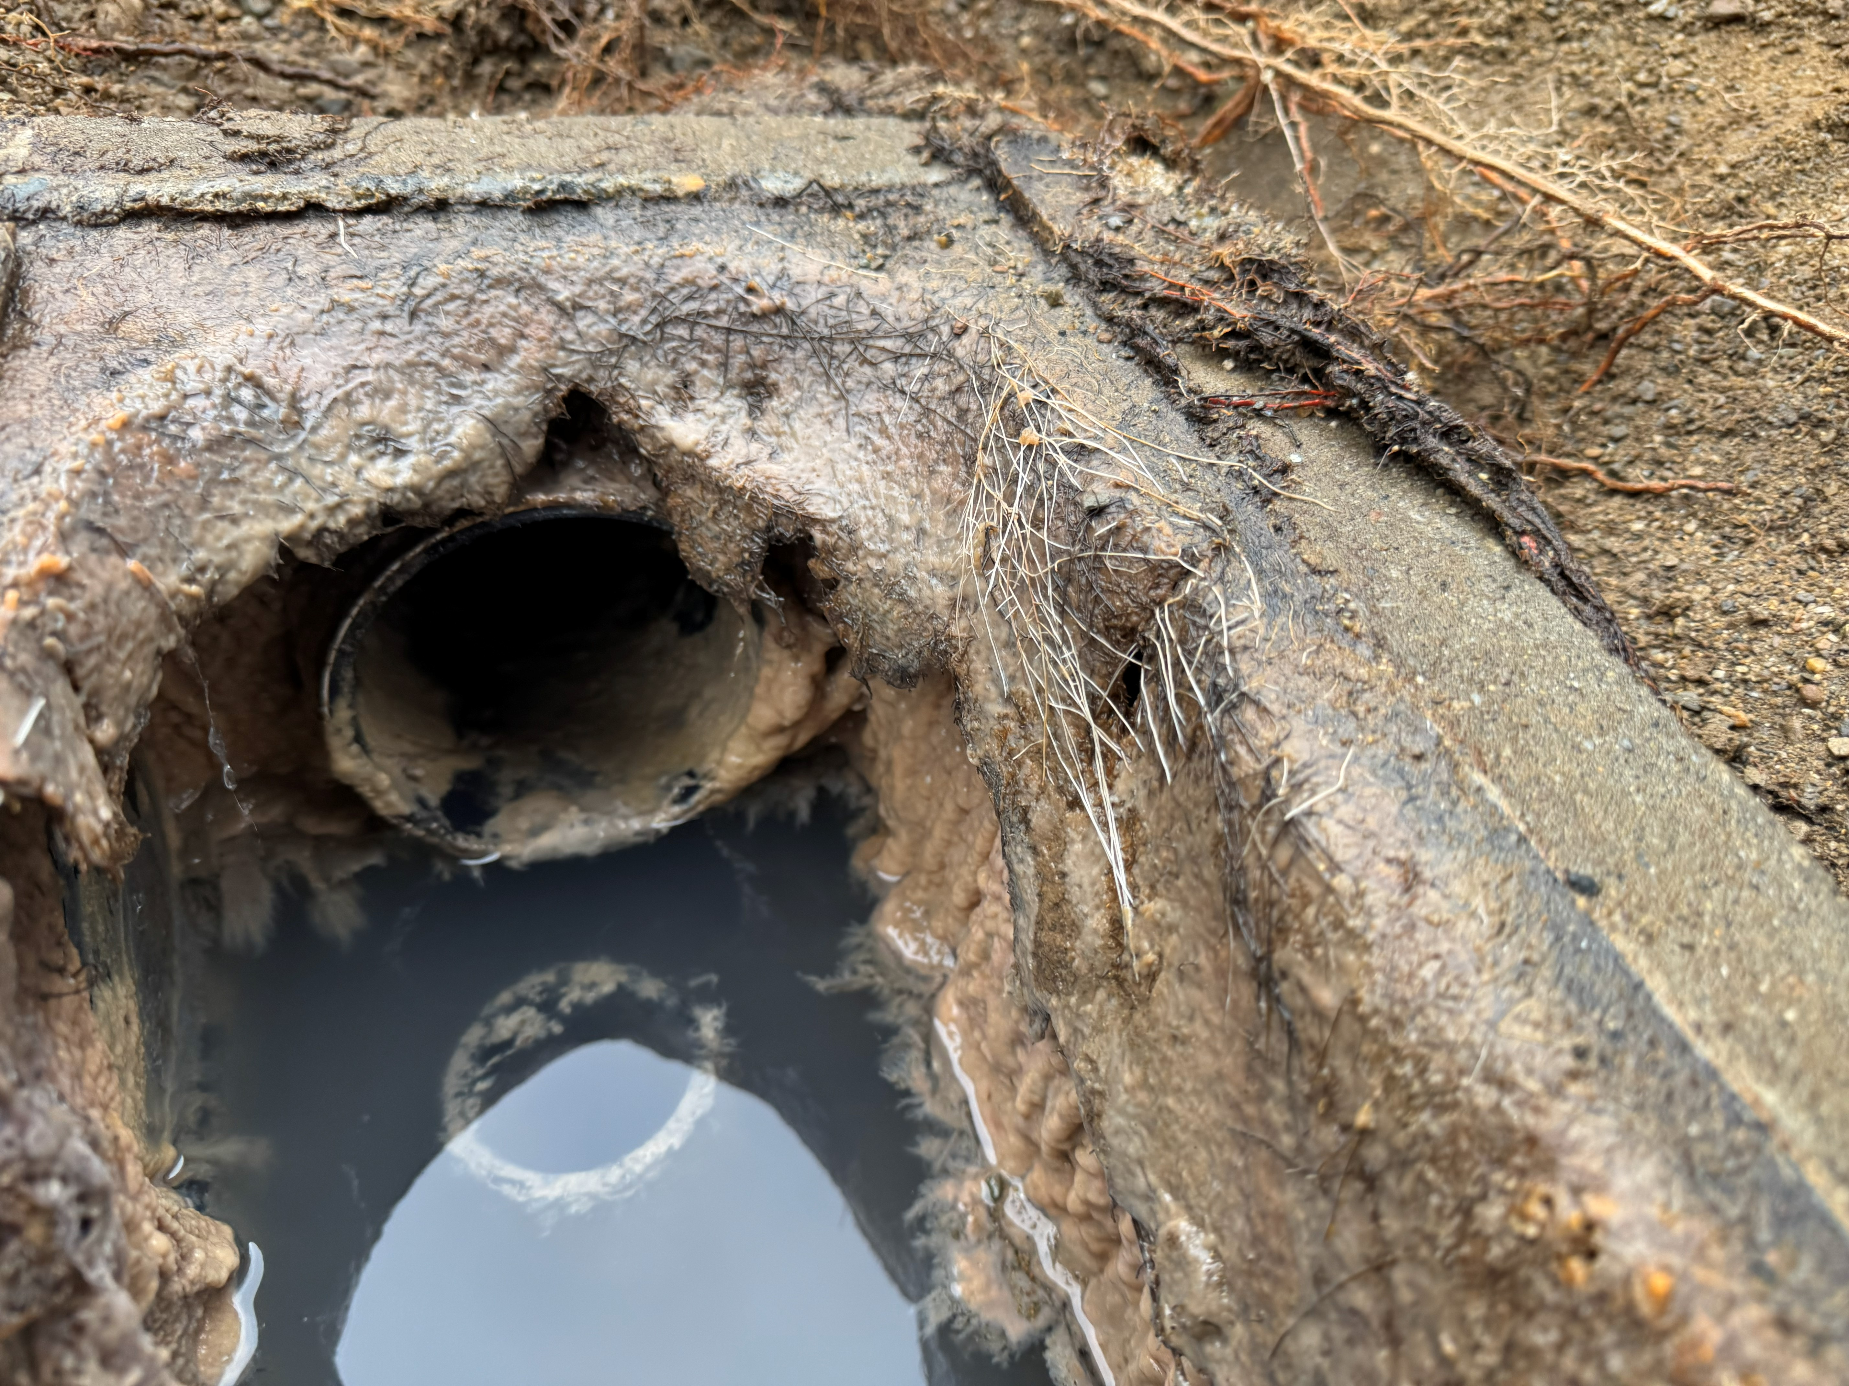
3. Start the Investigation
Distribution Box
Distribution Box:
Check level
Check speed levelers
Determine if you have a flooded lateral(s)
Pull Samples
Entry point for Snake Camera
Notes:
Not all systems have D-Boxes What does it tell you if the D-box is flooded?
Snake camera: (no D-Box: Pressure systems – cleanouts or use vents/endcaps of laterals)
Laterals clear, level, damaged/broken/crushed, full.
Can confirm length of laterals with wire tie on camera cable. What do cobwebs in a lateral tell you?
2. Solids in the lateral: saturated for long periods or solids getting past effluent filter
System with effluent filter but found wetwipes in the lateral – How? MX records showed missing effluent filter last pump…
Why pull samples from D-Box & outlet side of septic tank?

Slide 32
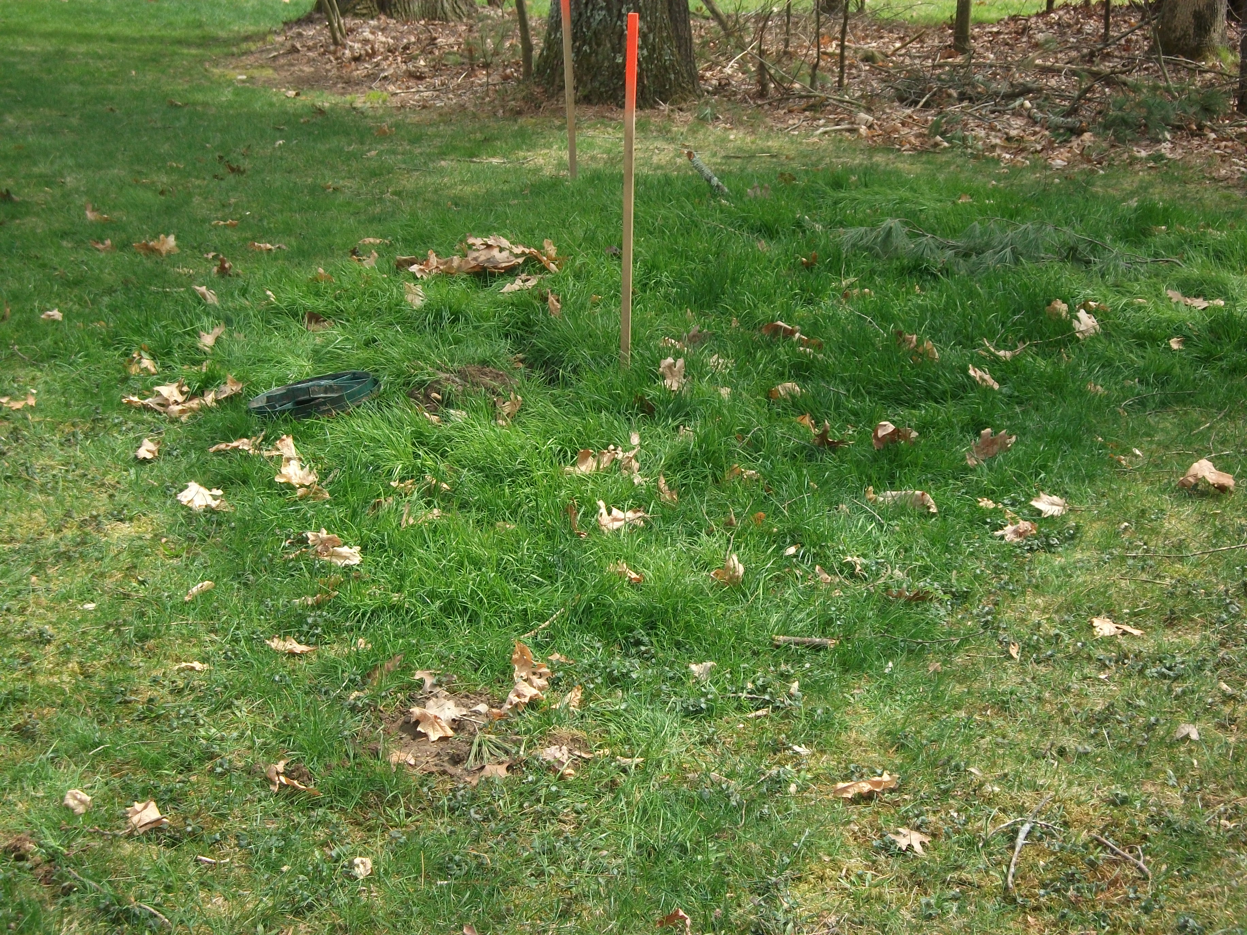
3. Start the Investigation
STA Observations

Slide 33
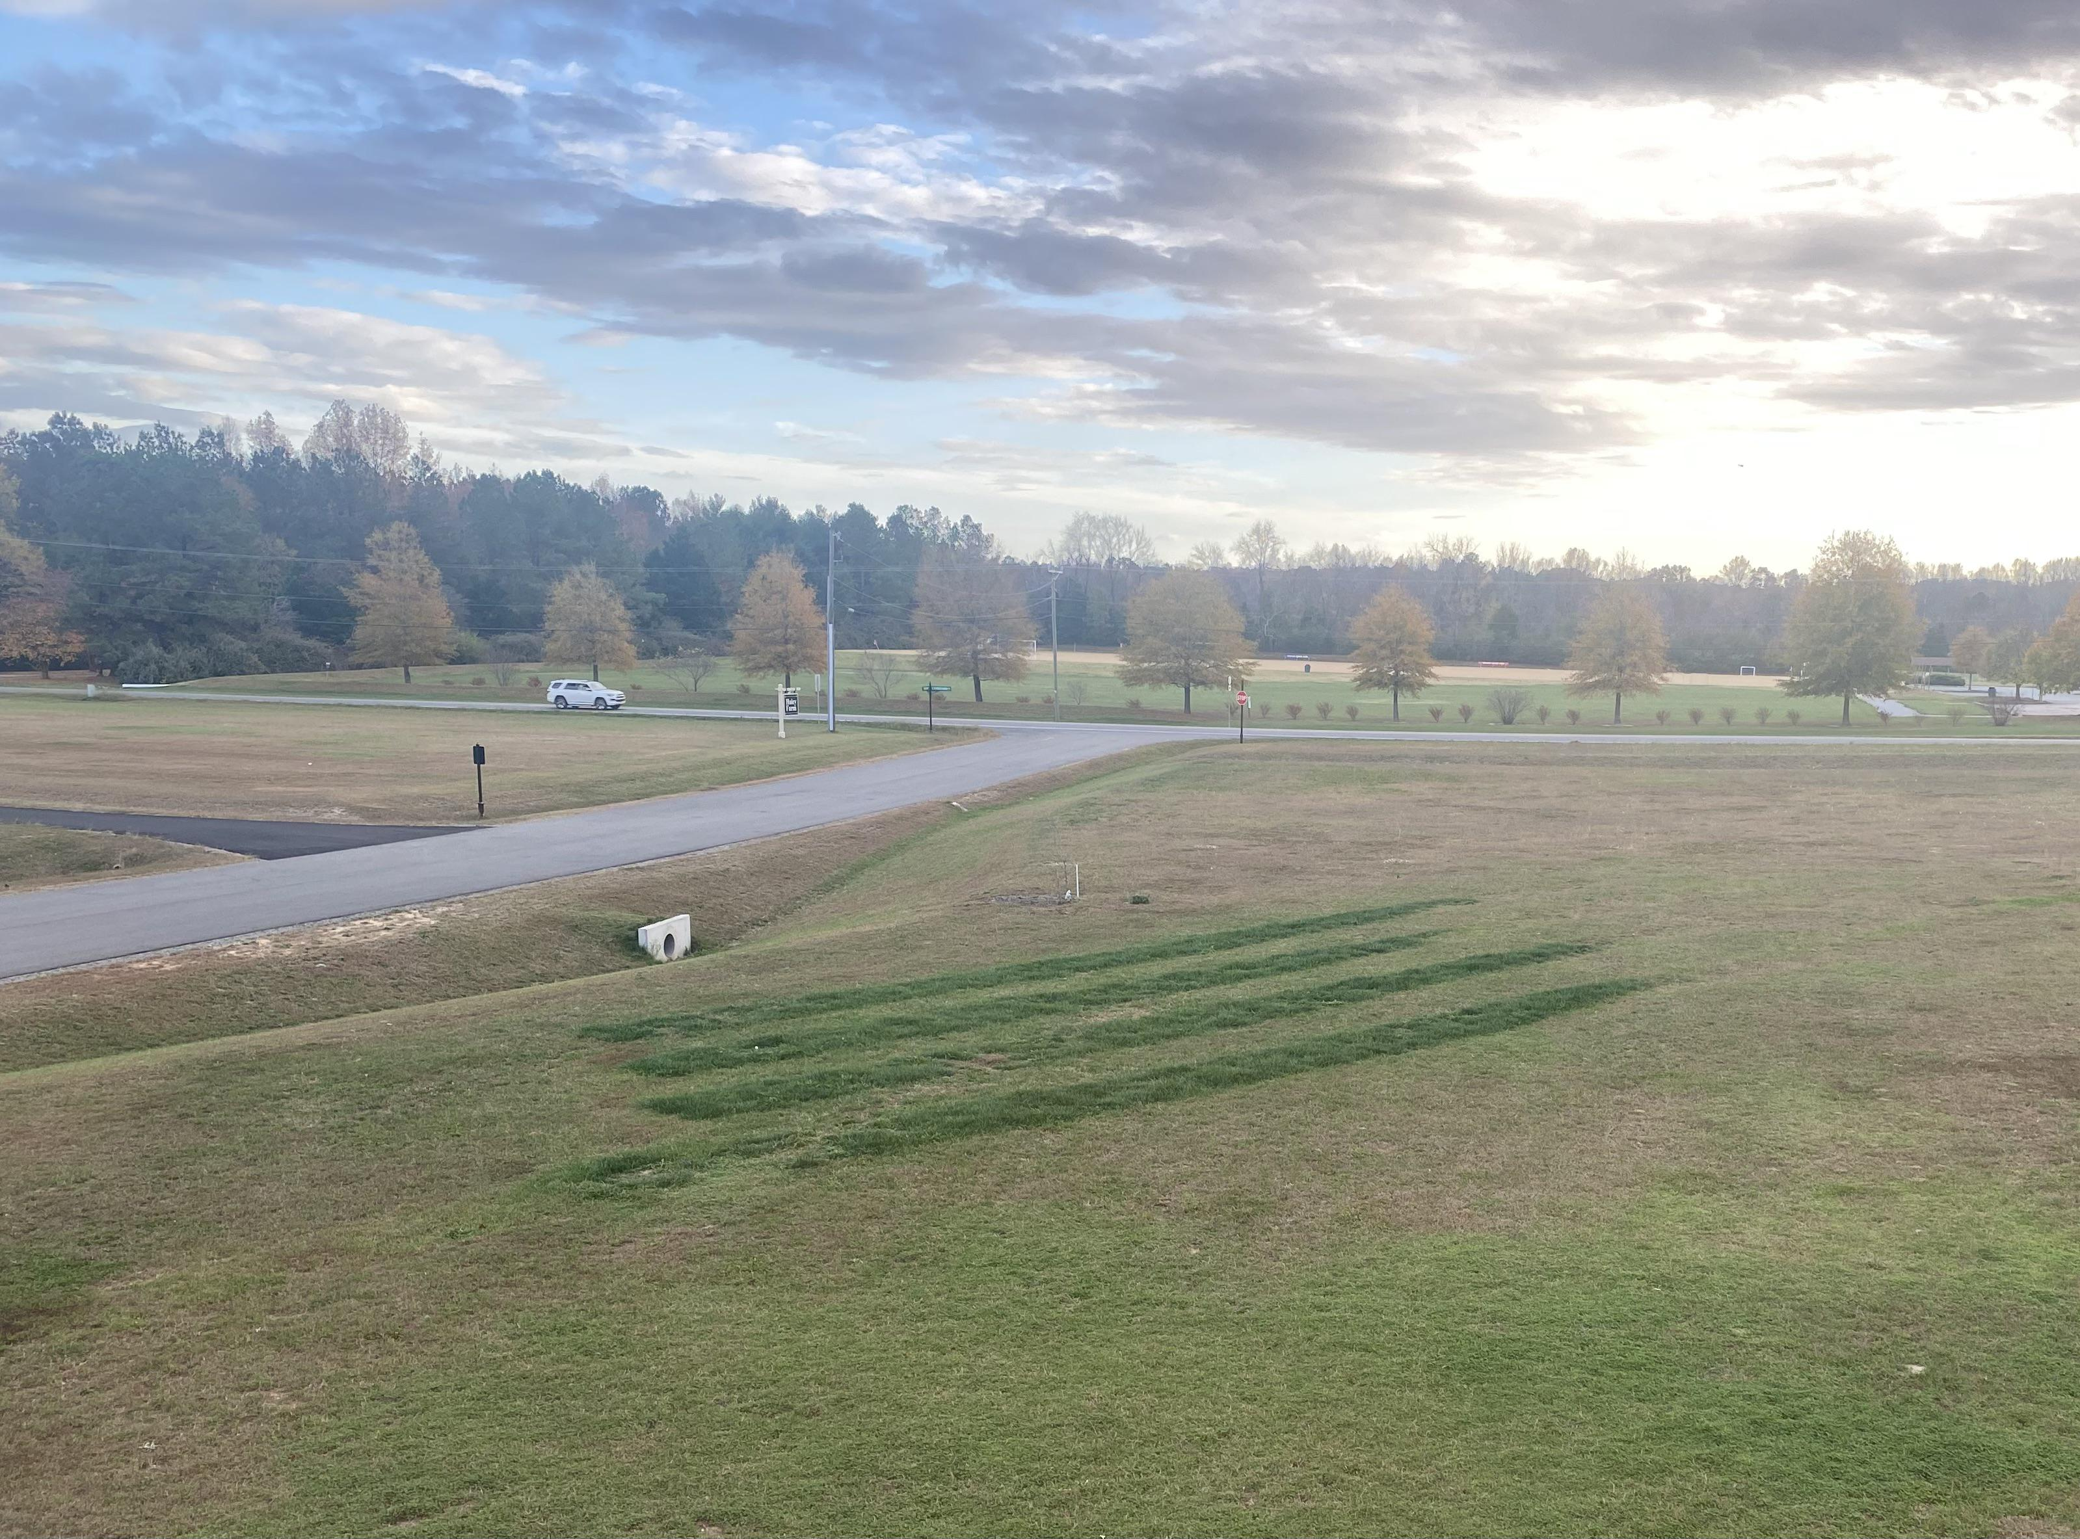
3. Start the Investigation
STA Observations:
Observation Ports
Note soil condition
Note vegetation
Test hole
Sized IAW As-Built
Does the system match the plan/as-built?
Notes:
Observation Ports
Note soil condition
Note vegetation
Test hole: inside STA: biomat development, saturation levels,
Correctly sized
Does the system match the plan – I’ve witnessed major differences between As-Builts and actual system
Snake system, use wire tie on cable to mark length

Slide 34

4. Document your Activities
Documentation: on site
Stop: Take a minute!
Document what was inspected
Take pictures along the way
– Review photos & take more
Review list of Questions
Was every question/lead followed up on?
Revisit any point needed while on site

Slide 35
4. Document your Activities – Observations (Symptoms & Clues)
Observation | Questions to Document
Damp or Spongy Soil over STA | Localized? Persistent?
Breakout/Ponding over System (septic tank to STA) | Localized? Persistent? Timing?
Foul Odors | Location? Timing?
Alarms (high water) | Repeated? Timing?
Slow/Gurgling Drains | Persistent? Location?
Lush Vegetation | Odor? Location? Weather?
Greening over STA | Location? Patchy?
Back-up into Structure | Repeated? Timing?
Notes:
If these are your observations: make note of the details of who, what, when, why, & how. The details are important.
Damp/spongy soil: entire system or just part. Over septic tank or D-box? Does it have foul odor?
Greening over STA: is there also damp/spongy soil?

Slide 36
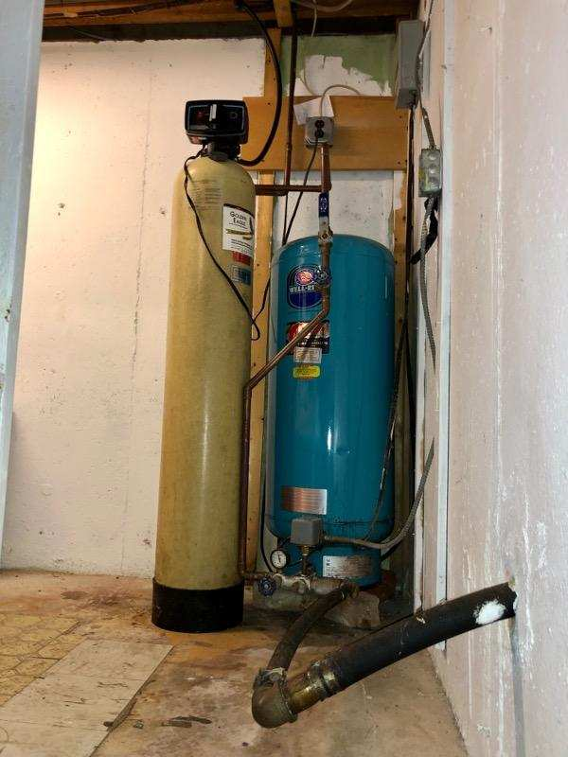
4. Document your Activities - Warning
We can’t see everything
This is a start to the investigation
Not all systems are the same
Slow and steady
Notes:
We can’t see everything - If something isn’t right… keep looking.
Limiting layers, unlevel laterals, broken pipes, clogs
This is a start to the investigation, be careful not to draw conclusions prior to results returning.
Not all systems are the same, not all homes are the same, not all soils are the same…
Slow and steady
Confer with your team, they may have ideas or questions you did not think of

Slide 37
5. Diagnostics/Testing & Way Forward
Suspicion | Symptom | Where to look | Why
Hydraulic Overload | Ponding, Alarms, Tank levels, slow/gurgling drains | Field, Tank, Alarms, D-Box | Flow exceeds design: Stormwater Intrusion, Leaky Fixtures, Excessive water use, over-occupancy,
Solids/FOG bypassing Septic Tank | Solids in the field, Ponding, Alarms, Tank levels, Slow/gurgling drains | Tank Outlet, Effluent filter, D-box/Laterals | Overflow in Tank, No Effluent Filter, Broken/Missing Baffles
Unequal Distribution | Localized Ponding/soggy soil, Partial Greening | D-Box, Laterals | Unlevel D-Box, Broke/crushed pipes, Settling
Heavy Biomat | Ponding, Alarms, Tank levels, Slow/gurgling drains | Field, Tank, Alarms, D-Box, Test Hole | Soils clogged preventing infiltration
Physical Damage | Tire tracks over system, Slow/uneven distribution | Tank, D-Box, Laterals, Pipes | Root Intrusion, Crushed Pipes, Compaction of Soils
Site Specific Issues | Season Failures, Site Changes | Tank, D-Box, Laterals, Pipes | Seasonal High Groundwater, Flooding, Landscaping/grading
Notes:
Hydraulic Overload: IF water use records are available: how do they compare to the design flow?
[Sources] - https://www.epa.gov/septic/resolving-septic-system-malfunctions - https://content.ces.ncsu.edu/why-do-septic-systems-fail - https://doh.wa.gov/sites/default/files/legacy/Documents/Pubs//337-099.pdf (clogging layer/HLR discussion)

Slide 38
5. Diagnostics/Testing & Way Forward
Method
What it confirms
Indicates
Water use audit + leak check
Hydraulic overload vs design flow
Distress with intermittent symptoms
Sludge/scum measurement + baffle check
Solids carryover risk
Rapid STA clogging; clogged filters
Effluent filter inspection
Outlet restriction; solids loading
Backups, alarms, slow drains
Tank liquid level at rest
Downstream restriction vs normal
Differentiate tank vs STA issues
Pump runtime/dose logs (if present)
Short-cycling, excessive dosing, float issues
Alarm-driven troubleshooting
D-box level check + flow test
Uneven distribution
Localized wetness/early biomat
Camera/jet of lines
Broken/crushed/blocked/unlevel laterals
Suspected unequal distribution
Observation ports / excavation
Ponding depth + recovery time
Confirm STA hydraulic dispersal
Test Hole / confirm groundwater depth
Limiting layers, Groundwater, Soils
Soils/site vs Weather-linked failures
Well sampling (where relevant)
Groundwater impact indicators
“Invisible” failures
What diagnostic methods do you use?
Notes:
[Sources] - https://content.ces.ncsu.edu/why-do-septic-systems-fail (water overload, filter cleaning, damage) - https://kingcounty.gov/en/dept/dph/health-safety/environmental-health/on-site-sewage-systems/maintaining-your-system/sewage-spills-septic-system-failure/ (dye tests used to confirm surfacing sewage source) - https://www.revisor.mn.gov/rules/7080.1500/ (compliance criteria examples)

Slide 39
5. Diagnostics/Testing & Way Forward – Educate the Homeowner
SYSTEM IN DISTRESS
SYSTEM FAILURE
Actions:
Actions:
Reduce water usage
System Maintenance
Pump Tank
Clean Filters
General System Maintenance
Verify system is draining
Check for air flow/water movement
Document
Reduce water usage
Keep people and pets away from surfacing effluent
Advise on next steps
Document

Slide 40
Follow-up
1) Submit Labs
What should we test for?
2) Confirm Site Observations
Review notes, septic plans, as-built, water & O&M records, pictures, available material
3) Determine short-term plan
Repair, pump and haul, etc.
4) Determine long-term plan
Repair components, add system, remove and replace system
5) Report
Finalize your report for all interested parties
Notes:
Submit Labs
- Effluent Samples - the basic labs are BOD, TSS, FOG, pH, DO,
If suspected water softer – dissolved metals (sodium)
If suspected soaps – surfactants
Sand Sieve –
Manufacture specified sand
Fill Package Sand – Most states have specifications

Slide 41
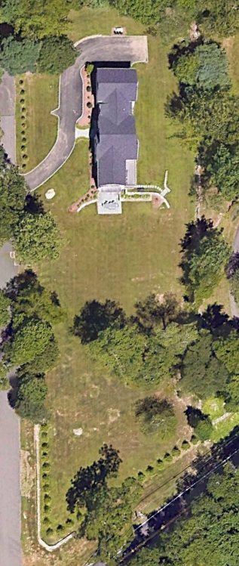
Site 1. Walk Through
4-year-old system
5-bedroom home
10 MPI perc (2021) Sandy soils
Dual compartment 1250gal septic tank
Gravity to D-box, center fed 60ft single trench
2 Adults, 2 children
New home/system, Original Owners (2021)
Garbage Grinder: No
Water Softener: No
Oversized Tub/Spa: No
Lawn Irrigation: Yes
Pool: under construction

Slide 42
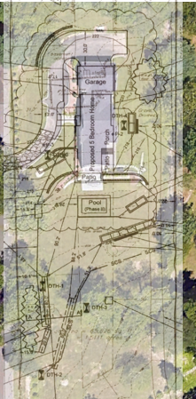
Site 1. Walk Through
Homeowners unaware of any issues until Arborist hired to remove tree
Arborist fell the tree on top of system, drove over system repeatedly during removal with wheeled vehicles
Homeowner had system immediately inspected and found spongy/saturated soil over entire system

Slide 43
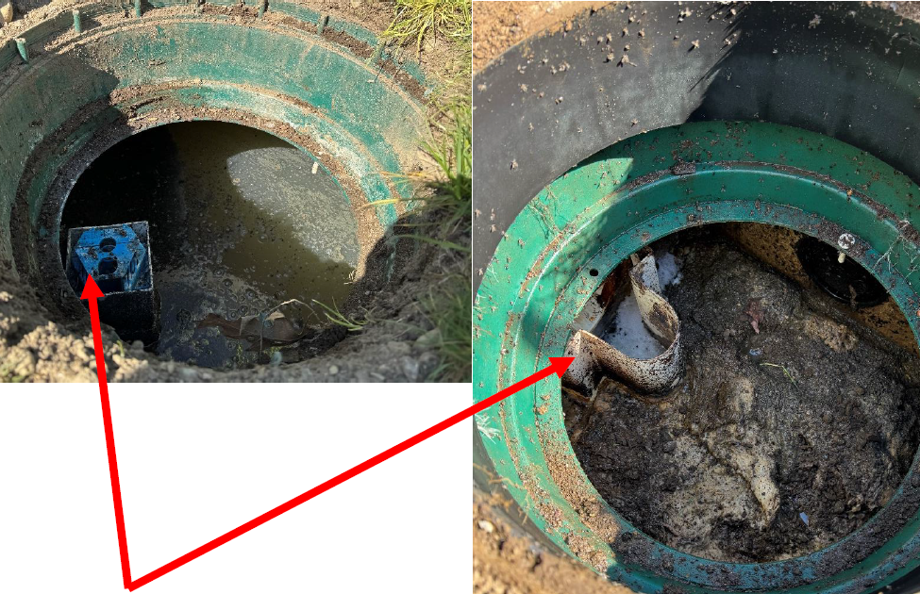
Site 1. Walk Through
Case Closed?
Distress or Failure?
Inspection:
Septic Tank/Field sized IAW min state requirements
O&M records:
Pumped at 3-yrs
“High Tide” evidence in septic tank
Solids above outlet = evidence of “high tide”

Slide 44
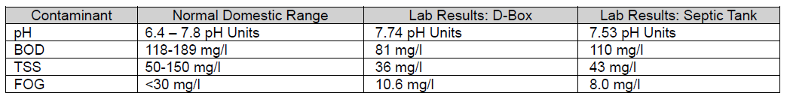
Site 1. Walk Through
Case Closed?
System clearly distressed (no surfacing)
Inspection:
Crush damage to system
Slight up/down on laterals (<2 in)
Biomat forming (light)
Effluent & Sand lab results w/in acceptable range
17/20

Slide 45
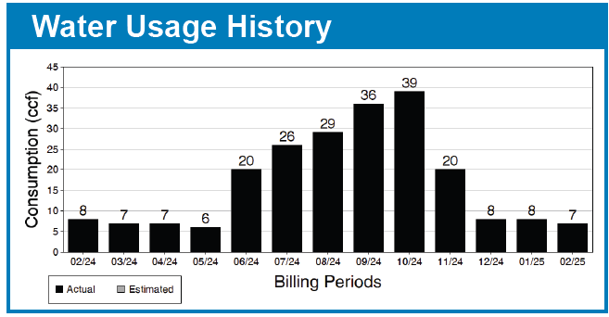
Site 1. Walk Through
Inspection:
System designed for 520gpd
Water use 1 ccf = 748gal
Dec - May = 150-200gpd
Highest use = 972 gpd (oct)
17/20
Notes:
CT Estimated daily flows: 528 gpd

Slide 46
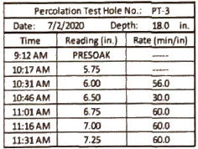
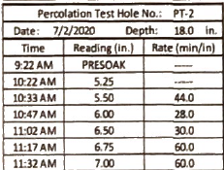
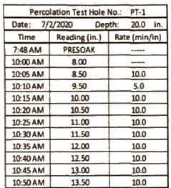
Site 1. Walk Through
Inspection:
Soils in all test pits are similar:
6”- 12” Topsoil
6/12”- 68” brown sand w/ some silt
Notes:
Is this suspicious?

Slide 47
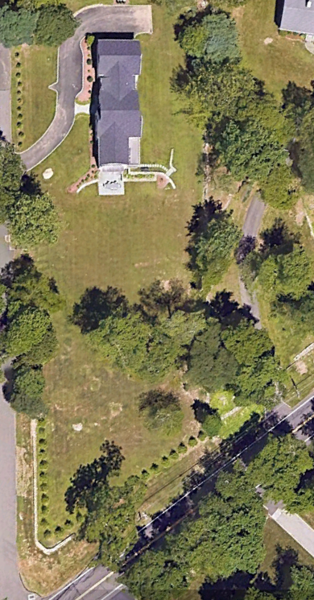
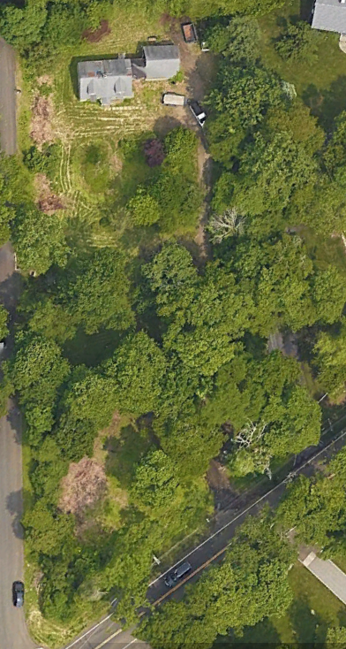
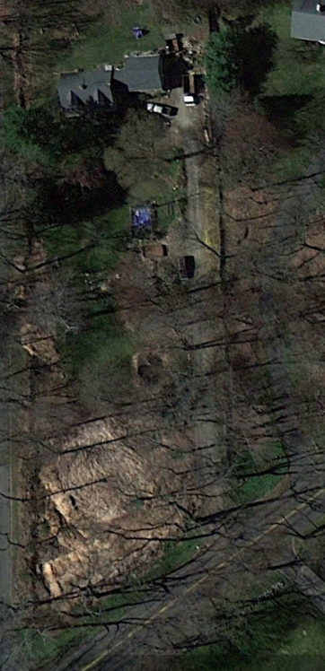
Site 1. Walk Through
2023
2019
2012
Notes:
Clearly this site has some history

Slide 48
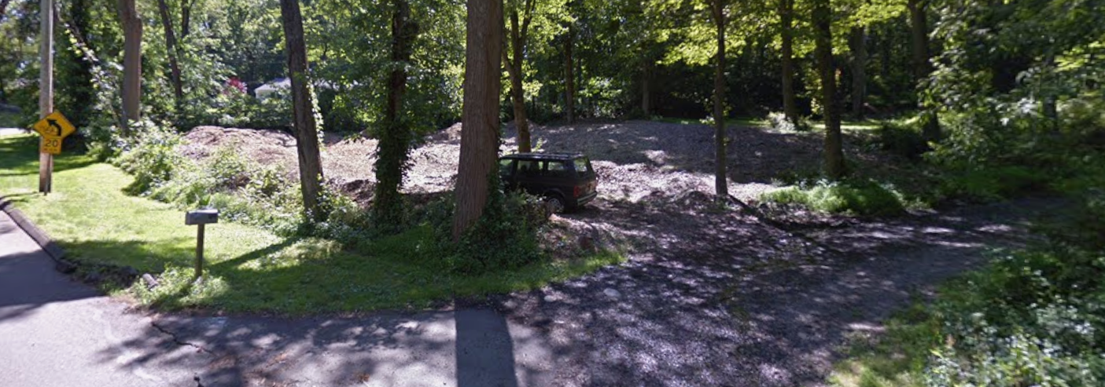
Site 1. Walk Through
2012
Notes:
CT Estimated daily flows: 528 gpd

Slide 49

Site 1. Walk Through
2016
Notes:
CT Estimated daily flows: 528 gpd

Slide 50
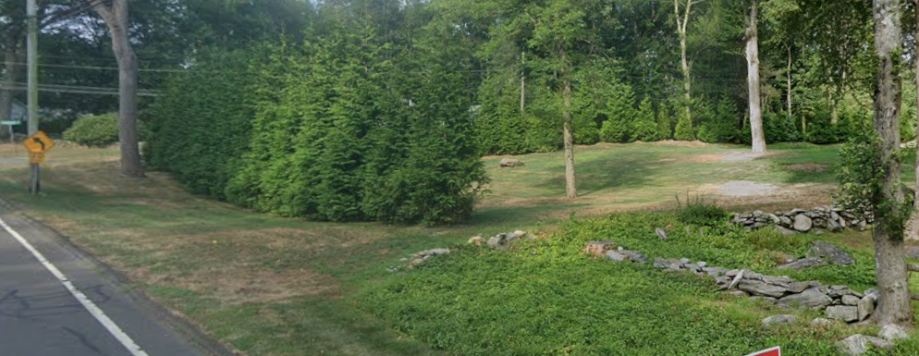
Site 1. Walk Through
2025
Notes:
CT Estimated daily flows: 528 gpd

Slide 51
Site 1. Walk Through
What do you suspect?
What diagnostics/test should be next?
What are the next steps?
What is the way forward?
17/20
Notes:
CT Estimated daily flows: 528 gpd

Slide 52
Site 1. Walk Through - Diagnostics/Testing & Way Forward
Notes:
Hydraulic Overload, no evidence of stormwater intrusion
No evidence of solids/FOG bypassing tank
Poor Distribution – mildly unlevel
Physical Damage – Yes, likely compaction, no crushed pipe
Site issues – Yes

Slide 53
Site 1. Walk Through - Diagnostics/Testing & Way Forward
Method
What it confirms
Indicates
Water use audit + leak check
Hydraulic overload vs design flow
Distress with intermittent symptoms
Sludge/scum measurement + baffle check
Solids carryover risk
Rapid STA clogging; clogged filters
Effluent filter inspection
Outlet restriction; solids loading
Backups, alarms, slow drains
Tank liquid level at rest
Downstream restriction vs normal
Differentiate tank vs STA issues
Pump runtime/dose logs (if present)
Short-cycling, excessive dosing, float issues
Alarm-driven troubleshooting
D-box level check + flow test
Uneven distribution
Localized wetness/early biomat
Camera/jet of lines
Broken/crushed/blocked/unlevel laterals
Suspected unequal distribution
Observation ports / excavation
Ponding depth + recovery time
Confirm STA hydraulic dispersal
Test hole / confirm groundwater depth
Limiting layers and groundwater
Soils/site vs Weather-linked failures
Well sampling (where relevant)
Groundwater impact indicators
“Invisible” failures
What would you look at next?
Notes:
Water Audit – family uses lots of water
D-Box was level
Jetted lines showed small deviations <2 inches

Slide 54
Site 1. Walk Through - Diagnostics/Testing & Way Forward
Educate the Homeowner
SYSTEM IN DISTRESS
SYSTEM FAILURE
Actions:
Actions:
Reduce water usage
System Maintenance
Pump Tank
Clean Filters
General System Maintenance
Verify system is draining
Check for air flow/water movement
Document
Reduce water usage
Keep people and pets away from surfacing effluent
Advise on next steps
Document

Slide 55
Site 1. Walk Through – Follow up
1) Submit Labs
What should we test for?
2) Confirm Site Observations
Review notes, septic plans, as-built, water & O&M records, pictures, available material
3) Determine short-term plan
Repair, pump and haul, etc.
4) Determine long-term plan
Repair components, add system, remove and replace system
5) Report
Finalize your report for all interested parties
Notes:
Submit Labs –
- Effluent Samples - the basic labs are BOD, TSS, FOG, pH, DO,
If suspected water softer – dissolved metals (sodium)
If suspected soaps – surfactants
Sand Sieve –
Manufacture specified sand
Fill Package Sand – Most states have specifications

Slide 56
Site 1. Walk Through - Conclusion
Educate the Homeowner
Immediate to-do:
Pump tank
Reduce Water use
Reduce lawn irrigation
Resolution:
New Soils Report
Compacted soil & fill
New Perc test: >20 MPI
New field sized: near double the original
Original trench retained for overflow
Notes:
New field was sufficient for entire house: Why did we save the old system?

Slide 57
Site 2. Walk Through
5-year-old system
4-bedroom home
8-10 MPI perc (2014)
Reported water surfacing and running off
2 Adults, 2 children
New home: original owners
History of issues: since occupation

Slide 58
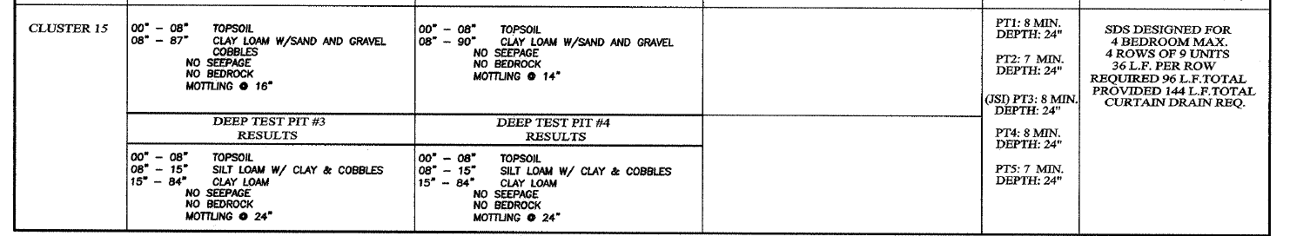
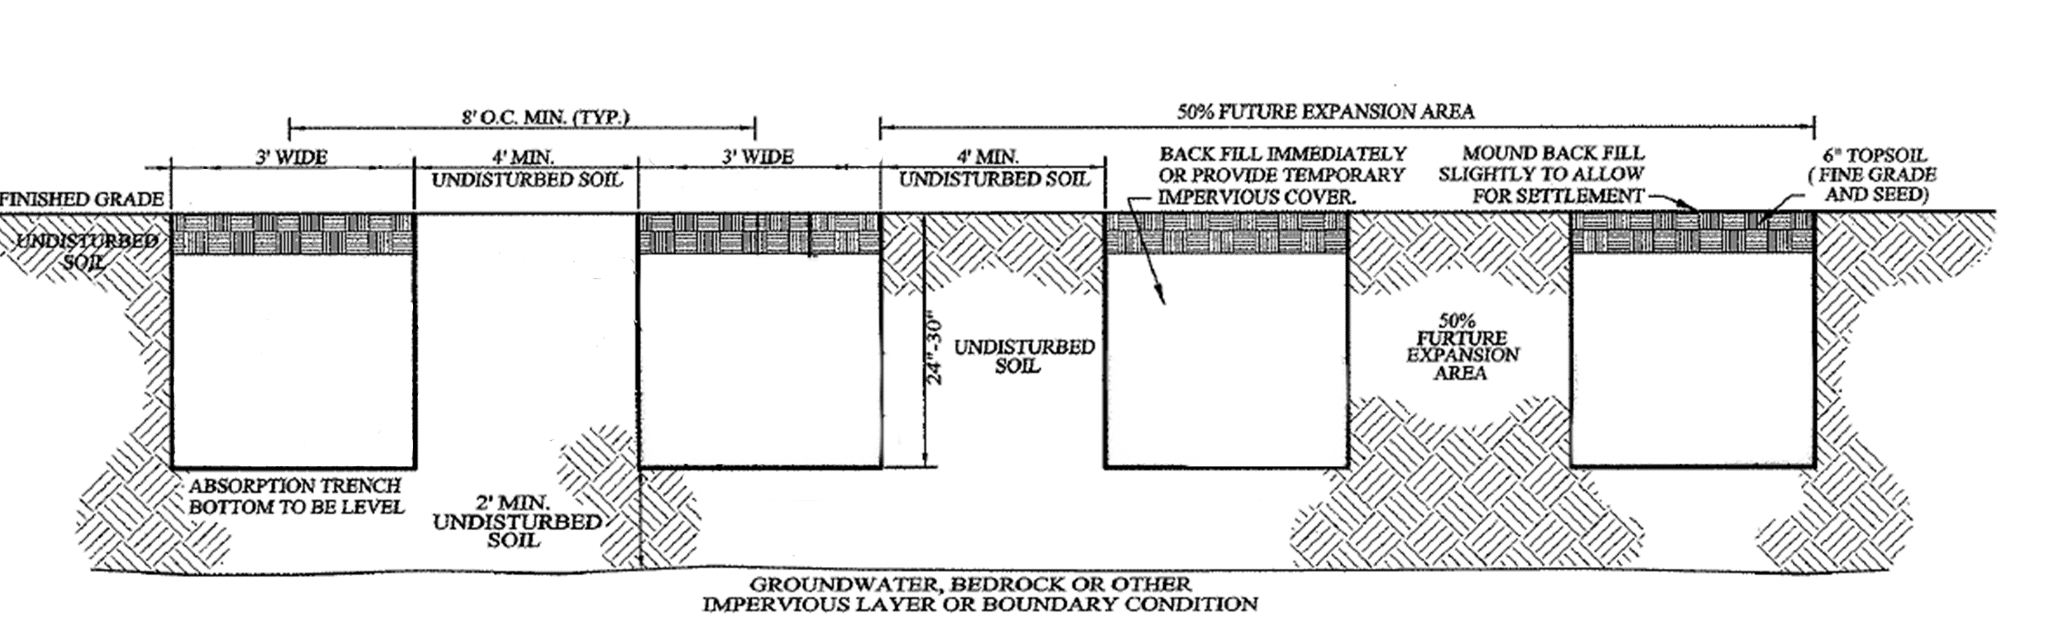
Site 2. Walk Through

Slide 59
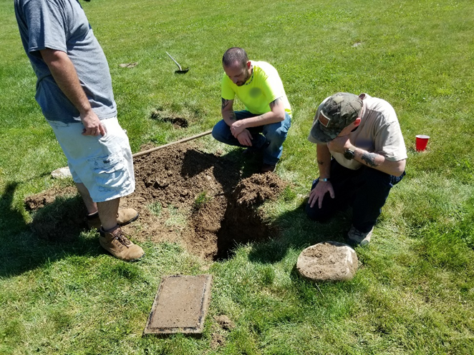
Site 2. Walk Through
Questions raised during the document collection process
Is the curtain drain installed?
What is the depth of the system?
What soils are present?

Slide 60
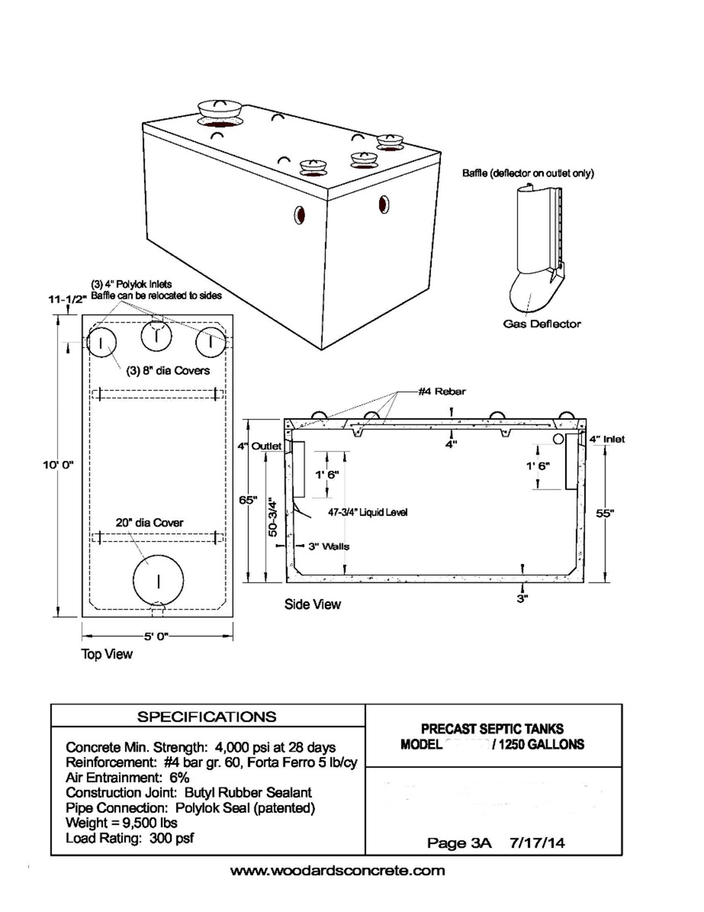
Site 2. Walk Through
Effluent filter present
1,250-gallon single compartment septic tank

Slide 61
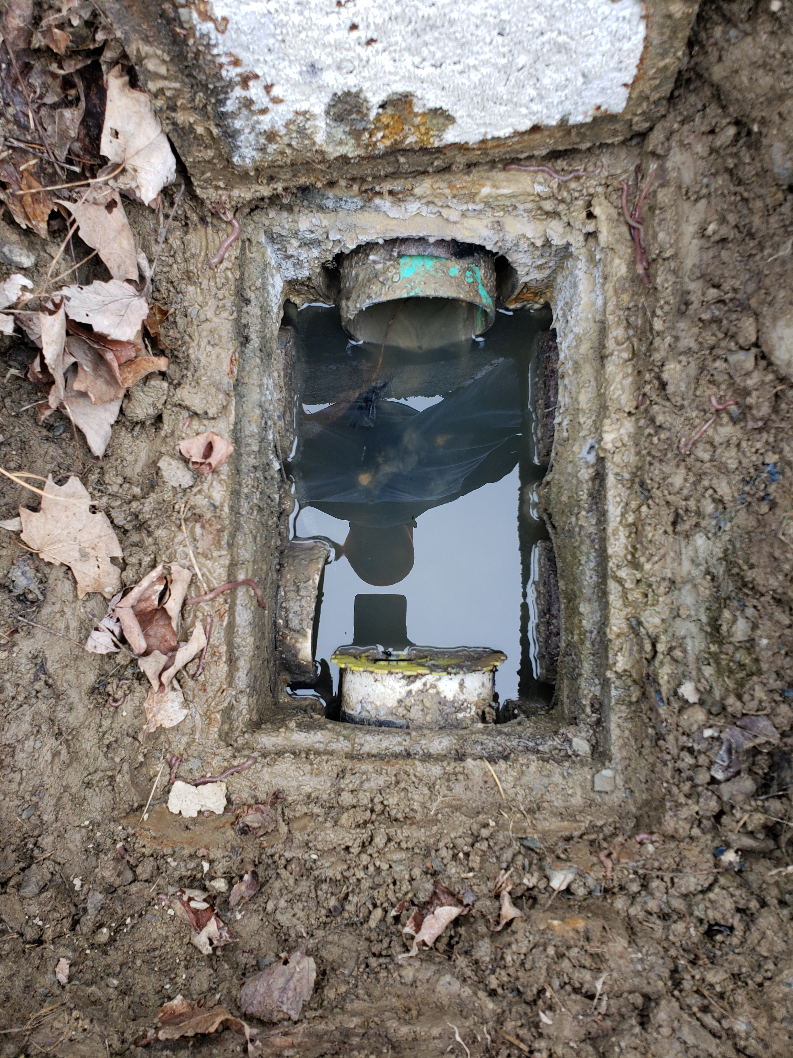
Site 2. Walk Through
Concrete 6-hole
1-inlet
2-outlet
Signs that laterals are full

Slide 62
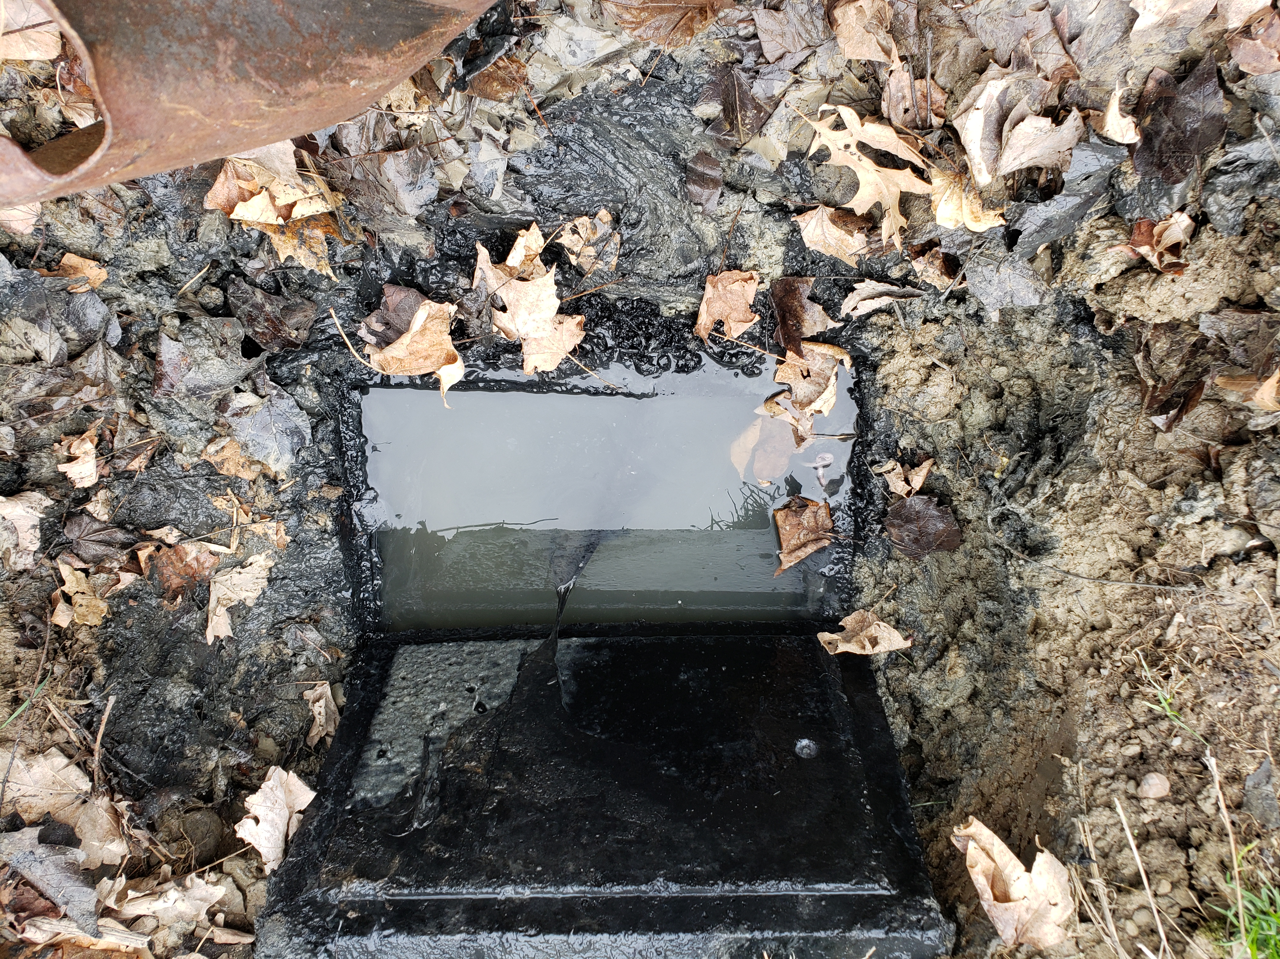
Site 2. Walk Through

Slide 63
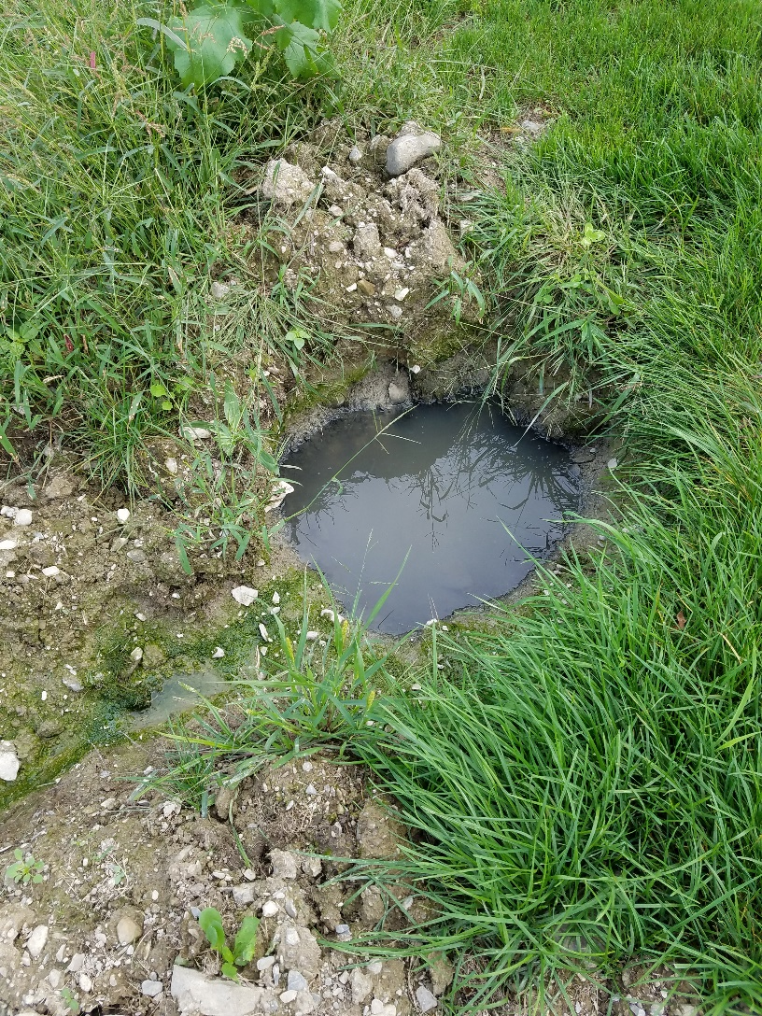
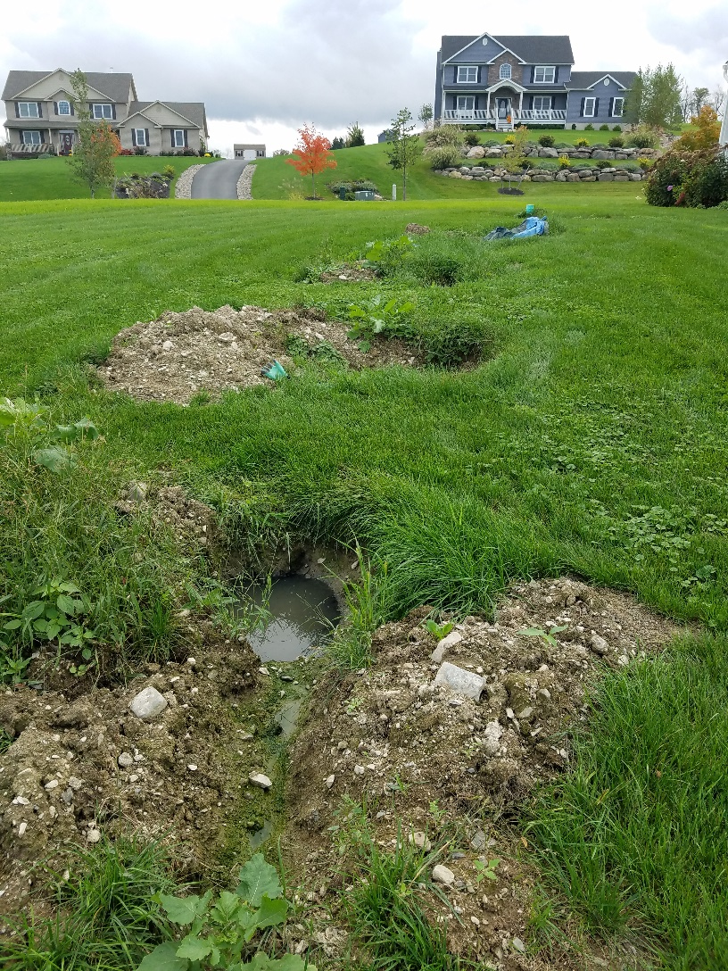
Site 2. Walk Through

Slide 64
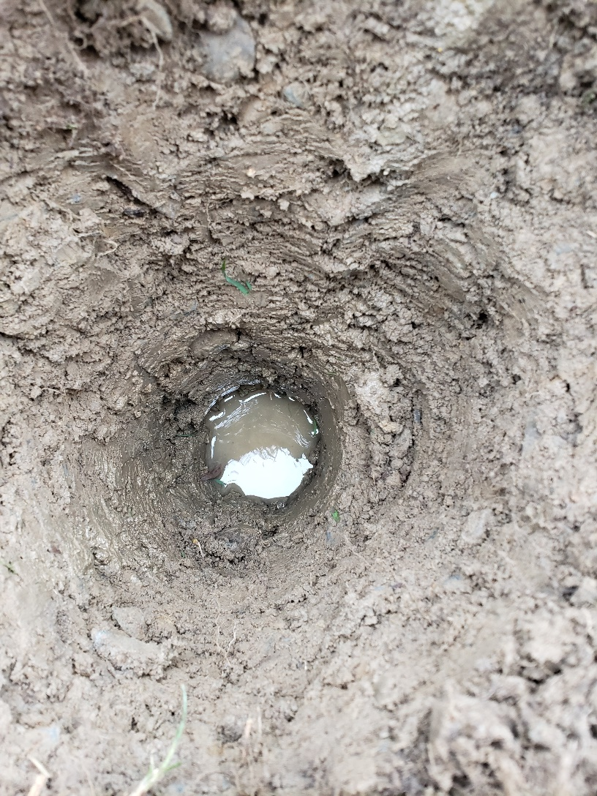
Site 2. Walk Through
Top of system located at 24” – 30”
No mottles observed in any excavation holes/pits
Soil has high clay content, not as described on plan

Slide 65
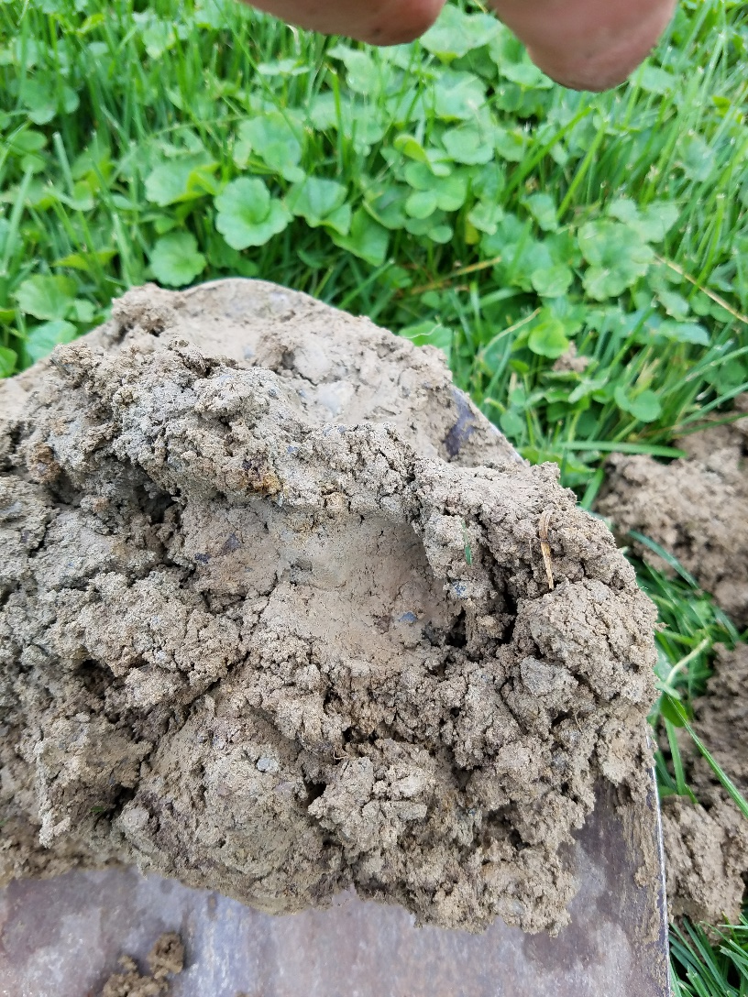
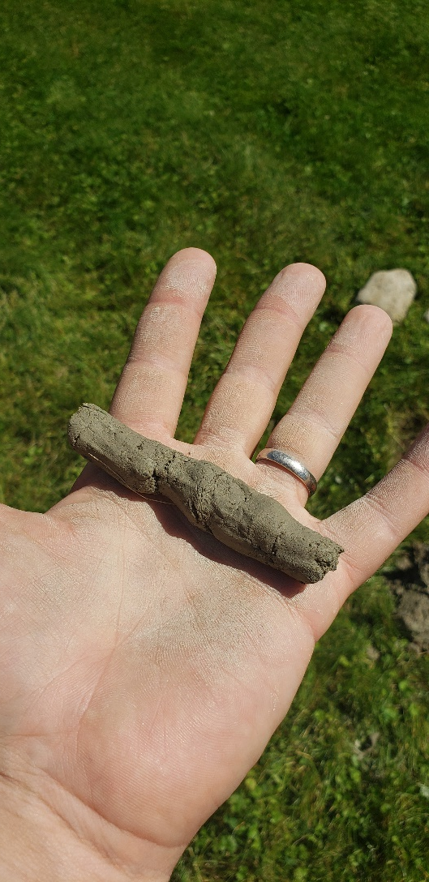
Site 2. Walk Through

Slide 66
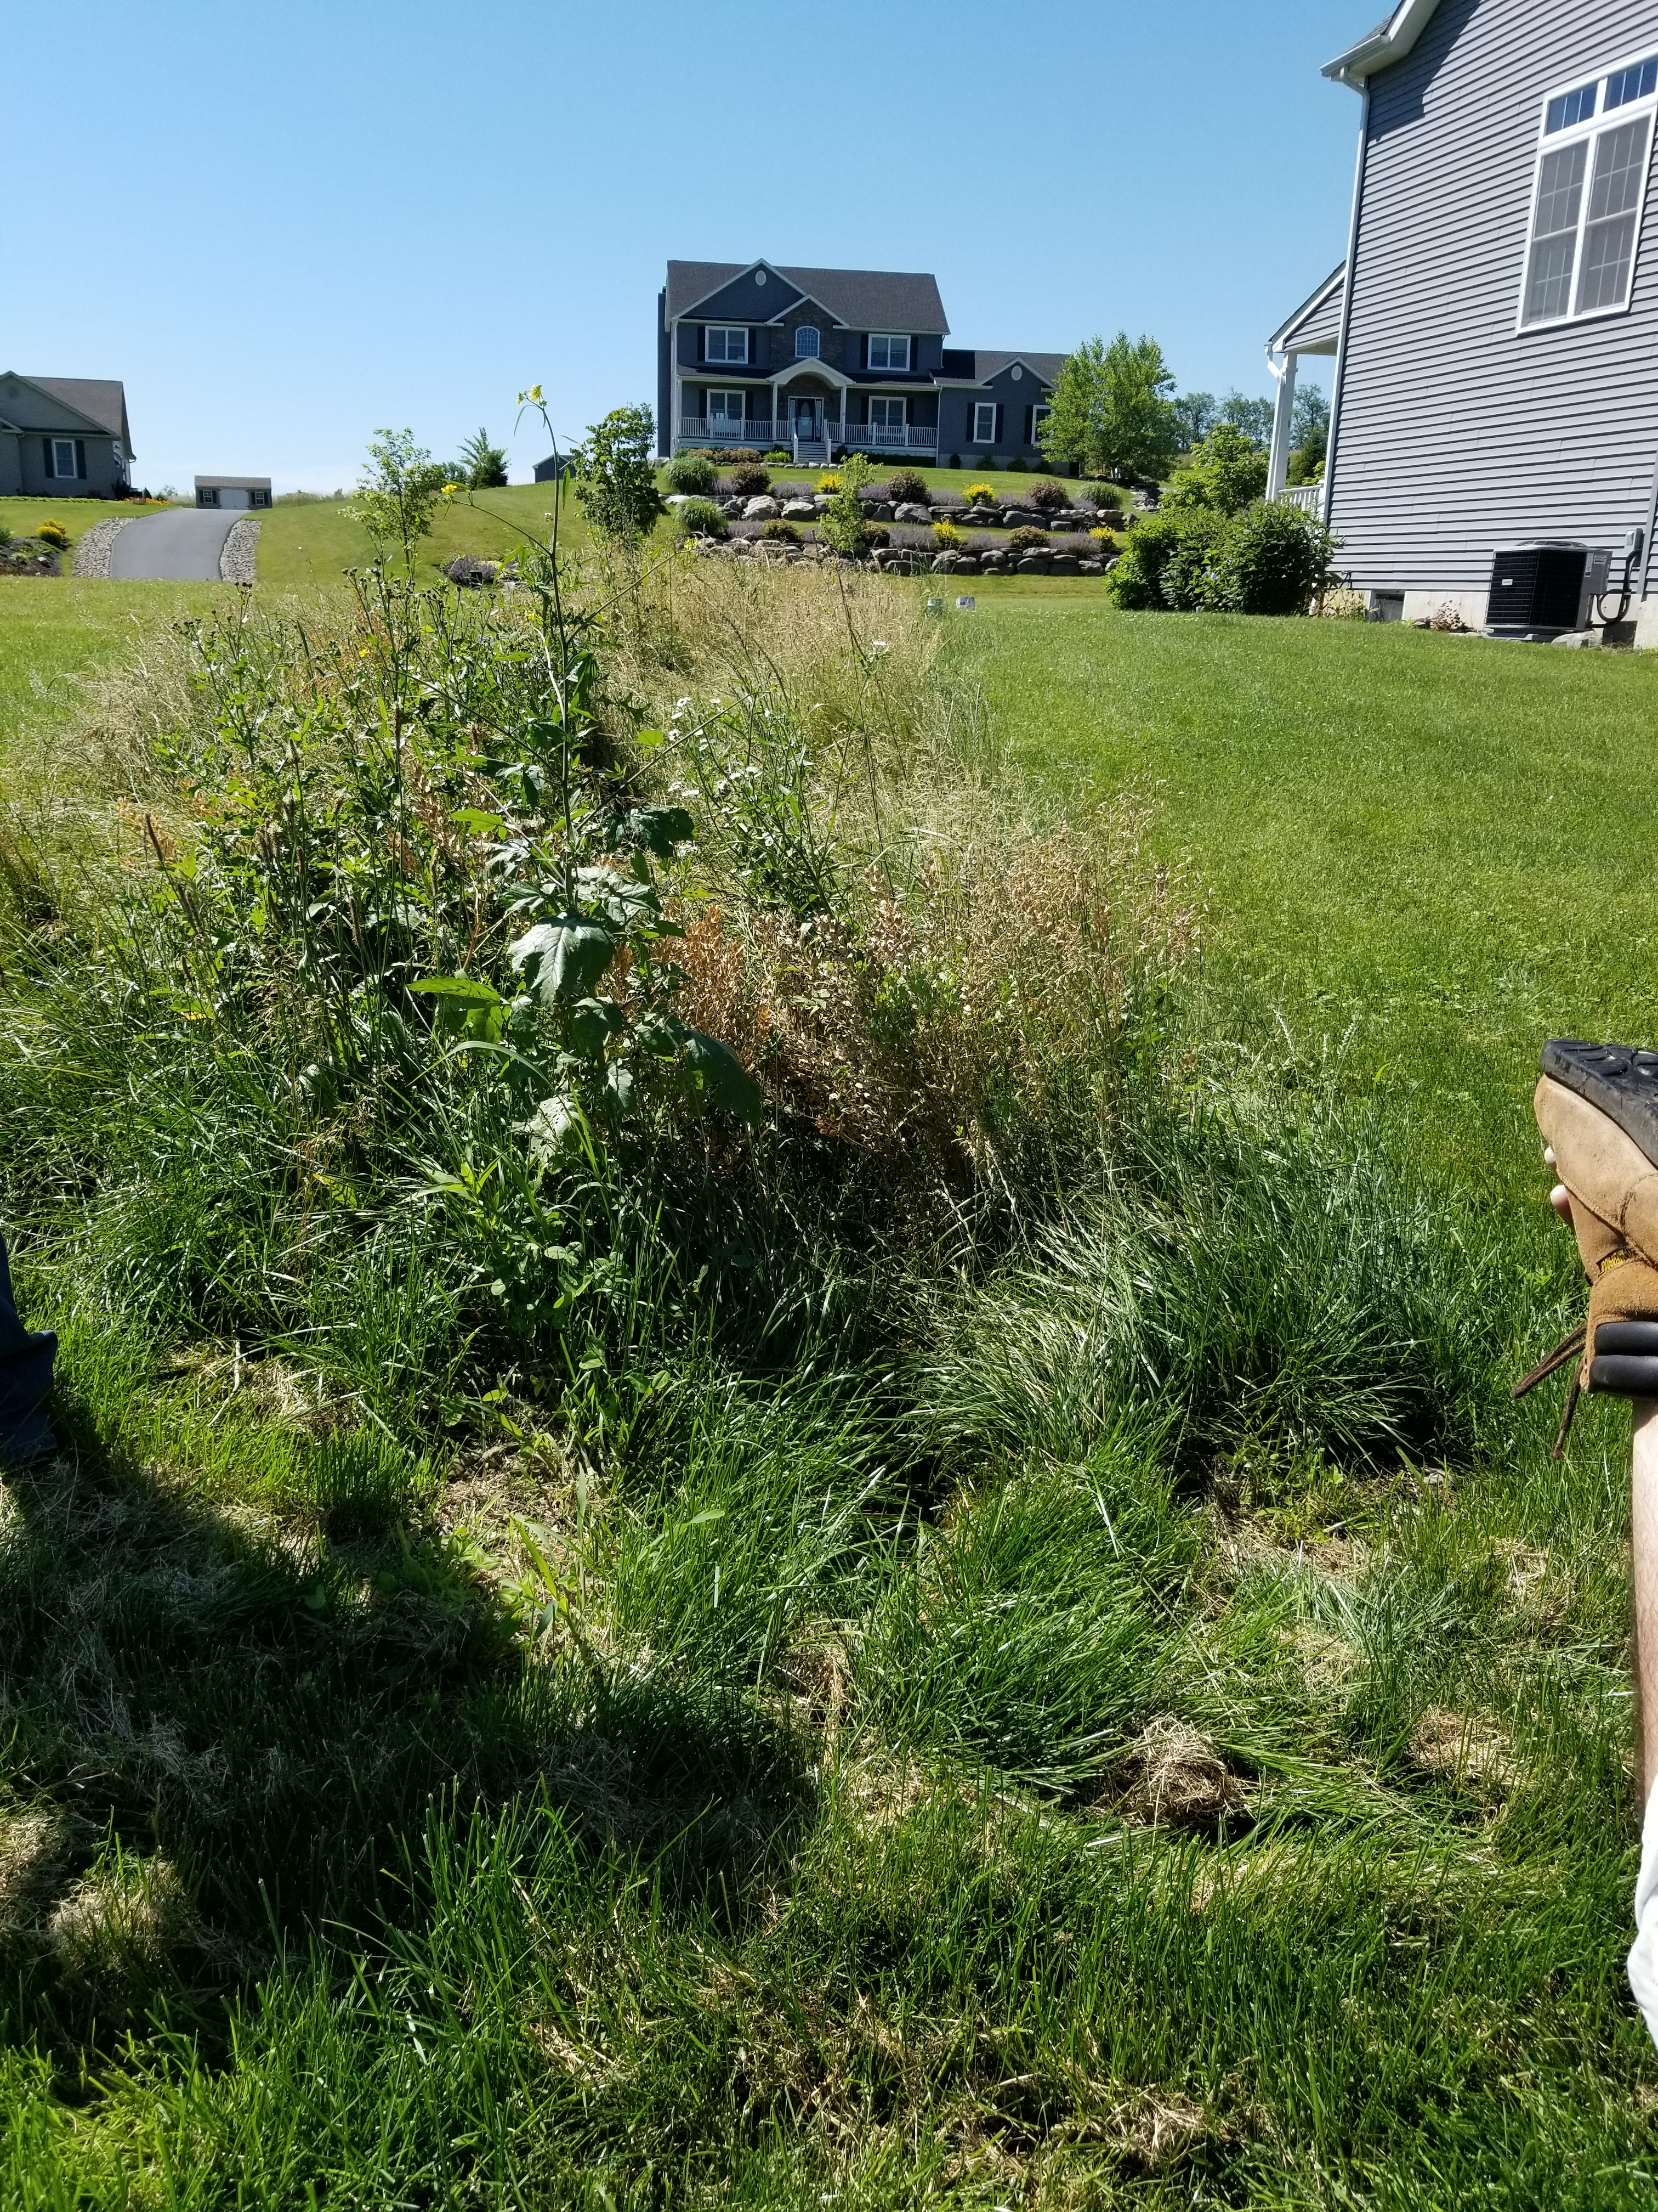
Site 2. Walk Through
Lush growth over STA
No Curtain Drain

Slide 67
Site 2. Walk Through - Diagnostics/Testing & Way Forward
Notes:
Hydraulic Overload – Yes – Why?
Solids/FOG – No
Poor Distribution: No Heavy Biomat – Maybe?
Physical Damage – No
Site Issues - Yes

Slide 68
Site 2. Walk Through - Diagnostics/Testing & Way Forward
Method
What it confirms
Best for
Water use audit + leak check
Hydraulic overload vs design flow
Distress with intermittent symptoms
Sludge/scum measurement + baffle check
Solids carryover risk
Rapid STA clogging; clogged filters
Effluent filter inspection
Outlet restriction; solids loading
Backups, alarms, slow drains
Tank liquid level at rest
Downstream restriction vs normal
Differentiate tank vs STA issues
Pump runtime/dose logs (if present)
Short-cycling, excessive dosing, float issues
Alarm-driven troubleshooting
D-box level check + flow test
Uneven distribution
Localized wetness/early biomat
Camera/jet of lines
Broken/crushed/blocked laterals
Suspected damage or roots
Observation ports / excavation
Ponding depth + recovery time
Confirm STA hydraulic failure
Soil borings / water table monitoring
Limiting layer and seasonal effects
Soil or Weather-linked failures
Well sampling (where relevant)
Groundwater impact indicators
“Invisible” failures
Notes:
Water audit – Maybe
Jet lines – if laterals were drained
Soil/Water table –

Slide 69
Site 2. Walk Through – Follow up
1) Submit Labs
What should we test for?
2) Confirm Site Observations
Review notes, as-builts, available material
3) Determine short-term plan
Repair, pump and haul, etc.
4) Determine long-term plan
Repair components, add system, remove and replace system
5) Report
Finalize your report for all interested parties
Notes:
Research into construction showed:

Slide 70
Summary
1) What is a Soil Treatment Area (STA)
2) Before Arriving on Site
3) What Happens once on Site
4) Follow-Up
5) Site Walk Through

Slide 71
Thank you
Zach Gardner
zgardner@eljen.com

Slide 72
Selected references
Primary sources used in this deck
US EPA — Resolving Septic System Malfunctions (overview of why systems malfunction).
US EPA — Types of Septic Systems (component diagrams).
WA Dept. of Health — Signs of Septic System Failure.
WA Dept. of Health — Hydraulic Loading Rates (337-099).
Minnesota Rules 7080.1500 (example compliance criteria: imminent threat/groundwater protection).
NC State Extension — Why Do Septic Systems Fail?
University of Minnesota — Septic troubleshooting.
Cornell Cooperative Extension — Your Septic System: Septic System Failure.
University of Rhode Island (NEOWTP) — Understanding Septic Systems (photos/diagrams).
University of Maryland Extension — FS-1110 Septic Systems and Best Available Technologies.
Notes:
[Sources] - https://www.epa.gov/septic/resolving-septic-system-malfunctions - https://www.epa.gov/septic/types-septic-systems - https://doh.wa.gov/community-and-environment/wastewater-management/septic-system/signs-failure - https://doh.wa.gov/sites/default/files/legacy/Documents/Pubs//337-099.pdf - https://www.revisor.mn.gov/rules/7080.1500/ - https://content.ces.ncsu.edu/why-do-septic-systems-fail - https://septic.umn.edu/troubleshooting - https://www.css.cornell.edu/cwmi/waterquality/septic/CCEWQ-YourSepticSystem-Failure.pdf - https://web.uri.edu/owt/homeowners/understanding-septic-systems/ - https://extension.umd.edu/resource/septic-systems-and-best-available-technologies-fs-1110

