Slide 1

PFAS and Decentralized Wastewater Treatment
“Forever Chemicals”, what we know about them, and what we still need to learn about them
Dr. Sara Heger
sfheger@gmail.com
Notes:
Image Credit: https://www.laytontechnologies.com/portfolio-view/forever-chemicals-legislation-pfas-roadmap-environmental-protection-agency-epa/

Slide 2
Outline
What are PFAS?
Where do they come from?
What do we know about PFAS in relation to onsite wastewater treatment systems (OWTS)?
What work needs to be done?

Slide 3
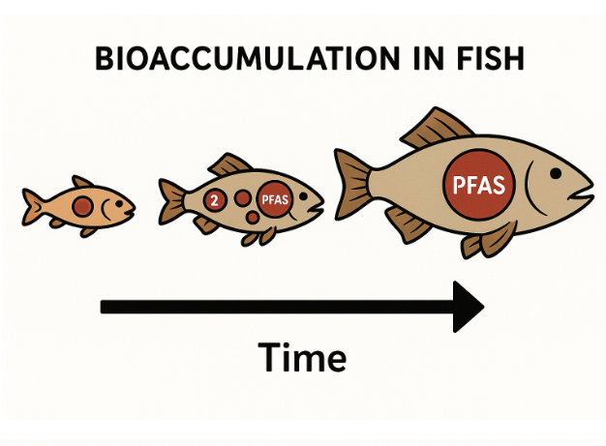
What are PFAS?
Per - and Polyfluoroalkyl Substances
Invented in the 1930 but peak usage in the 1990 – early 2000s
Called “forever chemicals” because they do not break down in the environment
Notes:
Often called forever chemicals because some of them do not naturally break down in the environment
Extremely stable chemicals due to their chemical structure. Known for their resistance to oil, water, and stains which leads to its use in a lot of consumer products.
The chemical structure makes for a very persistent, mobile chemical with lots of potential for bioaccumulation in humans, livestock, and aquatic life.
https://www.onsiteinstaller.com/editorial/2025/03/pfas-and-septic-systems
https://www.sciencedirect.com/science/article/pii/S0013935125014495?via%3Dihub
Image credit: https://waterpros.net/bioaccumulation-of-water-contaminants/

Slide 4

Where does PFAS come from?
Food packaging
Household products
Personal care products
Electronics
Firefighting foams
Medical equipment
Industrial equipment
Food
Notes:
PFAS is synthetically made to use in products created by humans and it doesn’t exist naturally in any large quantity. The list of products PFAS are in is shockingly long.
To start, moisture proof or grease resistant food packaging, single use plates and bowls and coated paper, especially microwave popcorn bags. Household products such as stain resistant upholstery and carpet, waterproof clothing, nonstick cookware, cleaning products, varnish, paint, and sealant all often contain PFAS. Personal care products such as floss, shampoo, nail polish, shaving cream, cosmetics, and sunscreen also often contain PFAS. Electronics such as cables, phones, digital cameras, and printers. Firefighting Foams, often used commercially at airports and military bases, are a source of PFAS going directly into waterways. Medical equipment such as catheters, tubes, grafts, inhalers, needles, and surgical sheets. Industrial equipment such as agricultural covers for greenhouses, car finishes, cements, tanks, pipes, glass, and radar systems. All of these things compound and end up getting into the soil, plants, and water, which leads to it getting into livestock, crops, and aquatic life, meaning it all ends up in our food and drinking water as well.
https://scitechdaily.com/forever-chemicals-found-in-97-of-children-concerning-new-study-reveals/
https://www.onsiteinstaller.com/editorial/2025/03/pfas-and-septic-systems
https://www.mdpi.com/2673-4672/4/1/9
Image source: https://greenwoodcpw.com/understanding-pfas/

Slide 5
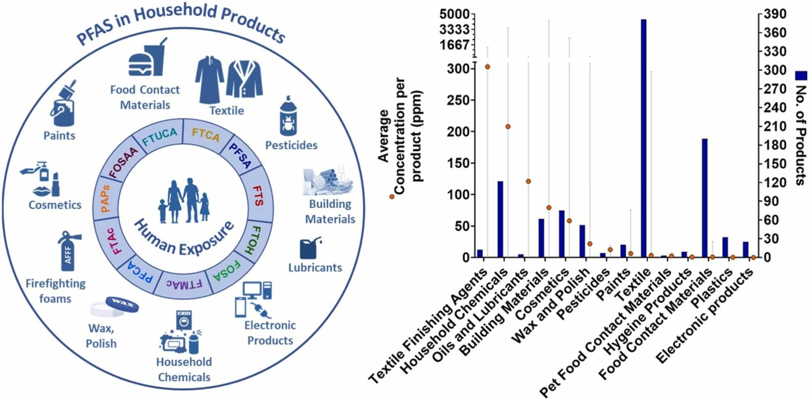
,
Notes:
Pradeep Dewapriya, et al. Per- and polyfluoroalkyl substances (PFAS) in consumer products: Current knowledge and research gaps, Journal of Hazardous Materials Letters, Volume 4, 2023,100086, ISSN 2666-9110

Slide 6
EPA Regulations on PFAS in Drinking Water (April 2024)
Specific to 6 most common PFAS compounds
PFOA and PFOS have maximum contaminant level (MCL) of 4 parts per trillion (same as micrograms/liter (μg/L))
  4 drop of food coloring in 18 million gallons
  Commonly used as heat and water resistant additives
PFHxS, GenX, and PFNA have MCL of 10 ppt
Compliance with standards is from annual average
So new that changes are likely as new research becomes availabel
Notes:
To prevent health risks, the Environmental Protection Agency put forth regulations in April of 2024 for the maximum contaminant levels for six PFAS compounds. The first two are very commonly used as heat and water resistant additives, but the EPA has deemed them harmful enough for a low maximum contaminant level of 4 parts per trillion. The next three are a little less harmful by EPA standards, with a maximum contaminant level of 10 parts per trillion, and are often used as replacements for the first two as grease and water resistant materials. The last EPA standard is to assess the harm of different combinations of these and other PFAS compounds, for which they use a hazard index. Compliance with the EPA standards is determined based on an annual average of samples from the site location. PFAS are a relatively up and coming area of study, with new research coming out all the time, so these regulations will most likely change as more information comes to light.
https://www.epa.gov/sdwa/and-polyfluoroalkyl-substances-pfas

Slide 7
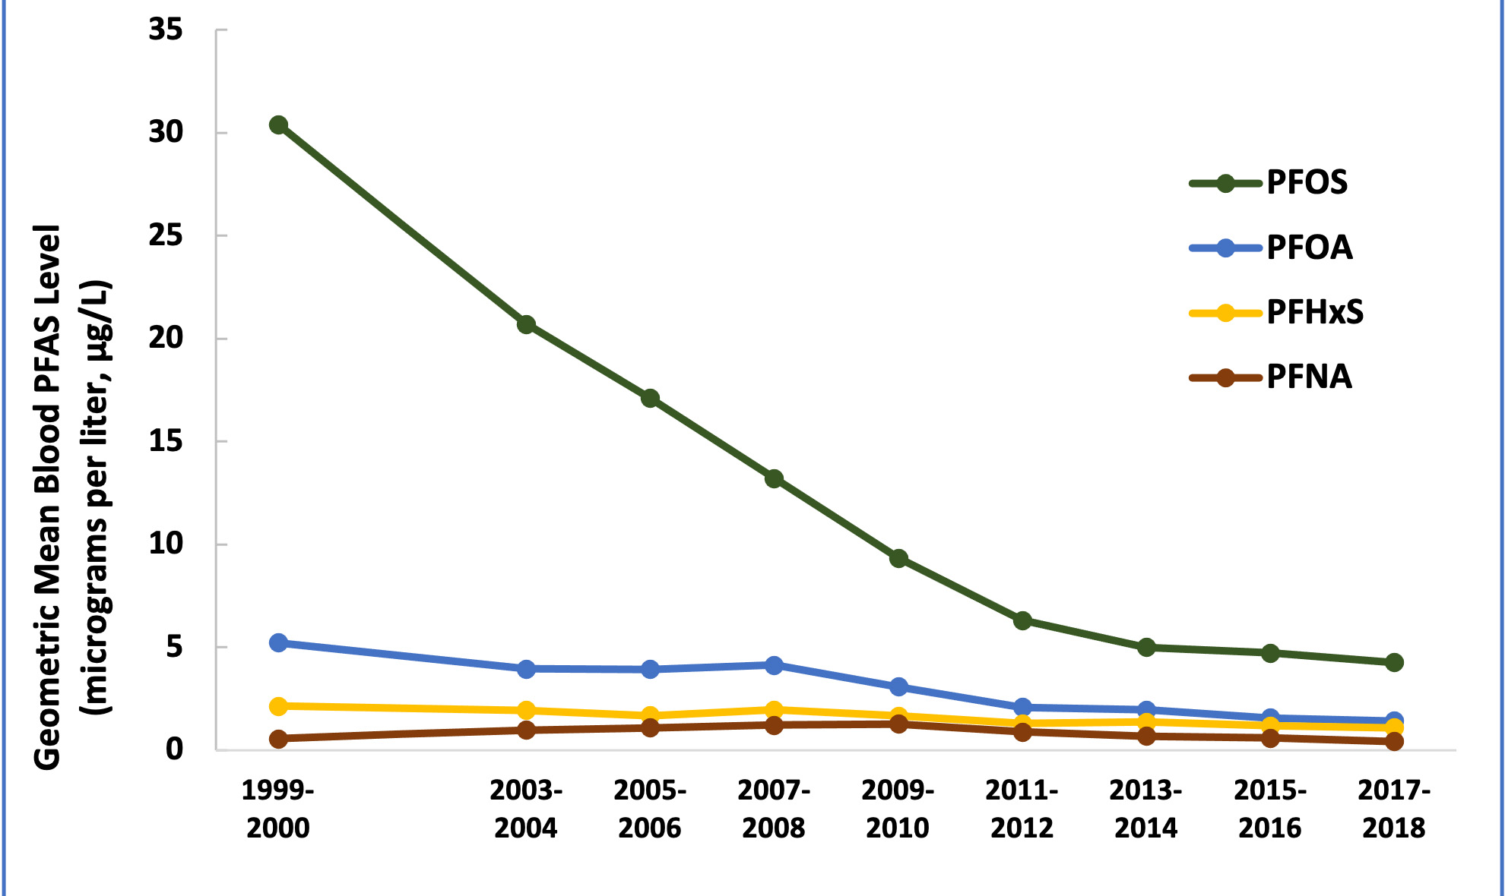
Blood PFAS levels in the US

Slide 8

Human Health Impacts of PFAS
Impaired immunological function
Chronic autoimmune diseases
Hepatotoxicity (liver damage)
Cancer
Decreased fertility
Toxic developmental effects
Notes:
Harmful impacts seen on humans from areas where significant PFAS contamination in waterways was found included immune function, autoimmune diseases, hepatotoxicity or liver damage, increased chances of cancer, decreased fertility, toxic developmental effects, and some lead to lower response to some vaccines. Harmful impacts seen on monkeys when tested were seen to be similar. Farmers in maine who inherited a farm previously using biosolids tainted with pfas were found to have higher pfas levels in their blood than employees at PFAS manufacturers. This has lead to further EPA evaluation into pfas levels of sewage sludge before it gets treated and used as biosolids.
https://www.sciencedirect.com/science/article/pii/S0048969723017424?casa_token=pUoz5ywsx0oAAAAA:gvni4TvPsxsA7_OWGcHfueuLkeuj7k5MLxCVavPm_RZVHeMMLjMwplrlDm10wYAHdetw7gh_fec
https://www.theguardian.com/environment/2022/mar/22/i-dont-know-how-well-survive-the-farmers-facing-ruin-in-americas-forever-chemicals-crisis
https://www.atsdr.cdc.gov/pfas/about/health-effects.html

Slide 9
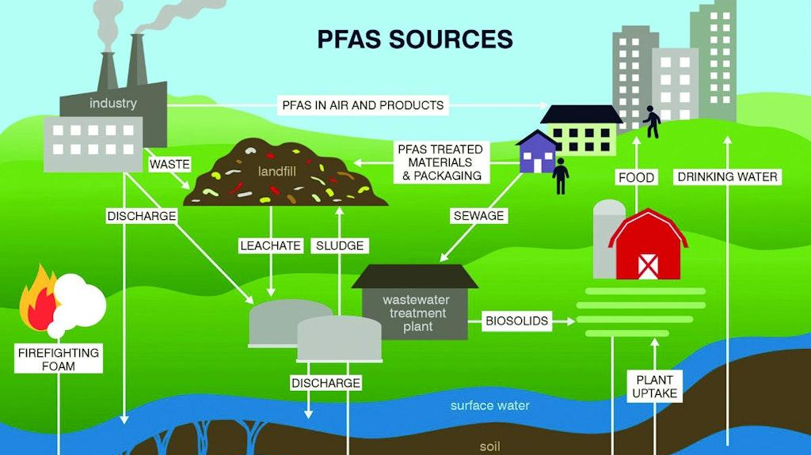
Notes:
All those products from the home and industry go into the landfill or into sewage. These go into wastewater treatment and the biosolids and treated water go into the soil, surface water, and groundwater. Then the PFAS accumulates into the plants and water, which impact the livestock, crops, and aquatic life which provide humans with food. Air and water pollution of PFAS also accumulates in humans along with the impact from food and products used frequently.

Slide 10

Available Research
New Hampshire OWTS
Wisconsin groundwater study
New York groundwater and wastewater
Ohio septage and pump stations
Minnesota septage
Florida biosolids

Slide 11
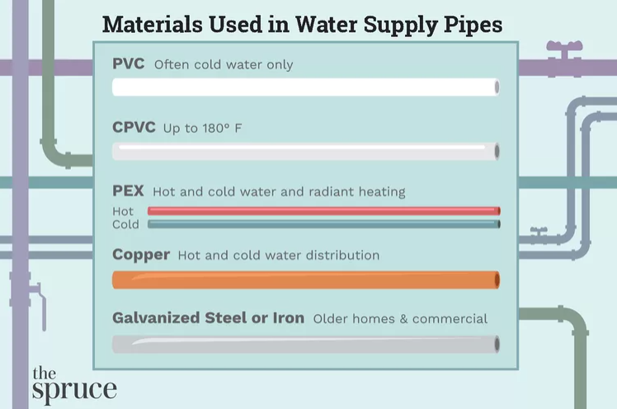
Can PFAS come from wastewater infrastructure?
OWTS Materials:
Concrete
Fiberglass reinforced plastic
Steel
Plastic (High density polyethylene)
Notes:
A question that might arise would be if PFAS can come from the wastewater infrastructure itself. The pipes or tanks. This varies based on manufacturer but there are a few standard materials used in pipes and septic systems. Looking into each, the ones with the lowest likelyhood to ever be built with PFAS would be concrete, steel, and fiberglass reinforced plastic septic systems, since the materials don’t lend themselves to need the properties PFAS provide. Not a lot of research has gone into PFAS prevalence in plastic septic tanks, but since it has been a problem in food packaging which uses fairly similar materials, the EPA has been strict on how much PFAS is allowed in plastic container production, which may apply to septic tanks as well. Most manufacturers of plastic septic tanks disclose the ingredients in the build of their tanks, which primarily only include high desnity polyethylene and cross linked polyethylene with little to no additives. As for water lines, they are built with different materials depending on the temperature of water going through them. Copper, galvanized steel, and iron are all going to be safe from PFAS. PEX (cross linked polyethene) water pipes are similar to the plastic septic tanks in that there’s no proof they’re made with PFAS but without proper research into this field it’s hard to tell for sure. CPVC and PCV pipes also don’t show any evidence of containing PFAS as a part of manufacturing.
https://www.thespruce.com/types-of-pipe-used-for-water-2718736
https://www.bowensseptictank.com/common-types-of-materials-for-septic-tanks
https://www.pfasinsights.com/2024/01/u-s-epa-seeks-to-eliminate-pfas-from-hdpe-plastic-containers/

Slide 12
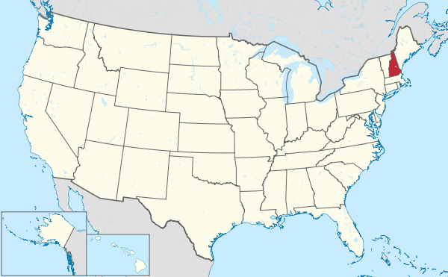
New Hampshire OWTS Evaluation
Objectives:
Evaluate isolated waste streams – carpet cleaning and floor stripping waste from a school
Evaluate supermarket and school OWTS with monitoring wells
Evaluate residential community OWTS wastewater

Slide 13
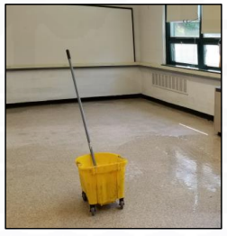
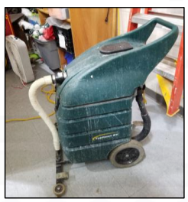
Results Isolated Waste Streams
Wastewater generated from floor stripping and carpet cleaning is highly concentrated with PFAS from products used and surfaces being cleaned
Commercial cleaning wastewater is a likely source of PFAS to septic systems

Slide 14
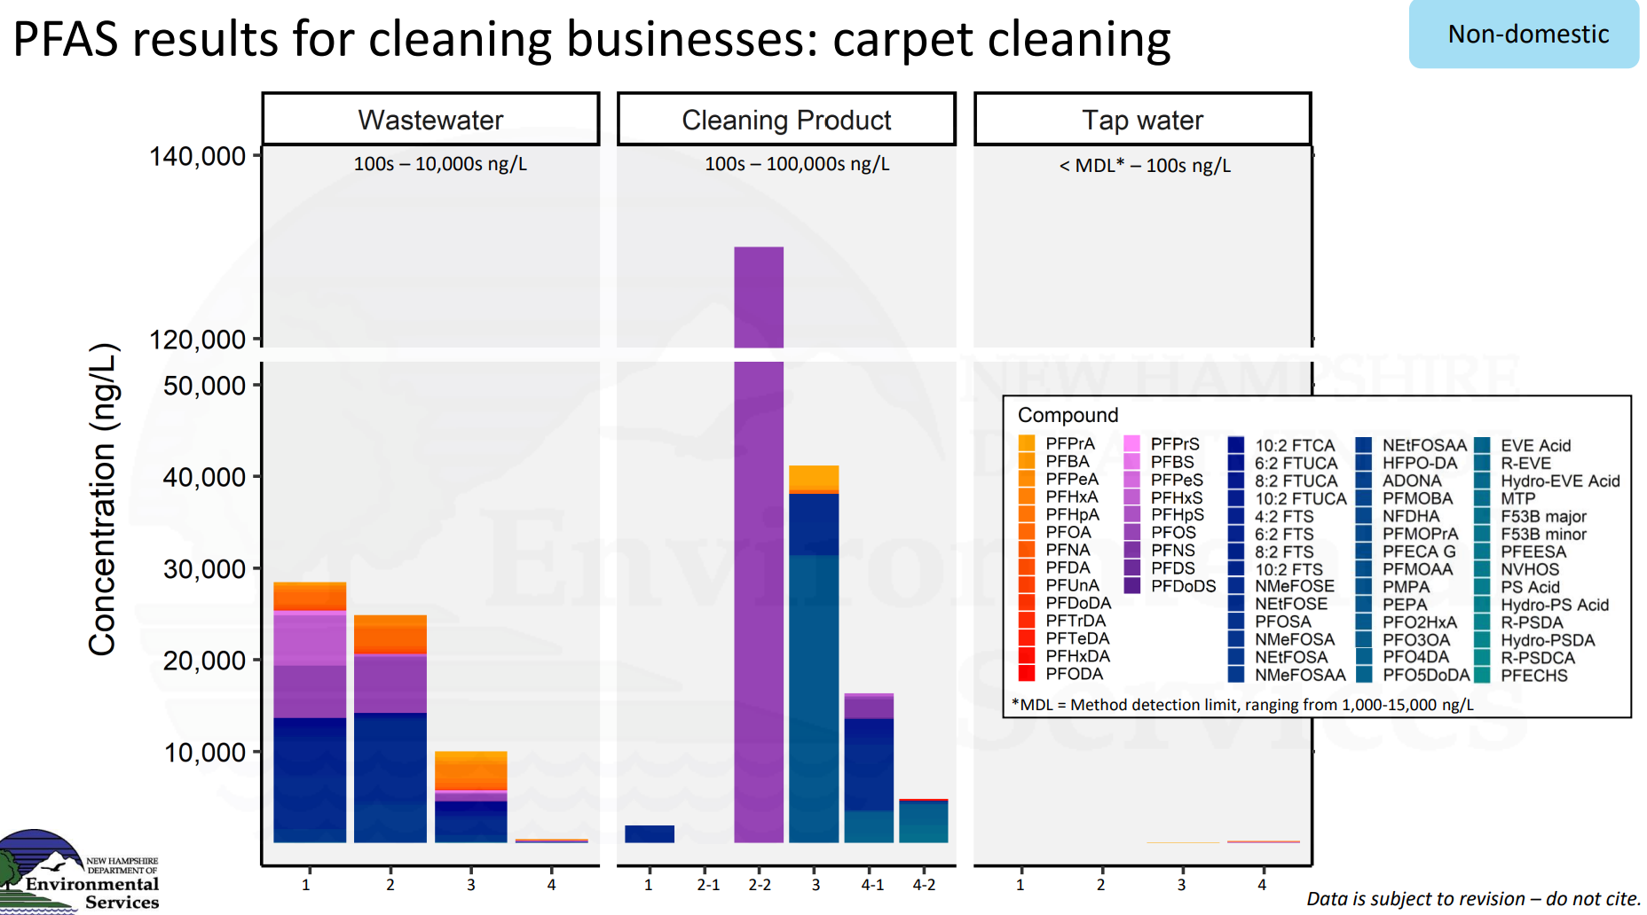
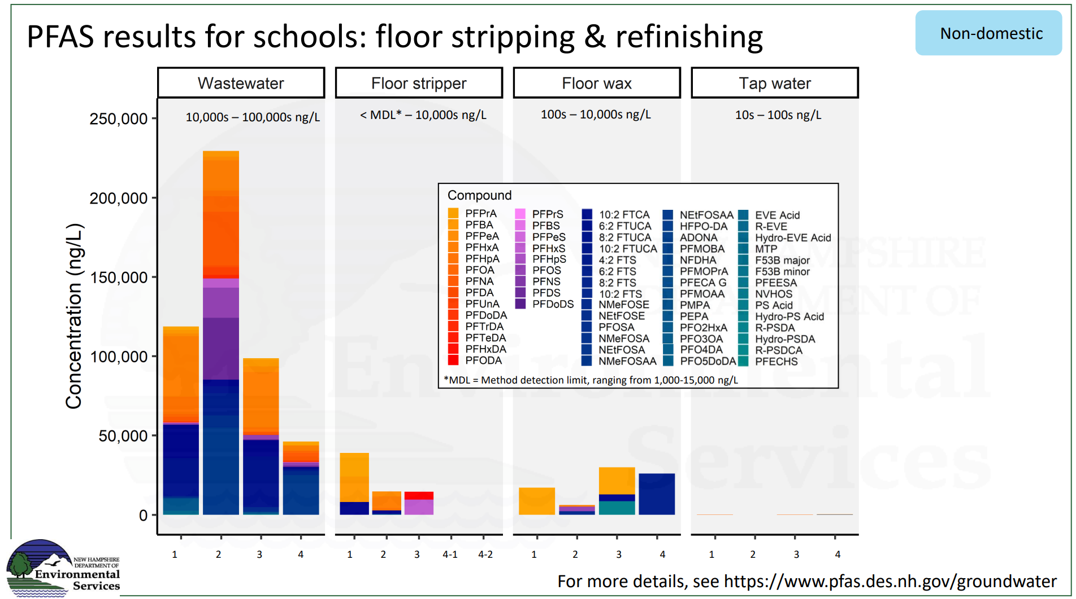

Slide 15
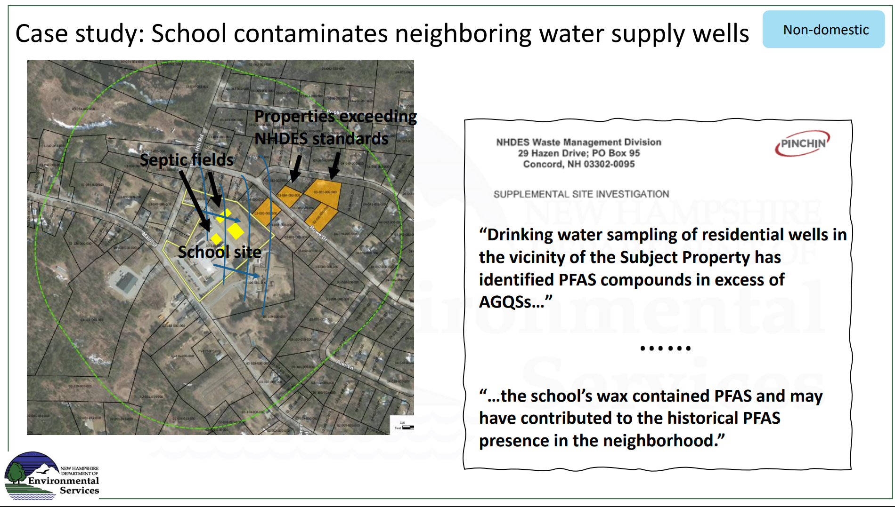
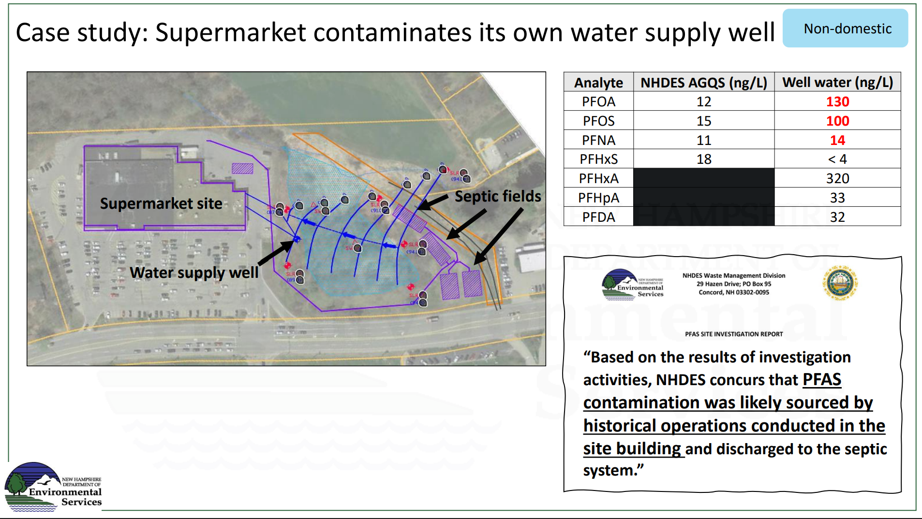

Slide 16
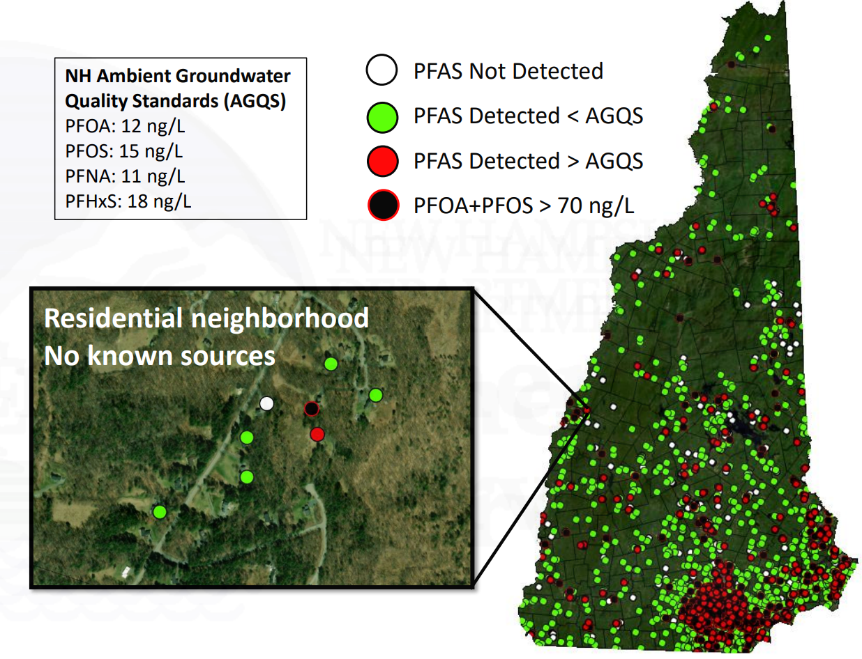
Groundwater Testing Results

Slide 17
Summary of 4 Community System Results
Two systems were conventional and 2 had advanced treatment
Two systems were residential and two were senior living
PFAS mass loadings from effluent range from 1 – 14 µg/person/day

Slide 18
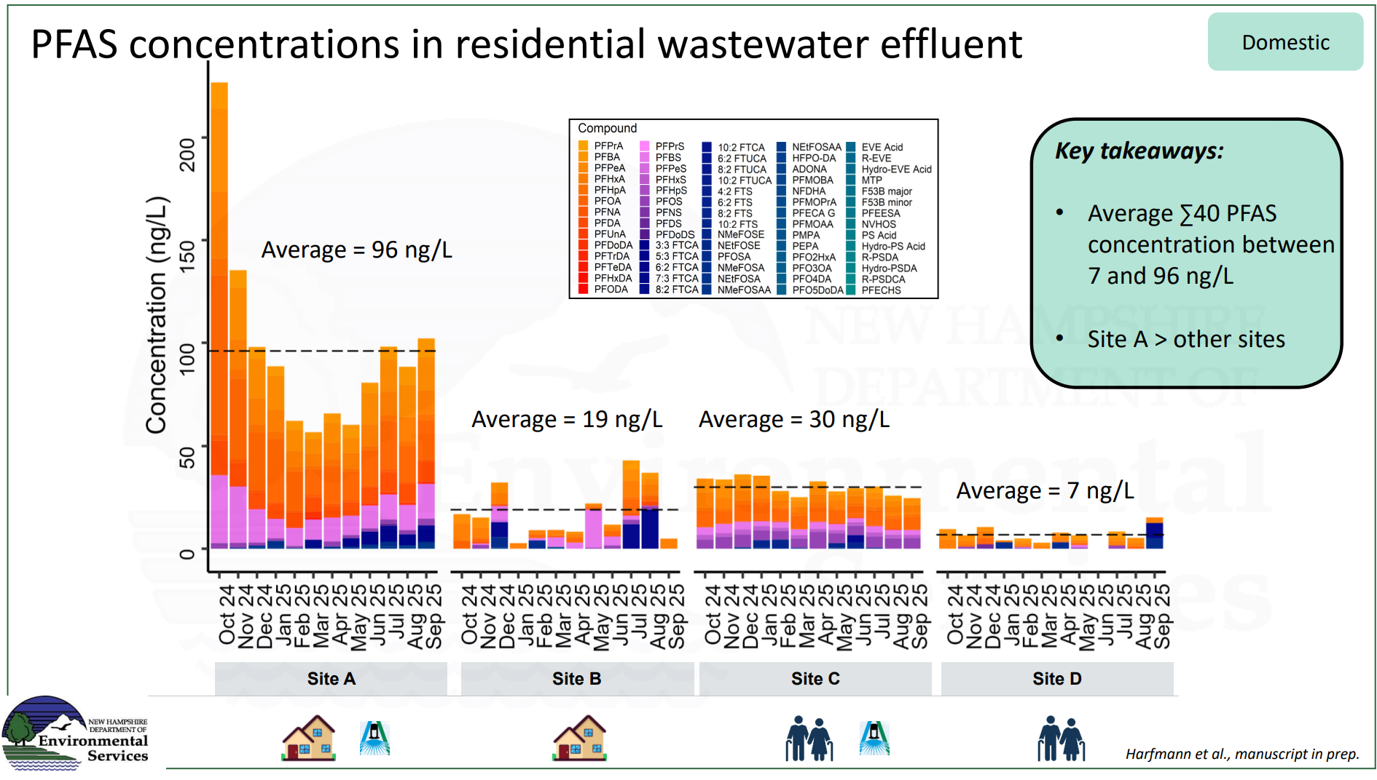

Slide 19
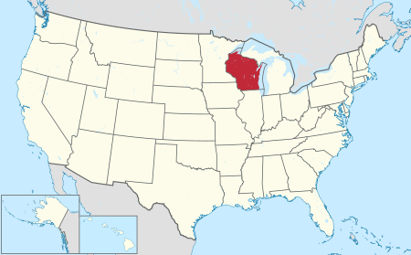
PFAS research methods - Wisconsin
Study of 450 homes with shallow private wells
Groundwater wells no deeper than 40 ft in Wisconsin
Tested tap water from home well water for 44 PFAS compounds and other organic and inorganic compounds
The additional compounds were primarily indicators of septic or agricultural influence
Notes:
Wisconsin study of 450 homes with shallow private wells, meaning groundwater wells no deeper than 40 feet. This depth is relevant since the depth of the groundwater equates to its relative age. Since PFAS only started being prevalent in the 1950s, the shallower the groundwater, the higher risk for PFAS contamination. The study used tap water from the homes well water and tested for 44 PFAS compounds and other organic and inorganic compounds in comparison to a blank water sample with no PFAS contamination. Additional compounds tested for were primarily those used as tracers for septic or agricultural contamination, such as artificial sweeteners, medication, and fertilizer components.
https://dnr.wisconsin.gov/topic/Groundwater/PFASStudy.html
https://pubs.acs.org/doi/10.1021/acs.est.3c02826
https://www.onsiteinstaller.com/editorial/2025/03/pfas-and-septic-systems?ref=loggedin

Slide 20
PFAS research results - Wisconsin
At least one of 44 PFAS chemicals tested was found in 71% of homes
3.7% of homes had levels exceeding maximum contaminant guidelines
  Several showed signs of human waste indicators
PFAS found commonly in all land use types, but most common in developed, forested, grassland, and agricultural areas in that order
Notes:
Wisconsin study of 450 homes with shallow private wells, meaning groundwater wells no deeper than 40 feet. This depth is relevant since the depth of the groundwater equates to its relative age. Since PFAS only started being prevalent in the 1950s, the shallower the groundwater, the higher risk for PFAS contamination.
At least one of the 44 PFAS chemicals found in 71% of homes, with at least one home reaching as high as 22 out of the 44. Additionally, 3.7% of homes had levels of PFAS that exceeded maximum contaminant levels, most of which also showed signs of human waste indicators, such as medications or artificial sweeteners, which can be released into groundwater via septic systems. PFAS found commonly in all land use types, but most common on developed areas with prevalence of 89%, forested areas with a prevalence of 70%, grassland areas with a prevalence of 69%, and agricultural areas with a prevalence of 65%.
Eighteen PFAS compounds have human health-based drinking water recommendations as determined by the Wisconsin Department of Health Services (DHS). Not all PFAS compounds currently have enough information to set human-health drinking water standards.
https://dnr.wisconsin.gov/topic/Groundwater/PFASStudy.html
https://www.onsiteinstaller.com/editorial/2025/03/pfas-and-septic-systems?ref=loggedin

Slide 21
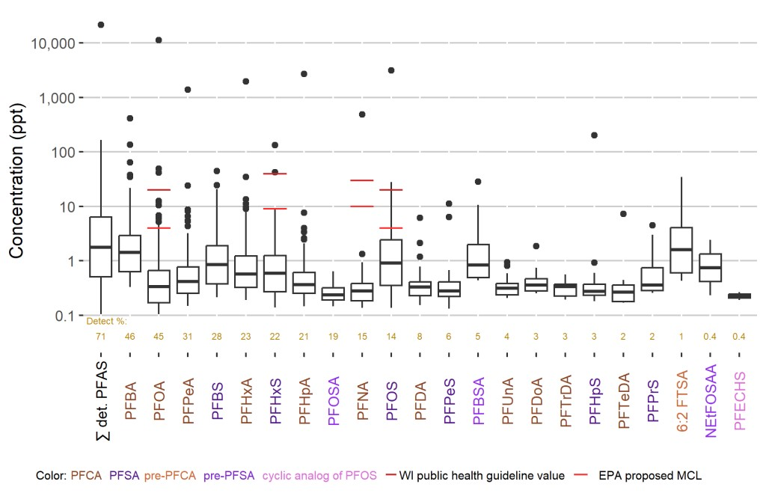
PFAS research results - WI
Notes:
From left to right, PFAS compounds are shown from highest to lowest detection frequency, starting with PFBA being detected in 46% of samples to PFECHS being detected in 0.4% of samples. Each box shows the median concentration detected (center line) and each box extends from the 25th to the 75th percentile concentration. Lines extending from each box are levels detected outside of those percentiles. The dots are samples with concentrations detected outside of those percentiles.
https://dnr.wisconsin.gov/topic/Groundwater/PFASStudy.html

Slide 22
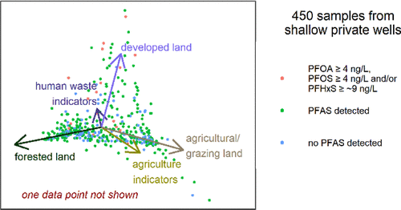
OWTS linkage?

Slide 23
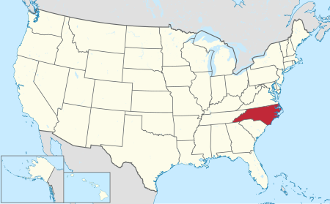
North Carolina Study
Objectives:
Quantify the amount of PFAS contamination in private wells and septic systems in Bladen County
Test for E. coli and total coliform in wellwater
Compare with EPA standards
Notes:
A study conducted on private wells and septic systems in Bladen County, North Carolina set out to quantify the amount of PFAS contamination between the two. They also tested for e. Coli and total coliform in the drinking water and compared the results of all tests to the standards set by the EPA.

Slide 24
PFAS research methods - North Carolina
North Carolina study of septic effluent and private wells from 18 homes chosen along the Cape Fear River or near it, at varying locations from the Chemours industrial plant
Field tested pH, oxidation reduction potential, turbidity, temperature, and specific conductance
Lab tested PFAS, PFOA, GenX, TDN, TSS, NO3, TKN, DOC, Chloride, E. coli, and total coliform
Notes:
North Carolina study of septic effluent and private wells from 18 homes. Study has significant importance since North Carolina sees a 50% population usage of septic usage and 25% population usage of domestic wells, so contamination from one to the other is a concern. Field testing and lab testing a variety of factors helped get a full picture of the impact of any contamination and if the changes came from PFAS or somewhere else.
https://www.onsiteinstaller.com/editorial/2025/03/pfas-and-septic-systems?ref=loggedin
https://www.nowra.org/Customer-Content/www/CMS/files/24Mega_Pradhan_PFAS.pdf

Slide 25
PFAS research results - North Carolina
Results showed detectable levels of one type of PFAS in 61% of wells and another type in 39% of wells
50% of these private wells exceeded EPA’s regulation levels for PFAS
No clear correlation between PFAS levels in septic effluent and the levels in that home’s well
The wells nearest to the Industrial Plant saw increased levels of PFAS compounds in varying ways
Notes:
Results showed that 61% of the homes showed detectable levels of one type of PFAS in the drinking water wells, and 39% of a different type of PFAS in wells, with 50% total exceeding the maximum contaminant levels. The levels of PFAS in septic effluent show no clear correlation with those in the same homes groundwater wells. This may be contributed to different well depths or septic system designs, the study doesn’t specify. Some sites show only slightly decreased levels of PFAS from effluent to wellwater while others show a drastic decrease, often to zero. The wells nearest to the industrial plant saw increased levels of PFAS compounds.
https://www.onsiteinstaller.com/editorial/2025/03/pfas-and-septic-systems?ref=loggedin
https://www.nowra.org/Customer-Content/www/CMS/files/24Mega_Pradhan_PFAS.pdf

Slide 26
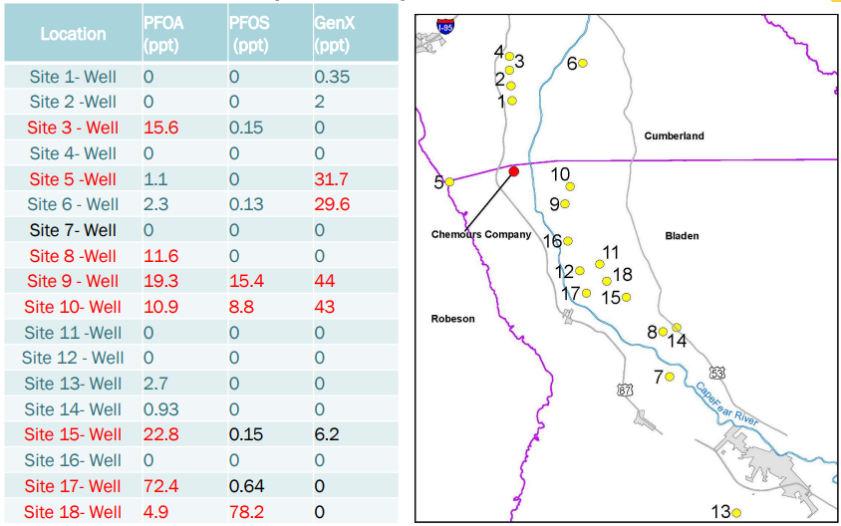
PFAS research results - NC
Notes:
Sites 5, 10 and 9 were aall closest to the industrial plant, and showed increased signs of PFAS contamination. Causation cannot be confirmed since distance from the plant does not seem to be the deciding factor in PFAS contamination. Again, well depth may play a role.
https://www.nowra.org/Customer-Content/www/CMS/files/24Mega_Pradhan_PFAS.pdf

Slide 27
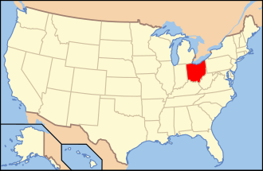
Ohio
Study
Objectives:
Compare PFAS levels in septage and pump stations by sampling both in several areas
Identify needs for reduction of PFAS contamination
Notes:
A study by researchers in Ohio was conducted to compare the levels of PFAS in septage and pump stations by sampling both at many different sites. Then the goal was to use the collected data to characterize the differences and identify needs for reduction of PFAS contamination from each.

Slide 28
PFAS research methods - Ohio
Study conducted by researchers from Ohio on pump stations compared to septic tanks when measuring 70 PFAS compounds
Grab samples taken over 4 week period in Spring at 12 total pump stations sampled twice each
Samples tested using isotope dilutions and extracted internal standard calibrations then treated using TOP assay technique
Notes:
Study tested pump stations compared to septic systems when measuring 70 PFAS compounds. Grab samples on 12 total pump stations were taken twice each over a 4 week period in Spring. Samples were tested using isotope dilutions and extracted internal standard calibrations. Then a portion of these samples were treated using TOP assay technique, which is the current leading PFAS detection method. https://pubs.acs.org/doi/full/10.1021/acs.estlett.5c00246?casa_token=gWcIDAC7mP4AAAAA%3A6y5hLt5y9PhWASDiDKa0B5vsaKw2Hf69LDoKxuA1ArvMoYsZ5CWP3E-gbH4CqseyPpZ4wVXHPy6y_d7Q

Slide 29
PFAS research results - Ohio
Out of the 70 PFAS compounds measured for, 27 total were detected
Septic tanks retain wastewater over long periods of time, allowing for the accumulation of PFAS
Pump stations rapidly transport wastewater to centralized facilities, meaning lower overall PFAS concentrations
Contamination of the environment from septic systems depends on the depth of the aquifer and the permeability of the soil
Pump stations lead to periodic PFAS contamination spikes
Notes:
Results showed detection of 27 of the total 70 PFAS compounds measured. Comparison of Pump stations to septic tanks revealed that Septic tanks, which retain wastewater over long periods of time, allowed for accumulation of PFAS over that stretch of time. By contrast, pump stations, which rapidly transport wastewater to centralized facilities, showed lower overall PFAS concentrations, but lead to periodic PFAS contamination spikes from pumping wastewater all at once. Contamination of the environment from septic systems is dependent on depth of the aquifer and permeability of the soil.
https://pubs.acs.org/doi/full/10.1021/acs.estlett.5c00246?casa_token=gWcIDAC7mP4AAAAA%3A6y5hLt5y9PhWASDiDKa0B5vsaKw2Hf69LDoKxuA1ArvMoYsZ5CWP3E-gbH4CqseyPpZ4wVXHPy6y_d7Q

Slide 30
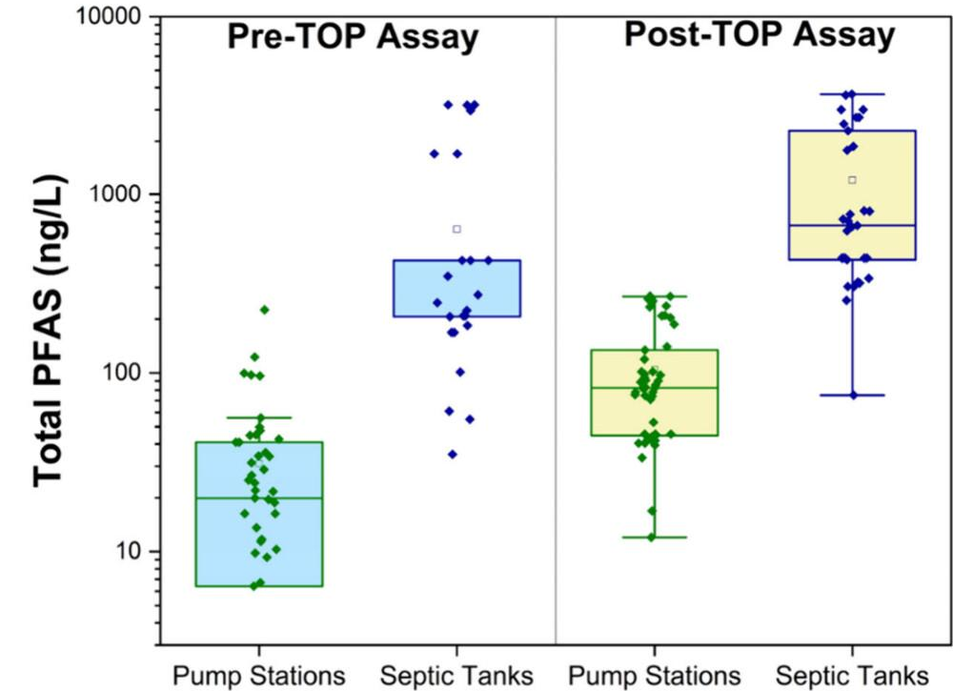
PFAS research results - OH
Notes:
Total PFAS amounts as recorded before and after treatment. PFAS levels are seen to be notably higher in septic tanks compared to pump stations, but both are seen to increase with treatment. This can be explained by taking into consideration the presence of PFAS precursors which can convert into terminal PFAS upon aeration and chemical treatment.
https://pubs.acs.org/doi/full/10.1021/acs.estlett.5c00246?casa_token=gWcIDAC7mP4AAAAA%3A6y5hLt5y9PhWASDiDKa0B5vsaKw2Hf69LDoKxuA1ArvMoYsZ5CWP3E-gbH4CqseyPpZ4wVXHPy6y_d7Q

Slide 31
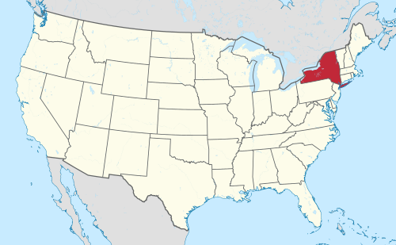
New York Study
Objectives:
Characterize PFAS contamination in area of shallow fractured bedrock, with shallow groundwater as primary water source
Test private bedrock wells, soil, groundwater, surface water and sediment samples from lakes and wastewater discharge outfalls
Notes:
A study conducted in a suburb of New York on a site notable for shallow fractured bedrock, shallow groundwater, and residents reliance on this groundwater as the primary water source. They set out to test for PFAS in private bedrock wells, soil samples, groundwater, surface water and sediment samples from lakes, and wastewater discharge outfalls.

Slide 32
PFAS research methods - New York
New York Study of 306 private bedrock wells, soil, groundwater, surface water and sediment samples from lakes and wastewater discharge outfalls
7 private water supply wells and 2 temporary overburden monitoring wells were sampled for septic tracer analysis
Sampling via soil borings, temporary monitoring wells, groundwater sampling via pumps, PFAS free scoops for sampling lakes and wastewater discharge outfalls.
Private water supply samples collected from faucets
Tested for 6 PFAS compounds using USEPA methods
Notes:
The study analyzed water samples from residents private wells, soil samples from around the area, groundwater samples obtained from pumps, surface water and sediment samples from the adjacent lake, and sediment and liquid samples from two wastewater discharge outfalls. Seven private water supply wells and two temporary overburden monitoring wells were sampled for septic tracer analysis because they were known to have septic systems and no close proximity to any other possible PFAS contamination such as a fire station or industrial plant.
https://onlinelibrary-wiley-com.ezp2.lib.umn.edu/doi/full/10.1002/rem.70001

Slide 33
PFAS research results - New York
PFAS was detectable and often exceeding comparison limits in all water samples, but notably higher in ground and well water rather than surface
Soil samples showed little trace of PFAS contamination except adjacent to the fire station and sludge tank at the wastewater treatment plant
Notes:
Results showed that PFAS was consistently detectible in all water samples, highest in groundwater and private wells rather than in surface water. PFAS was not significantly present in soil samples, only showing presence next to the sludge tank at the wastewater treatment plant and adjacent to the fire station. https://onlinelibrary-wiley-com.ezp2.lib.umn.edu/doi/full/10.1002/rem.70001

Slide 34
PFAS research results - New York
Septic tracer levels follow PFAS levels, indicating that PFAS contamination can be connected to septic effluent
PFAS contamination in groundwater are similar to that in the nearby lake surface water, indicating contamination by septic system discharges from properties near lake edge
Notes:
Septic tracers such as artificial sweeteners were tested and found to have significant correlation with PFAS prevalence, giving the impression that PFAS contamination could be traced to septic effluent. PFAS contamination signatures in groundwater were similar to those in the nearby lake surface water, indicating PFAS contamination in the lake from nearby septic system discharge.
https://onlinelibrary-wiley-com.ezp2.lib.umn.edu/doi/full/10.1002/rem.70001

Slide 35
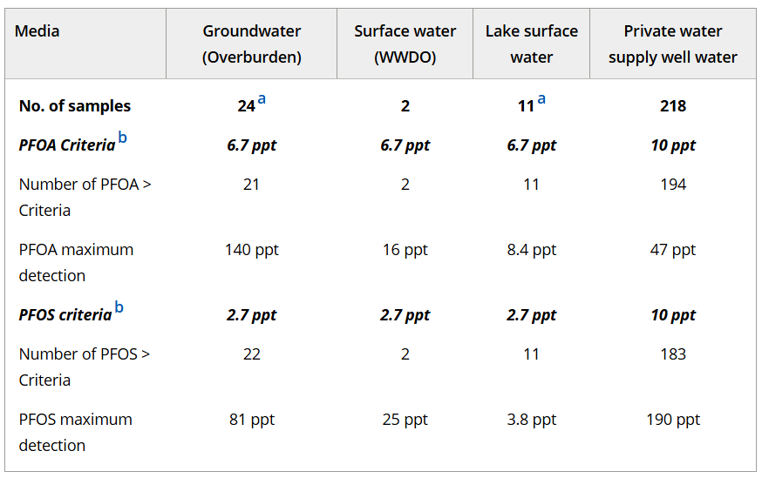
PFAS research results - NY
Notes:
Maximum concentrations and number of concentrations exceeding comparison criteria. As shown, PFAS was detected consistently in all water sample types, usually exceeding comparison criteria. PFAS numbers are consistently higher in groundwater and wellwater compared to surface water samples, supporting the idea of leaching from underground sources such as septic systems.
https://onlinelibrary-wiley-com.ezp2.lib.umn.edu/doi/full/10.1002/rem.70001

Slide 36
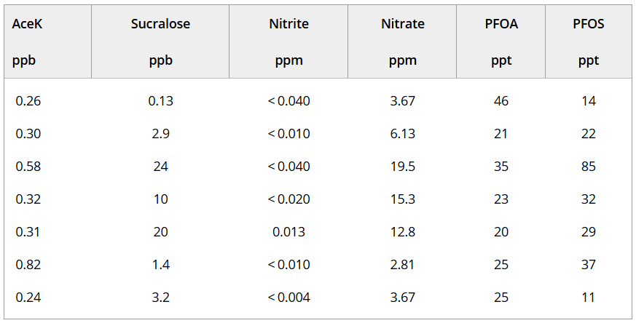
PFAS research results - NY
Notes:
Septic Tracers in private wellwater supplies. This data shows a positive correlation between presence of septic tracers and PFAS concentrations in private wellwater supplies, which supports the idea that PFAS contamination is caused by septic leaching.
https://onlinelibrary-wiley-com.ezp2.lib.umn.edu/doi/full/10.1002/rem.70001

Slide 37
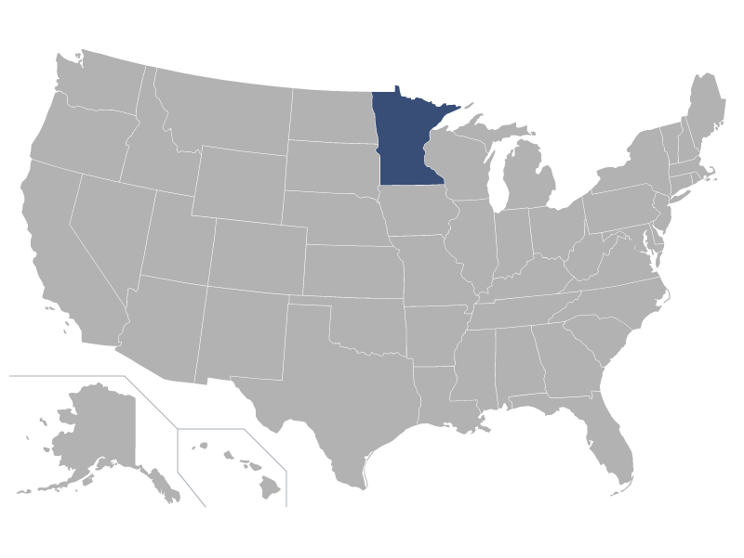
Minnesota Study
Objectives:
Characterize rest area septage
Measure a large variety of characteristics from many sites
Find how common PFAS contamination is in septage and identify possible sources
Notes:
We at the Onsite Sewage Treatment Program, working with the University of Minnesota in collaboration with the Minnesota Department of Transportation, conducted a study to focus on characterizing rest area septage. Compared to residential septage it receives only toilet flushing and sink usage, so it’s makeup and characteristics could be completely different and require different regulations. The goal was to measure a large variety of characteristics from many sites around MN. One of these being PFAS levels, to find how common PFAS contamination is in septage and identify possible sources based on the type(s) of PFAS compounds present.

Slide 38
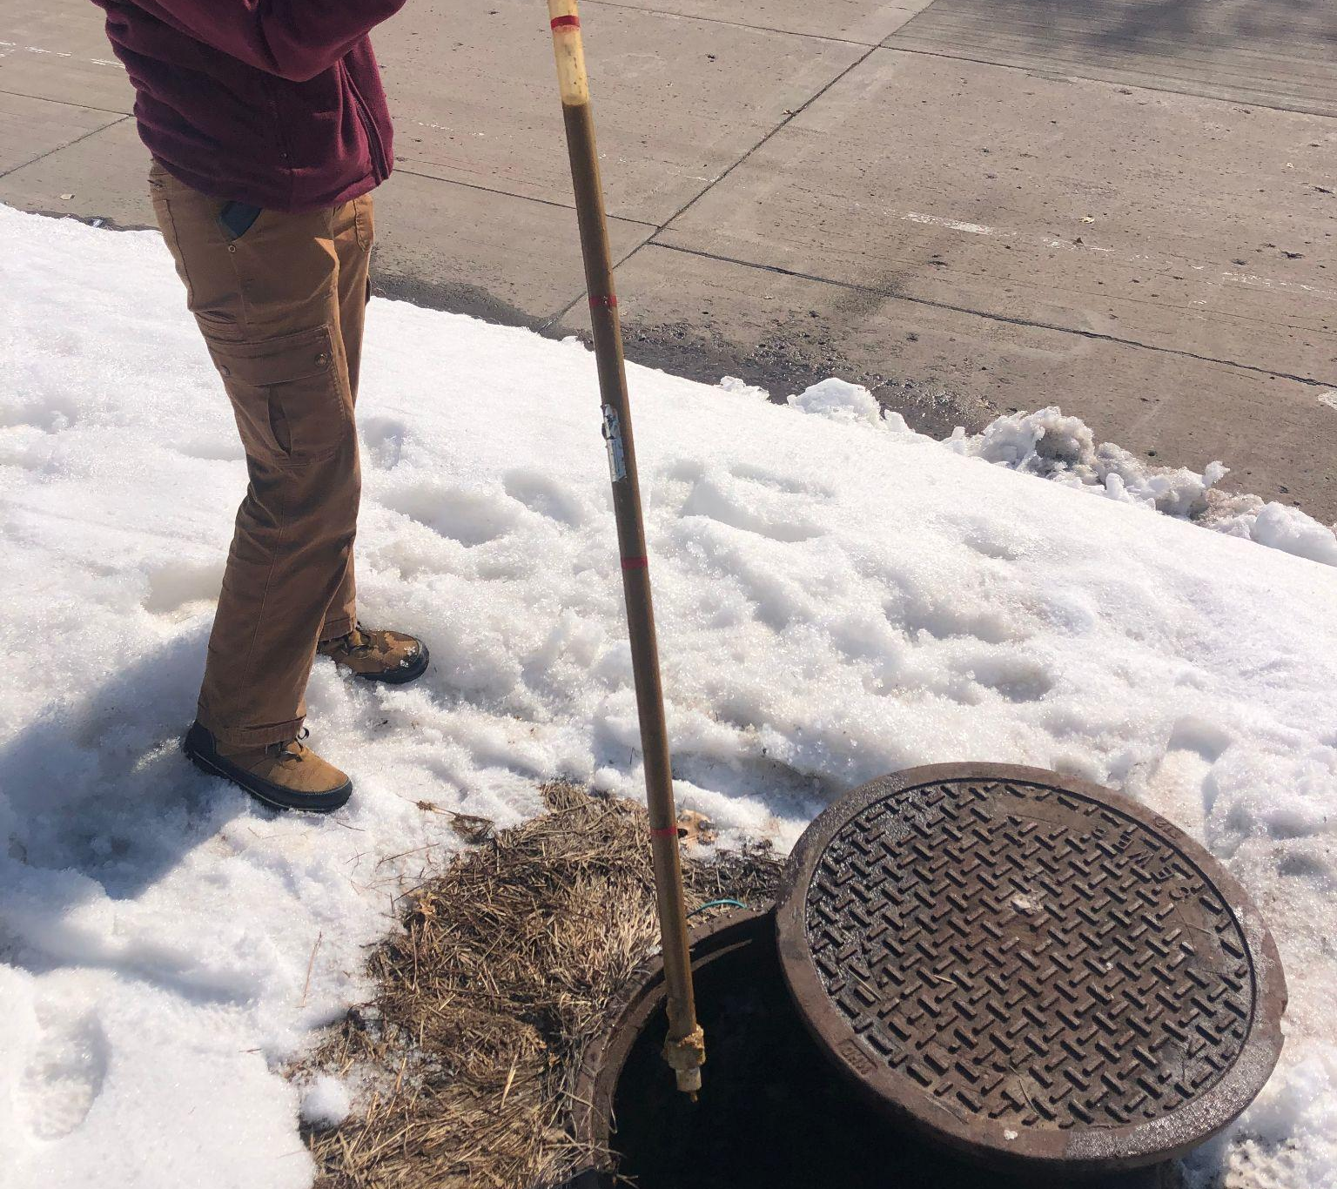
Minnesta PFAS research methods
5 rest areas (RA), septic tanks sampled during tank cleaning
Mixed septage/wastewater from the “dirtiest” load
Means, medians, minimums, and maximums were summarized and compared to EPA standards for all other test criteria
Notes:
We tested 25 total rest areas by sampling from the first septic tank during biannual or annual system maintenance, when the tanks were getting pumped, to ensure a well mixed, representative sample of each. These sites are unique as septic systems since they are only comprised of hand washing and toilet flushing wastewater, not any other usual uses from households. Of the 25 sites, all were tested for biological oxygen demand, chemical oxygen demand, total suspended solids, total kjeldahl nitrogen, total phosphorus, and pH. Five sites were sampled for 40 notable PFAS compounds. Sites were also sampled for various other factors like mercury, oil and grease, other metals, and ammonia. These tests could help identify patterns of makeup of septage which could be helpful for isolating responses from solely PFAS contamination.

Slide 39
Minnesota PFAS research results
PFAS concentrations were detectable at 3 of the 5 sites sampled
  13 different PFAS compounds were detected at St Croix (comtaninated groundwater)
  14 at Grand Portage
  12 at Goose Creek.
The three showed varying concentrations of different compounds, but St Croix showed a considerably larger total of 746.6 ng/L compared to Goose creek with 240.73 ng/L and Grand Portage with 91.2 ng/L
Notes:
Research results of test criteria besides PFAS were analyzed by collecting statistical figures and comparing to EPA standards.
PFAS concentrations were only detectable at 3 of the 5 sites sampled, with 12 different compounds at Goose Creek, 13 at St Croix, and 14 at Grand Portage. All three showed varying concentrations of different compounds, but St Croix showed a much higher total concentration of PFAS, with 746.6 ng/L compared to Goose Creek’s 240.73 ng/L and Grand Portage’s 91.2 ng/L

Slide 40
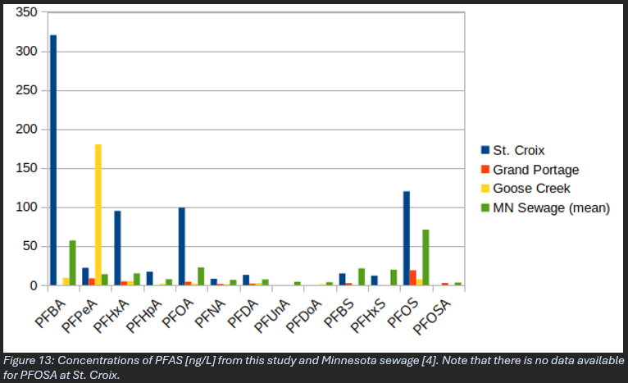
OSTP PFAS research results
Notes:
The graph comparing PFAS concentrations found in MN raw sewage to those found in this study. Many PFAS compounds and even total PFAS are seen to be significantly higher in St Croix septage than average MN sewage. Goose Creek showed a high level of one specific PFAS compound, the one possibly caused by recent construction or cosmetics in the septic, but shows less than MN sewage average for all the rest of the PFAS compounds.

Slide 41
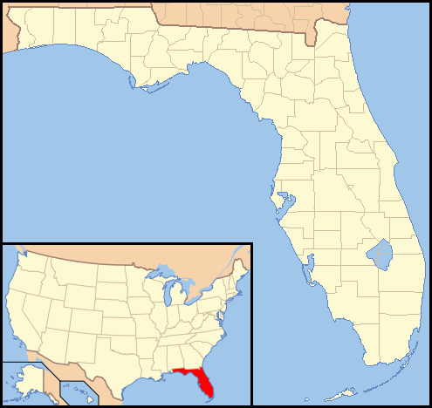
Florida Biosolids Study
Objectives:
Characterize movement of PFAS in biosolids during different treatment methods
Identify how PFAS will move in land application and what treatments are best to prevent leaching
Notes:
One field that is fairly new to being researched is the study of biosolids and PFAS, which was studied in Miami using centrifugation and digestion to see what percentage of PFAS stays with the solids and which move with the liquid.
This study set out to characterize the movement of PFAS in biosolids during different treatment methods prior to land application. Then they used this data to identify how PFAS will move once applied to the land and which treatment(s) are best to prevent leaching of PFAS into the nearby environment.

Slide 42
PFAS septage research methods - Florida
Sludge samples collected from two treatment plants with similar treatment processes: waste activated sludge mixed with polymer and sent to gravity thickeners and stabilized by anaerobic digestion, then dewatered via centrifugation
Sludge samples were collected after thickening, digestion, and dewatering and tested for total, fixed, and volatile solids
Sludge samples were rewatered with deionized water, mixed for 30 days and centrifuged then analyzed for 40 PFAS compounds
Notes:
In this study sludge samples were collected from two treatment plants with similar treatment processes of mixing the waste activated sludge with polymer, sending to gravity thickeners, stabilizing in anaerobic digestion, and finally dewatering via centrifugation.
Sludge samples were collected after thickening, digestion, and dewatering and tested for total, fixed, and volatile solids. These samples were then rewatered with deionized water to ensure that leaching was not due to any substances in the water but from the materials themselves, giving insight into how the materials would leach from irrigation or rainwater. Then they were mixed for 300 days, centrifuged for 30 minutes at 4,500 RPM, carefully decanted into solid and liquid then analyzed for 40 PFAS.
https://www.sciencedirect.com/science/article/pii/S0301479724023818?casa_token=sIhbjONINAQAAAAA:4qNbpG7C-ZKTAXJ-klYd_ZJsXKldzKqRXQbzSK6WqYYdDTRm6qya50G57_eXquQUUYj953yE430

Slide 43
PFAS septage research results - Florida
PFAS movement after biosolid land application was dependent on the type of PFAS compound and how it behaves, with solubility and affinity for soil organic matter being the deciding factors
PFAS levels in dewatered biosolids are lower compared to the samples from thickener and anaerobic digestion
Based on comparison of different treatment methods, 24 of the 40 measured PFAS compounds are highly mobile and soluble
PFAS made soluble did not get reabsorbed in digested sludge and in dewatered sludge
Notes:
PFAS movement after land application depended on the type of PFAS compound, with solubility and affinity for soil organic matter being the primary deciding behaviors. PFAS levels in dewatered biosolids were lower compared to samples from thickener and digestion. Results suggest that 24 of the 40 PFAS compounds studied were mobile and highly soluble, meaning a number can be removed from biosolids before land application, preventing bioaccumulation in soils and surrounding plants, water, and animals. A number cannot be removed, however, so care must be taken with application. Those removed from the solids into liquid phase were not reabsorbed into the sludge at any point.
https://www.sciencedirect.com/science/article/pii/S0301479724023818?casa_token=sIhbjONINAQAAAAA:4qNbpG7C-ZKTAXJ-klYd_ZJsXKldzKqRXQbzSK6WqYYdDTRm6qya50G57_eXquQUUYj953yE430

Slide 44
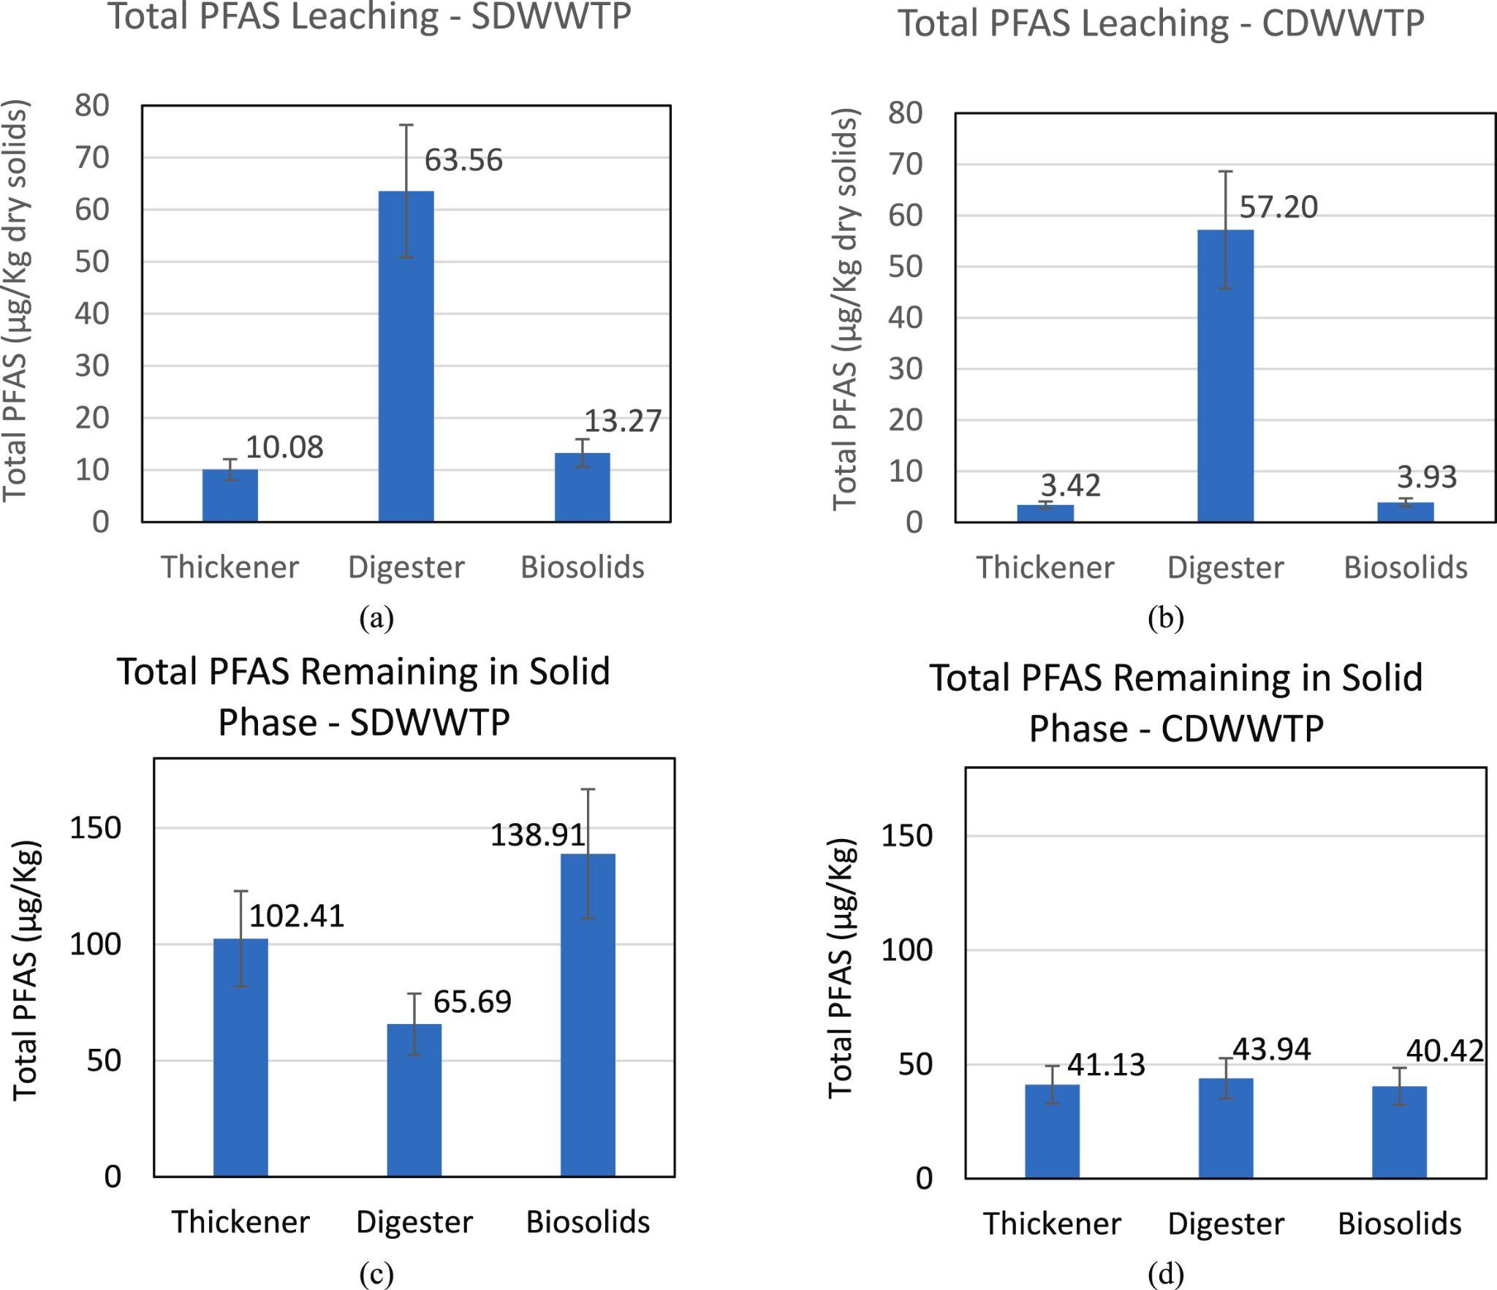
PFAS septage research results - FL
Notes:
Data showing the total amount of PFAS present in leachate vs solids from different types of treatment. Left being the Southern district plant and right being the central district plant. Significant difference in PFAS present to start with can be attributed to the southern district wastewater treatment plant getting runoff leachate from a nearby landfill.
https://www.sciencedirect.com/science/article/pii/S0301479724023818?casa_token=sIhbjONINAQAAAAA:4qNbpG7C-ZKTAXJ-klYd_ZJsXKldzKqRXQbzSK6WqYYdDTRm6qya50G57_eXquQUUYj953yE430

Slide 45
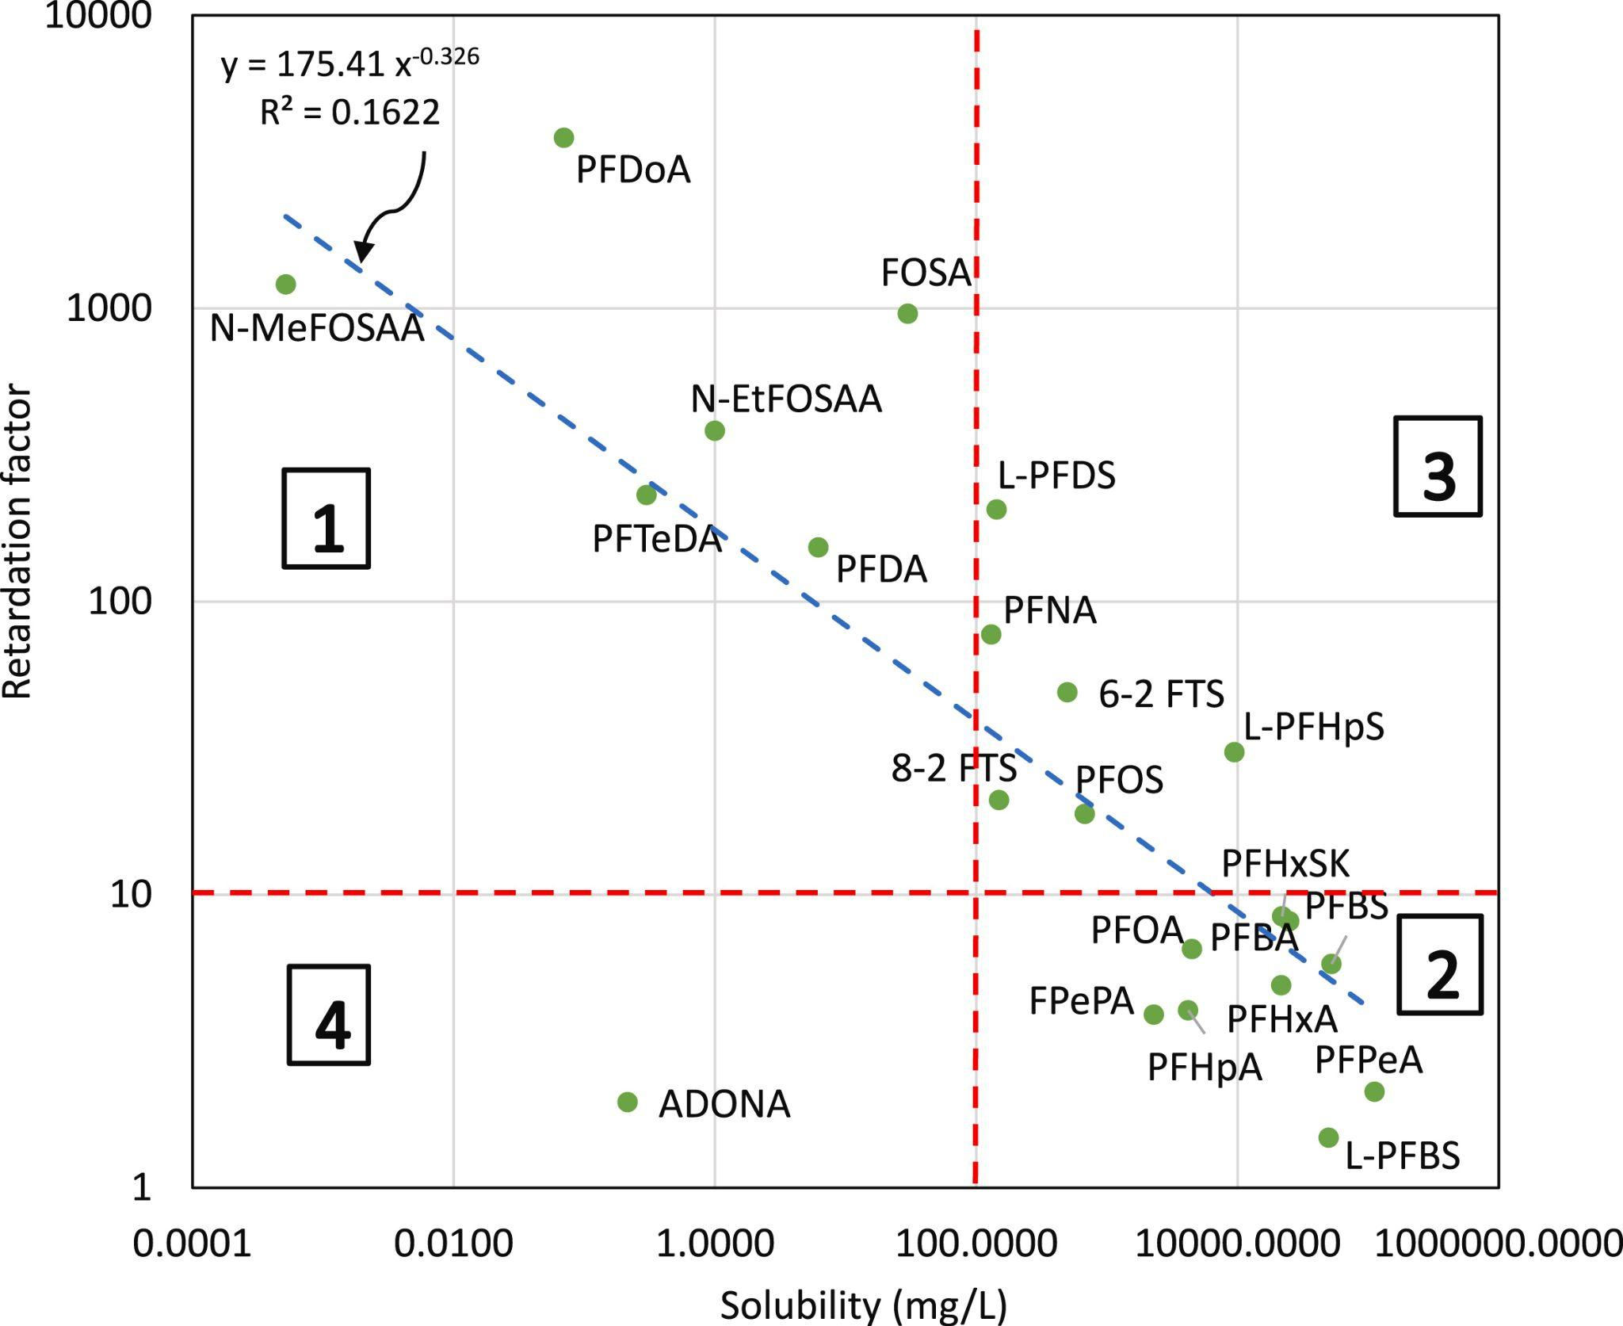
PFAS septage research results - FL
3 - High solubility and high affinity = re-aborb in soil
1– high solubility and high affinity = accumulate in soil
Solubility
Affinity
to soil
4 – low solubility and low affinity = accumulate in soil
2- High solubility and low affinity = mobilized through soil
Notes:
A graph showing all the different types of PFAS and splitting them into four categories based on solubility and affinity for soil organic matter. The PFAS shown in area (1) have low solubilities and high affinity for the soil, indicating that they are likely to accumulate in soil over time where biosolids are applied. The PFAS shown in area (2) have high solubilities and low affinity for the soil, suggesting that they can easily dissolve in water and be mobilized as the water flows through the soil. The PFAS shown in area (3) have high solubilities but also high soil affinity; therefore, they are likely to dissolve but reabsorbed by soil. They would be slowly moving through the soil due to their high affinity for soil organic matter. In the area (4), only one PFAS compound is present, corresponding to low solubility and low soil affinity. This indicates that PFAS in this area would accumulate in soil due to their low ability for movement.
https://www.sciencedirect.com/science/article/pii/S0301479724023818?casa_token=sIhbjONINAQAAAAA:4qNbpG7C-ZKTAXJ-klYd_ZJsXKldzKqRXQbzSK6WqYYdDTRm6qya50G57_eXquQUUYj953yE430

Slide 46
How do we remove it?
Stop it at the source
Removal/separation can capture PFAS for later destruction:
  Activated carbon
  Ion exchange
  Reverse osmosis/nanofiltration
Treatment: oxidation, photocatalysis, incineration, and bioremediation that break the strong carbon-fluorine bond

Slide 47
What work still needs to be done?
New products without PFAS
Research on biosolids and PFAS
Research on drinking water filtration for PFAS
  Reverse osmosis
  Ion exchange resins
  Charcoal
Research on PFAS in water from non-potable sources and soils
Deeper understanding of transport of PFAS in OWTS
Research on PFAS filtration from effluent to prevent leaching
Notes:
All of this research is very new and upcoming so there is still a lot that needs to be discovered and looked into. Many research results leave questions to be answered. These include more focus on biosolids and PFAS, filtration of PFAS from drinking water using reverse osmosis, ion exchange resins, or charcoal, PFAS in water from non-potable sources and soils, filtration of PFAS from septic effluent to prevent leaching, and more information on the transport of PFAS in onsite wastewater treatment systems.
Additionally once more information is gathered on these topics, regulation can be added to reduce PFAS contamination from onsite wastewater treatment systems.

Slide 48
Sources
(1)
San Román, A.; Abilleira, E.; González-Gaya, B.; Ayala-Cabrera, J. F.; Barroeta, Z.; Etxebarria, N.; Irizar, A. Tracking Early-Life PFAS Exposure in Children at Ages 4, 8, and 14 Years: A Longitudinal Study from the INMA Spanish Birth Cohort. Environmental Research 2025, 283, 122198. https://doi.org/10.1016/j.envres.2025.122198.
(2)
Habib, Z.; Song, M.; Ikram, S.; Zahra, Z. Overview of Per- and Polyfluoroalkyl Substances (PFAS), Their Applications, Sources, and Potential Impacts on Human Health. Pollutants 2024, 4 (1), 136–152. https://doi.org/10.3390/pollutants4010009.
(3)
Ehsan, M. N.; Riza, M.; Pervez, Md. N.; Khyum, M. M. O.; Liang, Y.; Naddeo, V. Environmental and Health Impacts of PFAS: Sources, Distribution and Sustainable Management in North Carolina (USA). Science of The Total Environment 2023, 878, 163123. https://doi.org/10.1016/j.scitotenv.2023.163123.
(4)
Brunn, H.; Arnold, G.; Körner, W.; Rippen, G.; Steinhäuser, K. G.; Valentin, I. PFAS: Forever Chemicals—Persistent, Bioaccumulative and Mobile. Reviewing the Status and the Need for Their Phase out and Remediation of Contaminated Sites. Environmental Sciences Europe 2023, 35 (1). https://doi.org/10.1186/s12302-023-00721-8.

Slide 49
Sources
(5)
Silver, M.; William Lyon Phelps; Masarik, K. C.; Burke, K.; Zhang, C.; A. Truman Schwartz; Wang, M.; Nitka, A.; Schutz, J. S.; Trainor, T. P.; Washington, J. W.; Rheineck, B. D. Prevalence and Source Tracing of PFAS in Shallow Groundwater Used for Drinking Water in Wisconsin, USA. Environmental Science & Technology 2023. https://doi.org/10.1021/acs.est.3c02826.
(6)
Pradhan, S.; Withrow, L.; Mize, W. PFAS in Septic Systems and Private Wells: What’s Next? https://www.nowra.org/Customer-Content/www/CMS/files/24Mega_Pradhan_PFAS.pdf (accessed 2025-12-29).
(7)
Medina, X. P.; Parzen, H.; et, al. Per-and Polyfluoroalkyl Substances (PFAS) Free Laboratory Analyses Program for Public Water Suppliers and Private Wells Final Report of the MassDEP-Drinking Water Program and UMass Amherst-Lowell; 2023.

Slide 50
Sources
(8)
Penrose, M.; Deighton, J.; Glassmeyer, S. T.; Brougham, A.; Bessler, S. M.; Mcknight, T.; Ateia, M. Elevated PFAS Precursors in Septage and Residential Pump Stations. Environmental Science & Technology Letters 2025, 12 (4), 454–460. https://doi.org/10.1021/acs.estlett.5c00246.
(9)
Raup, J.; Eberle, M.; Denly, E.; Glass, D.; Stefansky, J.; Dyber, J.; Scharf, B.; Saucier, S. A Conceptual Site Model for Per‐ and Polyfluoroalkyl Substance Water Supply Impacts in a Residential Community. Remediation Journal 2024, 35 (1). https://doi.org/10.1002/rem.70001.
(10)
Tansel, B.; Katsenovich, Y.; Natalia Soares Quinete; Ocheje, J.; Nasir, Z.; Maria Mendoza Manzano. PFAS in Biosolids: Accumulation Characteristics and Fate Profiles after Land Application. Journal of Environmental Management 2024, 370, 122395–122395. https://doi.org/10.1016/j.jenvman.2024.122395.

Slide 51
Thank you
Dr. Sara Heger
sfheger@gmail.com

