Slide 1


Options for Difficult Sites
Ben Kele: Managing Director of Arris Pty Ltd

Slide 2
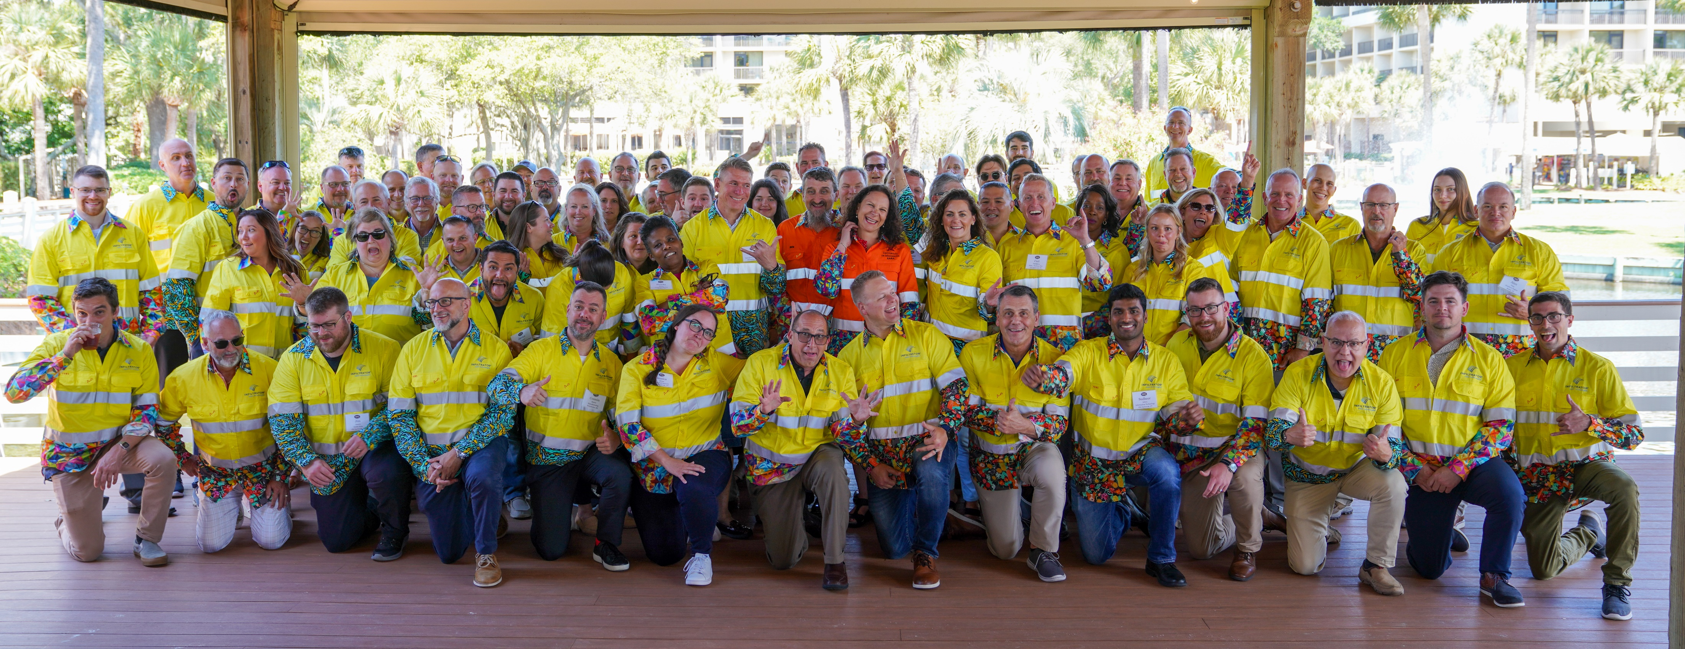
TradeMutt
Trademutt
Mental Health Initiative
Suicide prevention
https://trademutt.com/

Slide 3
Arris Pty Ltd
Work Australia wide & Internationally
Mixture of staff with academic and trade skills background
Design, build, operate & maintain water and wastewater treatment & recycling systems
We tend to work on difficult/unusual sites

Slide 4
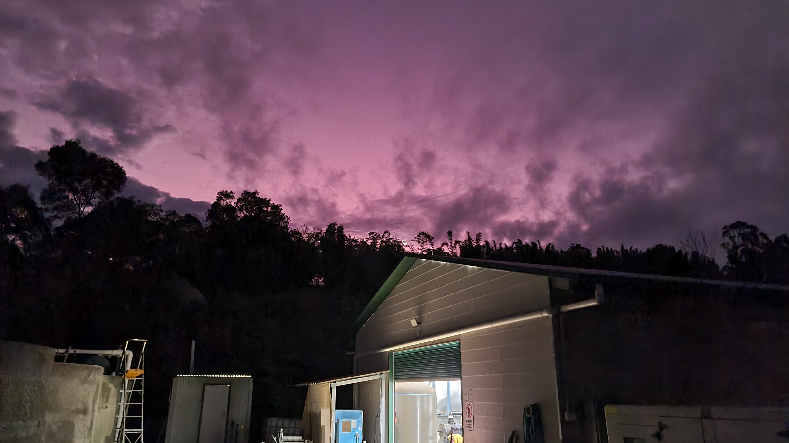
Technologies & Techniques
Not tied into any particular method of treating or reusing water
Aim for fit-for-purpose installations
We employ passive/low-input techniques all the way up to RO membranes, ozone disinfection, etc.
We do target robust & reliable treatment and reuse methods
Economic sustainability is just as important as environmental sustainability

Slide 5
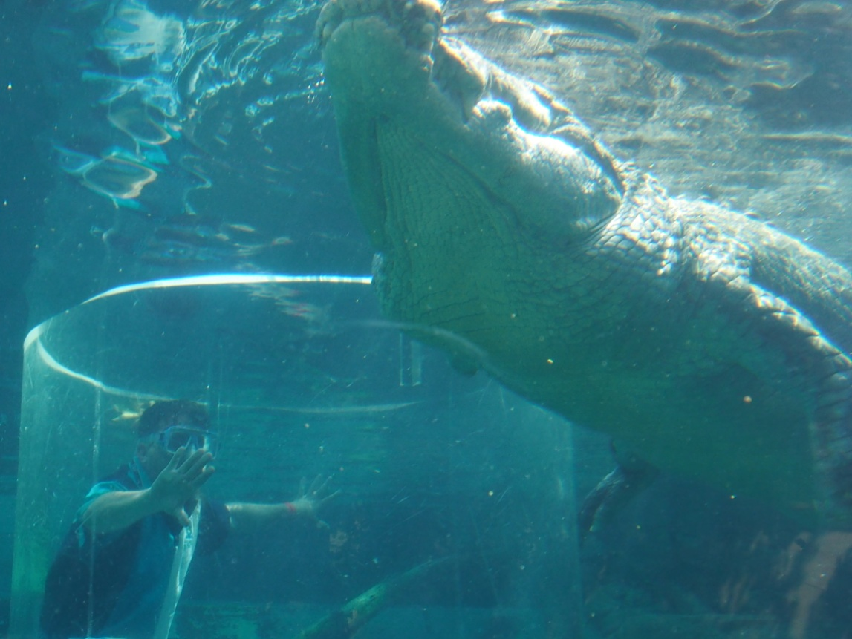
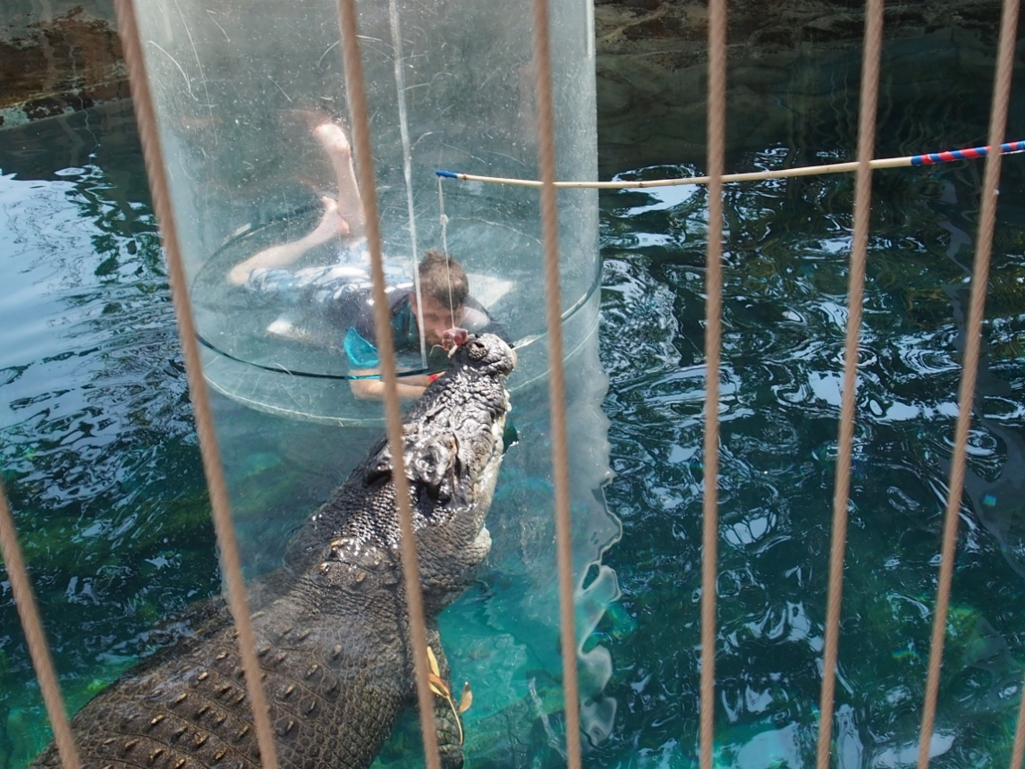
Some Sites are More “Australian” than Others

Slide 6
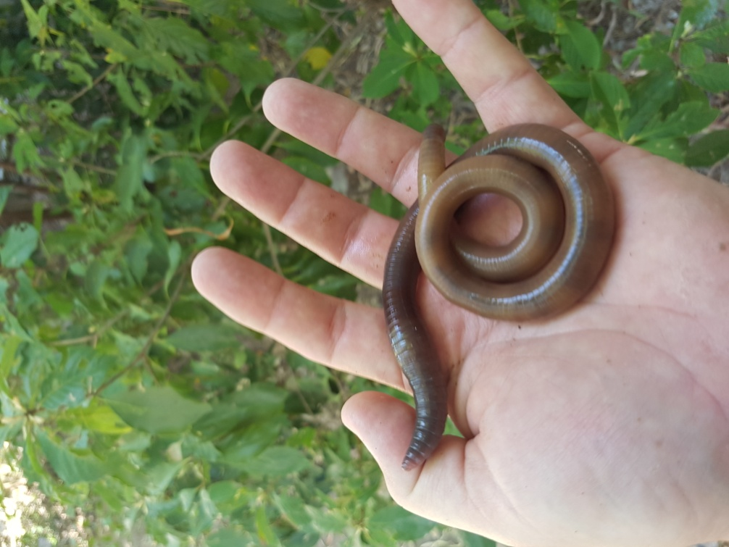
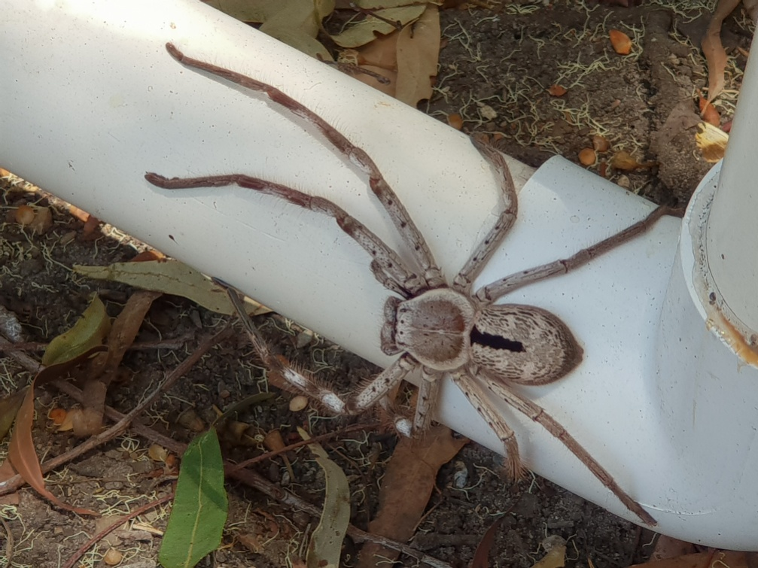
Interesting Wildlife at Sites

Slide 7
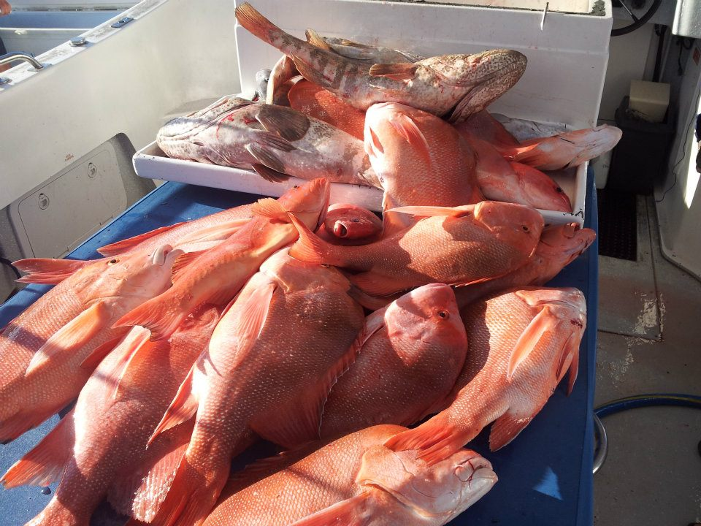
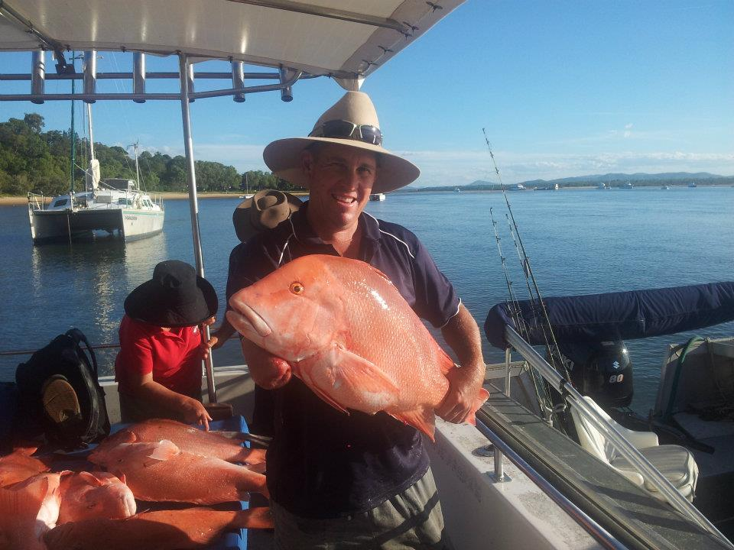
Very Good Fishing Spots

Slide 8



Pacific Islands in Australia
Water Treatment & Water Recycling is progressing
Australia is a dry continent; so water recycling is popular
Islands often the desire to improve water treatment and recycling is to protect the freshwater lens/aquifer under the island
This is often the main drinking water supply
Also a strong desire to minimise nutrient runoff to protect the waters surrounding the island
Especially in the area of the Great Barrier Reef
Looking to get the Whole Community Involved

Slide 9
Types of Passive & Low Input Systems
Anaerobic treatment
Compost systems
Vermiculture
Soil based treatment systems
Plant based treatment
Constructed wetlands
Sand filters
Mounds (Minnesota)
Woodchip filters
Media & Fabric filters
Dosing Siphons & Flouts
Venturi aeration
Flow past chemical blocks
Treatment chains can be used

Slide 10
Passive and Low Input Wastewater Systems
A passive wastewater system is a non-mechanical method of treatment
It typically needs no electricity to operate
A low input wastewater system has minimal mechanical processes
Frequently it just involves the pumps required to move water through the treatment system
Both passive and low impact systems typically mimic natural processes
Treatment systems, such as constructed wetlands, can be either passive or low input
It depends on the site

Slide 11
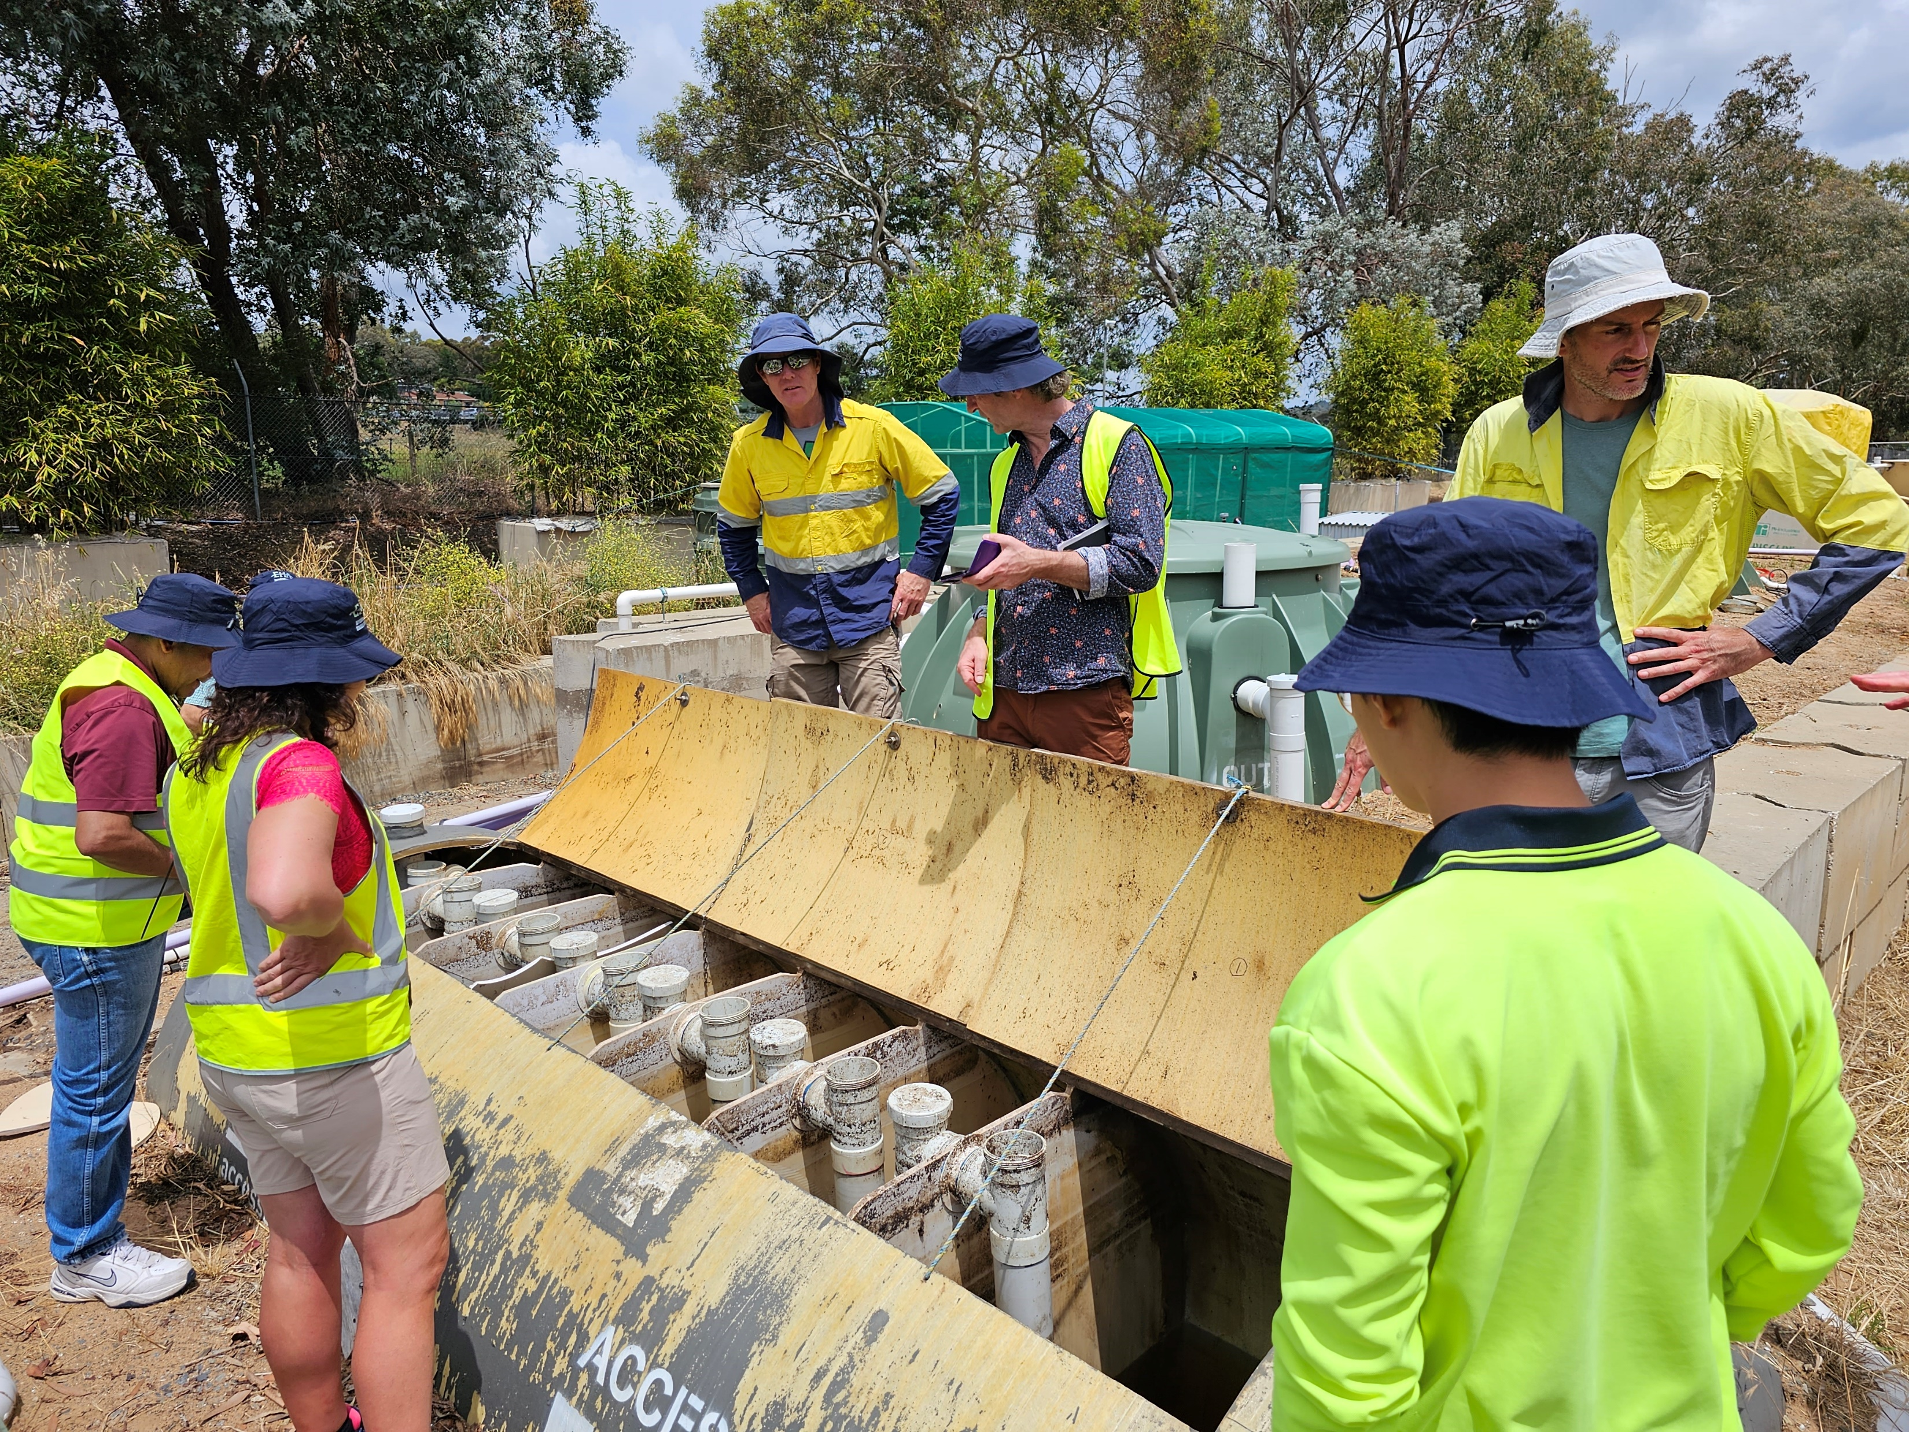
Who Uses Passive and Low Input Systems?
Used around the world
Popularity has changed over time
There has been a view point that mechanical systems mean more advanced treatment
Assessment of the performance of mechanical systems has questioned that view point
Long term operational costs, both economic and greenhouse gas emissions, of mechanical treatment wastewater systems have also caused people to look for other options

Slide 12
Scalability
Used from the single household up to municipal sized
Required footprint for the larger volumes can be a limiting factor
Cost of acquiring the required land
Capital cost can also be a limiting factor
Buying enough sand media to filter a city is very expensive…
Some techniques such as constructed wetlands are much more scalable
Europe has been doing larger constructed wetlands and exporting their ideas around the world
Ecobird https://www.ecobird.fr/
UFZ: https://www.ufz.de/index.php?en=40551
In Australia constructed wetlands are also being used for larger projects
Wet Systems: https://wetsystems.com.au/
Water & Carbon Group: https://waterandcarbon.com.au/

Slide 13
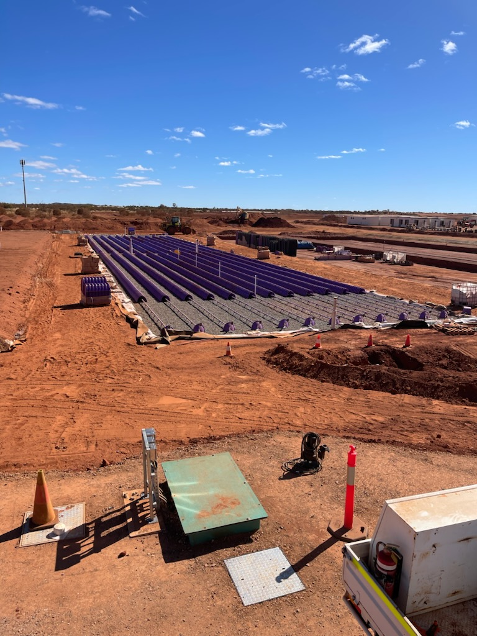
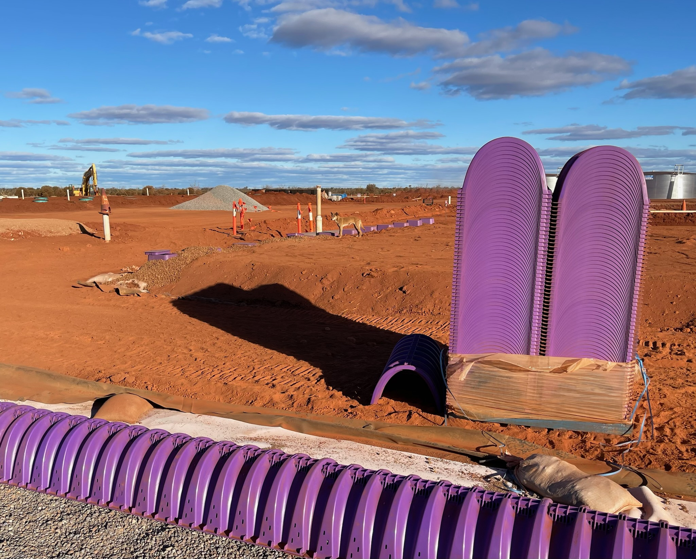
Low Input can be Large Scale

Slide 14
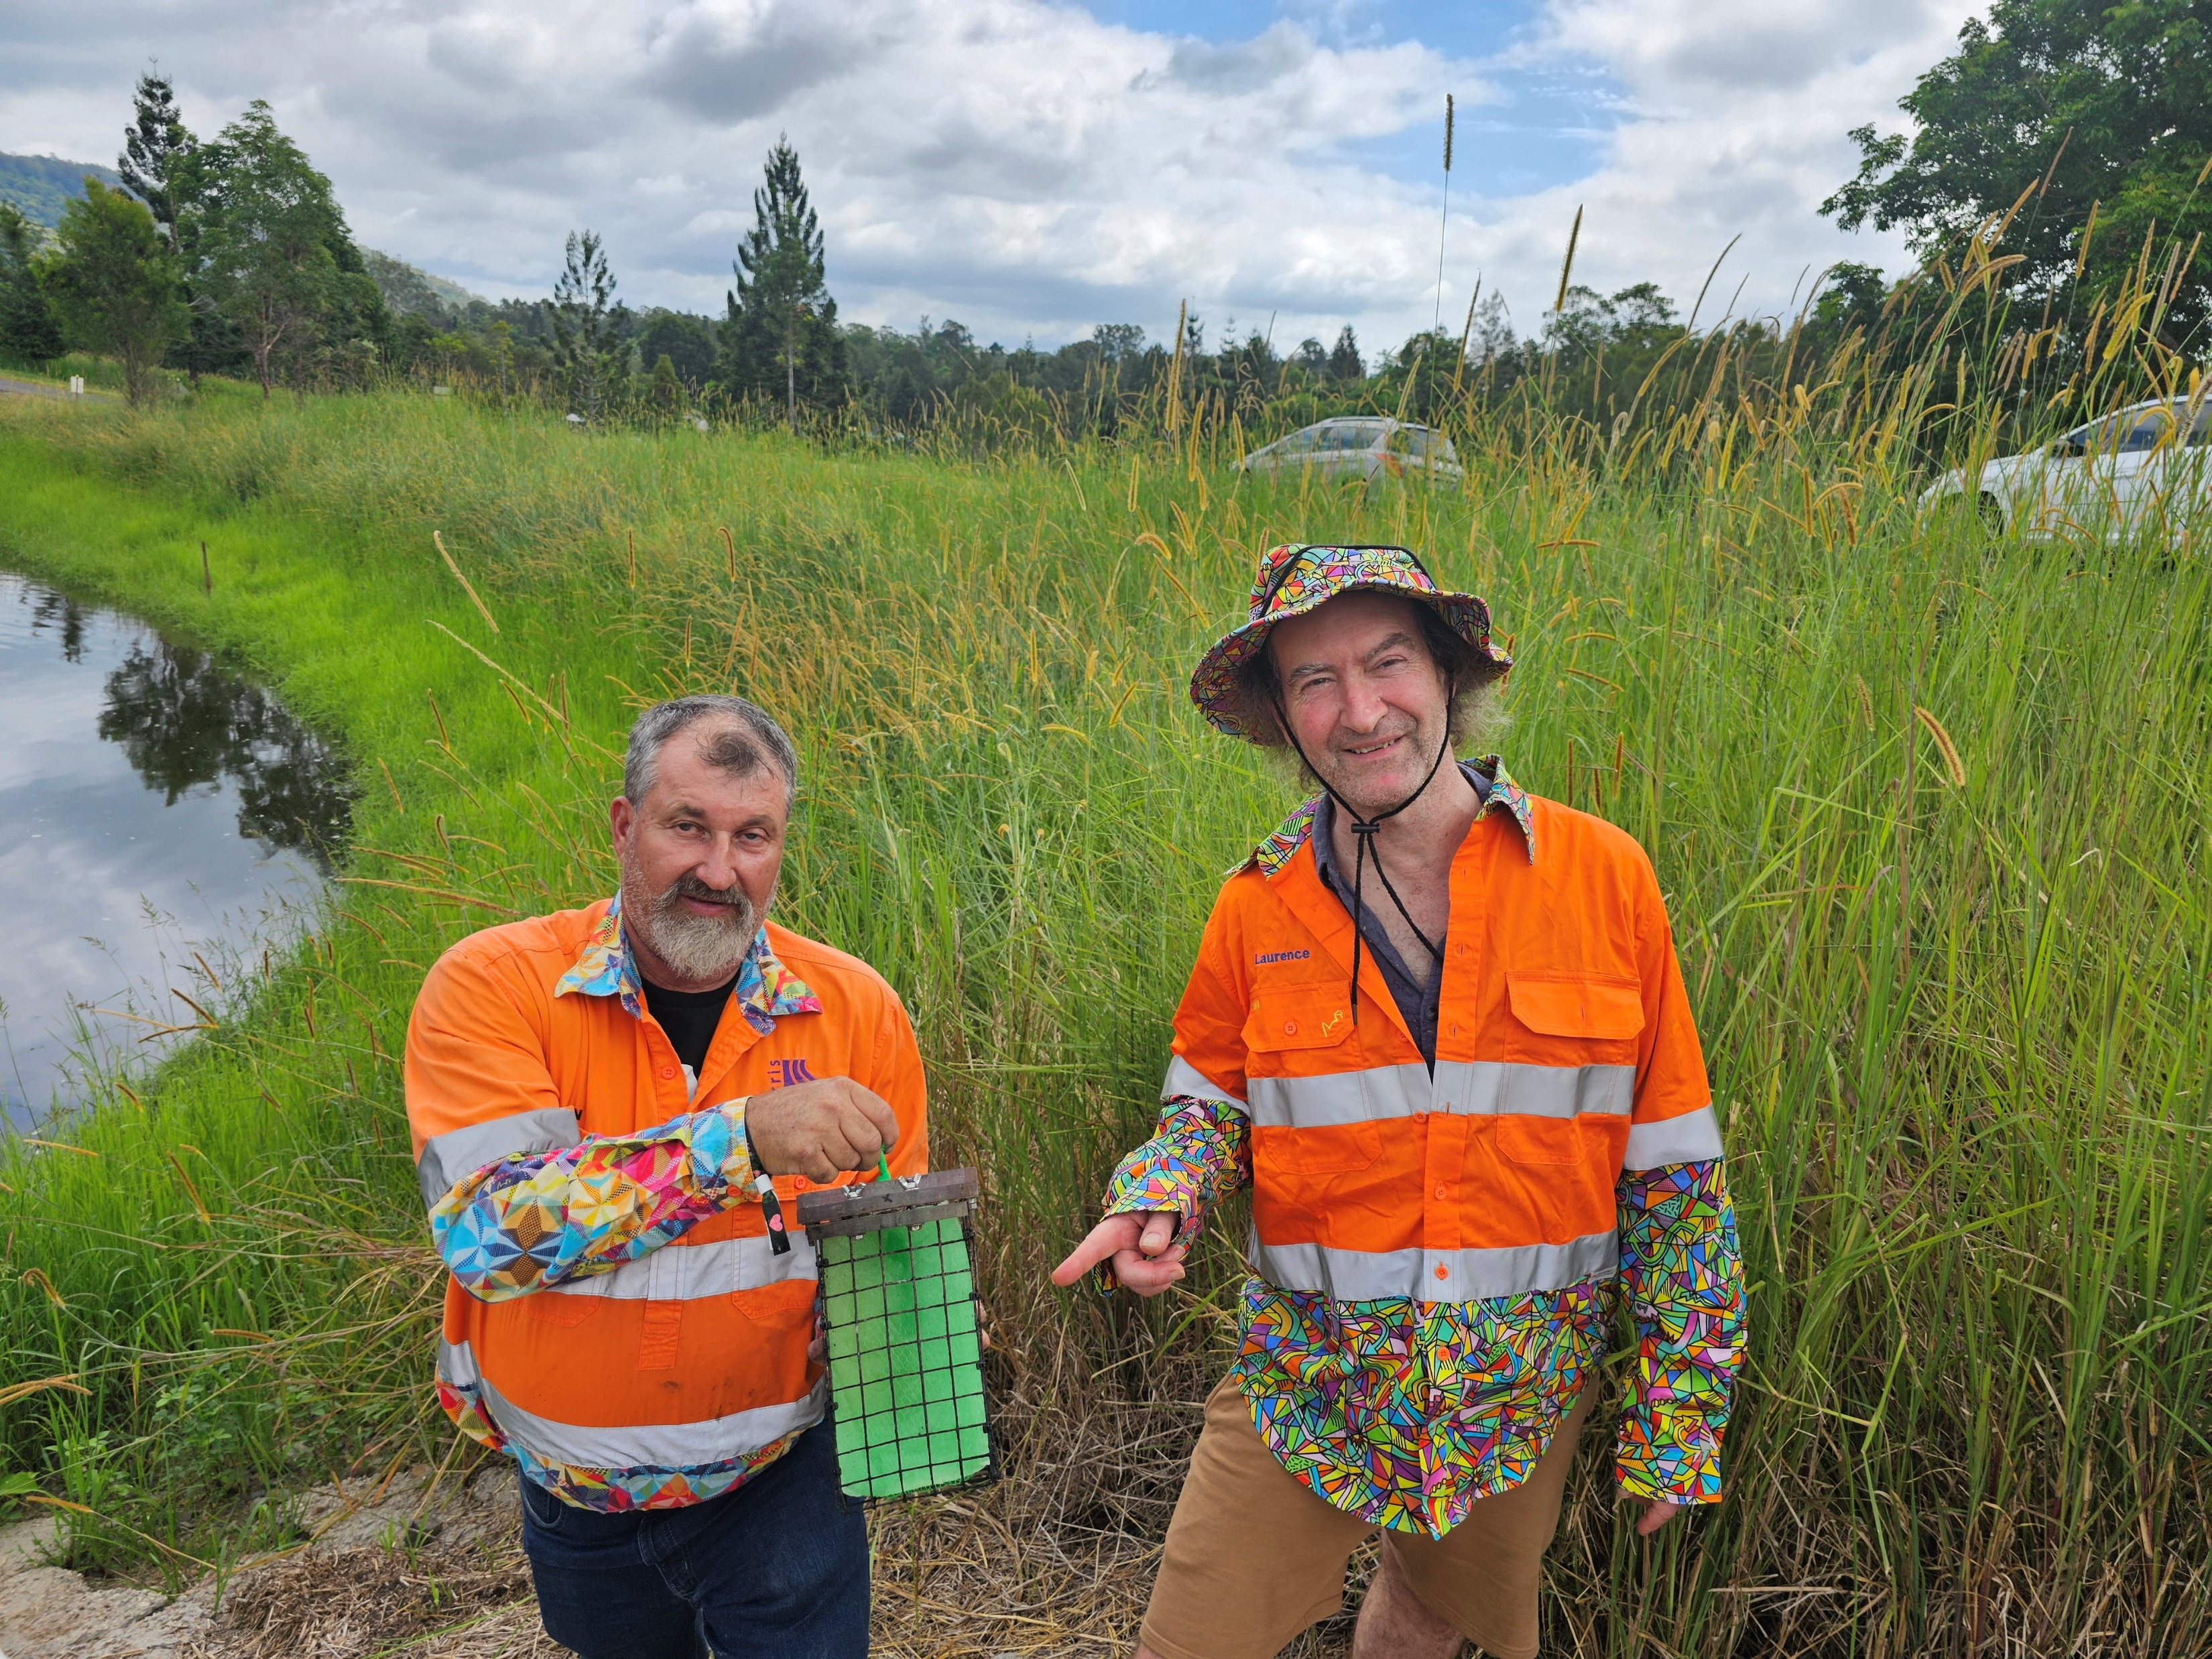
Gel Bloc Flocculants & Coagulants
Work at a wide range of pH’s
Cheapest form of Phosphorus removal I’ve encountered
Also reduces total suspended solids
Improves color
Initially designed for mining & stormwater but has wider applications
Easy to retrofit into a treatment chain

Slide 15
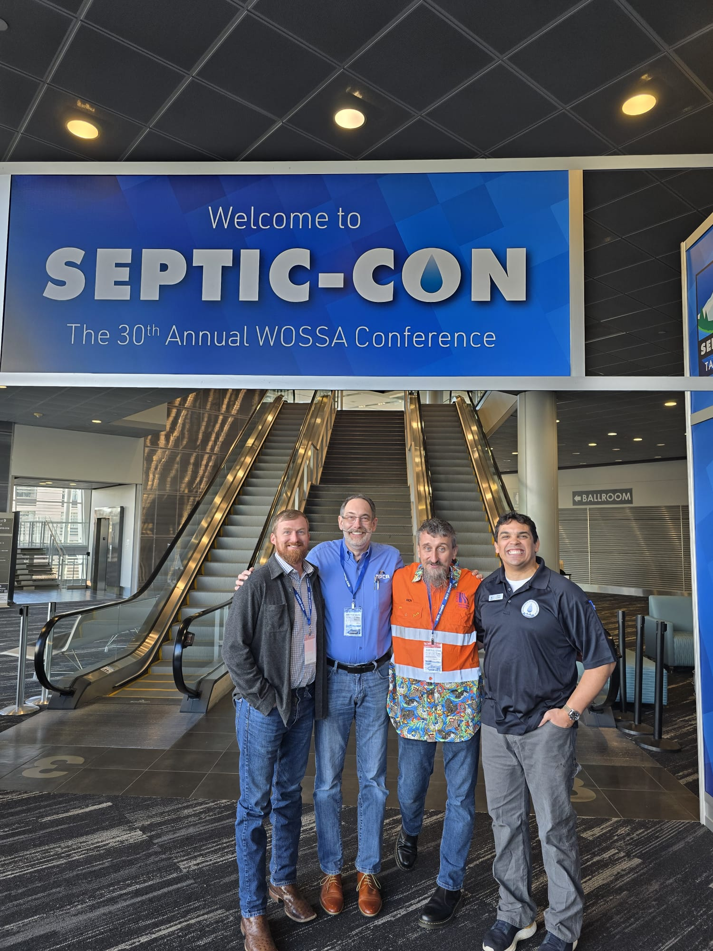
Fat, Oils & Grease
US Standards use lard mixture in a lab at a controlled temperature to test grease-traps, etc
Does not closely resemble what FOG is being encountered in the real world
National Precast Association is currently running a research program on this topic
Contact Ron Naumann
rnaumann@precast.org

Slide 16
Size Matters in Aeration
Early experiments with aeration mainly failed because of bubble size
Macro-bubble
Micro-bubble
Nano-bubble
All relates to the surface area of the air in the water

Slide 17
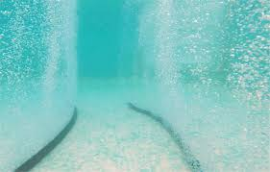
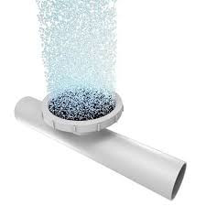
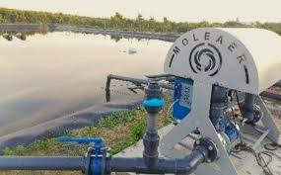
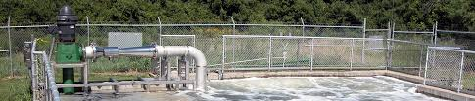
Bubble Size & Surface Area

Slide 18
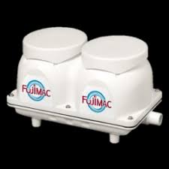
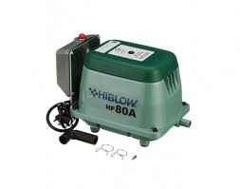
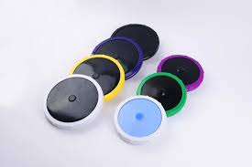
Aeration in On-site & Decentralized Wastewater
Mainly installed in ATU’s
Predominately Blowers with aeration discs
Can be bubble tubing
Tanks typically have an aeration chamber
Servicing the blowers is an important step in the maintenance of these systems

Slide 19
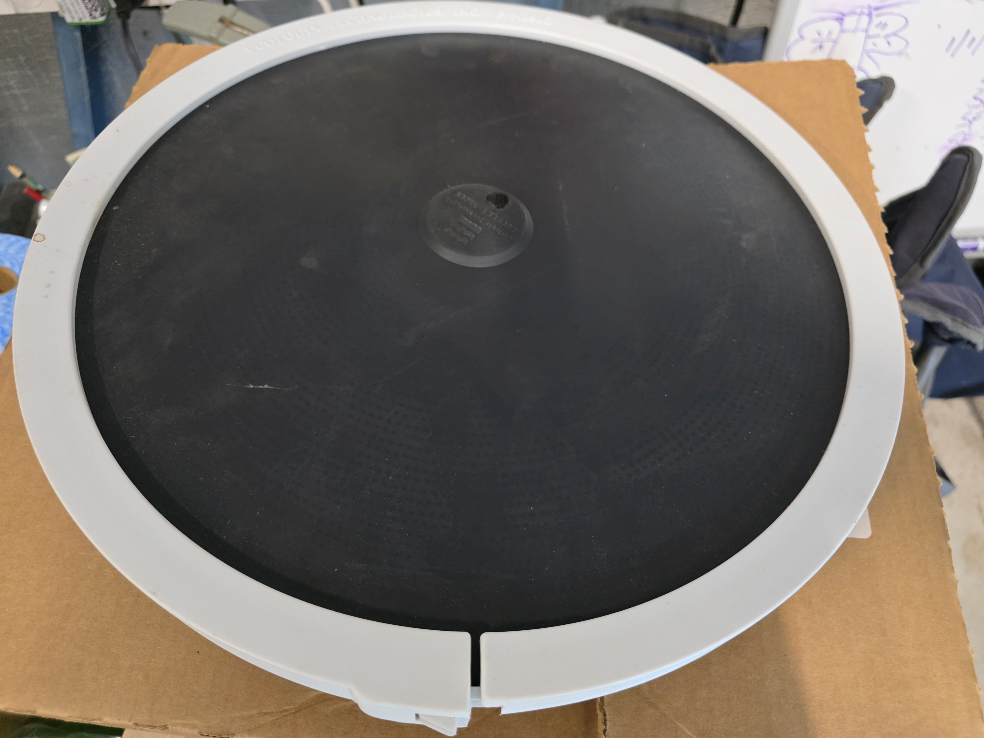
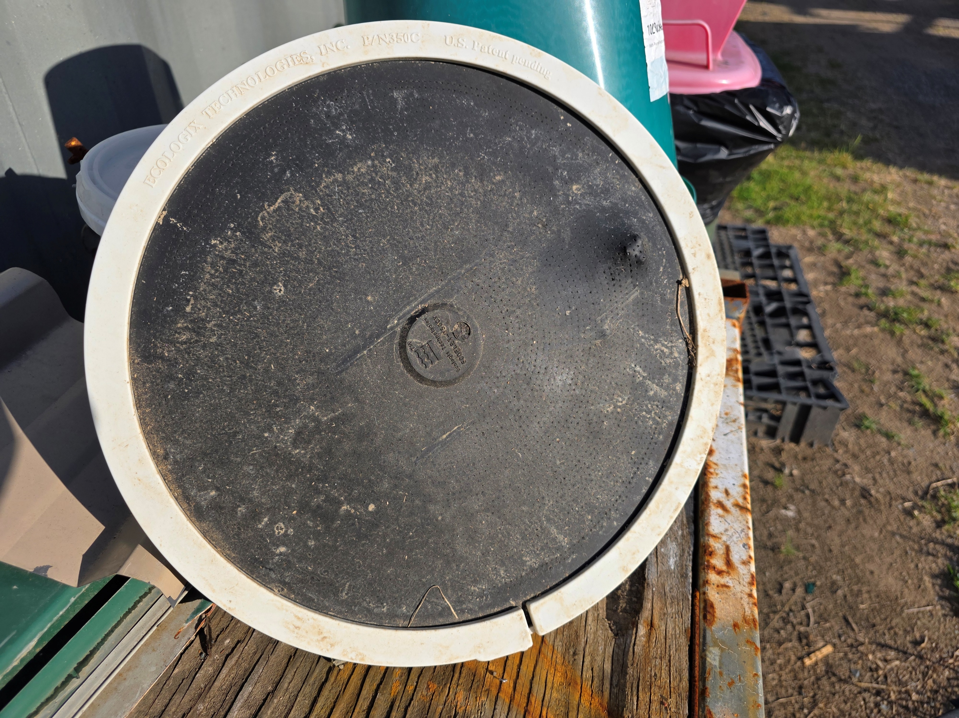
Aeration Discs

Slide 20
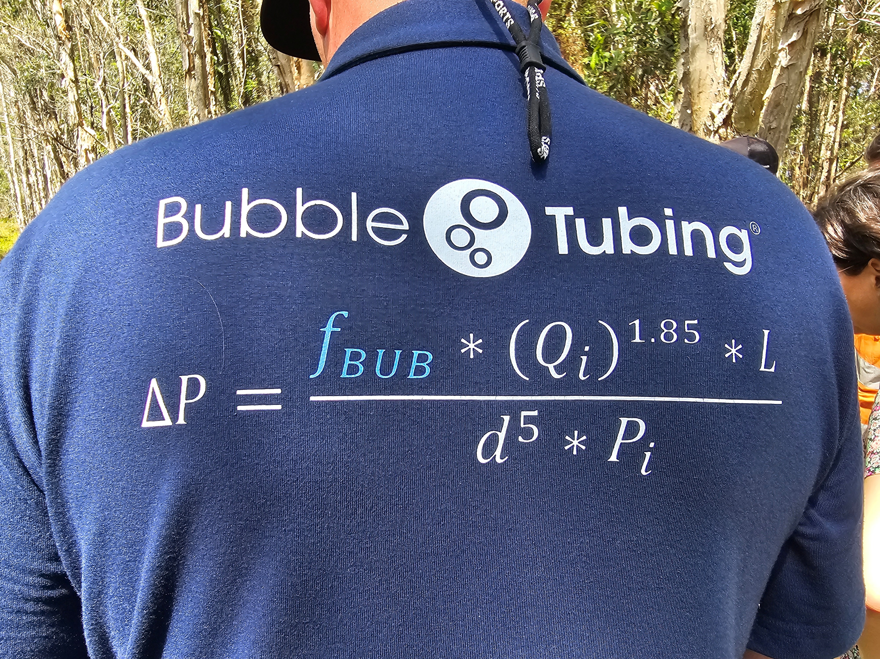

Slide 21
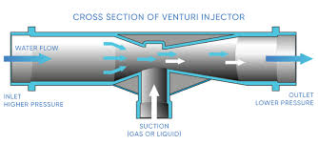
Low Energy Aeration
Venturi Injectors
Principle discovered in 1797
A venturi injector can be used to put micro-bubbles of air into a pumped water line
Aeration can be achieved without blowers/compressors; just using the power from the pump
Very good at keeping the soil in the dispersal field aerated
Very Good USA manufacturers

Slide 22
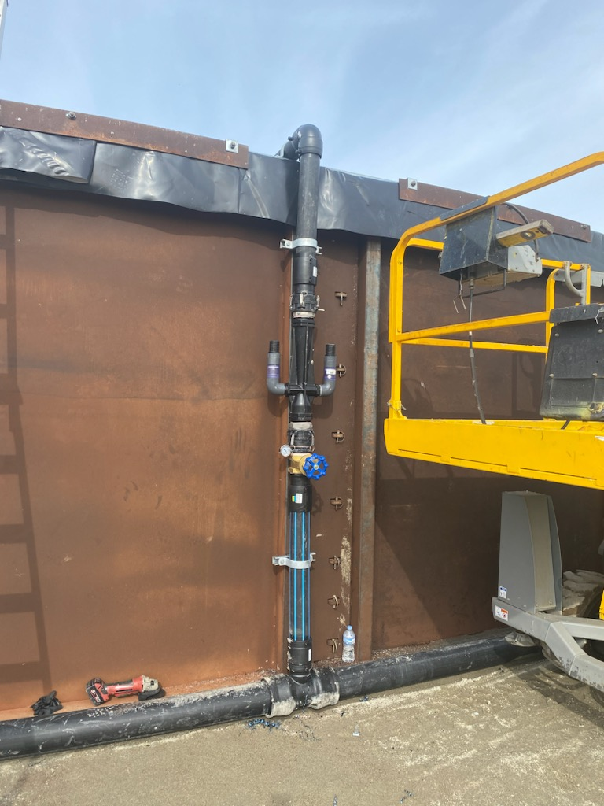
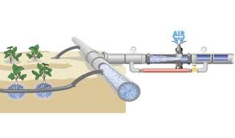
Venturi Aeration

Slide 23
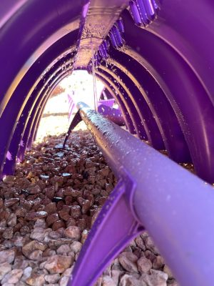
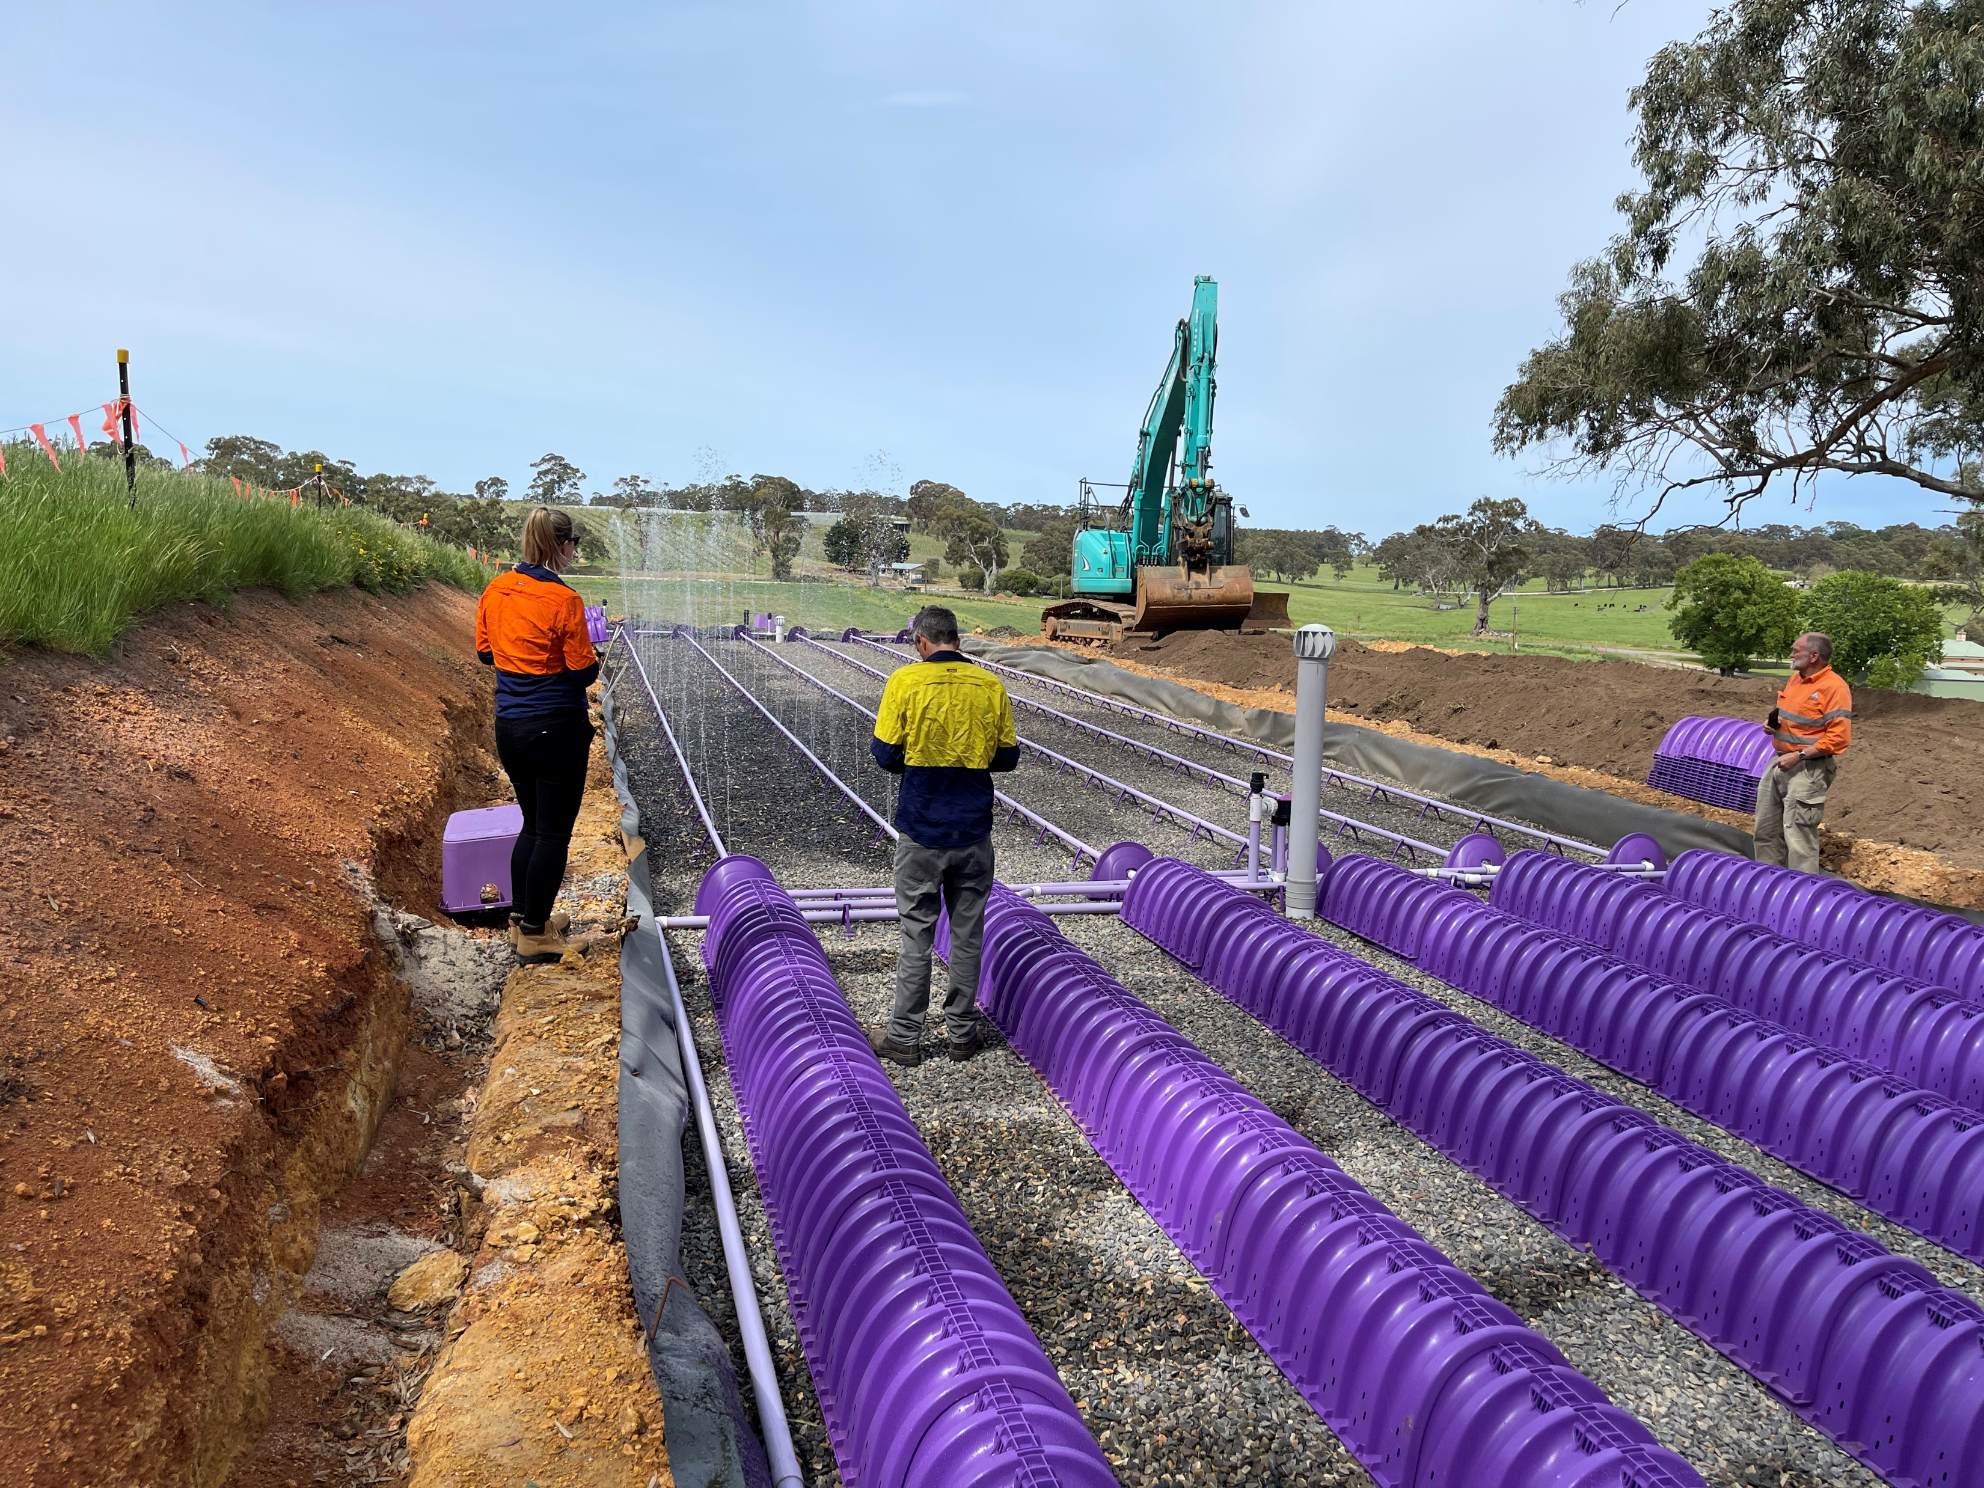
Aeration in Chambers

Slide 24
Rhizopod System
Contained Evapotranspiration Trench
Marketed as the Rhizopod System
Developed in Australia
1st installation in 1998
Tropical Australia
1st Installation in Temperate Australia 2002
Has a pre-treatment system
Majority are configured as ‘no-release’
Can also be designed to produce a polished recycled water

Slide 25
The Rhizopod System

Slide 26
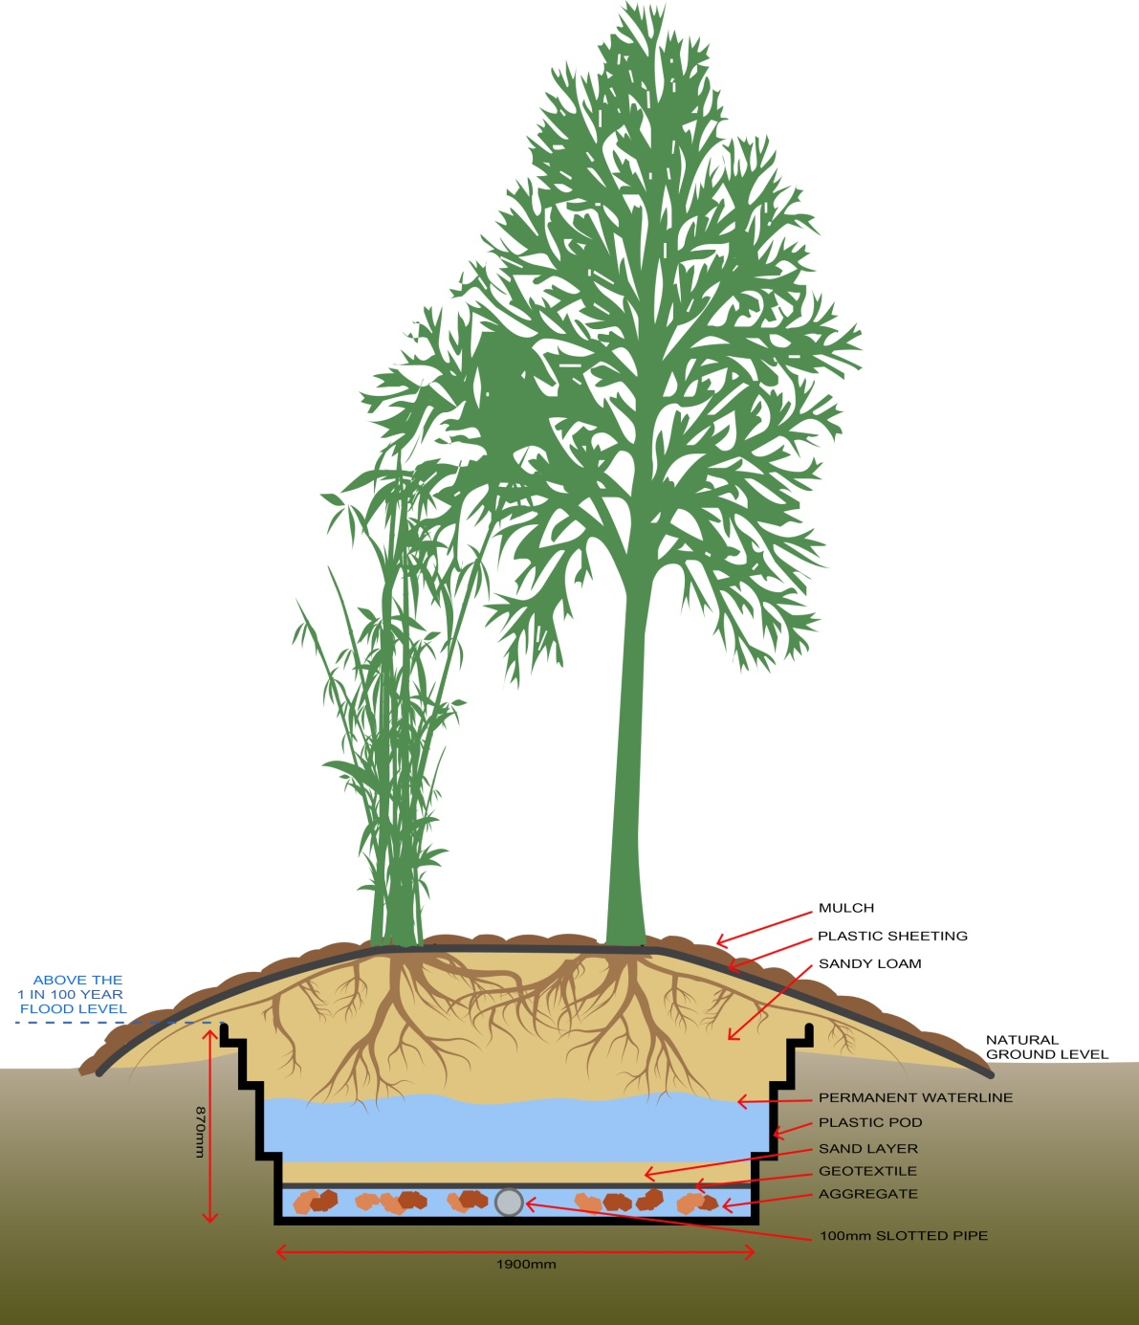
Rhizopod

Slide 27
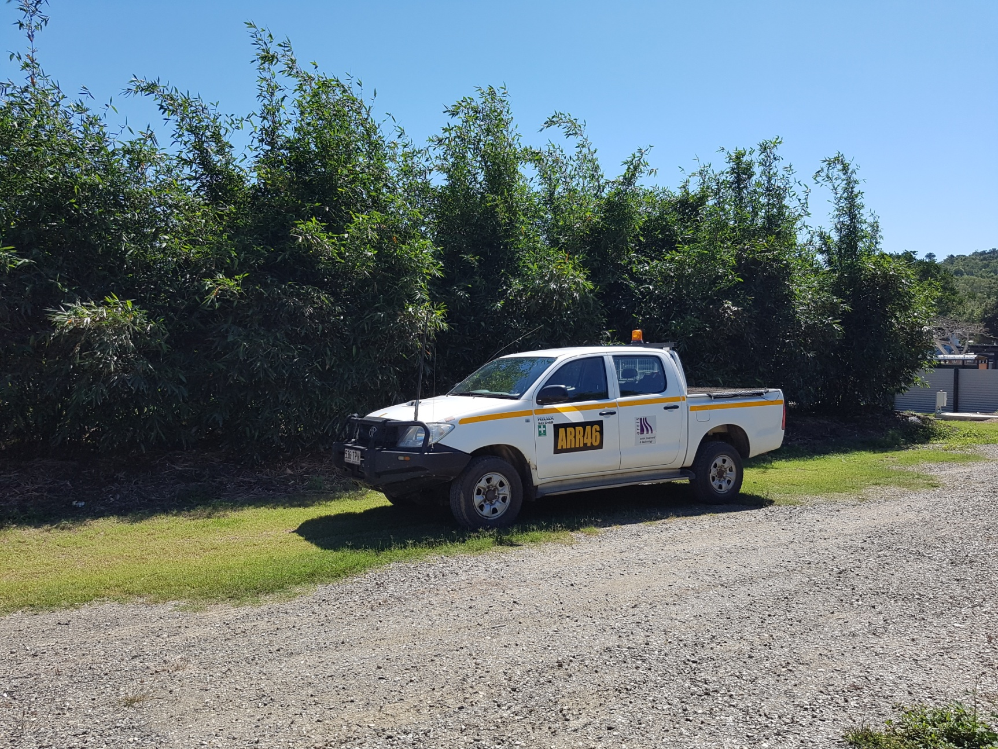
The Rhizopod System

Slide 28
No Such Magic Place as ‘Away’
In a no-release system some contaminants of concern will accumulate
Notably salinity
Sodium salts
Sodium Adsorption Ratio (SAR)
Some heavy metals
Variation in nitrogen & phosphorus
Management is required

Slide 29
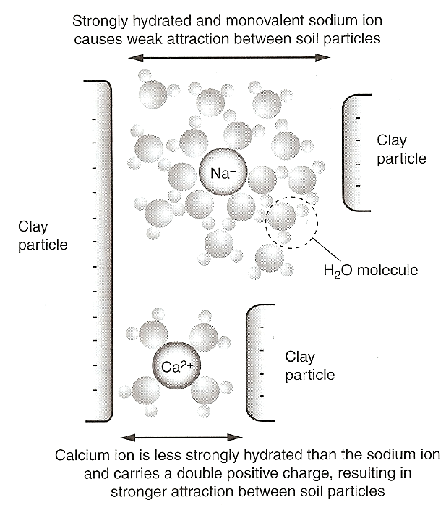
Sodicity
The effect of calcium and sodium ions on soil particles (Asano et al., 2007)

Slide 30
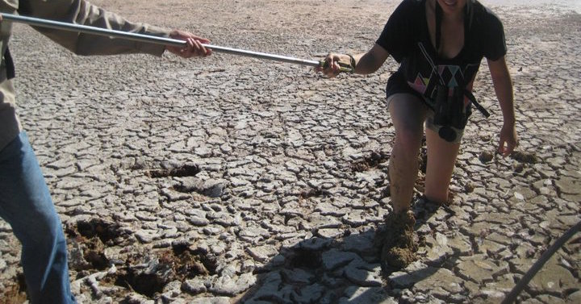

Sodium Adsorption Ratio (SAR)
The sodium absorption ratio (SAR) is the comparison of the relative preponderance of dissolved sodium (Na⁺) ions in water to the concentrations of dissolved calcium (Ca²⁺ ) and magnesium (Mg²⁺ )
The soil type in the proposed irrigation area is also very important.
Sodicity has the most impact on heavy clay soils and the least effect on sands

Slide 31
That’s Odd…
The last research site did not accumulate salinity in the same manner as the other 6 sites
The SAR also did not rise over time
Treating similar types of wastewater
The last research site had some ‘issues’ and one change was made to the design

Slide 32
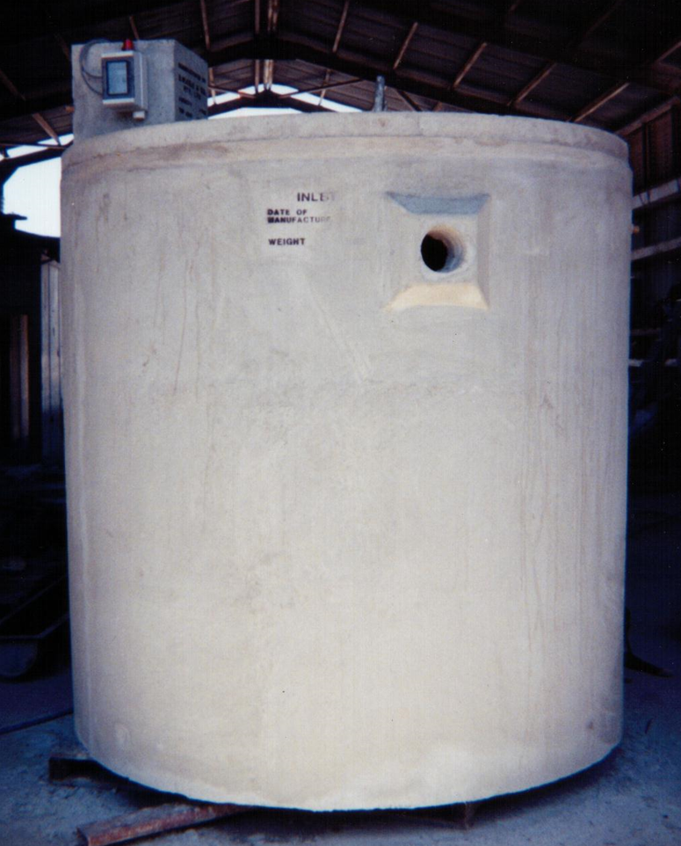
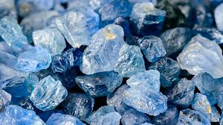
What was Different in the Construction?

Slide 33
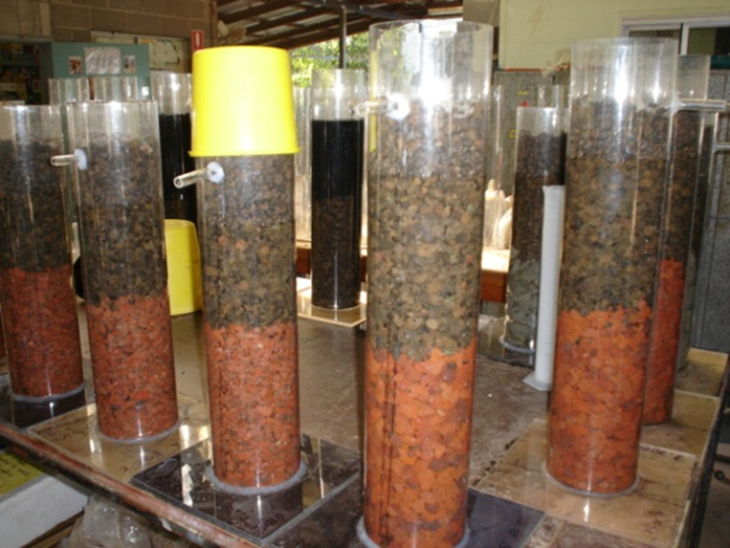
Volcanic Media
Ran a series of bench trials
Minimum of triplicate
Used different sources of real world high SAR water that had varying salinity
Trace chemicals
Did single media and dual media trials in different formats
Also tested some non-volcanic media
Looked at major cations, nitrogen and phosphorus, pH, & salinity

Slide 34
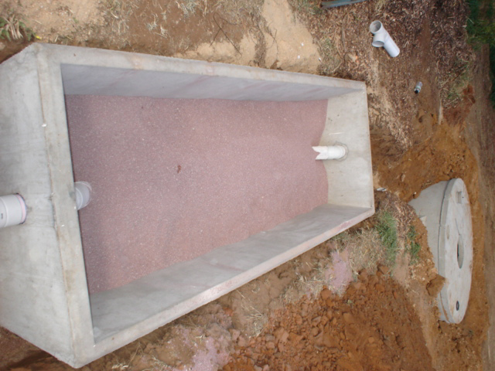
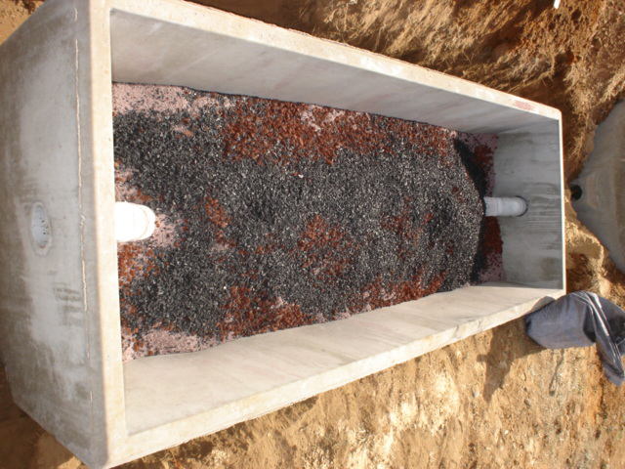
Mixed Ion Exchange and Adsorption Media

Slide 35
Mixed Media Results

Slide 36
Sample/Analysis | Na mg/L | K mg/L | Mg mg/L | Ca mg/L | SAR | NH₄ mg/L
Pump-well | 112.2 | 22.6 | 2.4 | 9.8 | 8.3 | 65.2
Zeolite Tank 1 | 61.3 | 1.1 | 9.9 | 22.3 | 2.7 | 4.9
Zeolite Tank 2 | 59.4 | 1.3 | 11 | 22.9 | 2.6 | 3.8
Pump-well | 120.8 | 22.3 | 2.1 | 8.6 | 9.6 | 69.9
Zeolite Tank 1 | 58.6 | 0.9 | 10.3 | 23.5 | 2.5 | 4.8
Zeolite Tank 2 | 66 | 1.3 | 11.1 | 22.1 | 2.9 | 4.2
Pump-well | 125 | 22.6 | 4.1 | 7.7 | 9.1 | 87.6
Zeolite Tank 1 | 57.6 | 0.9 | 9.8 | 22.6 | 2.5 | 4.9
Zeolite Tank 2 | 63 | 0.9 | 8.4 | 23 | 2.9 | 4.4
Pump-well | 110.4 | 21.9 | 5.5 | 11.3 | 6.7 | 92.6
Zeolite Tank 1 | 61.1 | 1.1 | 9.8 | 22.9 | 2.7 | 4.5
Zeolite Tank 2 | 62.3 | 0.9 | 9 | 21.6 | 2.8 | 4
Pump-well | 119.2 | 21.8 | 4.8 | 8.9 | 8.0 | 74.2
Zeolite Tank 1 | 64.2 | 1.1 | 10.2 | 22.3 | 2.8 | 4.6
Zeolite Tank 2 | 59.8 | 0.8 | 10 | 22.3 | 2.6 | 4.2

Slide 37
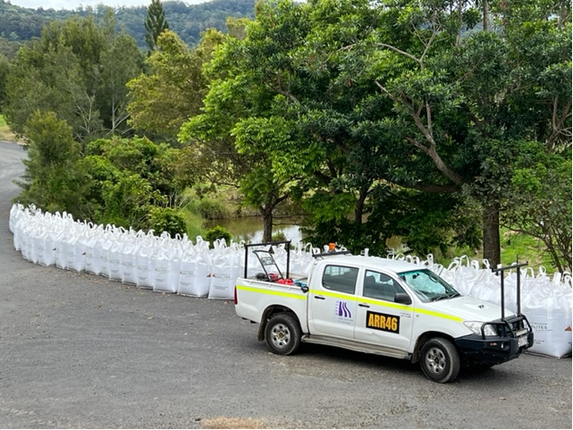
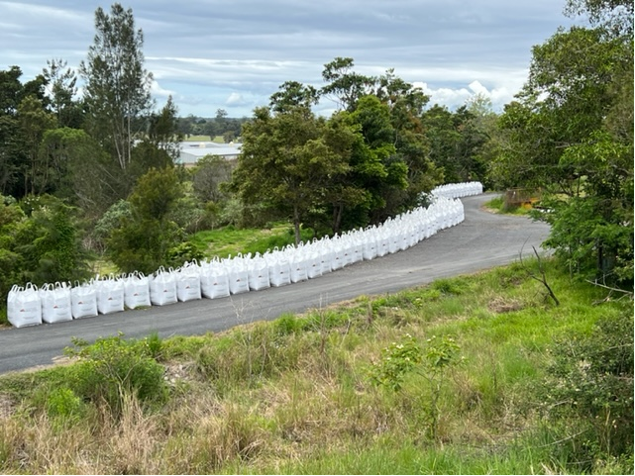
Media May Be Required in Bulk

Slide 38
Volume and Time Comparison 2017/2018

Slide 39
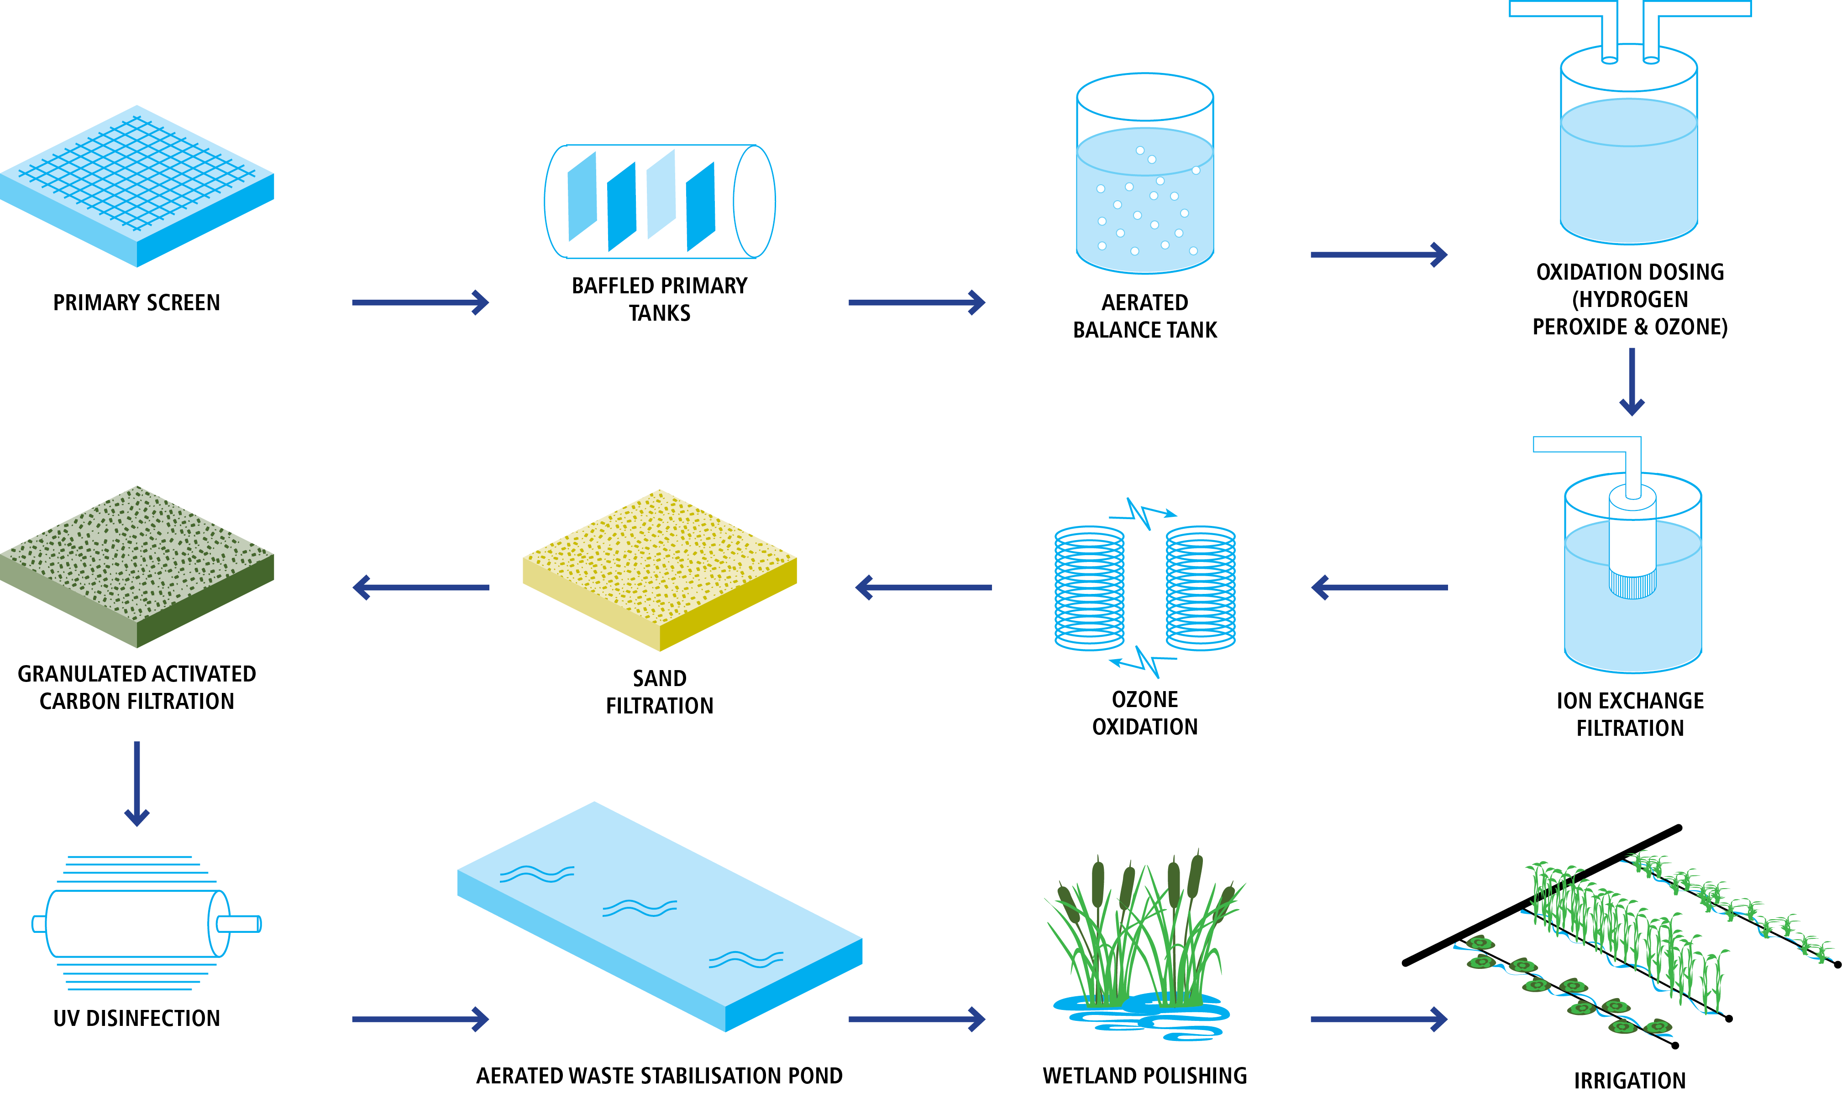
Treatment Chain

Slide 40
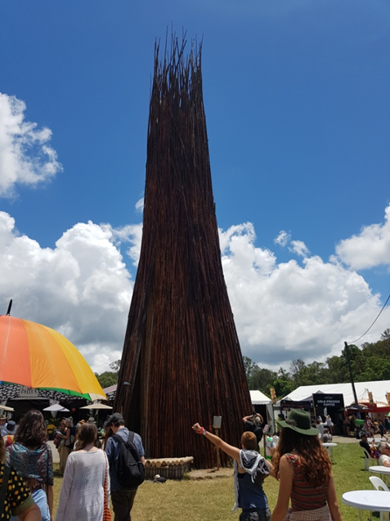
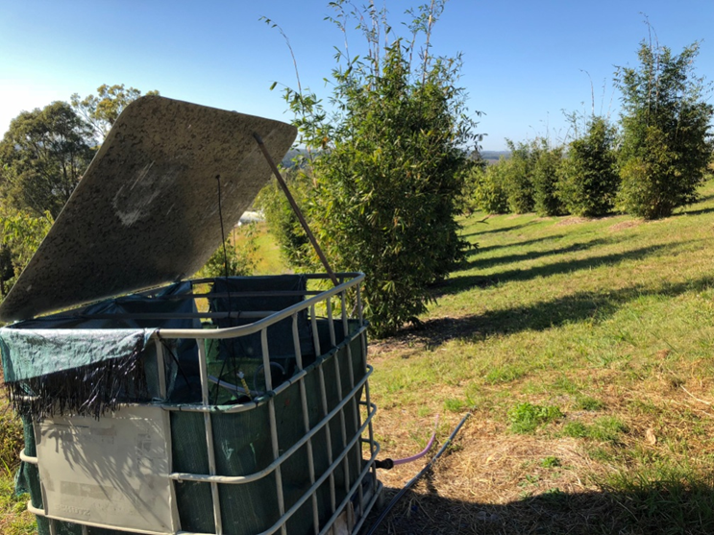
Bamboo Plantation

Slide 41
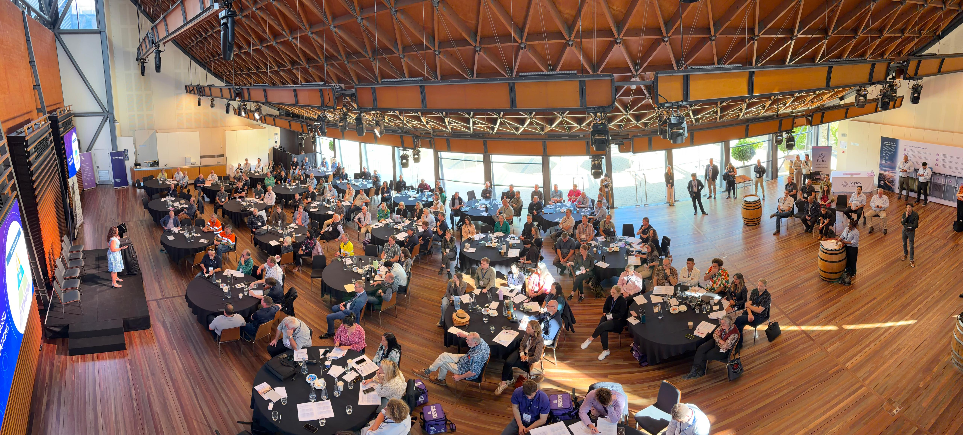

Slide 42
Conclusion
Variability in inflow wastewater chemistry, biology, and generation patterns means that treatment systems need to be carefully designed
A ‘one-size fits all’ approach is a common source of failure
Upsizing systems designed to treat domestic wastewater may not be fit-for-purpose
Specialized treatment chains may need to be designed
This does not mean that complex technological solutions are always the answer
A proper design process will detail the:
Inflow wastewater chemistry & biology
Wastewater generation pattern
Availability of suitable operational and maintenance

