Slide 1
NOWRA Update for CPOW
January 29, 2026
Tom Groves, Executive Director
Chris LeClair, President

Slide 2


The largest U.S. organization devoted exclusively to supporting members of the onsite and decentralized wastewater industry.
Established in 1991 in the state of Florida
501(c)(6) Not for Profit Trade Organization
More than 5,500 individual members
26 Affiliated Organizations representing 30 states
Represent all segments of the onsite industry
Contractors
Service Providers
Designers & Engineers
Regulators
Academics
Manufacturers
Who is NOWRA?

Slide 3
MISSION - Advancing sustainable decentralized wastewater infrastructure through advocacy and professional development, to protect public and environmental health
VISION - Leading the shift towards decentralized wastewater solutions, for a sustainable and resilient water future.
NOWRA at a Glance

Slide 4
NOWRA Organization Chart
Executive
Committee
Lobbying
Board of
Governors
Board of Directors
Tom Groves, Executive Director
Tricia Scott, Operations Specialist
Paula Smith, Administrative
Executive
Director & Staff
State
Affiliates
Corporate
Members
Committees
Task Forces
Partners
Notes:
The largest U.S. organization devoted exclusively to supporting members of the onsite and decentralized industry
Founded 1991 - Represent all segments of industry – with over 5,000 members (check)
Contractors
Service Providers/Pumpers
Designers & Engineers
Regulators
Academics
Manufacturers
AzOWRA (Arizona)
COWA (Callifornia)
COWRA (Carolinas)
CPOW (Colorado)
DOWRA (Delaware)
FOWA (Florida)
IOWWA (Iowa)
IOWPA (Indiana)
KSFA (Kansas)
MAOWP
(Mass)
MOWPA (Maryland)
MOWRA (Michigan)
MnOWA (Minnesota)
MSO (Missouri)
NOWWA (Nebraska)
NmOWA (New Mexico)
OWAI (Idaho)
POWRA-NM & NMOWA (New Mexico)
POWRA (Pennsylvania)
TOWA (Tenn)
UOWA (Utah)
VOWRA (Virginia)
WOSSA (Washington)
WOWRA & WPCA (Wisconsin)

Slide 5

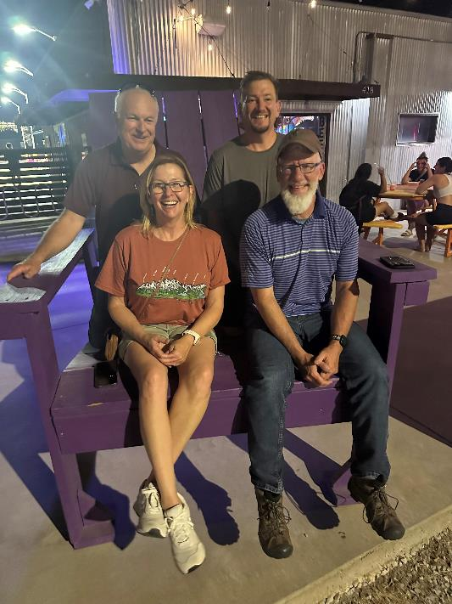
Current Executive Committee Dec 2025 – Nov 2026
Current Executive Committee Dec 2025 – Nov 2026
Role | Member
President | Chris LeClair (MN)
Vice President | Dwayne Jones (MD)
Secretary/Treasurer | Jim King (CT)
Past President | Allison Blodig (KS)
Executive Director | Tom Groves (MA)
NOWRA will be looking for the next Vice-President in 2026 to take position December 1, 2026.
Notes:
5

Slide 6
2025/26 Board of Directors
Category | Board Member
Academic | Gary Hawkins (GA) – reelected
 | Anish Jantrania (TX)
Engineer/Designer | Kate Carney (CO)
 | Kwame Agyare (CA) – reelected
Installer | Brian Koski (MN)
 | Brian Wakefield (TX) - elected
Service Provider | Chris Chapman (M0)
 | Zak Sherman (OH) - elected
Regulator | Nicholas Huber (OK)
 | Michael Broussard (NM)
Manufacturer | Claude Goguen (IN)
 | Ashley Donnelly (CT)

Slide 7
Current Committees
Committee/Task Force | Chair | Vice Chair
Conference | Kate Carney | Tom Groves/GOWA rep.
Corporate Members | Ed Schloss | Brenda Faz
Education | Gary Hawkins | Andrew Lazur
Emerging Professionals | Jonathan Kaiser | Jilian Maxcy-Brown
Government Relations | Carl Thompson | Roxanne Groover
Marketing | Donna Fiorentino
Online Training | Sara Heger
Onsite Journal | Anish Jantrania (editor) | N/A
State Leaders | Jessi Wood | Tammy Trantham
Technical Practices | Chris Strycharz | (co) Mike Vernon

Slide 8
Run for the NOWRA Board next year!
Join a Committee!
Chair a Committee!
Get Involved!
Make a Difference!
Make Lifelong Friends!
Contact Vice-President Dwayne Jones:
jones.nowra@gmail.com
https://www.nowra.org/about/governance/committees-and-task-forces
Help Us Move the Industry Forward!

Slide 9
NOWRA Organization Chart
Executive
Committee
Lobbying
Board of
Governors
Board of Directors
Executive
Director & Staff
State
Affiliates
Corporate
Members
Committees
Task Forces
Partners
Notes:
The largest U.S. organization devoted exclusively to supporting members of the onsite and decentralized industry
Founded 1991 - Represent all segments of industry – with over 5,000 members (check)
Contractors
Service Providers/Pumpers
Designers & Engineers
Regulators
Academics
Manufacturers
AzOWRA (Arizona)
COWA (Callifornia)
COWRA (Carolinas)
CPOW (Colorado)
DOWRA (Delaware)
FOWA (Florida)
IOWWA (Iowa)
IOWPA (Indiana)
KSFA (Kansas)
MAOWP
(Mass)
MOWPA (Maryland)
MOWRA (Michigan)
MnOWA (Minnesota)
MSO (Missouri)
NOWWA (Nebraska)
NmOWA (New Mexico)
OWAI (Idaho)
POWRA-NM & NMOWA (New Mexico)
POWRA (Pennsylvania)
TOWA (Tenn)
UOWA (Utah)
VOWRA (Virginia)
WOSSA (Washington)
WOWRA & WPCA (Wisconsin)

Slide 10

Colorado Professionals in Onsite Wastewater
THANK YOU FOR YOUR PARTNERSHIP!

Slide 11
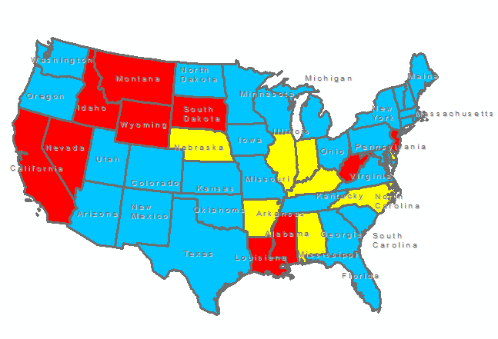
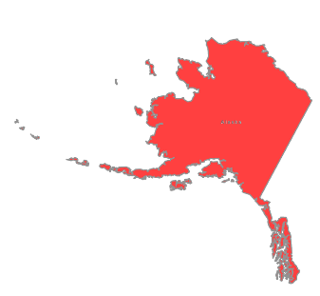
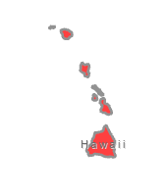
NOWRA State Affiliates
AzOWRA (Arizona)
CPOW (Colorado)
FOWA (Florida)
GOWA (Georgia)
GSOWA (New Hampshire)
IOWWA (Iowa)
KSFA (Kansas)
LIASA (New York)
MOWPA (Maryland)
MOWRA (Michigan)
MOWA (Minnesota)
MSO (Missouri)
NDOWRA (North Dakota)
O2WA (Oregon)
OOWA (Ohio)
OOWA-OK (Oklahoma)
POWRA-NM (New Mexico)
POWRA-PA (Pennsylvania)
SCOWA (S. Carolina)
TOWA (Tenn)
TxOWA (Texas)
UOWA (Utah)
VOWRA (Virginia)
WOSSA (Washington)
WOWRA (Wisconsin)
YOWA (New England)
5,500+ Members
30 states
26 affiliates
Blue = NOWRA State Affiliates
Gold = Non-affiliated state organizations
Red = States with no onsite association
Notes:
The reason NOWRA exists is because of you! It is to help you, our affiliates, succeed and raise the bar for the entire industry.
New in 2025 – South Carolina, New Hampshire, and Oklahoma!

Slide 12
NOWRA State Affiliates
AzOWRA (Arizona)
CPOW (Colorado)
FOWA (Florida)
GOWA (Georgia)
GSOWA (New Hampshire)
IOWWA (Iowa)
KSFA (Kansas)
MOWPA (Maryland)
MOWRA (Michigan)
MOWA (Minnesota)
MSO (Missouri)
NDOWRA (North Dakota)
O2WA (Oregon)
OOWA (Ohio)
OOWA-OK (Oklahoma)
POWRA-NM (New Mexico)
POWRA-PA (Pennsylvania)
SCOWA (S. Carolina)
TOWA (Tenn)
TxOWA (Texas)
UOWA (Utah)
VOWRA (Virginia)
WOSSA (Washington)
WOWRA (Wisconsin)
YOWA (New England)
Possible in 2026:
Alabama
Hawaii
5,500+ Members
30 states
26 affiliates
Blue = NOWRA State Affiliates
Gold = Non-affiliated state organizations
Red = States with no onsite association
Notes:
The reason NOWRA exists is because of you! It is to help you, our affiliates, succeed and raise the bar for the entire industry.
New in 2025 – South Carolina, New Hampshire, and Oklahoma!

Slide 13
NOWRA Organization Chart
Executive
Committee
Lobbying
Board of
Governors
Board of Directors
Executive
Director & Staff
State
Affiliates
Corporate
Members
Committees
Task Forces
Partners
Notes:
The largest U.S. organization devoted exclusively to supporting members of the onsite and decentralized industry
Founded 1991 - Represent all segments of industry – with over 5,000 members (check)
Contractors
Service Providers/Pumpers
Designers & Engineers
Regulators
Academics
Manufacturers
AzOWRA (Arizona)
COWA (Callifornia)
COWRA (Carolinas)
CPOW (Colorado)
DOWRA (Delaware)
FOWA (Florida)
IOWWA (Iowa)
IOWPA (Indiana)
KSFA (Kansas)
MAOWP
(Mass)
MOWPA (Maryland)
MOWRA (Michigan)
MnOWA (Minnesota)
MSO (Missouri)
NOWWA (Nebraska)
NmOWA (New Mexico)
OWAI (Idaho)
POWRA-NM & NMOWA (New Mexico)
POWRA (Pennsylvania)
TOWA (Tenn)
UOWA (Utah)
VOWRA (Virginia)
WOSSA (Washington)
WOWRA & WPCA (Wisconsin)

Slide 14

Federal Representation

Slide 15






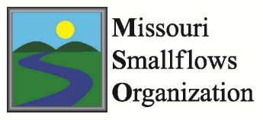



2025 Board of Governors Supports Lobbying
Notes:
2014 marked the shift from words to action
Core group of companies met in late 2013 at the NOWRA conference in Nashville and agreed to fund an advocacy campaign for our industry
Additional contributors stepped forward when asked
NOWRA’s advocacy effort was born

Slide 16
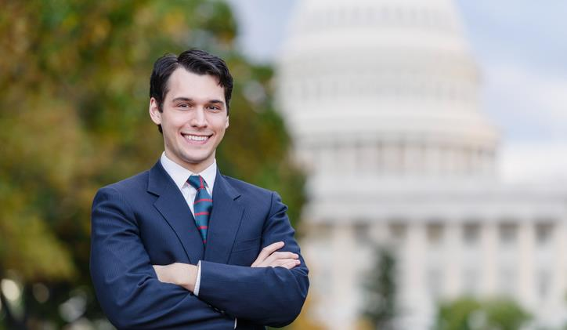
Increase market share 30% to 35%
Secure a larger share of existing federal funding
Work w EPA to change policies
Lobbying Objectives
Notes:
Increase market share for new construction using onsite-decentralized technologies from 30% to 35%
Secure a larger share of existing federal funding for wastewater treatment
Get EPA to change policies within the agency which discriminate against our industry

Slide 17

2025 Ongoing Work and Achievements
Lobbying/Government Relations
Maintain funding of existing USDA program for FY26 - $5M
Fight to secure funding of Decentralized Grant Program (EPA)
ACS Survey – Septic Question in 2026
Reauthorizing USDA Decentralized Water Systems Program - $20 M in Farm Bill
Modernization of SRF Allocation Formula for decentralized

Slide 18

Research

Slide 19
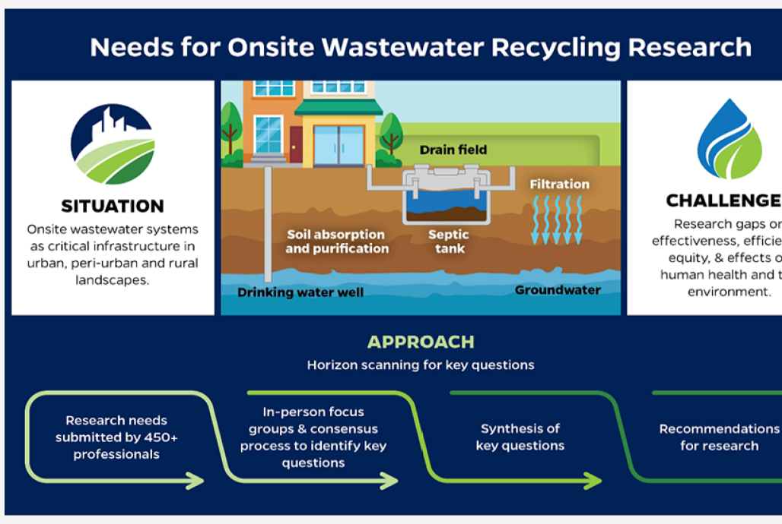
NOW-R2 -Identifying Priority Research Needs for Decentralized Wastewater
Spring 2021, w/Baylor University, NOWRA sent a survey asking about research needs in our industry
Technical
Policy and management
Education
Workshop with key industry sectors to focus survey data into the top needs
Notes:
Communication Vehicles

Slide 20
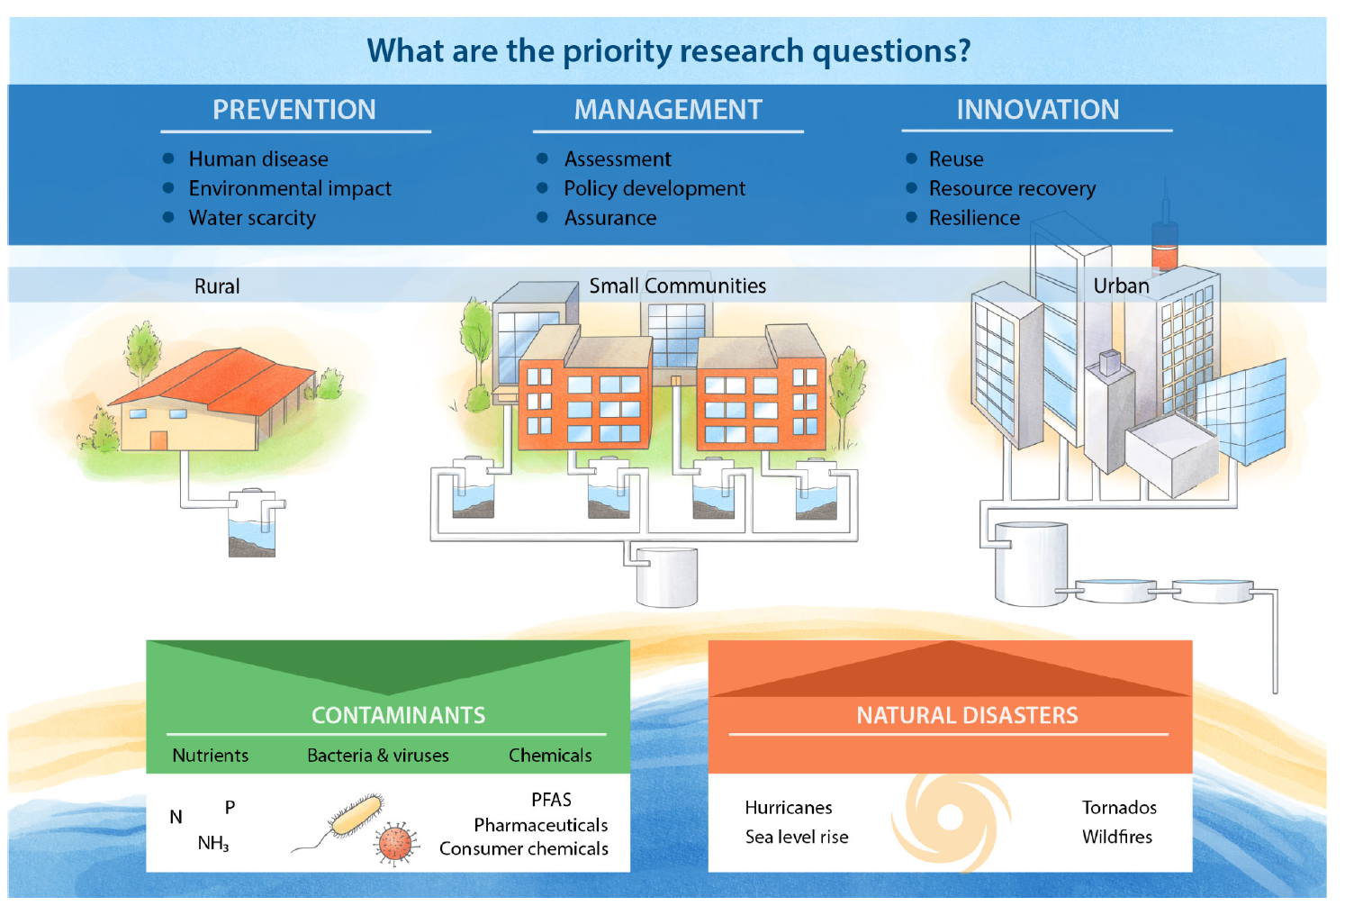

Slide 21
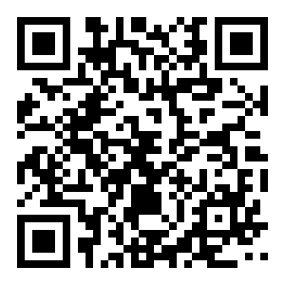
Use of the Results
https://z.umn.edu/NOWRAR2
Disseminate results to funding sources
Advocate for federal and state funding to answer these questions
Develop more information for improved understanding of prevention, management and innovation in the decentralized

Slide 22
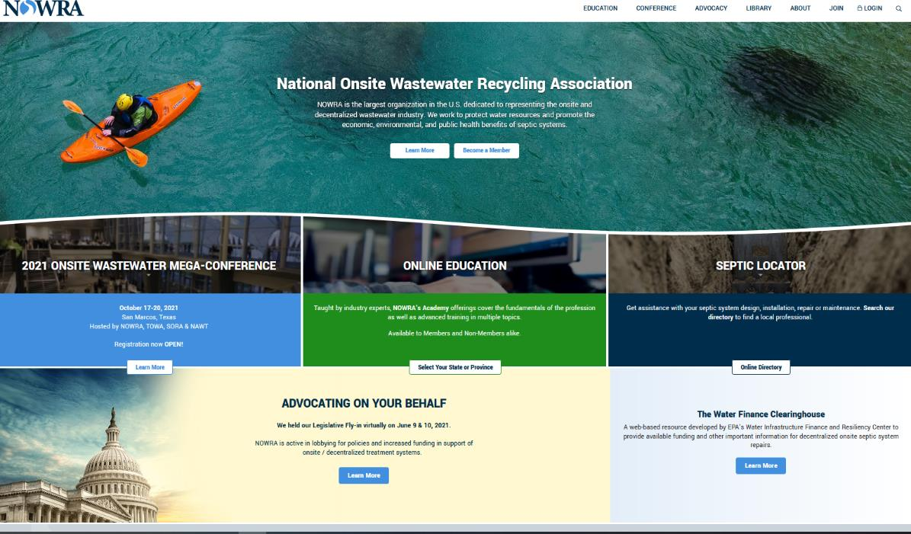
www.NOWRA.org

Slide 23

GOAL: Provide Great Learning Opportunities
Offer quality courses with a broad perspective
Help train employees
Reach non-affiliated states and other orgs
Raise revenue for affiliates
https://www.pathlms.com/nowra/
Notes:
Courses are meant to be non-state specific for a broad reach and universal
Companies can use them to help train new employees on the basics as needed – they don’t have to wait.
Working on expanding to non-affiliated states and other organizations that need them – like MOU partners

Slide 24

Achievement: Provide Great Learning Opportunities
Colorado Design Bundle
New courses coming soon in 2026
FREE member-only Business & Industry track!
Increased non-member rates to drive membership to you!
Notes:
Highlight the different types of courses offered – Design, Troubleshooting, A to Z, Installer, etc. Mention NEW free member classes. Most approved in Oklahoma

Slide 25
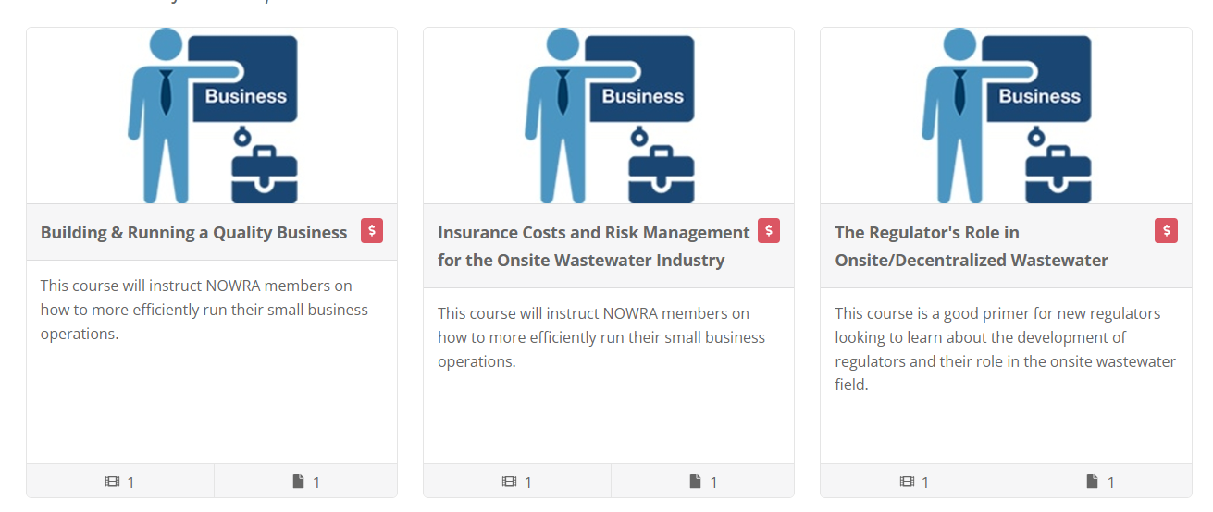
FREE for Members!
Notes:
Current listing of new FREE courses available online. More to come in 2025 – Marketing.

Slide 26

NOWRA Online Learning Academy
Pricing and Profit Sharing
PROFIT SHARING:
NOWRA Course
70% for NOWRA
30% for Affiliate
Affiliate Course (if)
70% for Affiliate
30% for NOWRA
Online Classes
$ 25/credit hour
($50 non-member)
2024 – CPOW received about $5,400
2025 – CPOW received $8,400
Notes:
Any money that comes in in shared with the state group.

Slide 27
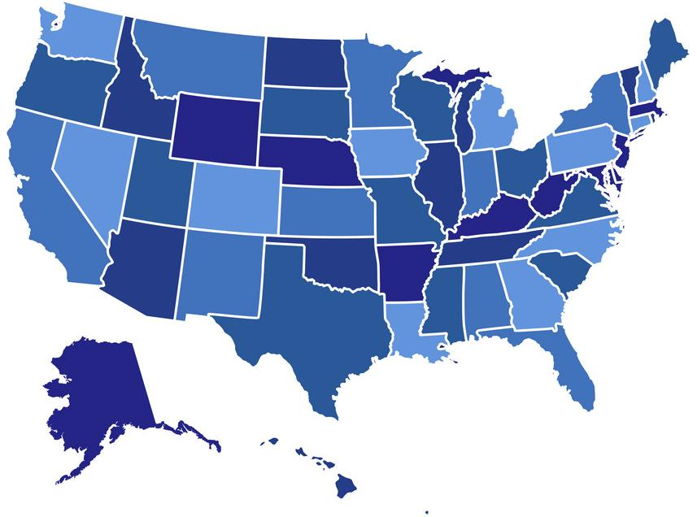

Next 3 Mega Conferences
Onsite Wastewater Mega-Conference
2025
Sandusky, OH
OOWA-OH
2026
Denver, CO
CPOW
2028
Norman, OK
OOWA-OK
2027
Columbus, GA
GOWA
Notes:
We are beginning the search for 2028 – if your state is interested in partnering with us, let the NOWRA office know.
2025 Sandusky Ohio
2026 Denver, CO
2027: Columbus GA 2028 Onsite Wastewater Mega-Conference – NOWRA has visited 2 hotel locations in OK (Tulsa and Norman) for possible sites for 2028 Mega-Conference. NOWRA expects to finalize this in the next few weeks. Would be a combined NOWRA-OOWA-OK conference in late Sept/early Oct. 2028.

Slide 28

2026 Onsite Wastewater Mega-Conference
October 25-28, 2026
Westin Westminster Hotel
Partnering w/ CPOW, SORA, & NAWT
Exhibit Booths
Technical Sessions
International keynote
Field Trips
Off-site Social Event

Slide 29
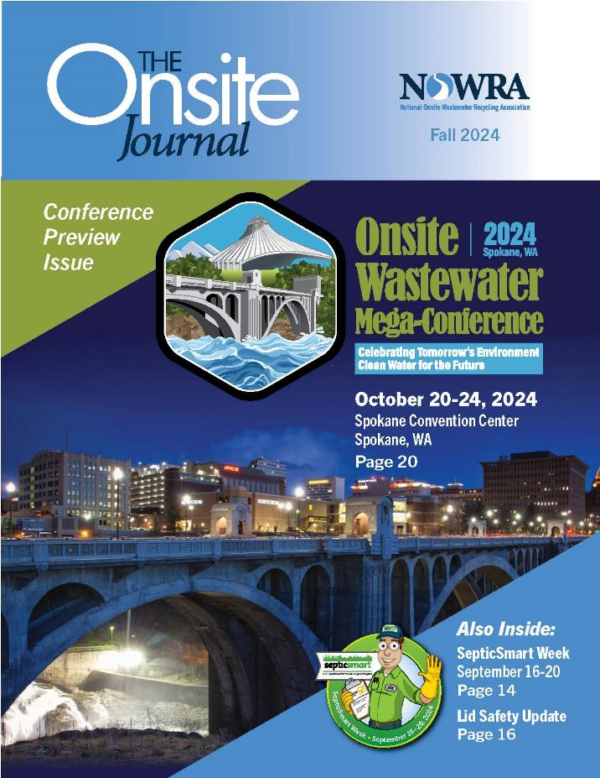
GOAL: Provide Outreach
Monthly Emails
Keeping you in the know!
Check your spam, make sure we have the right email.
Onsite Journal – 3 times/year
Updates on legislation, affiliates, industry news, research, and upcoming events
Make sure we have the right address
Social Media
FaceBook and LinkedIn
Notes:
We do reach out from time to time with emails and mailings…we encourage you to read them – a lot of effort goes into keeping you updated. If you are not getting the onsite journal or our emails please let your affiliate director know.

Slide 30


NOWRA Financials
Partnerships
US EPA
NAWT
NEHA
SORA
RCAP
USDA - RD
NRWA
WWETT Show (Informa)

Slide 31
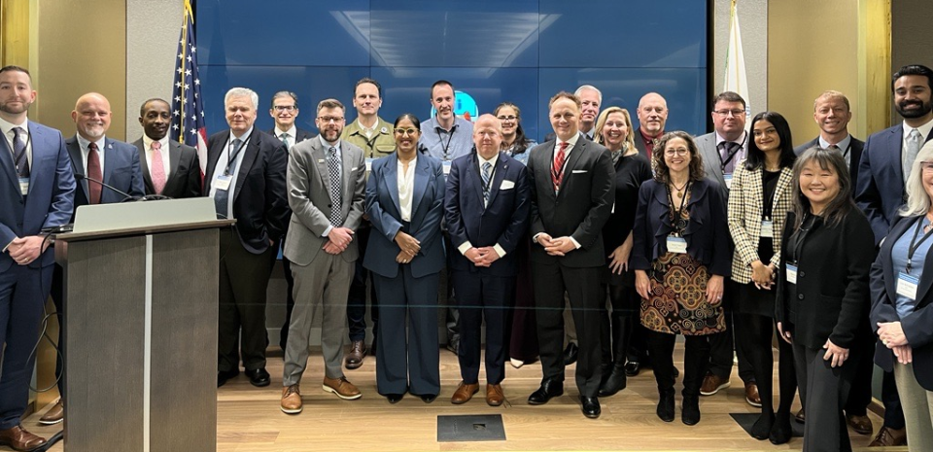
NOWRA Financials
Decentralized System Partners
EPA's Decentralized Wastewater Management Memorandum of Understanding (MOU) Partnership
EPA and 25 partner organizations are joined by an MOU to work collaboratively at the national level to improve decentralized performance and protect the nation's public health and water resources.

Slide 32
Subrecipient Agreement – 3 phases
RCAP Completed Homeowner educational training materials (Spanish too)
Concluding a 3-year effort for O&M, small communities, and difficult sites
Began Oct 1, 2025 – 3-year effort for college course, glossary, regulator training, RME, advanced O&M, difficult sites, etc.
Grants
RCAP

Slide 33
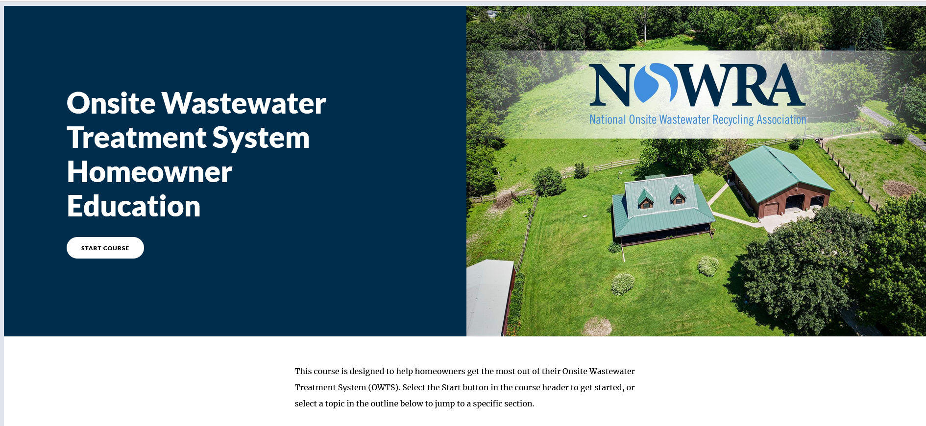

Slide 34
Other Agreements/Contracts
Idaho DEQ Septic Installer Exam
NRWA – new agreement starting 9/1/25 – 8/30/27
Train the trainer workshop
Tech Assistance to 10 communities
Applying for new grants as available
USDA – Tech Assistance
Others expected in 2026
Grants
Other

Slide 35
GOALS for 2026
Work towards the Goals identified in the Strategic Plan
Apply for a grant(s)
Grow organization
Continue to grow Learning Academy
Member Benefits for our affiliates
2026 Goals

Slide 36

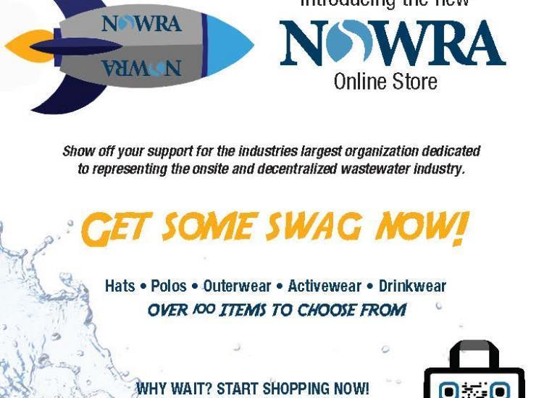

Member Benefits
Notes:
Handouts of these usually provided at the NOWRA table in the exhibit hall.

Slide 37


International Connections
Chris LeClair
Tokyo, Japan
11-11-2025 to 11-12-2025

Slide 38
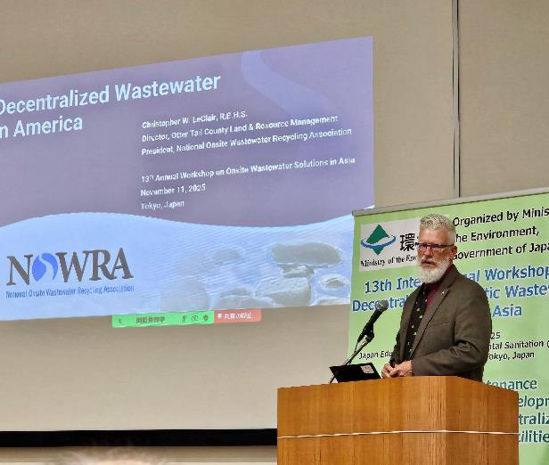
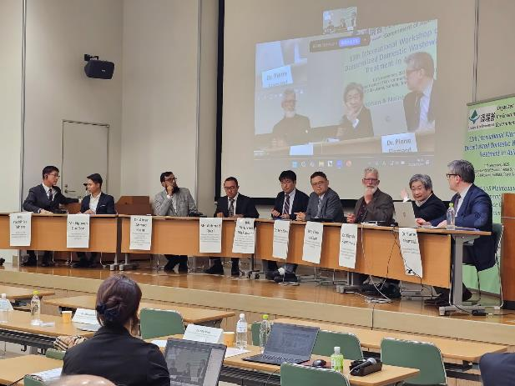
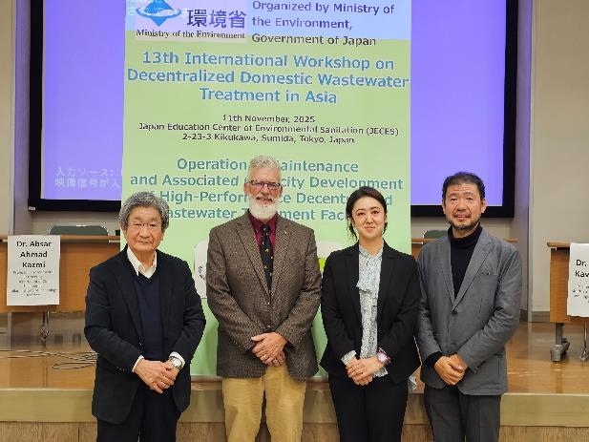
13th International Workshop on Decentralized Domestic Wastewater Treatment in Asia

Slide 39
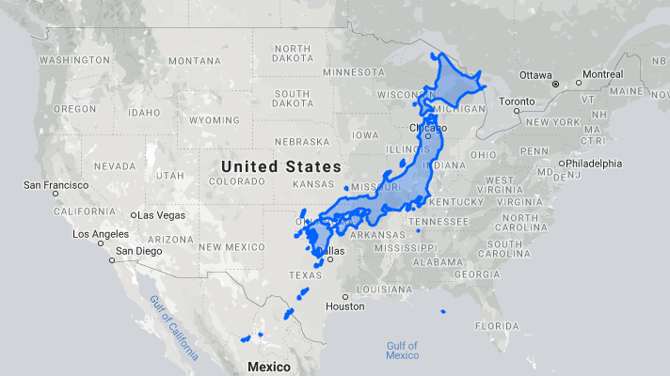
United States:
342 million people
3,809,525 mi²
89.8/mi²
Japan:
124 million people
145,937 mi²
849.7/mi²

Slide 40
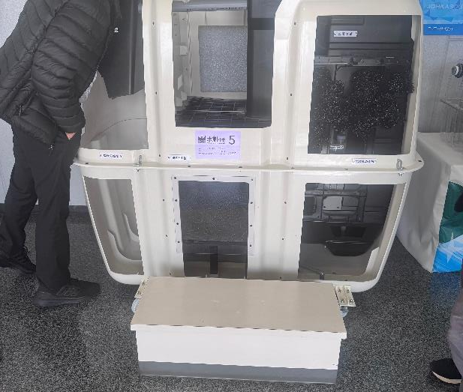
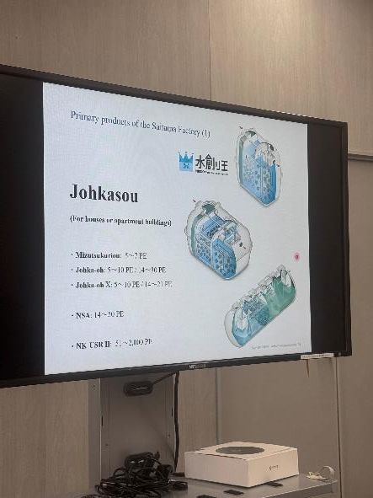
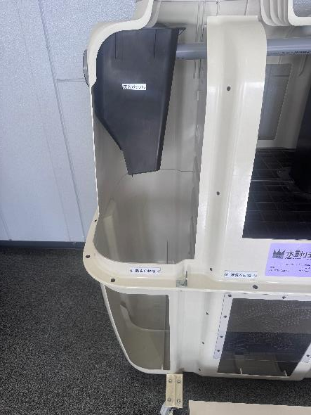
Johkasou

Slide 41

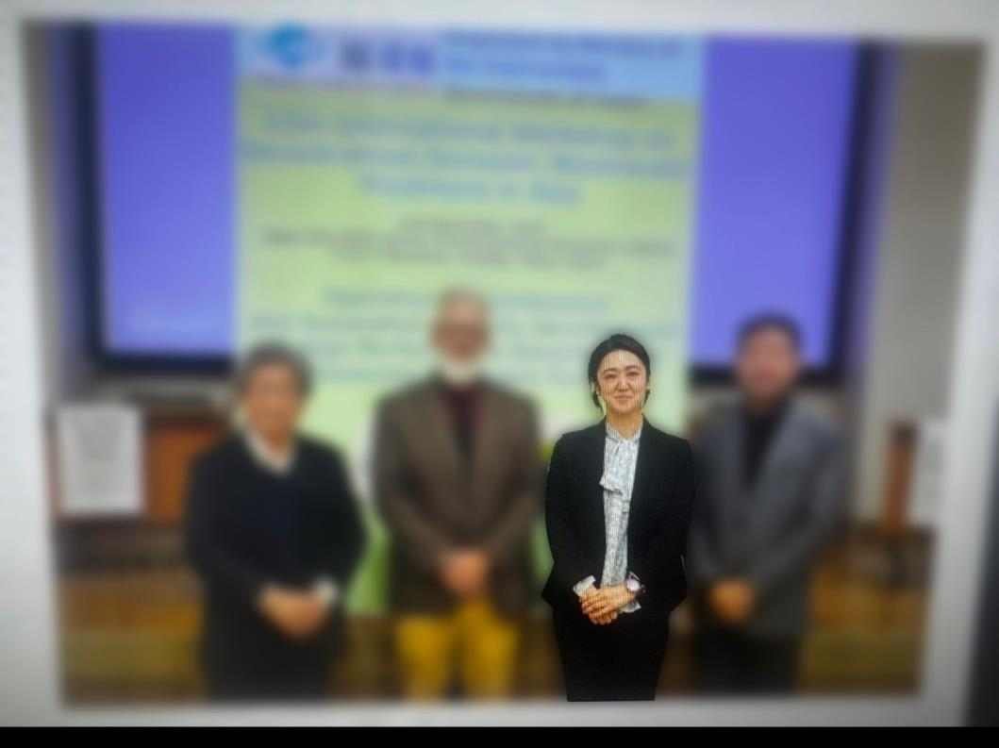
Dr. Yurie Shirakawa
Keynote Speaker
NOWRA Mega-Conference 2026
Denver CO

Slide 42
NOWRA Contact Information:
Thomas W. Groves (Tom)
Executive Director
P.O. Box 982
Westford, MA 01886
(phone) 978.496.1800
(fax) 703.997.5609
www.nowra.org
executivedirector@nowra.org
info@nowra.org

