Slide 1

NAWT OWTS Inspection Standards
WHAT’S NEW!!
Notes:
1
What is NEW with the NAWT OWTS Inspection process – STANDARDS!!
Welcome to the NAWT OWTS Inspection Standards - Inspecting Onsite Wastewater Treatment Systems (OWTS)
Each Trainer Introduces self if you have not done so to this point.
Give your background - Pumper - Installer - SEO - Home Inspector
Housekeeping & Ground Rules – This is an informal Session
Ask questions as you think of them. The greatest resource in this room is you, the trainees. If I get stumped, I’ll count on one of you for the answer!
Pit stops as needed - tell them where toilets are
Cell Phones and pagers on silent or vibrate – If you need to take a call – leave the room…please!

Slide 2
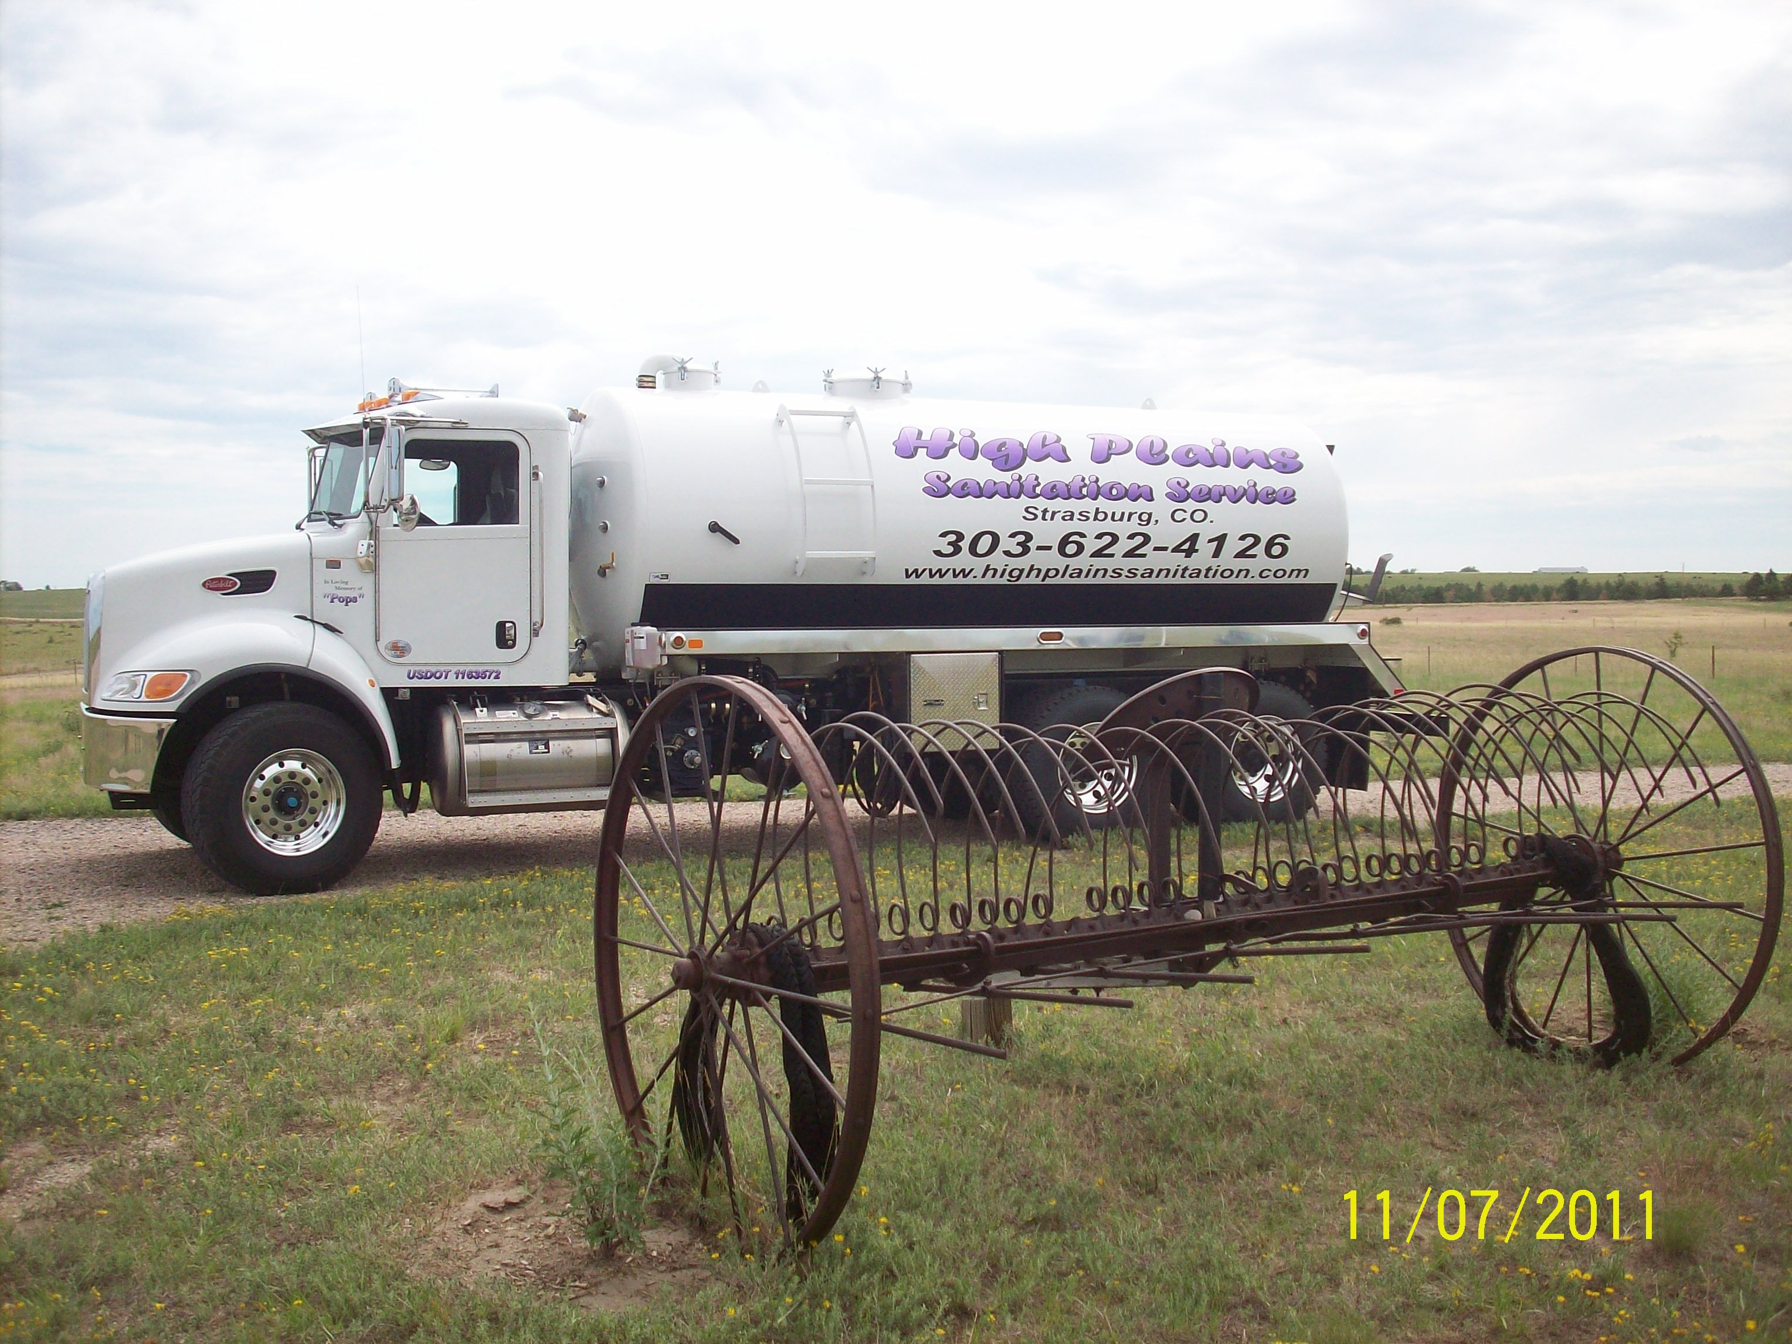
INTRODUCTION
Kim Seipp
High Plains Sanitation Service
CPOW
NAWT

Slide 3
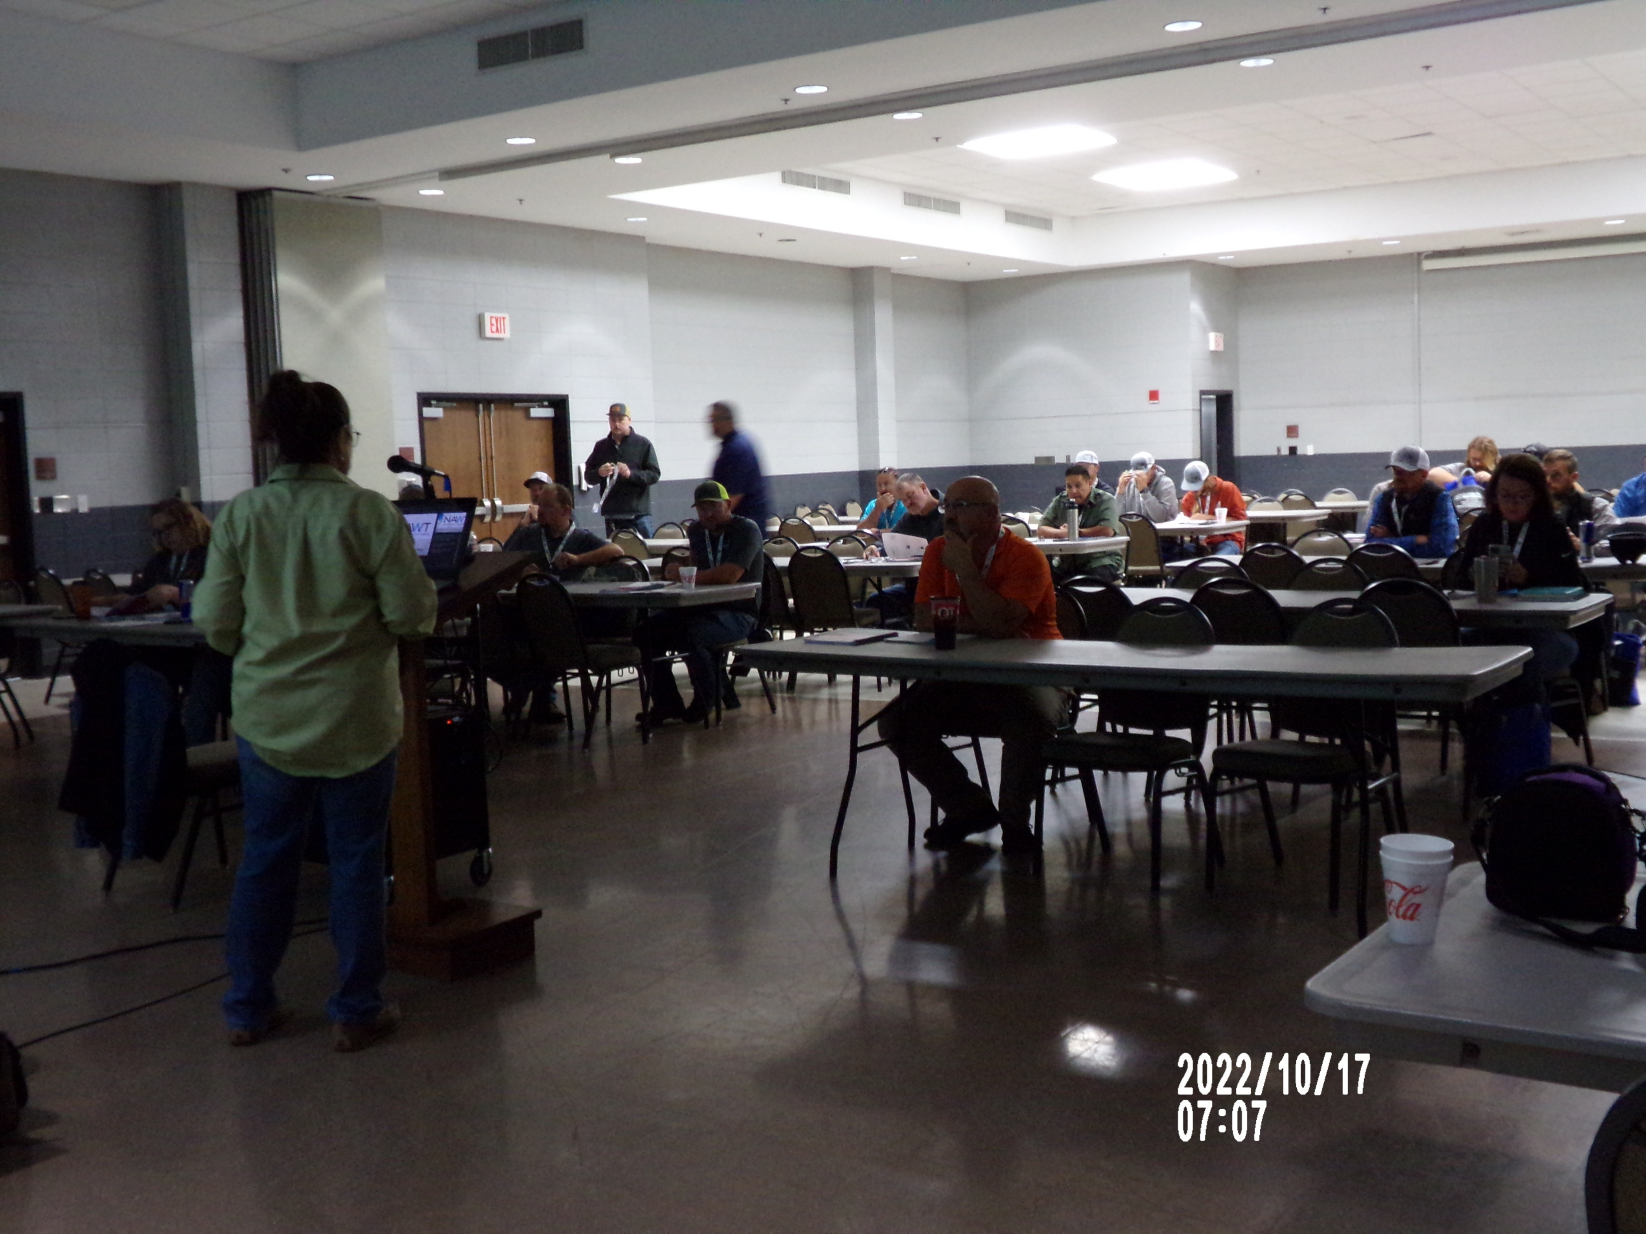
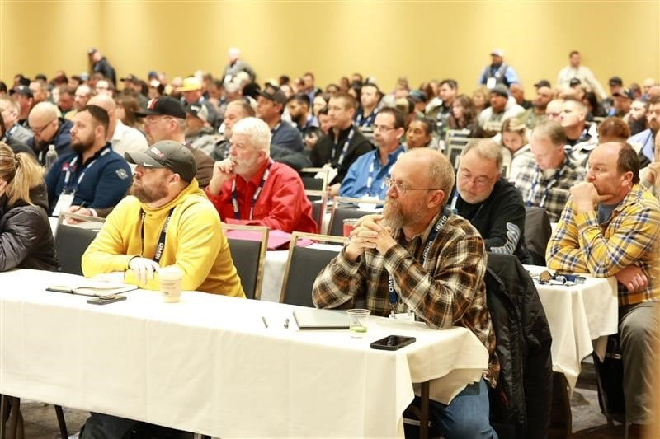
HISTORY
National Association of Wastewater “Transporters”
NAWT Inspection Course
Other NAWT Courses
Technicians
Notes:
NAWT has been around since the 1980’s **click
They developed the NAWT Inspector Training Course through an EPA grant for the purposes of address Time of Sale inspections on OWTS
This set the standard at the National Level for inspections –

Slide 4
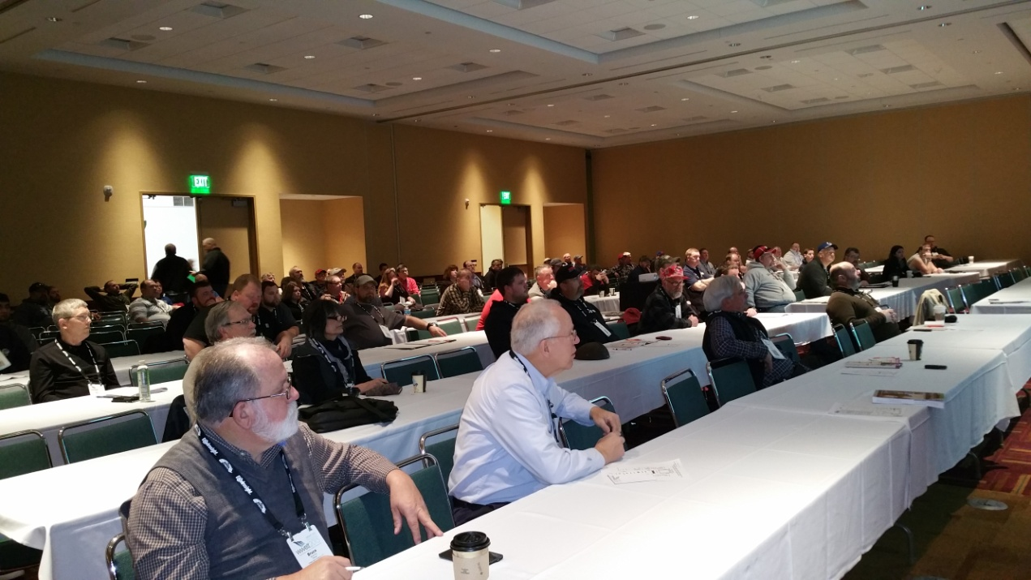
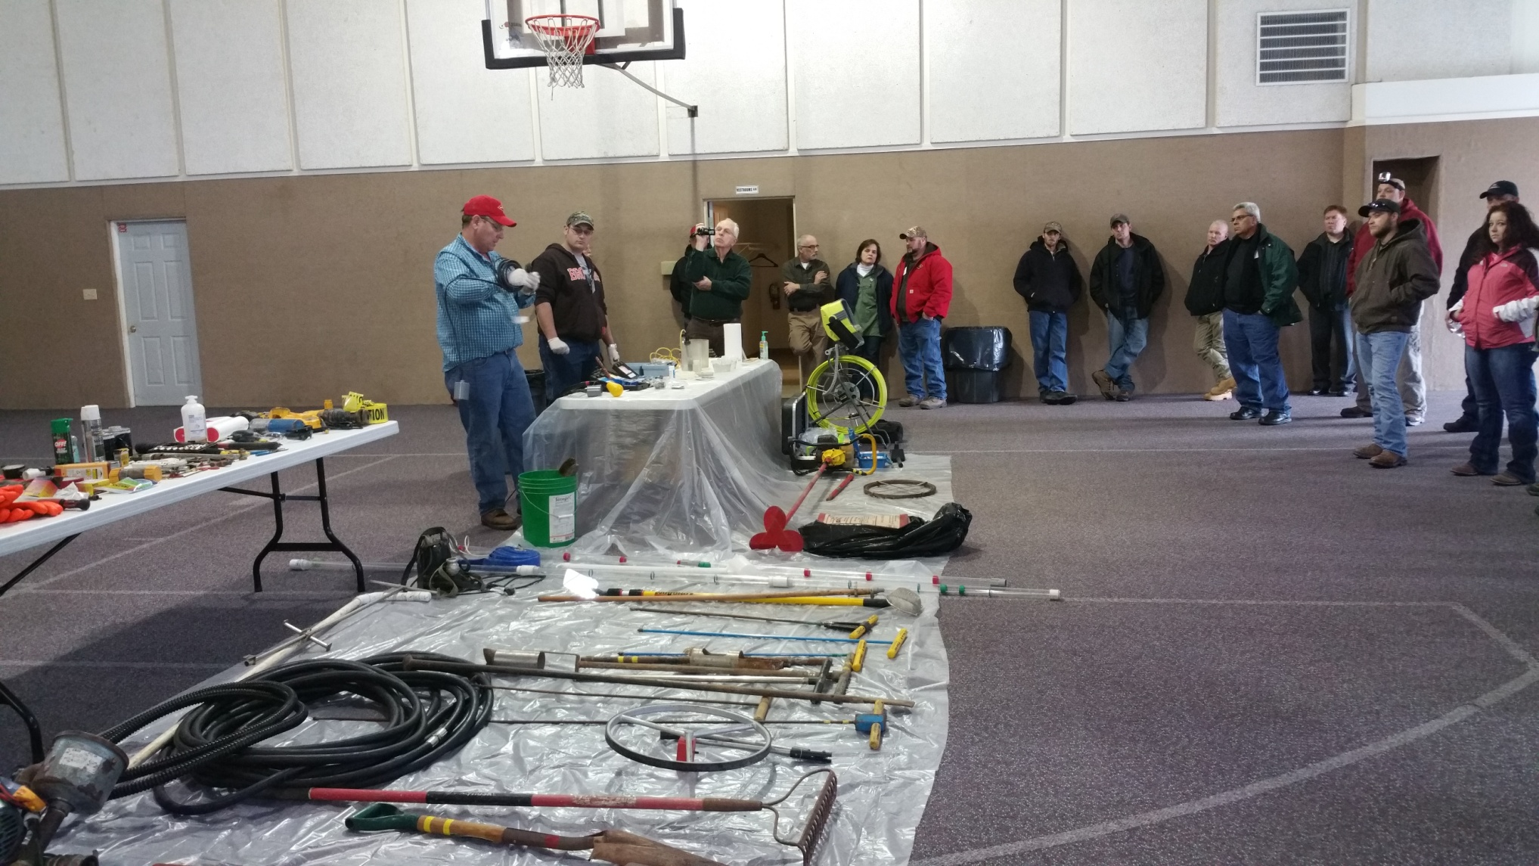
Notes:
NAWT participates in the National OWTS Conferences MEGA and WWETT – providing TEC for practitioners (boots on the grounds)
We work with training partners like CPOW, UAZ, POWRANM, Canada, etc to provide training – we have had practitioners across the world take these courses – primarily the Inspector Training, but we have had them attend other NAWT courses also
CPOW brought the NAWT courses to CO after the big regulation revision in 2010-2013

Slide 5
NAWT OWTS Standards
Development
Manuals
Getting back to the field!!
Notes:
First, We must understand what we are looking for when we do OWTS Inspections: regulatory vs. customer expectations
Over the past couple of years NAWT Standards Committee has been working on updating the manuals – Warren Brown was part of this process
Adding technologies and new and more information to day one, septic 101 – what it is and how it works. NAWT believes before anyone can fairly inspect or assess an OWTS they better know what’s supposed to be there and how those pieces and parts work together. That is why this section goes pretty deeply into flows, constituents (what makes up wastewater), the more you know, the better you will be able to relay and discuss any deficiencies with the system.
Developing a “Standard – step by step” process for evaluating OWTS – Very committed team **click
First, we must understand and define what an OWTS Inspection: snapshot in time – giving the client as much information as possible to make educated decisions – who is really interested in the inspection? – so why do we have the seller doing this process?? What makes this process difficult is who is your client. In other parts of the country, the Buyer is the primary customer, here in Colorado, the Seller is the “customer” – these two different customers have two very different expectations for the inspection process.
Using the Pennsylvania Septage Management Association (PSMA) Standards as the template (this is where NAWT actually got a lot of the initial protocol in the 1980’s) – PSMA has been doing Standards Inspections for over 30 years – and worked very closely with professors from Penn State (Dr. Paul Robilard and others from the Ag Engineering Department) to set up guidelines to follow for septic inspections during real estate transactions.
NAWT is putting into place updating processes and procedures so we don’t go so long between updates – the goal is currently to address issues as soon as they arise and not wait until anything gets catastrophic.

Slide 6

NEW TOOLS
More “Conclusions”
DAR
HLT
Authorization Form
Checklists
Notes:
The initial NAWT Inspection Protocol required that the inspector evaluate each and every component within the system. That includes the supply lines from source through and including the final dispersal or STA. Most of these components are, could, but certainly, should be accessible, with the exception of the STA in a subsurface discharge final dispersal component, which is underground, out of site, out of mind.
Some of the new Tools in the toolbox!
We’ll discuss each –

Slide 7
Conclusions
If a component is found to be unsatisfactory, the system is unsatisfactory until the component is repaired or replaced and such activity is verified by the inspector.
Terms such as “Failure” or “Malfunction” shall not be used by a NAWT OWTS inspector to describe the condition of a system.
Notes:
7
One of the new items within the Standards is CONCLUSIONS
Conclusions **click
Once all the fieldwork has been completed, the tech will draw a conclusion about the component and the system as a whole. We go though many scenarios and discuss what would be the most applicable “conclusion”. The goal with teaching this methodology is to help standardize the approach – doesn’t matter who is doing the inspection – should conclude the same. Having meaningful discussions with participants and dissecting the component, peeling the banana, we find that you can get to a single solid conclusion to report back unless you cannot access to evaluate the component – and then that leads us to “Needs more investigation.
This focuses on the conclusion drawing process, and this is the most critical skill that must mastered. **click
Terms such as “Failure” or “Malfunction” shall not be used by a NAWT OWTS inspector to describe the condition of a system.
(click to show last item)

Slide 8
Conclusions
There are four possible conclusions you may reach about each system component and the system as a whole;
ACCEPTABLE
ACCEPTABLE WITH CONCERNS
UNACCEPTABLE
MORE INVESTIGATON IS NECESSARY
Notes:
Reaching conclusions about the system
There are four potential conclusions – per component and then the system overall
ACCEPTABLE – There is nothing with the component that gives the inspector pause or that could be construed as Unacceptable
ACCEPTABLE WITH CONCERNS – There is something that raises concerns with the inspector, however the component may not need to be repaired per se, or replaced – it is expected that the inspector document what the concern is and what their recommended monitoring protocol would be – can be as simple as “monitored at regularly scheduled service”
UNACCEPTABLE – Component does not meet current expectation or code and needs to be replaced, mitigated at the very least addressed
NEEDS MORE INVESTIGATION – Either the component itself cannot be located or there is something that is causing the inspector to believe that the system needs to be delved into deeper to resolve the concern and be able to give the component an Acceptable or Acceptable with Concerns rating
These factors and thorough site notes enable a conclusion about every component in the system.
(click to show next item)
If a component is found to be unsatisfactory, the system is unsatisfactory until the component is repaired or replaced, and such activity is verified by the inspector. Each component will have a rating and then the system overall will have a rating. UNACCEPTABLE would be considered the LOWEST – NMI is exactly that – no final rating can be completed until that investigation has been completed.

Slide 9
Occupancy | Tank Structure | Liquid Level | Effluent Delivery | Soil Treatment Area
3 Bedrooms Occupied Structure age - 3 yrs. | Septic Concrete 1,000 Gallons Last pumped - Unknown Condition - OK | OK | Gravity | Bed 12 inches dry aggregate throughout bed
COMMENTS: | No surface discharge; no lush vegetation; runback observed at time of tank pumping.
Notes:
These are some scenarios that will be gone through to help teach this skill
CONCLUSION: UNACCEPTABLE **click
PAGE 50 – TREATMENT, HOLIDNG, DOSING, LIFT AND SIPHON TANKS – 2. THE BACKFLOW/RUNBACK OF LIQUID FROM THE STA AFTER PUMPING THE TREATMENT TANK

Slide 10
Occupancy | Tank Structure | Liquid Level | Effluent Delivery | Soil Treatment Area
4 Bedrooms Occupied Structure age - 15 yrs. | Septic Concrete 1,500 Gallons Last pumped – Every 2 yrs. | OK | Gravity | Trenches 12 inches dry aggregate in all trenches
COMMENTS: | All past pump-outs through 4-inch observation port. Main tank access is 4 feet below grade; tank not dug open.
Notes:
CONCLUSION: NEEDS MORE INVESTIGATION **click
PAGE 54 – TREATMENT TANK – 2. CANNOT ACCESS THE MAIN ACCESS PORT(S) OF THE TREATMENT TANK

Slide 11
Occupancy | Tank Structure | Liquid Level | Effluent Delivery | Soil Treatment Area
3 Bedrooms Occupied 4 Occupants Structure age - 10 yrs. | Septic Plastic 1,000 Gallons Condition - OK | OK | Gravity | Trenches 12 inches dry aggregate in all trenches
COMMENTS:
Notes:
CONCLUSION: ACCEPTABLE

Slide 12
NAWT
Dry “Aggregate” Rules
Notes:
12
This tool is to help the inspector better assess the STA – no longer out of site out of mind –
One of the first changes to the protocol is that if you cannot locate the STA you cannot arrive at a “acceptable, acceptable with concerns, unacceptable” conclusion – it must be “needs more investigation” – this again will be outside the typical inspection because it’s going to require more time and potentially more invasive exploration – but really, if you can’t find it you can’t fairly evaluate it.
DAR is going to help evaluate an STA if there is already liquid in the field – JUST BECAUSE THERE IS LIQUID DOES NOT MEAN THE SYSTEM IS NOT ACCEPTING LIQUID – DAR is going to help to determine if the liquid level is at an acceptable level, questionable level, or unacceptable level. Acceptable and unacceptable are easy – we’re done with the inspection – it’s that questionable level that needs to move on to more investigation. HLT

Slide 13
Systems Without Sand
Gravity STA
Pressure Dosed STA
Notes:
The DAR is a way of evaluating the level of ponding in a field –
Problems with current process – interpretation of liquid – what do we really know? There is or is not liquid in the STA… Is that a problem? We don’t really know.
PSMA, again, working with the soil scientists and engineers at Penn State developed a process whereby they could look at the soils and based on research, studies and other findings, make some agreed upon conclusions about what the liquid level in the aggregate really means and at what point should the owner be concerned.
We know with soils that limiting layers occur, what if the test pit was in a good part of the lot, but the final trench started in an area that has a limiting layer that was not identified, which actually slows the flow and causes minor ponding in the trench until the liquid rises about an inch and then it can flow easily away at that inch mark. And you find that the liquid has never been higher than that inch, but it takes that inch of liquid before the liquid can continue its journey. If the water is going away, is the system working? Probably, if all other variable support that the system is not backing up.
New process gives guidance for evaluation and further testing – where is the next flush going – do we have capacity??
This graphic shows a typical aggregate-based absorption area.
Say, “What are all the differences between the two STA cross sections?”
Looking for “Pipe size and overall amount of aggregate”
Say, “What governs how much aggregate is in the STA?”
Looking for “Pipe Size”
Say, “What are all the characteristics that are the same?”
Looking for 6” of aggregate under the laterals and 2” of aggregate above the laterals.
Say, “Which one is typically gravity, and which one is typically pressure dosed?”
Click…”How much liquid did I put in each STA?”
“How much dry aggregate is in each STA?
Click…Click…”How much liquid is each STA now?
“How much dry aggregate is in each STA?
Click…”Can you see the difference of what we are measuring?”

Slide 14
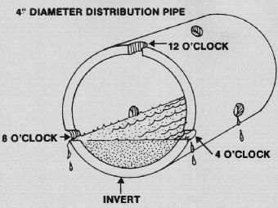
Standard Beds and Trenches - Gravity Distribution
Pg 32
Notes:
As you “click”, each part of the slide shows up. **6 clicks – graphics are used to show
Click…Say, “This is a cross section of a typical gravity bed or STA.”
Click…Say, “If a STA is fully ponded, can we all agree that the system is unacceptable?”**click
Click…
Click…Say, “In most states there are 2” of aggregate over the lateral and the lateral itself is 4” in diameter. Lateral holes are typically located at 4 and 8 o’clock or some configuration of this. There may be a tolerance, up or down, that the installer had when setting the lateral. For these reasons, we drew a line at 1” above the lateral bottom.”
Click…Say, “Therefore, If the liquid level is at 1” above the bottom of the lateral, or in other words, the STA has 5” or more of dry aggregate, the system is ACCEPTABLE.”
Click…Say, “If there is less than 5” of dry aggregate in a gravity STA, we don’t know if is acceptable. This is the GRAY area, so we will conduct a Hydraulic Load Test to determine if it is acceptable.”
The takeaway here is that we now have a way of determining if the system is still functioning even if there is measurable liquid in the field.
Is this process going to add “time” to the inspection. Most likely, but if we’re getting a better answer and not failing a system that is working isn’t it worth it?
We are working on adding a section to the DAR presentation to show the process of doing a DAR – it is not that complicated

Slide 15
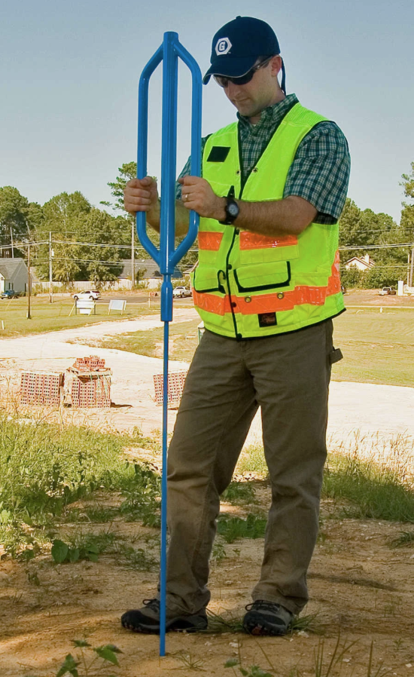
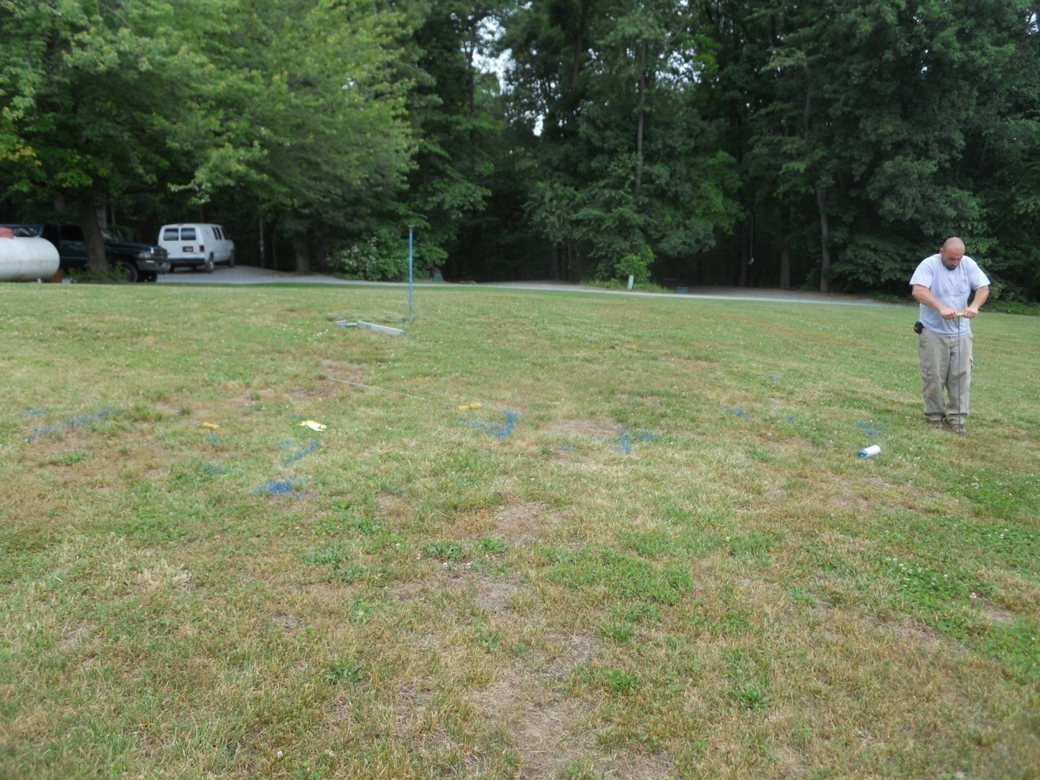
Notes:
The following 5 pictures show some of the steps used to evaluate DAR
Not going to belabor this, but this has been a sticking point – the fear of the unknown.

Slide 16
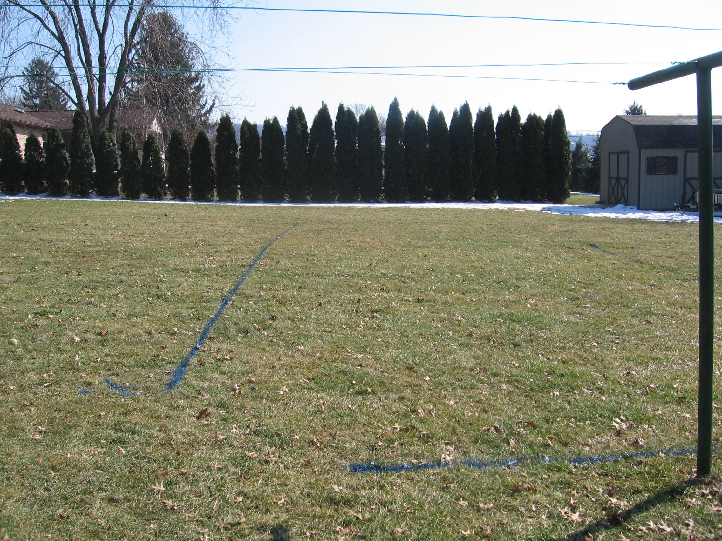
Notes:
Here the inspector used blue paint to mark the perimeters of a seepage bed.

Slide 17
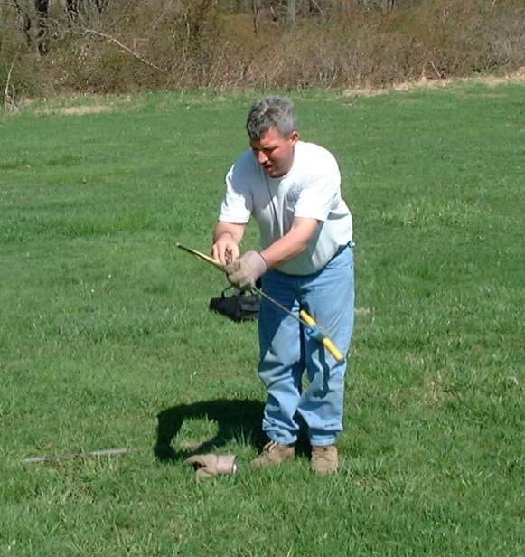
Measure and record the depth of soil to the top of the aggregate.
Notes:
Then he will measure the amount of soil to the top of the aggregate and record that depth.

Slide 18
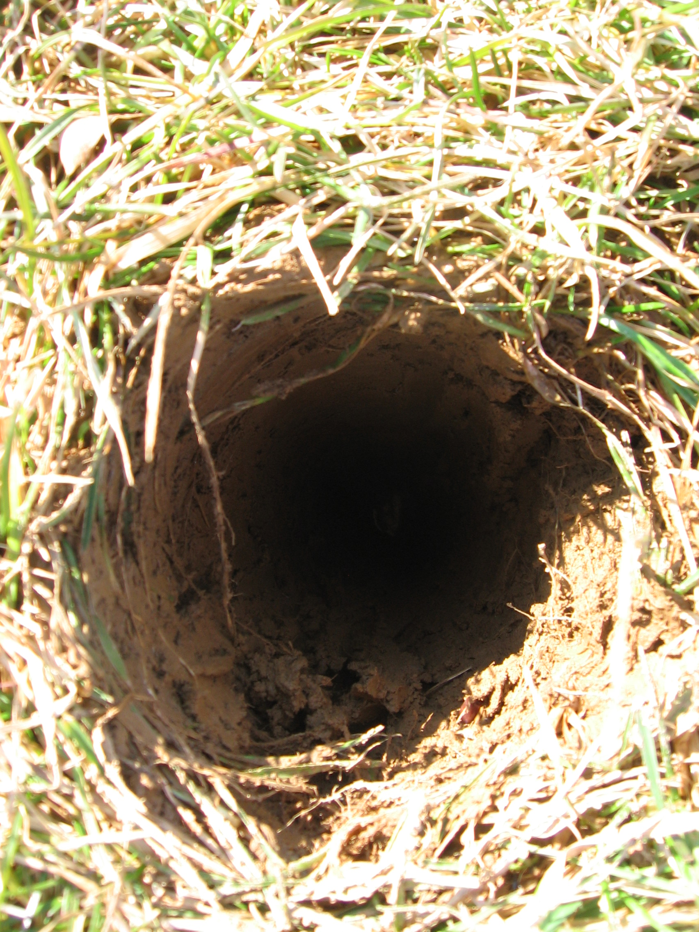
Notes:
Ask is a system with 10” of dry aggregate acceptable?
Consult the dry aggregate chart.

Slide 19
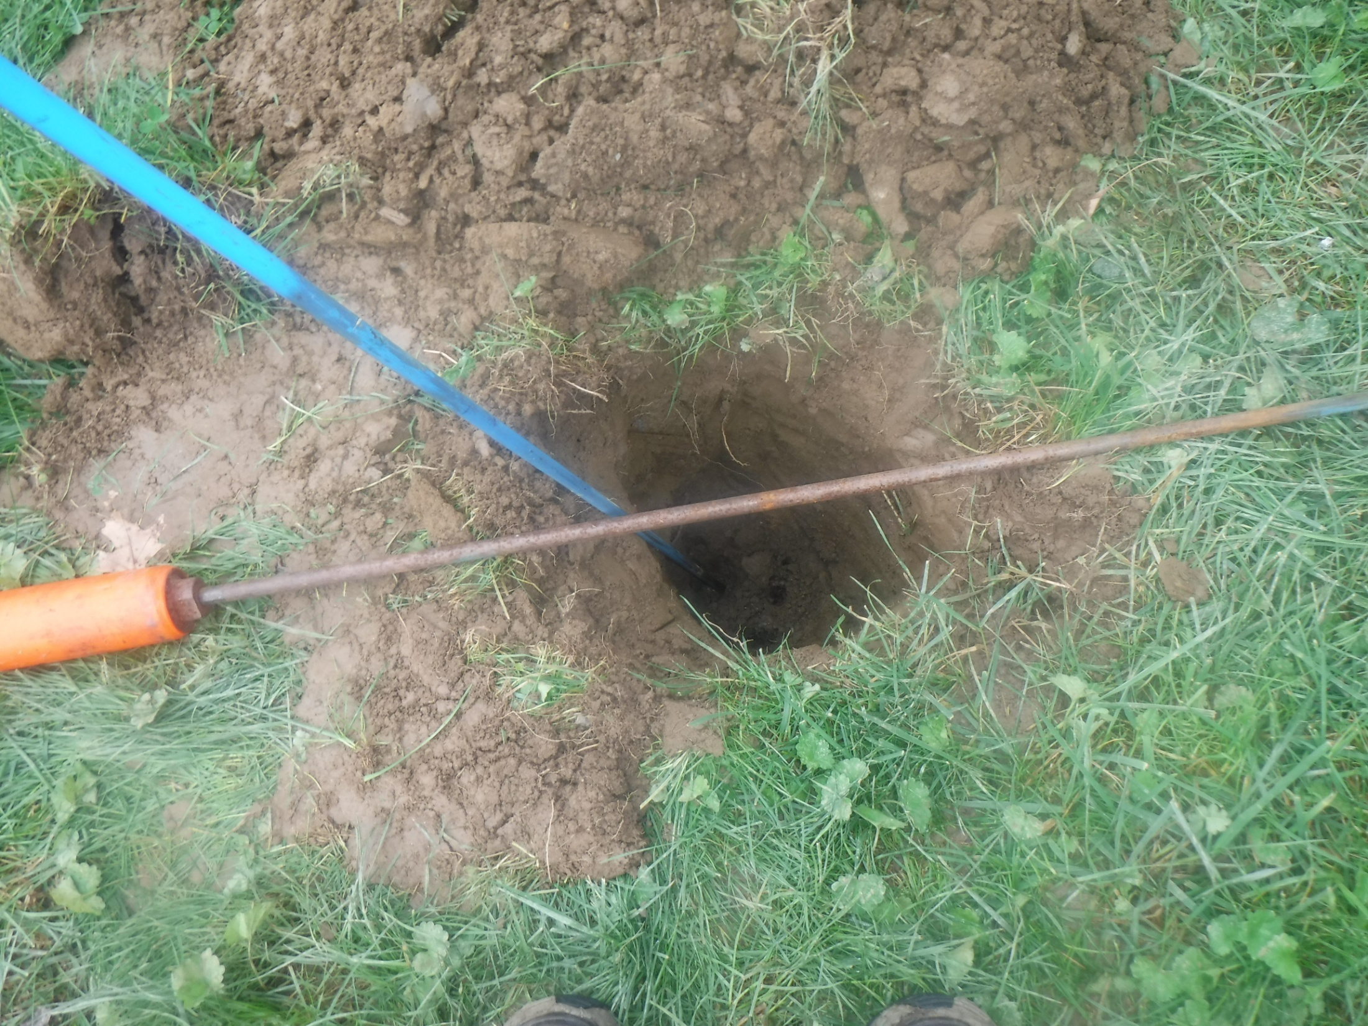
No Liquid found in the aggregate
What is the conclusion?
Notes:
The inspector probes into the aggregate and finds no liquid – what is the conclusion?

Slide 20
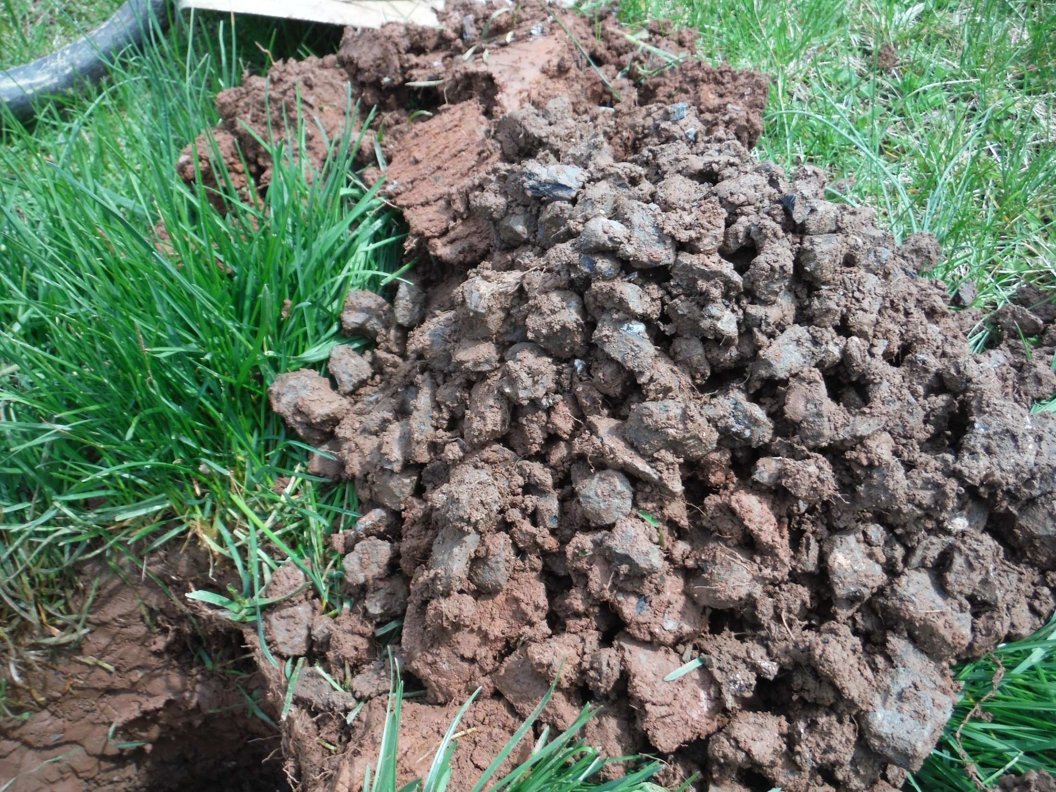
Unexpected
Find – soil
Mixed in with
The aggregate.
Notes:
NOTE: an unexpected find is that the inspector finds soil in the aggregate. (this may not have been noticed if a 1” bar was used here.)
Any suggestions what the inspector should suggest or report about this? Is this a problem – consult the standards – see the
Conclusion section.

Slide 21
Hydraulic Load tests
Notes:
21
Section 3 – Hydraulic load test
This section provides information about the process and procedures for conducting a hydraulic load test.

Slide 22

Remember - A NAWT HLT is a not a Flood
It is a
Controlled Application
Notes:
I know there seems to be a lot of “stress” with this potential testing –
Simply stated – can the system accept the amount of liquid that it was designed for – it should be able to, that is what the prospective buyer is looking for
It is OUTSIDE a typical inspection and is only recommended/required under certain circumstances – Page 35 of the new Standards

Slide 23
Hydraulic Load Test
The Hydraulic Load Test is a procedure by which the Inspector can assess whether an aggregate or chamber-based soil treatment area is able to accept and absorb the “Design Daily Volume” of wastewater in a 24-hour period.
Notes:
23
Hydraulic Load Test
Purpose: To determine if a soil treatment area can satisfactorily receive and allow to pass into the soil/environment the Design Daily Volume of sewage effluent.
The Design Daily Volume is based on occupancy, number of bedrooms or other regulatory factors. Why the daily design flow? That is what the regulations say that the system should accept so you should be able to add that amount of water and have it go away within a 24-hour period from when the first drop of water was introduced to the system.
Something to think about – As a buyer, they are expecting that system to be able to handle the daily design flow for any system, regardless of how many bedrooms that system was designed for – so something to ponder – if a home is designed for 3 bedrooms and being sold as a 5 bedroom – what is the “design flow” that should be used? Using this method, it could be solved very quickly if additional bedroom will require additional field capacity for any site. Even legacy systems.

Slide 24
Hydraulic Load Test
In its simplest form, the Inspector adds the Design Daily Load to the soil treatment area, then comes back in 24 hours and determines if the liquid-level in the soil treatment area has returned to its previous level.
To prove the soil treatment area has absorbed the Design Daily Volume, water is added to bring the liquid level up to the Day 1 final level.
Notes:
Hydraulic Load Test
+In its simplest form, the Inspector adds the Design Daily Load to the soil treatment area, then comes back in 24 hours and determines if the liquid-level in the soil treatment area has returned to its previous level.
+To prove the soil treatment area has absorbed the Design Daily Volume, water is added to bring the liquid level up to the Day 1 final level.
+This may be repeated a third day.

Slide 25
REASONS FOR A HYDRAULIC LOAD TEST (page 35 of the Standards)
Less than 24 hours’ volume in cesspool or seepage pit.
Structure vacant for more than 7 days. (1)
Treatment tank pumped in past 30 days. (1)
New gray water sources added in past 30 days. (1)
Soil fracturing in past 30 days. (1)
Initial level in treatment tank is below outlet pipe. (1)
When indicated by dry aggregate rules.
Atypical flows to soil treatment area. (1)
If the inspector is informed that the system will be subjected to increased daily flows due to increased occupancy or change in use,
an HLT shall be recommended.
Notes:
25
Hydraulic Load Test ** 2 clicks
Indications of the Need for a HLT
A hydraulic load test should be performed if any of these conditions are discovered during the course of a NAWT Inspection:
(click to show each item)
Less than 24 hours’ volume in cesspool or seepage pit
Structure vacant for more than 7 days
Treatment tank pumped in past 30 days
New gray water sources added in past 30 days
Soil fracturing in past 30 days
Initial level in treatment tank is below outlet pipe
When indicated by dry aggregate rules
Atypical flows to absorption system
Sludge in aggregate or stains in soil above
(click & read the following)
If the inspector is informed that the system will be subjected to increased daily flows due to increased occupancy or a change in use, an HLT shall be recommended.

Slide 26
Alternatives to Conducting a Hydraulic Load Test
With TIME available & CONCURRENCE of the Inspector, the absorption area can be re-inspected & re-evaluated when:
House is reoccupied for 30 continuous days even if tank was not pumped.
Deviation Form – NEW
HLT is not recommended in new, never used absorption areas.
Notes:
26
Hydraulic Load Test ** 2 clicks
Alternatives to conducting a Hydraulic Load Test
When a Hydraulic Load Test is indicated, if there is sufficient time available and with the concurrence of the inspector, the soil treatment area can be re-inspected and reevaluated when...
(click to show each item)
1. Occupancy for more than fourteen continuous days is reestablished and verified by the inspector
2. Occupancy for more than thirty continuous days is reestablished and verified by the inspector
(explain that the numbers after the alternatives correspond to the superscripts in the indications)
HLT not recommended in new, never used soil treatment areas.
AT any time during an HLT if the aggregate becomes SATURATED to the top – the test is stopped – depending on the scenario, there may be a third day option – however, that is going to definitely LIMIT that “within 24 hours the design flow must go away” requirement. Take away, we know can verify that the system is NOT functioning as designed and needs to be addressed.

Slide 27
New Forms!!
Unified Forms
Forms to CYA – Authorization to proceed
Checklists to consistently evaluate
Deviation form

Slide 28
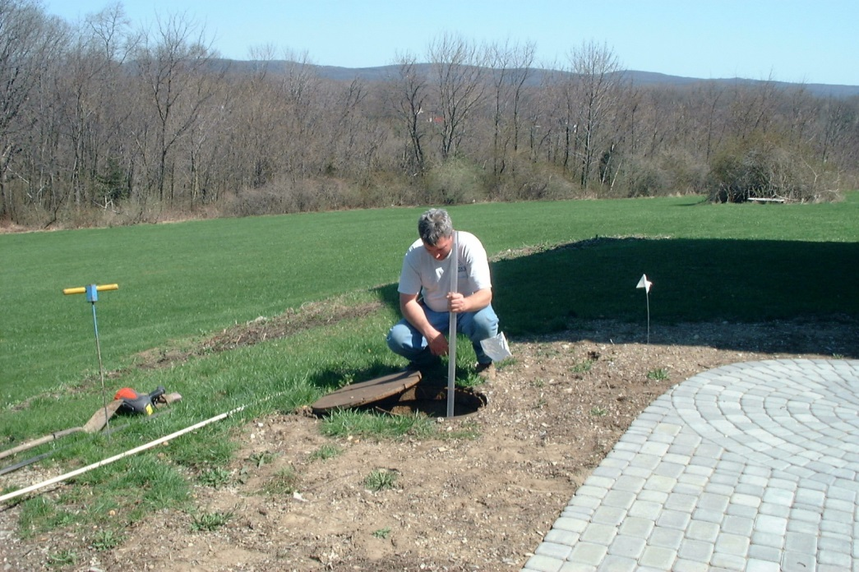
Inspection Procedures
What is the FIRST step in any inspection?
Before you start any inspection…
Getting an Authorization Form signed by the responsible party, your client, is highly recommended.
There is a sample form within the Standards
Appendix A - Pages 66 - 67
Notes:
Inspection Procedures ** click 2
What is the FIRST step in any inspection Ask the question – click for answer
Answer: Get an Authorization Form signed.
A sample can be found within the standards – Appendix A pages 66 - 67.
This form is not required, but highly recommended

Slide 29
Notes:
New forms will be coming out next year – you will have access to these forms as members of NAWT – they can be very helpful in making sure all the components of the OWTS are address and evaluated **4 clicks
One of the MAJOR new forms is the Inspection Authorization form – helps CYA – gives the disclaimer –
The other new MAJOR form is the Preliminary information – gathers all the information you will need to answer all the questions regarding the system, who is responsible, etc. – we encourage you to use these.

Slide 30
Notes:
NEW Checklists take you systematically through the system evaluation process ** 4 clicks
I did visit with the WQCMG and we discussed a unified form for CO. I still believe the more uniform we can get with the form the more information we can provide the better inspections we are going to be able to do

Slide 31
Notes:
DEVIATION FORMS
As a Standard, NAWT is hoping that Inspectors will follow the inspection process to the tee. We can defend inspectors if that is what they are doing. If they stray from the Standard, we cannot defend and will be asking that if they choose to do a different inspection than the NAWT Standard inspection that they do not call the inspection a NAWT OWTS Standards Inspection.
We also recognize that sometime circumstances beyond their control requires the Inspector to stray from the Standards. In those cases, we have a Deviation form that they can utilize to back up that they did in fact follow the protocol, but due to A, B or C they could not do it. Sometimes that may require they obtain a signature from the individual declining the “further investigation”

Slide 32



SUMMARY
Notes:
Improving the process by using a step-by-step instruction/process
Arriving at consistent conclusions that can be easily recorded and replicated and providing the customer with as much information so that they may make the best informed decision they can.
All to ensure our protection of our water resources.

