Slide 1


International Perspectives for On-site & Decentralized Wastewater
Ben Kele: Managing Director of Arris Pty Ltd

Slide 2
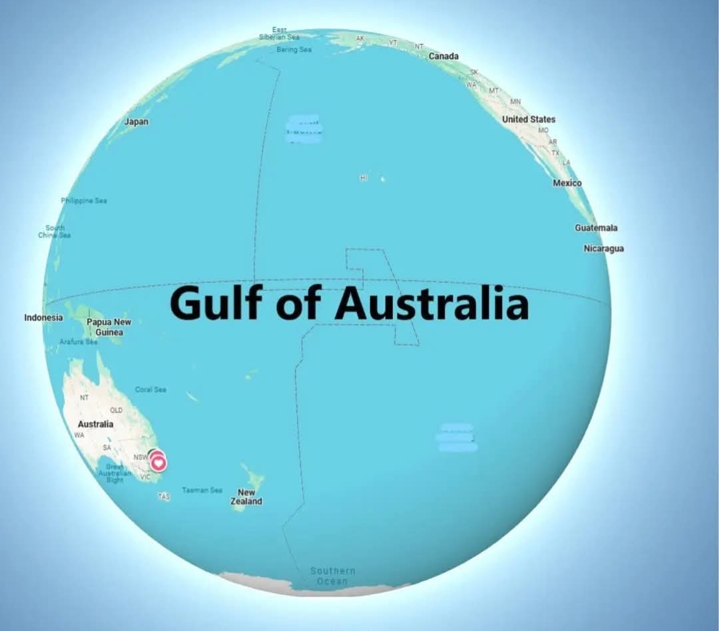

Slide 3
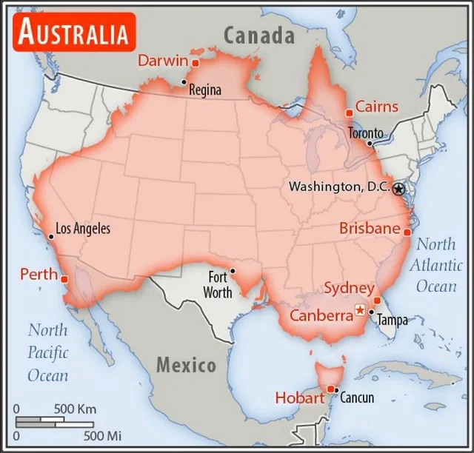
Australia/North America Comparison

Slide 4
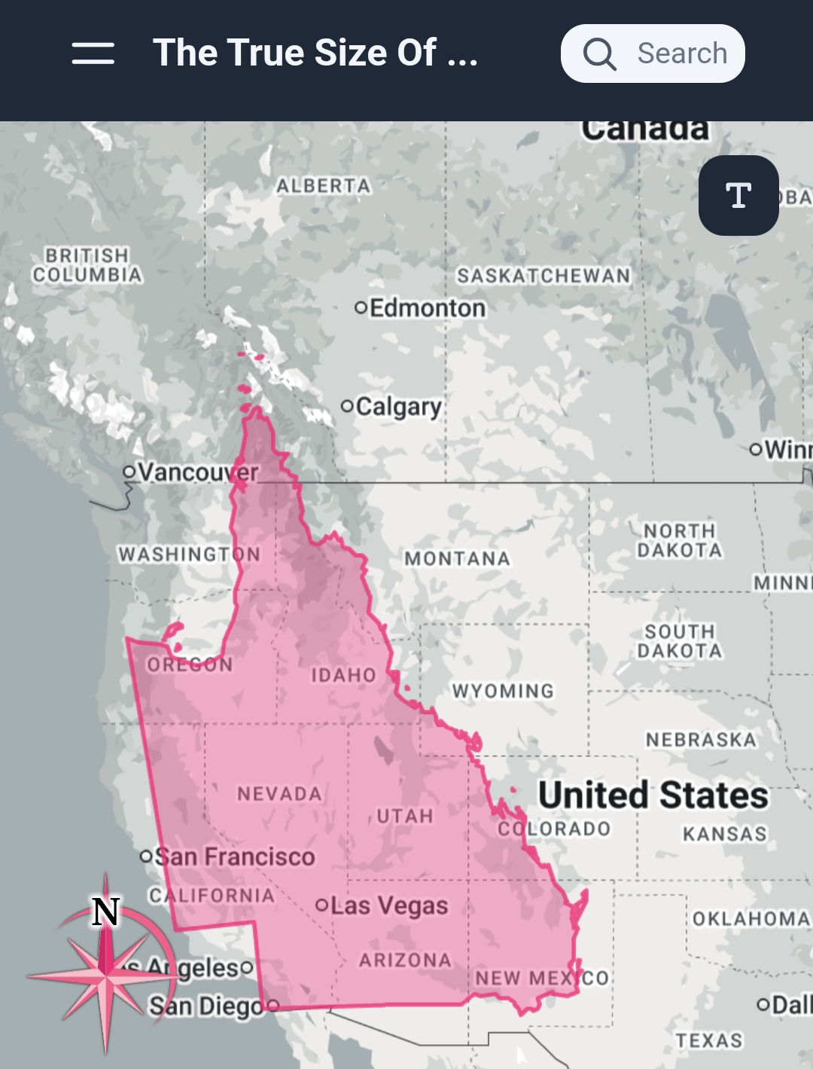

Slide 5
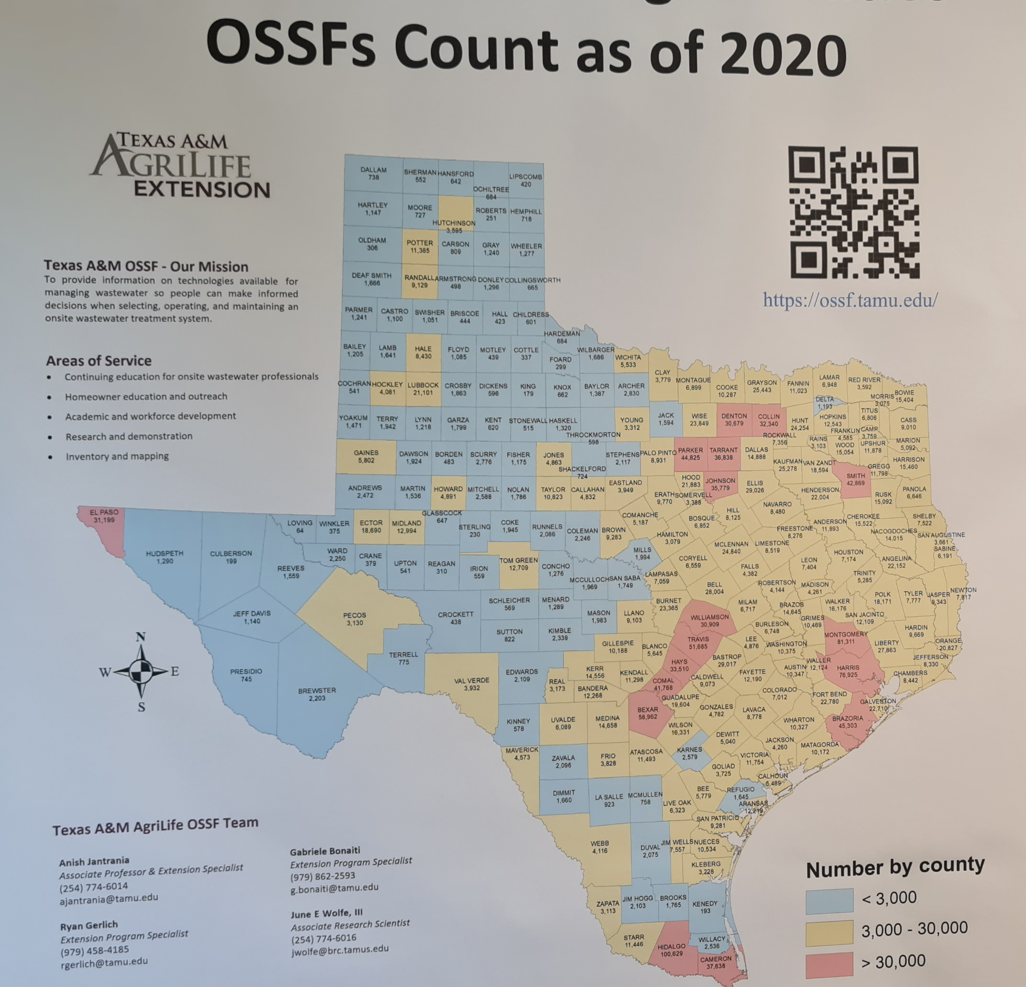

Slide 6
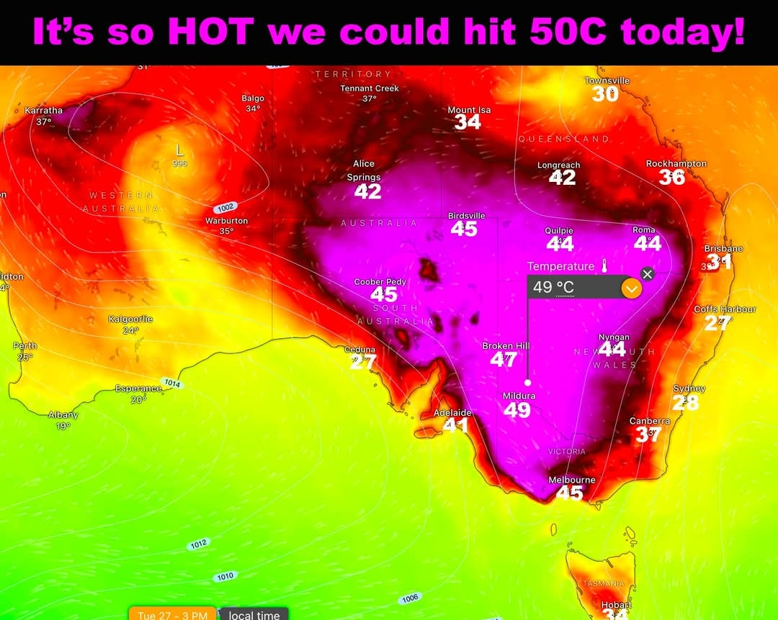

Slide 7
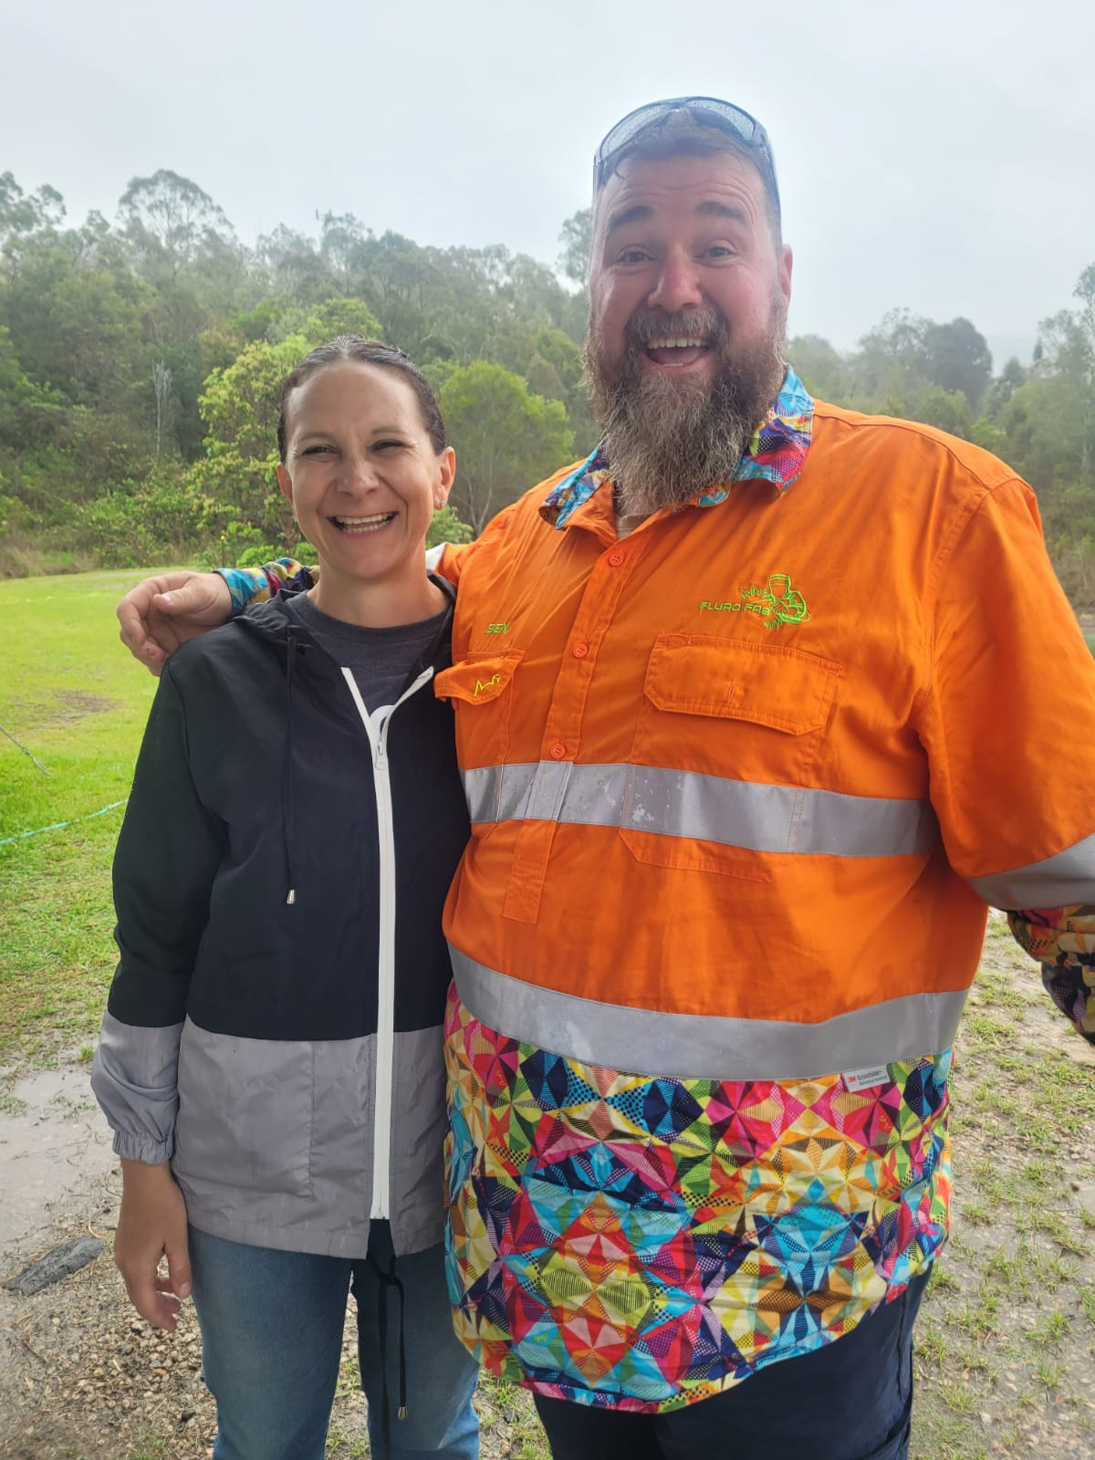
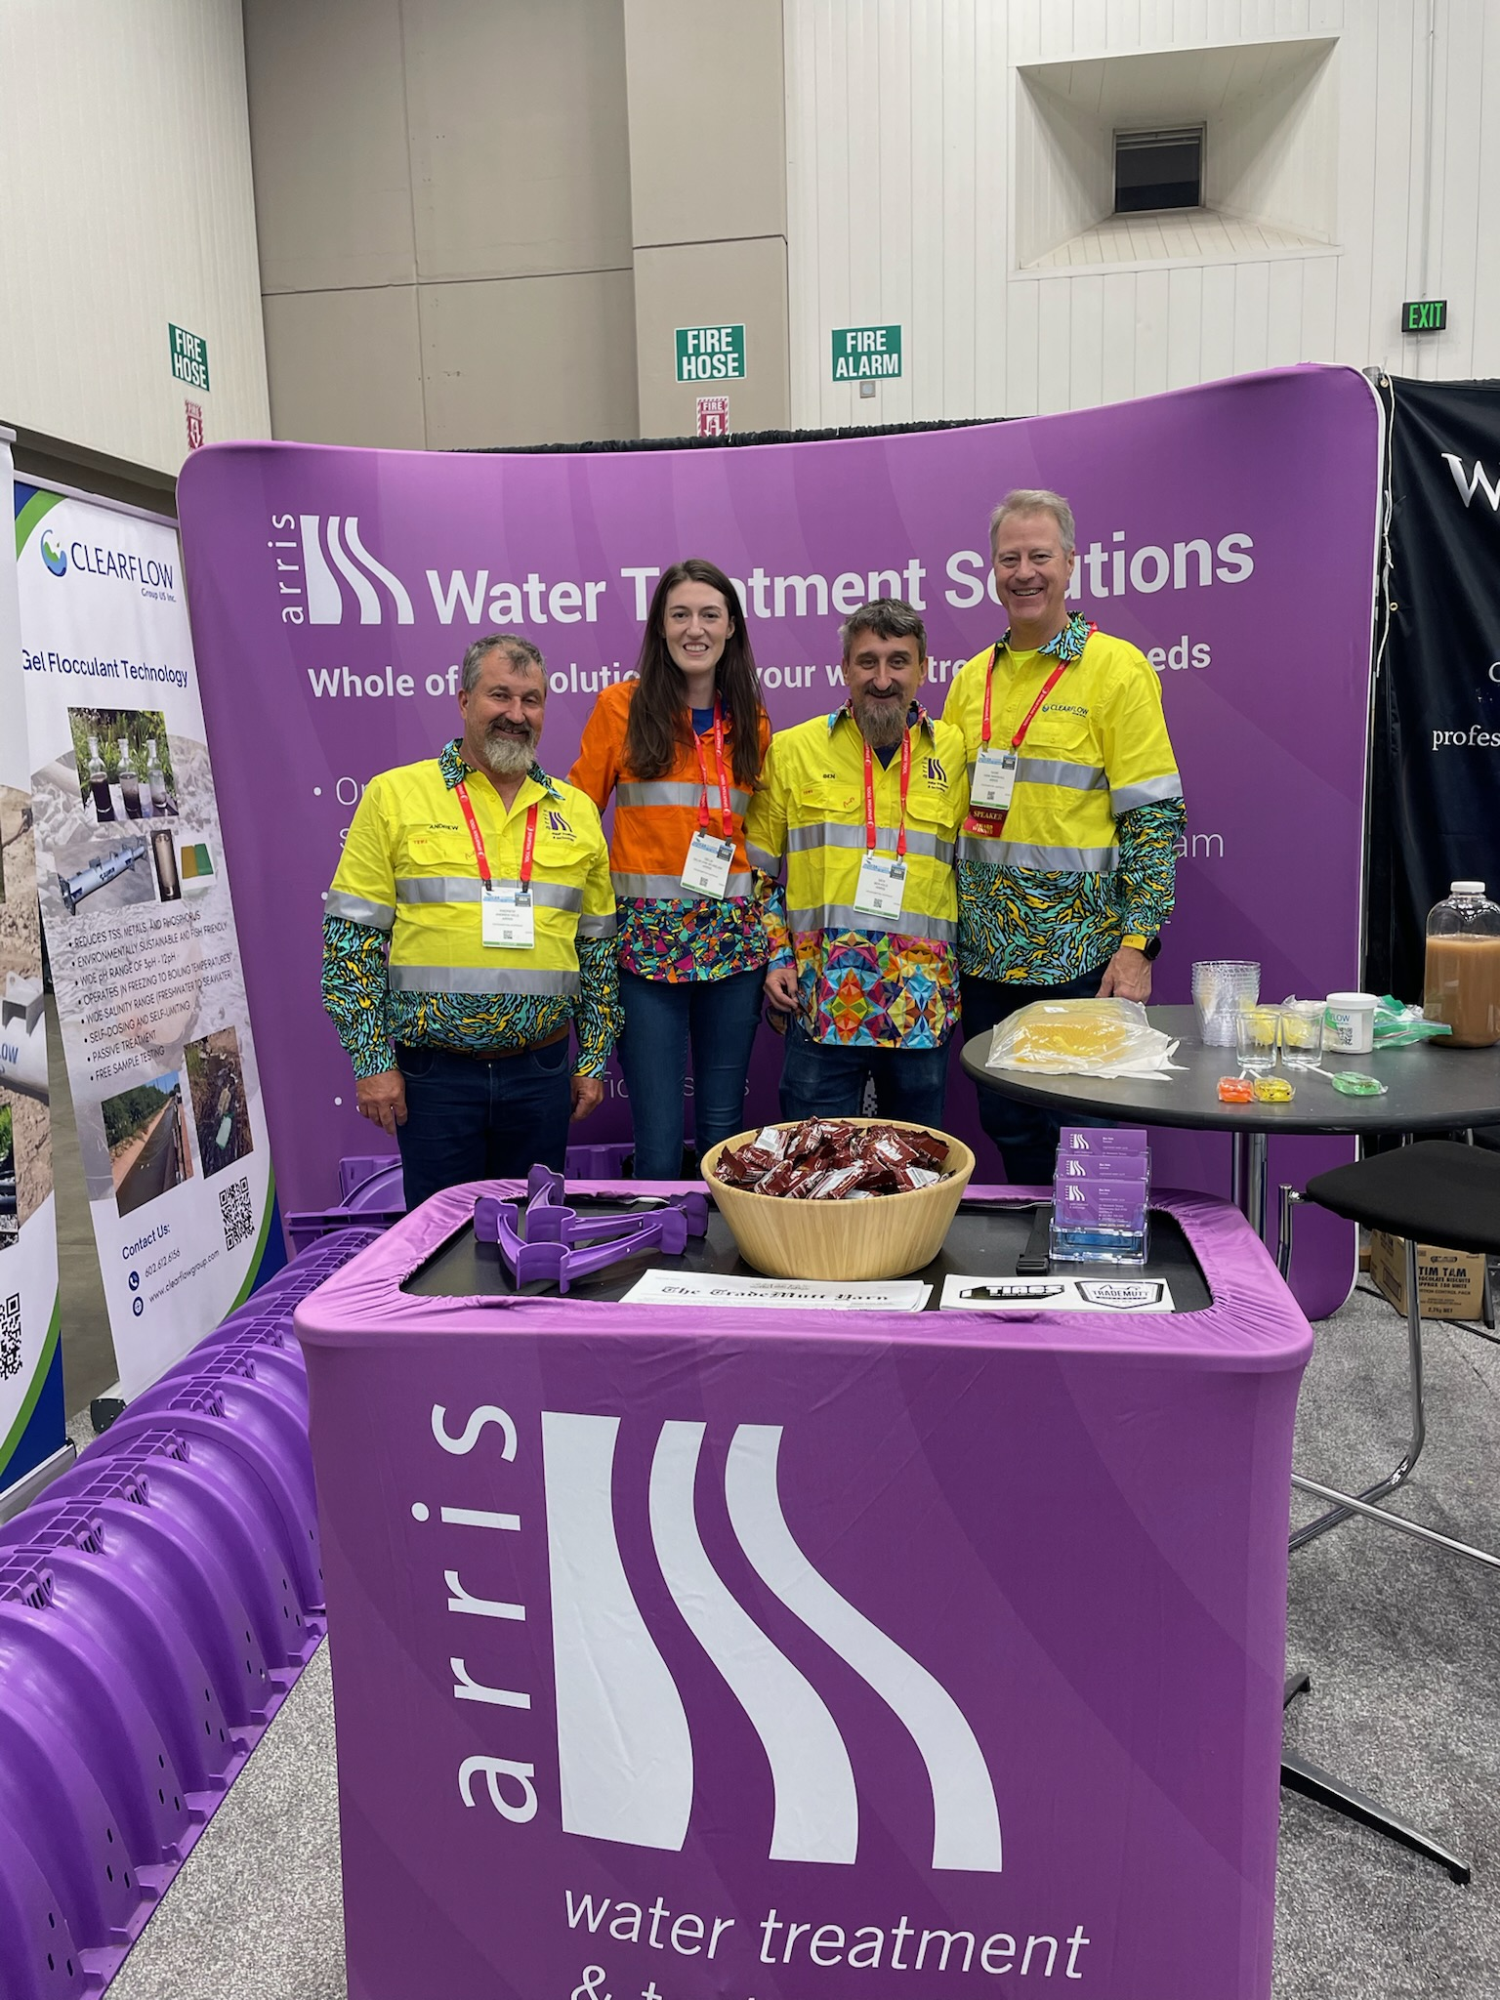
TradeMutt

Slide 8


Why Are There Difference Across the World?

Slide 9
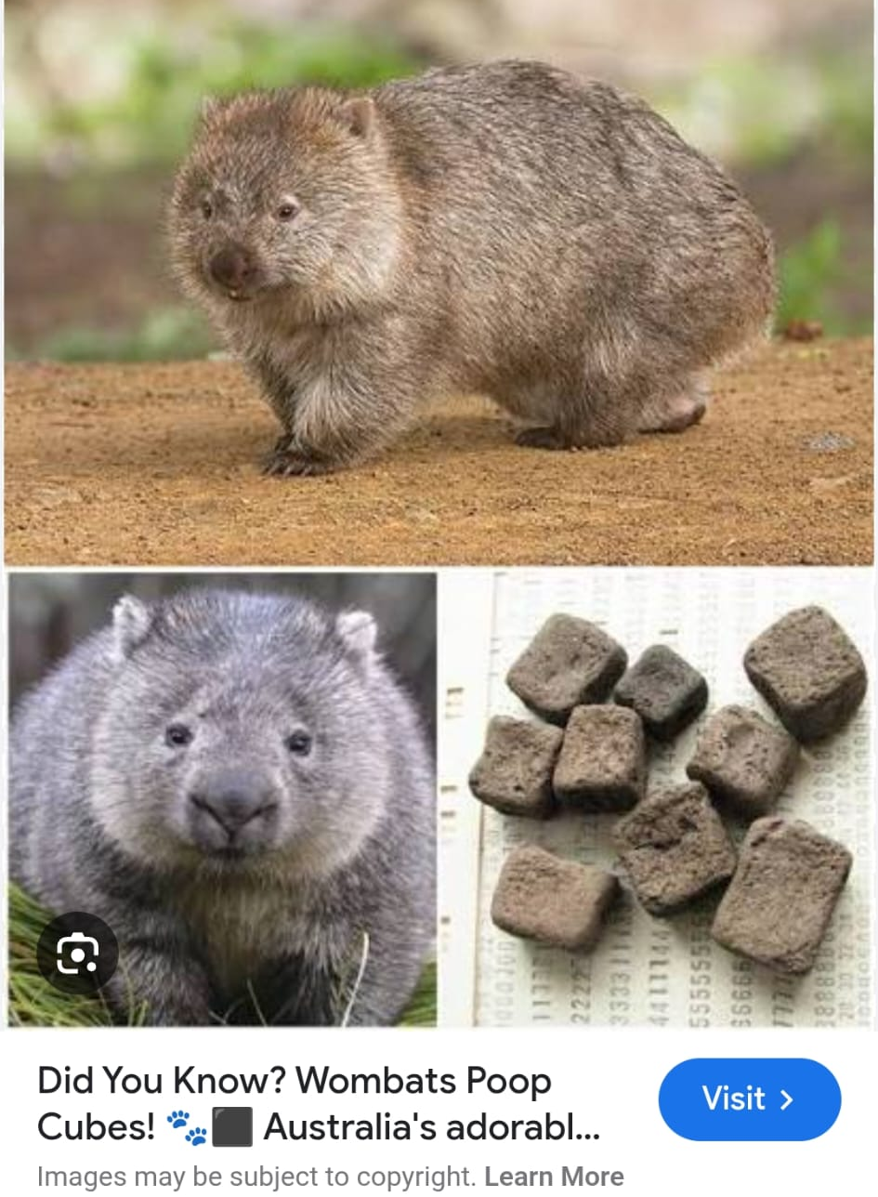
Wombats

Slide 10
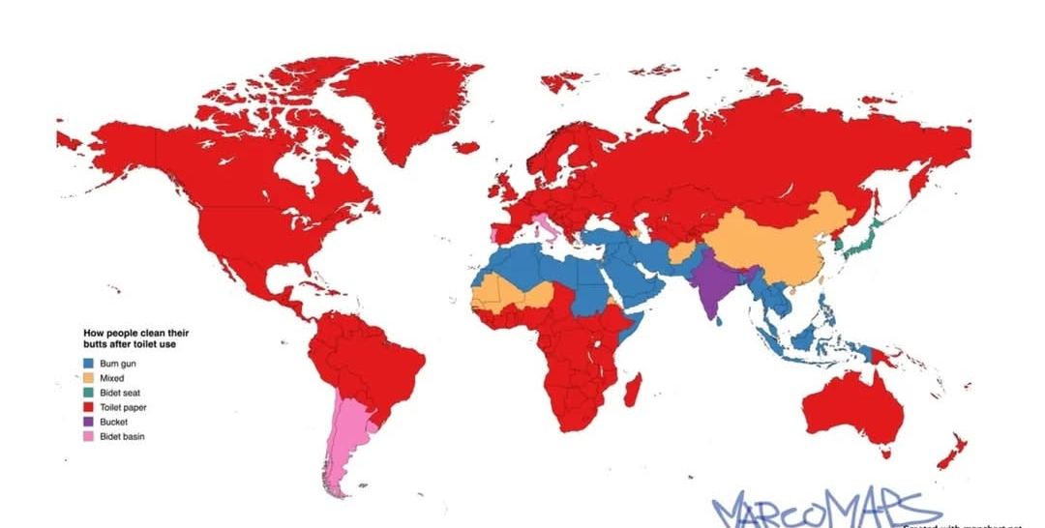
We Don’t Produce Wastewater the Same

Slide 11
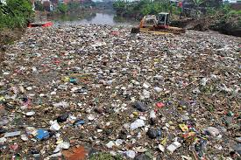
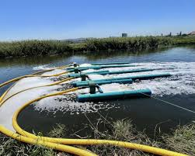
Different Priorities

Slide 12
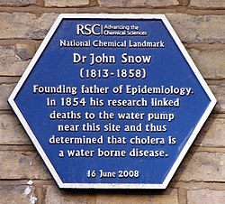
History of Regulations
The Big Stink in the Thames
Dr John Snow and the pump handle
Public Health Acts

Slide 13
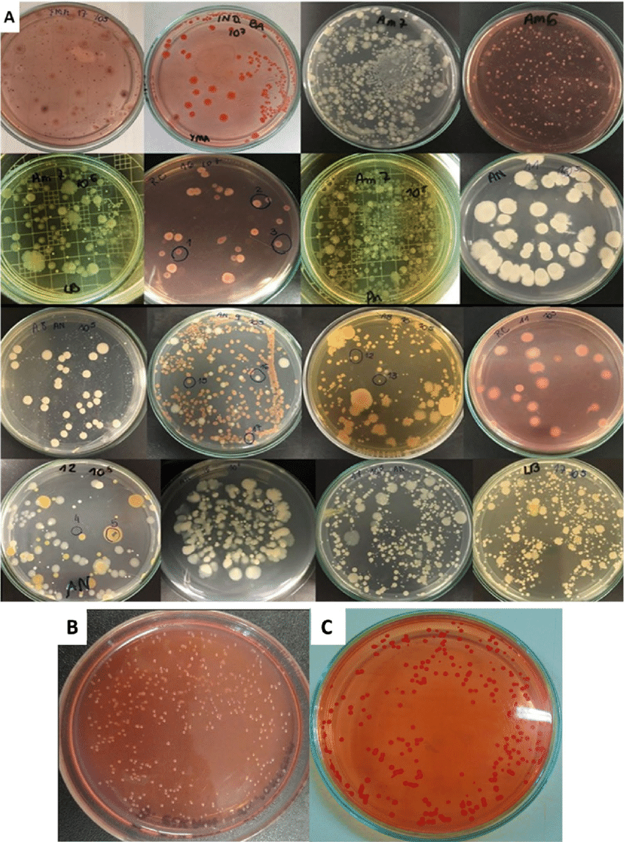
On-Site Wastewater Regulations
Generally Municipal wastewater regulations have been transferred over to the on-site sector
Especially in regards to water quality
Challenges as most Municipal sites discharge to water whereas on-site systems disperse into soil
Means that some of the water quality parameters are not a great fit
Such as BOD (BOD₅, cBOD₅)
Historical methods tend to linger
Influenced by mythical numbers
Blue Baby Syndrome
Change in test parameter is very hard
Escherichia coli (indicator)

Slide 14
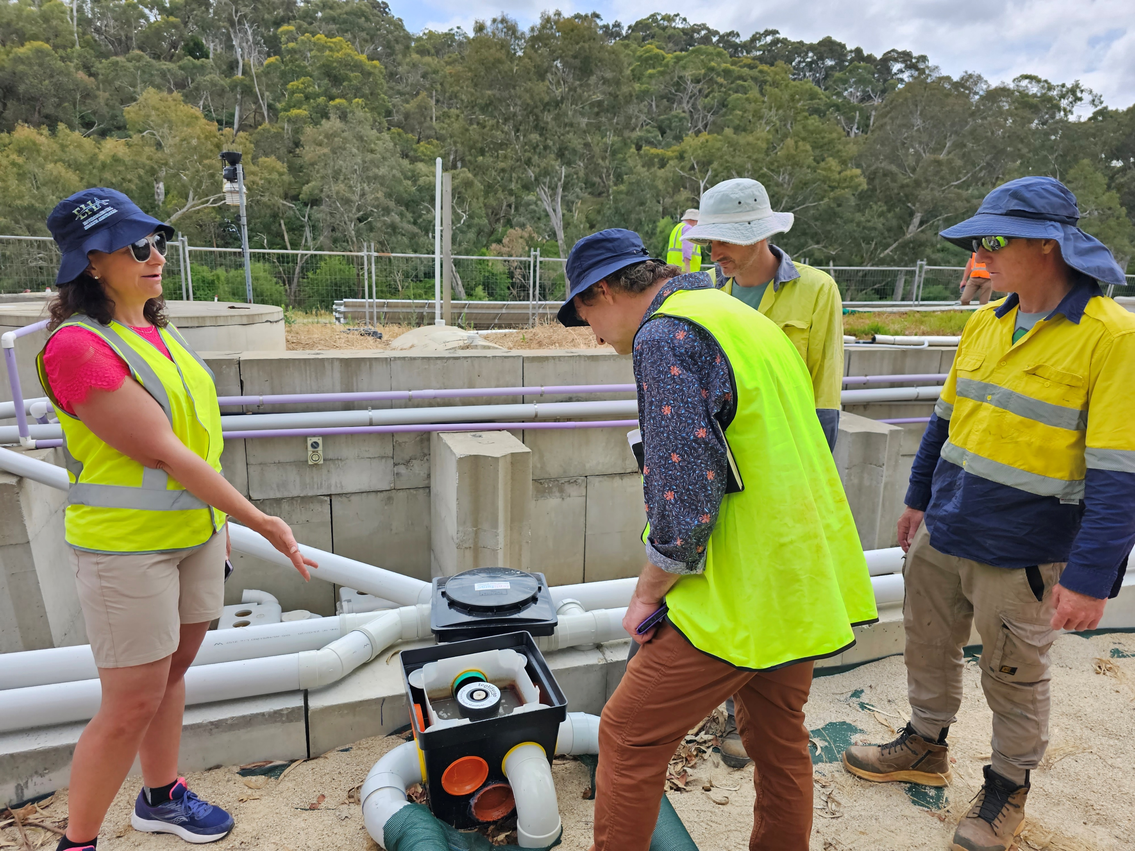
Accreditation Sites
Reasonably similar across the USA, Canada, Europe, the UK, Australia and New Zealand
Some differences in inflow concentrations, temperatures, flow volumes
Aim to make a uniform and fair process for different brands of on-site system to be tested
Uses a ‘domestic’ strength inflow wastewater

Slide 15
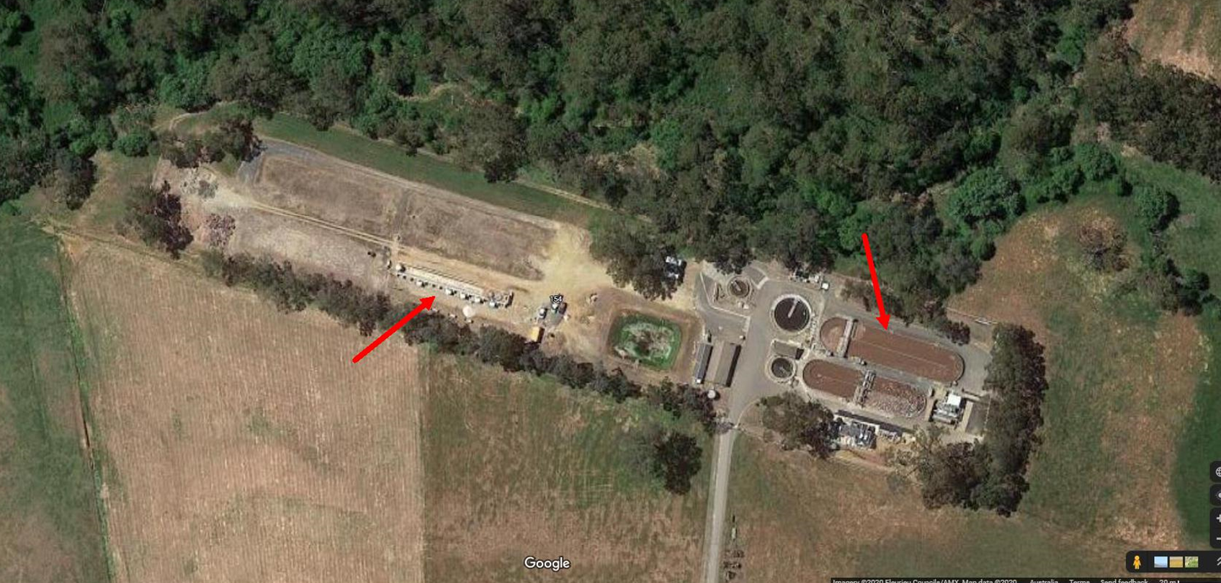
Accreditation Sites

Slide 16
What We’ve Learnt From Running a Testing Facility
High level of installation errors
Over 70%
High level of faults in units
Over 50%
Reliability issues over the course of the trial period
Difficulty in getting manufacturers to site for maintenance
Slight changes in temperature and inflow water quality can quickly impact treated water quality
Green marketing can impact water quality (energy consumption)
Surprising to us, because this is not a cheap process to undertake
Issues with ‘non-domestic’ wastewater at the Test Facility

Slide 17
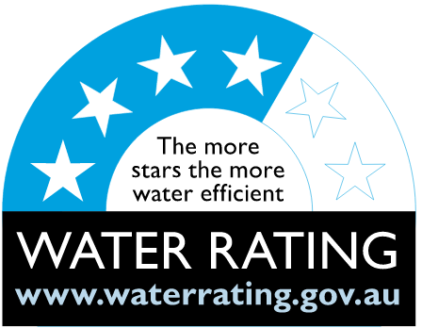
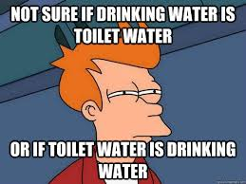
International Accreditation Standards
NSF water quality limits for the testing of on-site wastewater treatment systems are relatively ‘dilute’
Australia has Australian Standard (AS) 1546.3
BOD₅ is much higher than most other nations
Prevalence of drought in Australia has meant that water efficient infrastructure is used
WELS: water efficient labelling scheme
Toilets, shower heads, dishwashers, washing machines, taps, urinals.
Increased the concentration of certain contaminates in untreated wastewater
TSS, TN, TP, & BOD/COD
Change in AS 1546.3 meant that Australian on-site systems needed to be recertified
Some struggled with the changes in untreated wastewater limits
Commercial sites often have untreated wastewater concentrations outside of typical domestic ranges

Slide 18
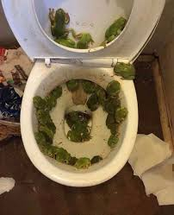
Frogs in the Toilet are a ‘Thing’

Slide 19
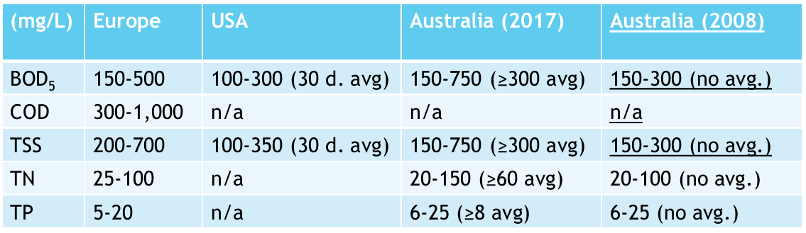
Domestic Inflow Water Quality

Slide 20
Lessons from AS1546.3
Any type of system can fail…or pass…
Pressure dosing
Peak flow and/or surge testing
Tests the capacity for hydraulic short circuits to adversely impact water quality
Holiday testing
Tests the impact of a no-flow scenario on water quality
Winter testing
Impact of lower temperatures on performance
Air temperature is critical
Installation errors are common
Competition impacts on the design of the system
Size of system
Passive and low input systems are typically non-propriety
Specialised equipment, such as tunnel/chambers, used in installation
Testing a passive/low input system can be challenging
Liners

Slide 21
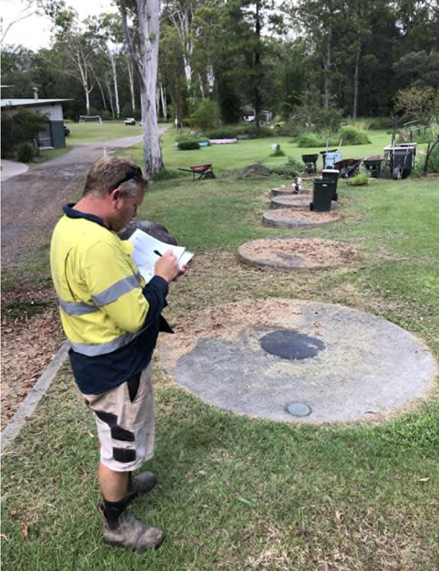
Lessons Not Taught by AS1546.3
Great effort is made to ensure inflow wastewater is consistent at an accreditation site
Real life is often very different
Water quality, flow patterns, site issues
Can be as simple as the number of people in a dwelling
Maintenance at a testing site is done promptly
Systems monitored by SCADA
Maintenance in the real world can be very infrequent
Lack of organic carbon
Influence of contaminants of concern
Disinfectants, wet wipes, cleaning chemicals, etc
Different installation methods
Soil types at sites
Opinions of relevant Regulators

Slide 22
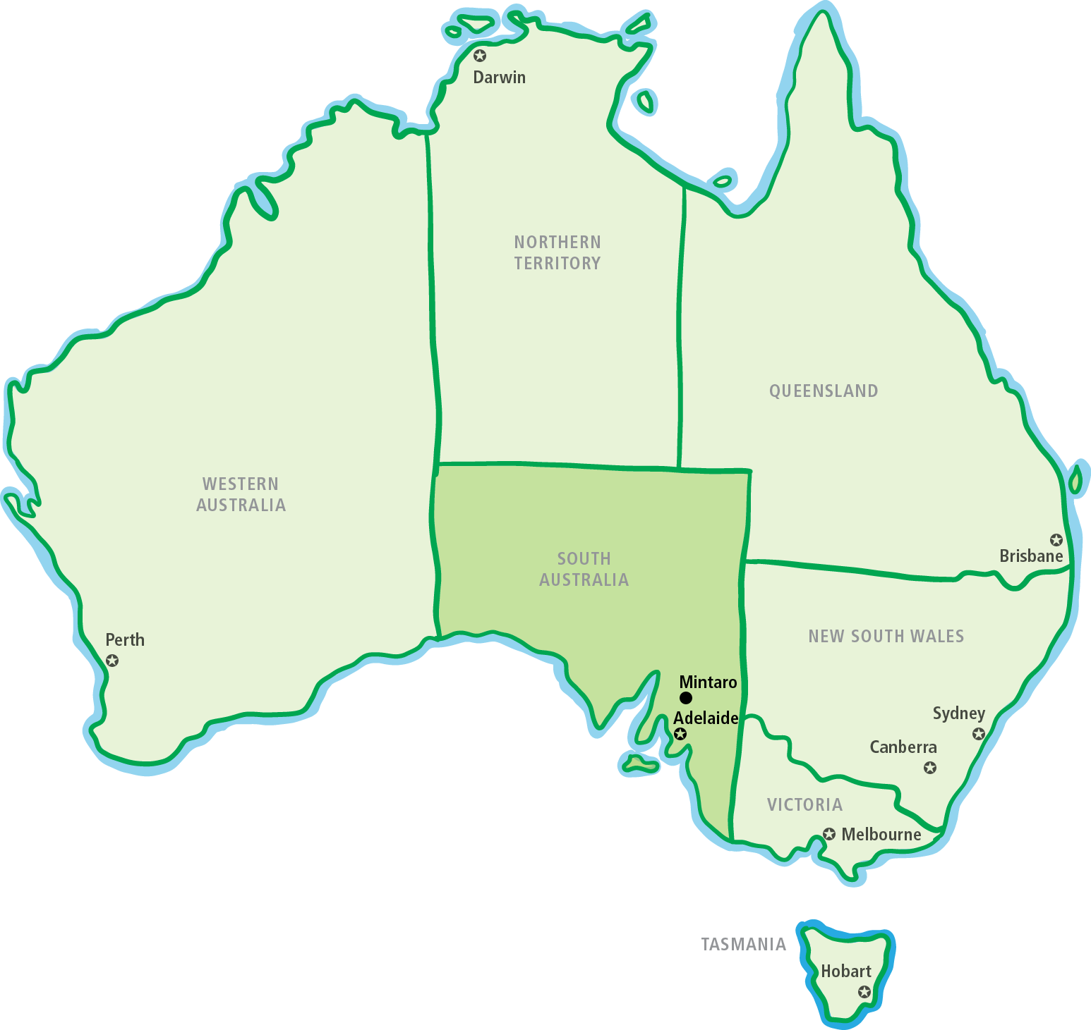
Climate: Evapotranspiration Modelling

Slide 23
Reference FAO56 Evapotranspiration
Example Daily ET0 for 2 years
Darwin vs Mintaro

Slide 24
Soils in On-site Wastewater Regulations
Often neglected in regulations in regards to specific risks
Water quality parameters are generally linked to water discharge not soil dispersal
BOD or organic carbon is bad for streams/lakes/aquifers/oceans, but essential for soil health
Gravity versus pressure dosing regulations are interesting
Distribution boxes
Little attention is paid to salinity and sodicity risks

Slide 25
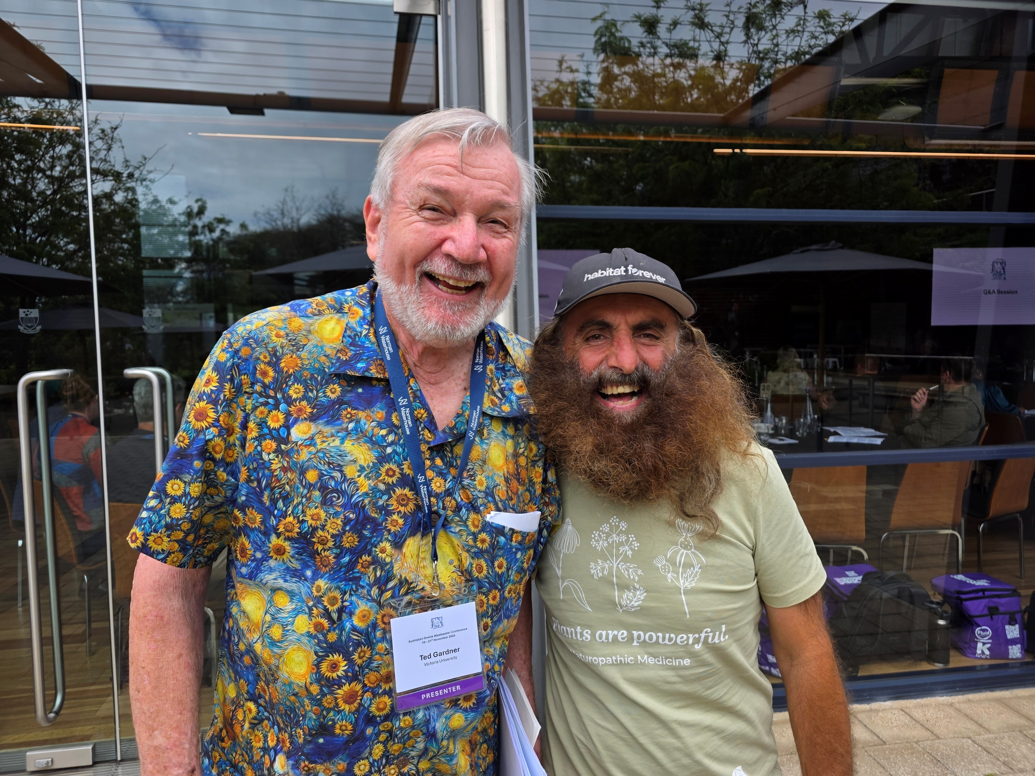
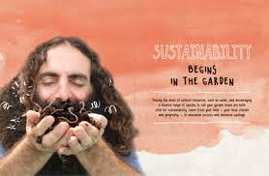
Soil Health

Slide 26
Salinity
Salts can be defined as compounds that disassociate in water to form negative ions (anions) and positive ions (cations) (Patterson, 2007).
Chemically a salt is the result of a neutralisation reaction between an acid and a base (Lambert and Turner, 2000).
A salt is an ionic compound that can be either an organic or inorganic chemical (Lambert and Turner, 2000).
The concentration of all salts present in a soil or water is the definition of salinity (VanDeGraaff and Patterson, 2001).

Slide 27
Types of Salinity

Slide 28
Sodicity
Sodium is present in most types of water and soil
The sodium absorption ratio (SAR) is the comparison of the relative preponderance of dissolved sodium (Na) ions in water in contrast to the concentrations of dissolved calcium (Ca) and magnesium (Mg)

Slide 29
Sodicity
SAR = Na/
Where: Concentrations are in centimoles (+) per litre (Van de Graaff and Patterson 2001)
What impact the SAR has when applied to a soil is greatly depended on the soil structural components (sand, silt, clay), the cation exchange capacity (CEC) and the exchangeable sodium percentage (ESP) of the soil.

Slide 30
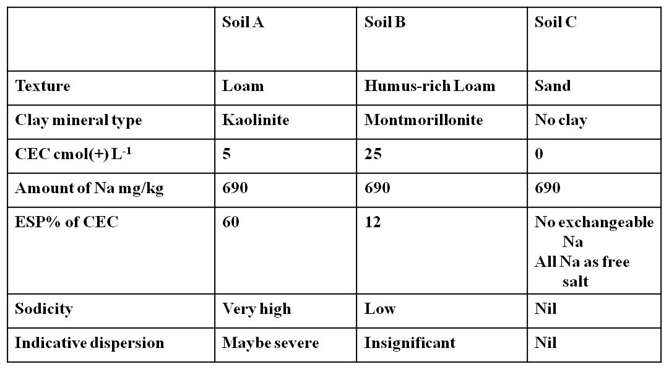
Sodicity Relationship with 3 Soils

Slide 31
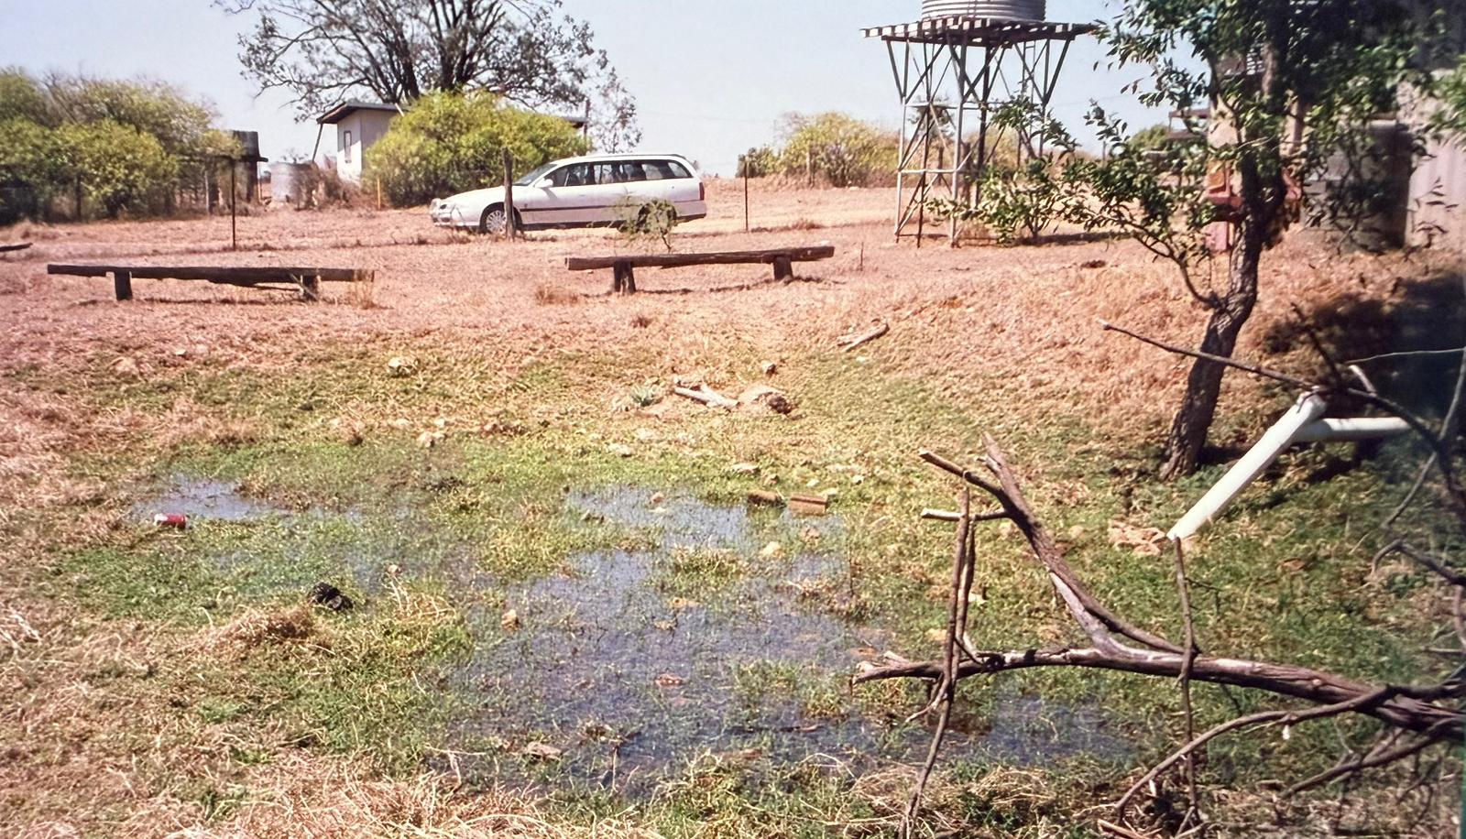
Impact of Salinity & Sodicity

Slide 32
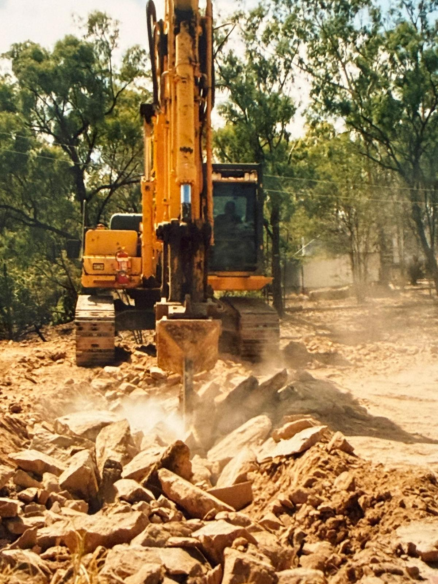
Australian Soils

Slide 33
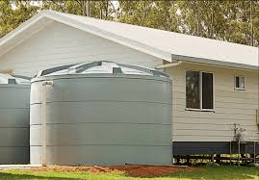
Rainwater Tanks
Legal all over Australia
Used in Urban & Rural Areas
Don’t need to meet drinking water standards
Around 15% of the Population uses for drinking water
Competes with treated wastewater for water recycling opportunities
Toilet flushing
Laundries

Slide 34
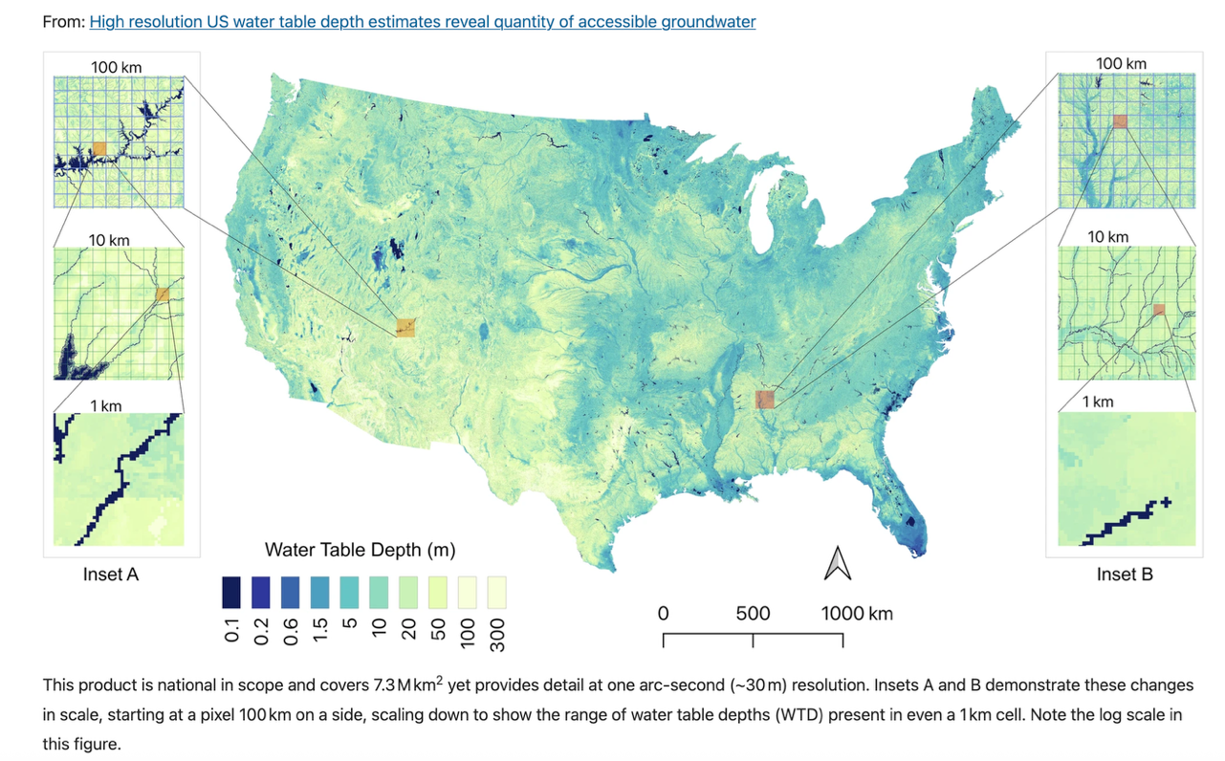
Abundance of Freshwater in USA

Slide 35
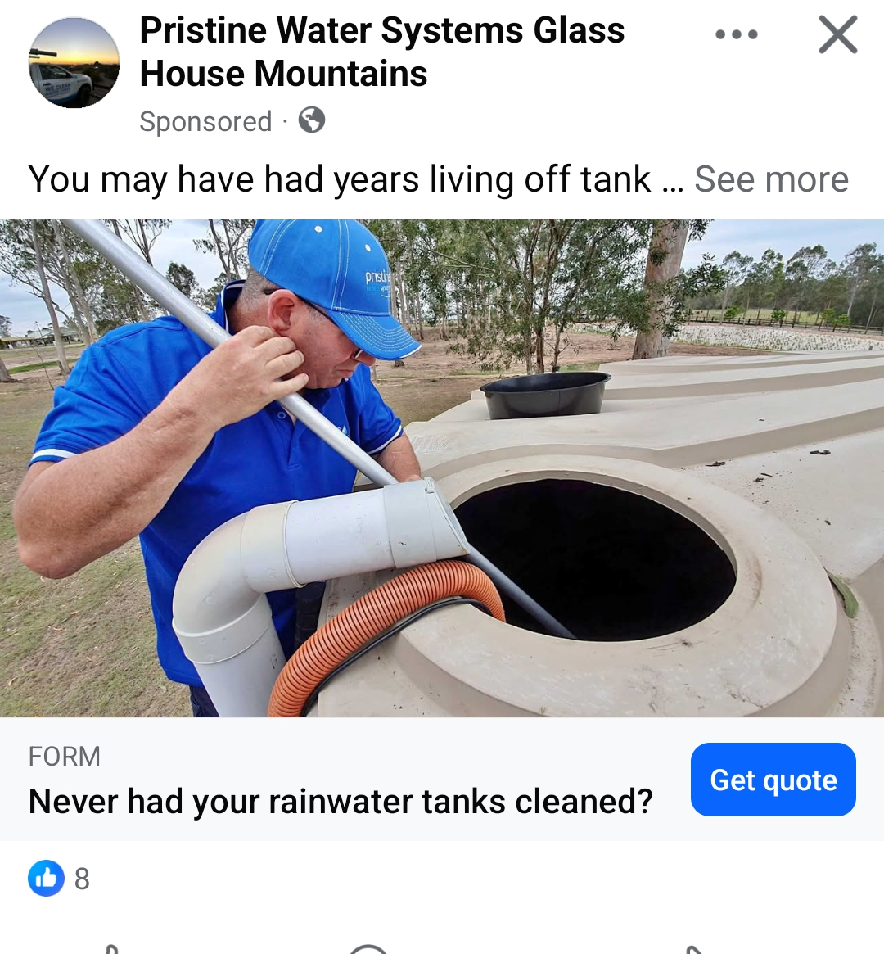
Rainwater Tanks
Overall good quality water
Low salinity
Low microbes
Low TSS
Low BOD/COD
Very soft
The low pH can cause issues
Biomat/sludge layer can form on the bottom of the tank

Slide 36
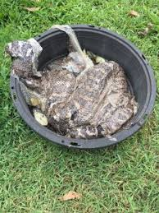
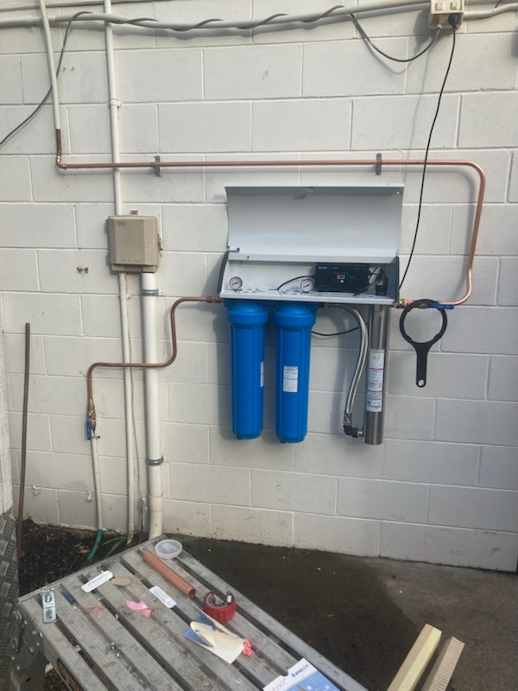
Cleaning Rainwater Tanks

Slide 37
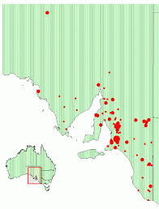
Decentralized Domestic
Popularity varies across Australia
Hundreds of systems in some States
Relatively few in others
But increasing in popularity
Regulator & Government support
Housing crisis
Often uses treatment chains rather than a single package ATU unit
Small to Medium pipe

Slide 38
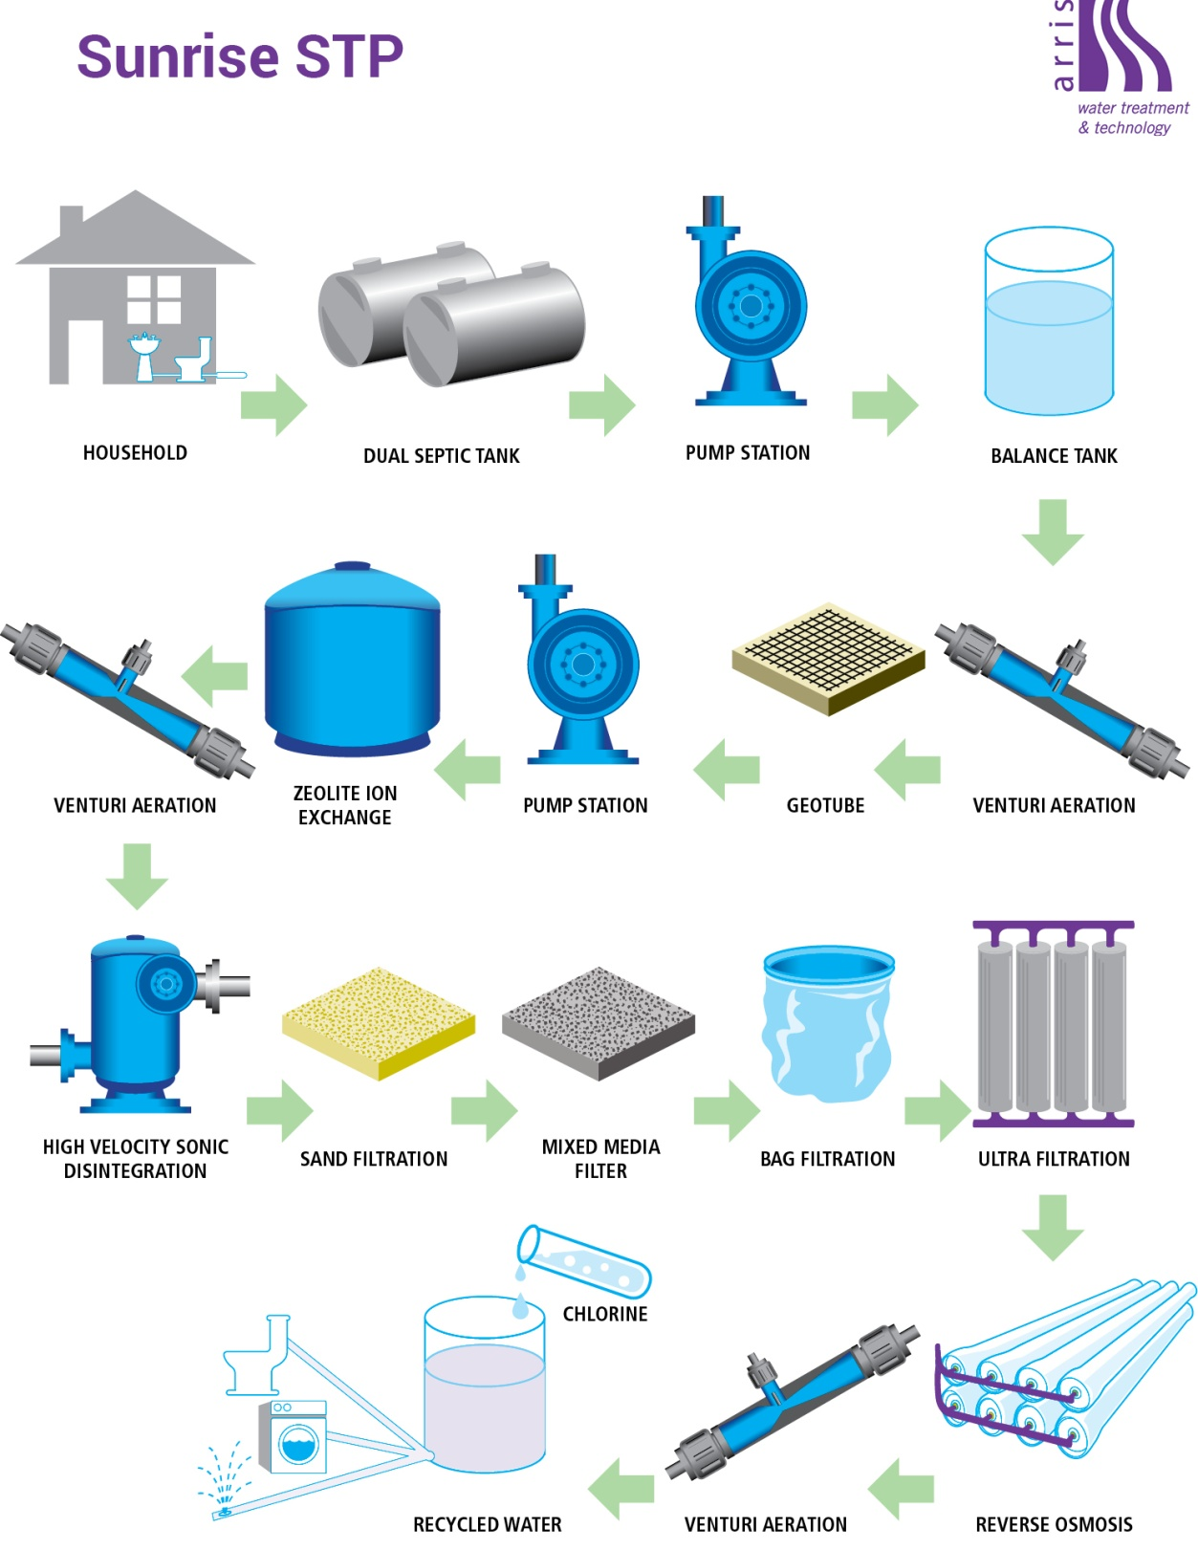

Slide 39
Decentralized: Non-Domestic
Many different types of sites
Commercial
Industrial
Leachate
Mining & Gas
Require different types of treatment solutions that are ‘fit-for-purpose’ to the type of wastewater being treated and the reuse/dispersal method
Discharge to water is more common than for domestic decentralized
Very high water quality can be achieved

Slide 40
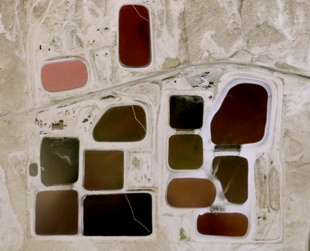
No Such Magic Place as ‘Away’

Slide 41
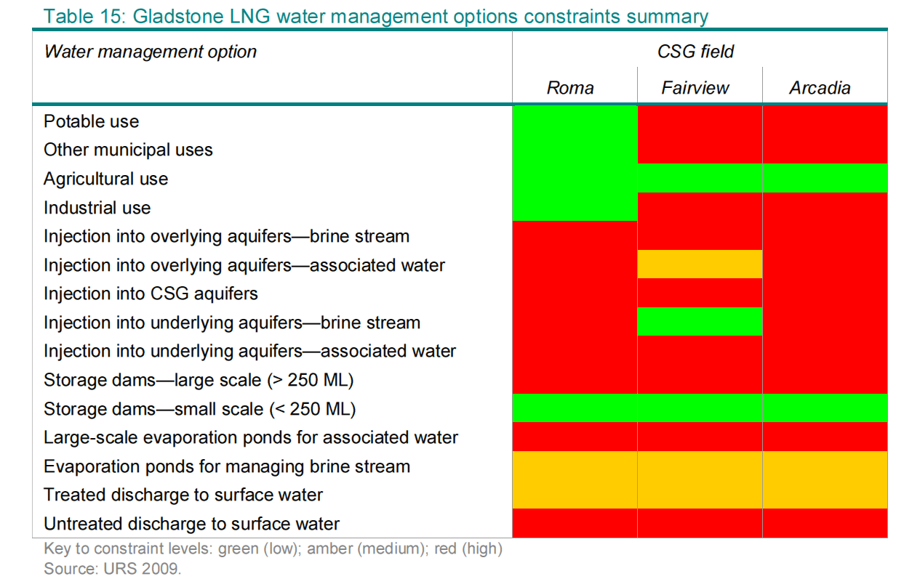
Risk Management

Slide 42
Reverse Osmosis
Very good water quality
This itself may cause issues
Not very effective at reducing SAR
Need for chemical adjustment
Very effective at reducing Salinity
Some ions not effectively removed
Boron, Bromide, sometimes Fluoride
Energy intensive
High Opex
Produces a brine

Slide 43
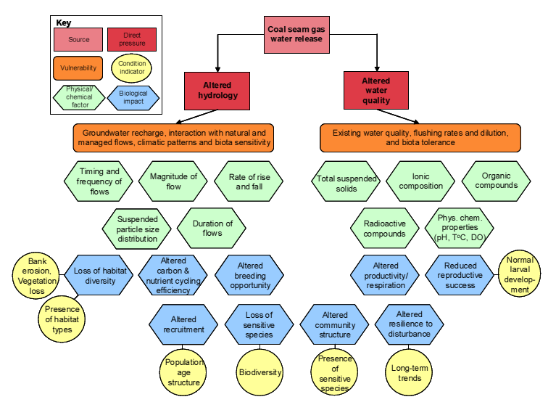
Excellent Water Quality is No Problem…Right?

Slide 44
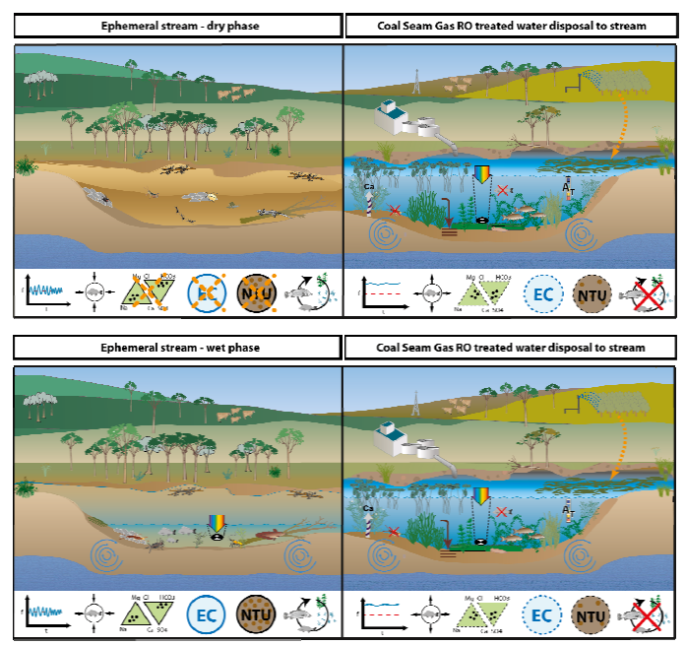

Slide 45
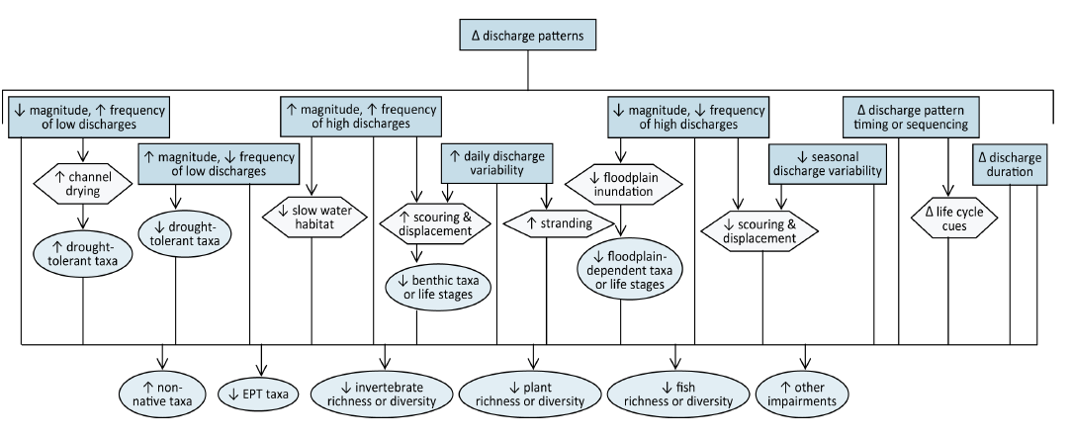
Too Much Good Quality Water Hasn’t been a Traditional Problem

Slide 46
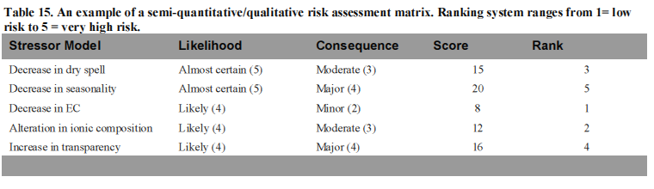
Risk Assessment

Slide 47
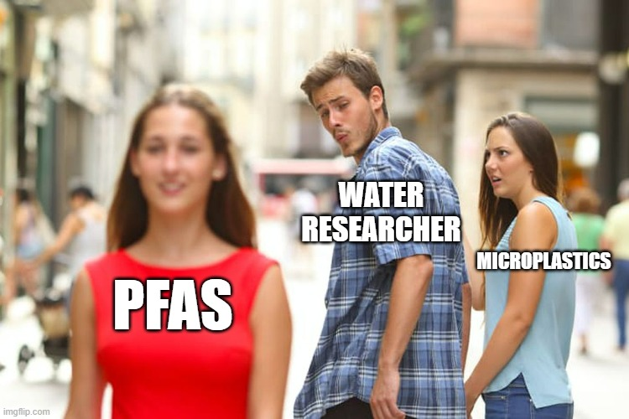
Research for On-Site & Decentralized
Water research has trends
Often influenced by Big-Pipe Issues
Doesn’t mean they are not interesting
Important data can be collected
Funding grants specifically for on-site & decentralized issues are very rare
Industry Associations are very important in ensuring good research is performed

Slide 48
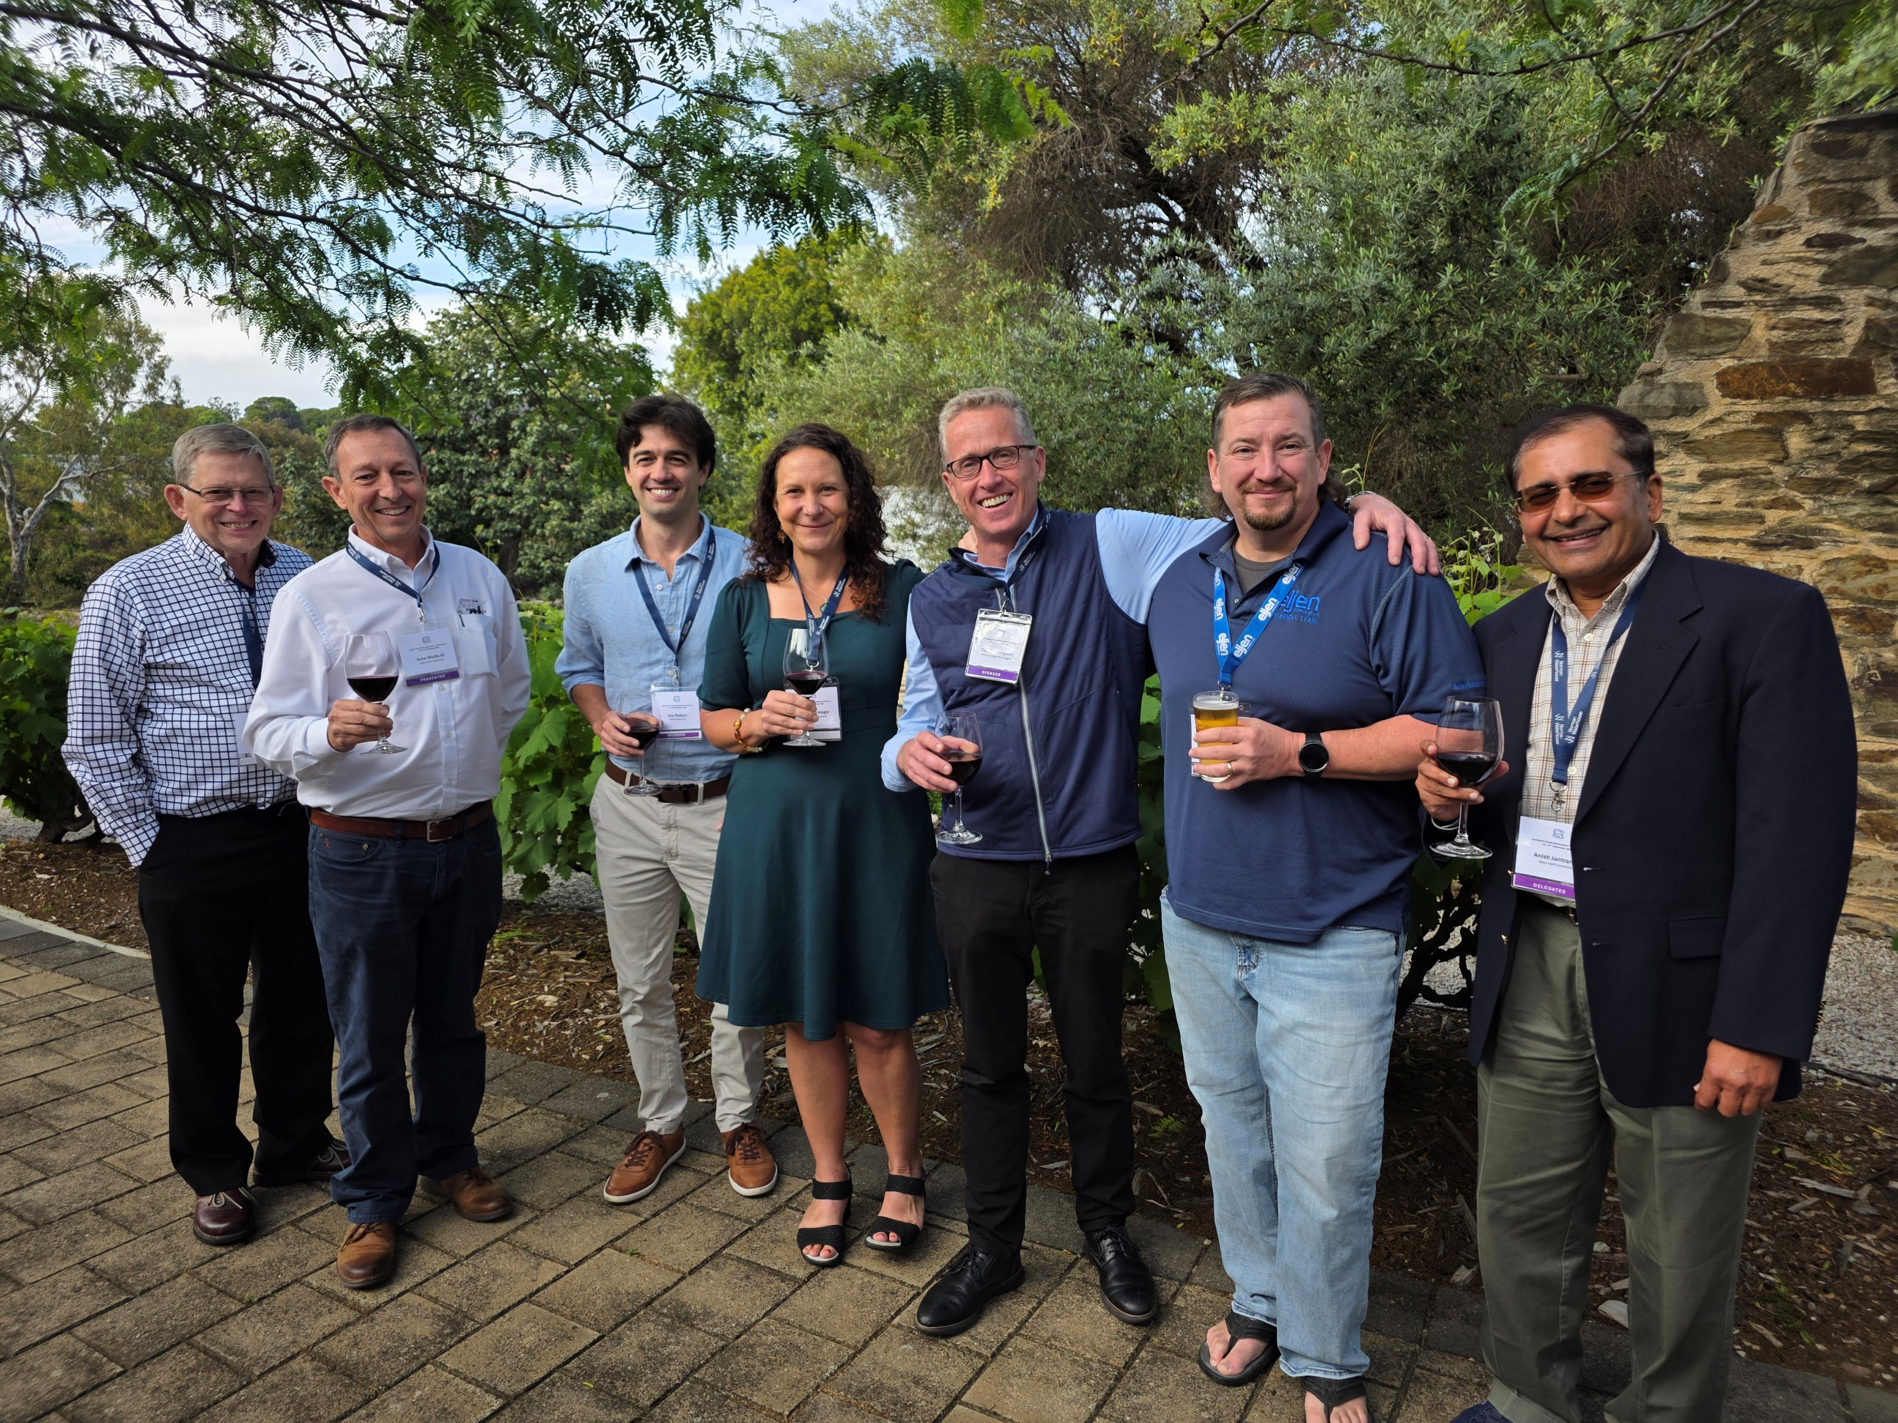
Australian On-Site Conference
1st Conference in 13 years held in 2025
Would not have happened without the support of NOWRA members & the US Industry
Looking to restart an Australian On-site Wastewater Association in 2026
Next Conference in 2027
Updates connect with me on LinkedIn and/or follow Arris Water on LinkedIn

