Slide 1

Evolving Wastewater –
How Do We Adjust?
Dr. Sara Heger
sfheger@gmail.com

Slide 2
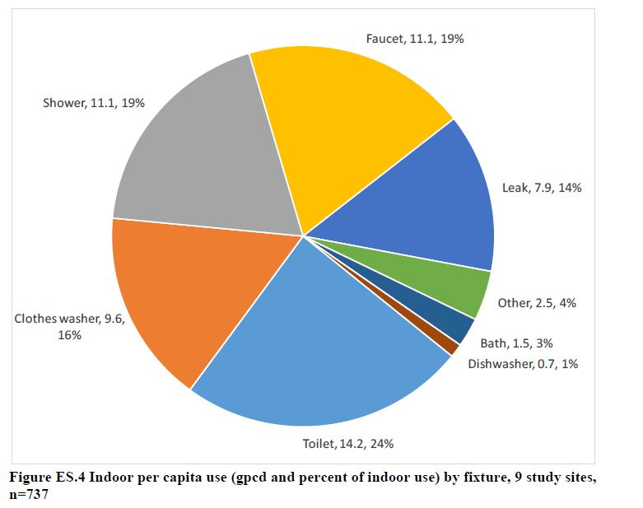
Presentation overview
Research on change in concentrations
Impacts for OWTS
Design considerations

Slide 3
Changing Parameters
Quantity hydraulic loading volume per day
Quality organic loading
pounds per day
Toxics Pharmaceuticals
Cleaning products
Notes:
The required size and capability of an onsite wastewater treatment system is dependent on the wastewater’s quality, or strength, the oxygen demand the constituents will generate, and the daily wastewater flow.
We will describe wastewater loading in a couple different ways mainly in relation to:
We’ve already spent some time discussing Wastewater Quantity which is the Hydraulic loading and
Wastewater Quality which relates to Organic loading
We will then discuss the difference between Residential and commercial facilities.
Wastewater quantity and quality are actually interrelated parameters that cannot be totally separated. We will discuss them separately but need to keep this interrelationship in mind.
Across the nation there are a few states that are now making a real clear statement as what is domestic waste. Because our regulations across the nation, simply address domestic waste. Residential waste. They don’t address commercial waste. And that’s the real challenge here, is how do we take it from where we’re at to where we know we have to be? So what we’re saying in some states is that when we call it domestic waste, then the highest BOD5. It’s 300 ml per liter, not every state identifies that.

Slide 4
Hydraulic Loading
Wastewater quantity
Hydraulic loading
Residential Design/Peak values are 100-200 gallons per bedroom
Typically, residential average values are less then 1/2 of peak
Commercial facilities are very different
Average flows of >70% of design are problematic

Slide 5
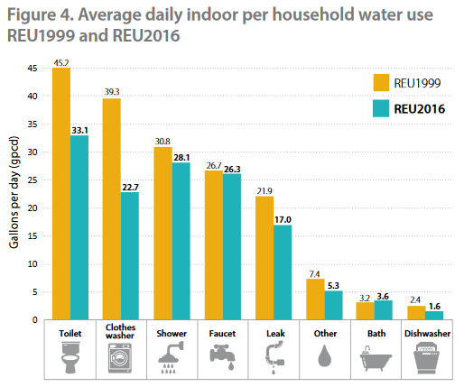
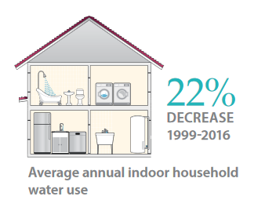
Typical household
1999
  177 gphd
2016
  138 gphd

Slide 6
Average daily indoor 1999 vs 2016

Slide 7
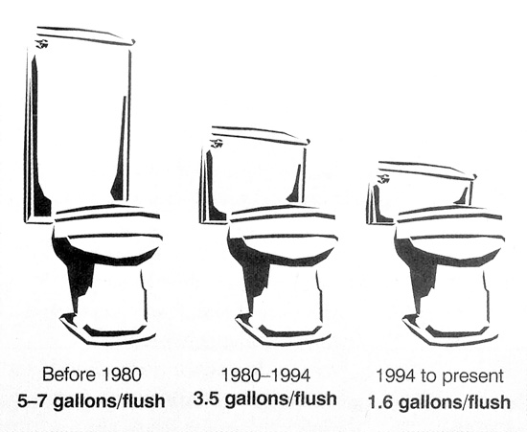
Change in Toilet Flush Volumes

Slide 8

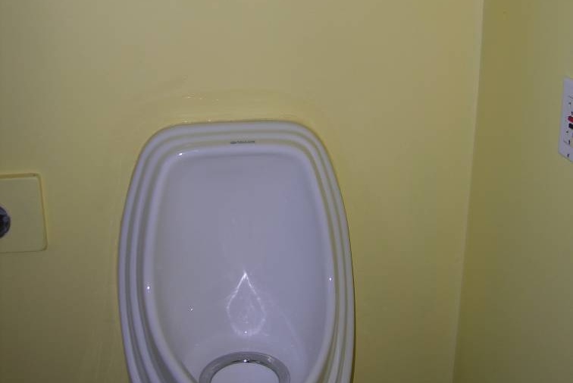
Water saving devices
Decrease water quantity
Wastewater strength increases
No change in mass load
Notes:
Water saving devices only change the hydraulic loading. The mass loading will not change although with less dilution water, the concentrations will increase.

Slide 9
Water saving device example
A 4-person household produces 0.56 lbs/day TSS without water saving devices (75 gpd/person)
Then that family installs two new toilets, and so they only use 60 gpd/person
What is the change in TSS concentration after water saving devices are installed?
Notes:
This example shows how using water saving devices effect the TSS loading of a system. We are going to assume that a family of 4 produces .56 pounds of TSS per day. Their flow began as 75 gals per day per person before they switched to water saving devices. The flow per person dropped to 60 gallons per person per day.

Slide 10
Water saving device example calculation
TSS Concentration (before)
____ 0.56 lbs/day = 224 mg
300 gal x 0.00000834 L
TSS Concentration (after)
____ 0.56 lbs/day = 280 mg
240 gal x 0.00000834 L
Notes:
The loading remains constant even with water saving devices. Calculating the concentrations for the different flow values show that the concentration increases when the flow decreases although the overall loading is the same.

Slide 11
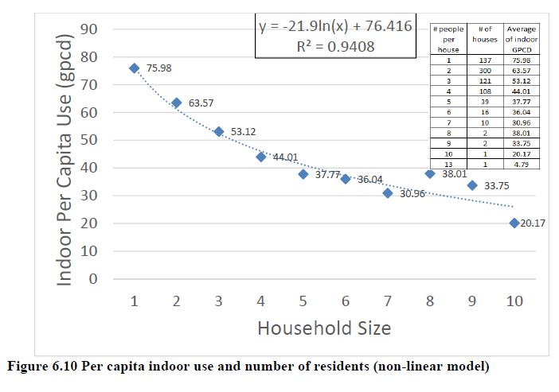
Non-linear use per person

Slide 12
Why are most code values higher?
Code values are peak flow values
System should be designed to not malfunction during times of peak usage
Unknown size of family in the future and no benefit of average across a community so maximum occupancy assumed
Most codes building in safety factor and do not critically evaluate mass loading (more to come)

Slide 13
Importance of hydraulic load
The daily flow must not exceed the system’s hydraulic capability
  Hydraulic detention time (HDT)
    Example: solids are not able to settle in a septic tank if the water moves through too quickly.
  Hydraulic overload of the soil
    Effluent surfacing
  Reduction in water use WILL increase retention times
Notes:
The two most significant impacts of hydraulic overload are in components that have particular hydraulic detention time necessary to provide the treatment. This is particularly important in tanks such as septic tanks or grease traps. If the water flows through too fast then the solids won’t have time to settle. Also if water moves too fast solids might get stirred up. The other aspect of excessive hydraulic loading rates are the soil acceptance rates. The soil must be able to accept the water from the treatment system.

Slide 14
Impact of Reduced Hydraulic Loads – Increased Retention Time
Notes:
Now that we know the Flow and the Biological values, we combine the two to determine the mass load
The organic loading is much more significant when converted to a mass loading rather than a concentration.

Slide 15
Example Septic Tank Detention
Typical sizing - Hydraulic retention time (HRT) plus solids storage
  2 days of HRT of design flow
  Add solids storage volume equal to 1/3 - 1/2 of the above hydraulic detention
Example 450 gpd design flow
  2 days of HRT = 900 gallons
  1/3 of design flow for storage = 225 gallons
  Total = 1125 gallons
  Actual flow = 225 gpd → HRT = 4 days
  Actual flow = 112 gpd → HRT = 6 days

Slide 16
Pros and Cons of more HRT
More settling and anaerobic treatment in a septic tank
More time for aerobic treatment in ATUs, mounds, sand filters, etc
More time for temperature loss (only good with a restaurant with a high temperature dishwasher)

Slide 17
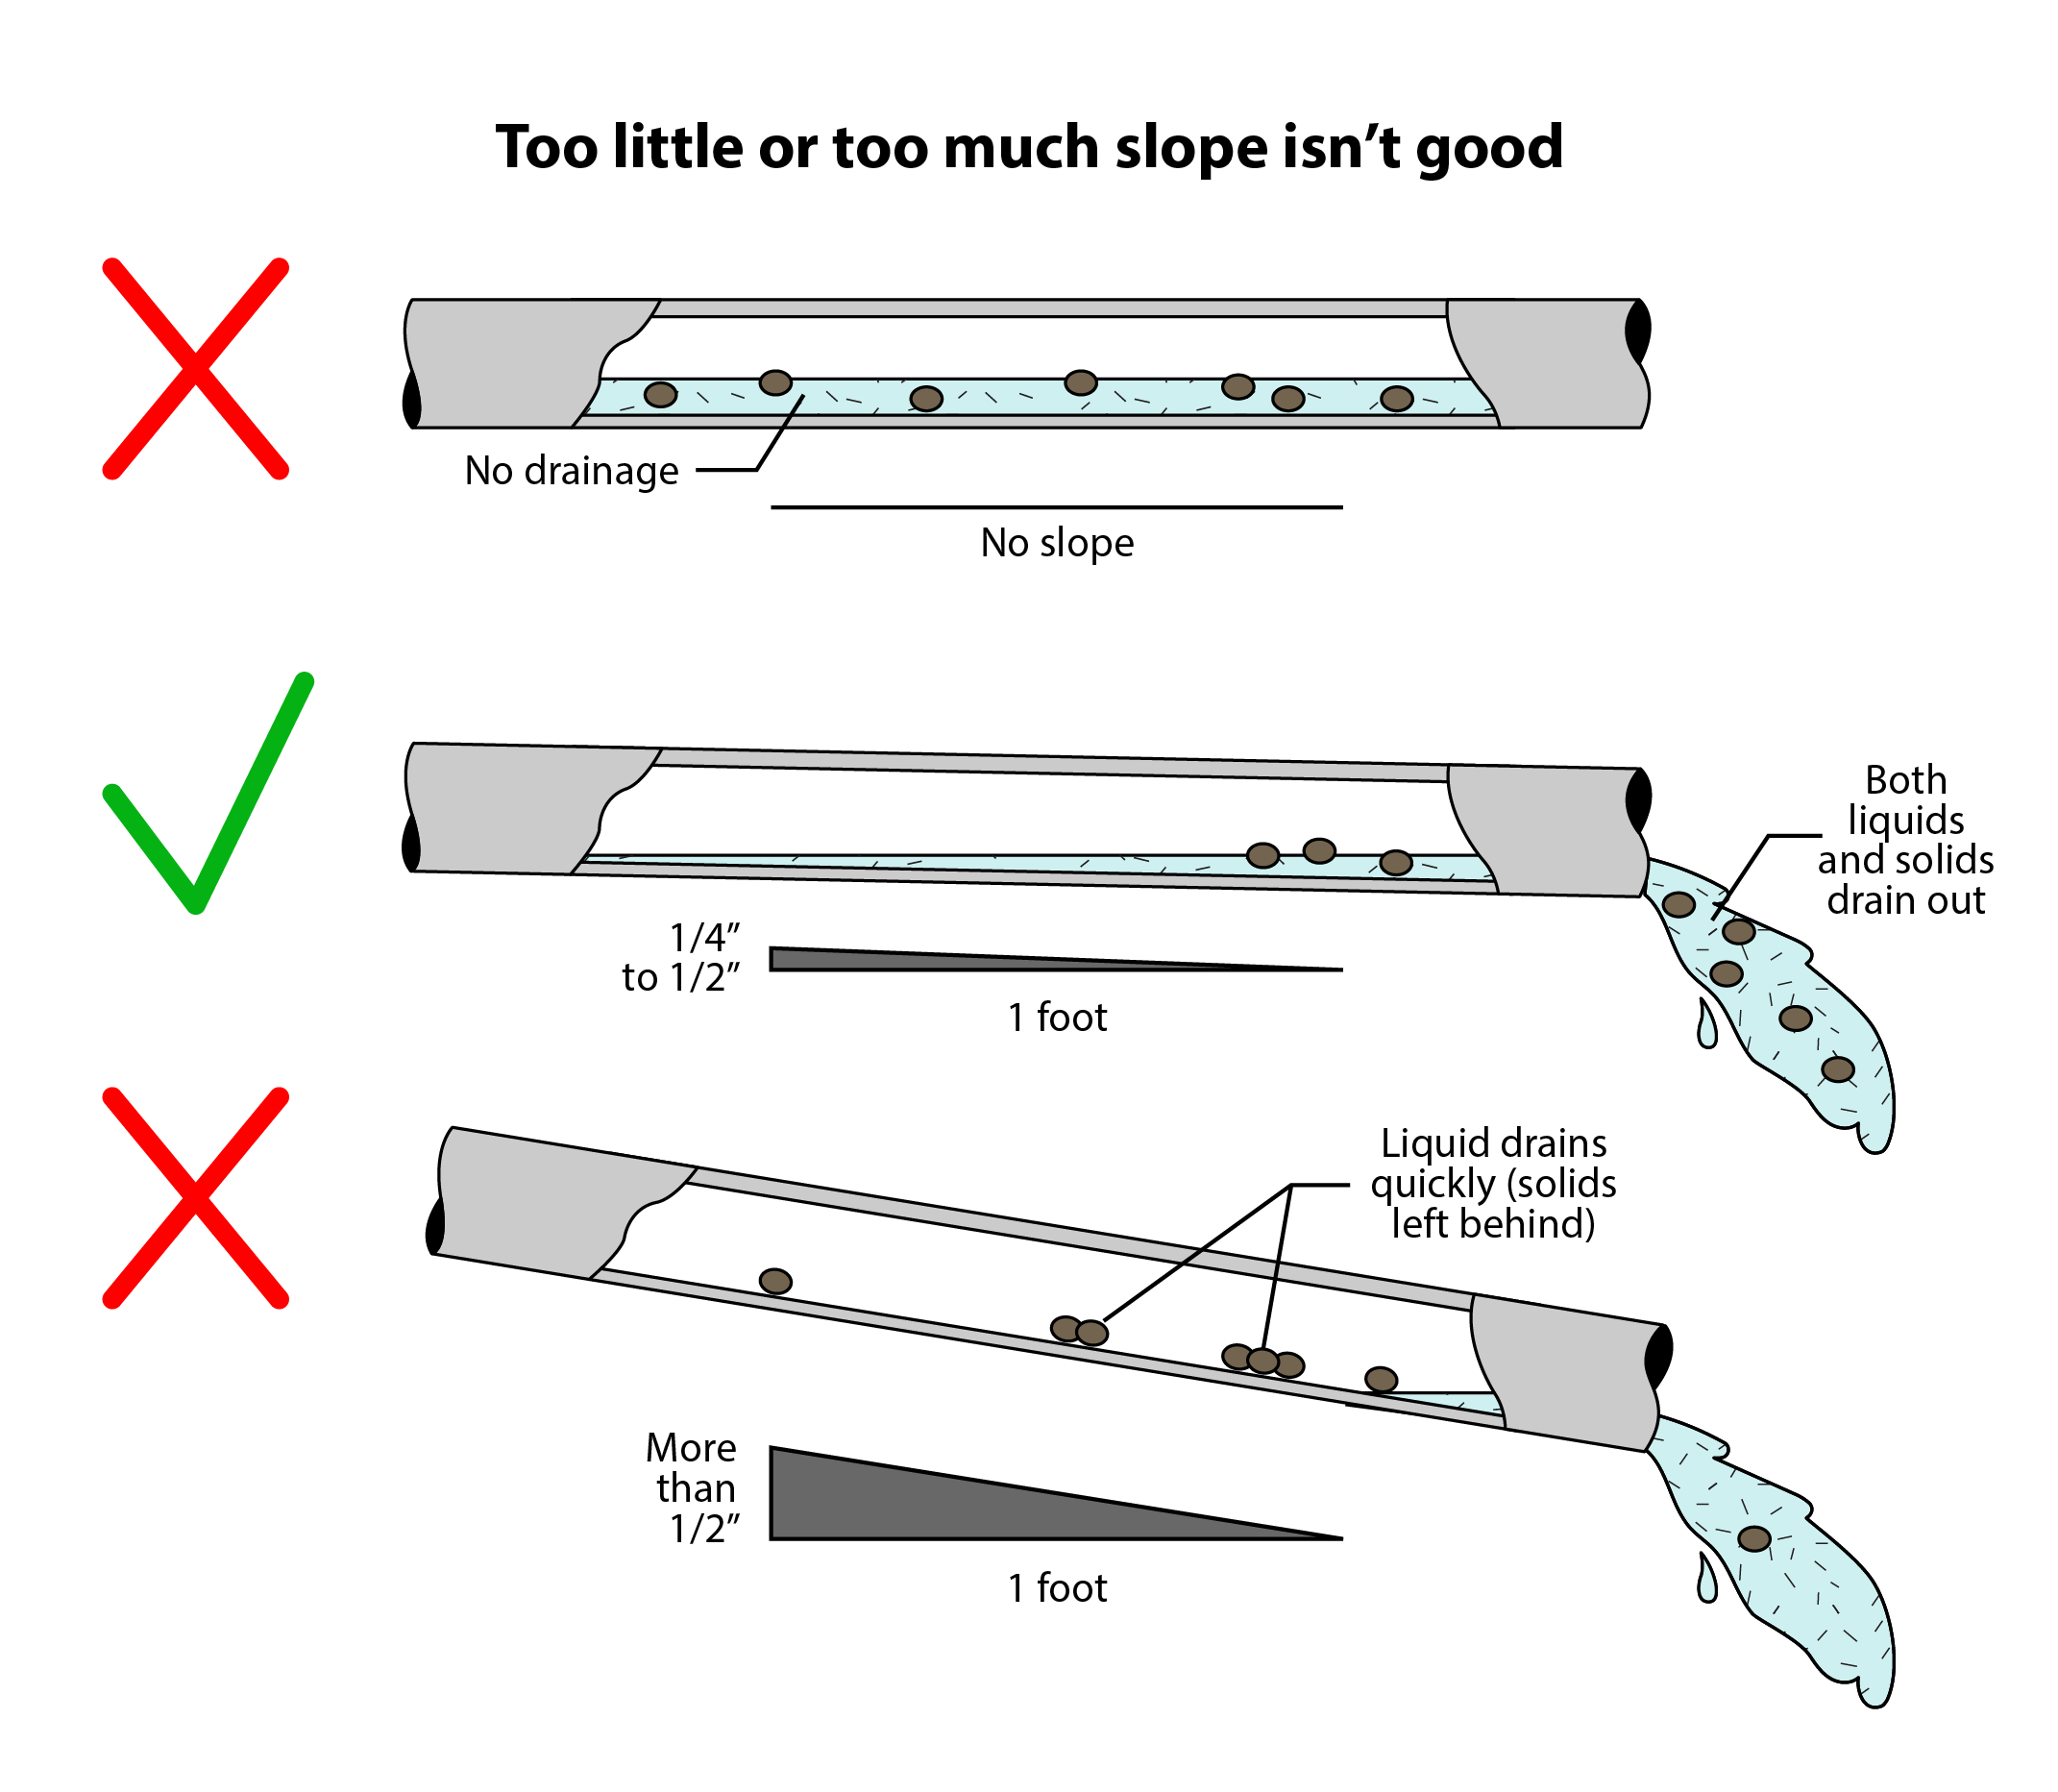
Impact of Reduced Hydraulic Loads – Less Flow in Pipes
Solids Build-Up
Notes:
Now that we know the Flow and the Biological values, we combine the two to determine the mass load
The organic loading is much more significant when converted to a mass loading rather than a concentration.

Slide 18
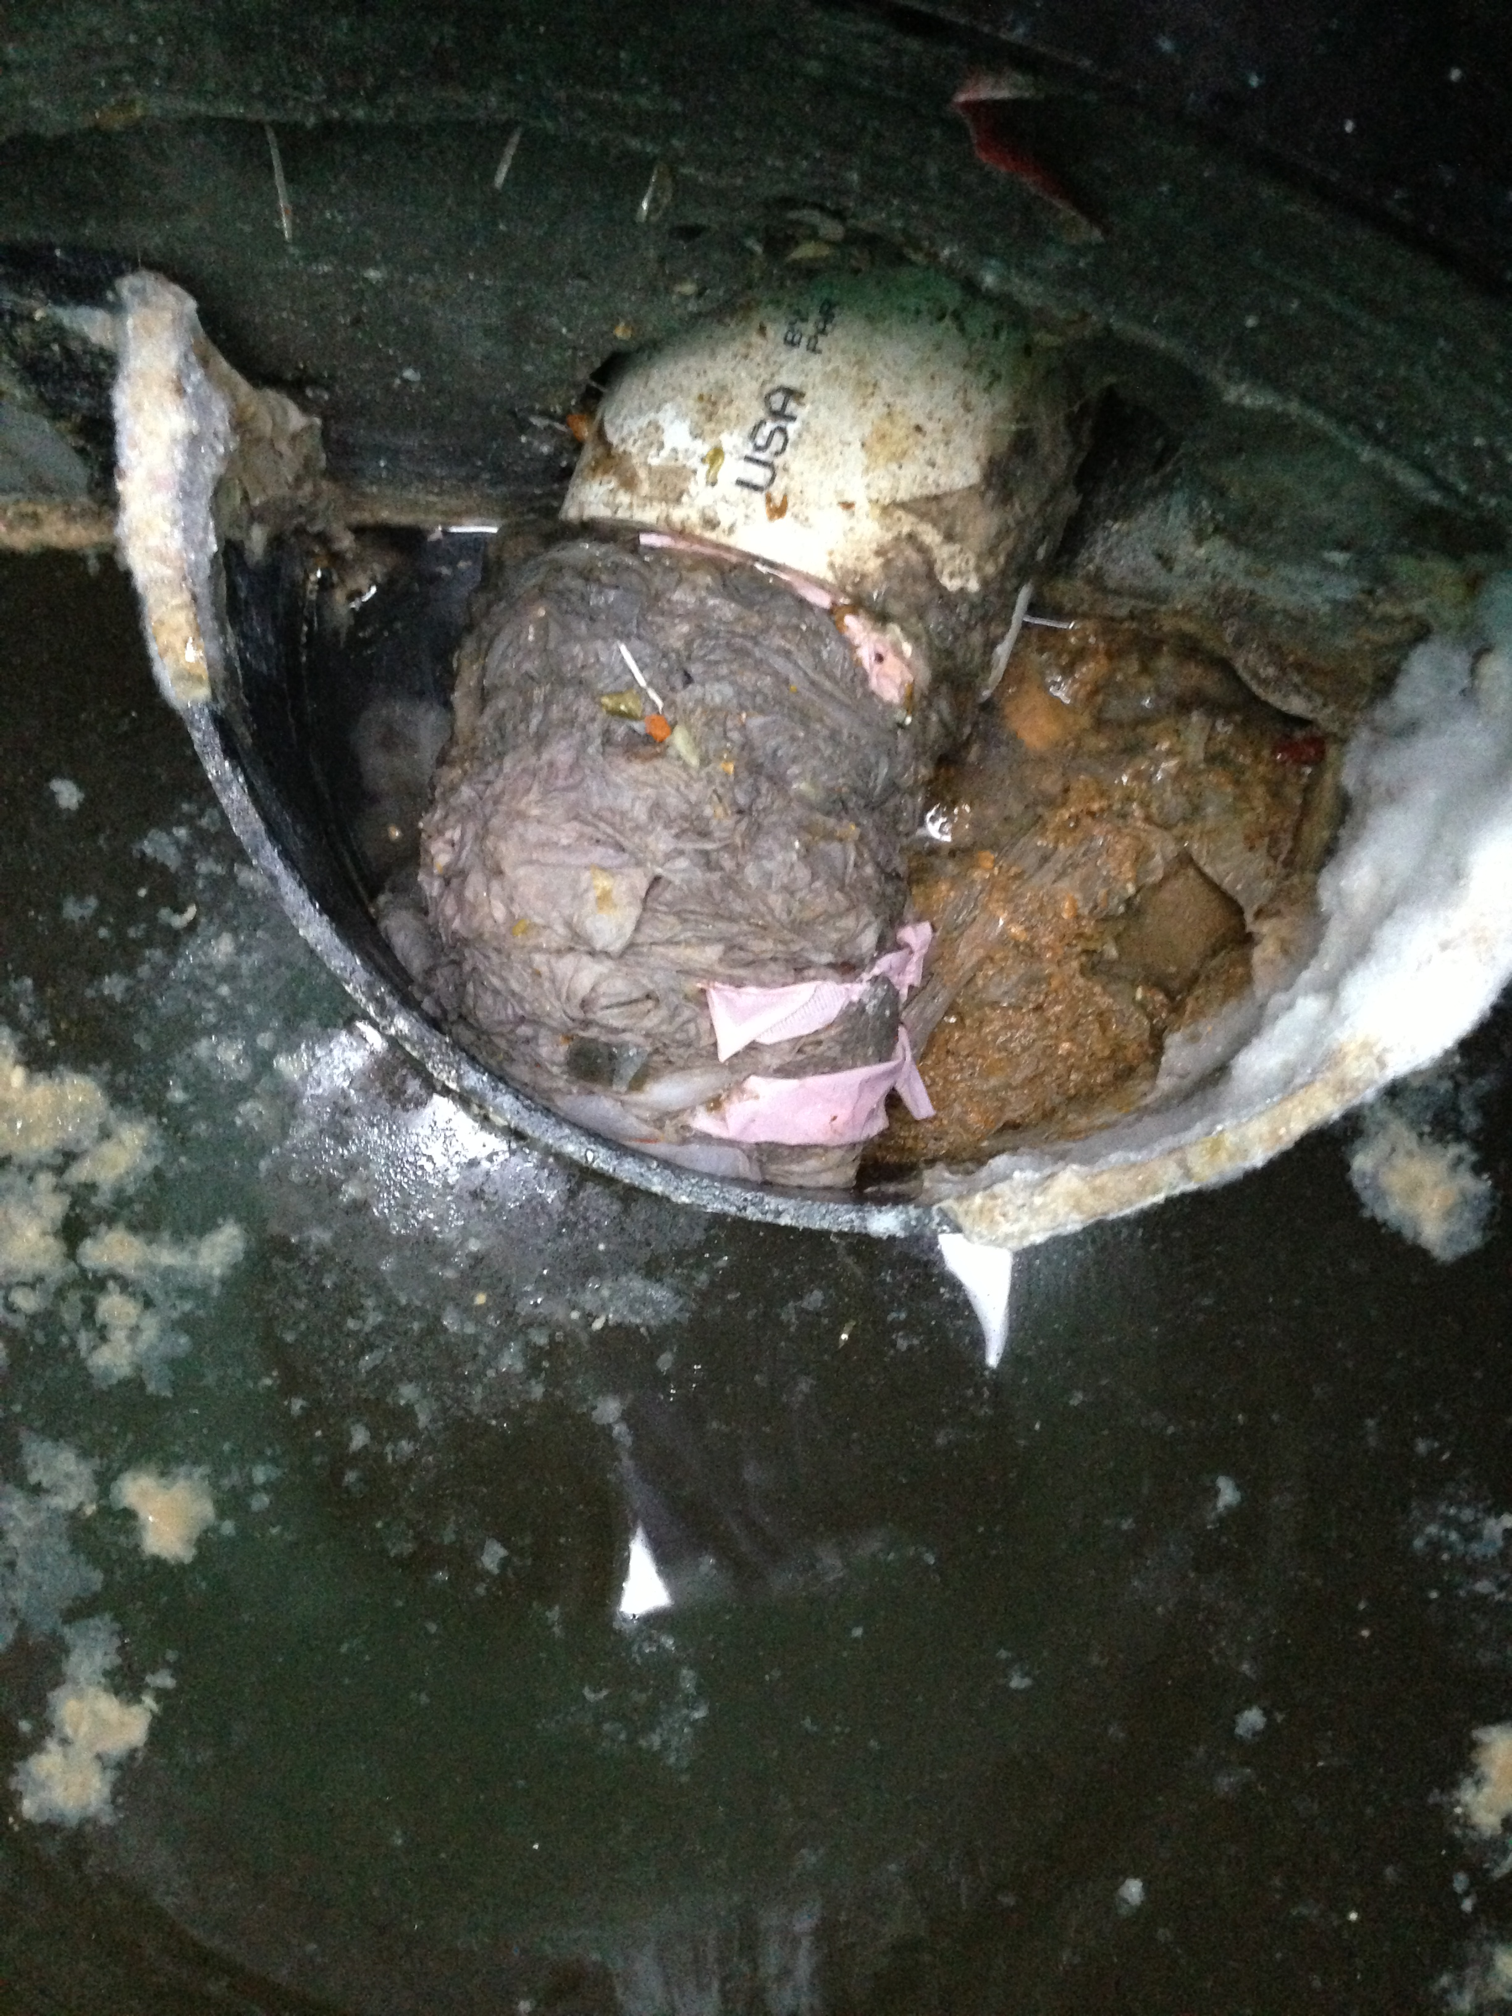
Challenges with Less Flow in Pipes
Risk of solids being trapped in pipes
Decreased flow velocities in gravity applications
Inlet baffle plugging due to low flush volumes
Trickle flows more likely to freeze

Slide 19
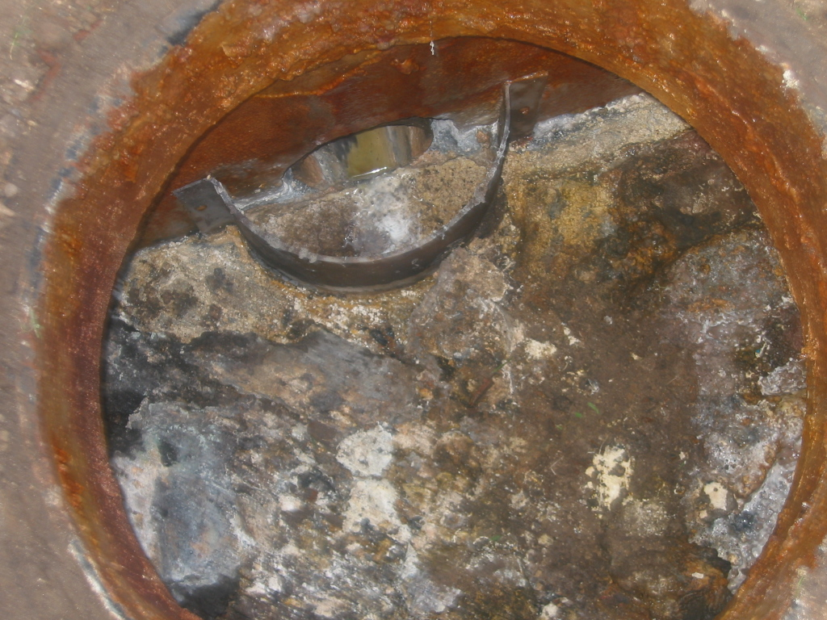
Changing Organics Concentrations

Slide 20
Examples of Wastewater Strength used in Standards (residential applications):
 | Missouri | Minnesota | Texas | New York | Wisconsin
BOD₅ | - 210 mg/l (PE) | 300 mg/l (raw) 170 mg/l (STE) | - 140 mg/l (STE) | 100-300 mg/l (raw) - | 220 mg/L (STE)
TSS | - | 200 mg/l (raw) 60 mg/l (STE) | - | 100-350 mg/l (raw) | 150 mg/L (STE)
TKN | - | - | - | - | -
 | Derived from buried sand filter organic loading rate | Chapter 7080, Individual Subsurface Sewage Treatment Systems | On-Site Sewage Facility Rules Compilation §285.91(3) | Adheres to NSF Standard 40 | SPS 383.44
STE = septic tank effluent
Most testing facilities get sewage from a public collection system (infiltration is very likely)

Slide 21
Impacts of reduced water use
Raw sewage BOD₅, Nitrogen and phosphorus :
 | Expected concentration From policies or certification protocols | Expected concentration for 15 % daily sewage volume reduction | Expected concentration for 30% daily sewage volume reduction
BOD₅ | 200 to 300 mg/l | 235 to 353 mg/l | 286 to 429 mg/l
TKN | 35 to 70 mg/l | 41 to 82 mg/l | 50 to 100 mg/l
Phosphorus | 4 to 15 mg/l | 5 to 18 mg/l | 6 to 21 mg/l
Septic tank effluent BOD₅ :
 | Expected concentration From policies or certification | Expected concentration for 15 % daily sewage volume reduction | Expected concentration for 30% daily sewage volume reduction
BOD₅ | 140 to 200 mg/l | 165 to 235 mg/l | 200 to 286 mg/l

Slide 22

2009 Influent Constituent Characteristics of the Modern Waste Stream from Single Sources
Kathryn S. Lowe, Maria B. Tucholke, Jill M.B. Tomaras, Kathleen Conn, Christiane Hoppe, Jörg E. Drewes, John E. McCray, Junko Munakata-Marr
http://www.ndwrcdp.org/documents/04-dec-1/04dec01web.pdf

Slide 23
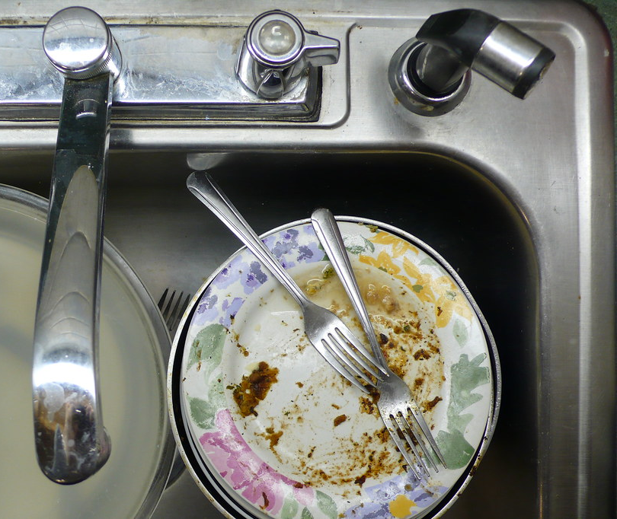
Organic solids
Definition
  Digested and undigested animal and vegetable material
  Synthetic (artificial) organic compounds
Impacts
  Requires oxygen to be broken down (BOD)
  Reduces dissolved oxygen (DO) in lakes, rivers, and streams

Slide 24
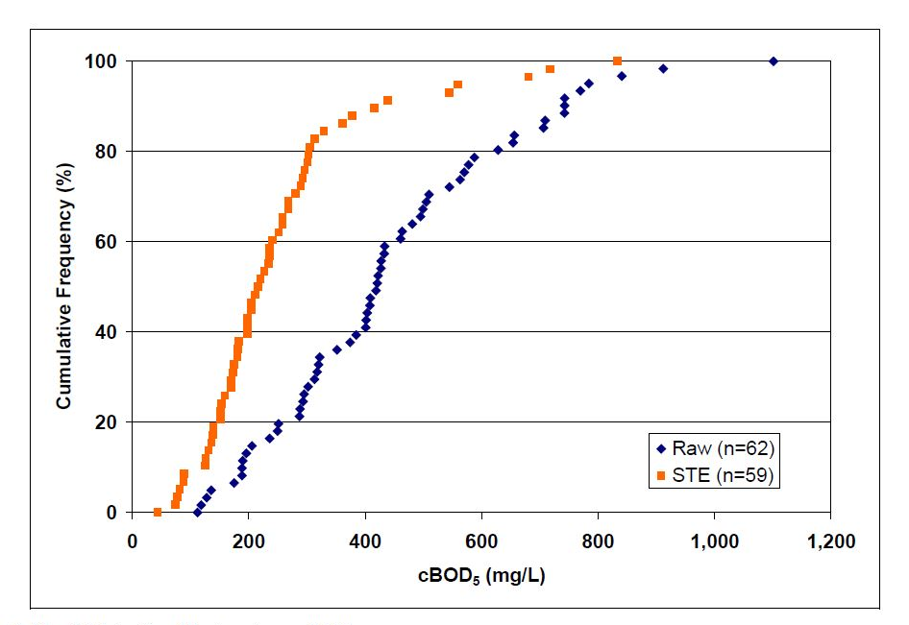
BOD in raw and septic tank effluent (STE)
BOD₅ higher than values used in standards (200 to 300 mg/l vs 443 mg/l for raw sewage)
140 to 210 mg/l versus 216 mg/l for septic tank effluent
Median STE 216 mg/L

Slide 25
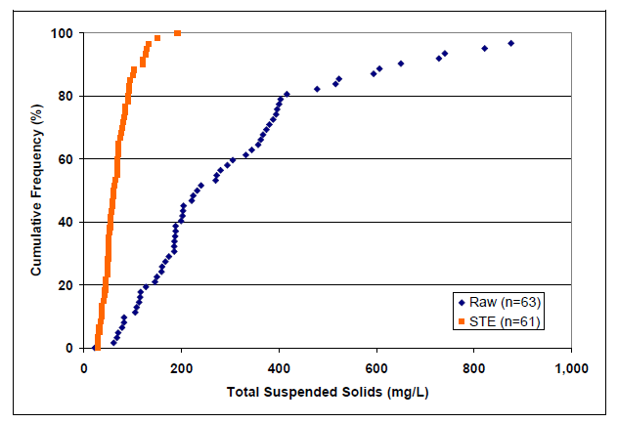
Inorganic Solids
Definition
  Fibers from synthetic clothing (lint from washing machine), minerals, metals and salts from soil material, plumbing, make-up
  Typically estimated with total suspended solids test (TSS)
Impacts
  Inert and not subject to decay
  Causes clouding of water (turbidity)
  Plugging of soil pores
Septic tanks appears to perform well their duty of removing solids
Effluent filter is an added safety factor

Slide 26
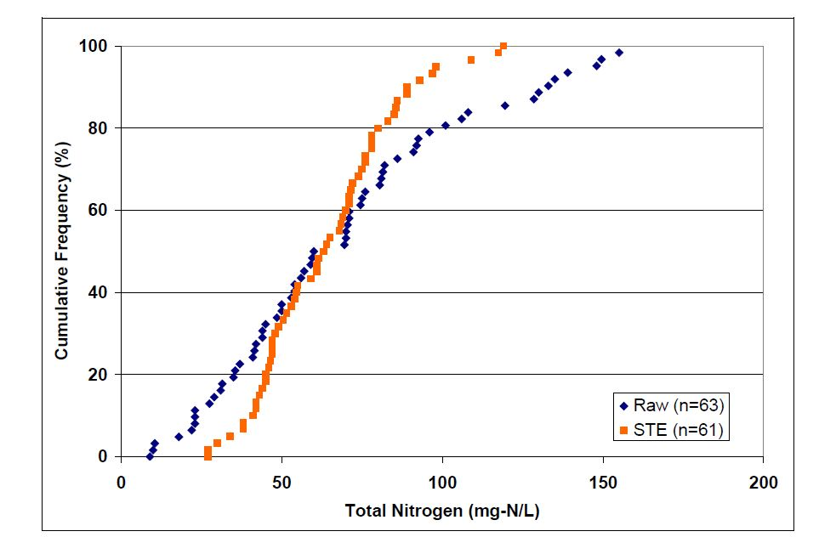
Total nitrogen in raw and septic tank effluent
Median 60 mg/L

Slide 27
Changes in Diet - Fiber
Fiber consumption in the United States is generally low, with most Americans consuming less than the recommended amount
If fiber consumption increases in a home, the weight and size of fecal waste increases
Some foods, like corn, nuts and seeds, are high in fiber and can be difficult to digest.
With some of these high fiber foods, the body’s enzymes are unable to break down the outer coating, such as the cellulose in corn’s outer casing, so the food particles remain
If these solids do not settle out in the septic tank, there is the risk of clogging an effluent filter or downstream components

Slide 28
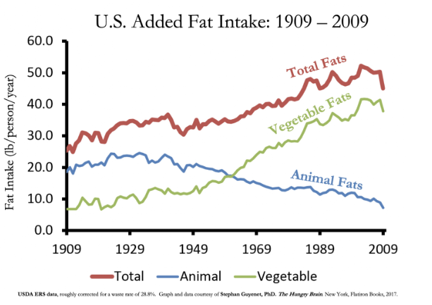
Changes in Diet - Fat

Slide 29
Changes in Diet - Fat
More fats being consumed increases the risk for fats to go down the drain
Can accumulate inside pipes and lead to clogging of downstream components
They also contribute to the biochemical oxygen demand

Slide 30
Changes in Diet - Protein
A recent movement sees more Americans thinking about their protein consumption
In the last 10 years, the market size of protein powders alone has nearly doubled and is projected to continue on this upward trend
When people consume more protein than their bodies need, excess nitrogen is flushed out in urine
Research has shown that anywhere from 67–100% of the nitrogen in human sewage results from our consumption of protein
Protein deficiency is very low in the U.S. → overall the amount of nitrogen in our wastewater will increase

Slide 31
Impact of Higher Organic Concentrations - Treatment Performance
Biological treatment processes involve complex interactions between microorganisms, oxygen availability, retention time, temperature, etc.
Those reactions are not following linear relationships
Performances are very likely to be impacted by strength
Some types of systems will have greater impacts than others
Notes:
Now that we know the Flow and the Biological values, we combine the two to determine the mass load
The organic loading is much more significant when converted to a mass loading rather than a concentration.

Slide 32
Impact of Higher Organic Concentrations - Treatment Performance
The quality of effluent distribution in often the weakest point in a design
Even distribution over the entire contact area (or between treatment units) is critical in achieving the desired performances
All soil-based systems are design on a hydraulic loading rate that implicitly consider effluent distribution to be perfect
Stronger effluent combined with imperfect distribution is likely to result in negative impacts such as premature clogging, water table contamination, reduced life expectancy
Notes:
Now that we know the Flow and the Biological values, we combine the two to determine the mass load
The organic loading is much more significant when converted to a mass loading rather than a concentration.

Slide 33
Increase in Toxic Loading
Naturally occurring bacteria and fungi are the workhorses of wastewater treatment
They prefer their food (carbon) source to be non-toxic
Low/High pH impacts
Sanitizing impact from pharmaceuticals and cleaners

Slide 34
pH Impacts
Microbes prefer a neutral pH of 6-8
High or low levels and dramatic changes can impact levels and therefore treatment

Slide 35
Low pH Impacts
The process of nitrification – converting ammonia to nitrate releases hydrogen ions
Natural alkalinity in source water (calcium carbonate more commonly found in groundwater) can help buffer
If not buffered the hydrogen will lower the pH

Slide 36
Low pH Impacts
Household products with a VERY low pH:
  Toilet Bowl Cleaners (pH 1–3): Often contain hydrochloric or phosphoric acid to dissolve tough mineral stains
  Rust Removers (pH 2–3): Designed to eat through oxidation
  Lemon Juice (pH 2): Contains citric acid
  Vinegar (pH 2–3): Contains acetic acid; commonly used for cleaning and cooking

Slide 37
Low pH Impacts Cont’d
Household products with a low pH:
  Carbonated Soft Drinks (pH 3): Contain phosphoric and carbonic acids
  Orange Juice (pH 3.5): Natural citric and ascorbic acid (Vitamin C)
  Wine & Beer (pH 4): Produced through fermentation
  Tomatoes (pH 4.5): Naturally acidic fruit/vegetable
  Hydrogen Peroxide (pH 3–6): Often used as an antiseptic or mild bleach
  Black Coffee (pH 5): Mildly acidic.
  Skin Care Products (pH 5.5): Many soaps and lotions are formulated at this pH to match the natural "acid mantle" of human skin

Slide 38
High pH Impacts
Household products with a very high pH:
  Drain Cleaners (pH 14): Often contain sodium hydroxide (lye). They work by turning the grease in pipes into soap through a process called saponification
  Oven Cleaners (pH 13–14): Designed to dissolve baked-on carbon and grease
  Bleach (pH 11–13): Sodium hypochlorite is a powerful oxidizer used for whitening and disinfecting
  Commercial Degreasers (pH 12–13): Used for heavy industrial cleaning or removing oil from garage floors

Slide 39
High pH Impacts
Household products with a high pH
  Ammonia (pH 11): Often found in window cleaners and floor strippers
  Borax (pH 10): A common laundry booster and natural mineral cleaner
  Laundry Detergent (pH 10): Formulated to be alkaline to help lift dirt and oils from fabrics
  Milk of Magnesia (pH 10.5): An antacid used to neutralize stomach acid

Slide 40
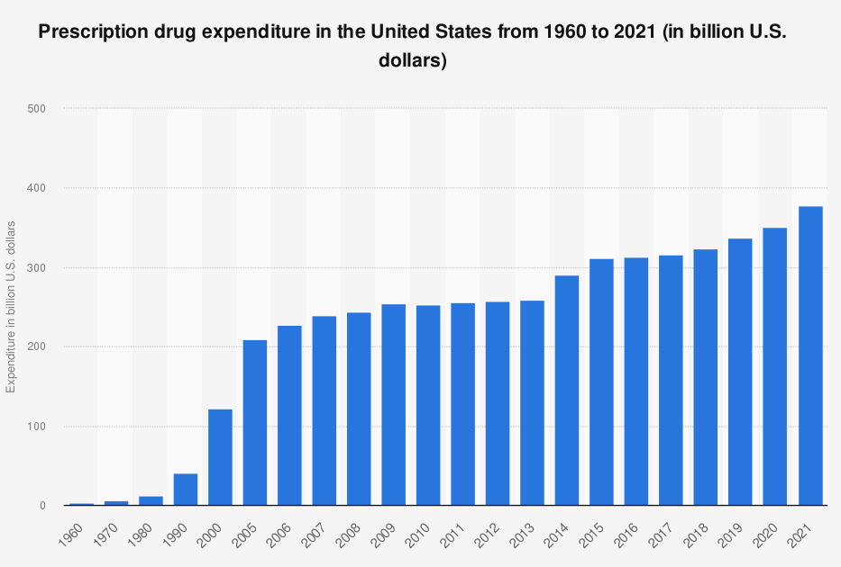
Prescription Drug use in the US
68% of US is on at least 1 prescription drug
  30% on two or more
  26% on four or more
Up to 90 percent of oral medications pass through the body unchanged

Slide 41
Change in Cleaning Products
Product Category | 1960 Usage (Est.) | 2025 Usage (Est.) | Trend Driver
Laundry Detergent | 45 lbs (Powder) | 75 lbs (Liquid/Pods) | More frequent washing / larger machines
Dish Detergent | 5 lbs (Hand soap) | 25 lbs (Pods/Gel) | 85%+ Dishwasher ownership
Surface Cleaners | 2-3 Gallons | 8-10 Gallons | Specialization (Glass, Granite, Floor)
Cleaning Wipes | 0 units | 1,500+ wipes | Convenience / "Throw-away" culture
Disinfectants –Quats – “ammonium chloride” | Minimal (Bleach only) | High (Sprays & Aerosols) | Post-pandemic hygiene standards
Total Packaging Waste | Low (Glass/Cardboard) | High (Plastic/Multilayer) | Shift to liquid formulas & single-use

Slide 42
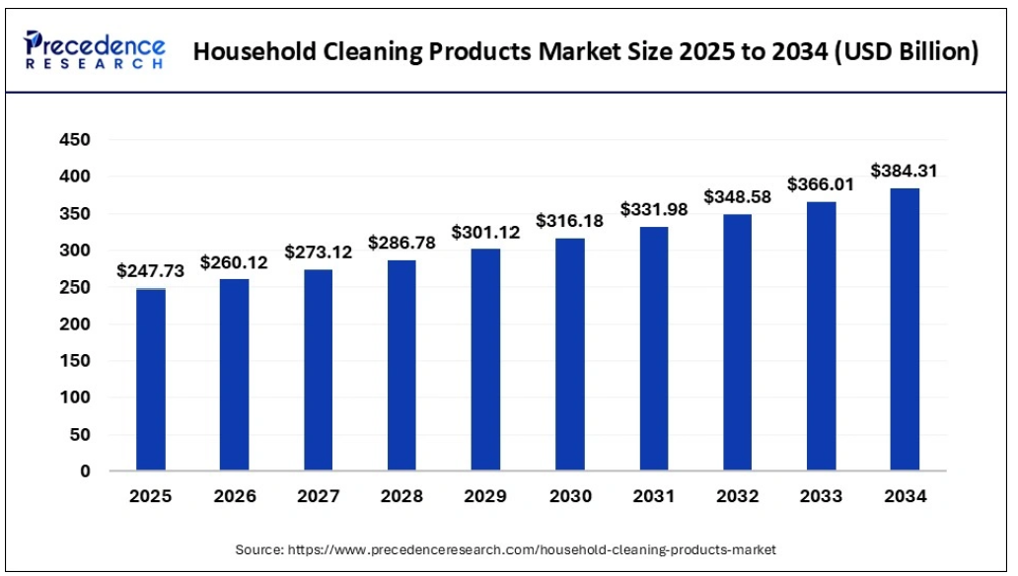

Slide 43
Adapting Onsite Designs
  Recognizing that being proactive is better than being reactive
  Recognizing the impacts of sewage flows and strength on our designs and the limitations of some of the concepts and techniques we are using
  Recognizing that technologies may have been certified/tested with conditions different from those encountered in some situations
    Ask manufacturers for advices

Slide 44
Adapting Onsite Designs
Provide more cleanouts and access to grade
Insulate tanks and access lids to prevent heat loss
Consider a small basement pump for very low flows (into sewer line, not septic tank)

Slide 45
Adapting Onsite Designs
In any septic design and even more importantly when dealing with stronger effluent, trench system or single pass systems, the quality of effluent distribution should become a priority
With pumped system dealing with stronger effluent, aim for more frequent doses of smaller volumes and go low pressure distribution

Slide 46
Adapting Onsite Designs
  Evaluating design flow - Do you have access to water meter reading ? Does you client mostly use water saving devices ? # of bedrooms vs actual people living in the house, etc.
  BOD removal needs oxygen
    More BOD = more oxygen demand
    Adequate air flow through the system is critical to performance and longevity
  When dosing stronger effluent - use more frequent smaller doses over fewer larger doses

Slide 47
Adapting Designs and Management
Check the pH – if low or high evaluate sources
Evaluate source for toxics
Evaluate COD/BOD ratios
  Usually 1.5: 2 for biodegradable material with low toxics
  For wastewaters with ratios higher than 3, toxics are of concern

Slide 48
Adapting Designs and Management
Commercially education may help but source separation may be needed
Residentially education can help

Slide 49
Summary
Flows are going down
Concentrations are going up
More challenging waste is coming our way
Designs and management should evaluate waste streams and make modifications

Slide 50

Thank You
LinkedIn
www.linkedin.com/in/dr-sara-heger
X - Twitter
@SaraSeptic
Email
sfheger@gmail.com
Phone
612-239-89188

