Slide 1
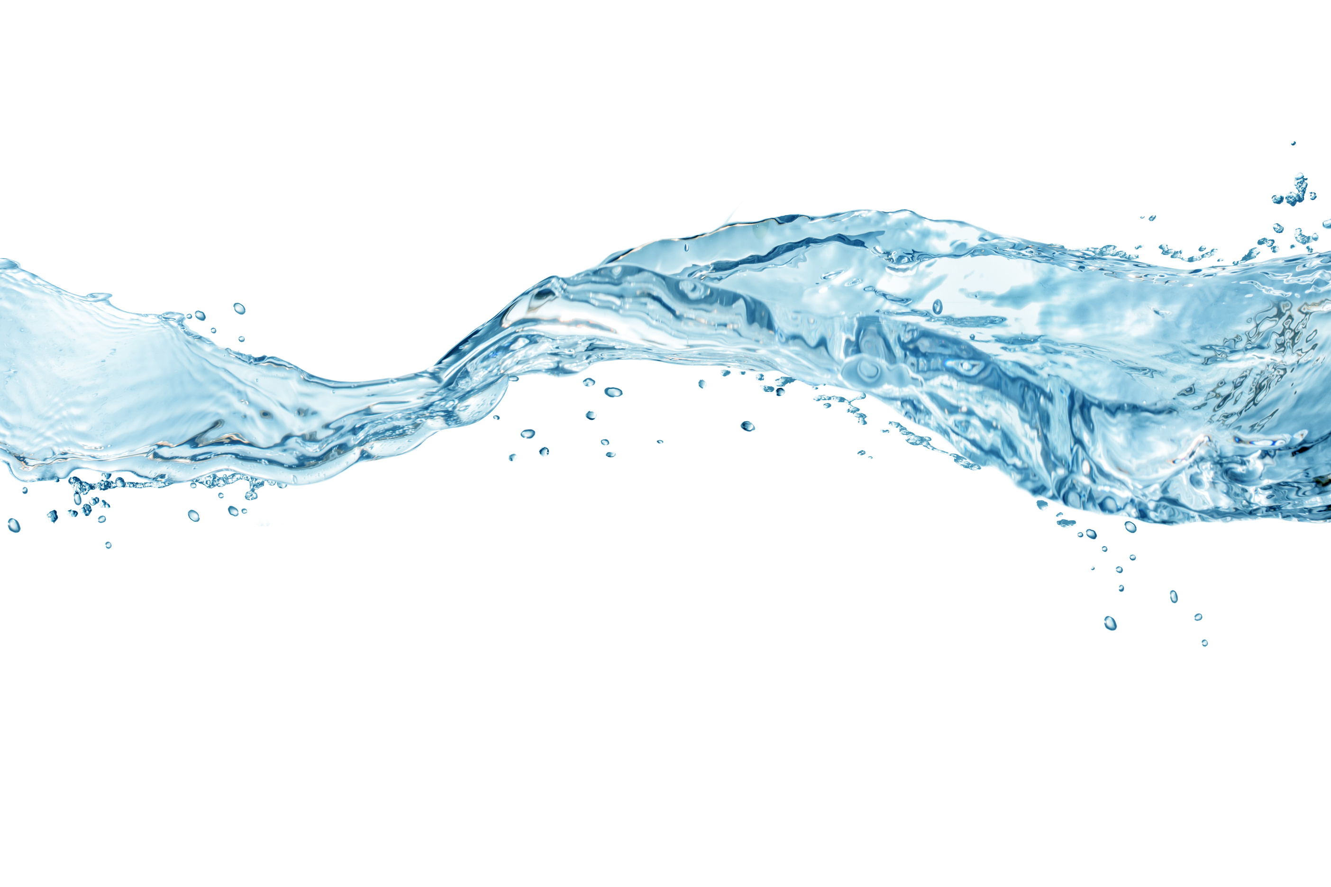

A PRACTICAL
GUIDE TO DRIP SYSTEMS

Slide 2


WELCOME
Your presenter today is
Sean McGuigan
25+ years
Patented inventor
Technical Sales Manager
Septic licenses in three states
Specialties: designing, quoting, and training on treatment systems

Slide 3



People
Oriented
Preserve
Sustain
One Place Solutions
Notes:
Who we are:
Anua focuses holistically on People, Planet, and Solutions to ensure optimum outcomes.
We are People oriented. We listen and collaborate. We care about the planet. We preserve and sustain.
We offer solutions. Our One Place Solutions is simple and flexible.

Slide 4
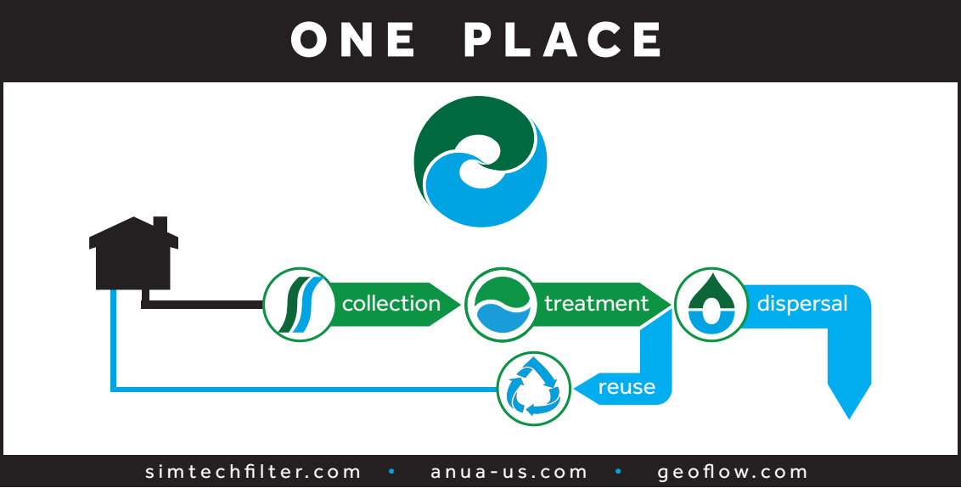
Notes:
Anua offers a One Place solution to collect, treat, and disperse or reuse wastewater in a responsible and effective way.
We have manufacturing locations in Greensboro, NC since 1993 and in Boyne City, MI (Sim/Tech since 1998).
We have worldwide customers and distribution.

Slide 5
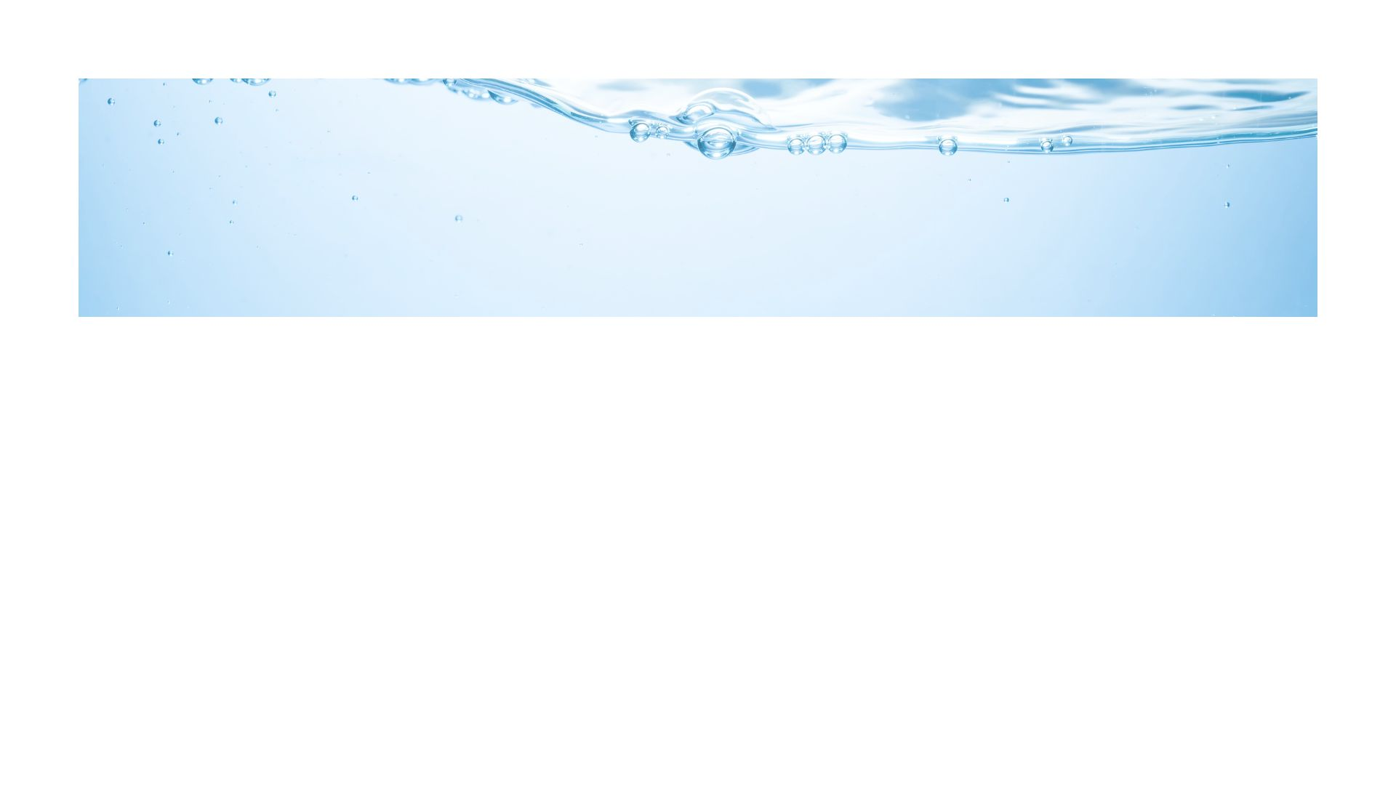
TODAY’S GOALS
1.
2.
3.
Essential
Design Basics
Drip System Basics
Maintenance
Routine
Overview
System Components & Functions
Inspection & Cleaning
Walkthrough
Critical Parameters of Parts
Design & Calculations

Slide 6
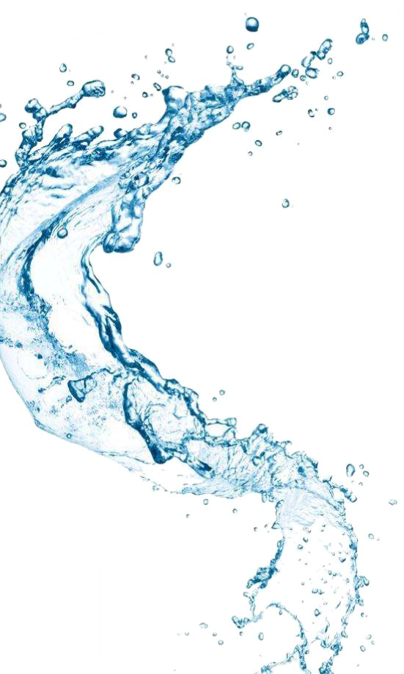
1.
Drip System Basics
Overview

Slide 7
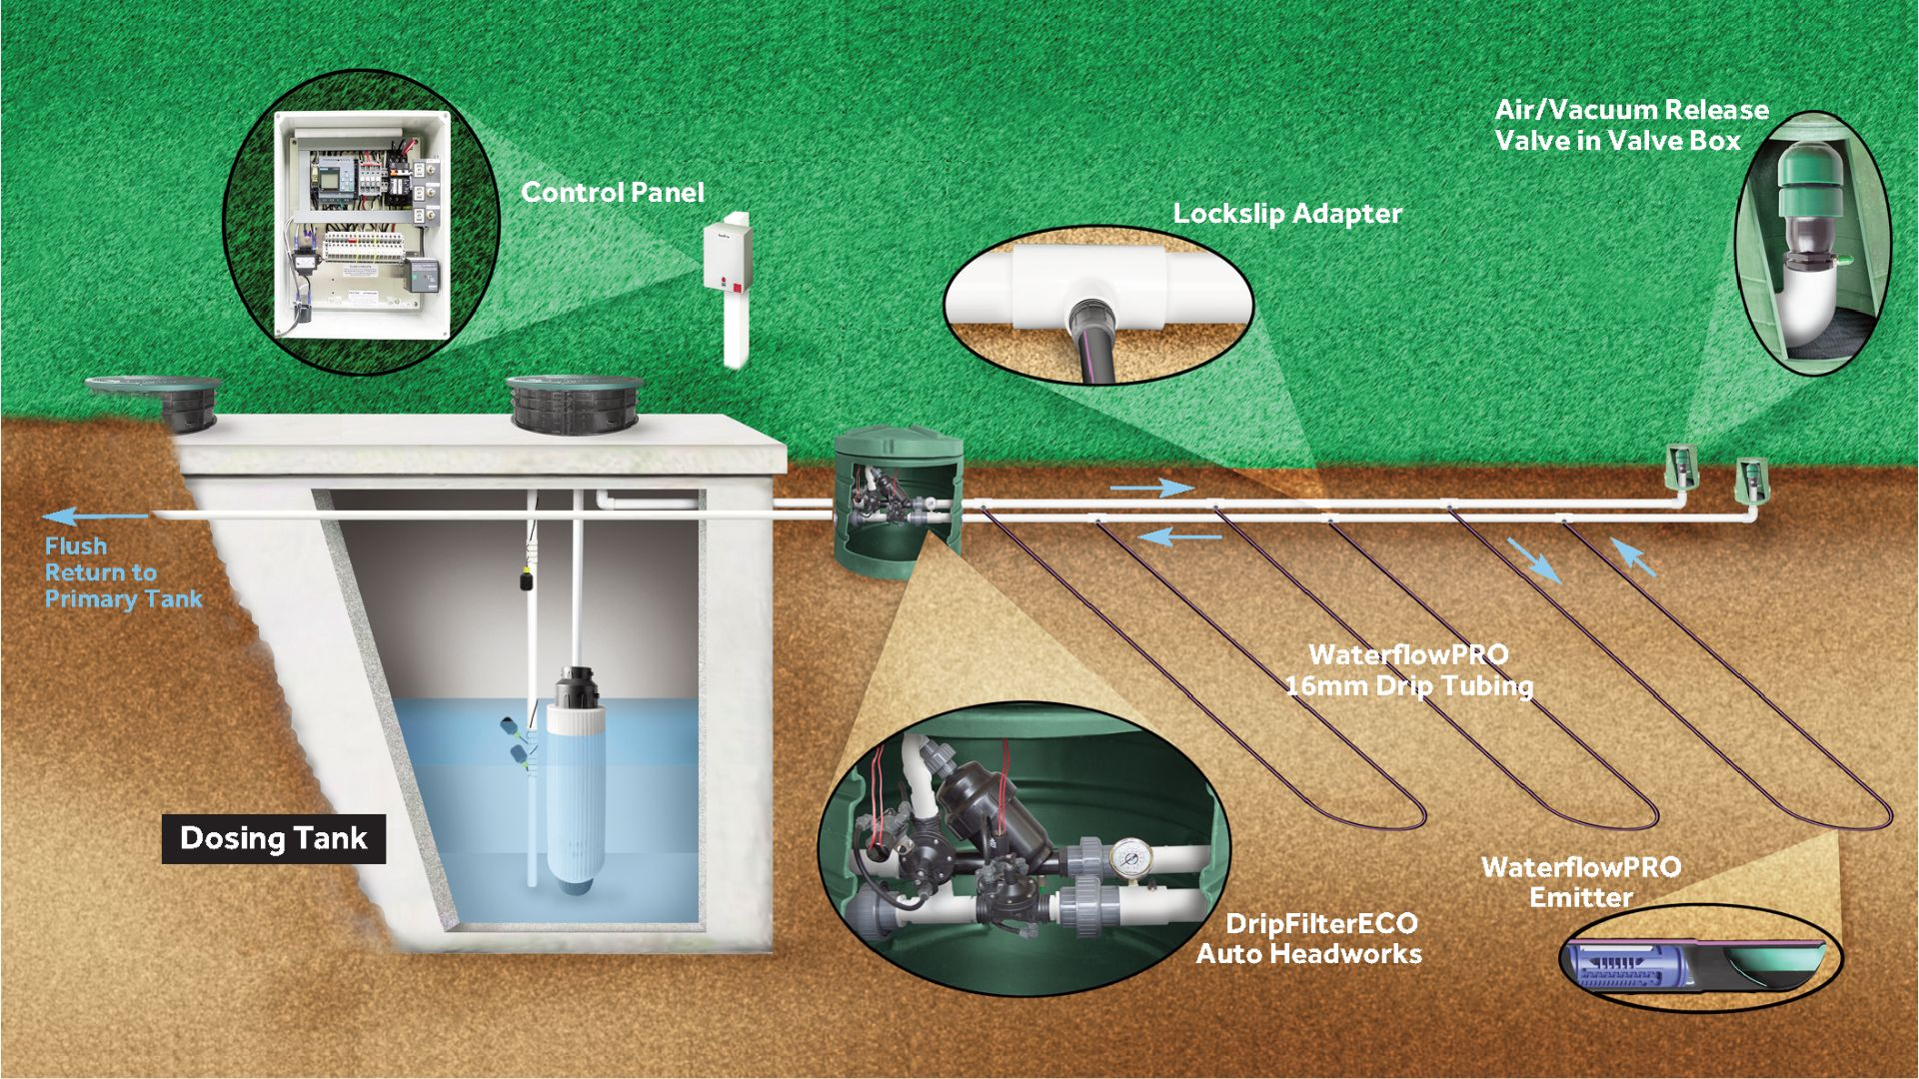

Slide 8
1.
Drip System Basics
System Components
& Functions

Slide 9
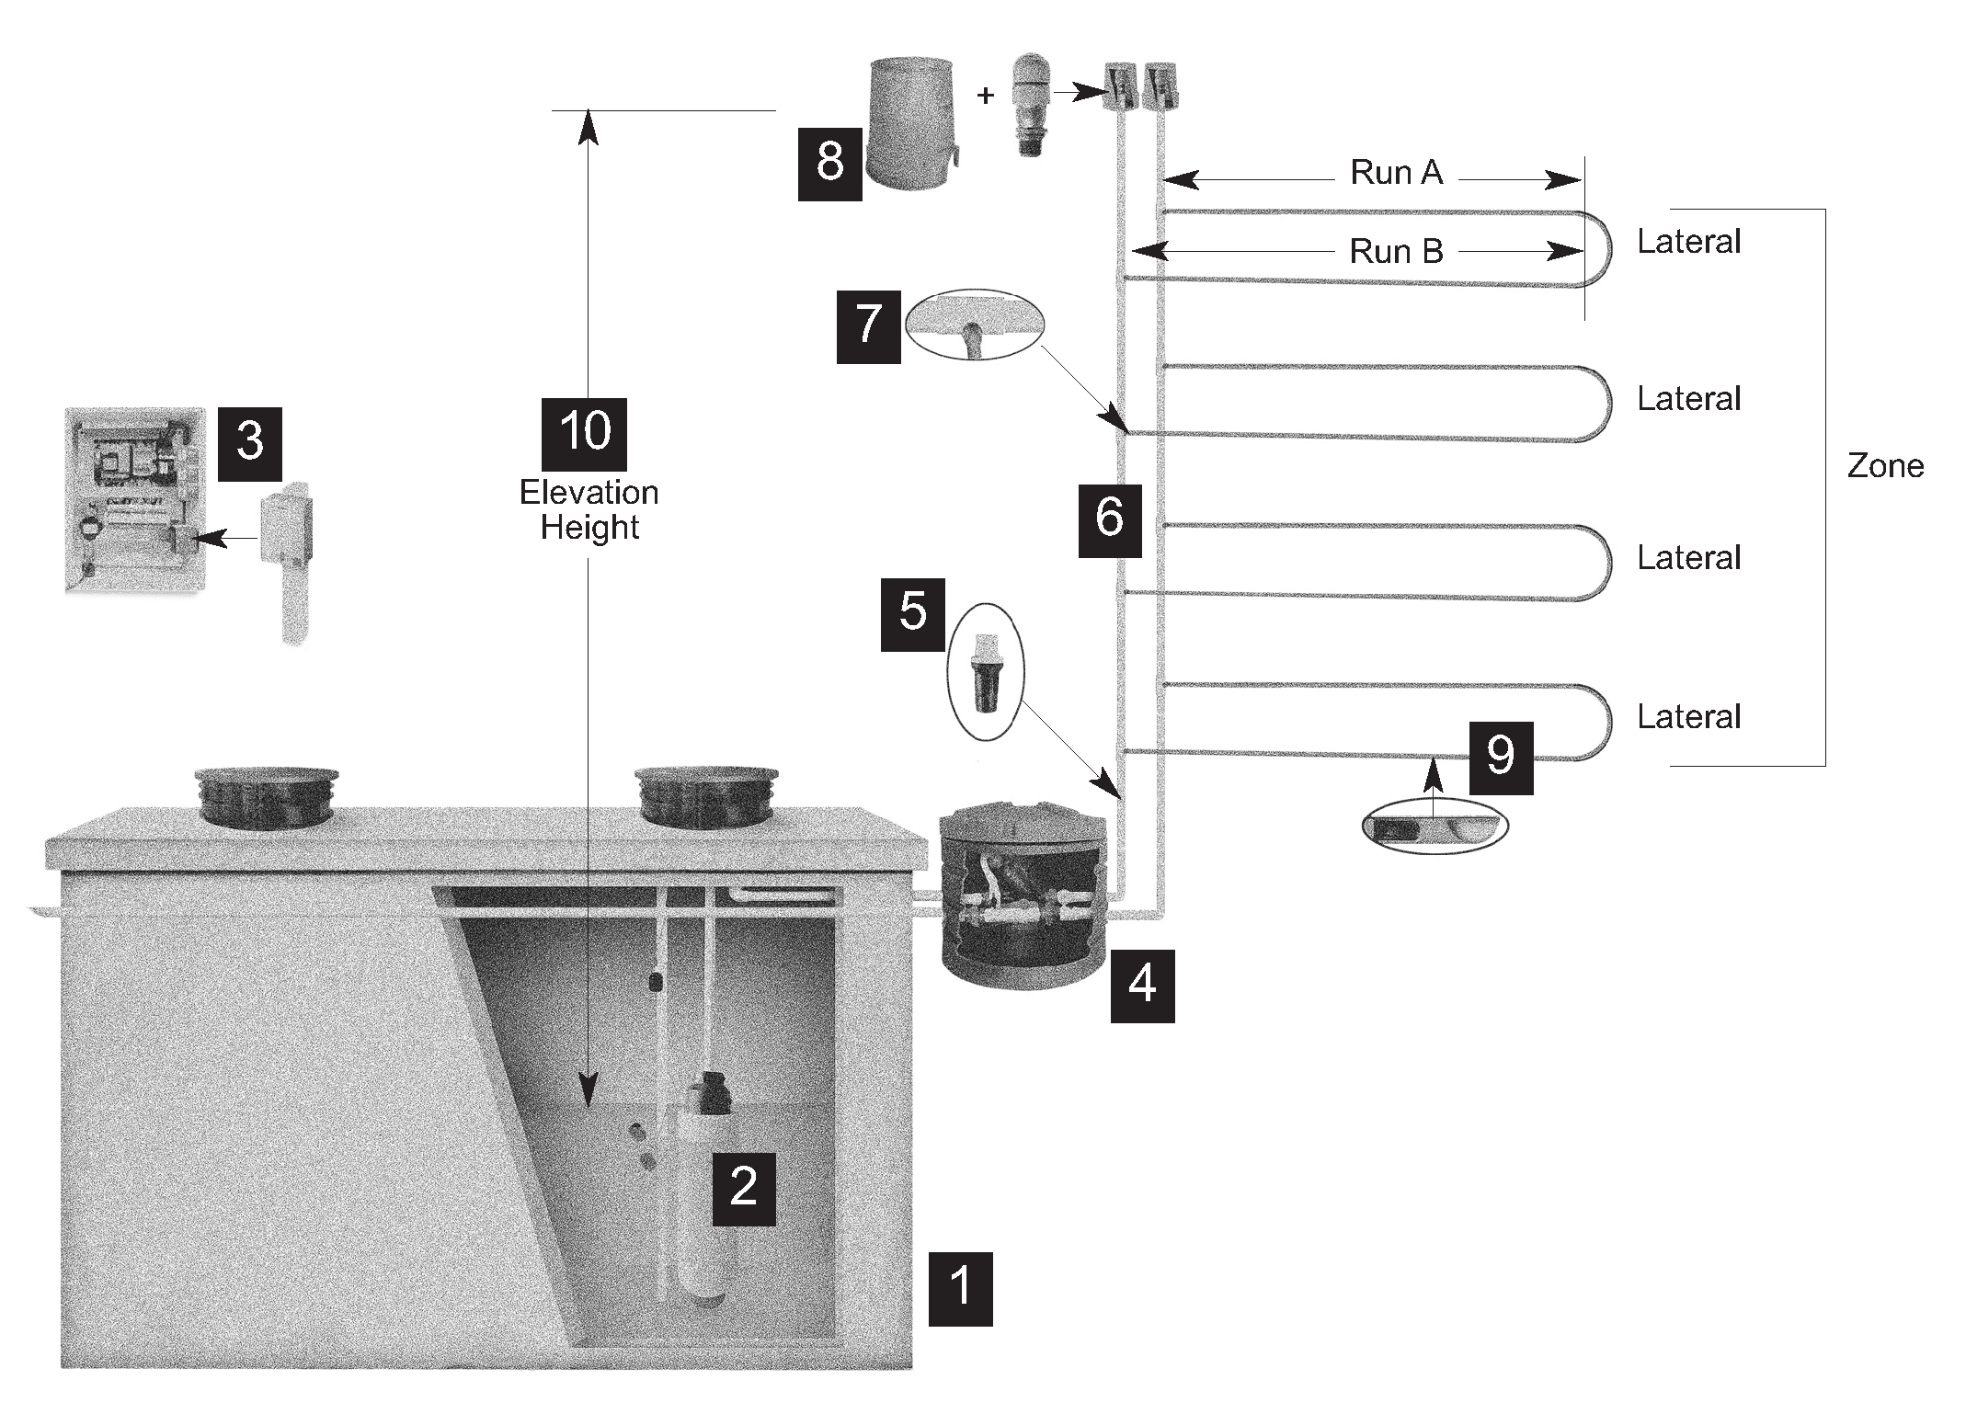
Notes:
Use adequate size, minimum isn’t the best. Flow EQ helps with size.
Access to the tank, risers to grade.
Access to the pump(s), unions near the lid.
Access to the floats, float trees with plenty of slack.
Access to secondary filters.

Slide 10
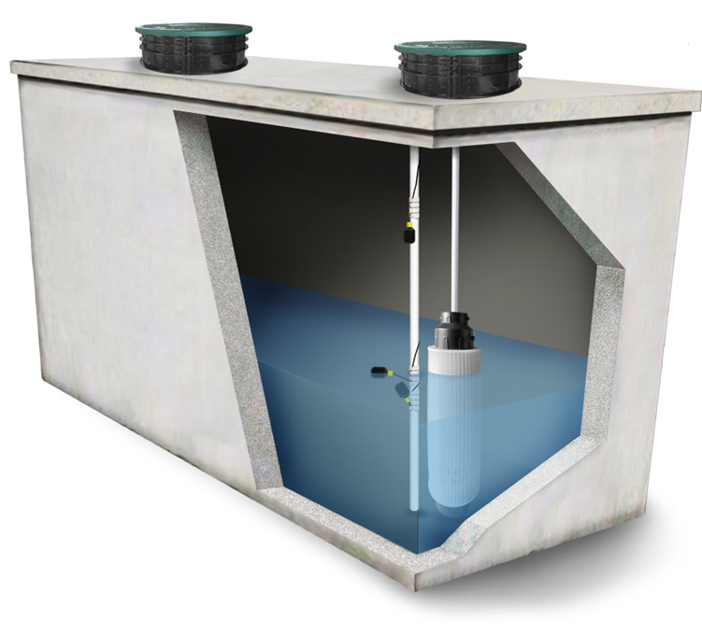
1
Drip Pump Tank
Use adequate size
Access to:
Tank
Pumps
Floats
Secondary filters
Notes:
Use adequate size, minimum isn’t the best. Flow EQ helps with size.
Access to the tank, risers to grade.
Access to the pump(s), unions near the lid.
Access to the floats, float trees with plenty of slack.
Access to secondary filters.

Slide 11
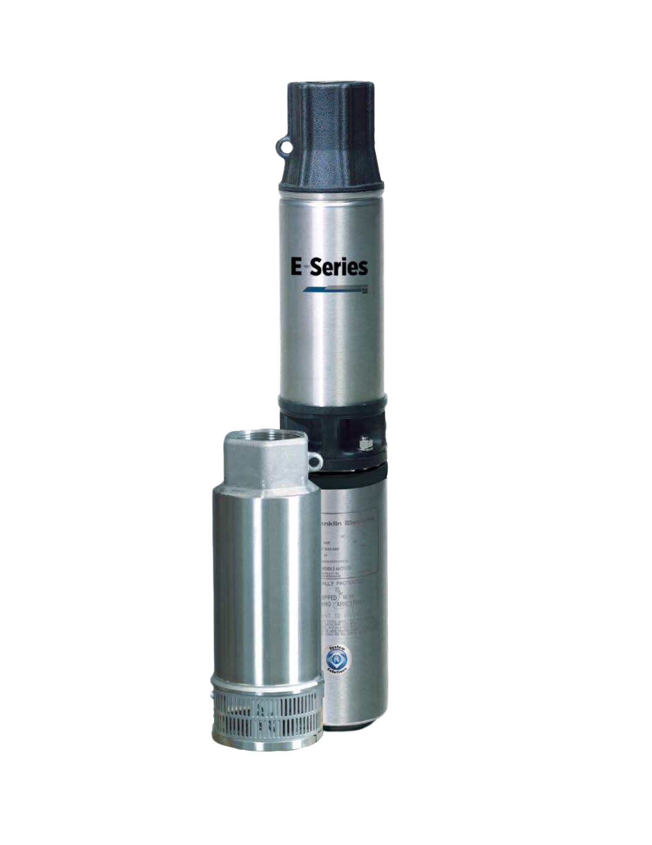
2
Turbine Pumps
Selection order:
Must meet minimum system pressure
Higher flow rate > 4 GPM is better
Notes:
Turbine pumps are used for drip system instead of normal effluent pump.
Turbine pumps are sized to meet minimum pressure first then selected for GPM.
Pressure requirement of the system are first looked at and then the higher flow rate pump should be picked in that series.
Flows to a drip system should be at least greater than 4 GPM.

Slide 12
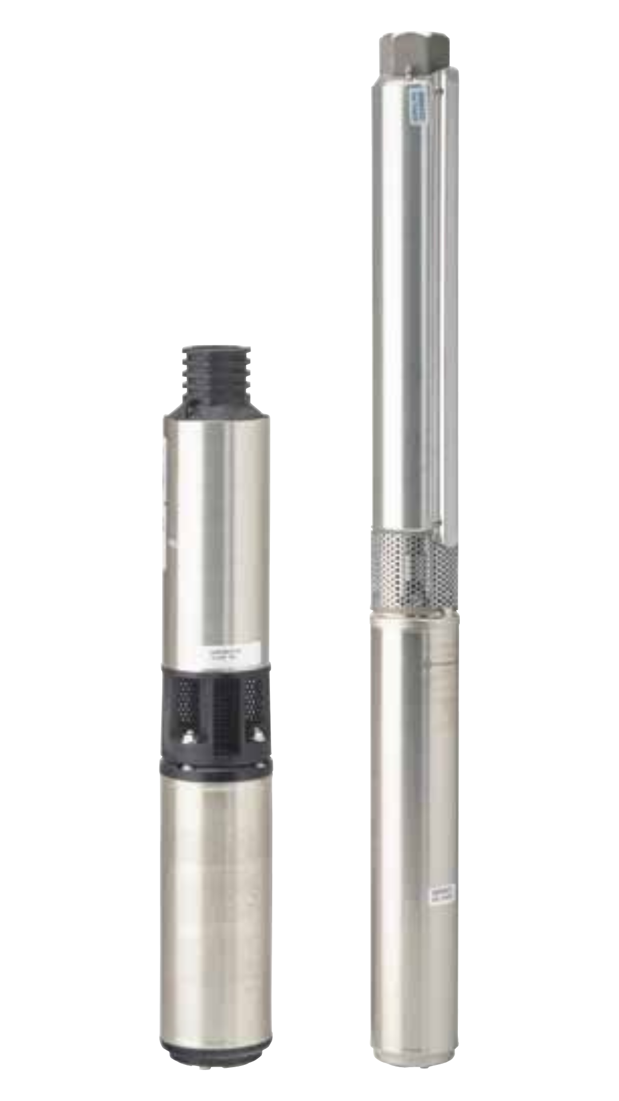
2
Turbine Pumps
Overcome system TDH to flush
Sufficient GPM required
After meeting TDH, higher flow rate preferred
Velocity aids performance
Notes:
Need to overcome system TDH to properly flush drip tubing.
Need to pump enough GPM to flush components.
Turbine pumps are designed for this type of flow, effluent pumps are not.
Rule of thumb, after TDH is satisfied, higher flow rate pump is preferred.
Velocity is your friend, but bigger isn’t always better.

Slide 13
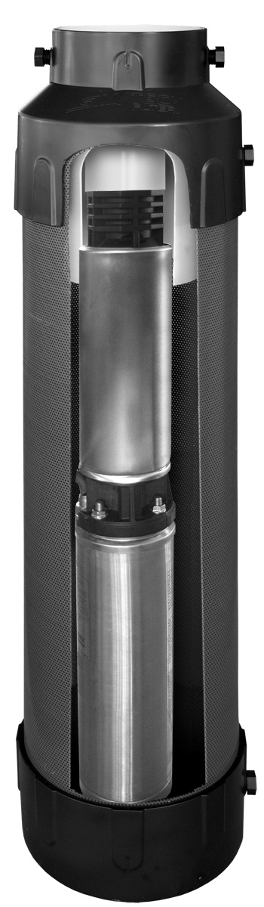
Sim/Tech
No-Vault Filters
Turbine pumps have small intake area
External filtration, 1/16” great add-on
Not required
Notes:
Turbine pumps have a small intake area
Great idea to add external filtration for the turbine pump; 1/16” is a nice size (add on, not requirement)

Slide 14
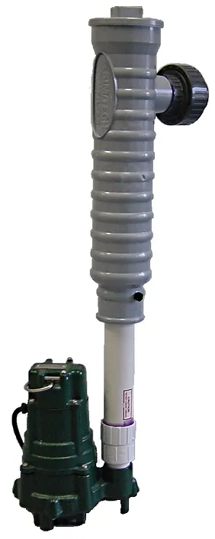
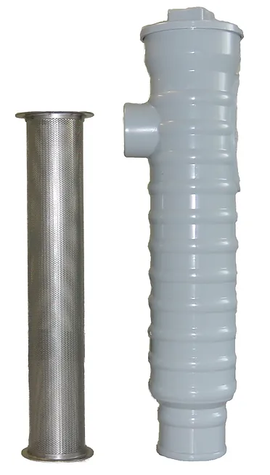
Sim/Tech
Pressure Filters
Secondary filter
Installed between pump and headworks filter
Add-on for coarser filtration
Notes:
The secondary filter is placed after the pump but before the drip system's headworks filter.
If the water quality isn't as clean, this pressure filter serves as an add-on to provide additional coarse filtration.
It’s installed in-line between the pump and the headworks, ensuring that the water undergoes extra filtration before reaching the drip head.

Slide 15
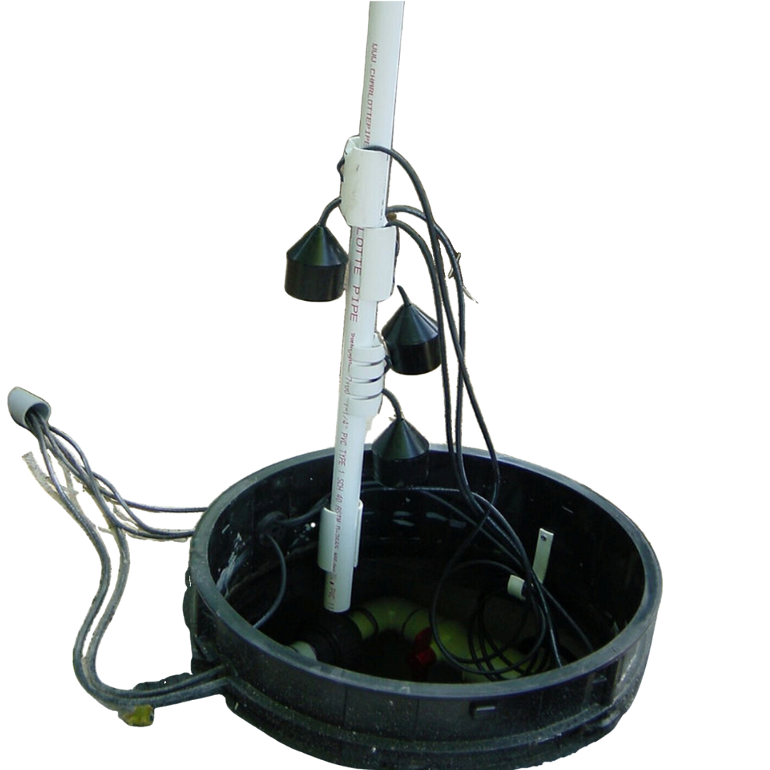
Sim/Tech Float Tree Kit
Floats:
ALWAYS on a separate float tree
NEVER mounted on pump line
Notes:
Floats should always be on a separate float tree
Should never be mounted on pump line (because pump vibrates)

Slide 16
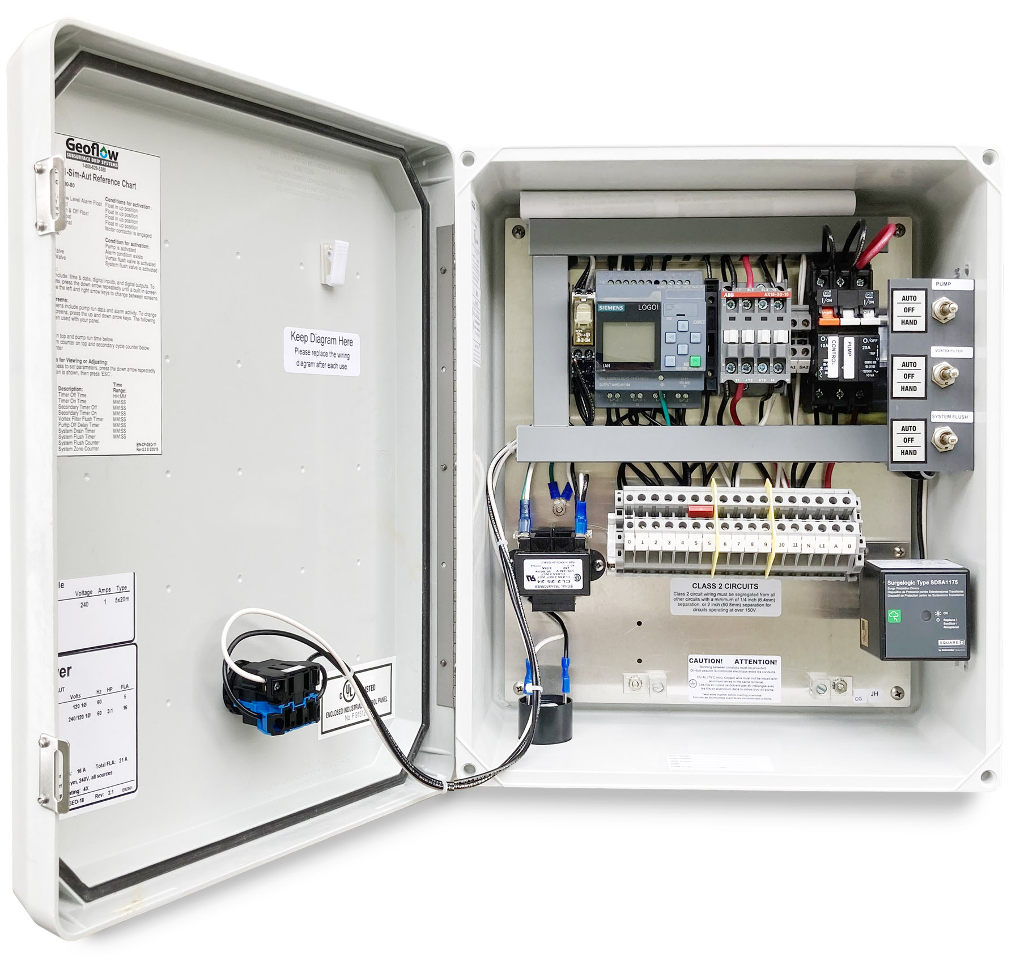
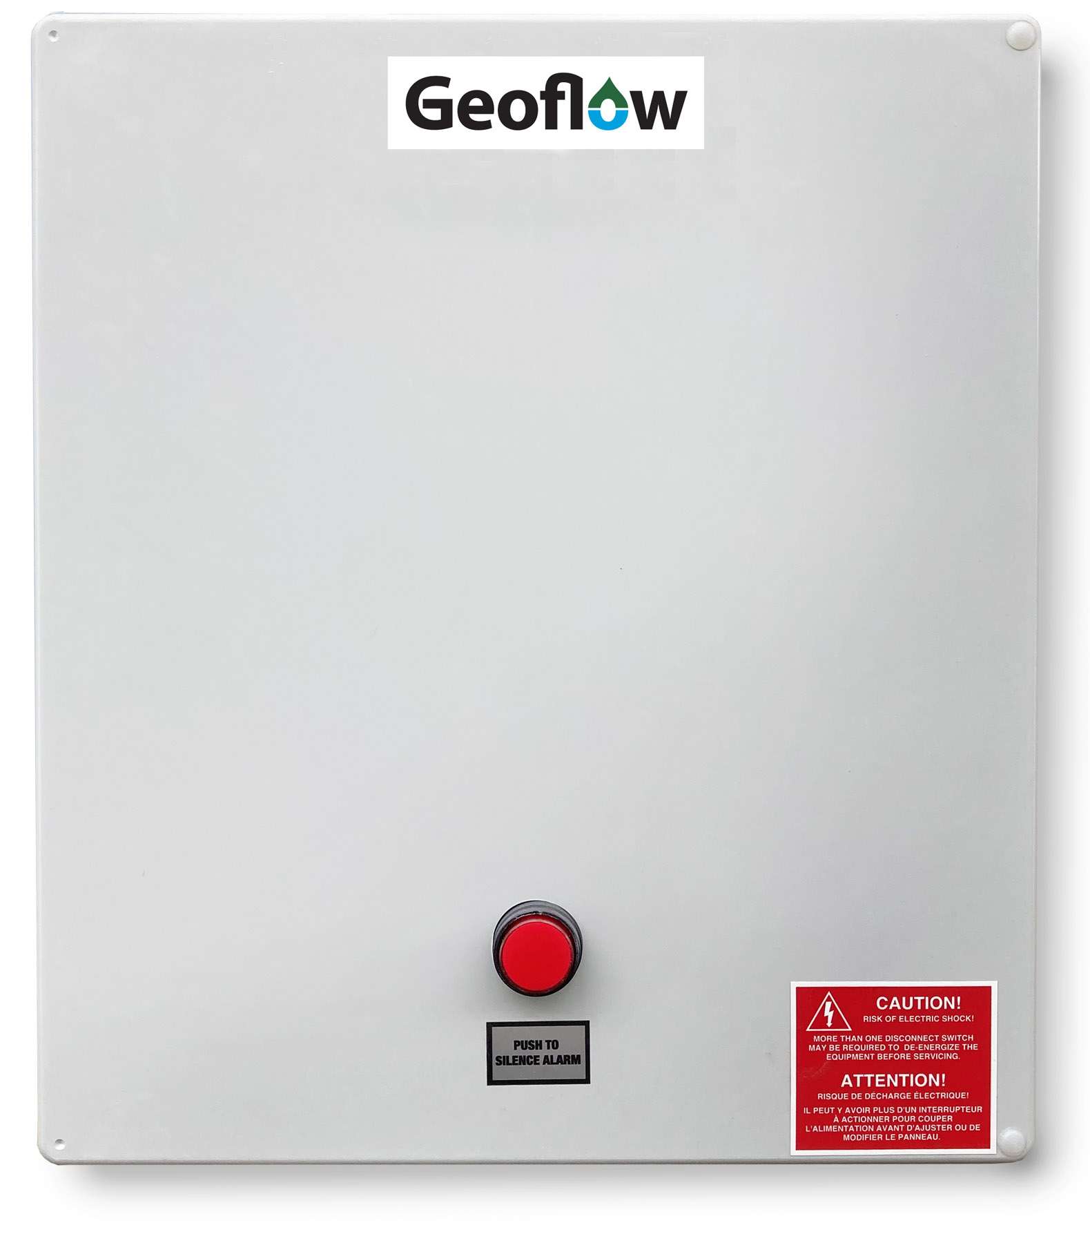
3
Control Panels
– Residential & Commercial
Notes:
Needs to adequately perform the functions required.
Timing on/off, flushing functions, timing to zones if needed.

Slide 17
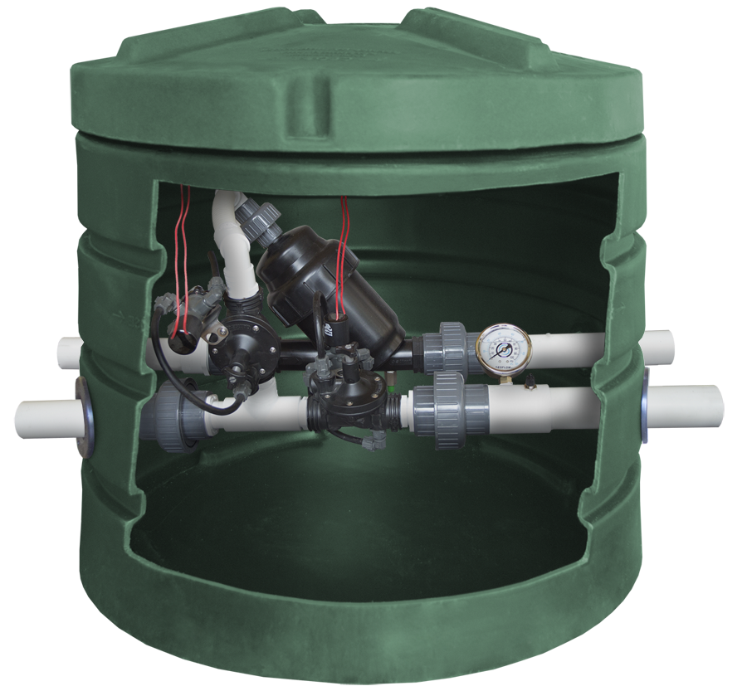
4
DripFilterECO – Residential Headworks
Auto washdown and field flush
Notes:
The more filter the better
ACCESS to components, ALWAYS
Auto washdown and auto field flush should be the MINIMUM, use best practice.

Slide 18
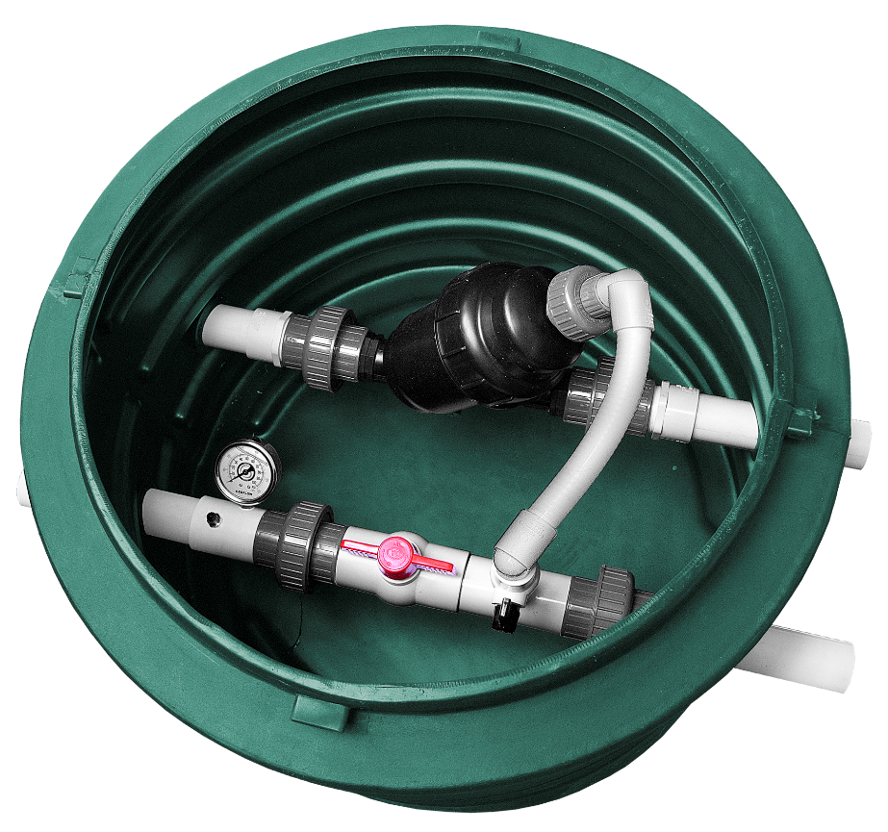
4
DripFilterECO – Residential Headworks
More filter is better
Components: ALWAYS accessible
Notes:
The more filter the better
ACCESS to components, ALWAYS
Auto washdown and auto field flush should be the MINIMUM, use best practice.

Slide 19
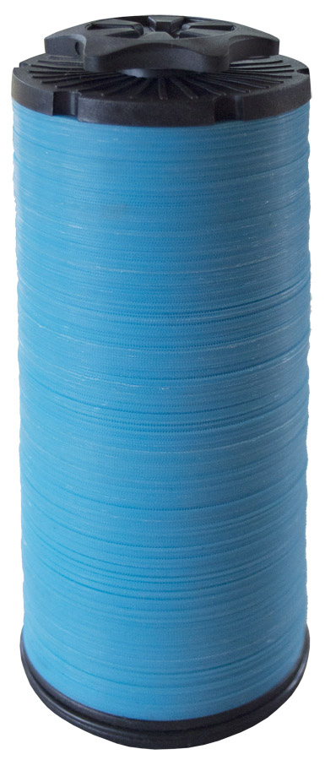
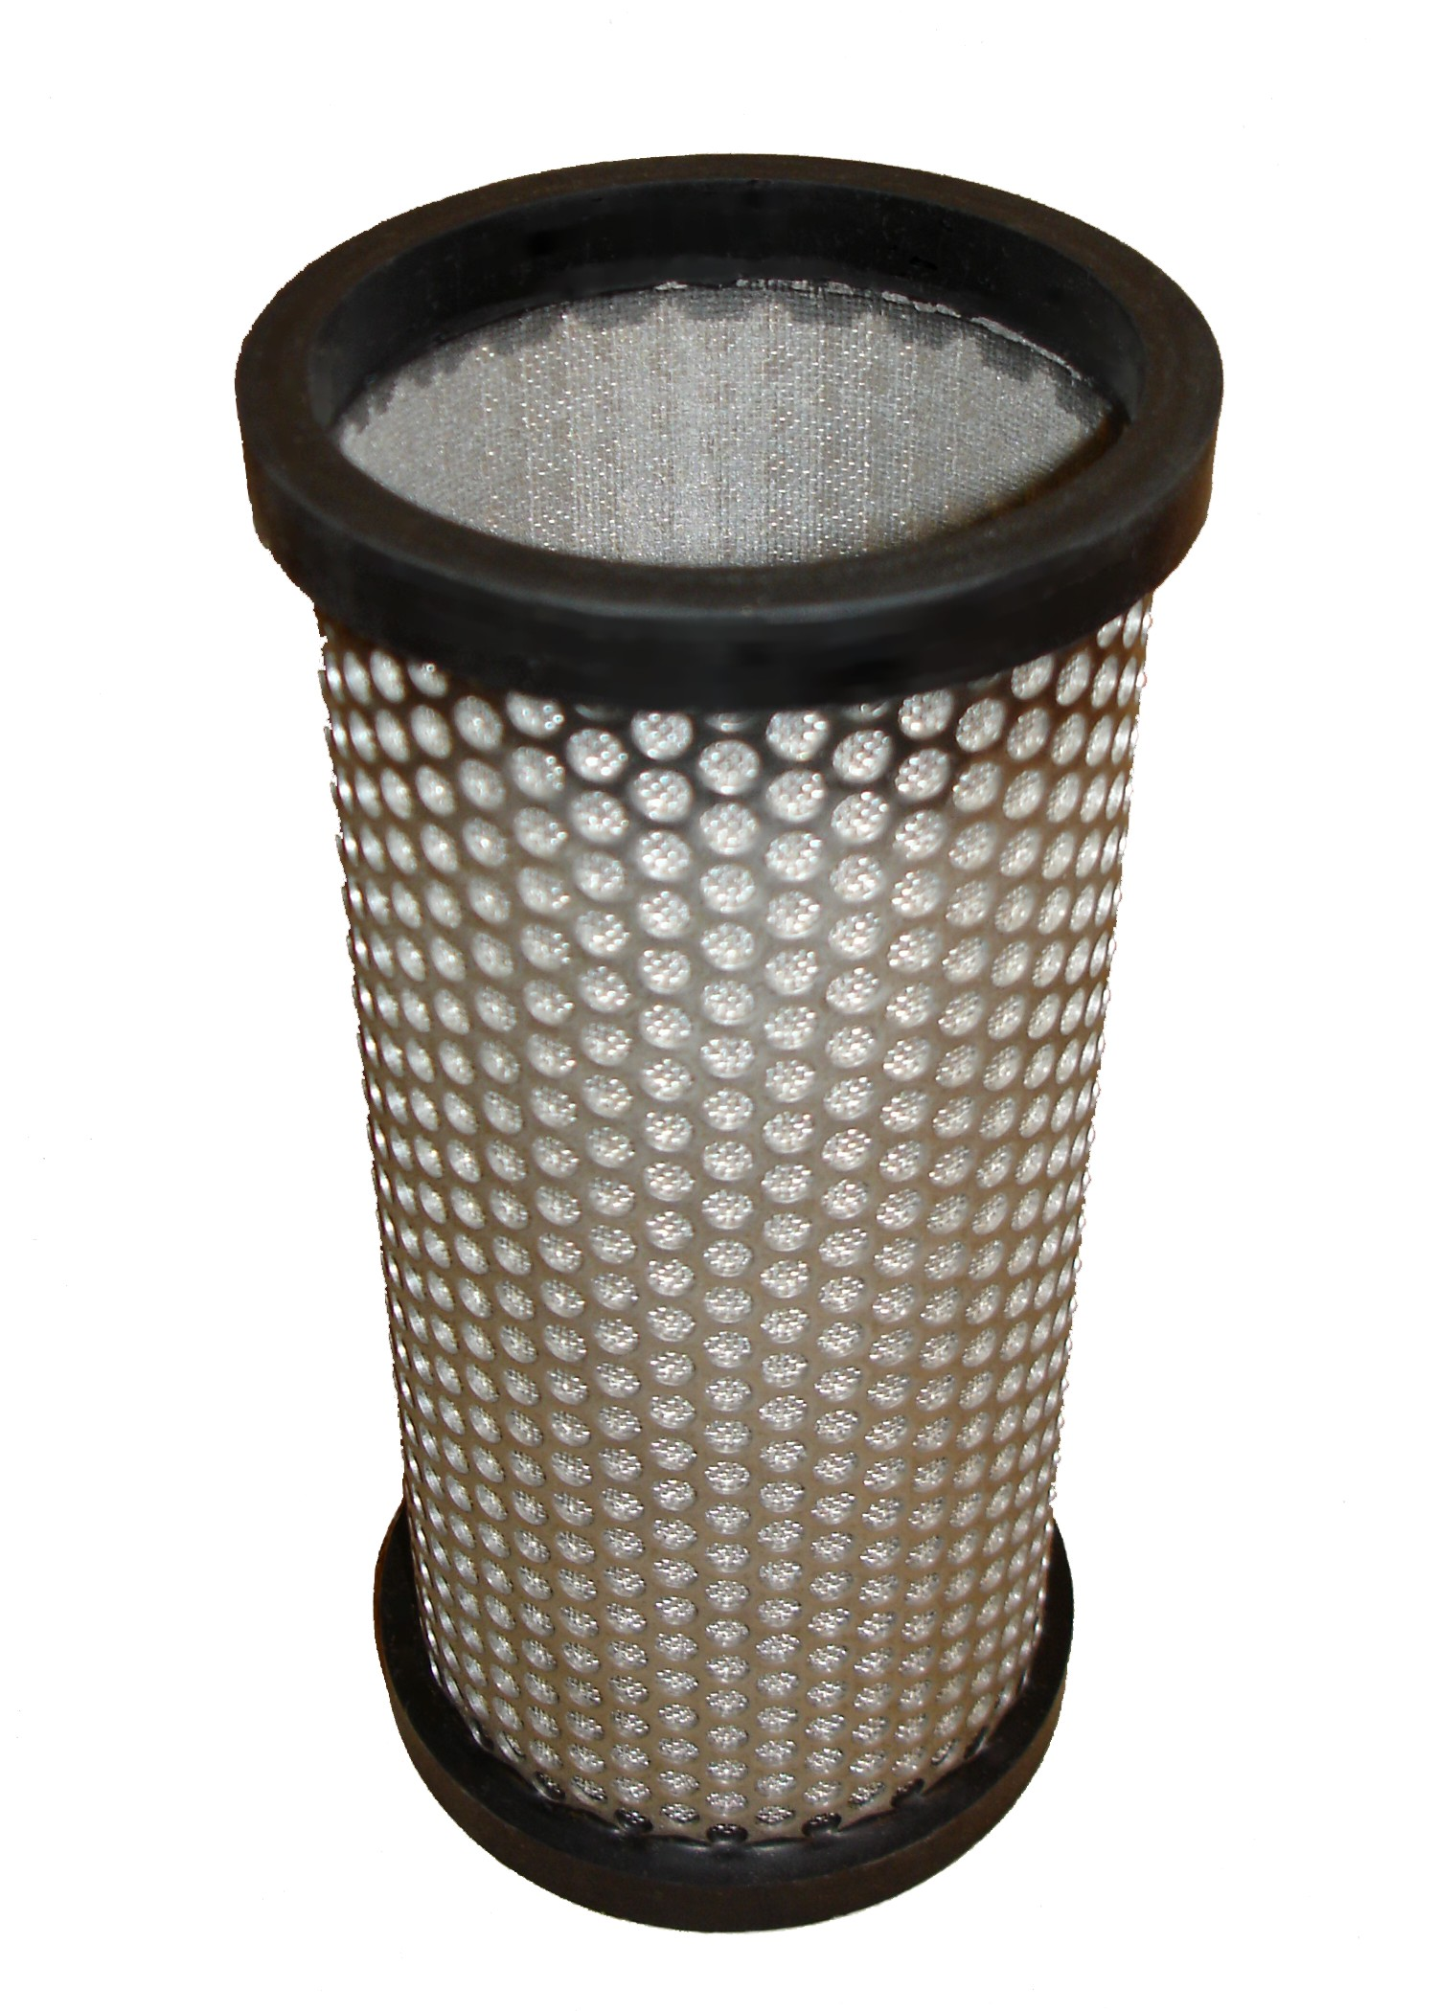
Screen Filters
vs. Disc Filters
130 microns
Notes:
This is a choice to use screen or disk filter. The disk filter is 3D. The more filter area is better

Slide 20
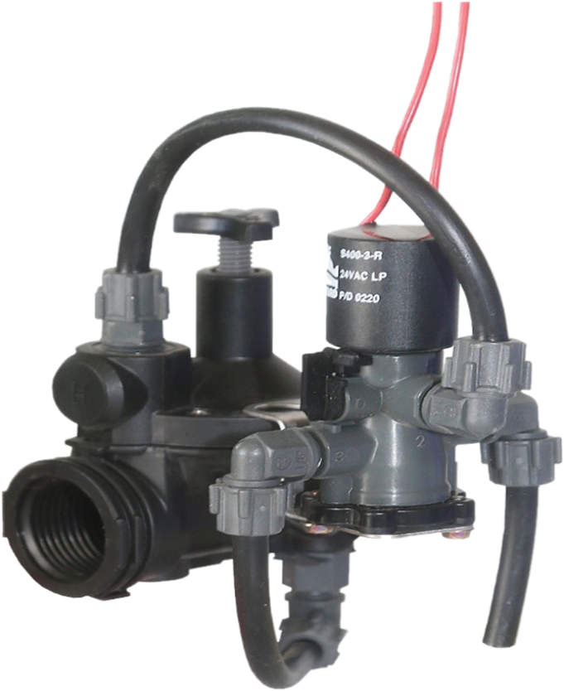
Solenoid Valves (External)
Better zone management
Air release valves may be needed
Design dependent
Less maintenance
Notes:
Internal solenoid valves NOT preferred
Prefer External solenoid valves. Better zone management, different timer settings possible.
May need air release valves, design dependent.

Slide 21
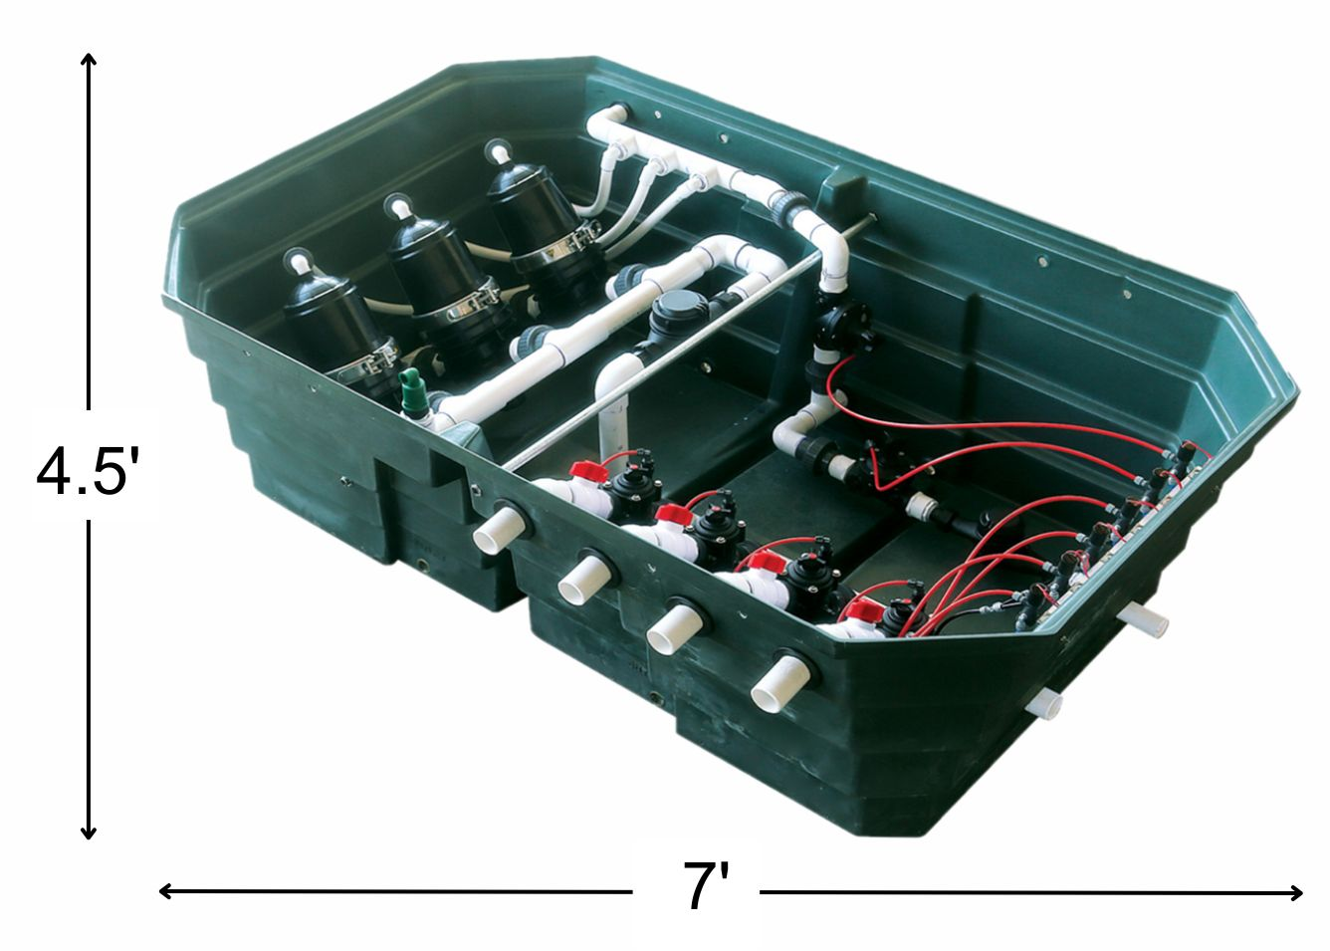
DripFilterECO
– Commercial
Headworks
Filter headworks are scalable
Notes:
Filter headworks are scalable. Multiple configurations available.
Options include filters only, zone valves only, or filters/zone valves combo.
Can be plumbed together like "train cars" based on the number of filters and zones required.
Jumbo headworks is 4.5’x7’, the size of a piece of plywood.

Slide 22
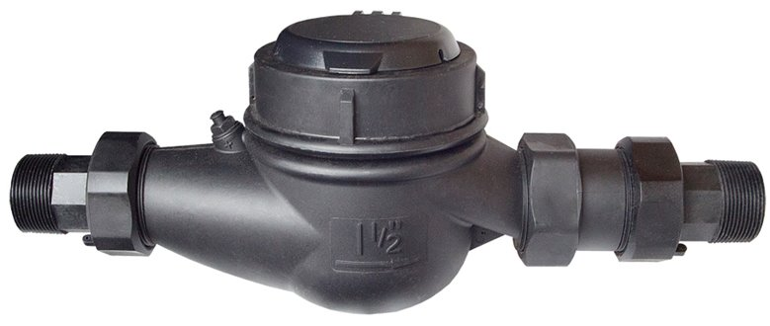
Flowmeters
Use for system monitoring

Slide 23
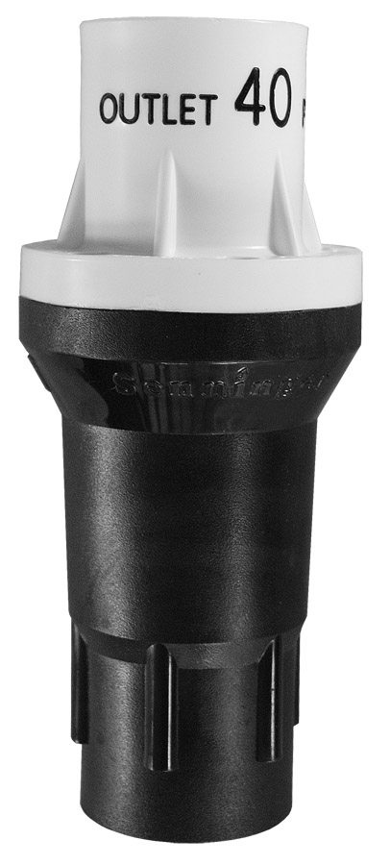

5
Pressure Regulators
Accessible for maintenance
Drip tubing < 50 PSI
Use for each zone
Notes:
Drip tubing shouldn’t run over 50 PSI
Should be placed just before inlet manifold before each zone
If more than one zone is designed, Pressure Regulators are used at each zone
They have ratings on them for GPM and PSI

Slide 24
Notes:
Use adequate size, minimum isn’t the best. Flow EQ helps with size.
Access to the tank, risers to grade.
Access to the pump(s), unions near the lid.
Access to the floats, float trees with plenty of slack.
Access to secondary filters.

Slide 25
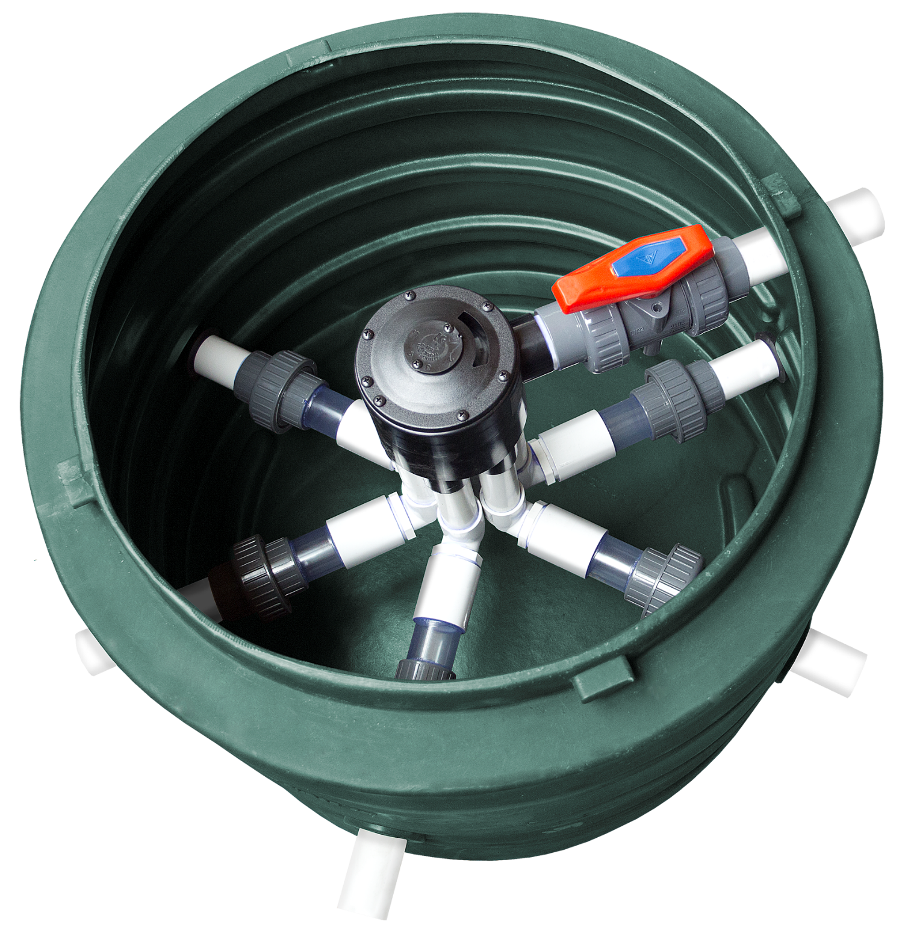
Diverter Valves
Need proper positioning
Need air release valves
Widely used
Notes:
Need to be positioned correctly on the landscape.
Should have air release valves.
Are widely used

Slide 26
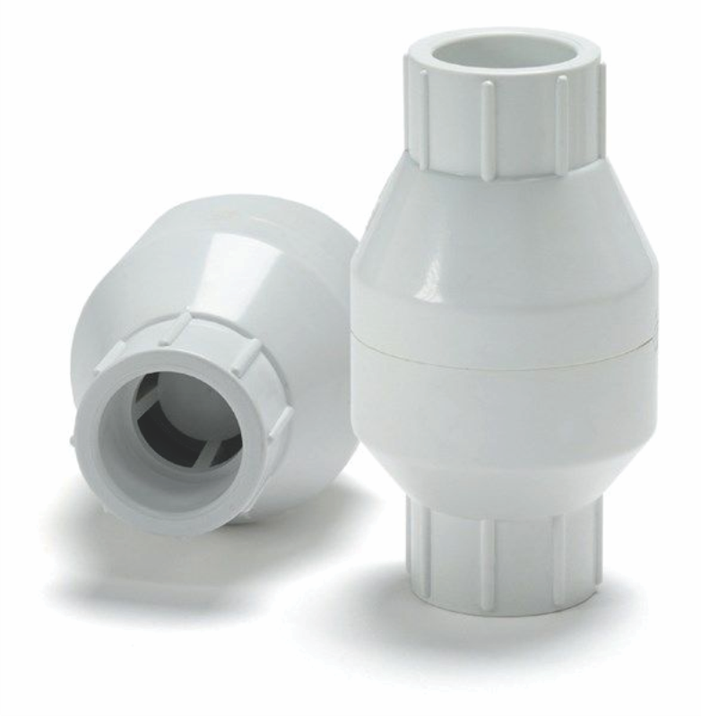
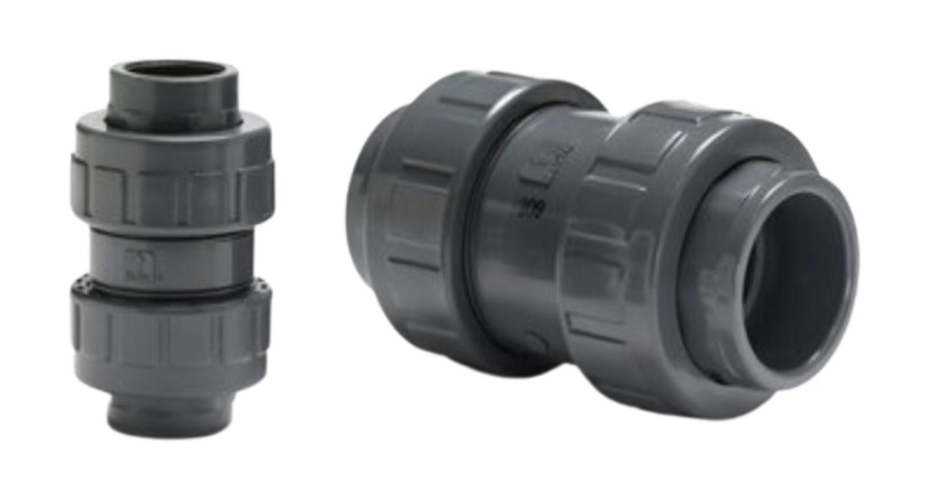
Check Valves
More than one zone
Use to isolate individual zones
Must be accessible for maintenance
Notes:
If more than one zone is designed, Check Valves are used to isolate individual zones.
All of these must be accessible for maintenance. (Basins or Boxes)
They will leak someday

Slide 27
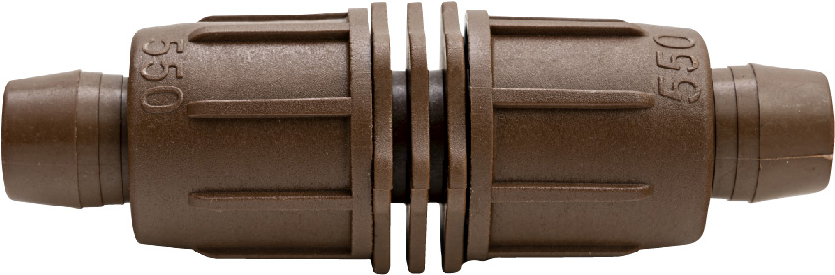
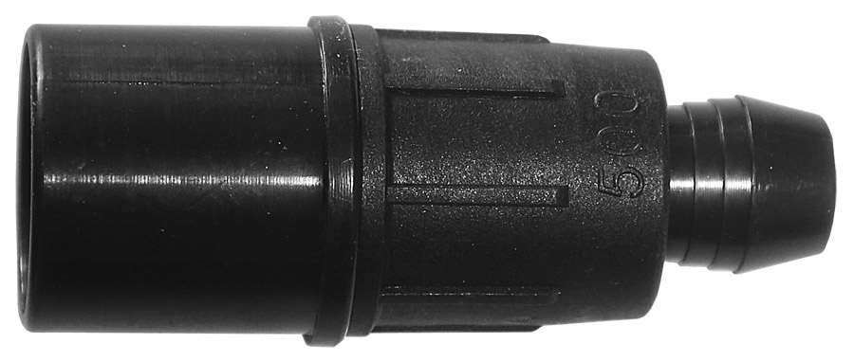
6
Lockslip Fittings
Slip style headers most common
Couplings
Joining a loop
Splicing tubing
L’s
For loops
Go around things
Notes:
The most common are the Slip style for the headers
The couplings are next and used for joining a loop or splicing tubing
L’s are for loops and to go around things
The brown locksilp is for 17mm tubing and black is for 16mm.

Slide 28
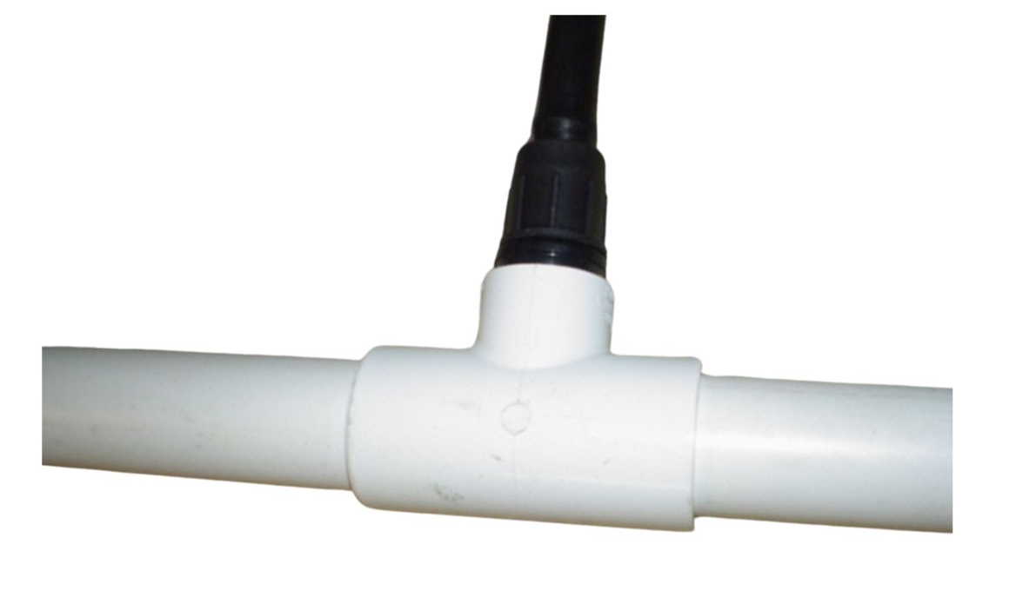
6
Manifold Connection
Notes:
This is a 1” x ¾” T and the slip fitting inserts and glues in.
The picture shown is a ½” socket x ¾” spigot is most popular

Slide 29
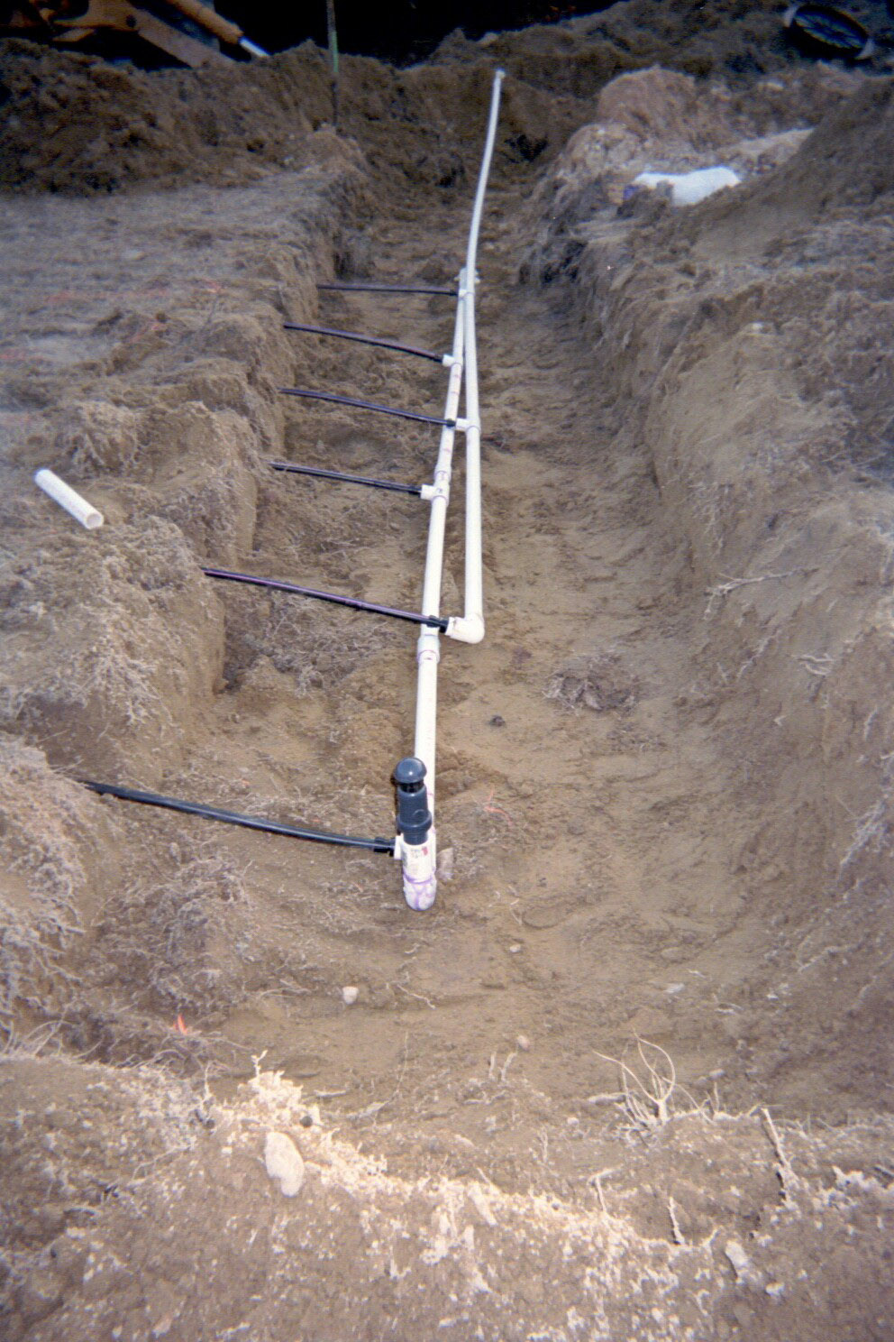
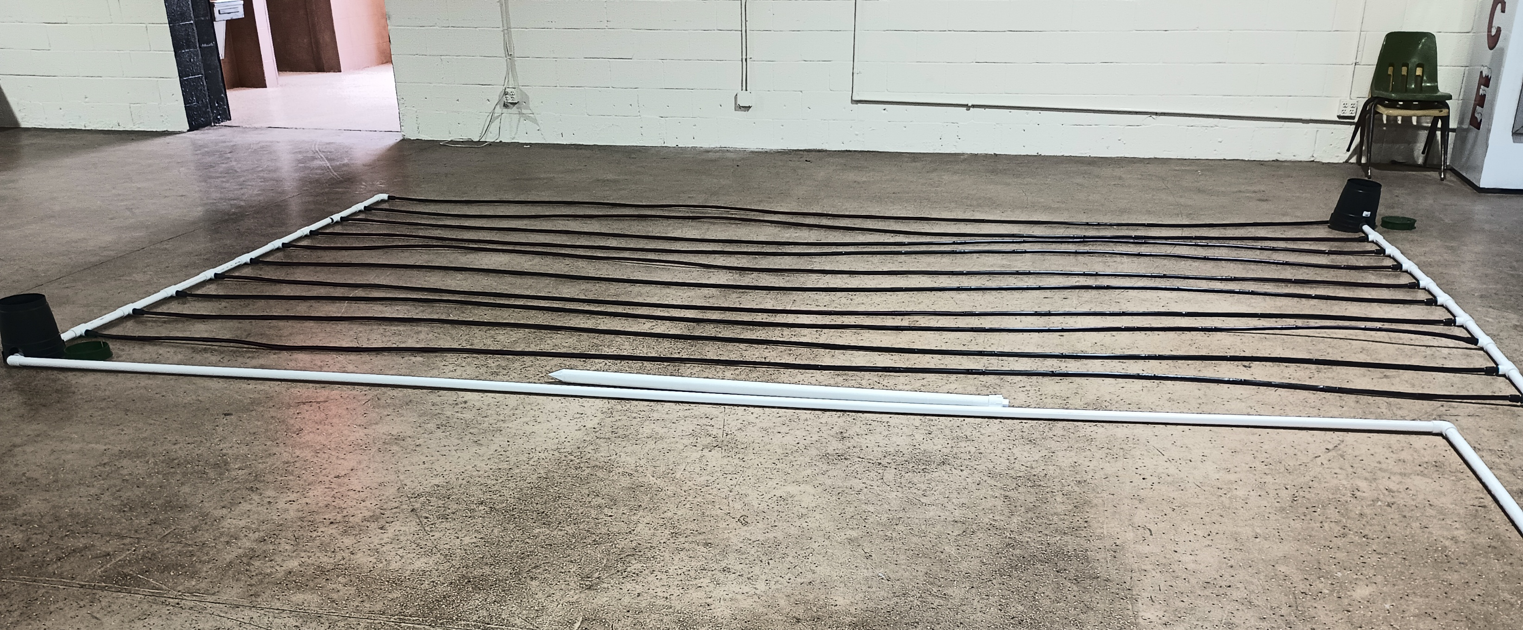
6
Manifold Connection

Slide 30
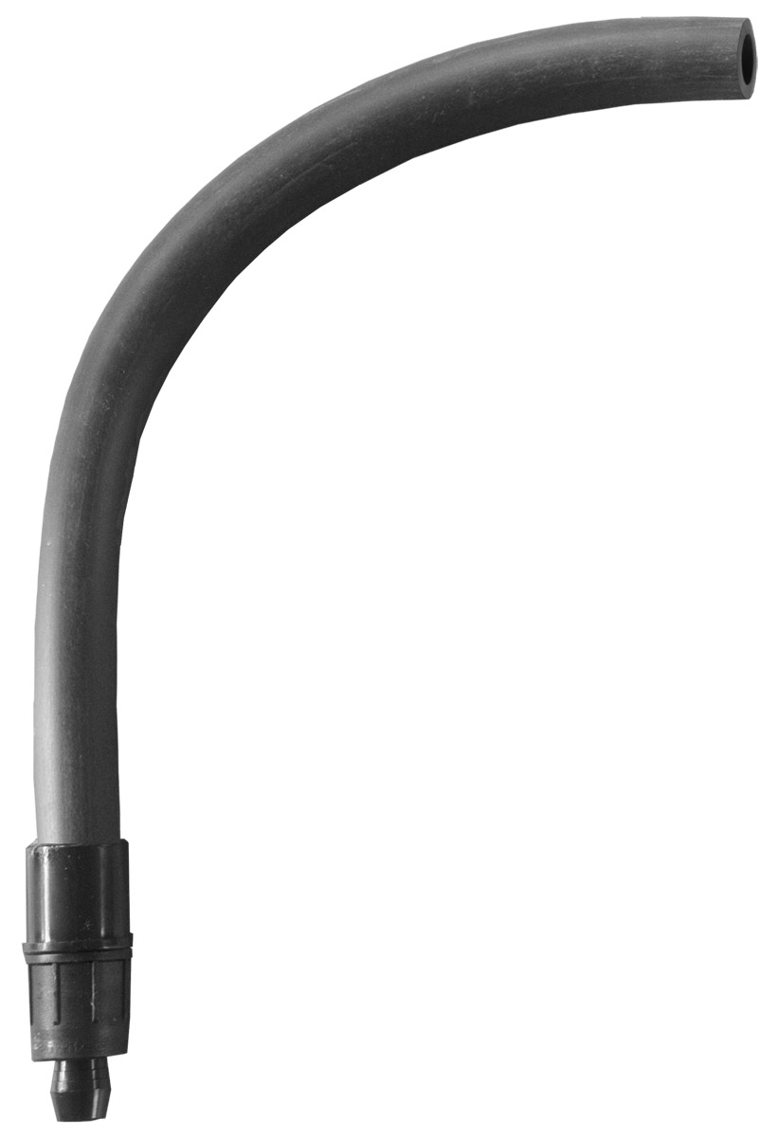
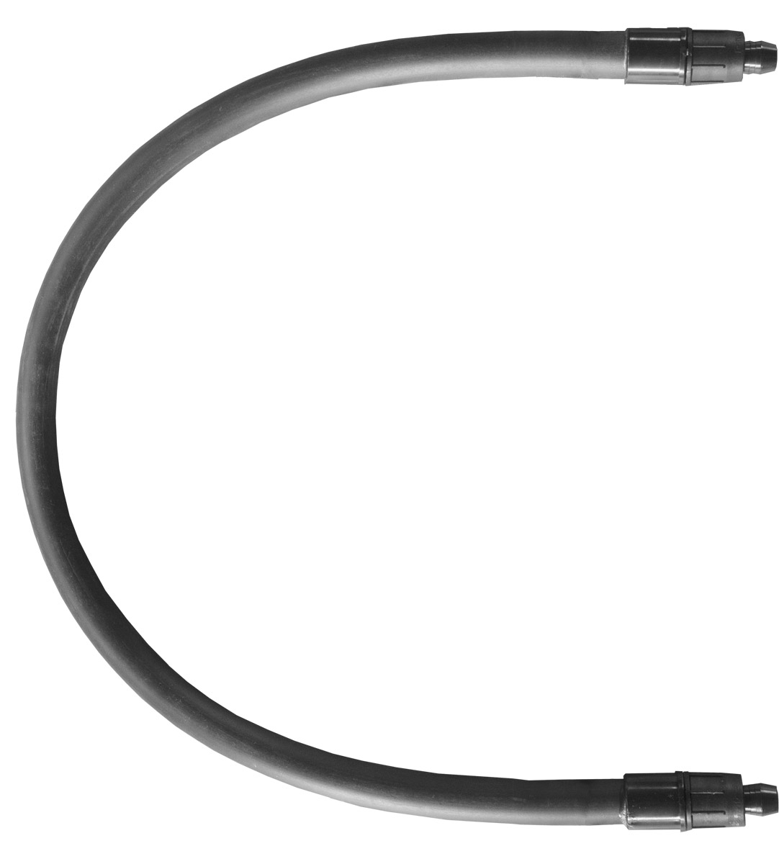
7
Lockslip Loops & Risers

Slide 31
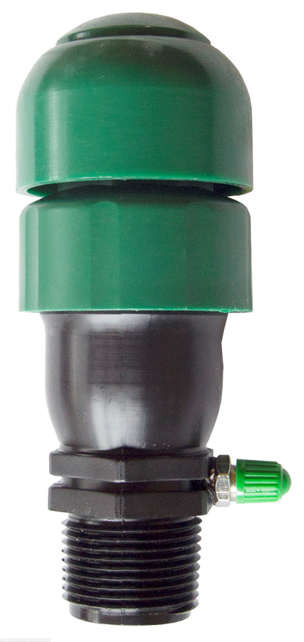
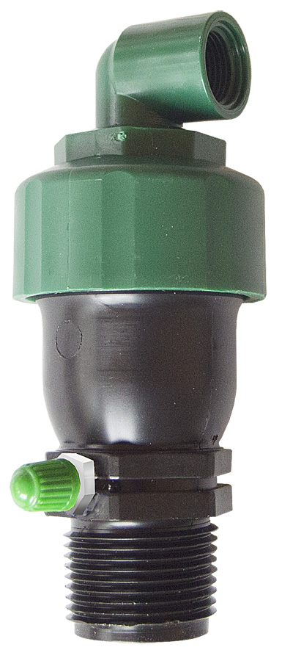
8
Kinetic Air Release Vacuum Breakers
Drip tubing should NEVER be under negative pressure
Need 2 per zone:
High point of pressure side
Return side of manifold
Only points to accurately check system pressures
Notes:
Break vacuum and release some air.
Kinetic means motion, once closed no more air is released.
Most importantly, vacuum breaking, drip tubing should NEVER be under negative pressure.
Need at least one of these at the high point of the pressure side manifold and the return side manifold (one at each side) for each zone.
These are the only points that accurately check the pressure in the system.

Slide 32
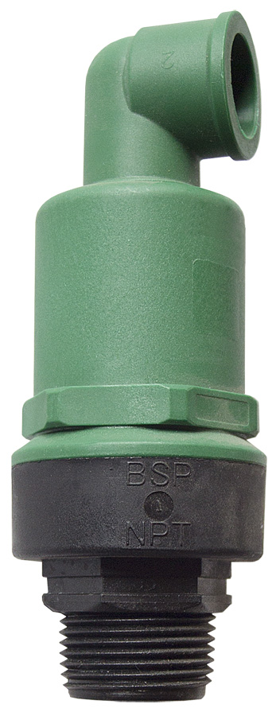
8
Continuous Air Release
Vacuum Breaker Valve
CONTINUOUSLY releases air and breaks vacuum
Used for systems with:
Long runs
Dips
Valleys
Notes:
Break vacuum and release air CONTINUOUSLY
Systems that have long runs, dips and valleys should use Continuous Air Release Valves
May be needed in multiple locations.

Slide 33
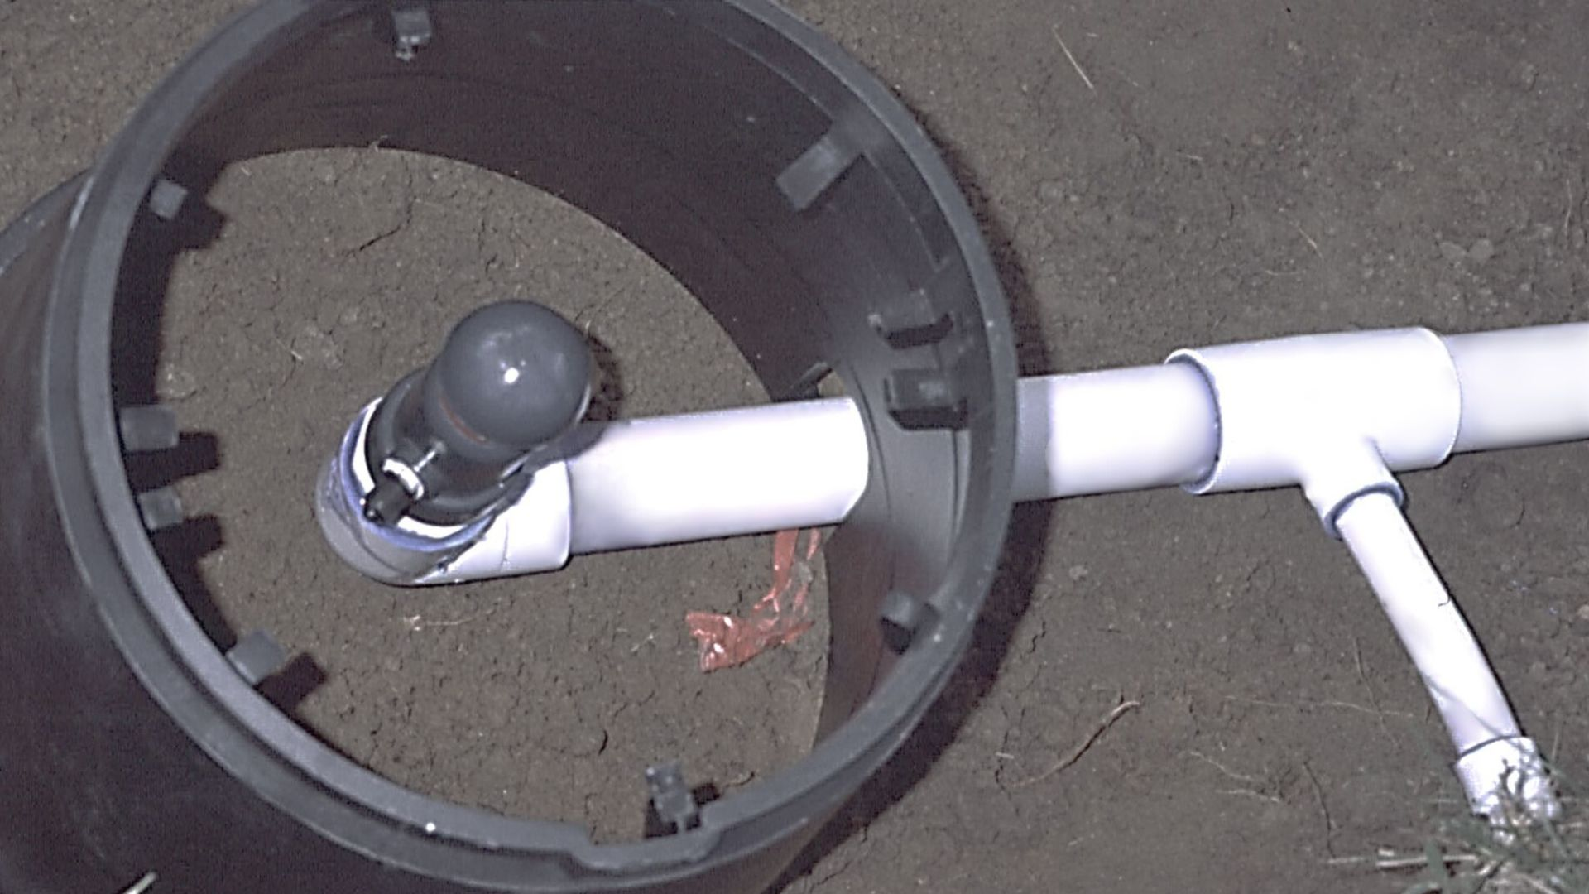
8
Air Release/Vacuum Breakers
Must be accessible
CORRECT place to check system pressure
Notes:
Air release vacuum breaker must be accessible
The CORRECT place to check the system pressure

Slide 34
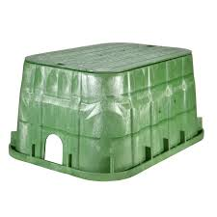
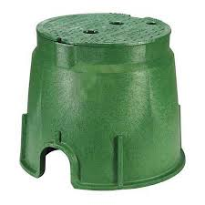
Valve Boxes
Notes:
All parts need to be accessible for maintenance
Check valve PMRs
Air Vac releases etc.

Slide 36
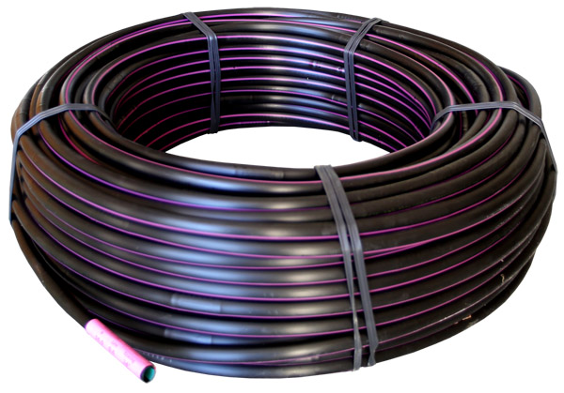
9
WaterflowPRO Drip Tubing
PC
0.6 or 0.9 GPH
Optimal PSI 20-50
12” or 24” emitter spacing
Notes:
Different Diameters, 16mm & 17mm others can be made.
Different nominal flow rates from Emitters
Flow rates on PC PRO Tubing are .6 gph or .9 gph with optimal PSI range 20-50, but over 60 PSI fitting malfunctioning may occur.

Slide 37
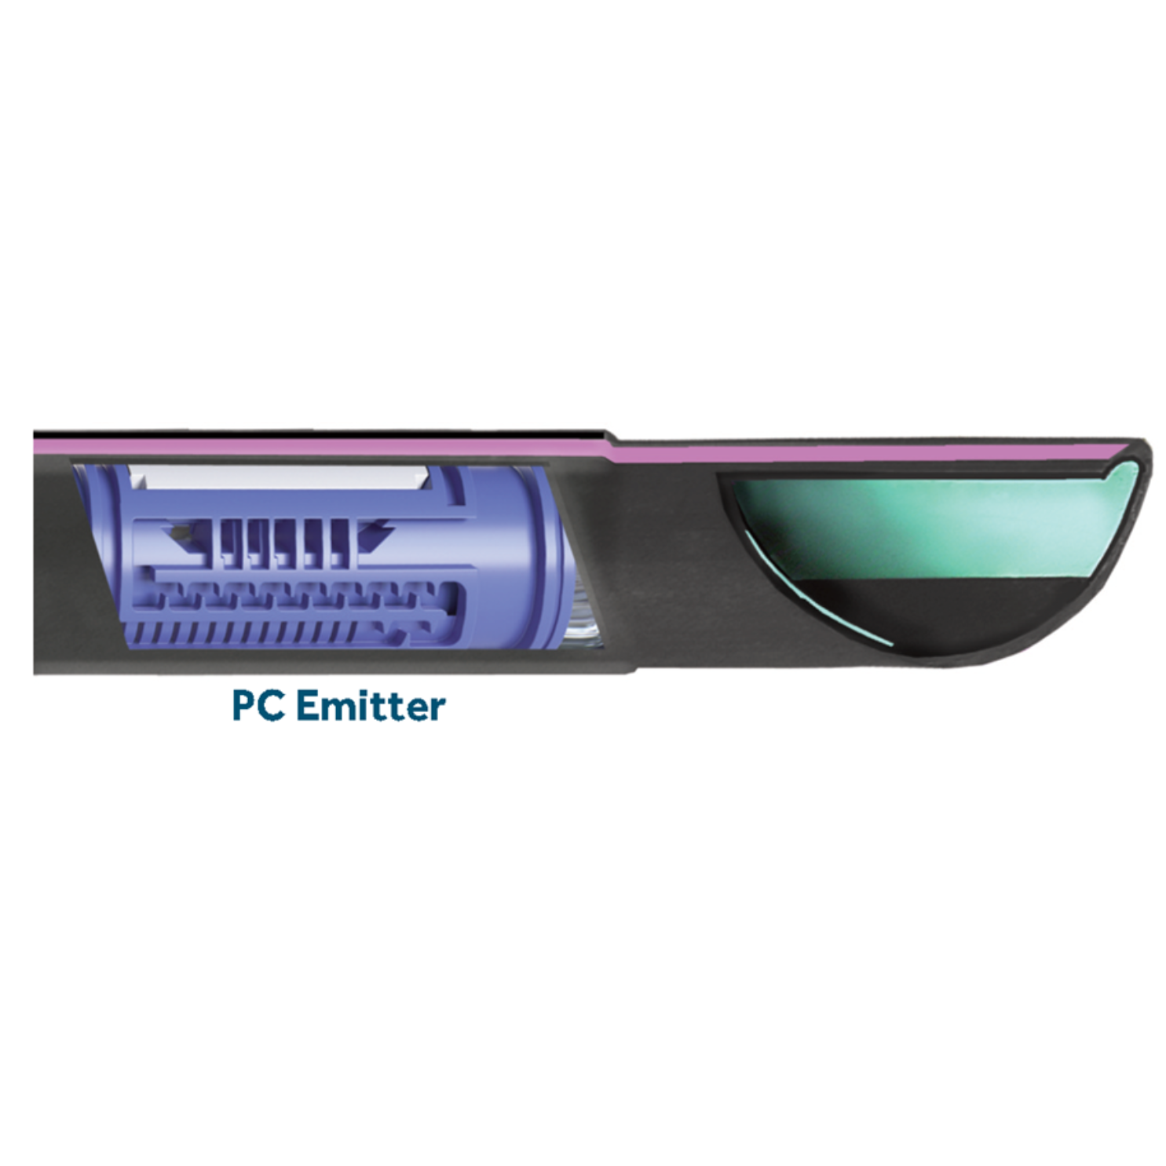
9
WaterflowPRO Drip Tubing
Notes:
Once pressure releases water oozes out of the tube.
Compensating Chamber operates under pressure.

Slide 38
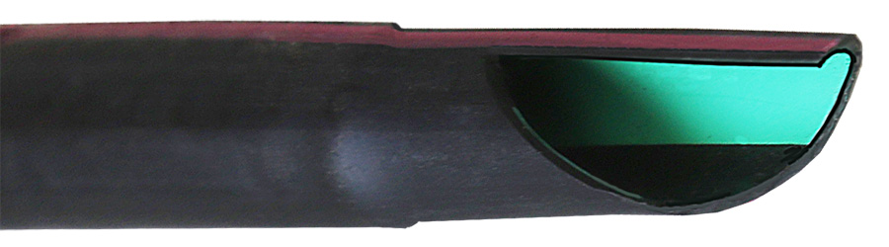
9
Geoshield®
Antimicrobial lining
Prevents biofilm build-up inside
Flushing works better even at lower velocity
Geoshield® lining
Notes:
Geoshield® antimicrobial lining prevents biofilm build-up inside tubing.
Allows flushing to work better, also at lower velocity.

Slide 39
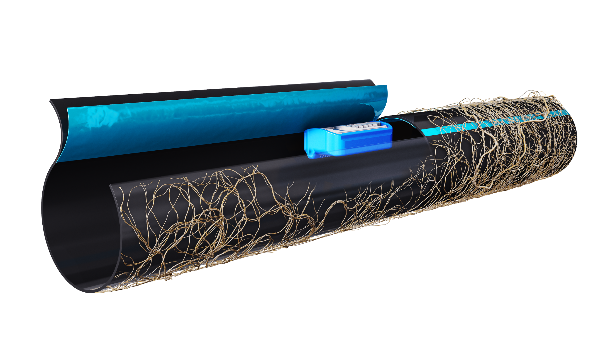
9
Rootguard®
Patented nano-Rootguard® band prevents root intrusion
Notes:
Patented nano-Rootguard® band Protects against root intrusion
Pre-emergent and does not leach out

Slide 40
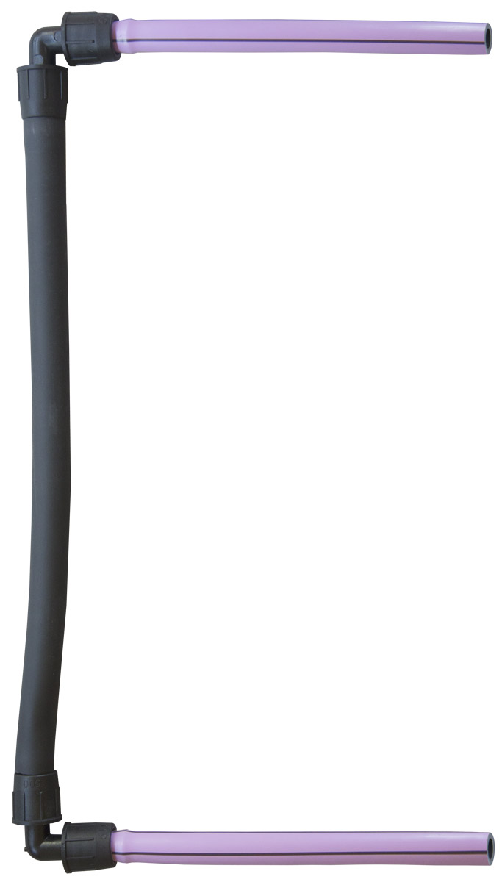
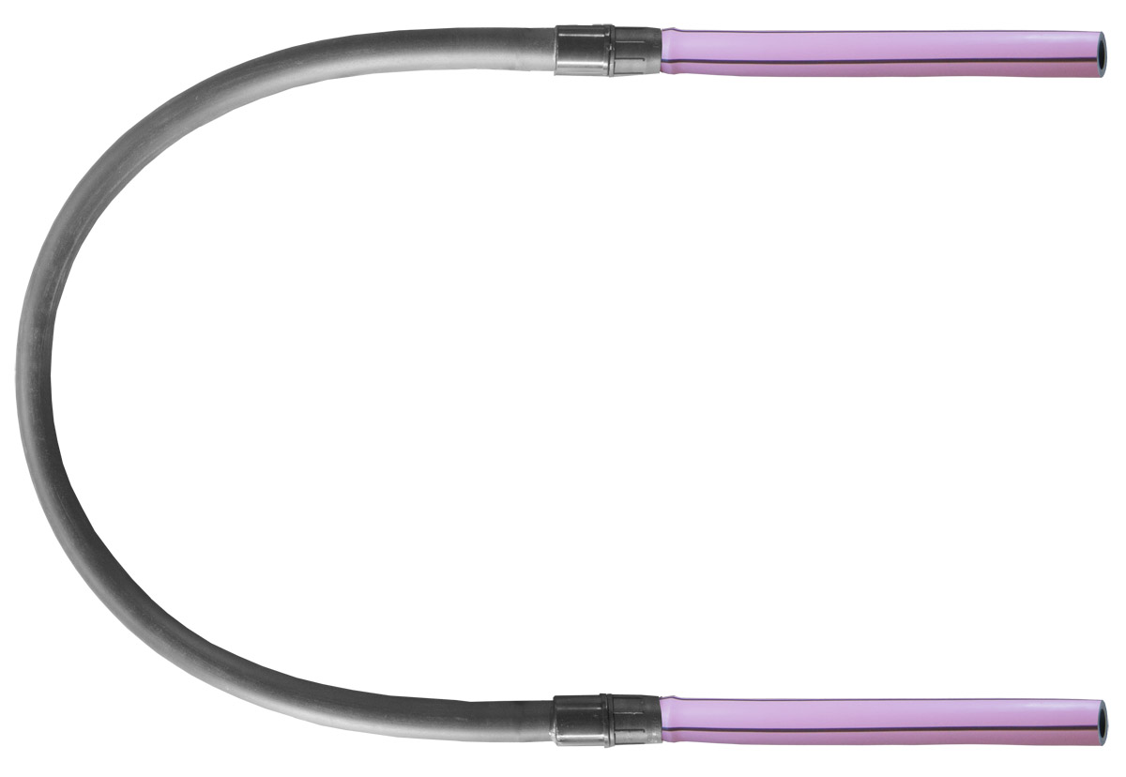
9
Notes:
Three styles of connections used.

Slide 41
2.
Maintenance Routine
Inspection & Cleaning

Slide 42
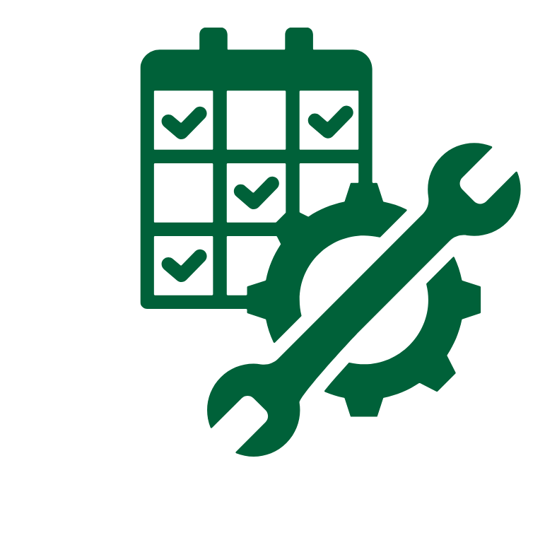
Maintenance Routine
Pump
Auxiliary Filters
Headwork Filters
Flushing
Vacuum Breakers
Inspection
Valves

Slide 43
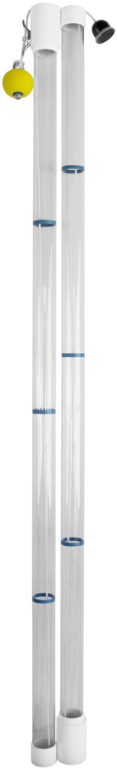

Pump
Follow pump and treatment manufacturer maintenance guidelines
Monitor and remove solids from pump and treatment units as needed
SimTech Tru Core Sludge Sampler
Notes:
Check with pump and treatment plant manufacturer for maintenance recommendations.
Check for solids build-up in pump chamber and treatment unit/septic tanks. Pump out when needed.

Slide 44
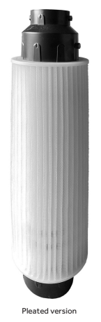
Auxiliary Filters
Clean auxiliary filters
Septic tank
No-Vault
Pleated Gravity Filters
Notes:
Maintain and clean auxiliary filters – septic tank filter, no-vault filter

Slide 45
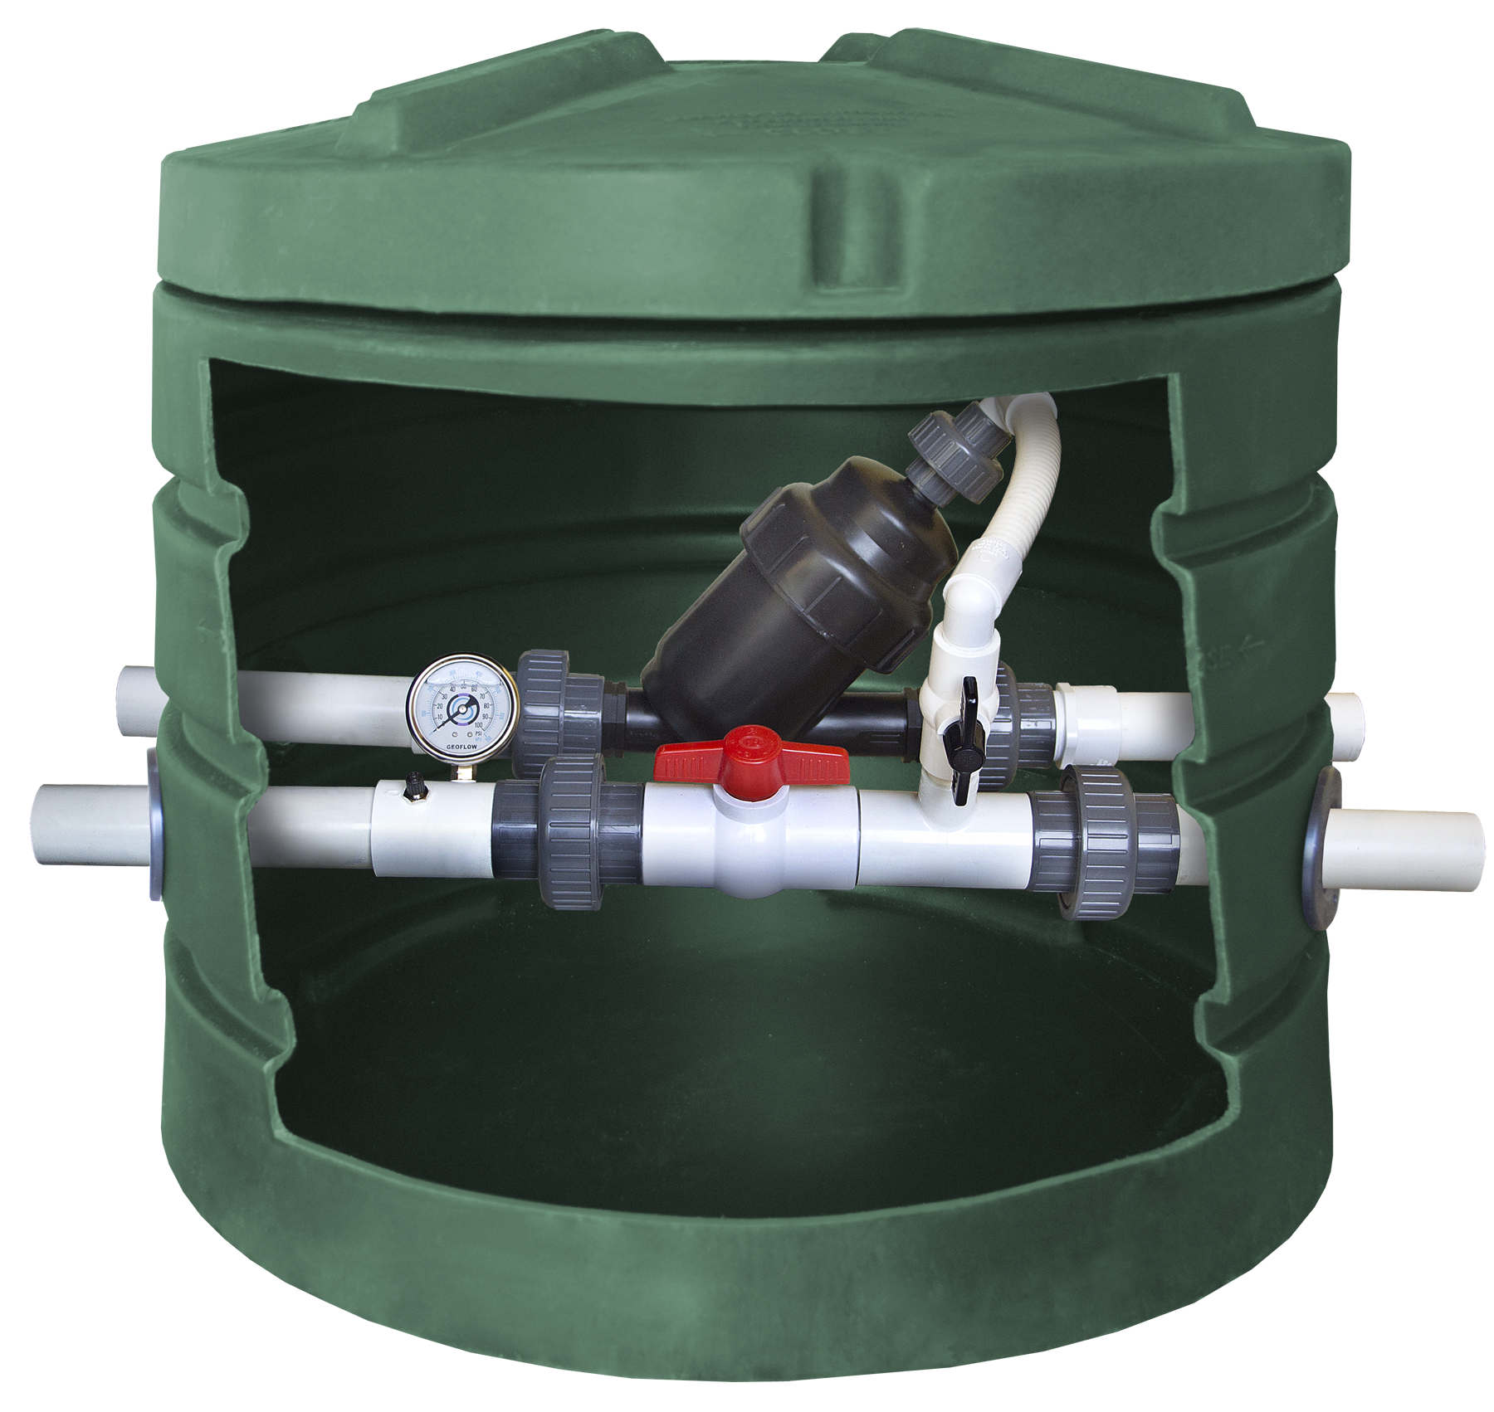
Headwork
Filters
Clean/replace headwork filters
Notes:
Clean and/or replace headwork filters

Slide 46
Flushing
PUMP
Flushing:
Activate pump
Open return line valve
Flush each zone same duration as dose
Reset return line valve
Check field pressure and flow rate
OPEN RETURN
FLUSH
RESET
PRESSURE
FLOW
Notes:
Activate pump and open return line valve. Flush each zone for same time as dose.
Reset return line valve to original setting and check field pressure. (Check flow rate if system includes flow meter).

Slide 47
Vacuum Breakers
Check for proper operation
Clean
Notes:
Check vacuum breakers for proper operation. Clean them.

Slide 48

Inspection
Record in log
Date
Counters
ETM
Field pressures, etc.
Fields
Pooling of water
Dry and wet areas
Notes:
Check field for any signs of distribution issues – pooling of water, dry area in some and wet in other.
Record date, counters, ETM, field pressure(s), etc. in log.

Slide 49
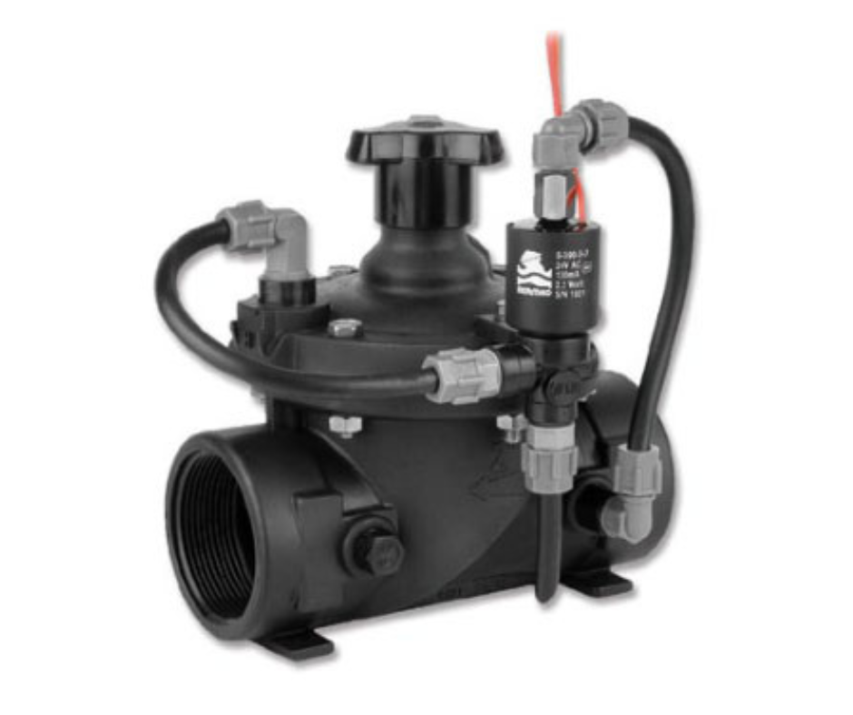
Solenoid Valves
Remove, disassemble and clean
Every 2 – 3 years
Reset control system for auto operation
Notes:
If Pressure Reducers (PMR) check valves or electric solenoid valves are used:
remove, disassemble and clean every two to three years to insure long life and continued operation.
Reset control system for auto operation.

Slide 50
3.
Essential Design Basics
Walkthrough

Slide 51

Design Walkthrough
For designs < 2,000sq.ft
Critical parameters of parts
Design Basics
Calculations simplified
Notes:
Starting a design 1,000 sqft and smaller.
Critical parameters of parts, design basics, design calculations simplified.
Florida rules need to be followed.

Slide 52

Worksheet
Notes:
Starting a design 1,000 sqft and smaller.
Critical parameters of parts, design basics, design calculations simplified.
Florida rules need to be followed.

Slide 54
3.
Essential Design Basics
Critical Parameters of Parts

Slide 55

Design Parts
Turbine pump
PVC plumbing
Automatic headworks
Panel
Drip tube
Air vacuum release
PMR valve

Slide 56

Turbine
Pump
20 GPM is BEST

Slide 57

PVC Plumbing
Out: 1.25" BEST
Flush return: ≤ 1" OK
Distance:
100' out
100' back
Pump to riser: 1.25"
Elevation up to 20ft
Notes:
1" is better for out, can use smaller for flush return
Distance less than 100' out and 100' back
Use 1.25" on pump to riser outlet
Elevation up to 20 ft

Slide 58

Automatic Headworks
Automatic = controlled (Solenoids)
Some manufacturers use switching flushing filters AND solenoids for field
Notes:
Florida rules: "All systems shall incorporate an automatic mechanism for backwashing or flushing the drip lines and filters"
To be automatic it must be controlled, that means Solenoids
Some manufactures use switching flushing filters AND solenoids for field

Slide 59
Panel
Specifications
3 floats MINIMUM
Time-dosed over 24hr
3 FLOATS
24 HR
EXCESS
Alarm
Notes:
Specifications
3 floats minimum
Rule: "Drip irrigation systems shall be time-dosed over the 24-hour period. Demand control dosing shall override timed-dosing in periods of flow where timed dosing cannot accommodate the excessive flow."

Slide 60

Drip Tube
Spacing between runs:
MAX 24"
MIN 6“ or less
BEST for small systems
Notes:
WFPC-16-4-12
Max spacing 24” between Runs, Min Spacing 6” Between Runs
Best tube for small systems
Pump needs GPM above 4.5 GPM for 300’ of Drip Tube

Slide 61

Air Vacuum Release, PMR Valve
MINIMUM 2 Air Vacs
High point of pressure
Return lines
PMR after filter
Notes:
Minimum Two Air Vacs
– Air vacs go on the high point of the pressure and the return lines
PMR after filter, 40 PSI is a good choice.

Slide 62


Slide 64


Slide 65


THANK YOU
FOR YOUR ATTENTION

Slide 66

Contact Me For Anything Septic
e sean.mcguigan@anua-us.com
t 603.348.7579
w geoflow.com
simtechfilter.com
anuainternational.com

