Slide 1
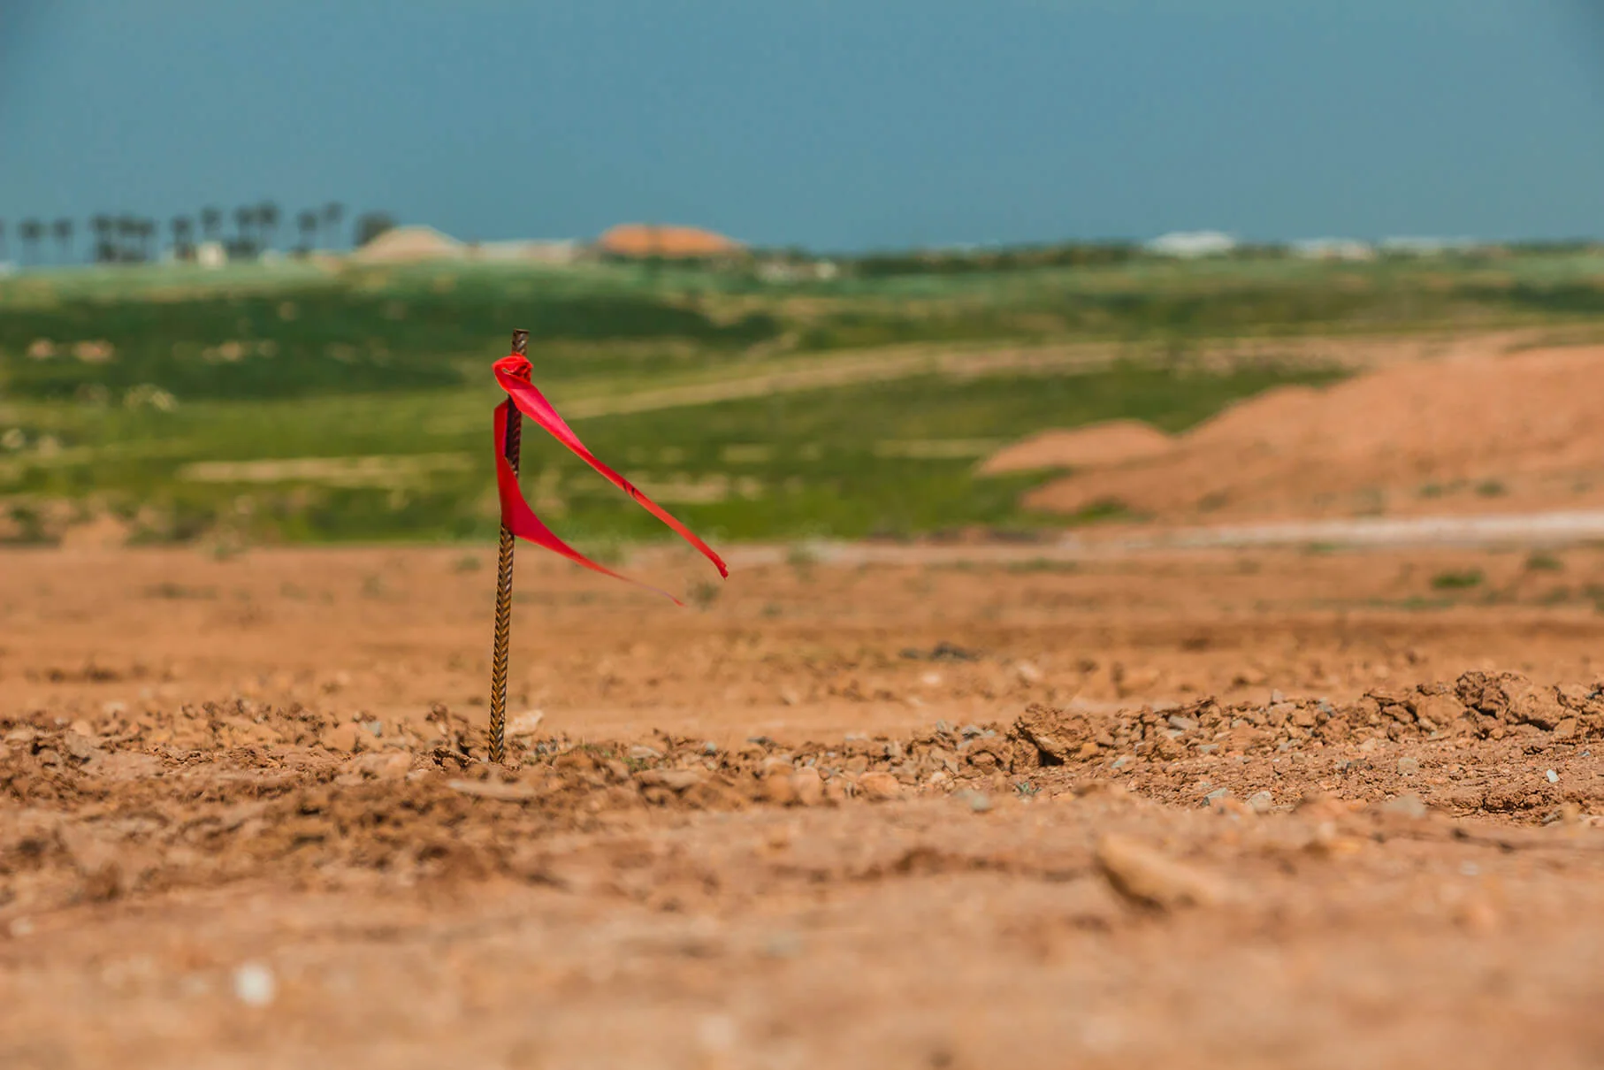


Challenging Install
Clint Britt _ Installer Rep.
CPOW Conference 2026

Slide 2
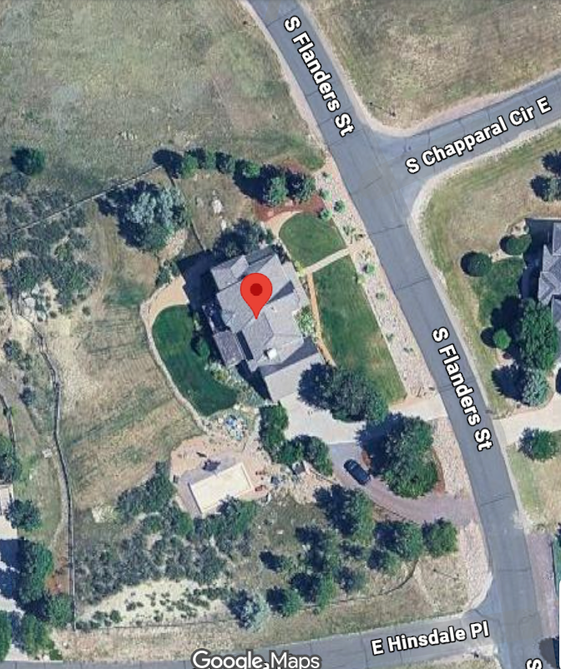

INSTALL CHALLENGE: FLANDERS

Slide 3
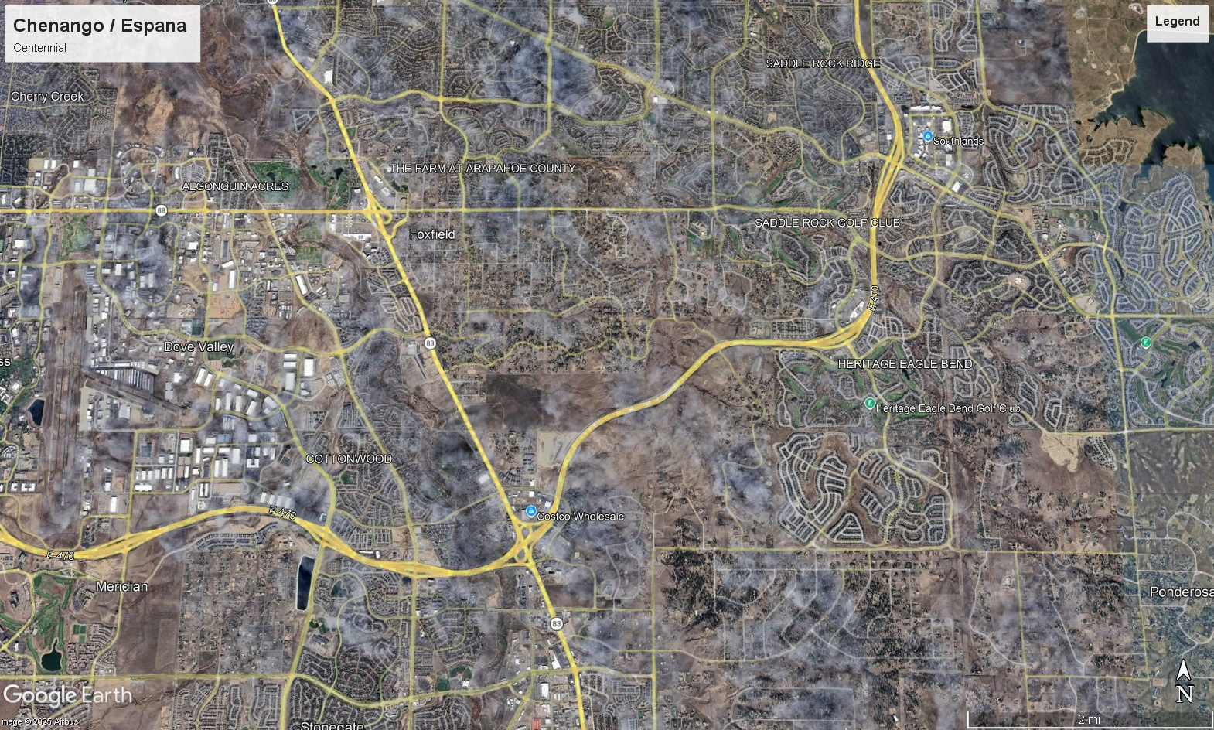
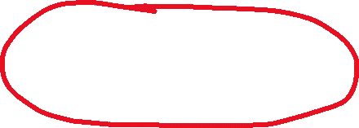
“Failed STA - No!!! Not Chenango”

Slide 4
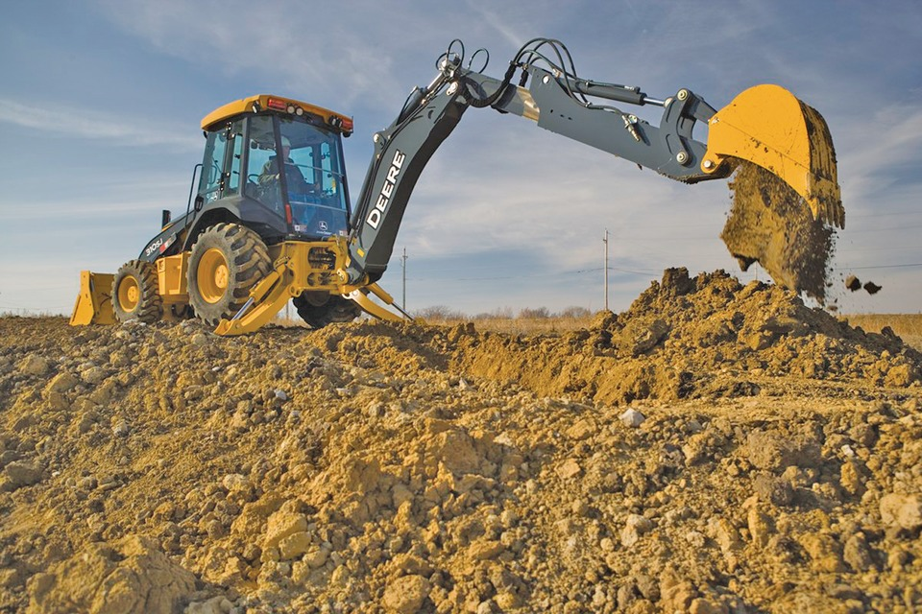
Space, Soils, & Flow
Space: 1.35 Acres
Soil Test. Type? – You guessed it: Type 4
Bedrooms? Of Course there are 5.

Slide 5
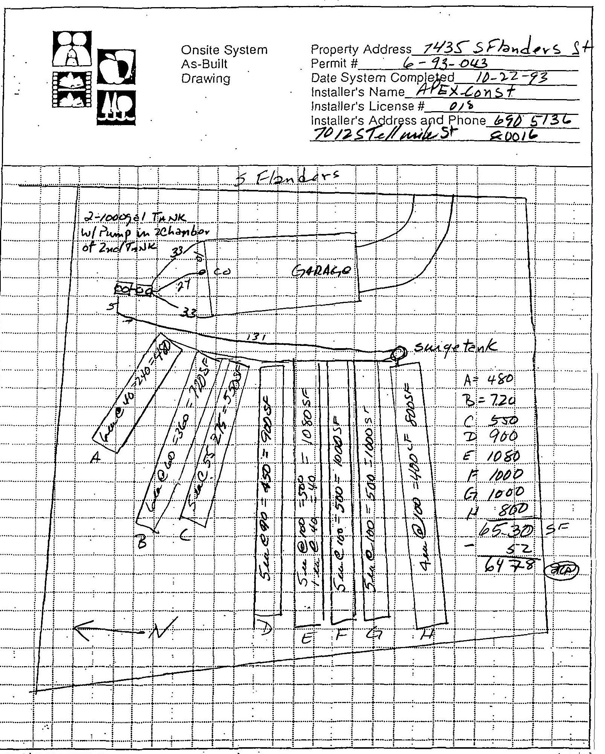
As Built

Slide 6
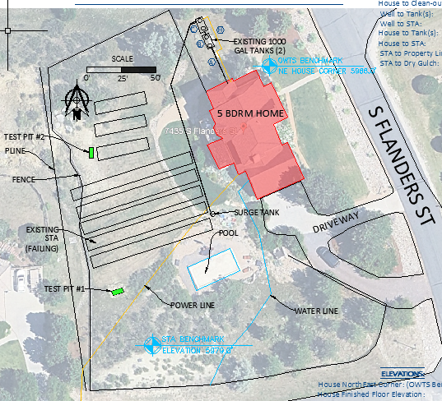

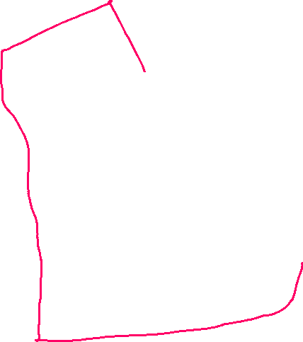












Existing System, Utilities, Pool
Client:
“Please don’t destroy my yard and please don’t break my fence”

Slide 7
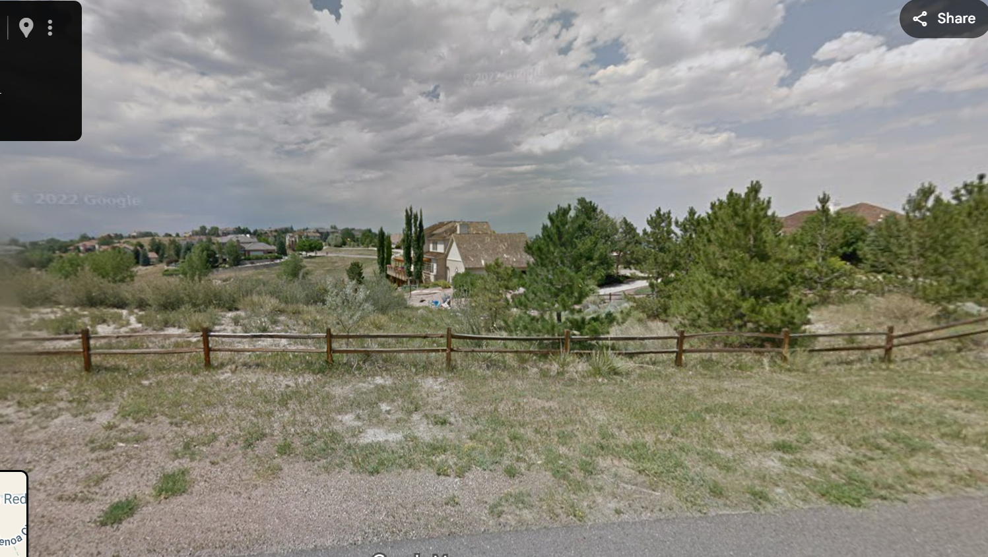
Challenging Landscape

Slide 8



Space Needed…
TL1
675 GPD / .2 LTAR = 3,375 SqFt
3,375 SqFt x .7 x 1.0 = 2,362.5 SqFt
3’ Sand Filter TL3
675 GPD / .3 TL3 LTAR = 2,250 SqFt
94’ x 24’ Wide Bed

Slide 9
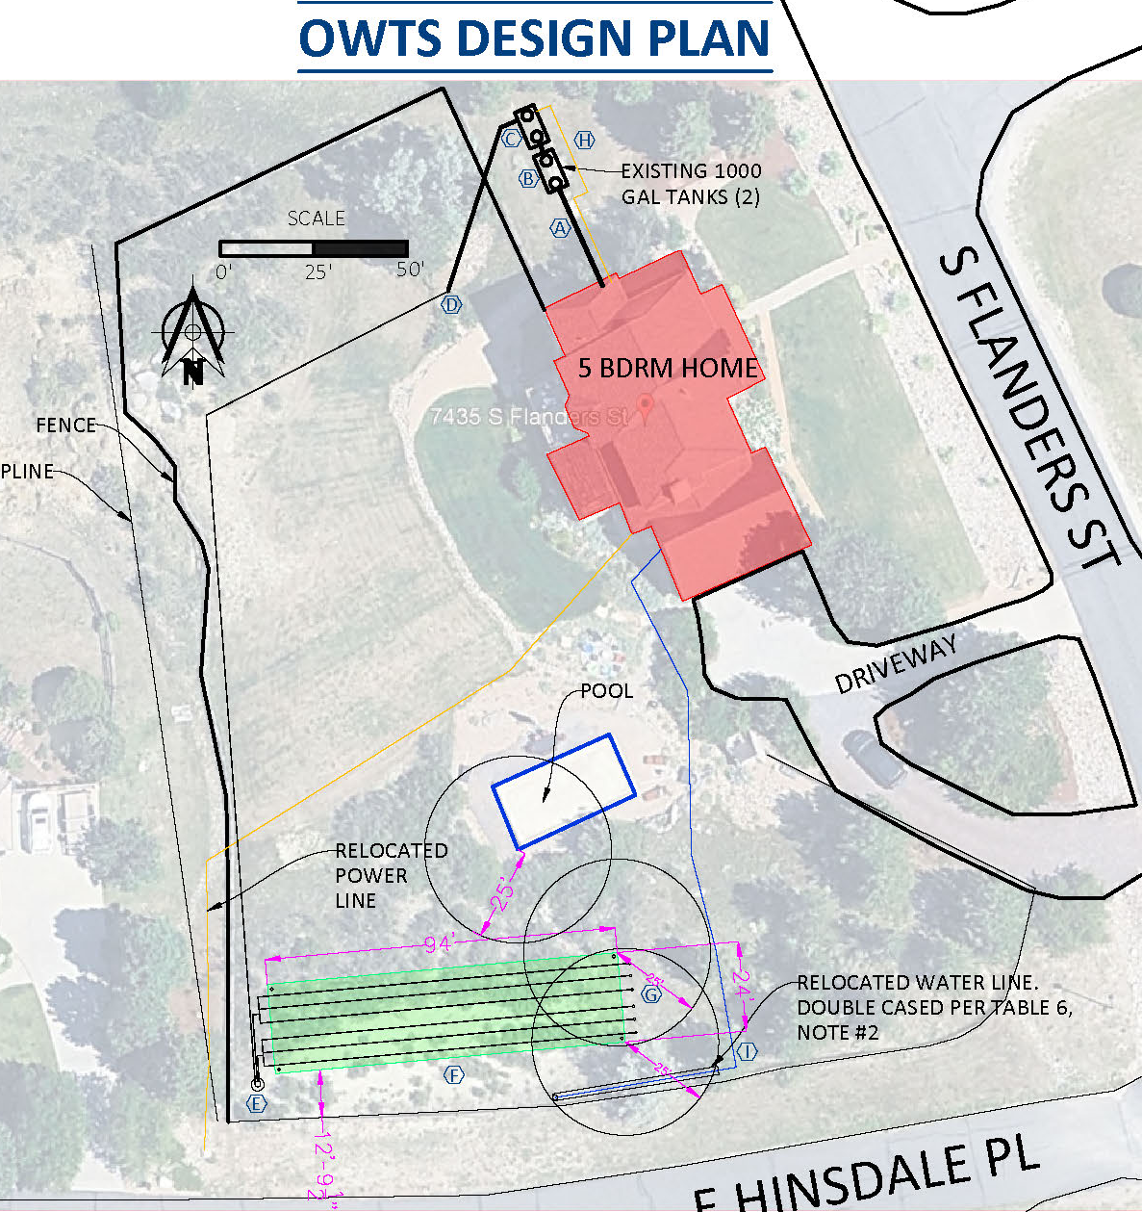


Tetris
Setback Issues
Swimming Pool
Water Line
Property Line
Relocate
Water Line
Power Line

Slide 10
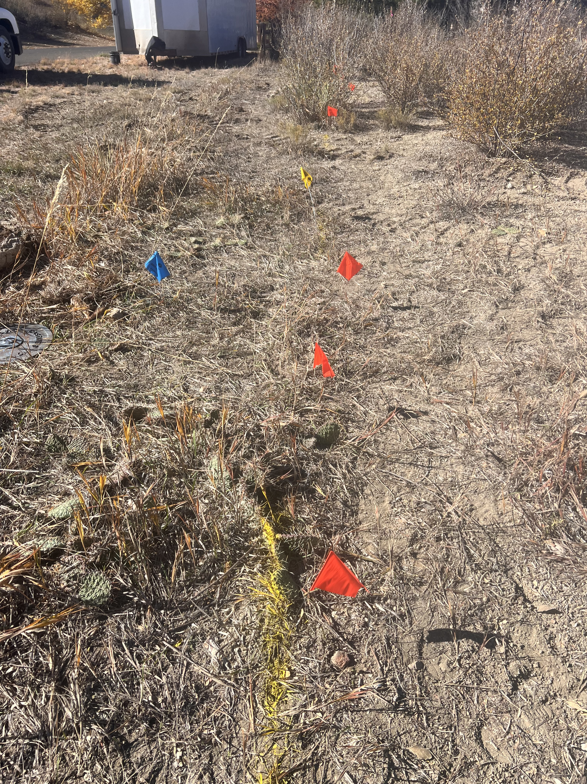
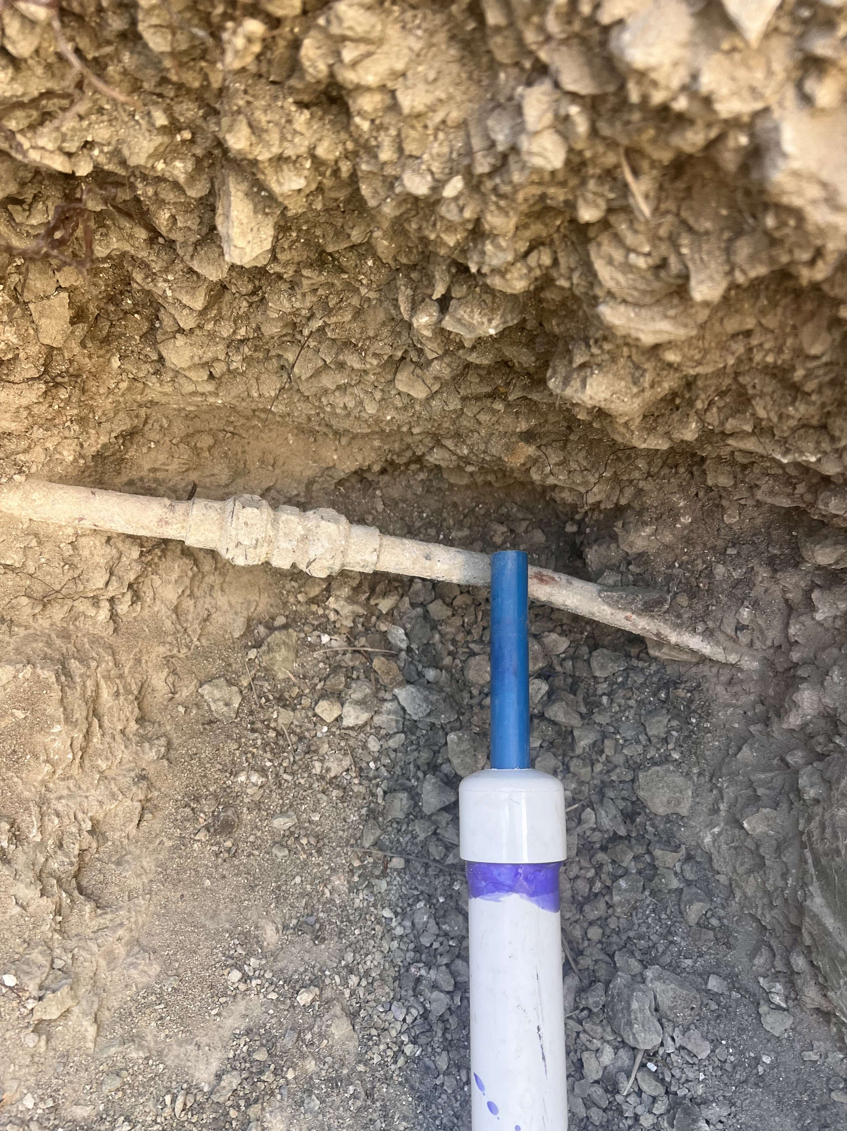
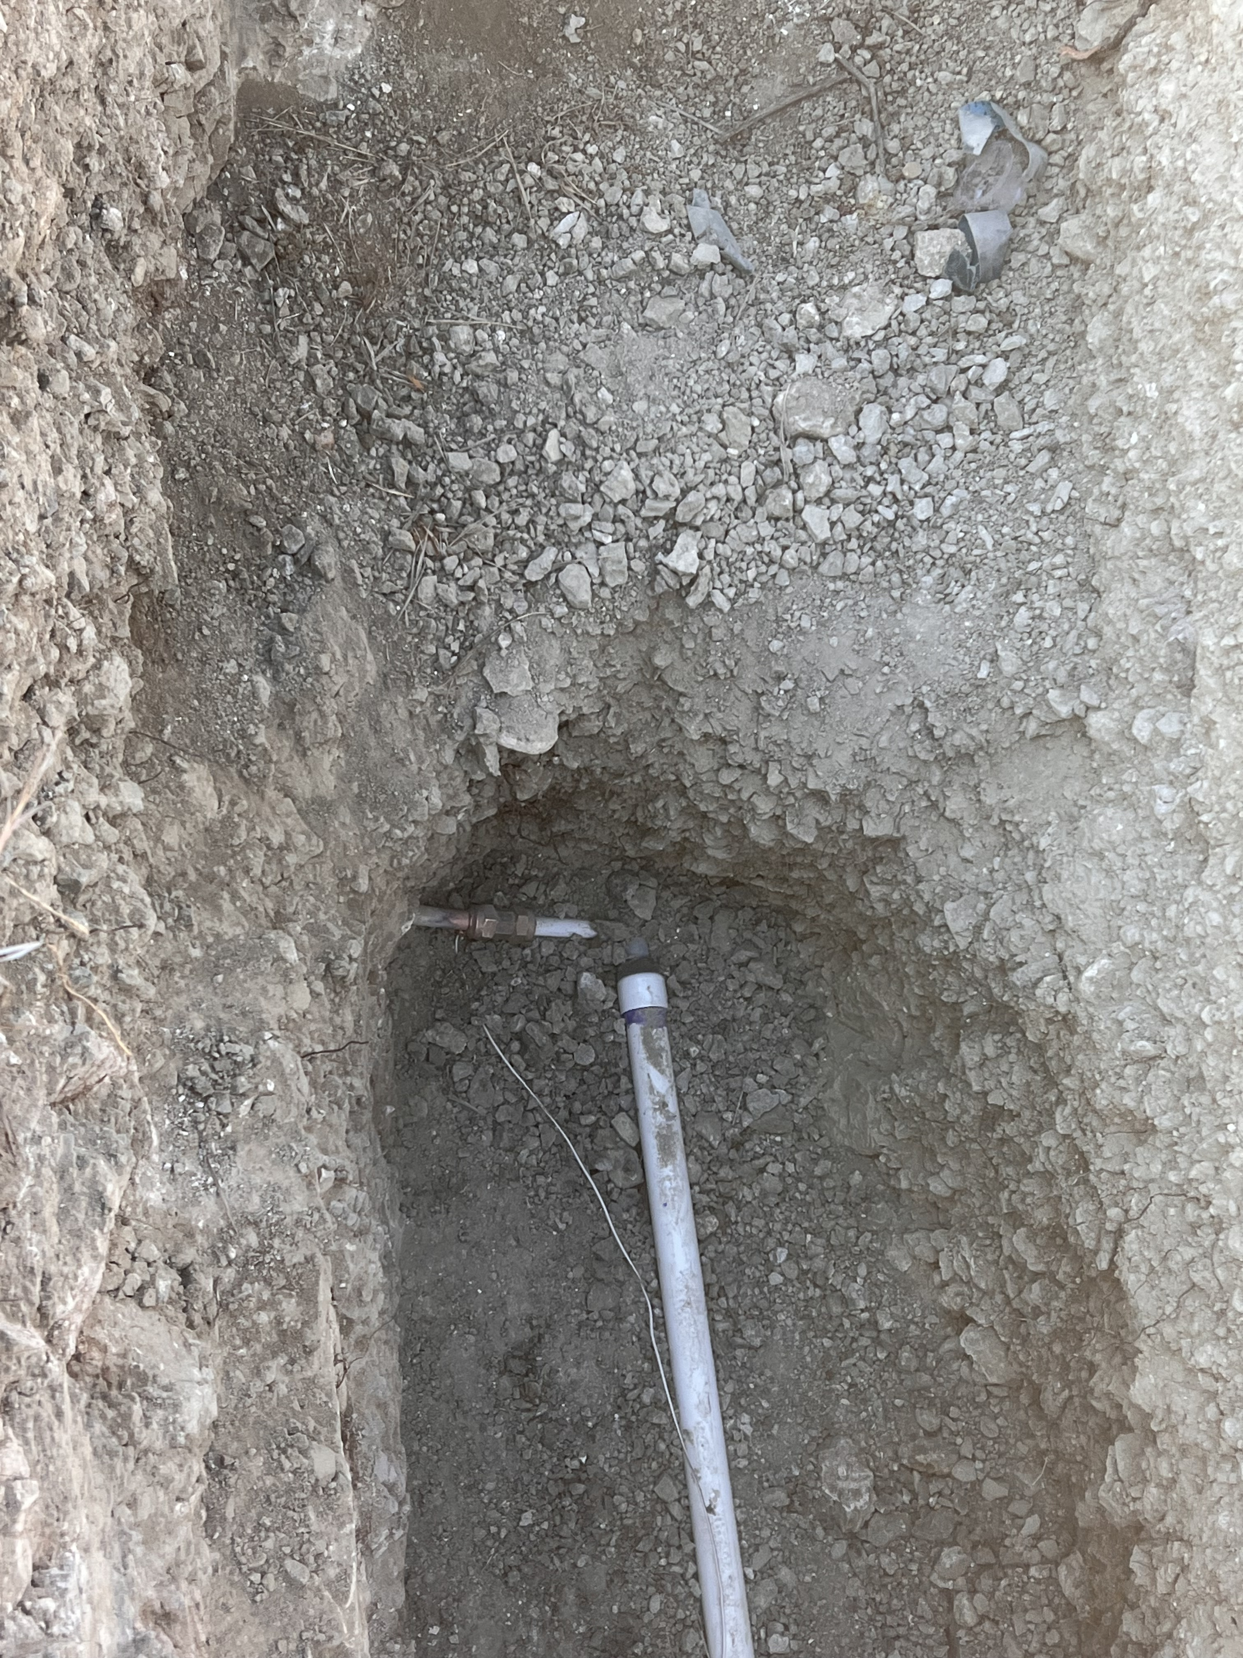
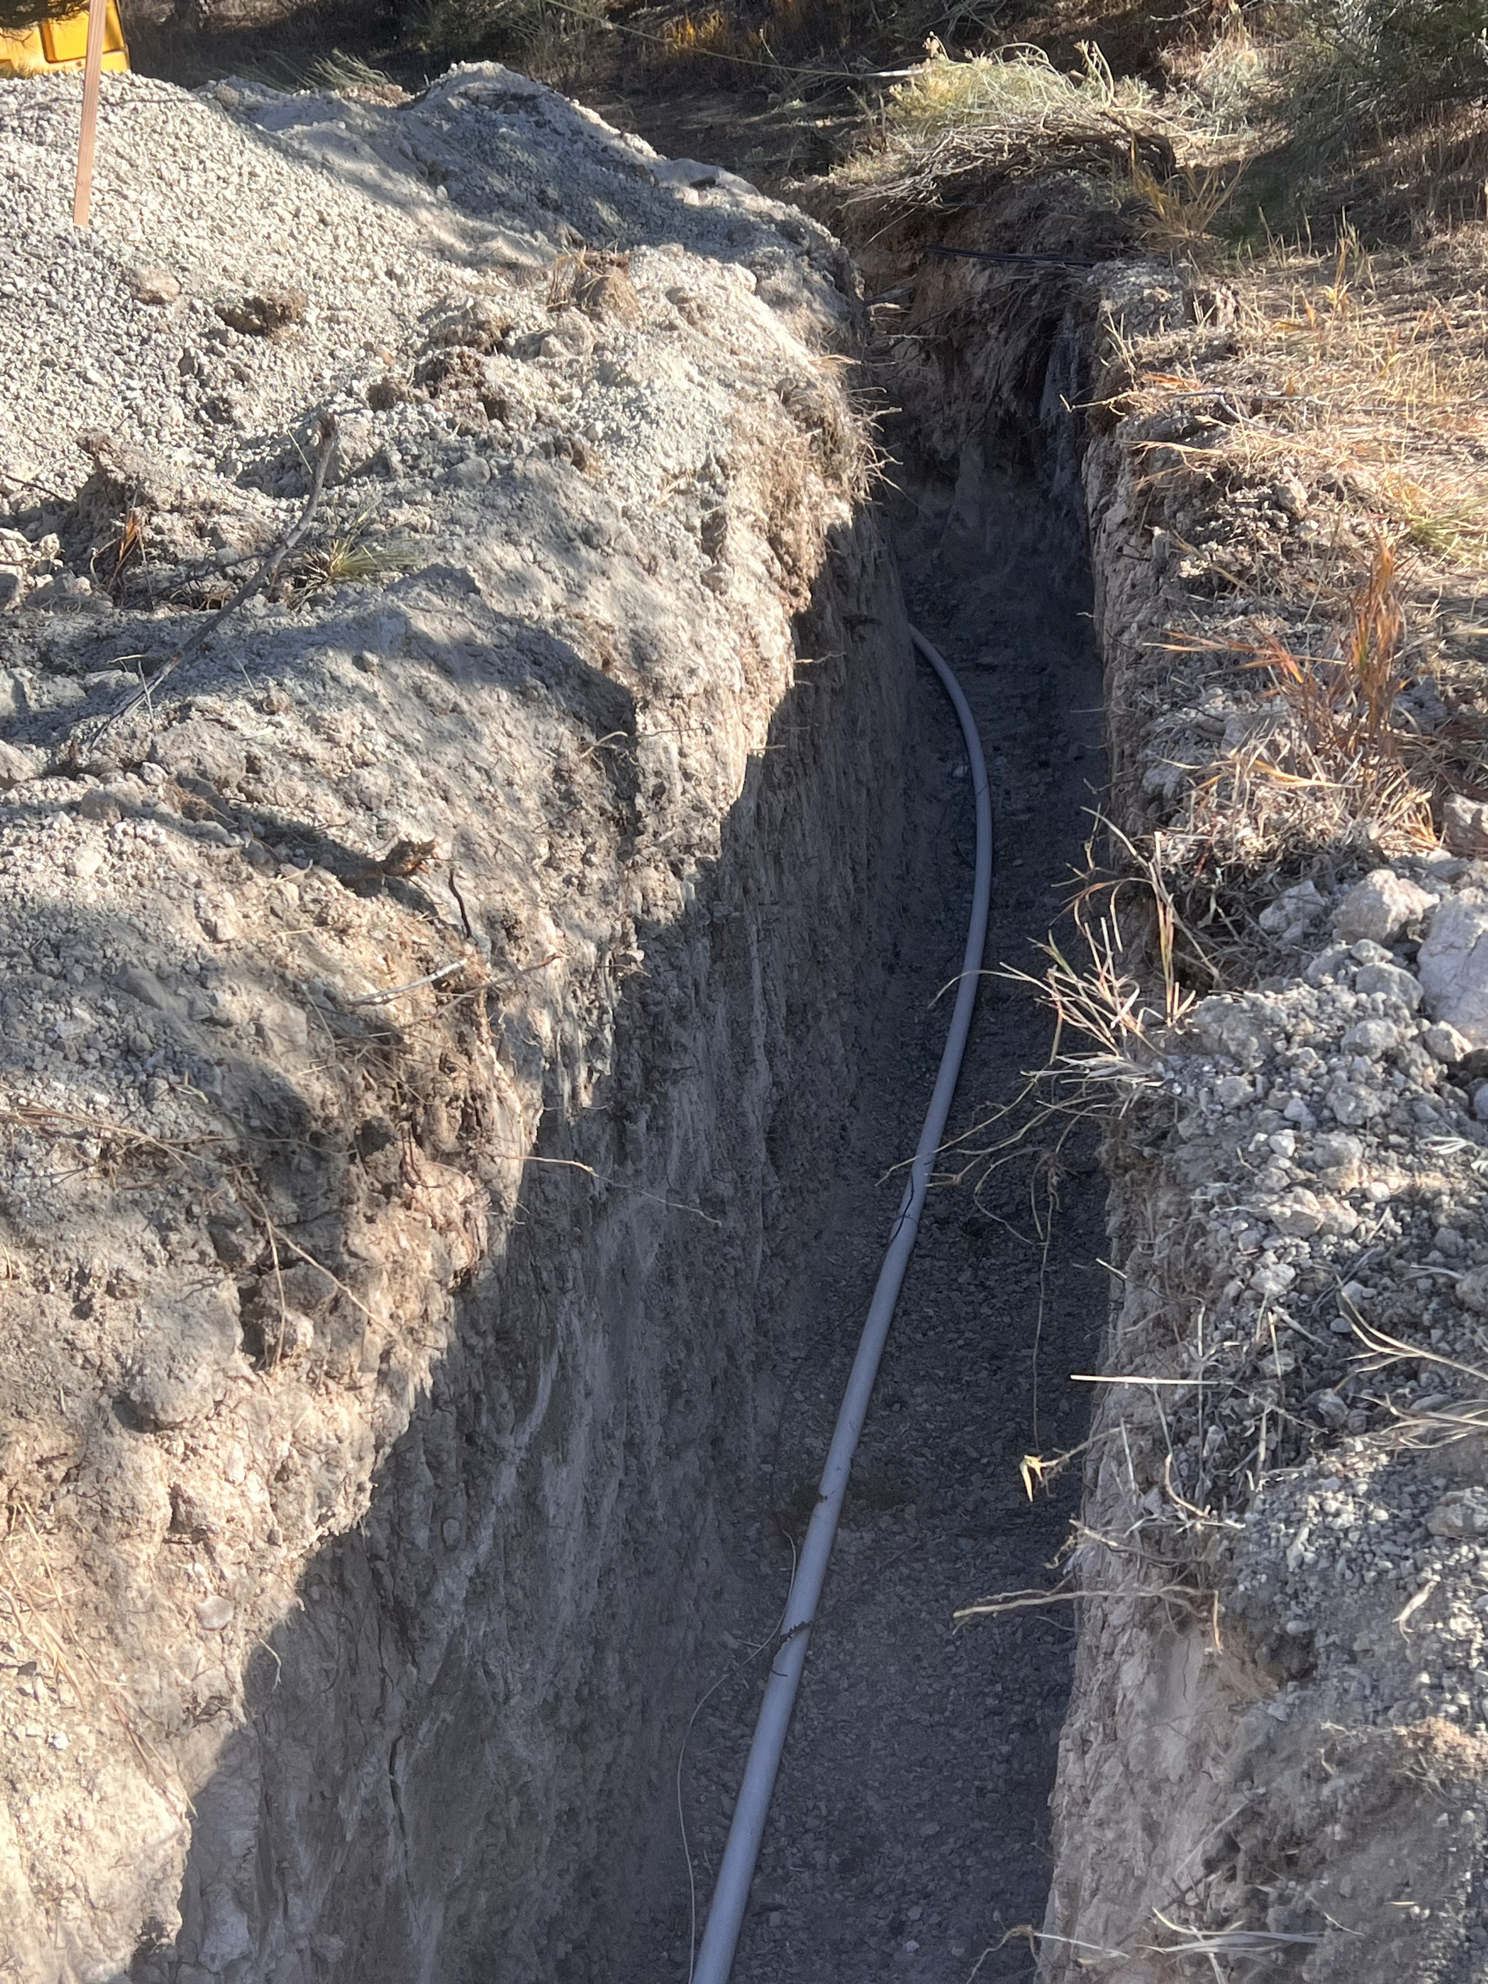
Water Line Relo

Slide 11
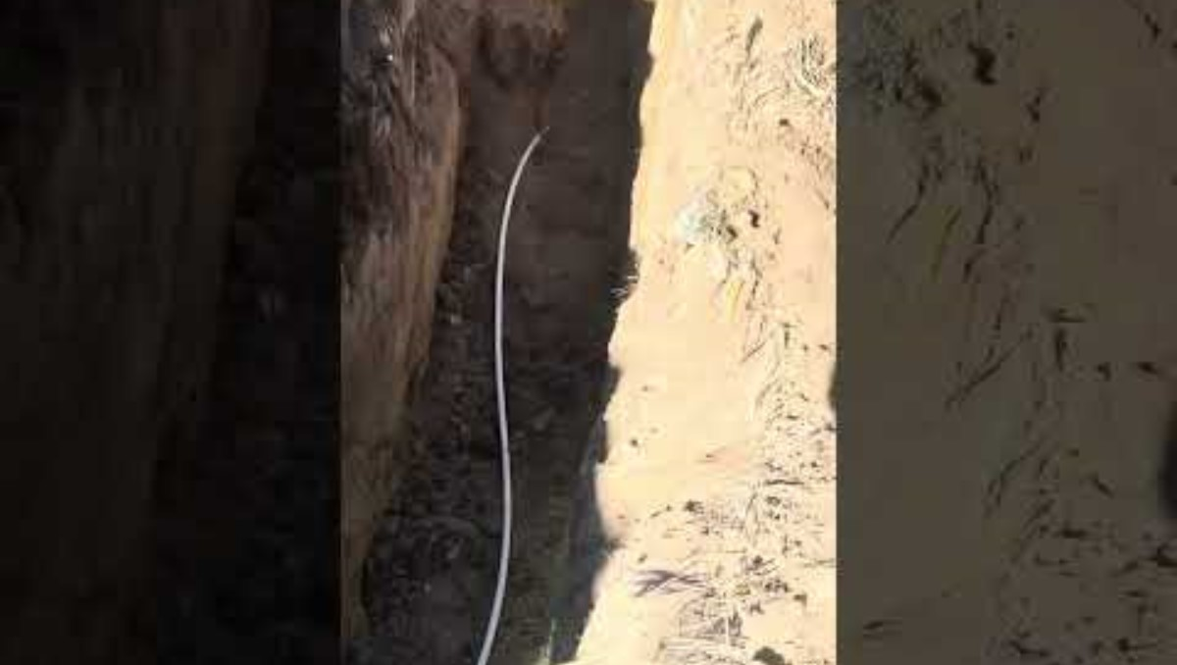
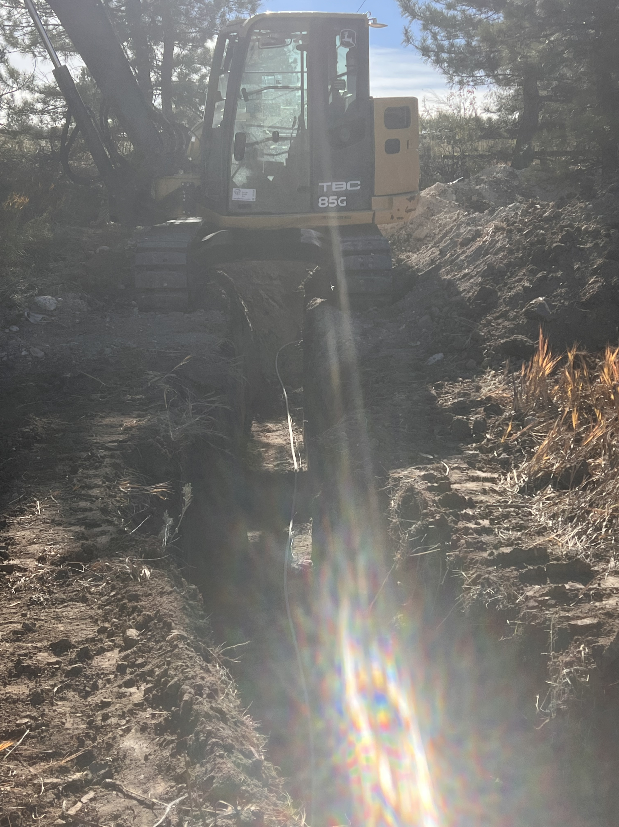
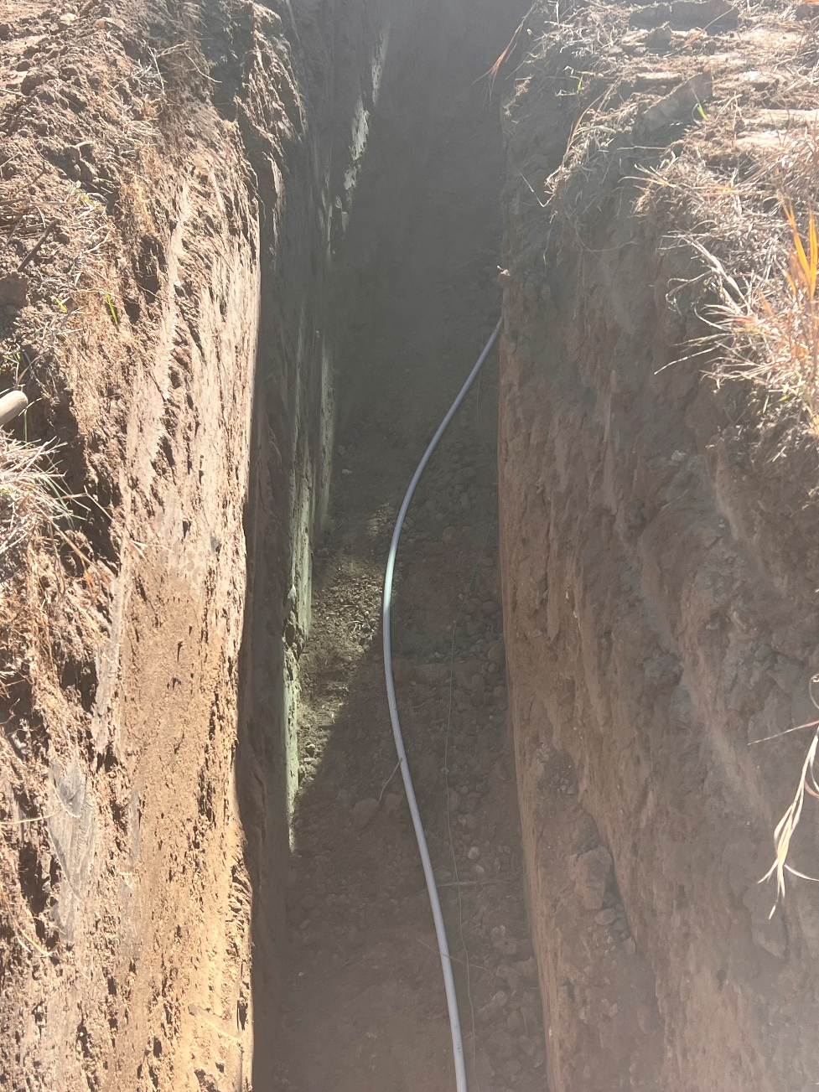
Water line Relo

Slide 12
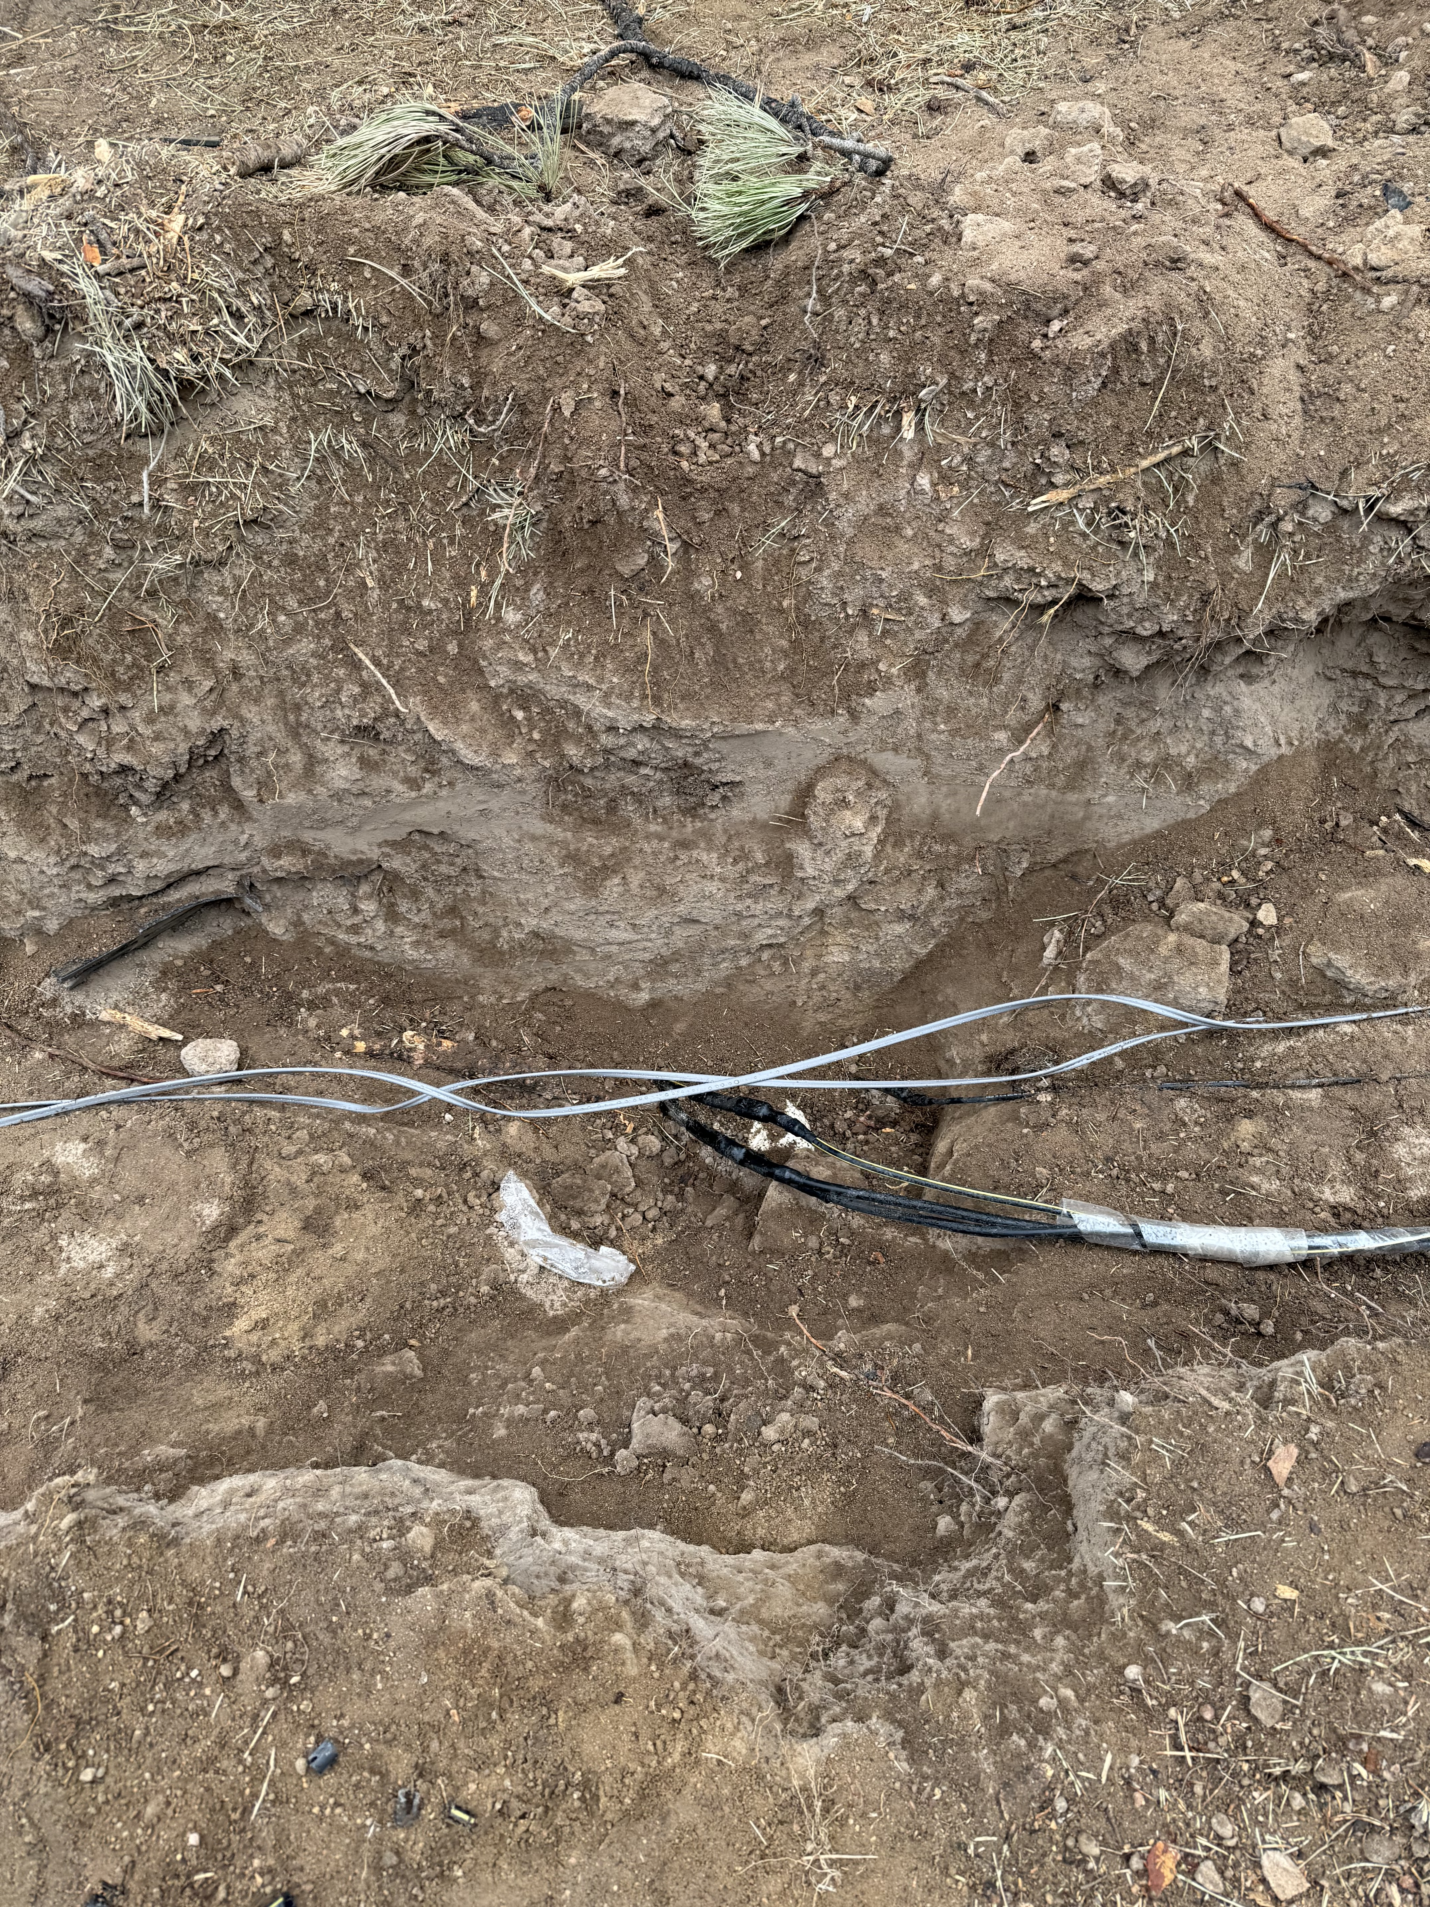
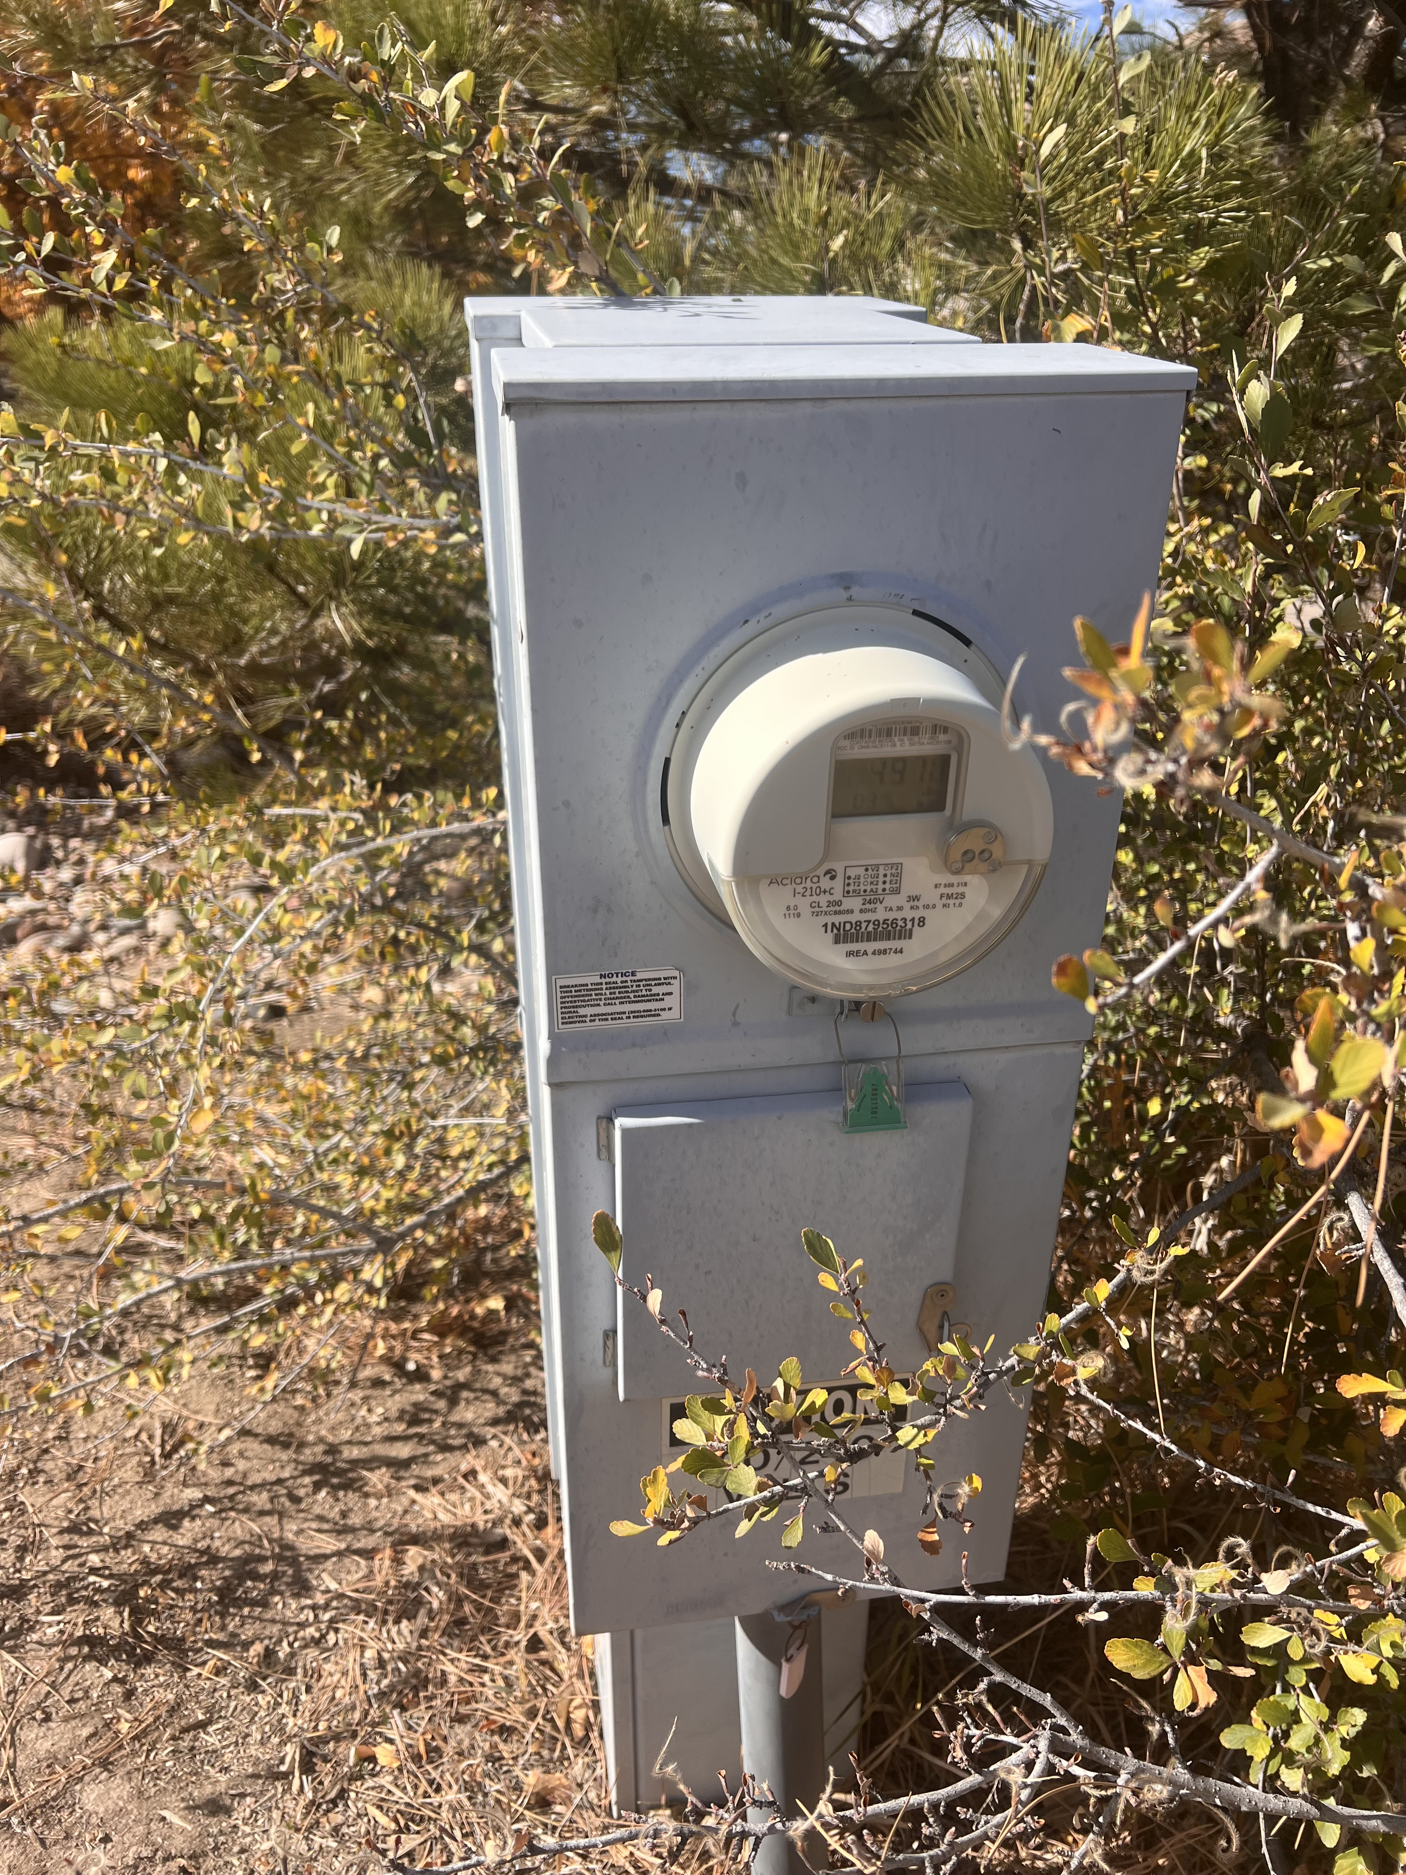
Power Line Relo

Slide 13
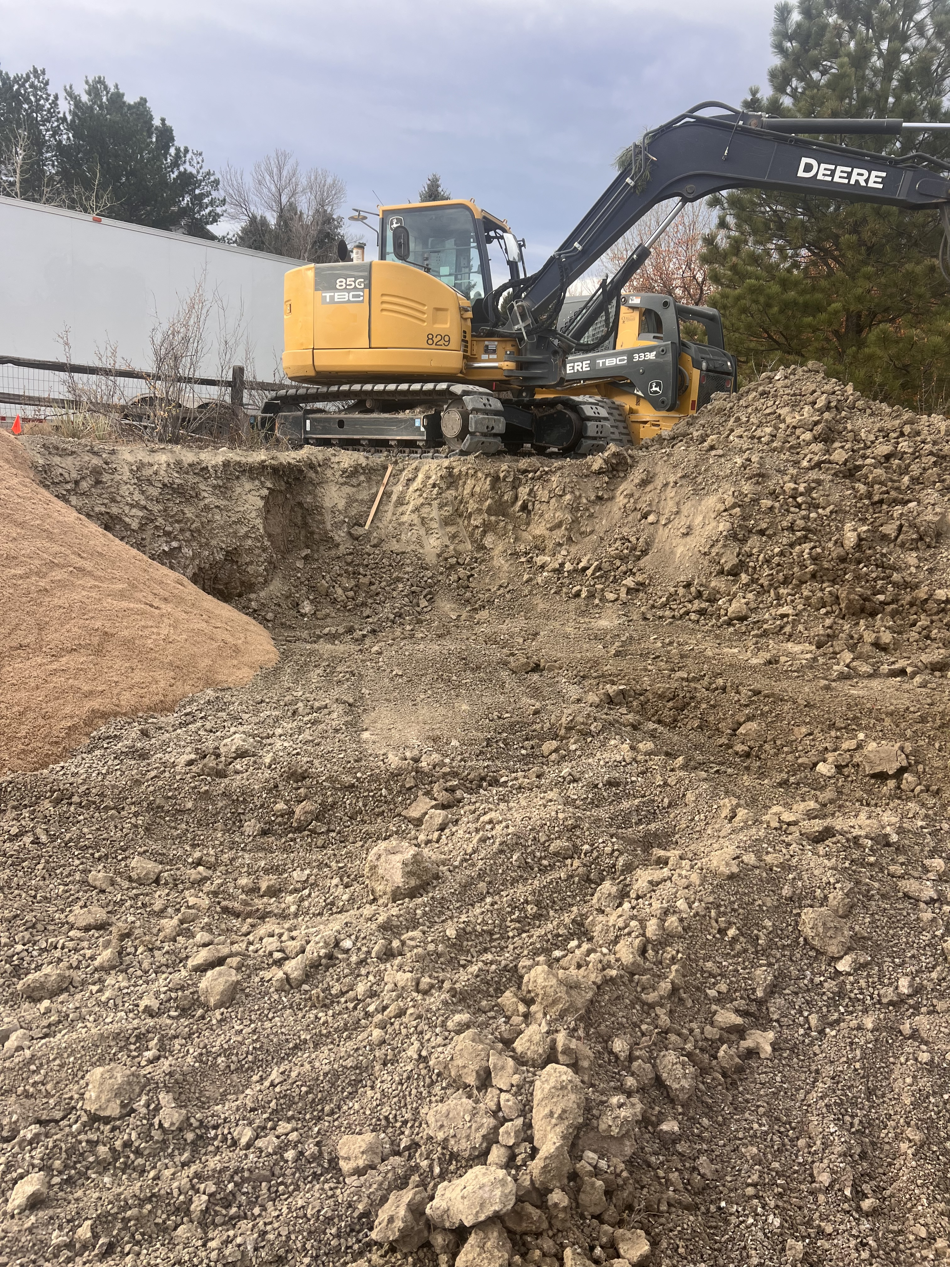
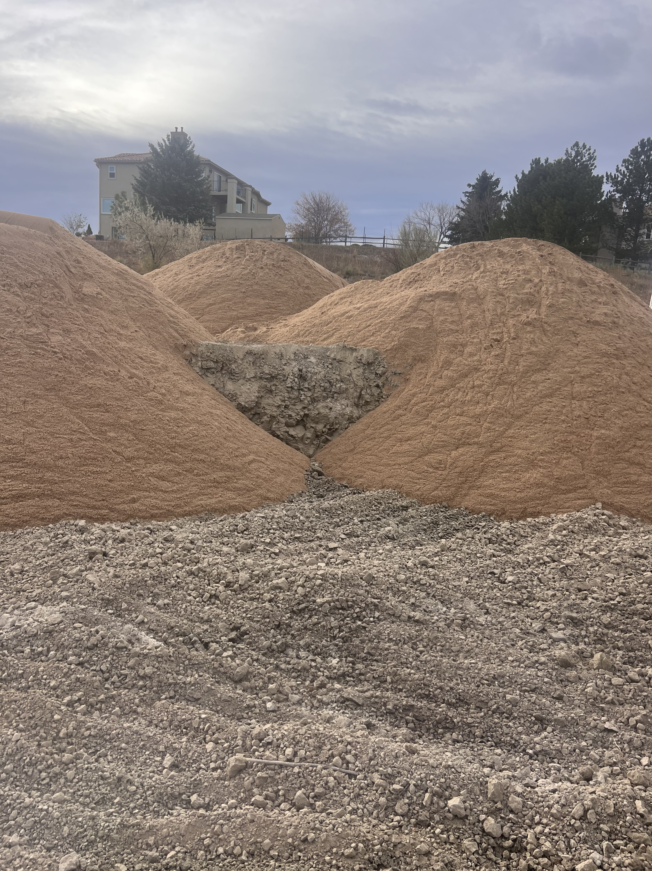
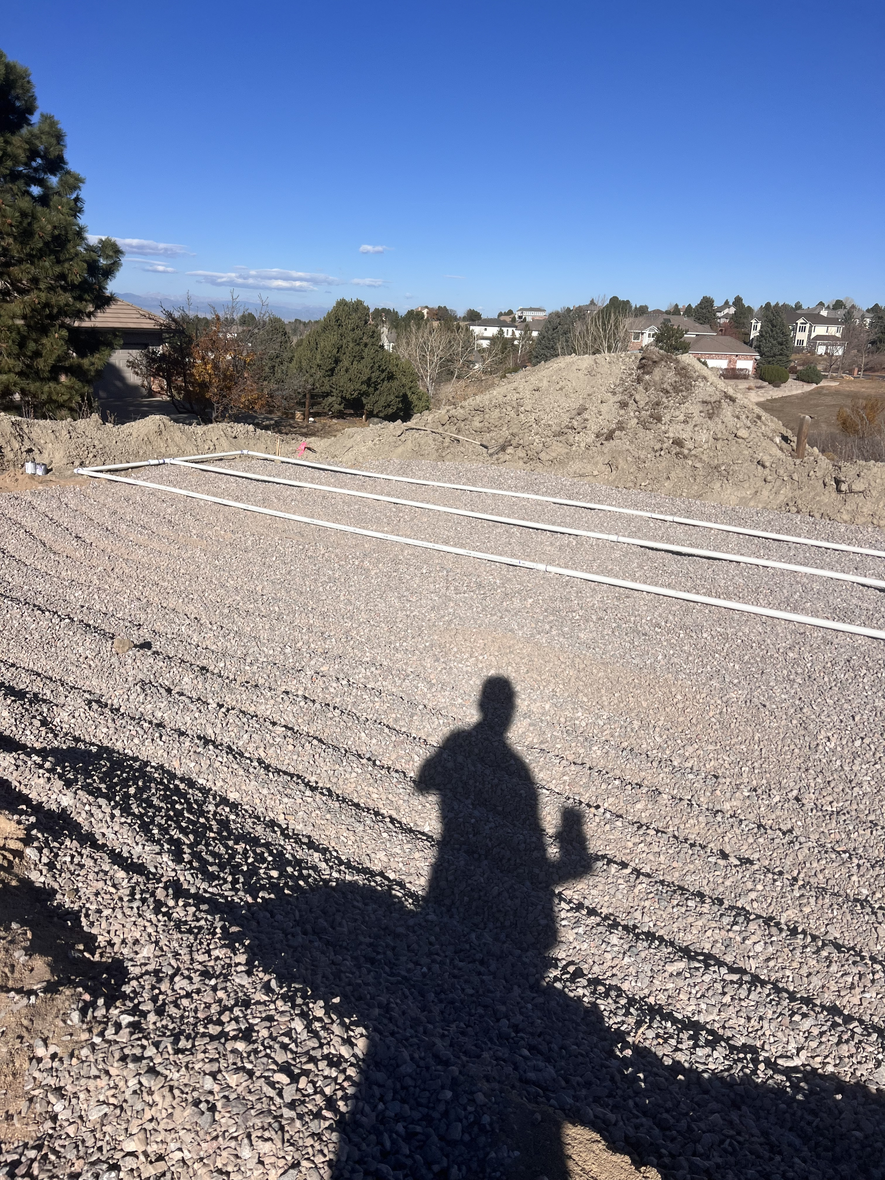
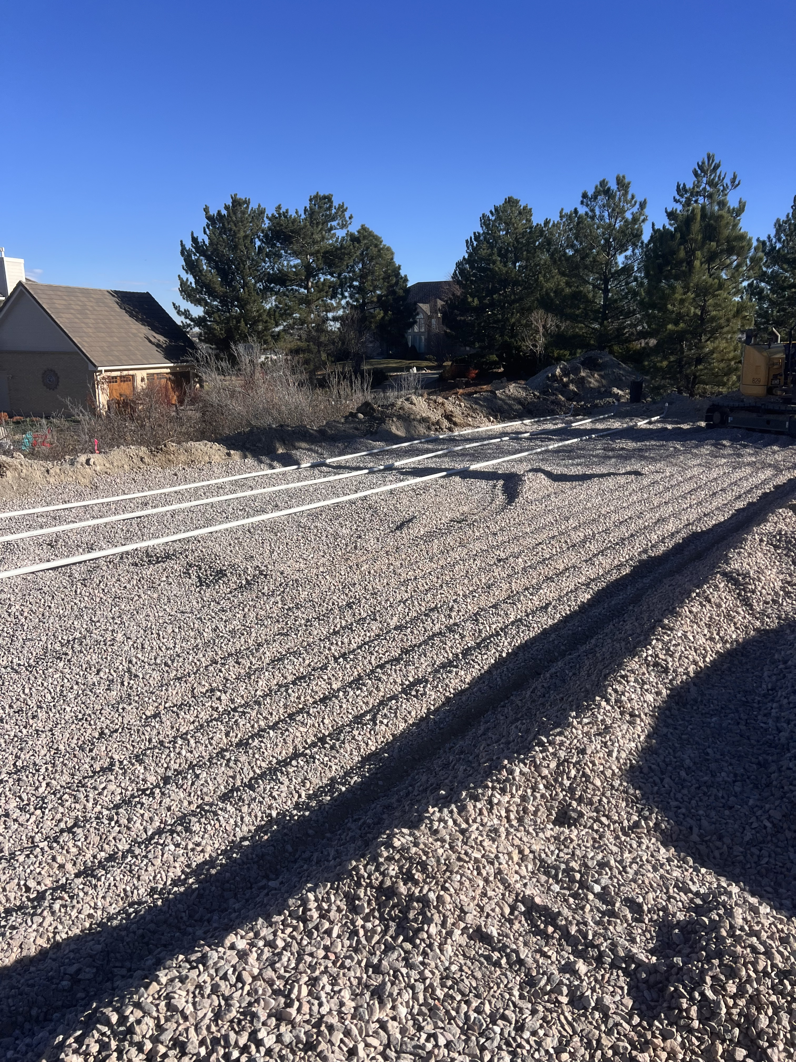
Install

Slide 14
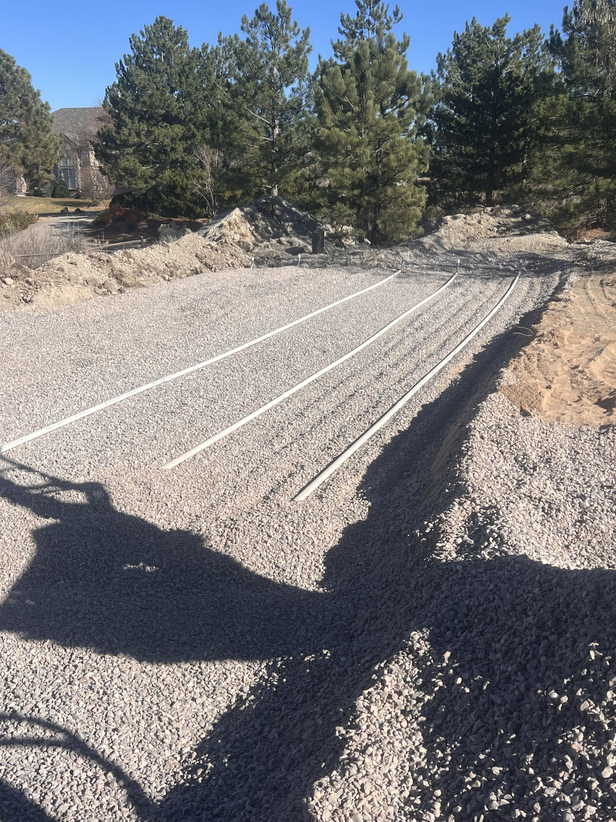
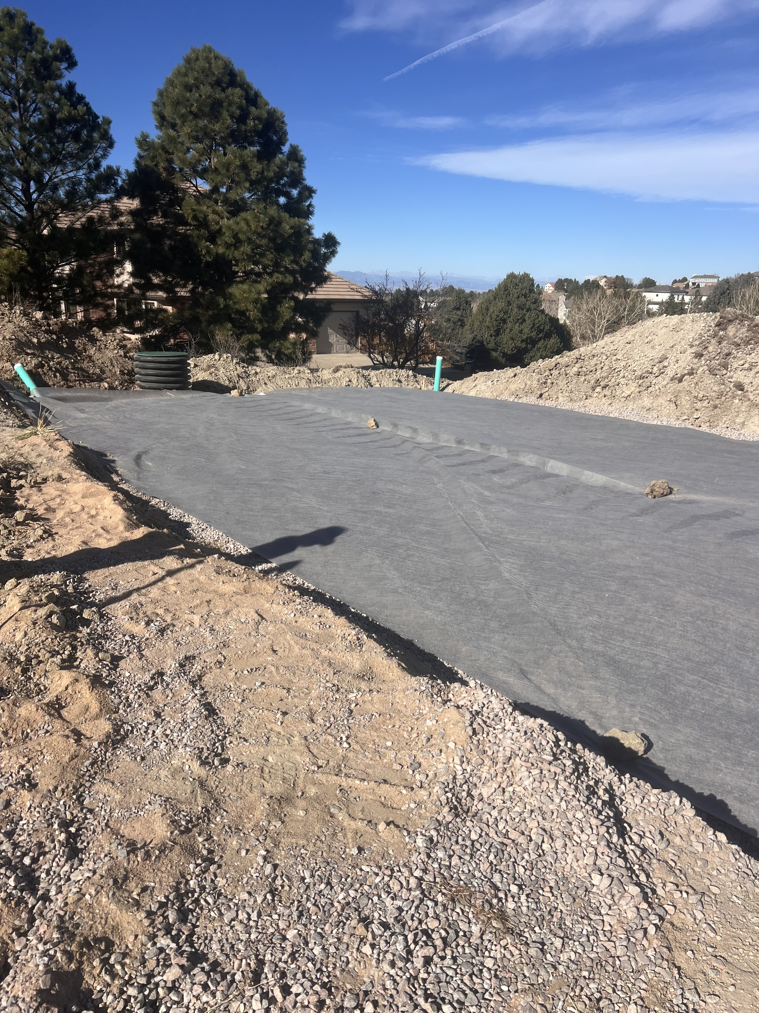
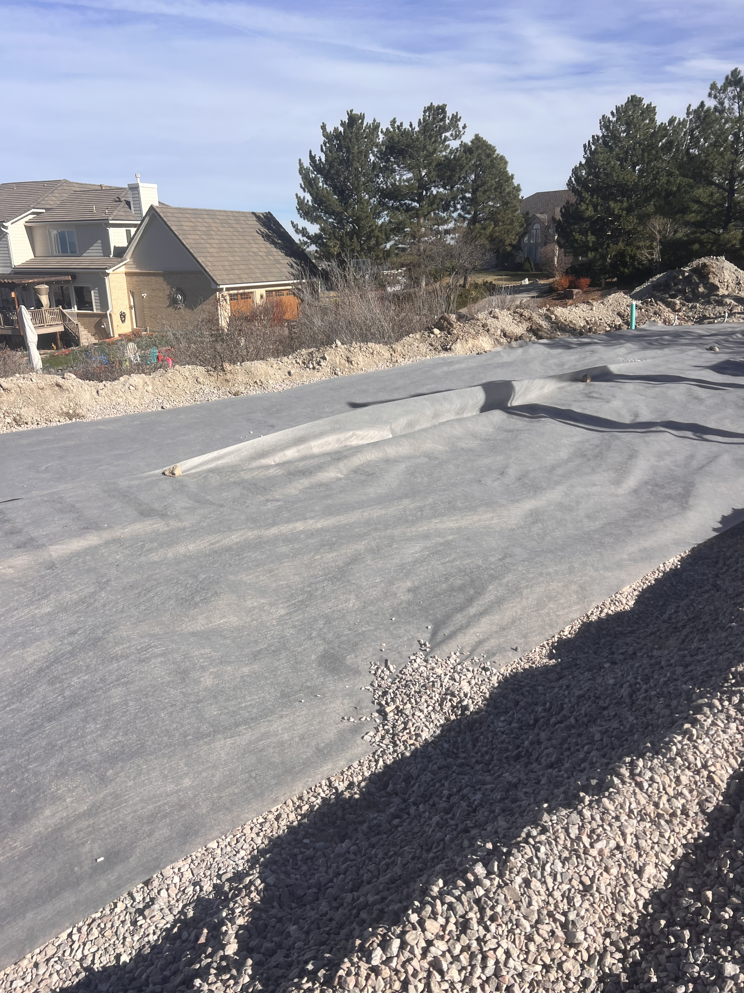
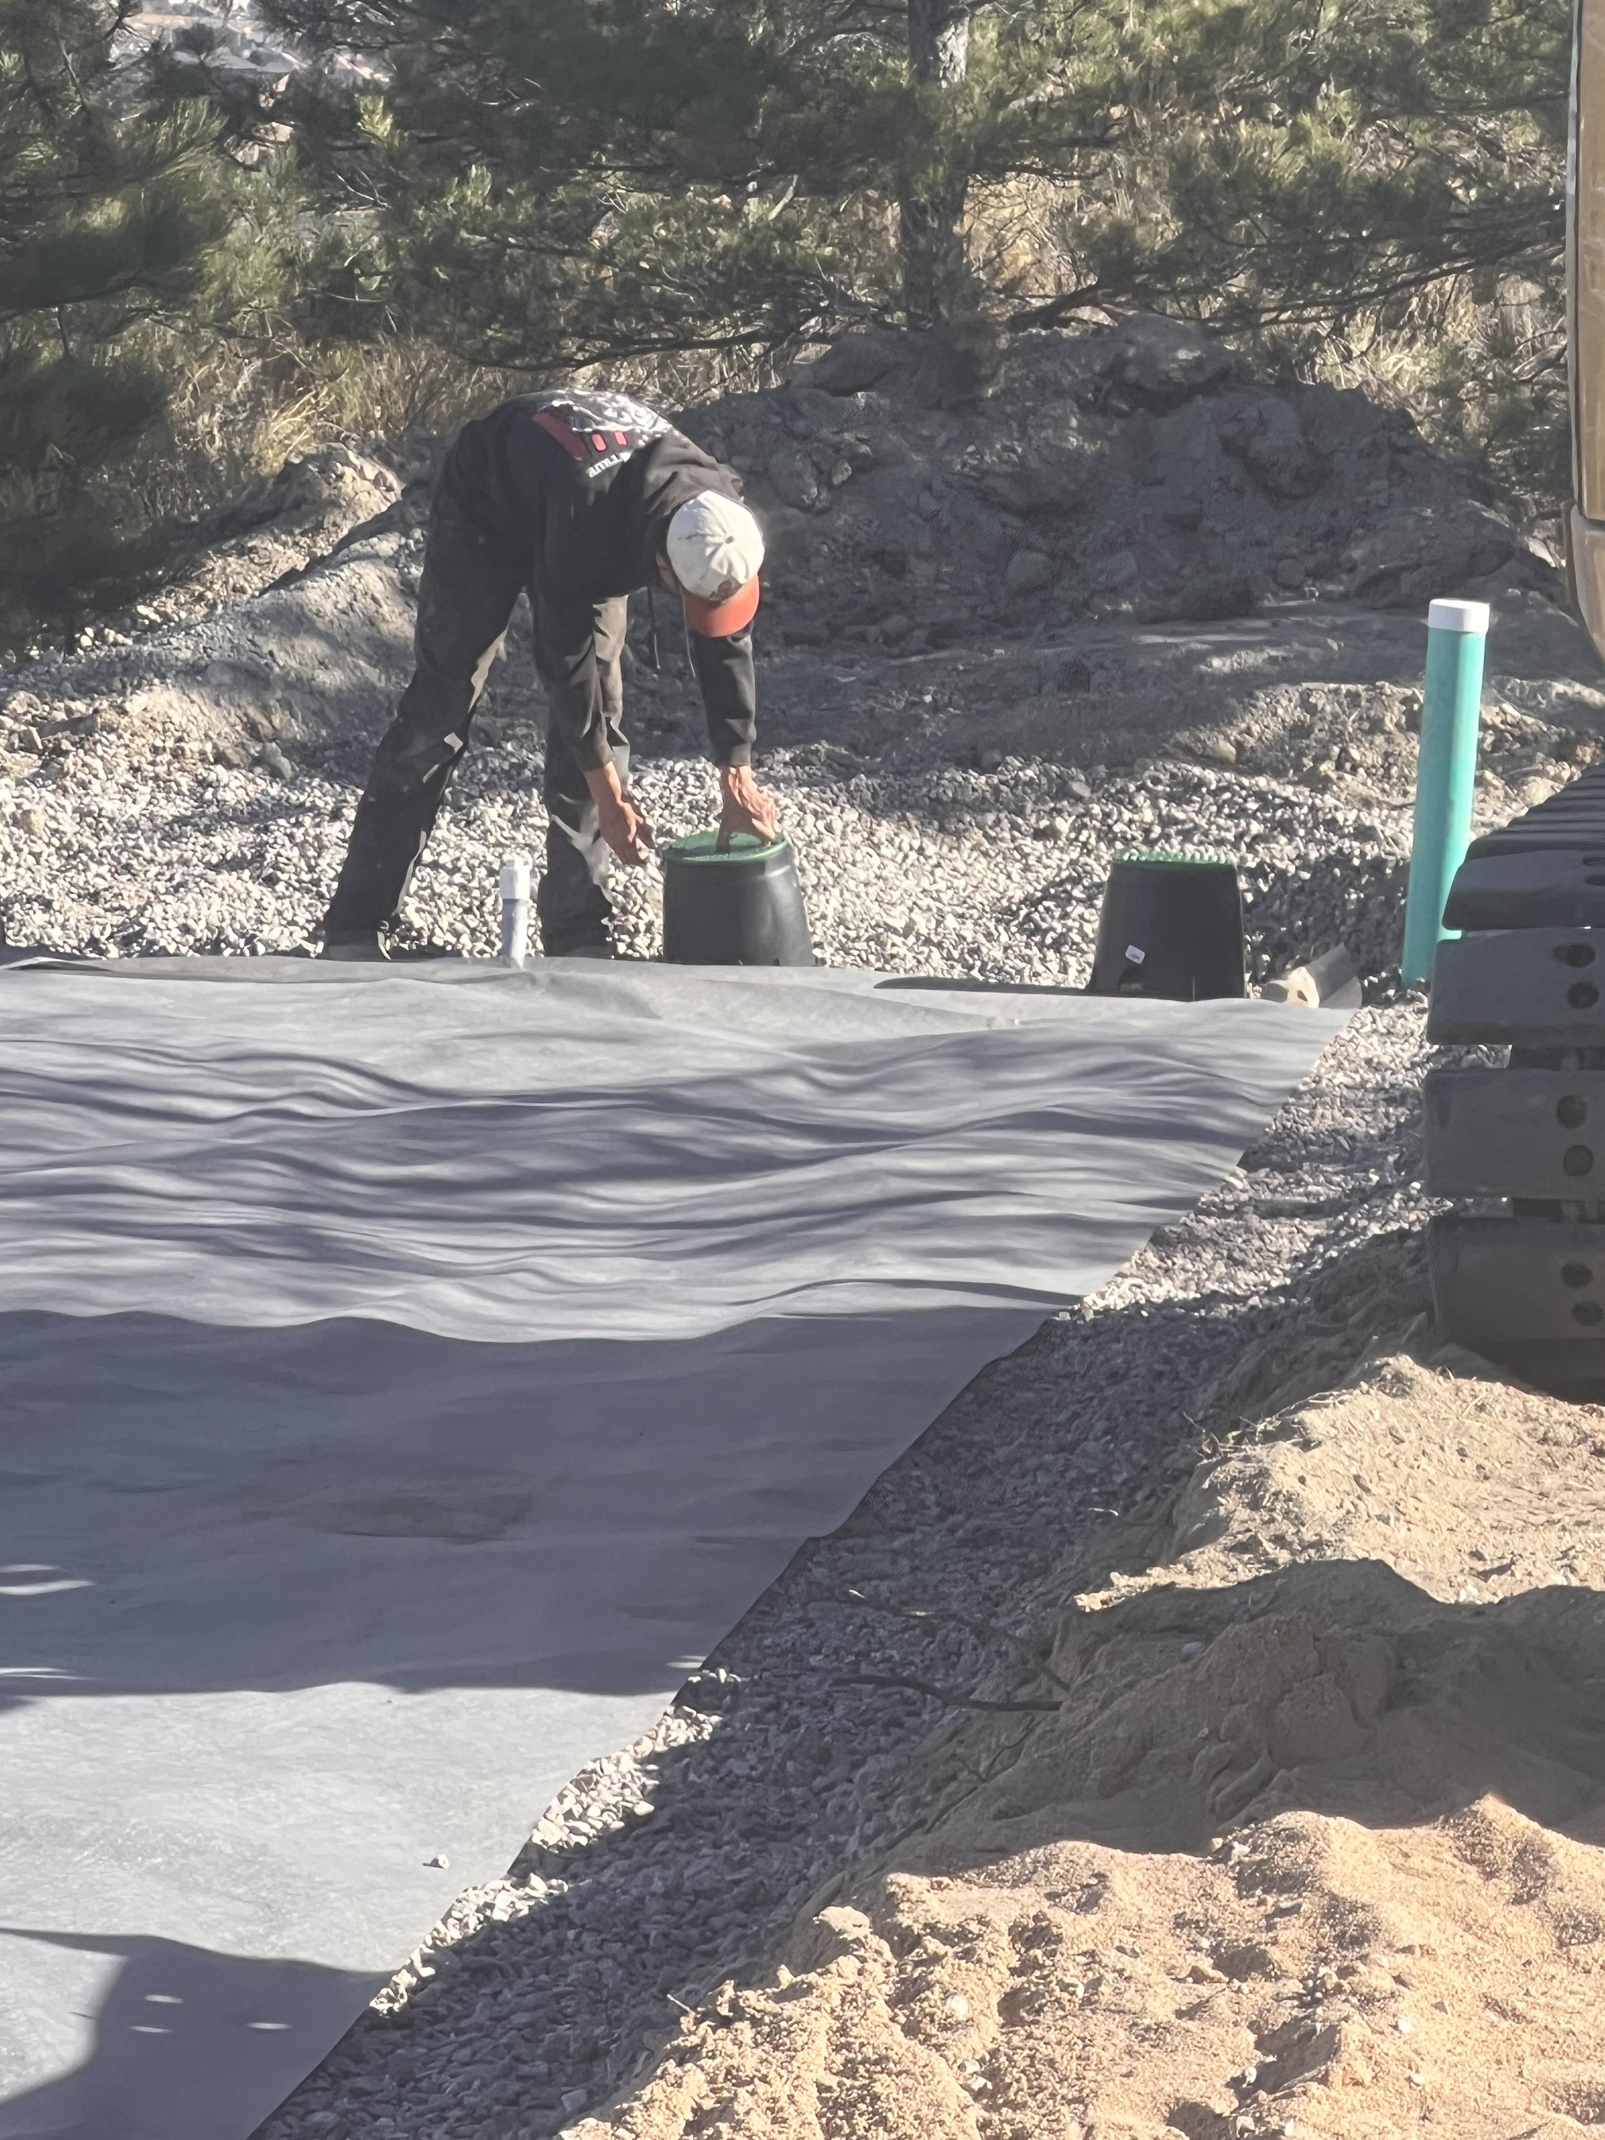
Install

Slide 15

CONCLUSION
Clint Britt
303.513.6348
clint@tbcseptic.com
Don’t be afraid of relocating water and power lines.

