Slide 1
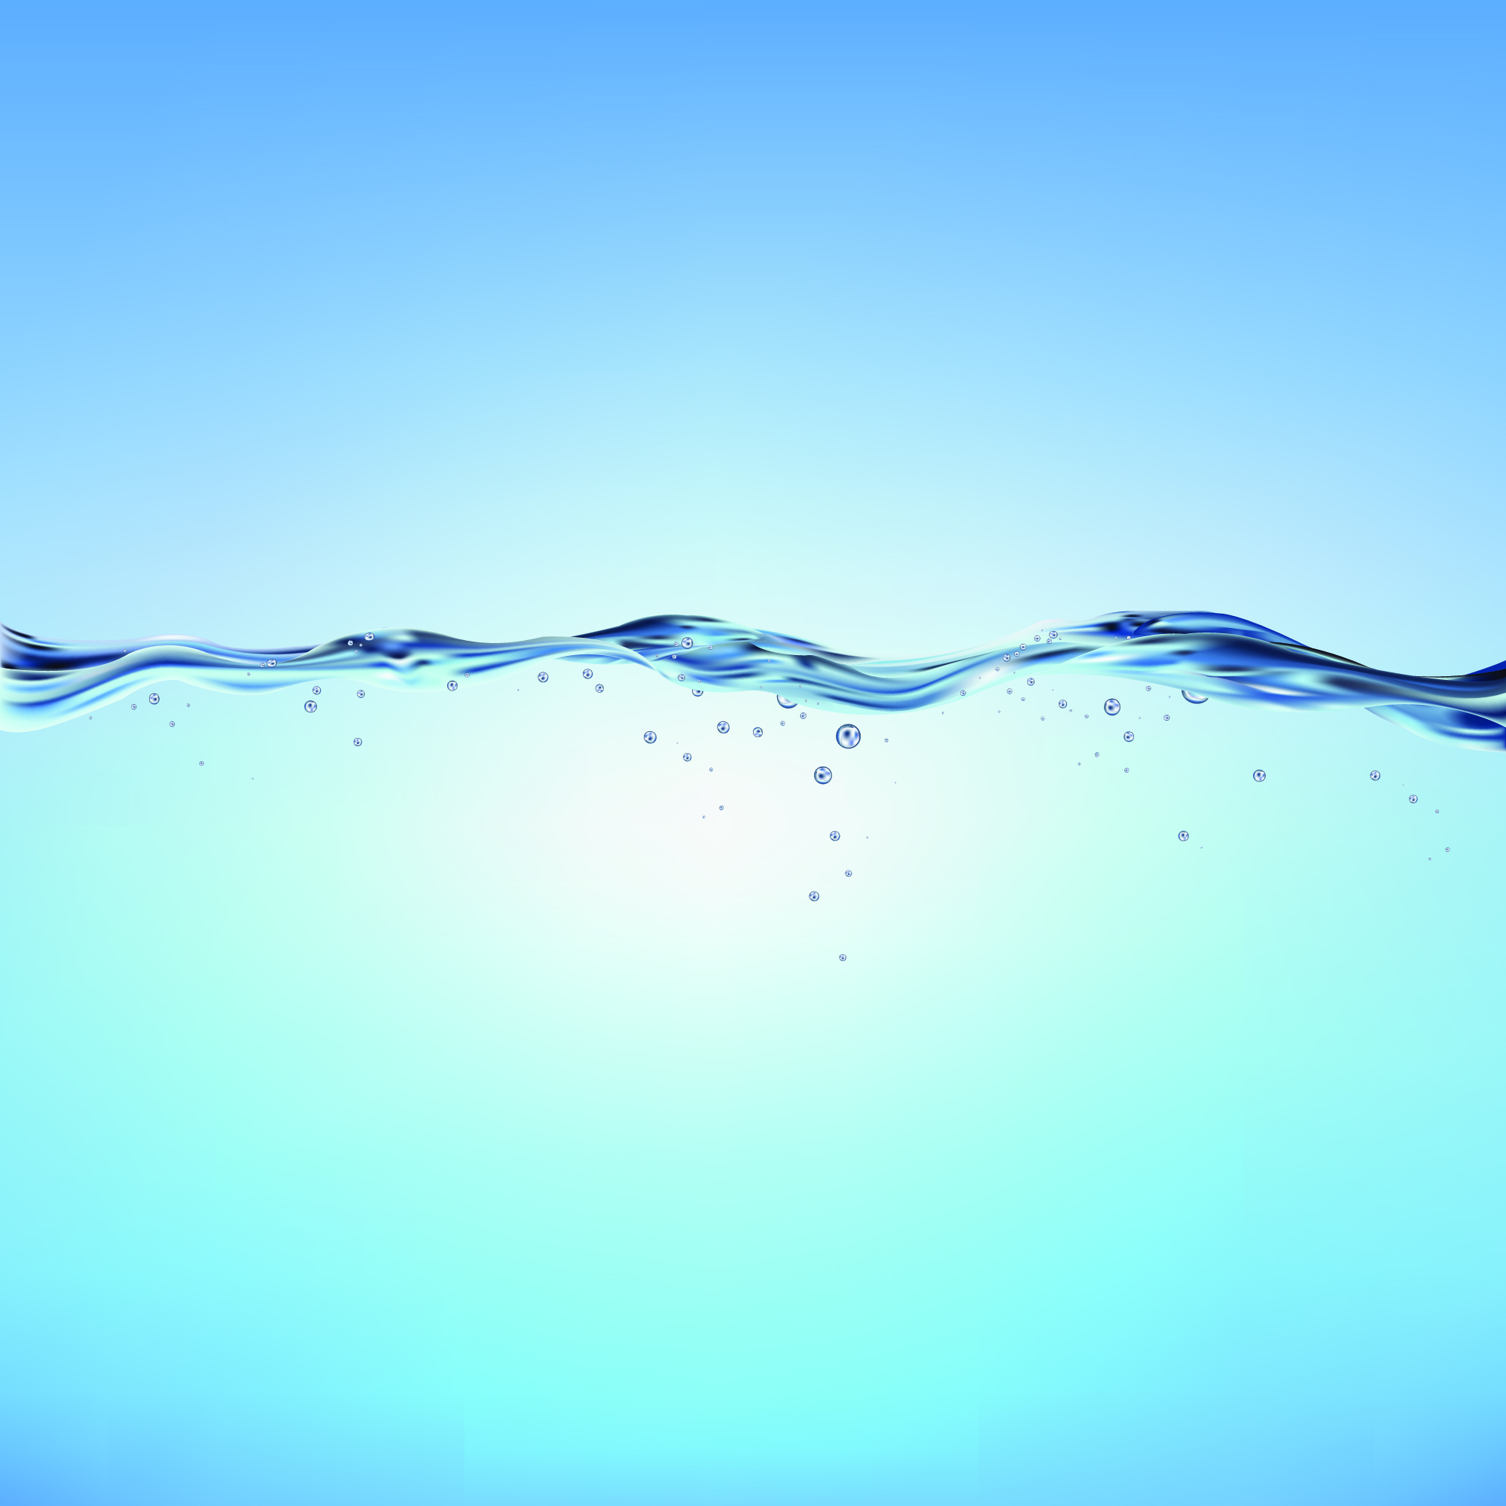

To Chlorinate or Not to Chlorinate, Advantages and Disadvantages of Different Disinfection Types
Ben Kele Managing Director of Arris Pty Ltd

Slide 2
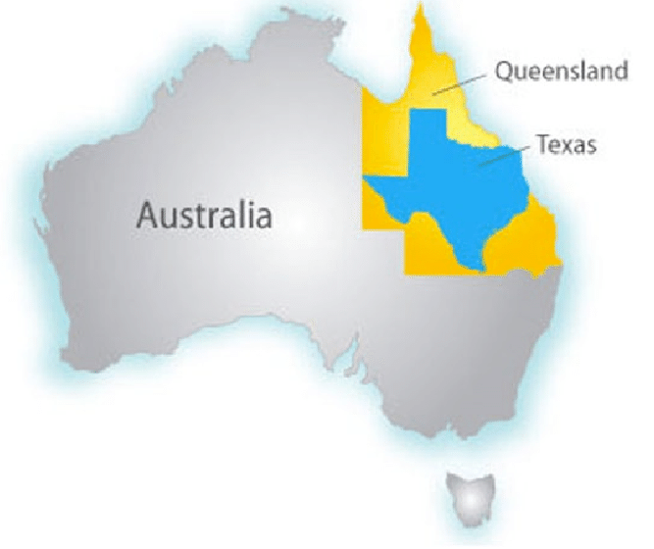
Queensland Comparison to Texas

Slide 3

Size Also Applies to the Wildlife

Slide 4
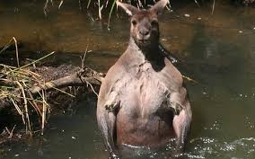
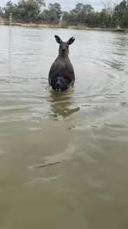
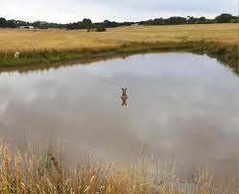

Slide 5
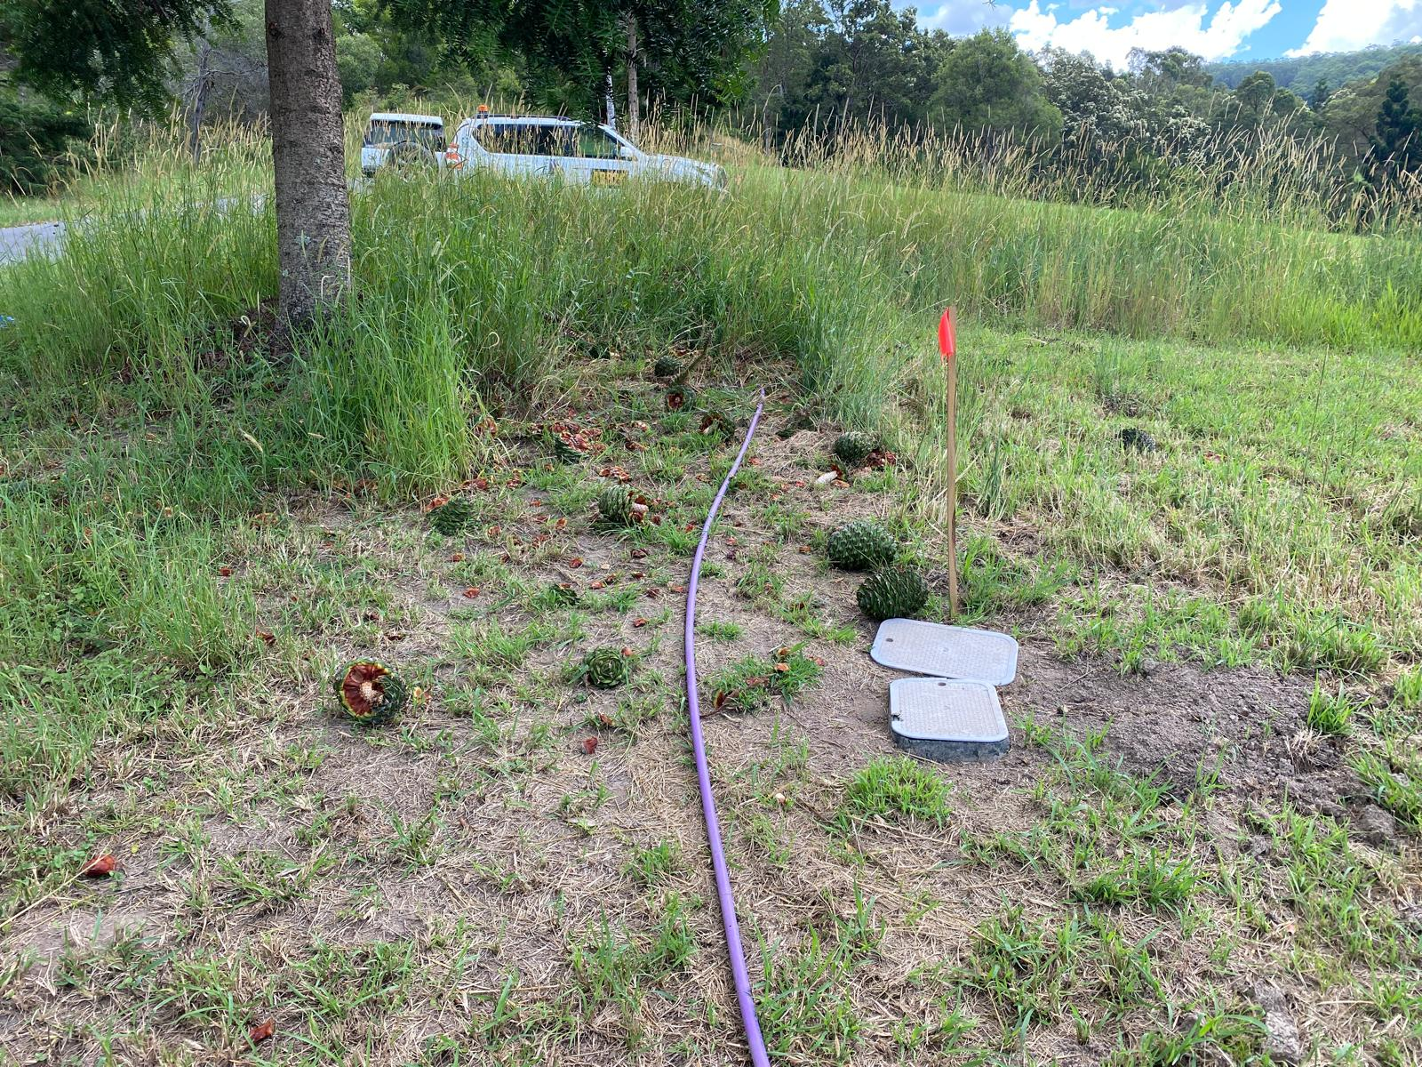
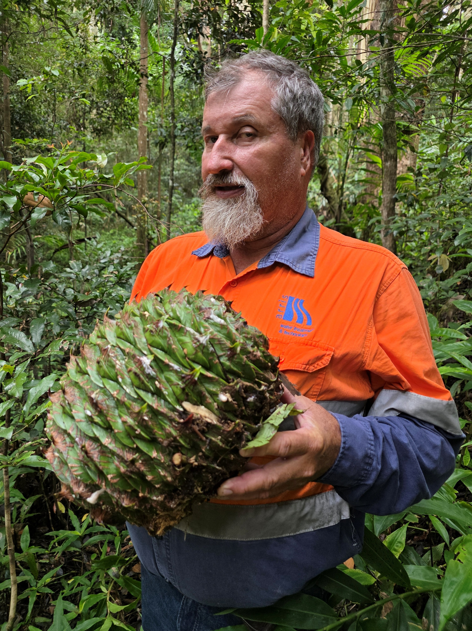
It’s Not Just the Animals

Slide 6
Disinfection
Processes used to remove potential pathogens
  Other microorganisms (including beneficial ones)
Many different techniques
On-site Wastewater tends to mimic what’s used in the Municipal sector
Often used when surface irrigation/dispersal is used compared to subsurface application
The aim is to produce a treated water that is safe to disperse in regards to public and environmental health

Slide 7
Chlorine Disinfection
Oxidising agent
Can be used via tablets, liquid, or gas forms
  Have not personally seen gas used for on-site systems
Has different chemical compositions
  Sodium hypochlorite, calcium hypochlorite, or chlorine dioxide
Disinfects mainly bacteria, algae, limited protozoa, but not effective against most viruses
Commonly used in many parts of the world, including Australia
  Not as common in Europe
  Rarely in New Zealand

Slide 8
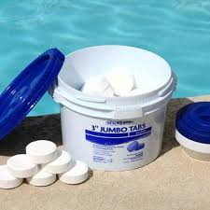
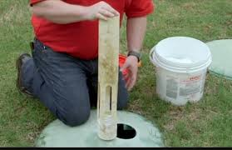
Chlorine Tablets

Slide 9
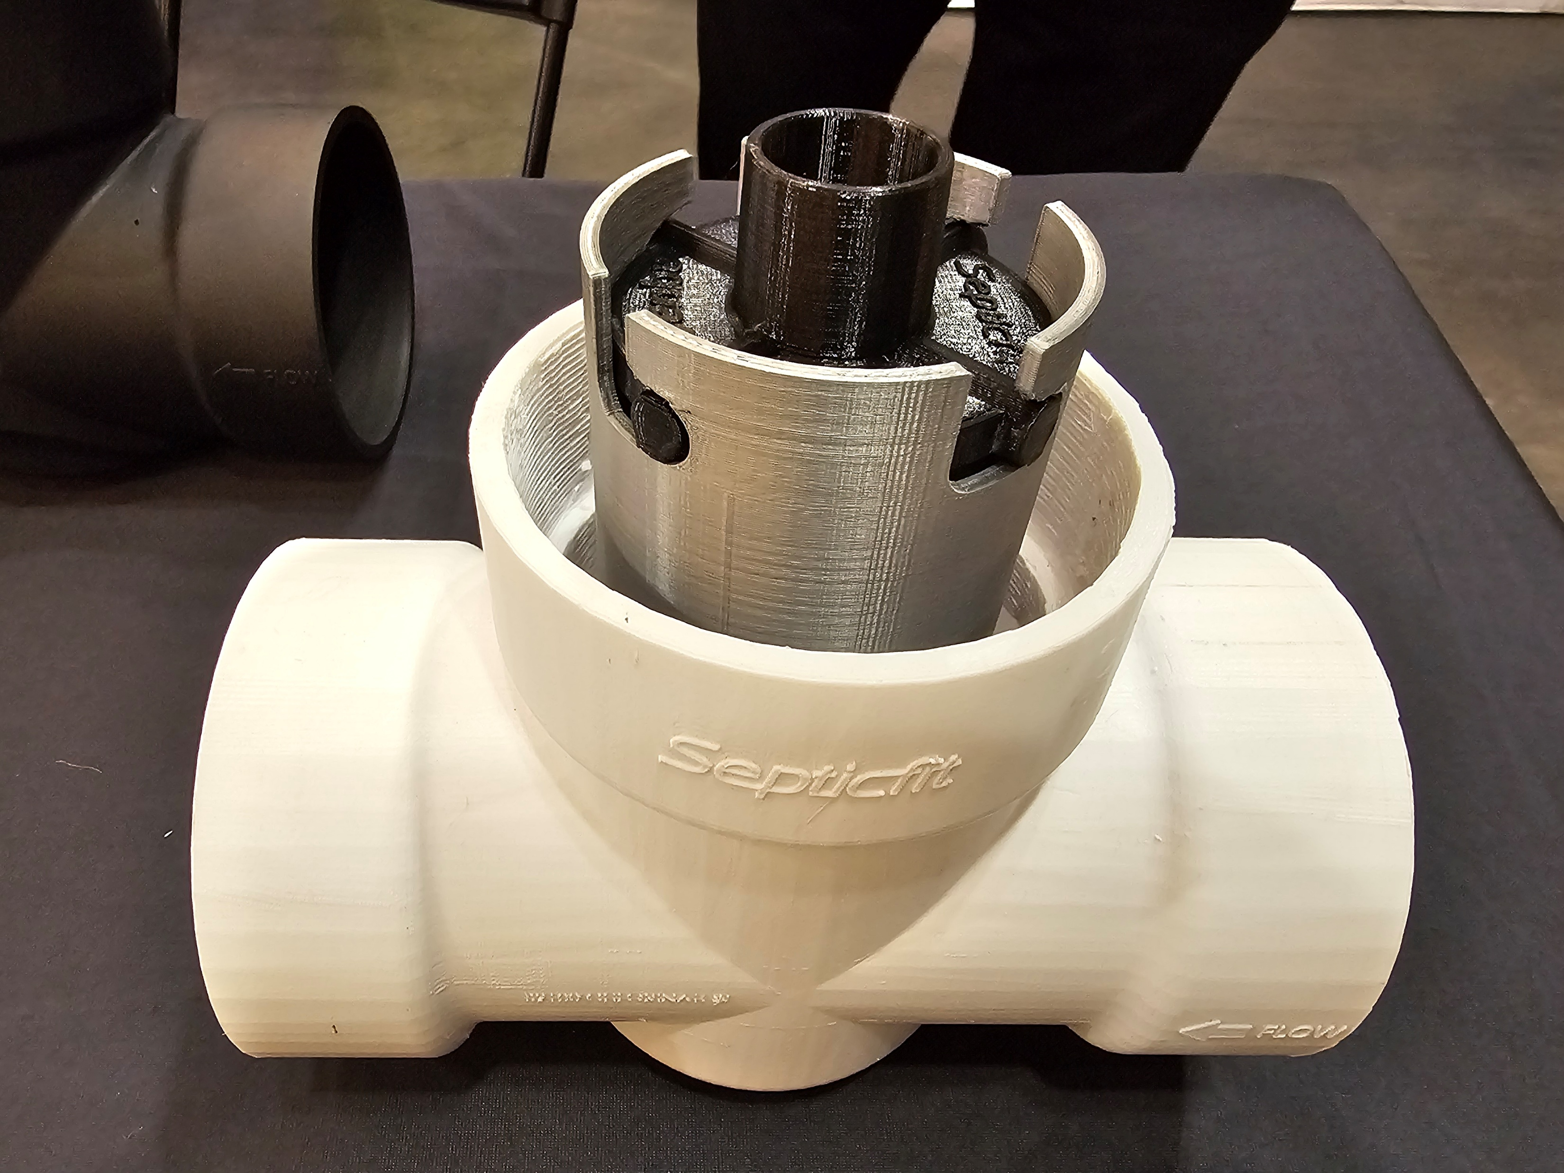
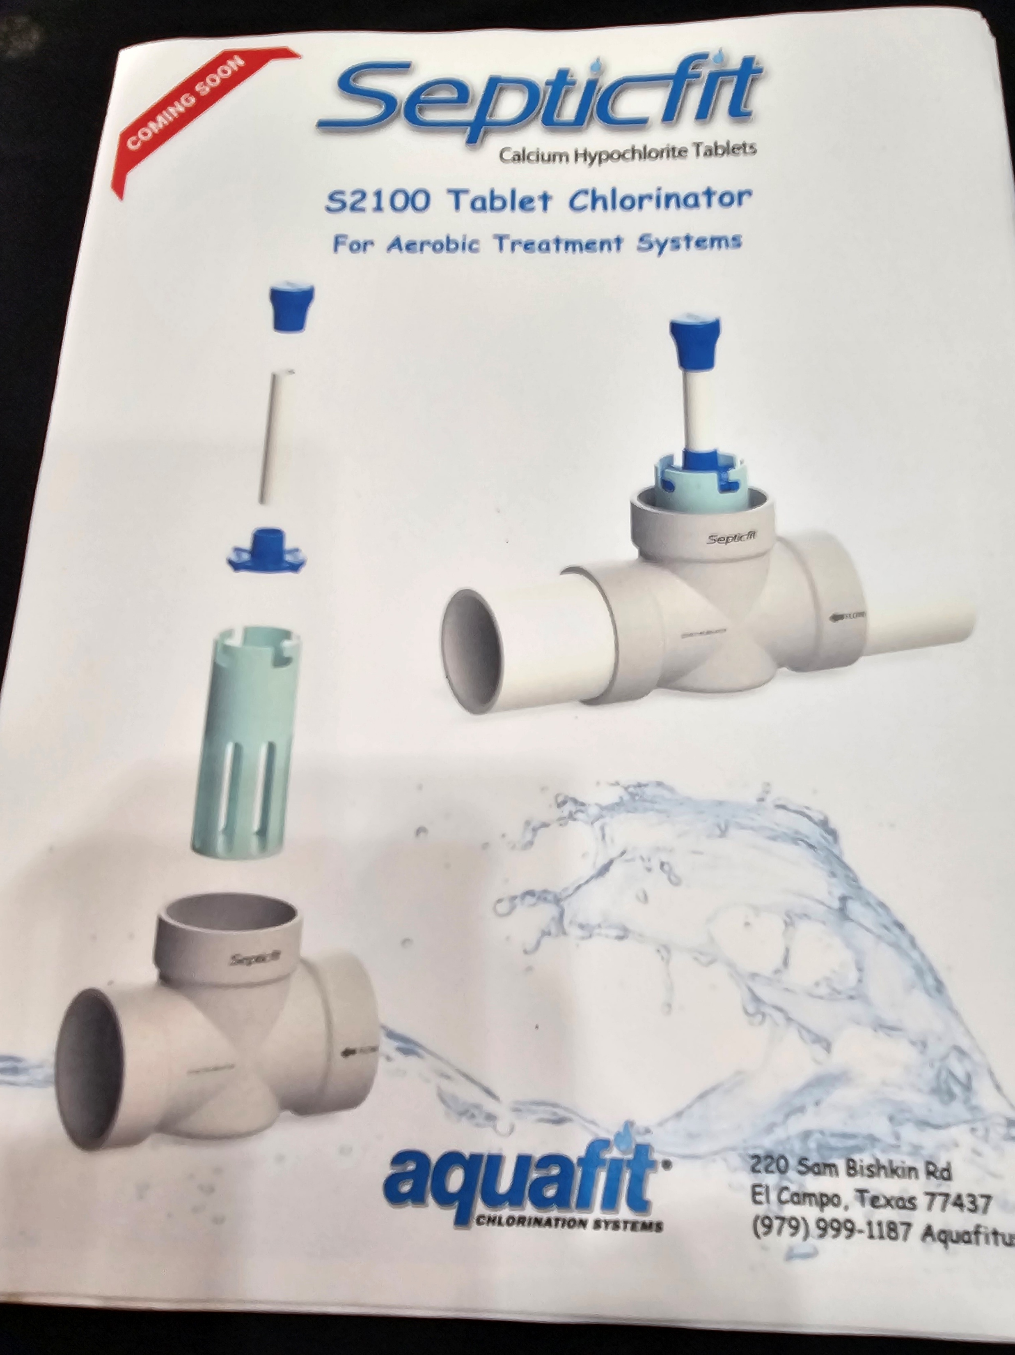
Chlorine Tablets

Slide 10
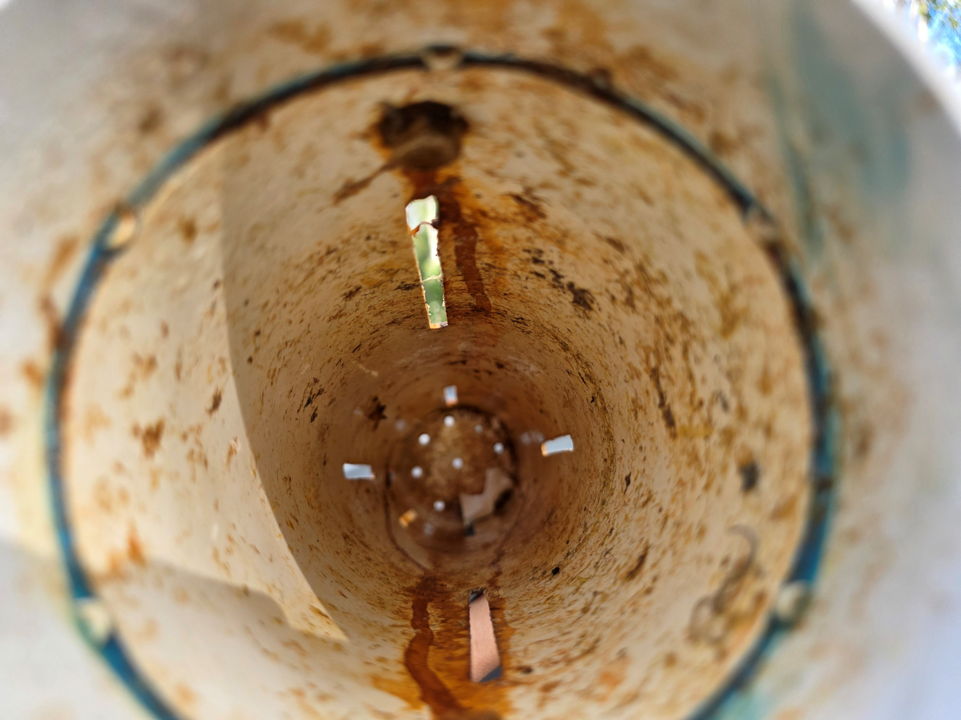

Slide 11
Chlorine Tablets
Low Maintenance
Low Cost
Do provide a disinfection residual
Limited control over dosing rate
Often over chlorinate when 1st installed and are totally consumed before the service agent next visits
Efforts to have householders involved in the maintenance/replenishment of the tablets have not been successful

Slide 12
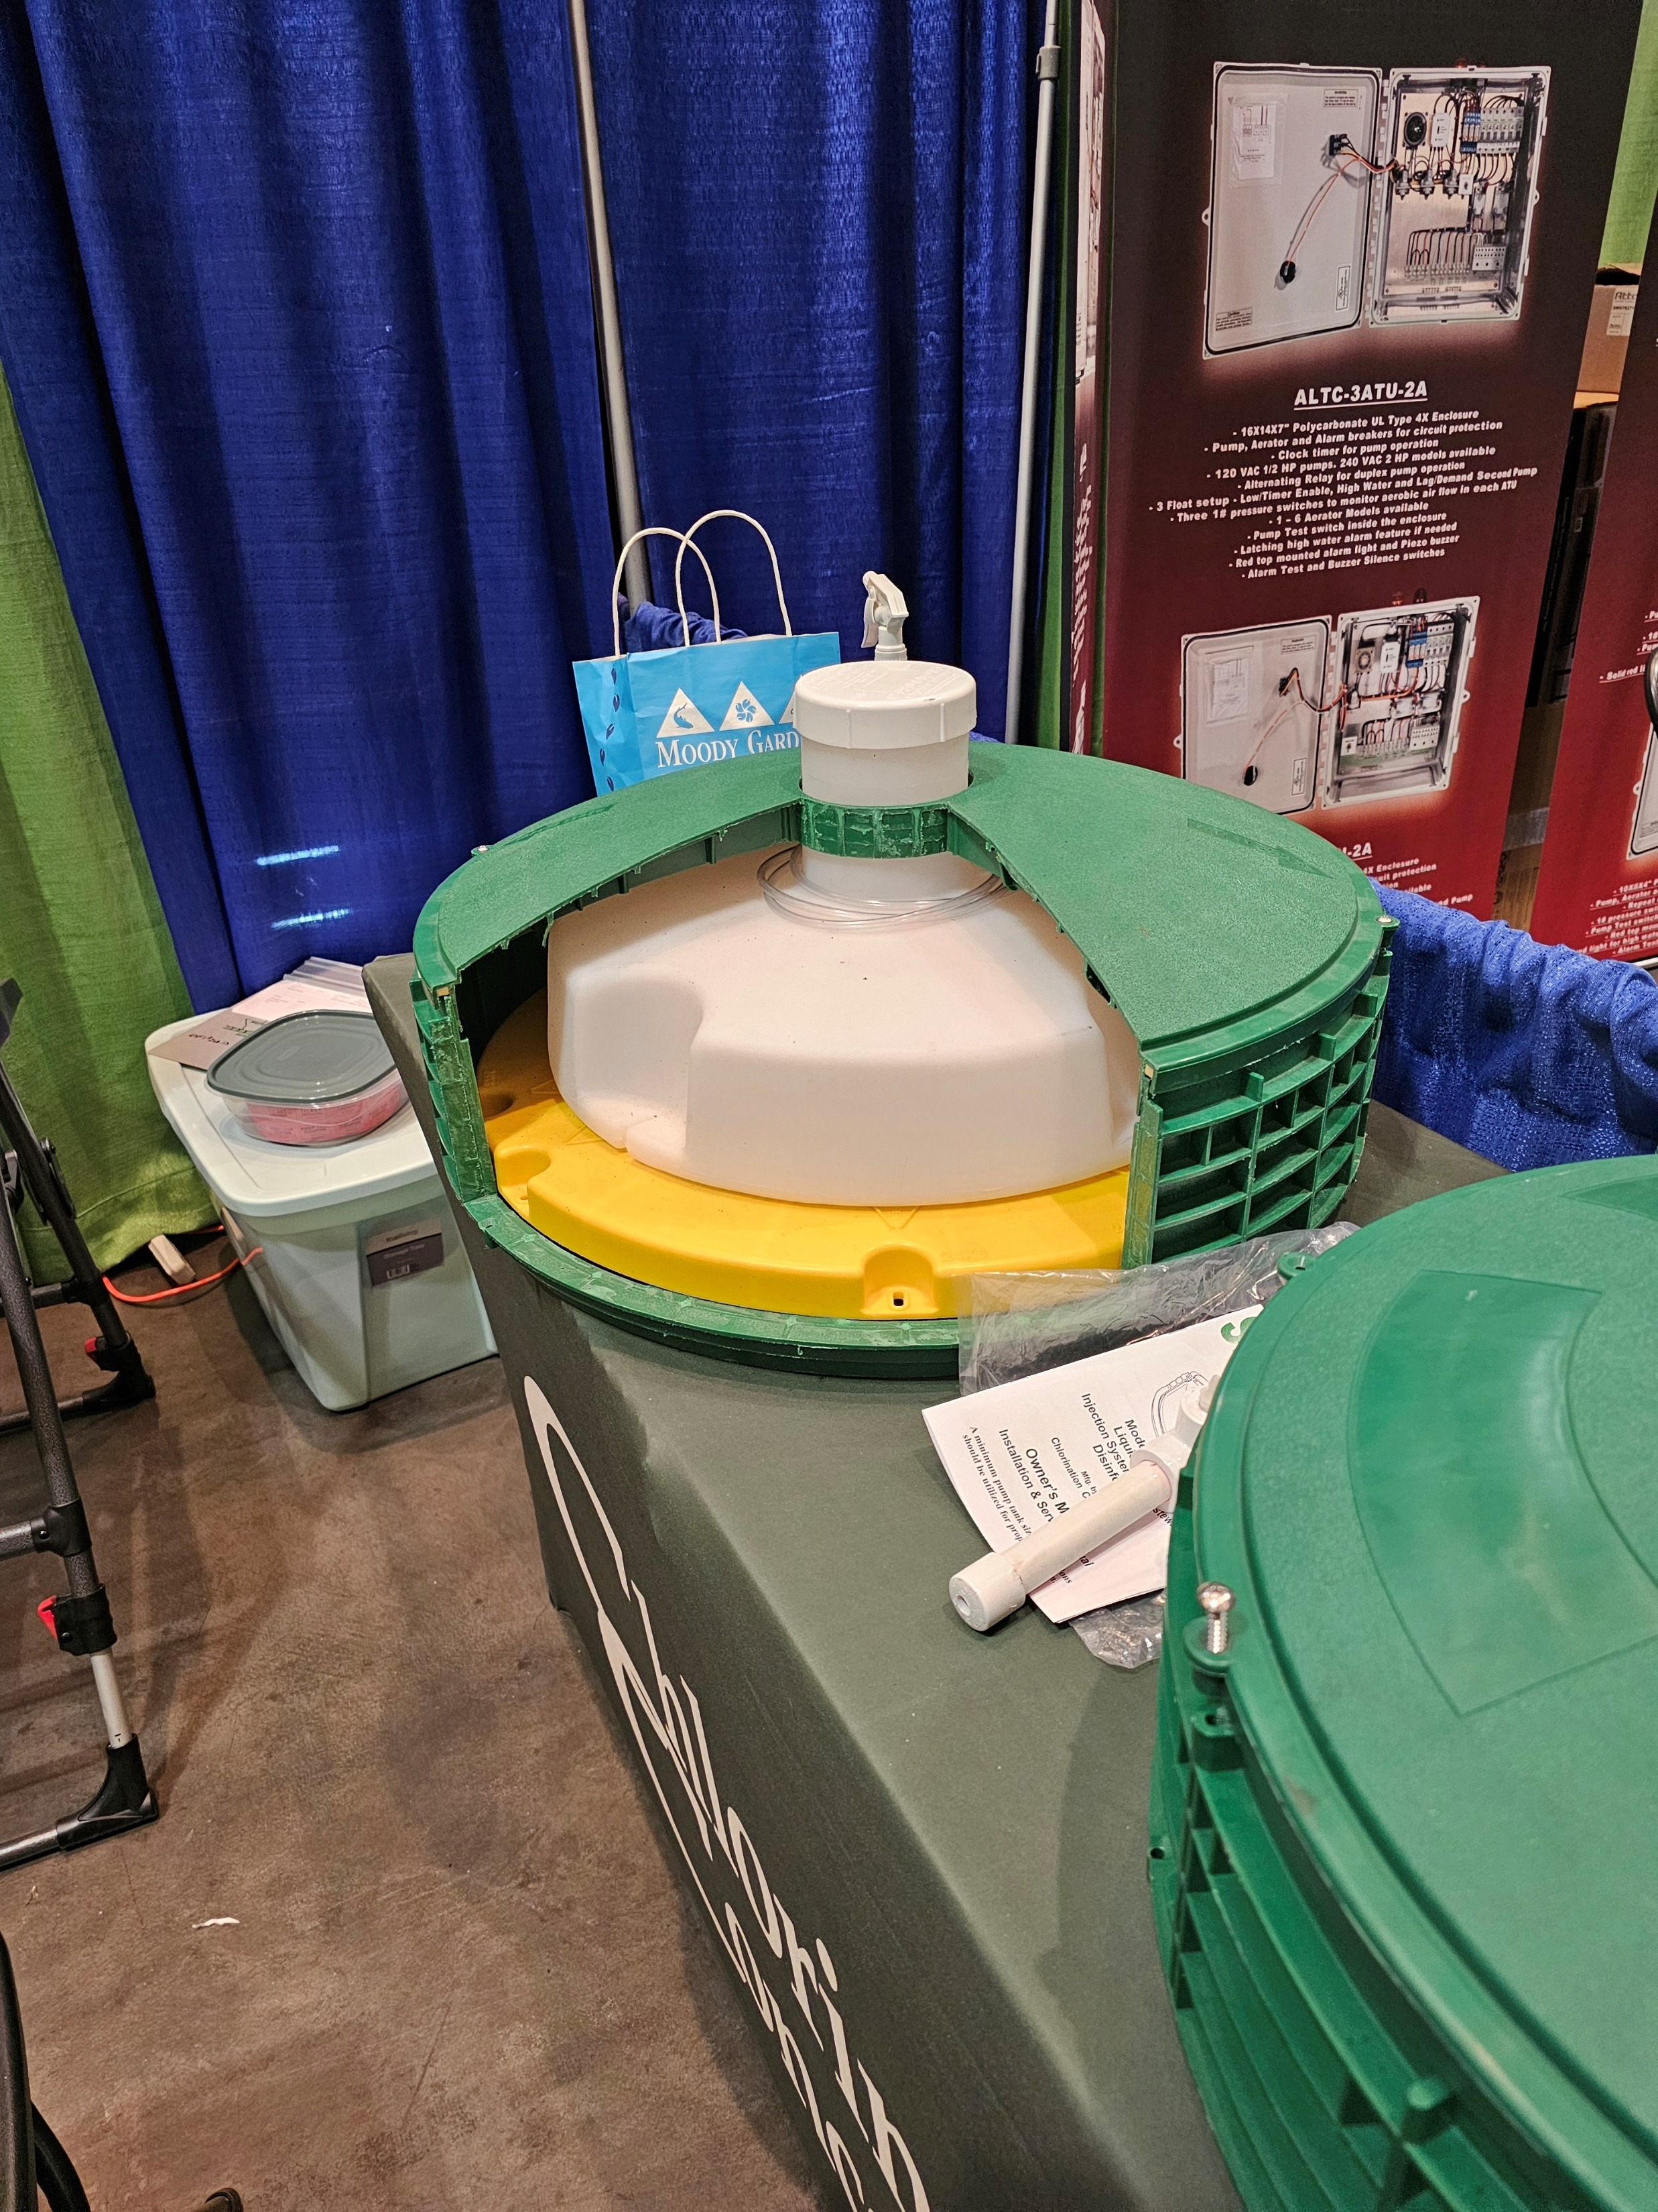
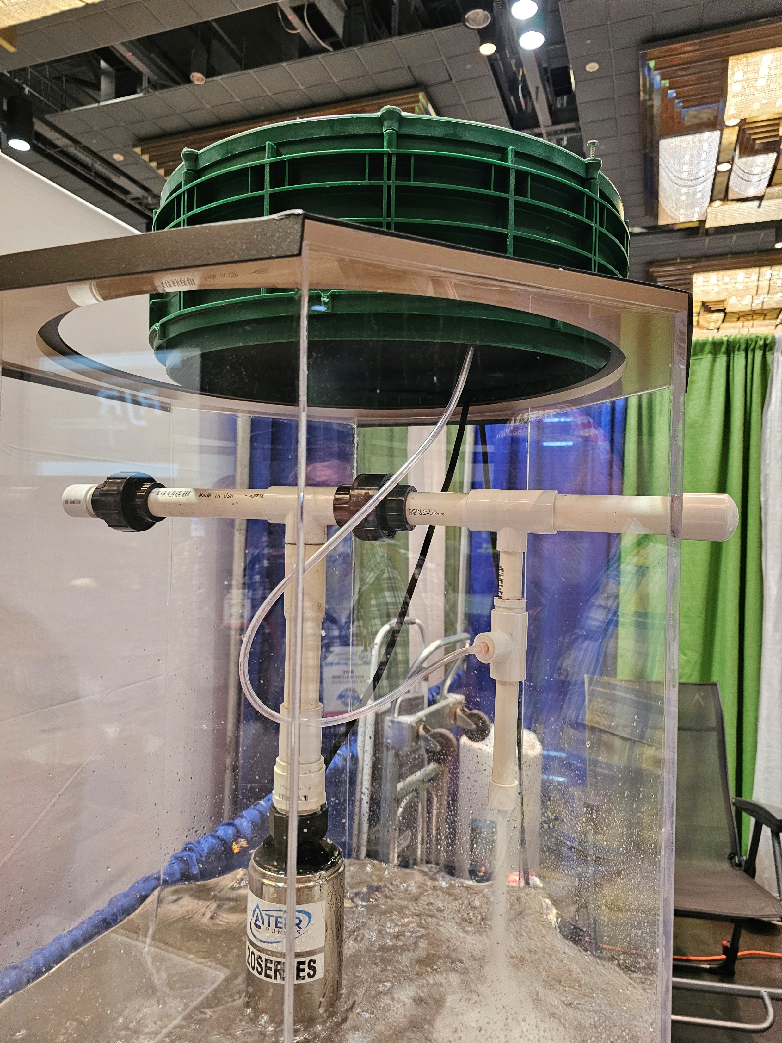
Liquid Chlorine

Slide 13
Liquid Chlorine
Relatively expensive
  Dosing pump replacements
  Pipeline replacements
Higher level of maintenance
  Calibration of probes/sensors
  Replacement of liquid chlorine
May require pH adjustment
Difficult for domestic on-site wastewater
More common for Commercial/Industrial sites

Slide 14
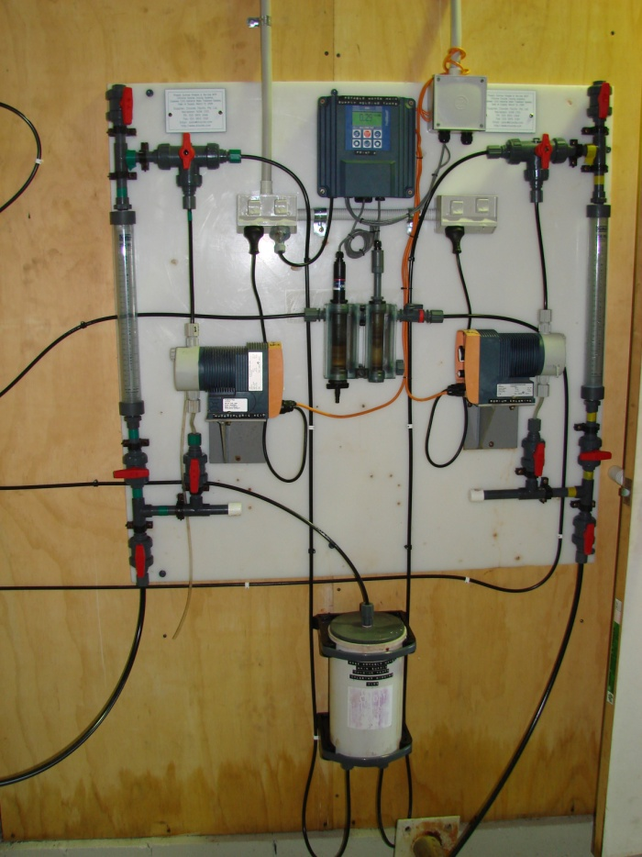
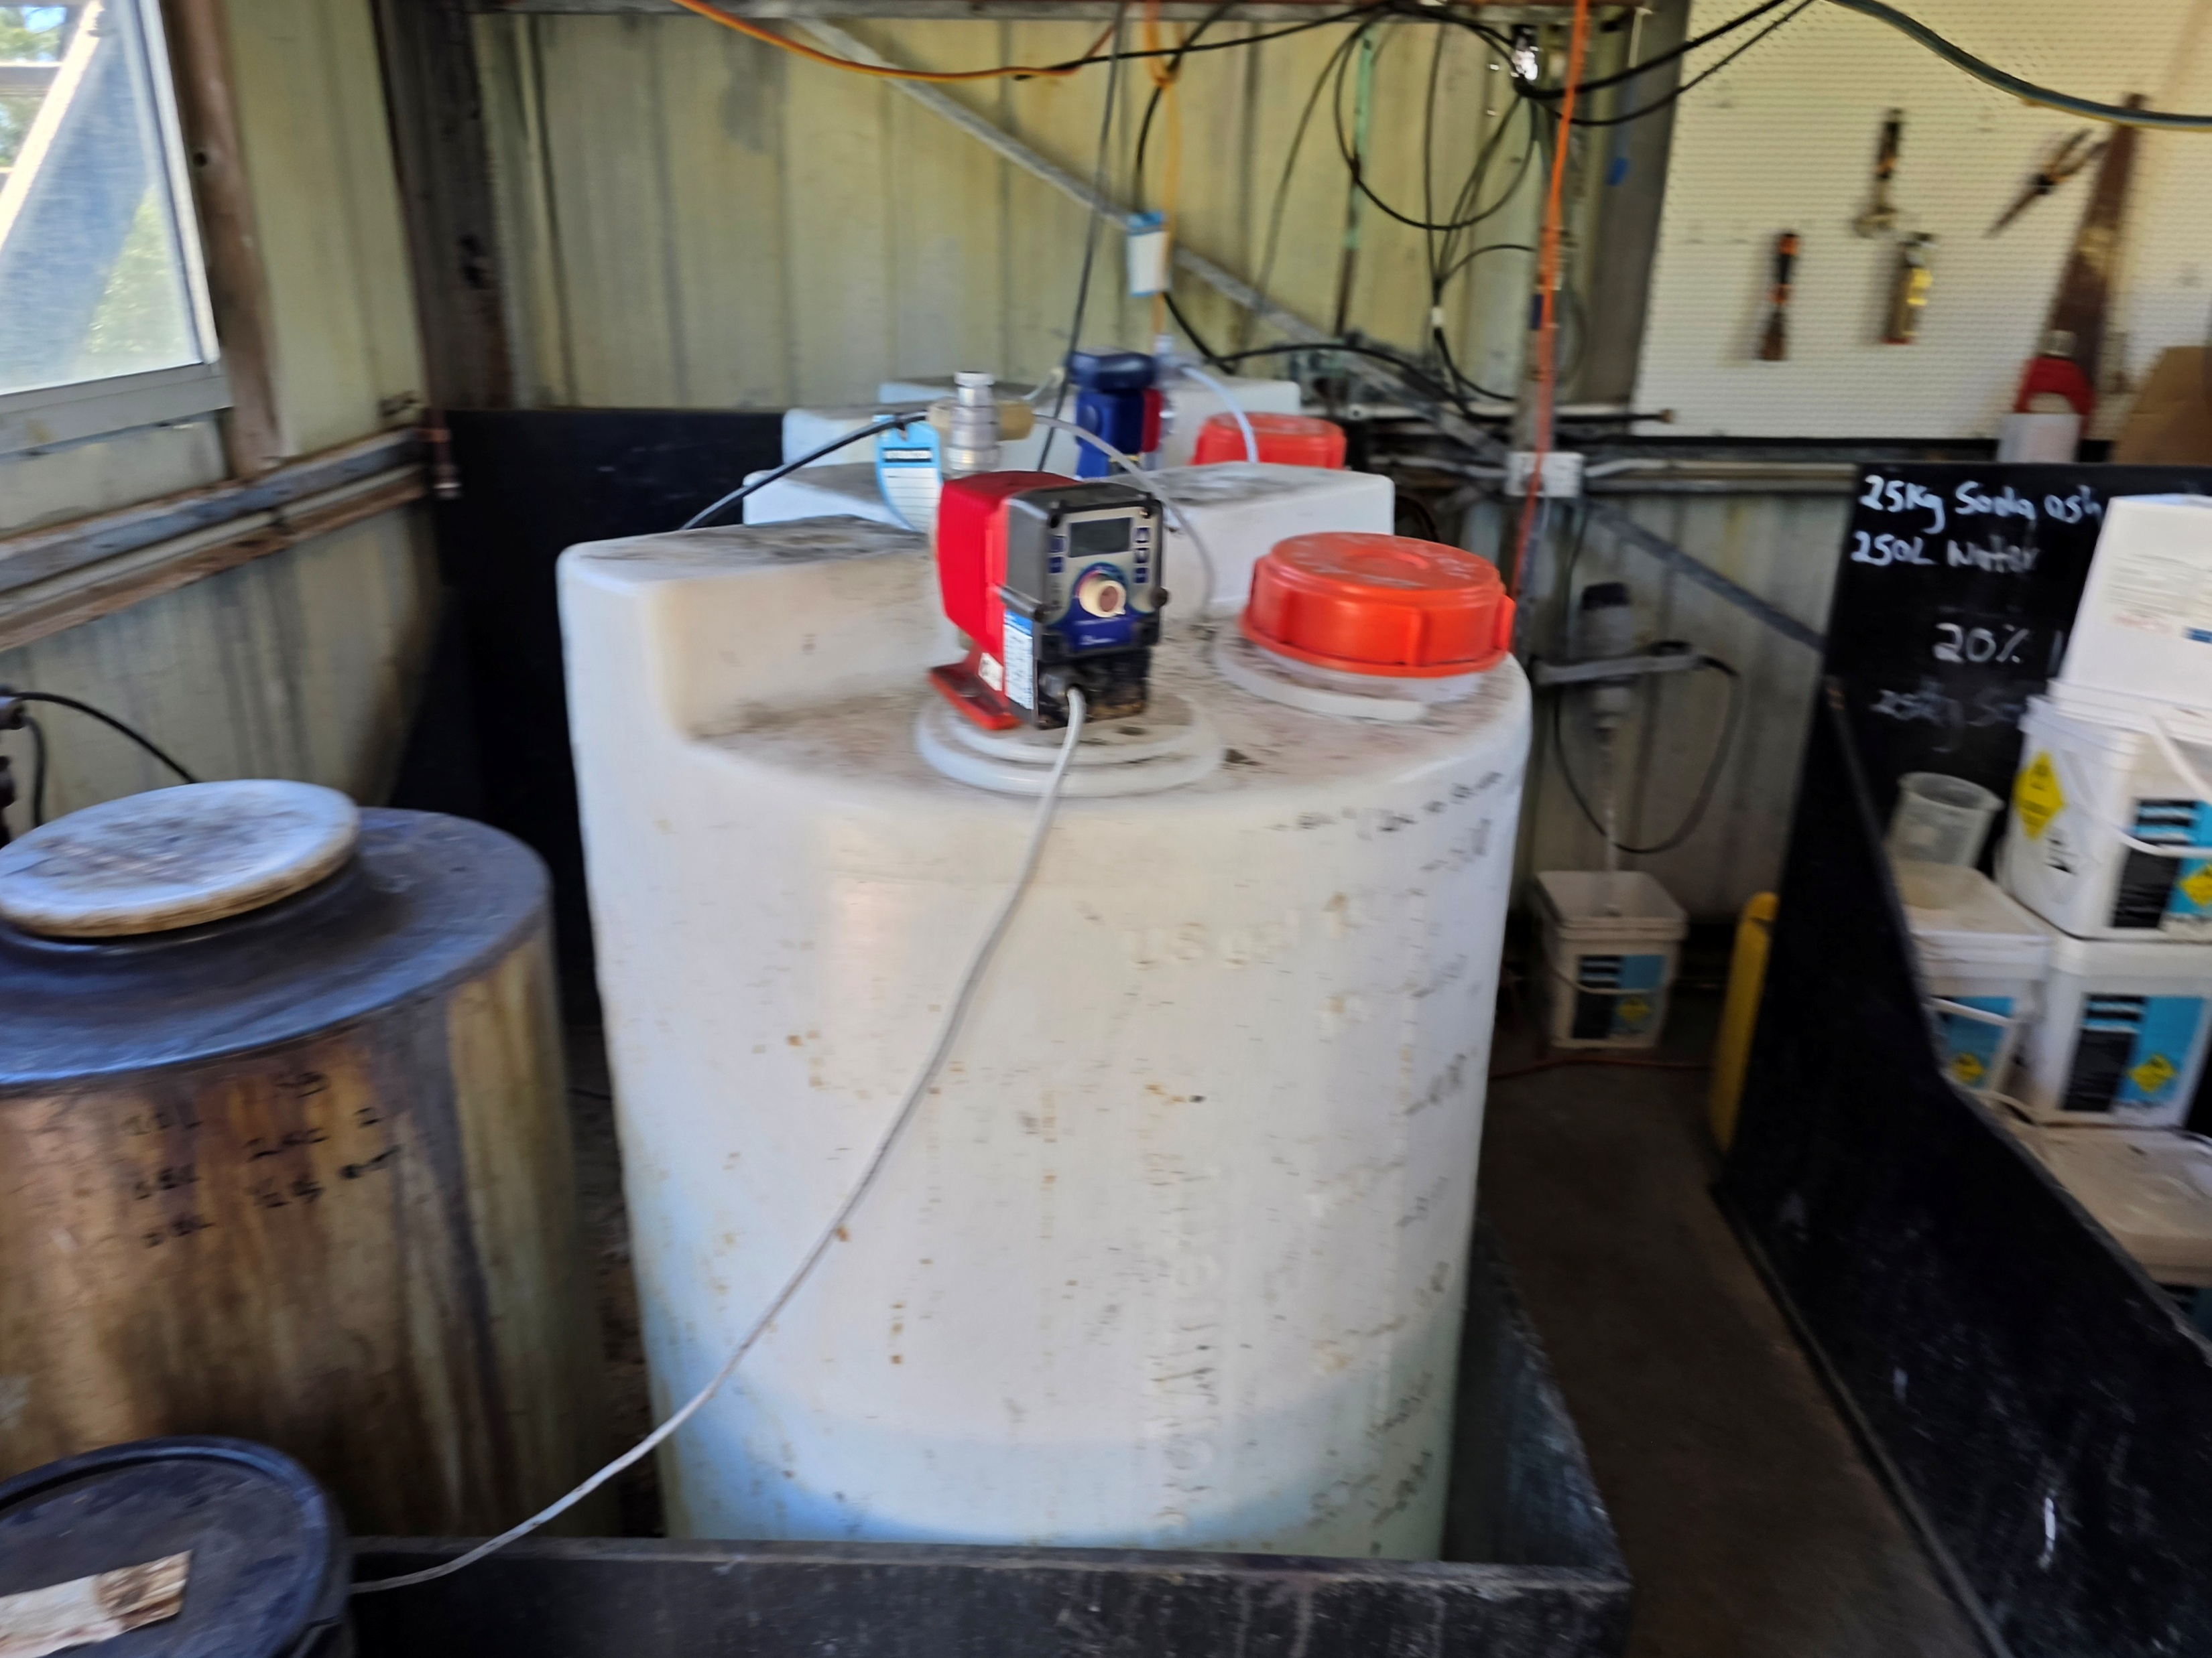
Chlorine Dosing Skids

Slide 15
Chlorine Disinfection
Provides a disinfection residual
Many different treatment technologies available
Application in On-site Wastewater is common; can be required by Regulation
  But success is variable
  Mainly due to maintenance issues
Often associated with sodium ions that are not beneficial to clay and loam soils; sodicity risk
Chlorine can produce disinfection byproducts, such as chlorinated hydrocarbons, that are mutagenic and cancerogenic
Needs to be used correctly to avoid workplace health and safety concerns

Slide 16
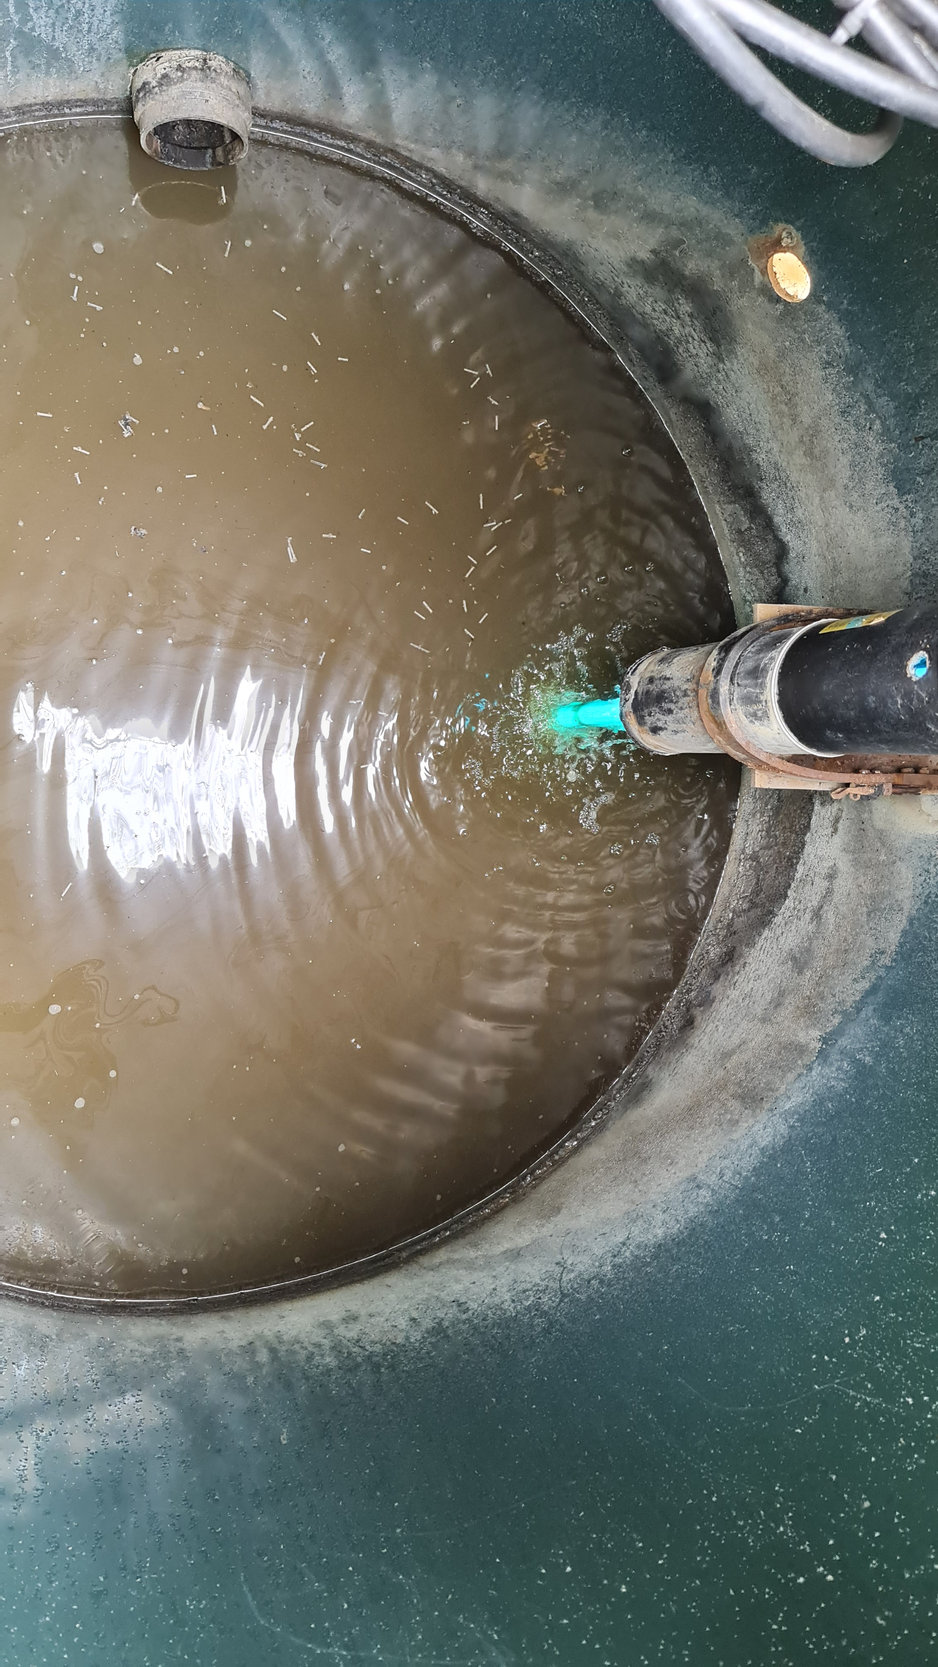
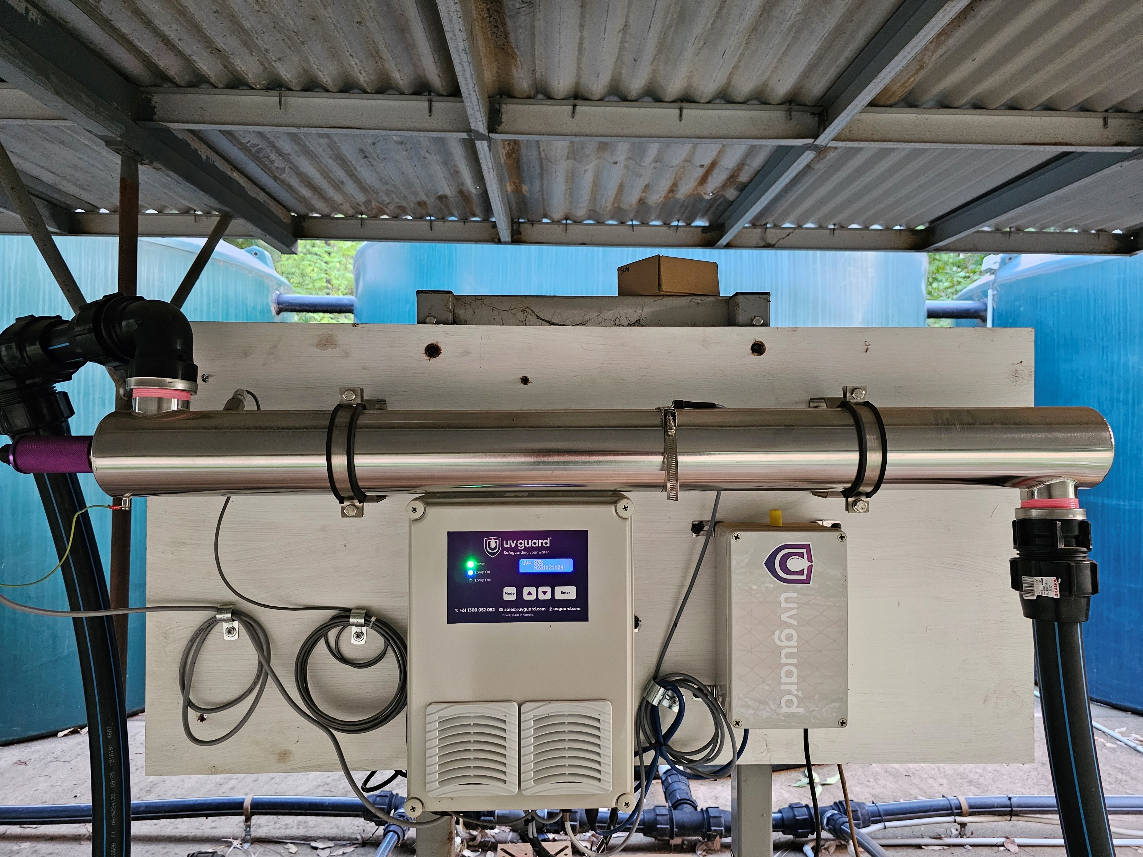
UV Disinfection

Slide 17
UV Disinfection
Uses ultraviolet light to disinfect via disrupting genetic material of microorganisms
Effective against bacteria, viruses, protozoa, helminths, and algae
No disinfection residual
Requires the water to have a low total suspended solids, and a high clarity (low turbidity)
Commonly used around the world
Preferred disinfection technique in Europe
Requires power
Maintenance involves keeping the bulb/s clean, replacing the bulbs, ballast, etc
  Specialised maintenance typically required yearly

Slide 18
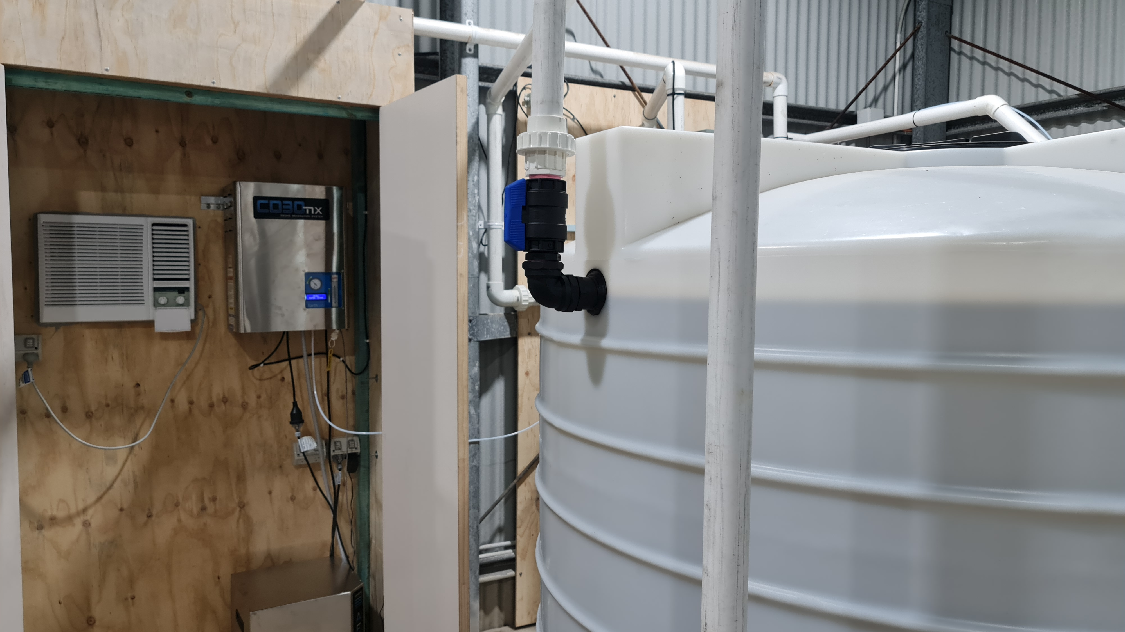
Ozone Disinfection
Used to:
  Disinfect
  Remove Colours
  Remove Odours
  Reduce BOD/COD
Made at the site via an ozone generator
Set up in a batching mode with a contact tank
Or in a mixing chamber; higher dose rate

Slide 19
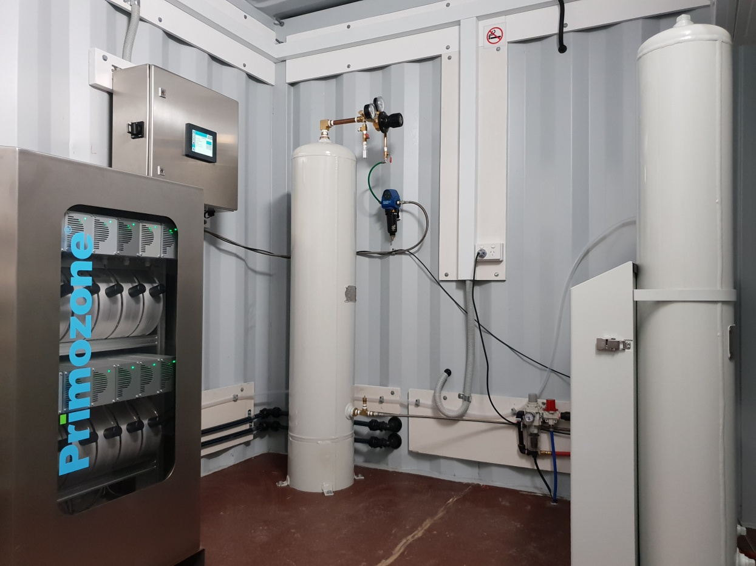
Ozone Equipment

Slide 20
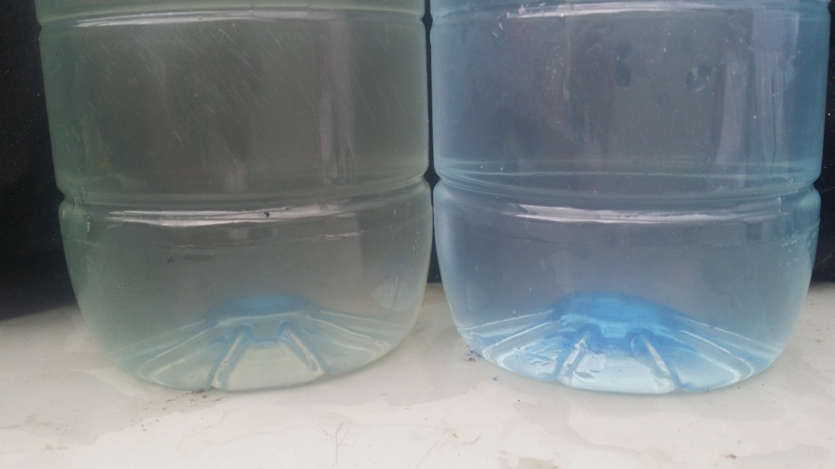
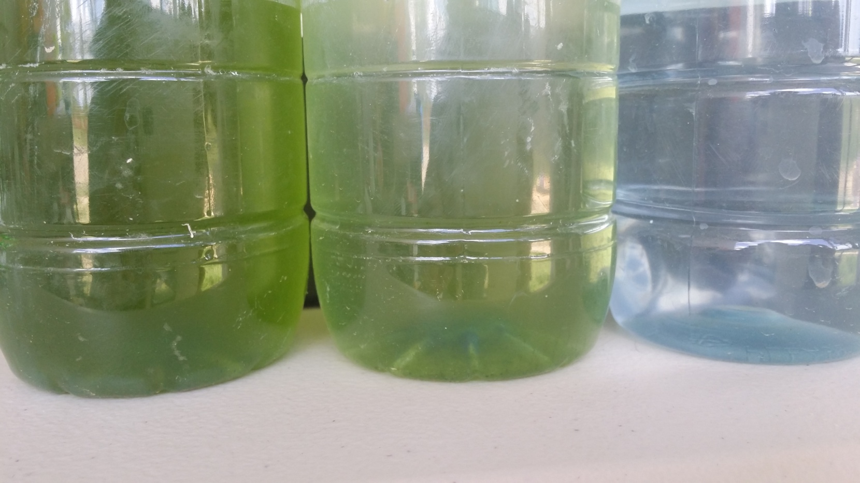
Impact of Ozone
Disinfects bacteria, viruses, protozoa and algae
Removes colours and odours
Reduces BOD & COD
Acts as a Flocculent

Slide 21
Ozone Disinfection
Relatively expensive
Requires a relatively large amount of power
Oxygen concentrator requires a relatively large amount of maintenance and controlled conditions
No disinfection residual
Some disinfection by-products in the presence of bromide
  Bromate formation
Effective against bacteria, viruses, helminths, algae, and most protozoa
Total suspended solids and clarity of the water can be poor
Multiple other treatment benefits
  BOD/COD reduction, colours, TSS, odours, pharmaceuticals and personal care products, and acts as flocculant

Slide 22
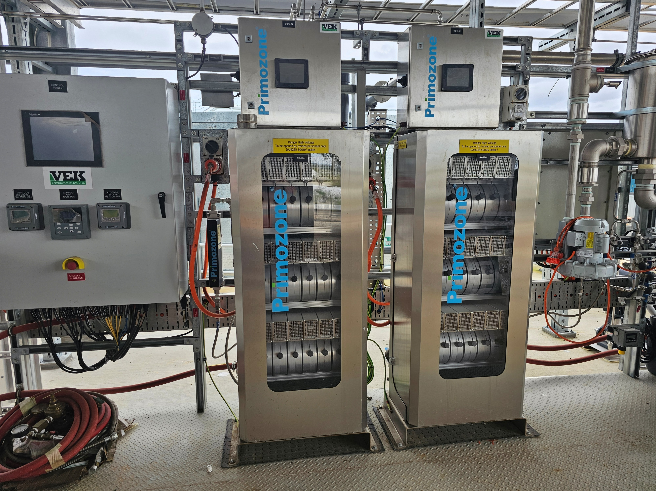
PFAS Treatment

Slide 23

Hydrogen Peroxide
Strong oxidizer
Very similar to Ozone
Can be purchased in a liquid form
Literally rocket fuel
Similar chemical handling procedures to liquid chlorine
Effective against bacteria, viruses, helminths, algae, and some protozoa
No disinfection residual

Slide 24
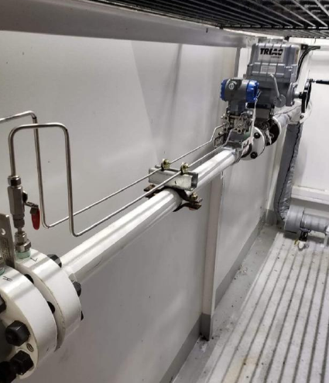
Electrochemical
Use cathodes and electricity to make a variety of disinfection chemicals
  Ozone
  Hydroden peroxide
  Forms of chlorine
  Acids
Requires power
Specialized maintenance
Solids

Slide 25
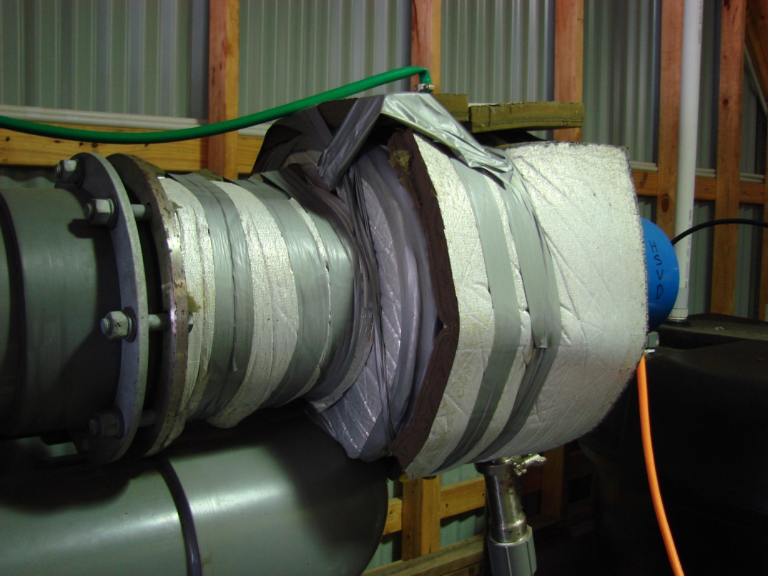
High Velocity Sonic Disintegrator (HVSD)
Novel form of disinfection using sound waves and pressure
Effective against bacteria, viruses, protozoa & nematodes
No disinfection residual
Very loud
  Over 160 decibels
Invented in 2003/2004
  Limited numbers installed
  Servicing/maintenance issues
Has shown good disinfection rates over time
End of life will most likely replace with an ozone unit

Slide 26
Natural Disinfection
Most common form of disinfection for faecal indicator bacteria
Temperature
Natural sunlight
Other microorganisms
  Soil biota
Natural conditions typically not conducive for faecal bacteria to replicate
Viruses, protozoa, helminths, and cyanobacteria are much more variable
  Some bacteria as well, such as Salmonella
Used by soil based, sand filters, and constructed wetlands in on-site wastewater treatment

Slide 27
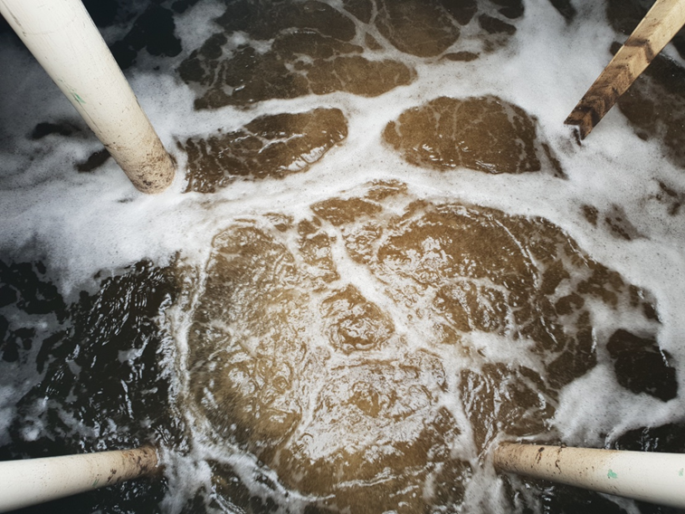
Natural Disinfection
Temperature
Air (oxygen)
Competition from other microorganisms
Sunlight

Slide 28
Lake Gkula
Designed & built by Patrick Handley of Waterscapes Australia
  http://www.waterscapesaustralia.com.au/
Lake Gkula is named after local Indigenous man Uncle Noel Blair of the Jinibara people and it means Koala
  https://woodfordfolkfestival.com/lake-video/
Volume is approximately 13 million litres or 3 million gallons
Natural swimming Lake
No disinfection chemicals
  No chlorine, ozone or Ultraviolet light disinfection
Water filtered by up-flow rock filters and beneficial microorganisms
Lake stocked with fish, reptiles, birds, eels, and mollusc’s
Planted with native plants

Slide 29
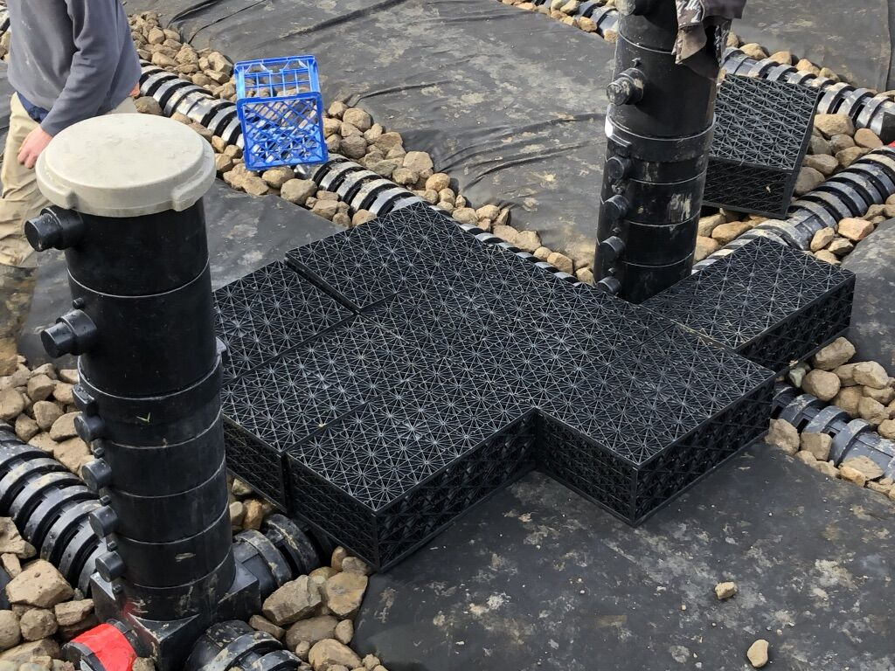
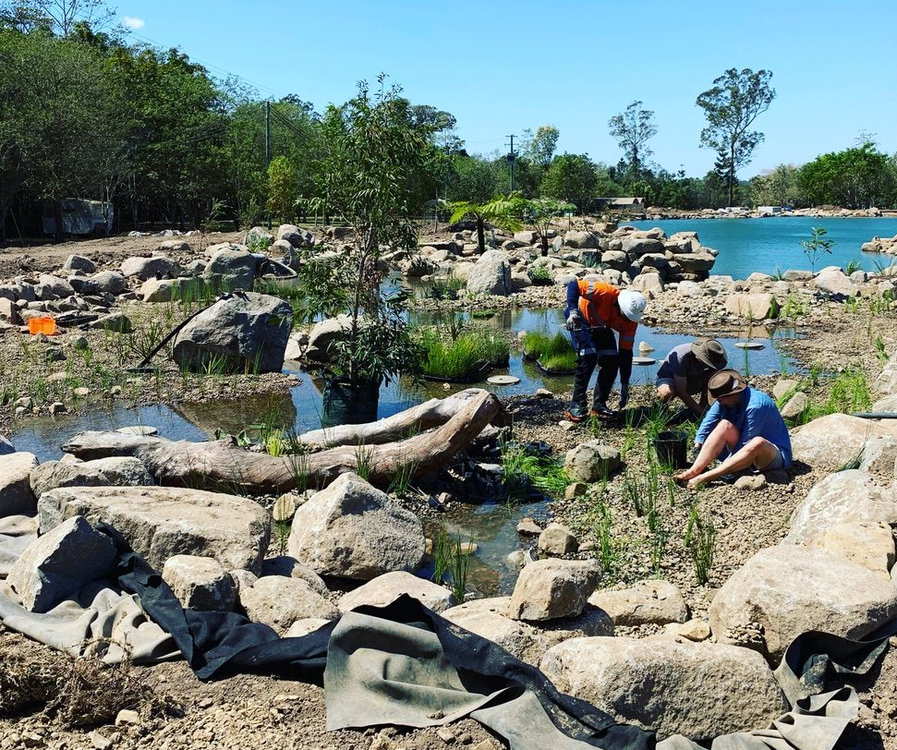
Up-flow Filters

Slide 30
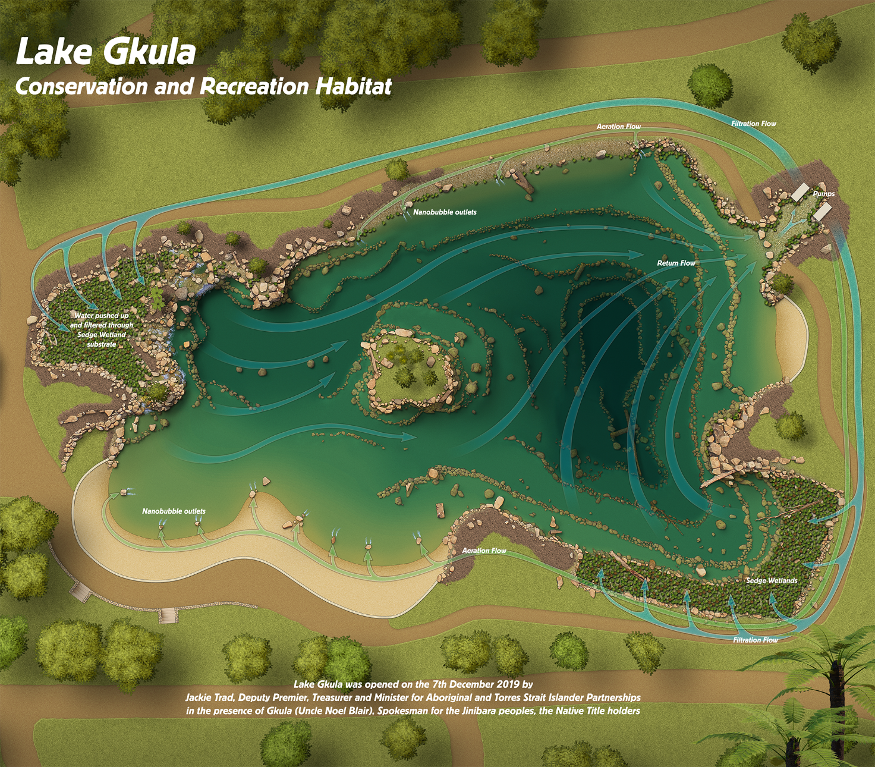

Slide 31
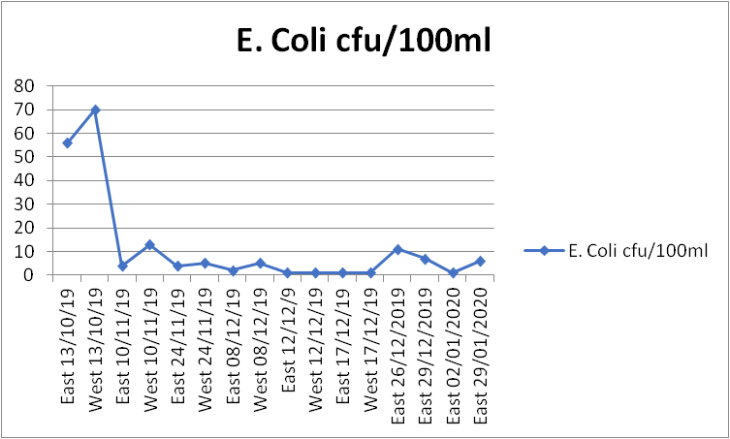
Escherichia Coli
With no chemical or Ultra Violet disinfection process the colony forming units of E.coli are very low
  Especially as wild-life & swimmers will be constantly adding low levels of E.coli
During the commissioning period the numbers of cfu’s was higher but once the beneficial microorganisms established on the up-flow rock filters the numbers of E.coli quickly decreased

Slide 32
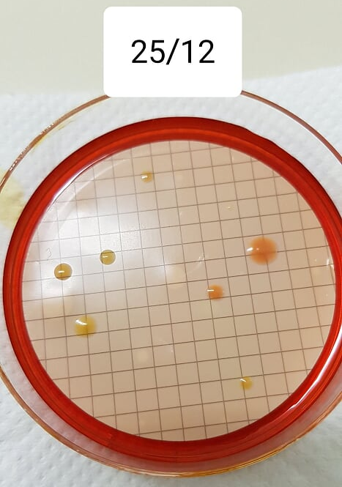
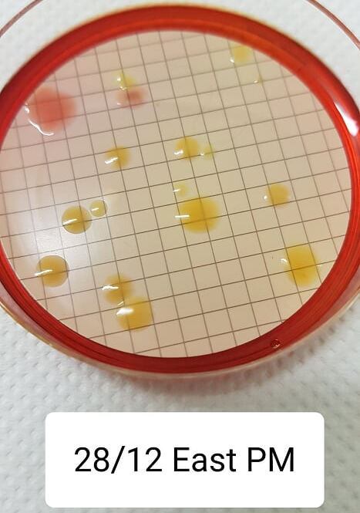
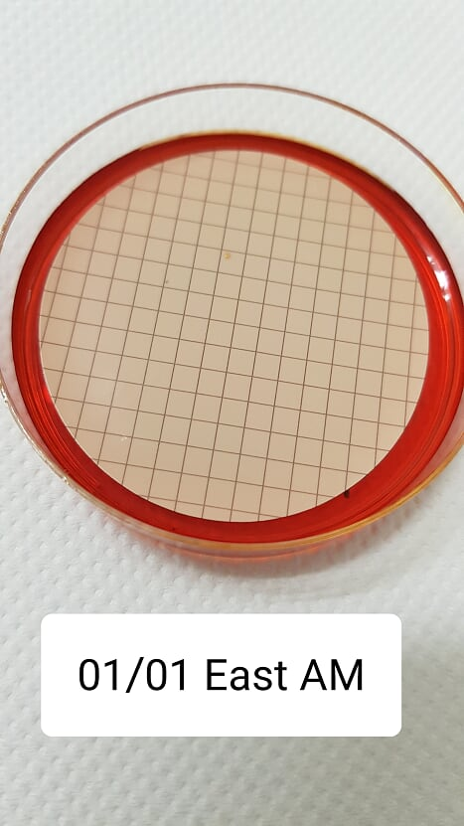
Faecal Coliforms Plates Done in-situ

Slide 33
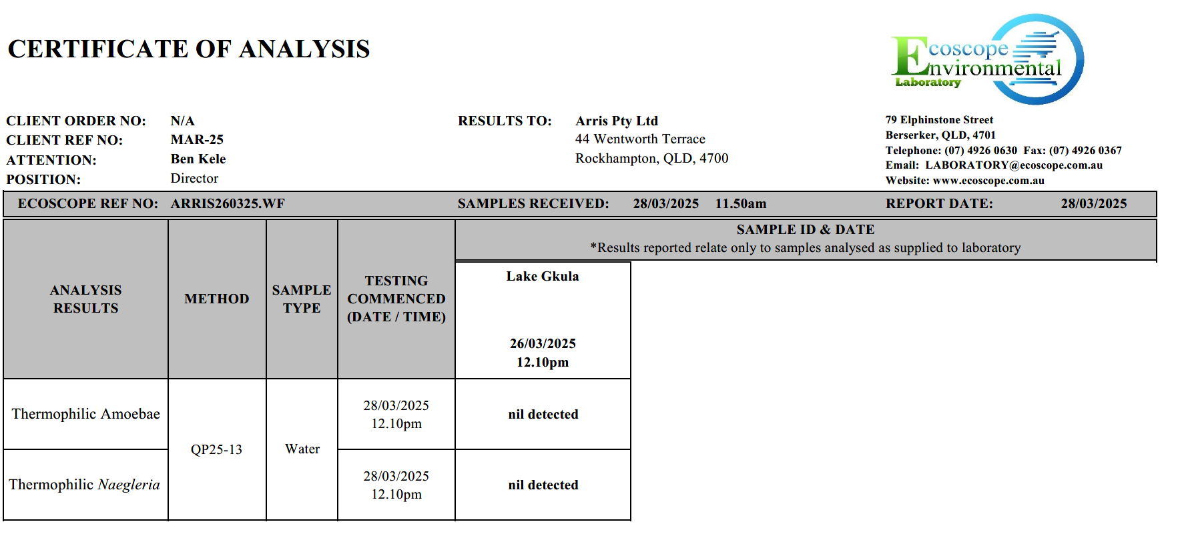

Slide 34
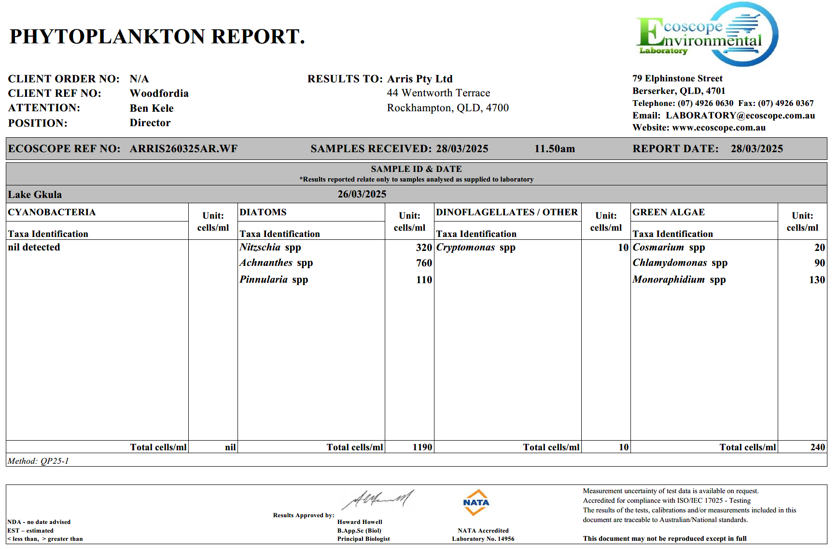

Slide 35
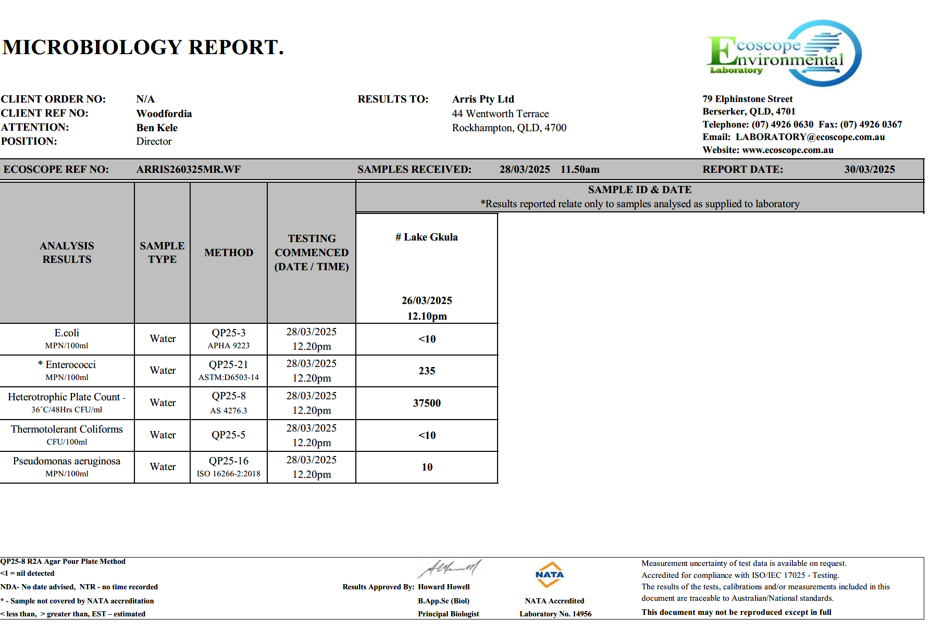

Slide 36
Natural Disinfection
Low cost
Low maintenance requirements
No disinfection residual
Design is very important
  Hydraulic short-circuits can cause major issues
  Old tree roots, sandy soils, etc
No adverse impacts to the soil linked to disinfection
Minimal control if something goes wrong

Slide 37
Multiple Barrier Approach
Any disinfection system can fail
Plan to manage potential failure in your designs
A multiple barrier approach is considered best practice
  Multiple treatment techniques that provide disinfection
  Complete disinfection is not required by each technique
  Log reductions
Use a risk assessment to minimize the chances of non-disinfected water coming into contact with people and sensitive environments

Slide 38
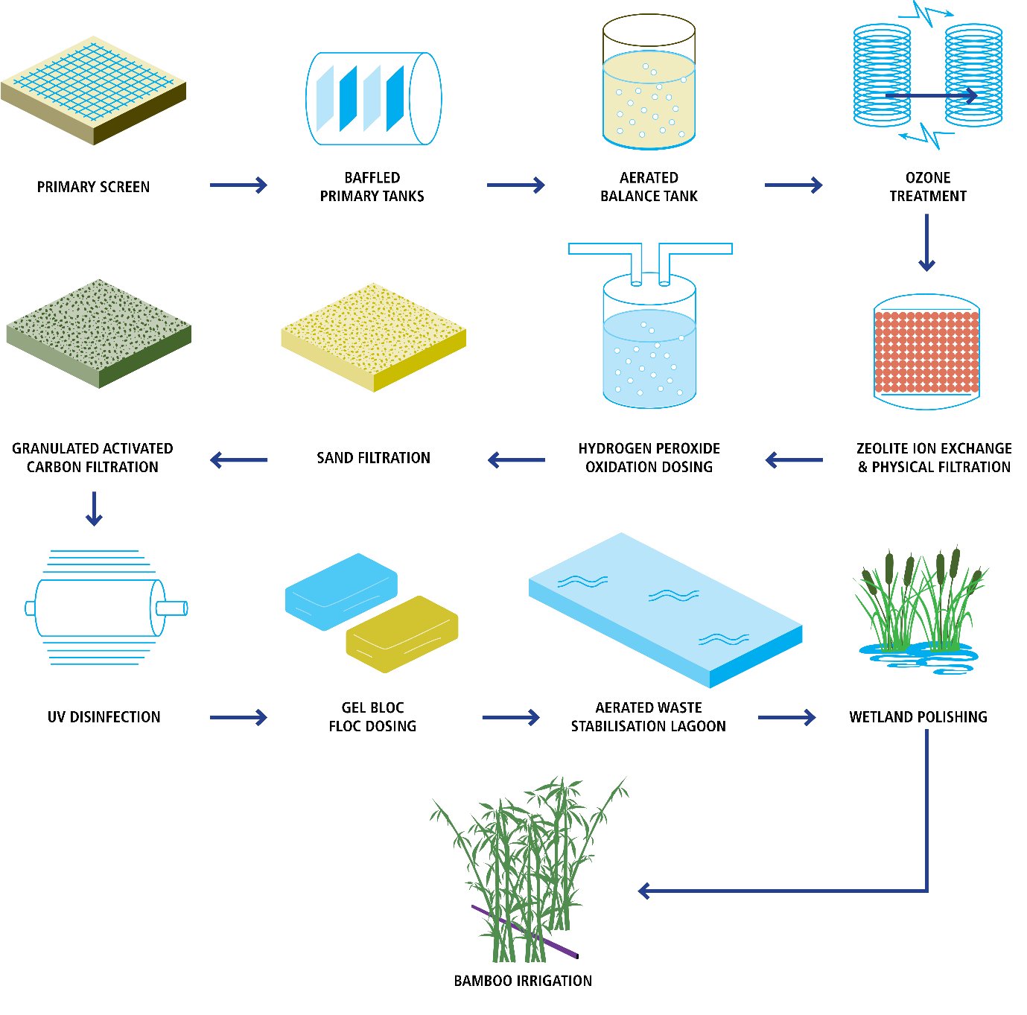
Woodfordia Treatment Chain

Slide 39
Conclusion
All disinfection techniques have advantages and disadvantages
Understanding these and incorporating them into your design and/or risk assessment is important
A multiple barrier approach is good risk management
Natural disinfection processes are not to be underestimated

