Slide 1

Understanding an Onsite System Failure
Reflections on a Career in OWTS; Lessons from the Trenches, and Other Head-Scratching Occurrences
Chuck Cousino, REHS
Retired, OWTS Professional
Notes:
Glad to see familiar faces
You are the ones tasked with fixing whatever mess I left behind
Today I’ll be looking to share some things that I came across throughout my career that may help you moving forward. I guess we’ll call it “lessons from the trenches.”

Slide 2
45 years in the OWTS industry…
Regulator: 23 Years – Early and Late Career
11 yrs. – Local Agency (MI, CO)
12 yrs. – State Agency (CO)
Engineering: 22 Years (Michigan)
Residential/Commercial/Cluster System OWTS Design
Site/Soils Evaluation
TOT Inspections
System Maintenance; Residential/Commercial
Just prior to retirement, I was asked:
What were some of the craziest things that you came across?
What were your lessons learned? Any advice?

Slide 3

Notes:
Advice?!?!?

Slide 4


Slide 5

Notable Quotes:
"Experience is simply the name we give to our mistakes.“
“An expert is someone that travels more than 500 miles to tell you something that you probably already know”
“The expert in anything was once a beginner”
“We’ve been given one mouth and two ears. Which means we should only talk half as much as we listen”
Notes:
So maybe instead of giving advice, I thought that I maybe could start with some quotes that I came across over the years
’ll provide you with random quotes that I’ll insert throughout the presentation

Slide 6

Things that make you go…
Notes:
So again, I was asked what crazy things I came across during my career:
Bbbbbbbbb…..
So I asked my cohorts across the country on the SORA bd. If they had any situations that they came across

Slide 7
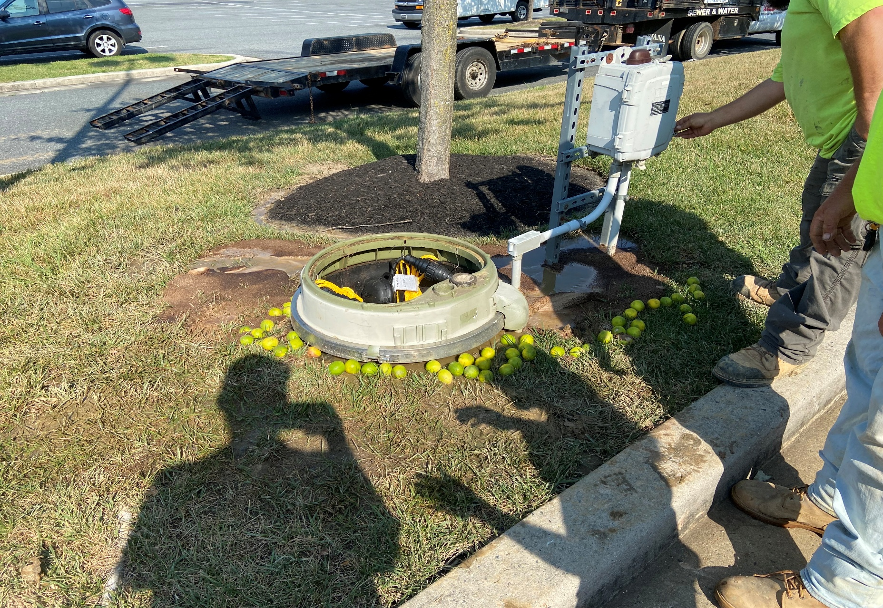
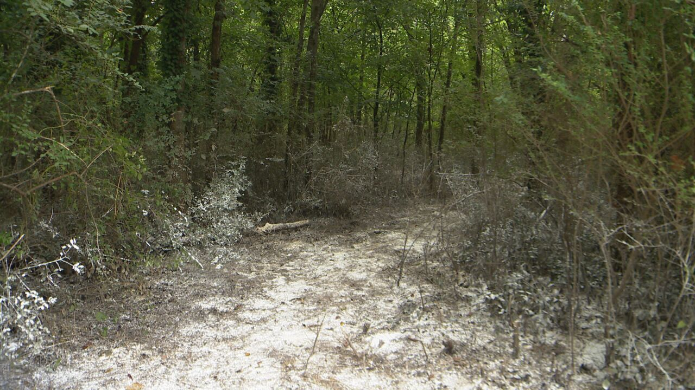
Sewage Overflow: Installer told to “Lime” the area
Notes:
From Maryland:
This brings me to another one of my favorite quotes

Slide 8
“We need to ensure that we attain our full level of incompetency” - Coll. Prof.
Notes:
Prof. said to be sure to ask questions, so we attain….
And speaking of incompetency… (next slide)

Slide 9
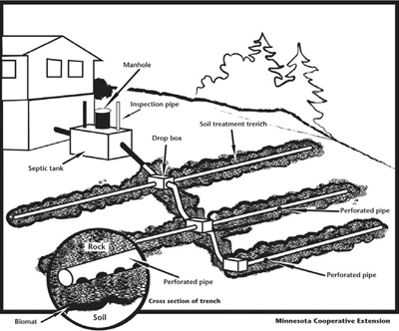
Contour Distribution
Notes:
Parrallel to the slope… right?

Slide 10
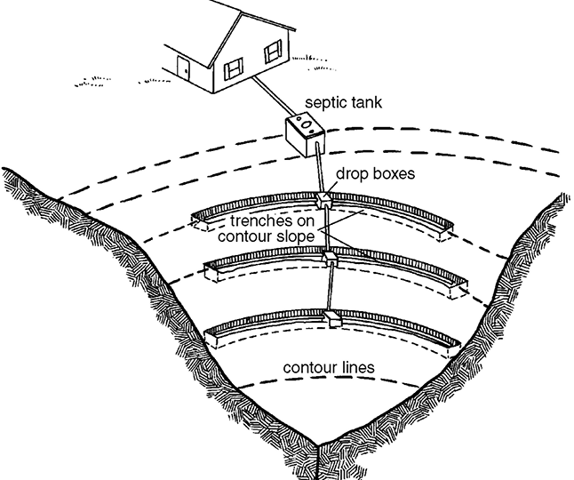
Notes:
Found this online; funneling the effluent… WRONG
Must be correct, because everything on the internet is correct… right?

Slide 11
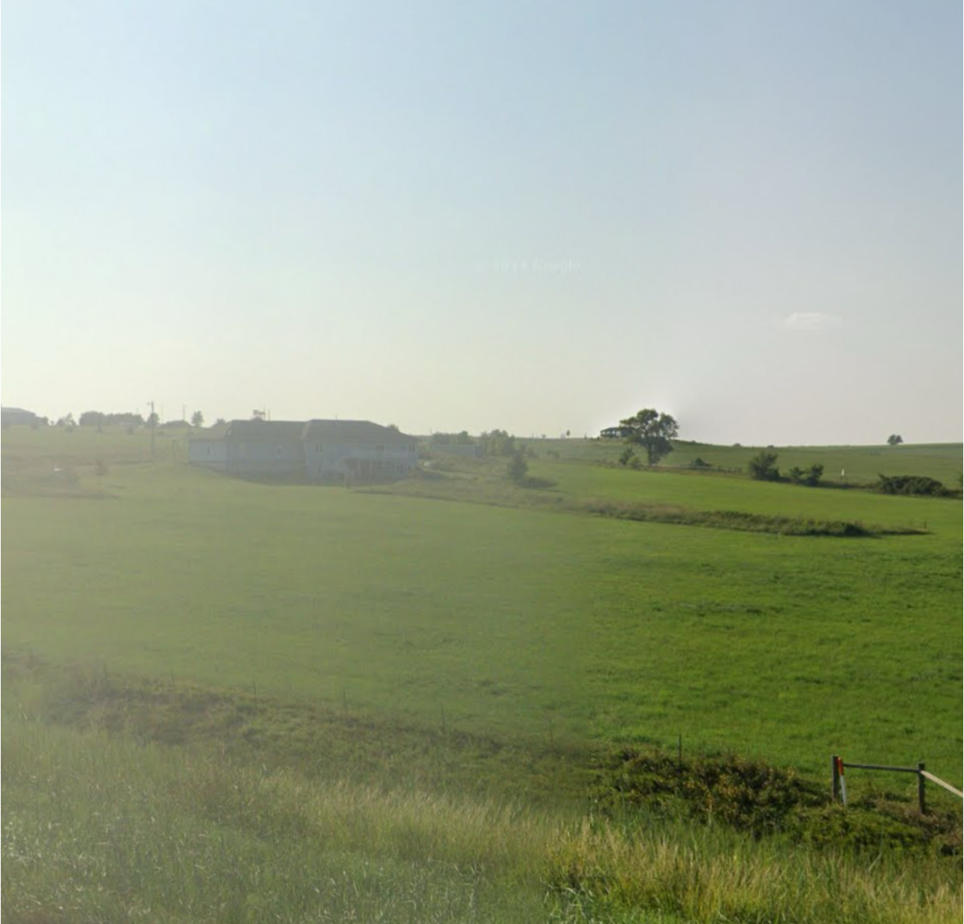
System constructed perpendicular to the contour
Slope
Notes:
Here’s a photo of an actual installation in Kansas

Slide 12
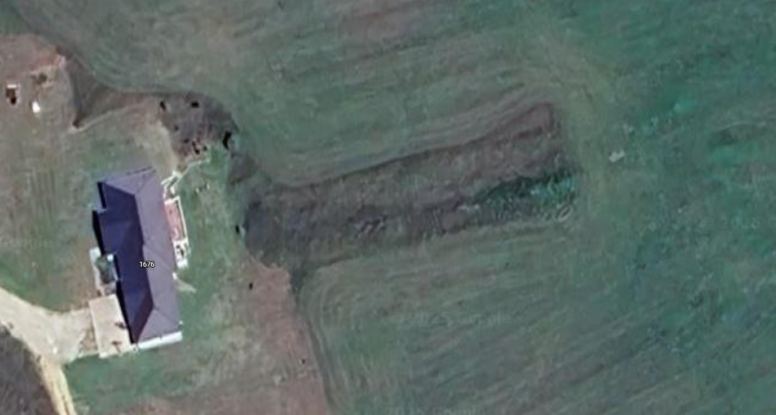
94
96
100
98

Slide 13
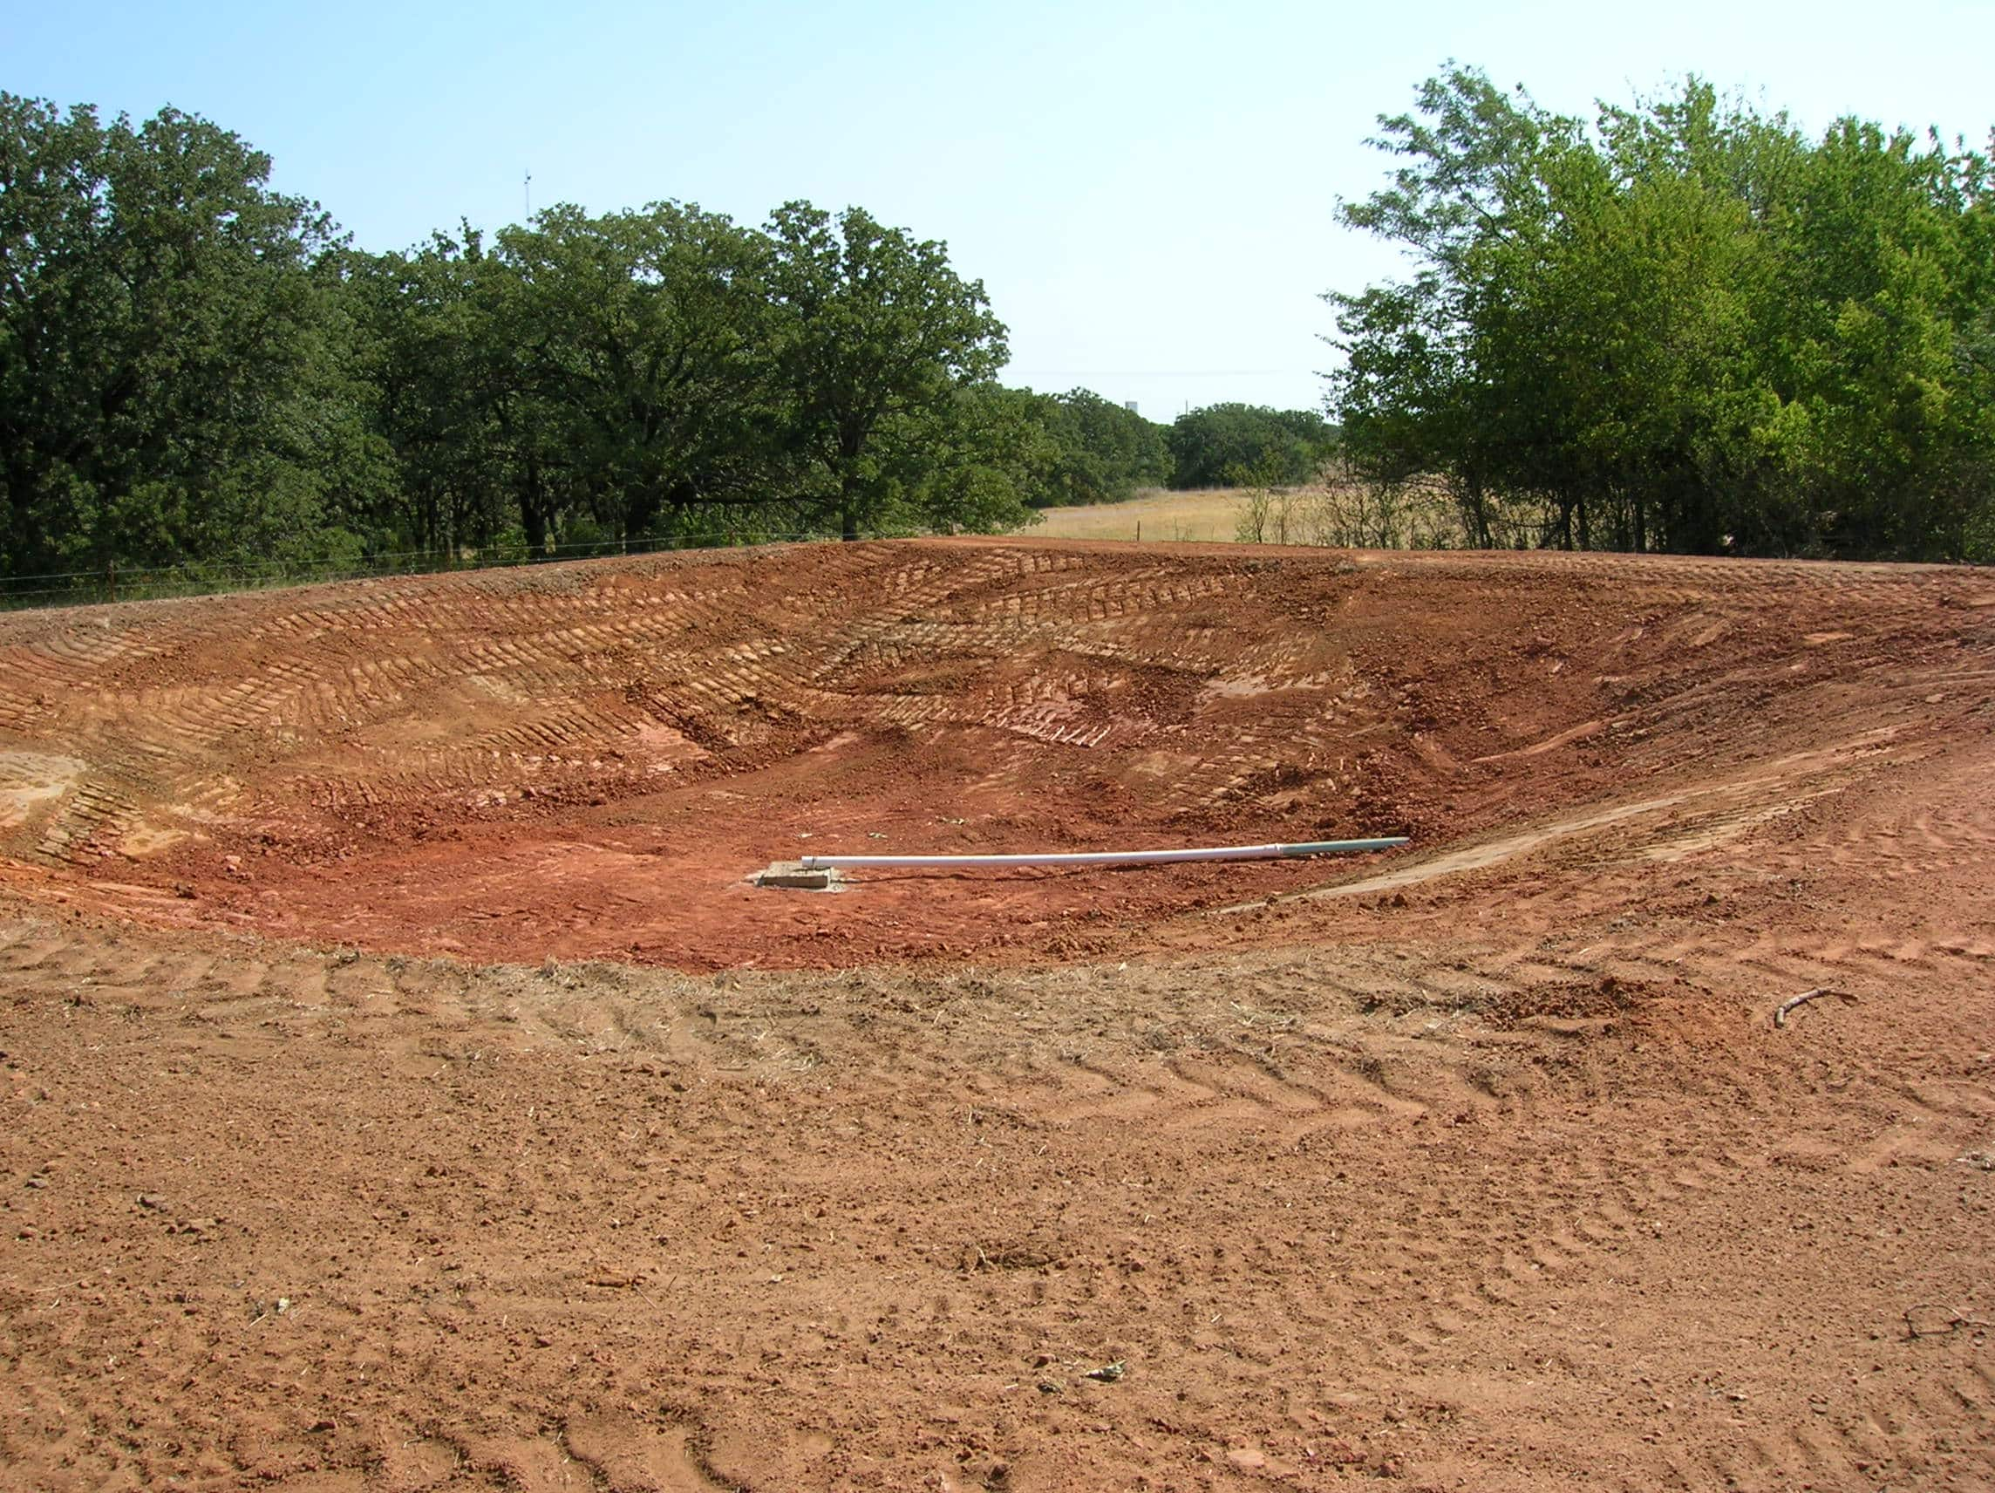
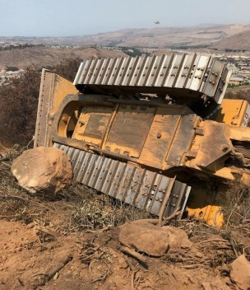

“One typically passes failure on the way to success.“
Notes:
Oklahoma lagoon installation

Slide 14
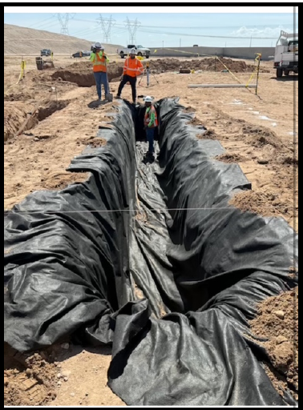
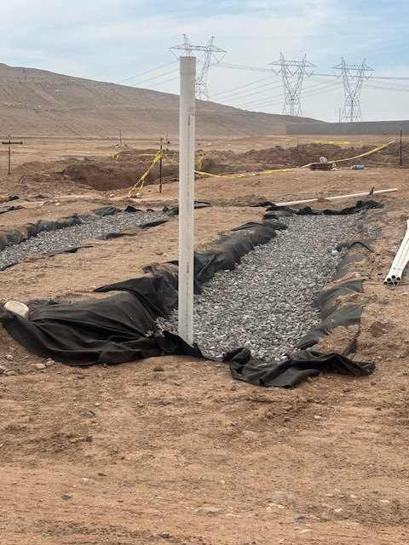
Woven landscape fabric to prevent fines from clogging the soil interface
Notes:
Minnesota?

Slide 15
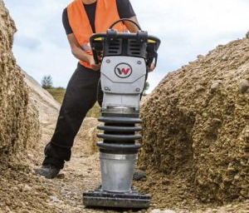
Compacting a trench so it is perfectly level
Notes:
Installer thinking that he is doing a good thing

Slide 16
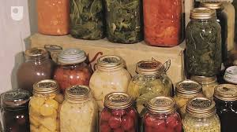
A lady called and said that she thought that a septic issue caused nearly 400 of her home-canned jars to unseal over a 12-hour period of time. They were all different types of canned goods from different canning events. The only jars that did not unseal were canned water. She was pretty sure that it was some sort of differential pressure issue from a drain trap failure that caused the break of the vacuum. She wanted to know my thoughts and if this was a common occurrence…
Notes:
Another one from MN

Slide 17
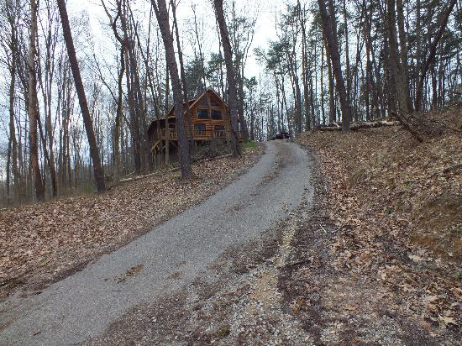
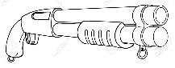

Suggest you pass on this complaint inspection
If you can read this, you’re in range

Slide 18
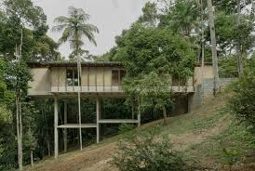
Proposed Cantilevered home
Notes:
So, no sewer available. Where does the OWTS get installed?

Slide 19
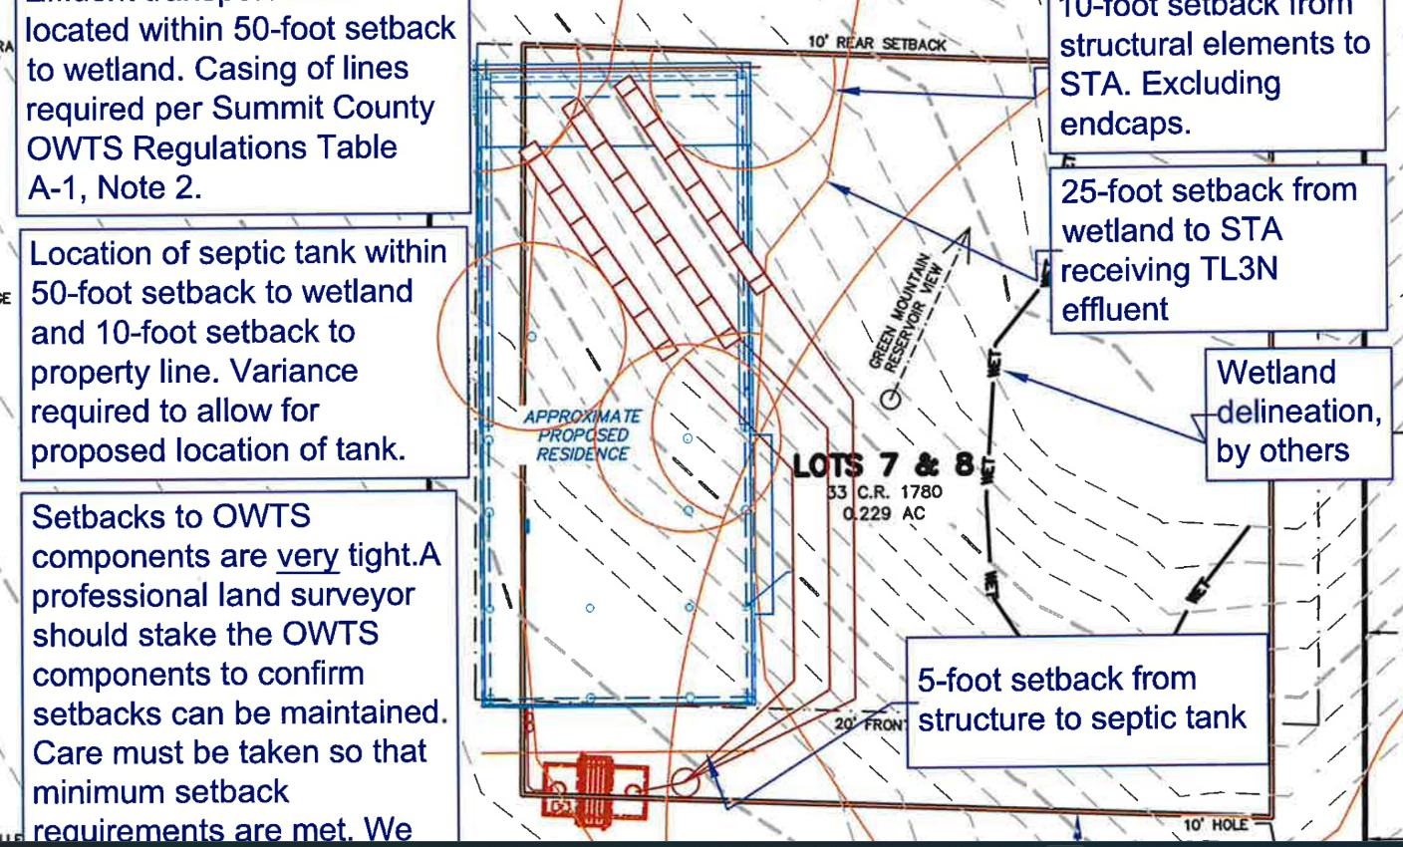
STA proposed below the home
Proposed Cantilevered home

Slide 20
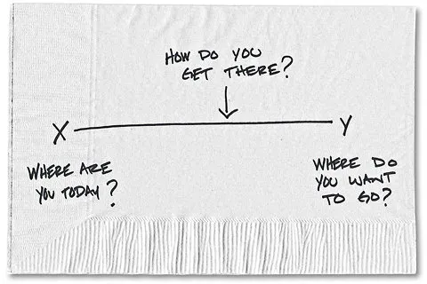
In the “Notes” section of an OWTS plan:
“In order to provide clarity, certain details have been removed”
Notes:
One of my all-time favorites!

Slide 21
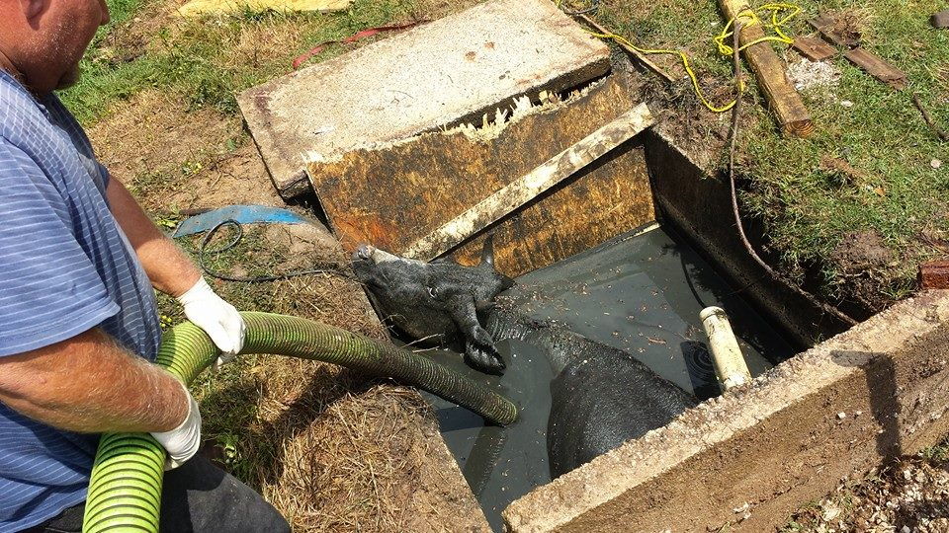
Particle board is not an adequate cover for a septic tank

Slide 22


Slide 23
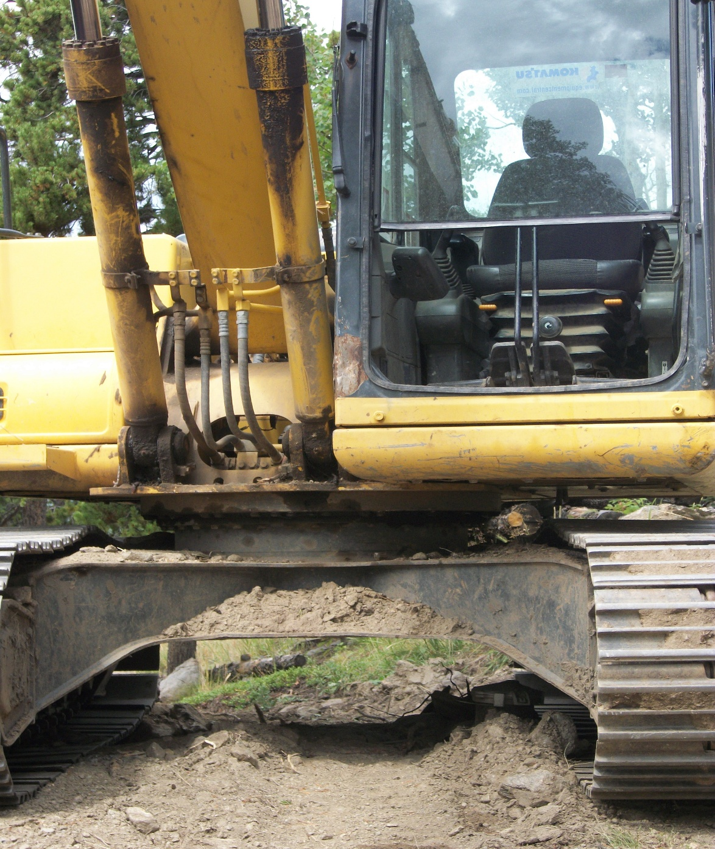

Slide 24
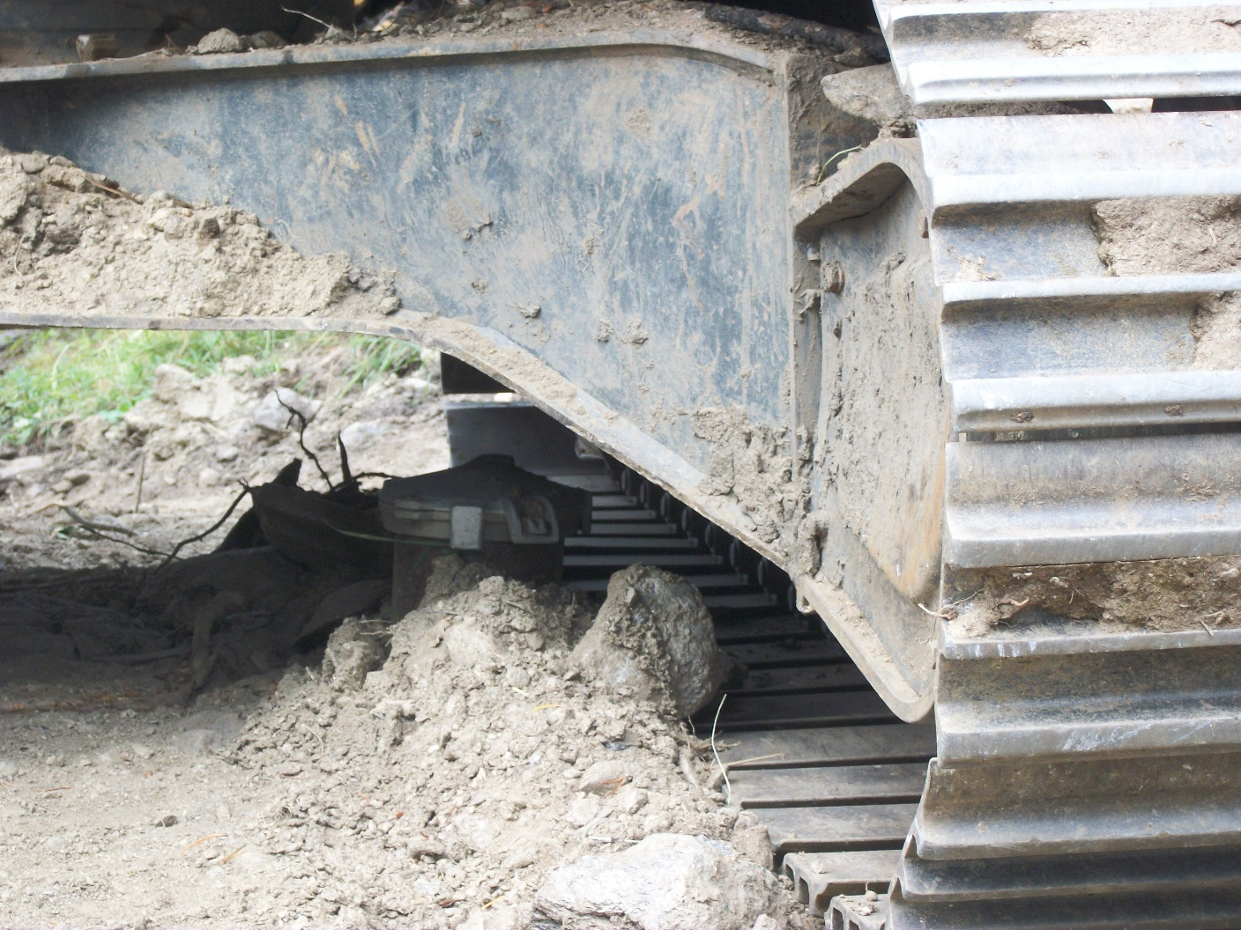
Notes:
Now, one of my favorite quotes (next slide)

Slide 25

Regulators do not like to be regulated
While reviewing county reg. submissions

Slide 26
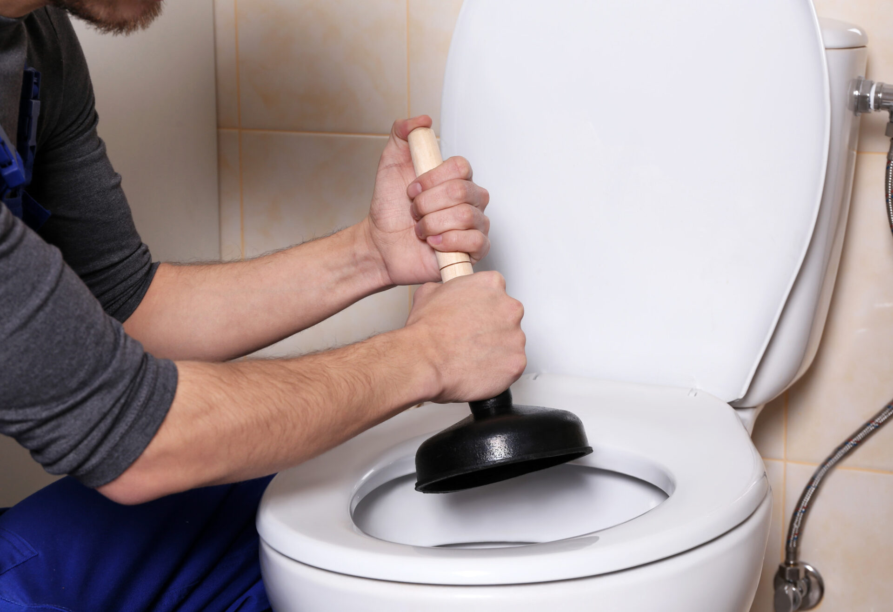
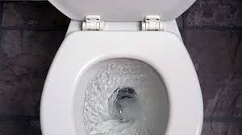
Where does our sewage go?
Away!!
Notes:
When you ask the homeowner, do you know where your sewage goes?
BTW, I think this guy needs a longer plunger

Slide 27
How is “Failure” defined in Colorado?
"Failure" (Reg. 43) means a condition existing within any component of an OWTS which prevents the system from functioning as intended, and which results in the discharge of untreated or partially treated wastewater onto the ground surface, into surface water or ground water, or which results in the back-up of sewage into the building sewer. Other conditions within an OWTS component that are deemed by a local public health agency to be a threat to public health and/or safety may also be deemed a failure.
Notes:
So, what causes a system failure?

Slide 28
When an OWTS fails, the H.D. says:
The system is >15 years old, so that’s about average
The system was less than 15 years old;
The system was not properly maintained
The homeowner abused the system
Could have been poor construction practices

Slide 29
When an OWTS fails, the Installer says:
The system is over 15 years old, so that’s about average
The system was less than 15 years old;
The system was not properly maintained
The homeowner abused the system
Must not have been properly designed

Slide 30
When an OWTS fails, the Homeowner says:
I thought that I was connected to the city sewer
I thought that these things lasted 50 years
The system must not have been properly designed
The system must not have been properly installed
Who’s going to pay to fix this?

Slide 31
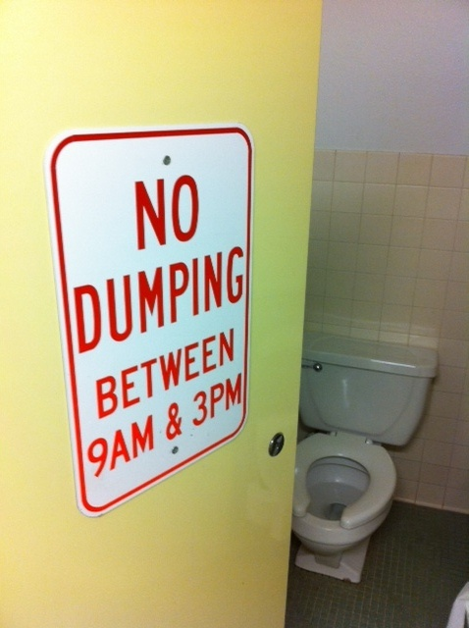
And remember… We must understand that from the perspective of most homeowners, when they flush, it should just go ……..
AWAY

Slide 32
What needs to occur to prevent system failure:
Proper site evaluation
Proper design
Proper installation
Thorough inspection
Proper grading/landscaping
Proper use by the homeowner
Proper operation/maintenance
Record retention

Slide 33
Roll of the “Trained Professional” (System Designer)
Preferably experienced, trained professionals; with,
Understanding of basic onsite design principals
Awareness of regulatory requirements
Awareness of design options; proprietary products
The Designer must “design” the system. It should not be up to the installer or homeowner to figure out how or where the system should be installed

Slide 34
Roll of the “Trained Professional” (System Installer)
Understand the system/components being installed
Ask questions if something does not make sense
Prior to installation
Pre-construction meeting
Get everyone on the same page
Continued communication; Regulator, Eng., Homeowner
Because…….. What could possibly go wrong?

Slide 35

Crazy situations that I’ve come across; and other “WTF” moments
Notes:
So again, I was asked what crazy things I came across during my career:
Pesci: Tales from the Crypt movie – basically says, “WTF is this POS”
Each of the following can obviously cause system failure

Slide 36
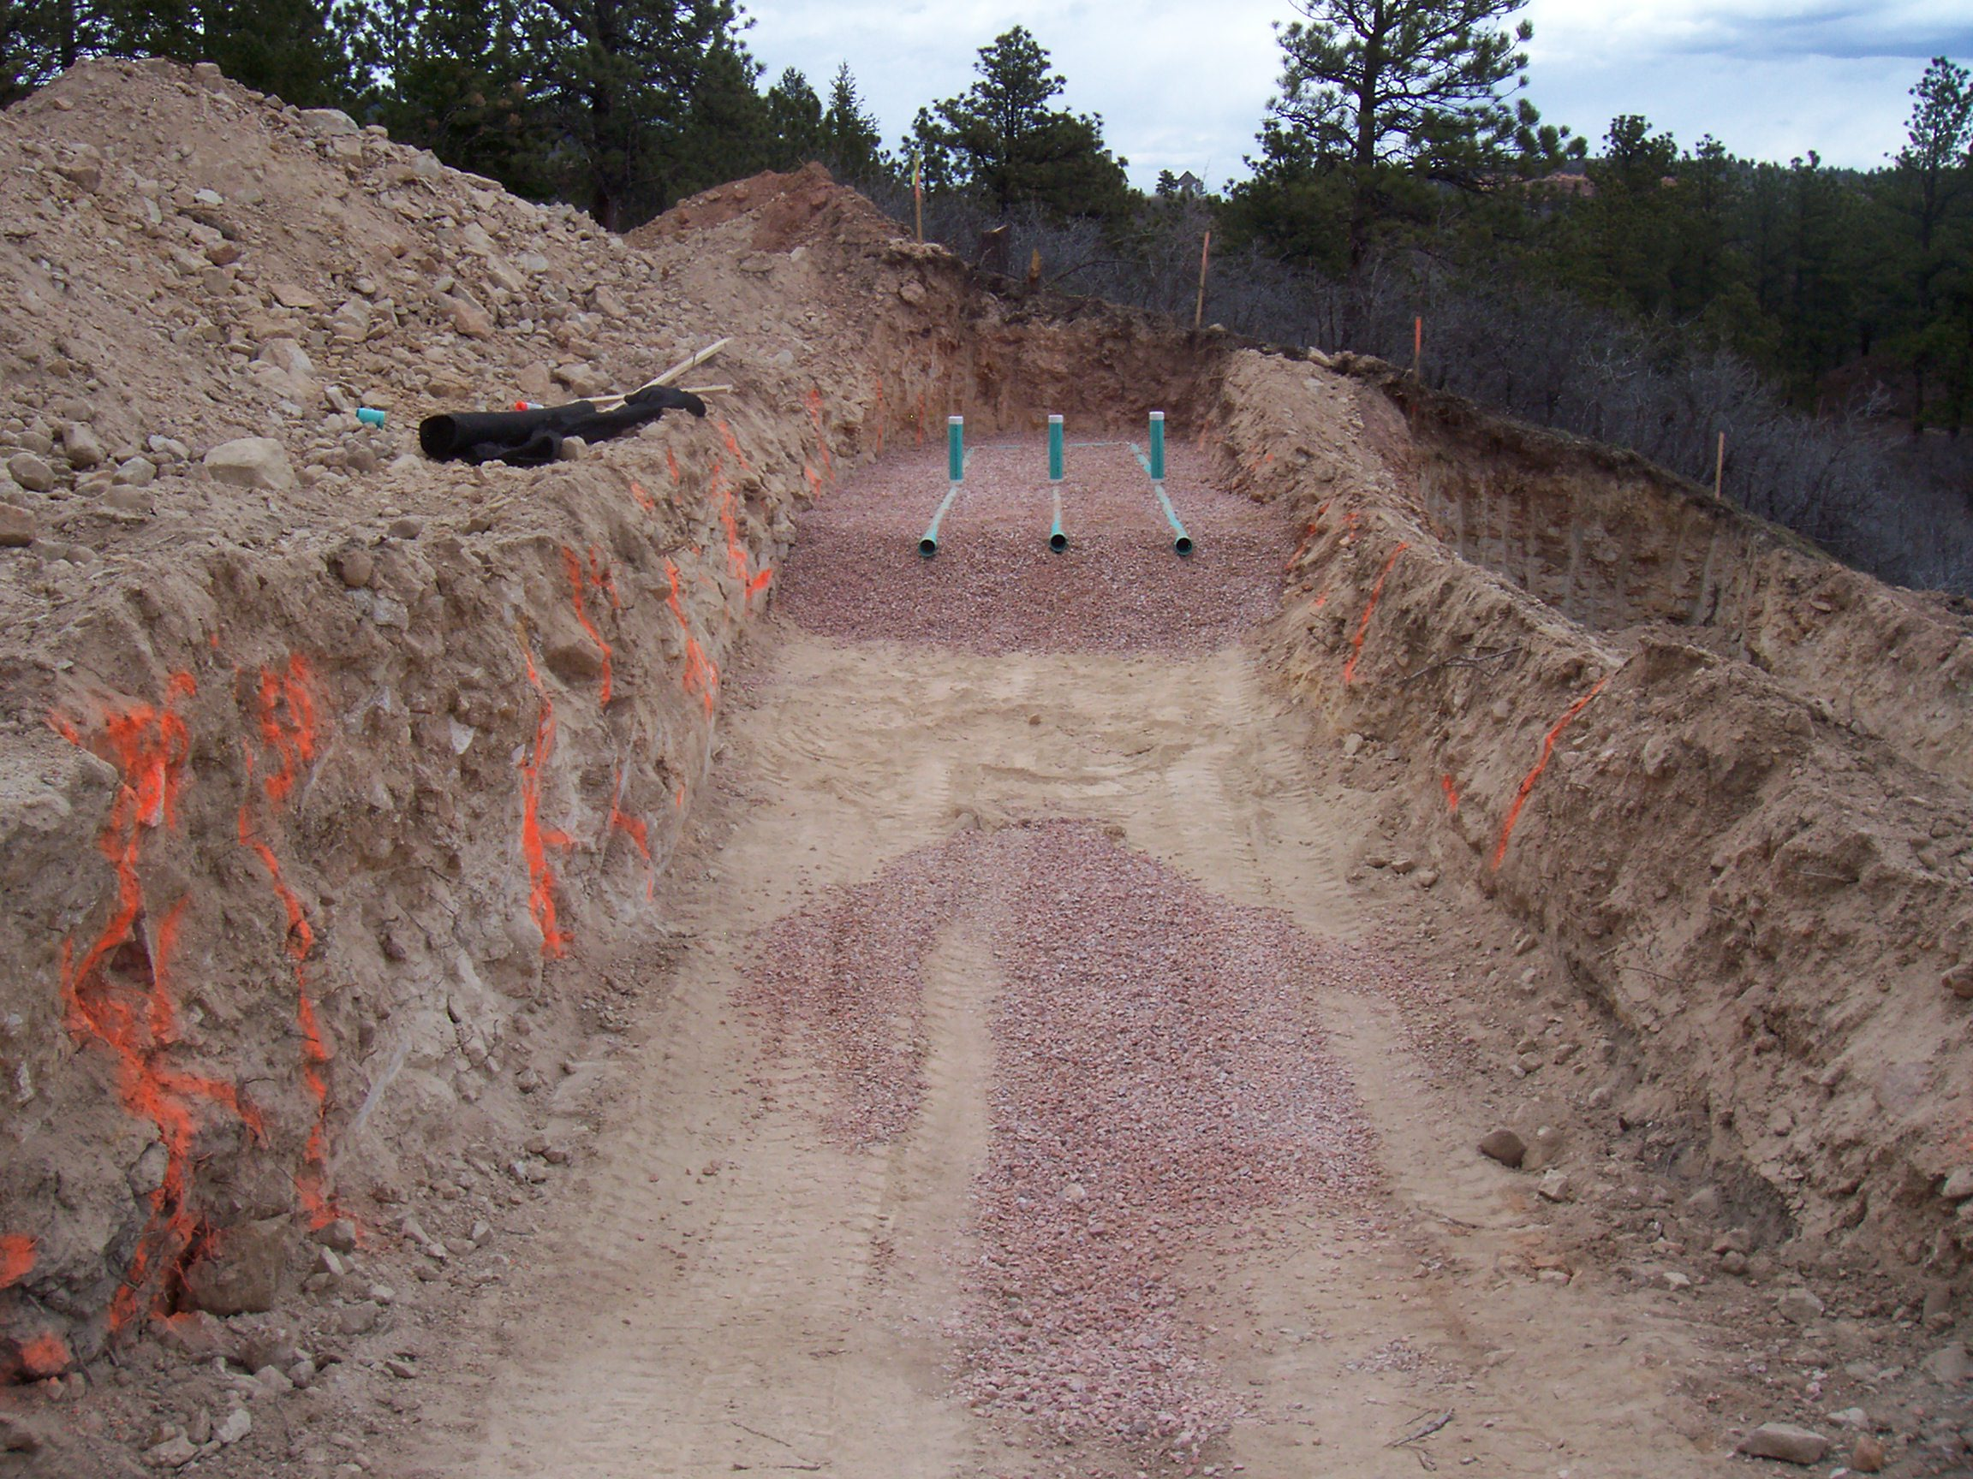

Notes:
Compaction of infiltrative surface

Slide 37
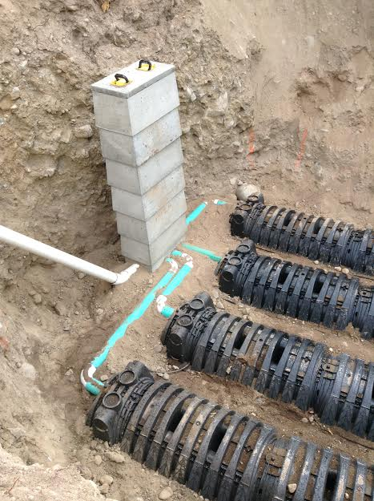
Notes:
Infiltrative surface >6’

Slide 38
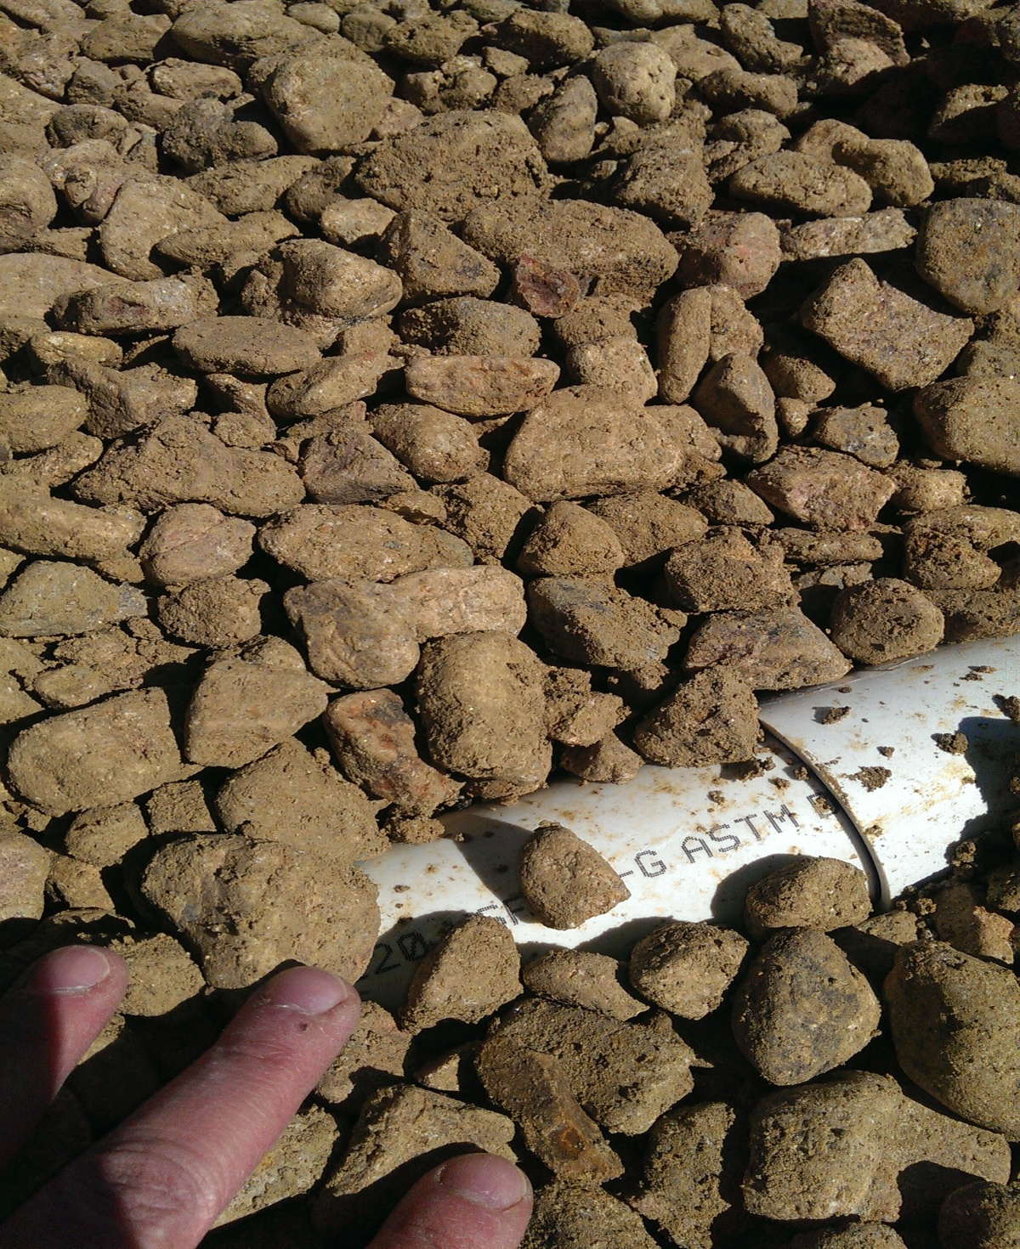
Notes:
Dirty stone

Slide 39
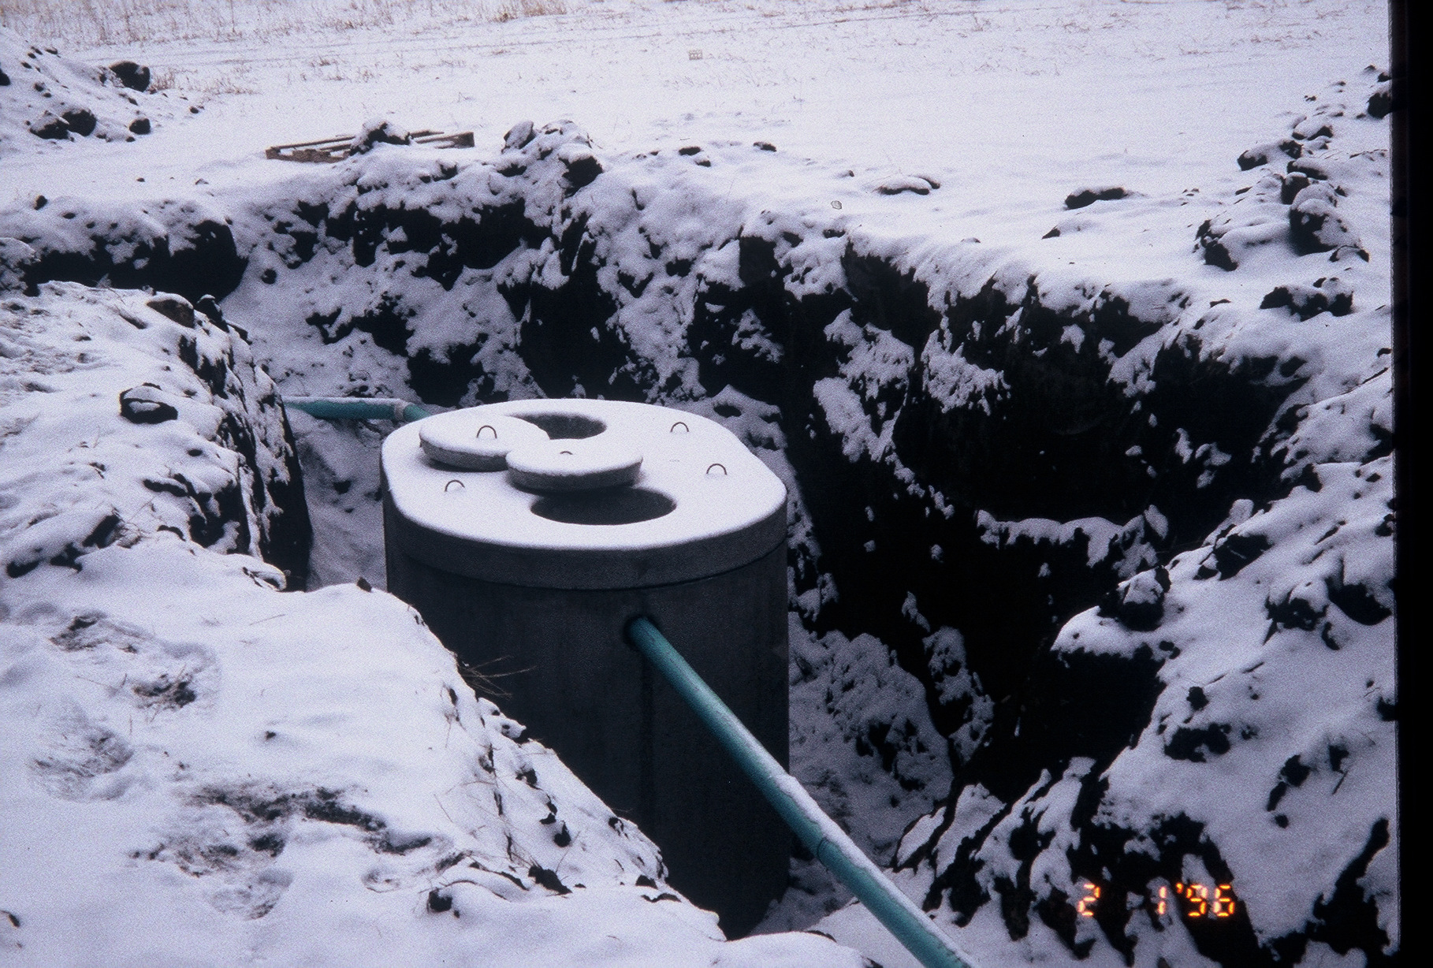
Notes:
Piping improperly bedded

Slide 40
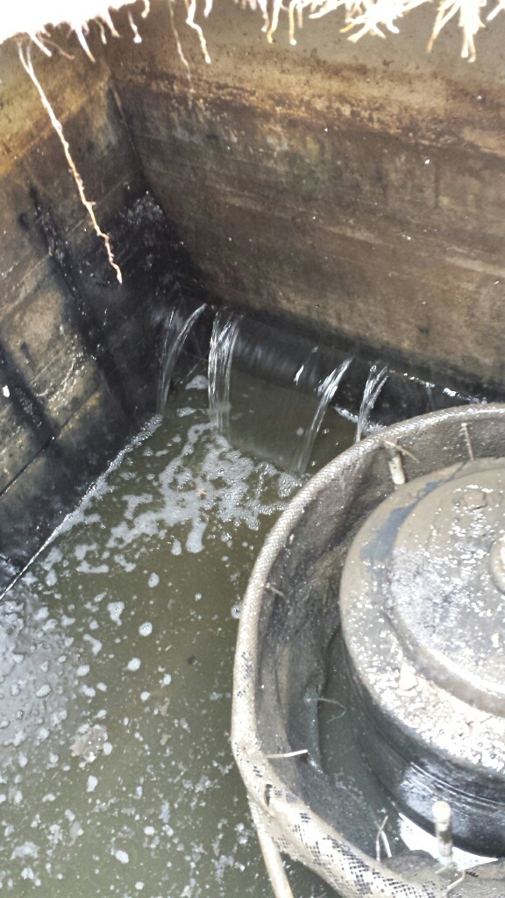
Notes:
First comp. of a tank leaking into the 2nd comp/PC

Slide 41
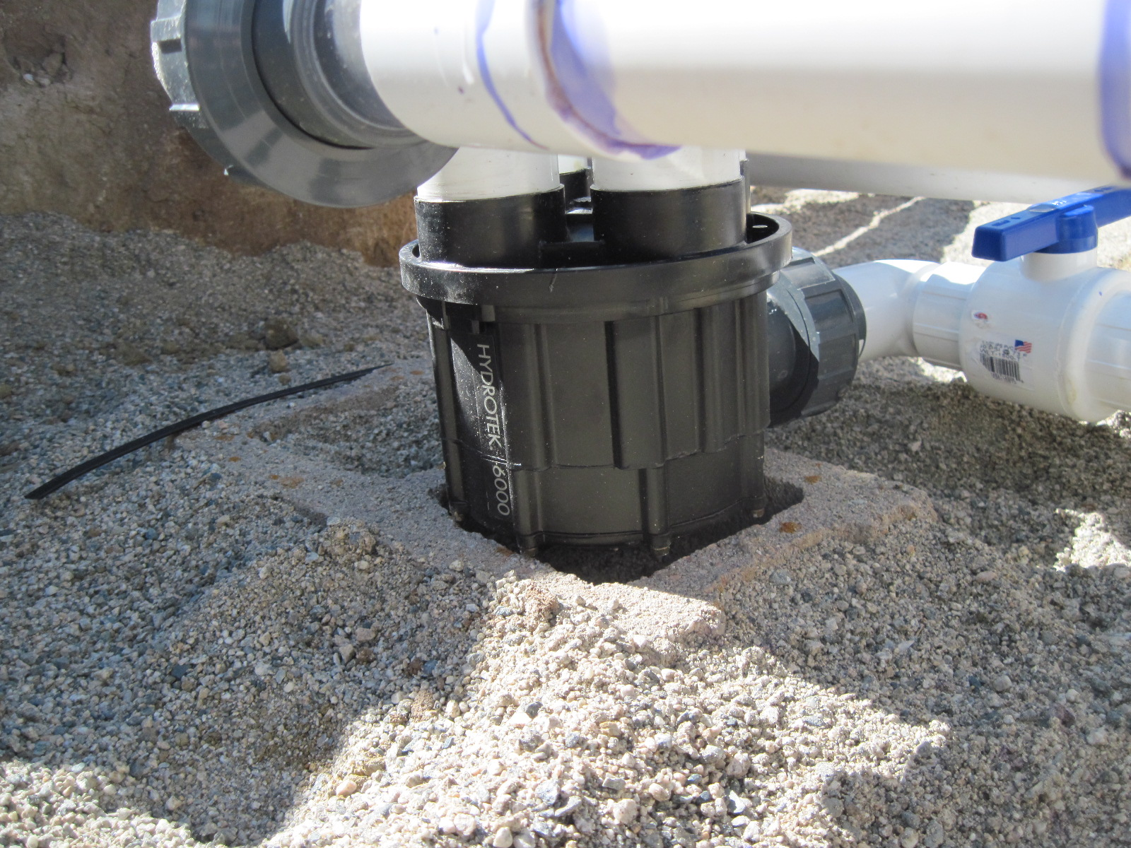
Notes:
Up-side-down ADV

Slide 42
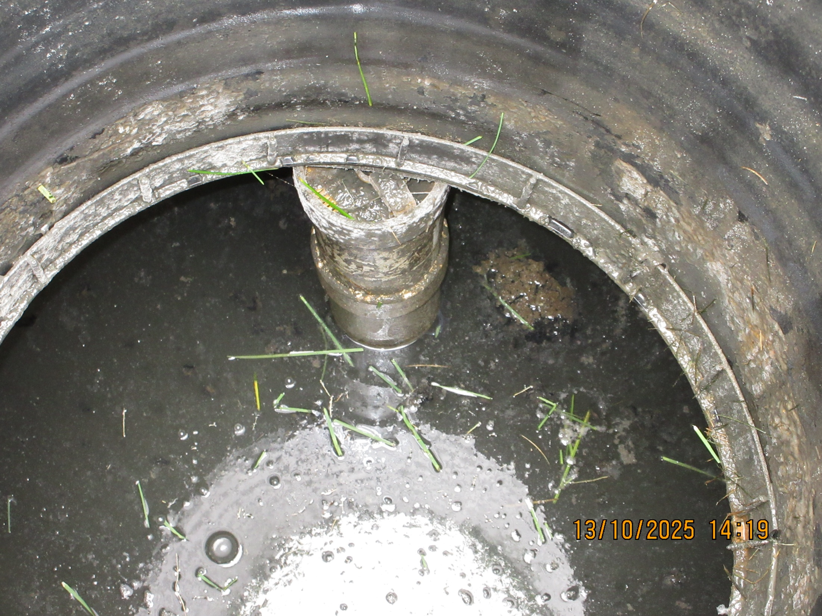
Notes:
Effluent filter; impossible to remove.
Placed in tee prior to installation?

Slide 43
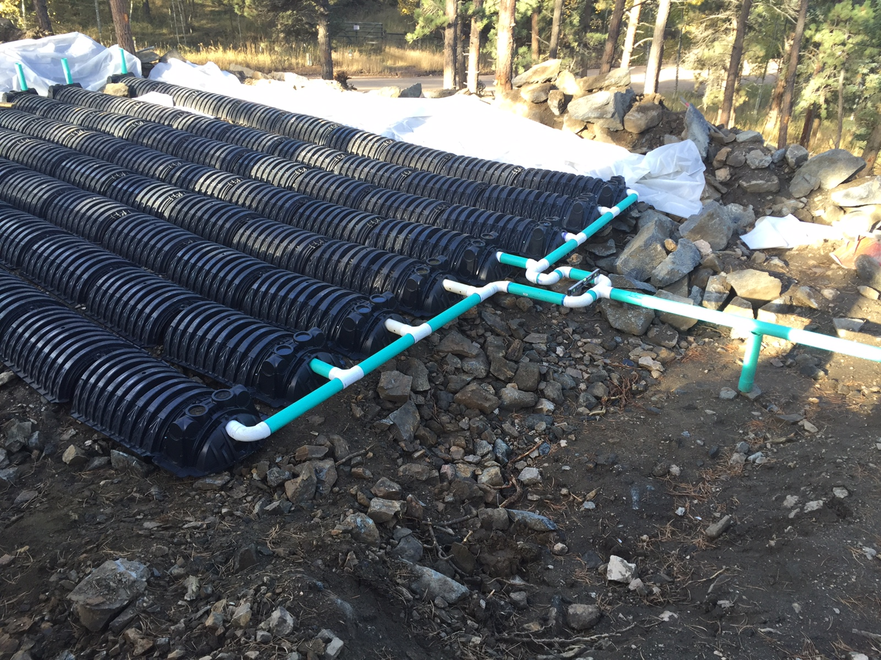
Notes:
Where do I start with this one?

Slide 44
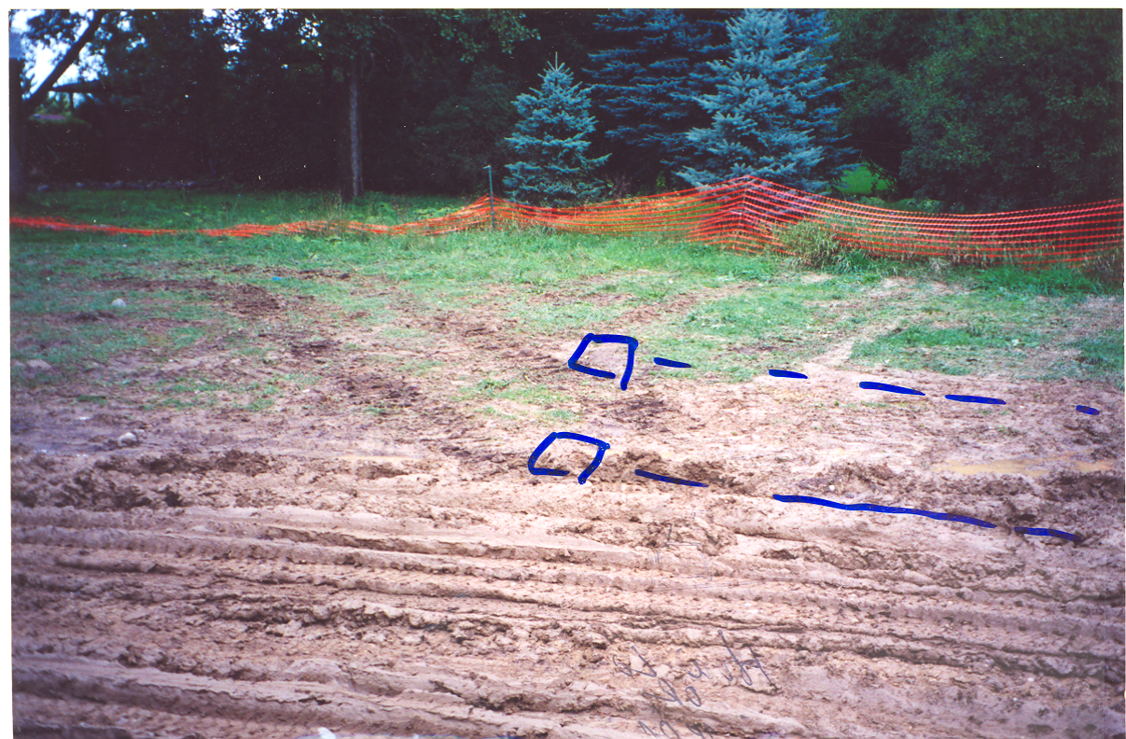
Proposed Trenches
Notes:
STA/soils compacted. Sites should be restricted to traffic

Slide 45
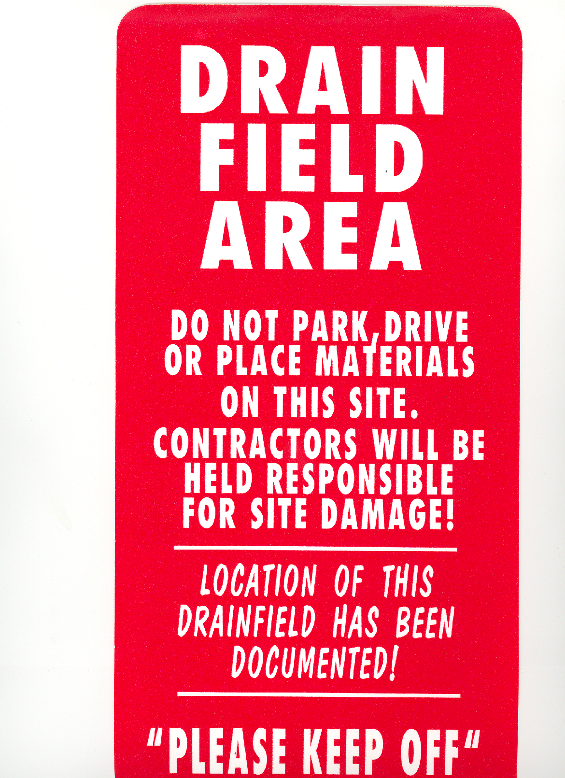
Protect the soil before, during, and after construction
Signs
Fencing
Communication with Construction Mgr. / Builder
Protect the active area, reserve area, and greenbelts!

Slide 46
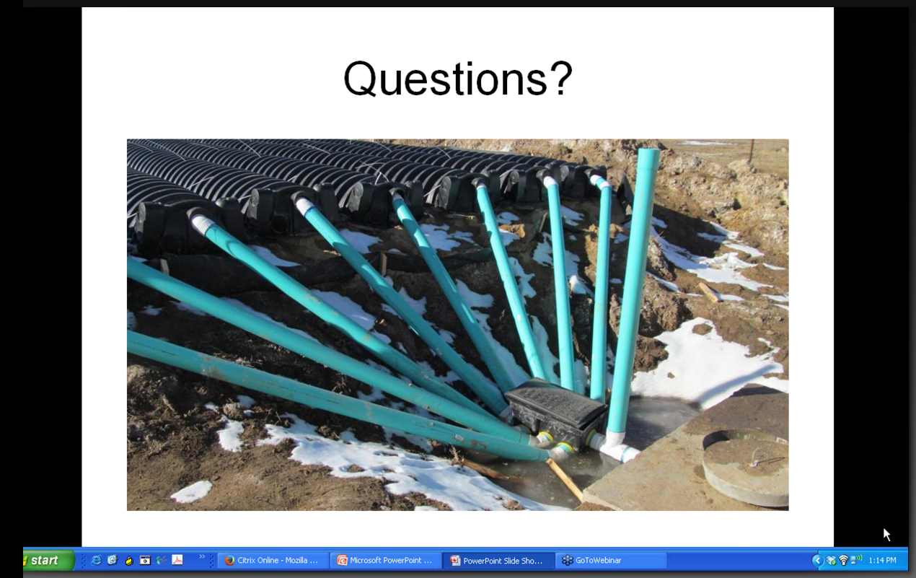
Notes:
Homeowner install; gravity system

Slide 47
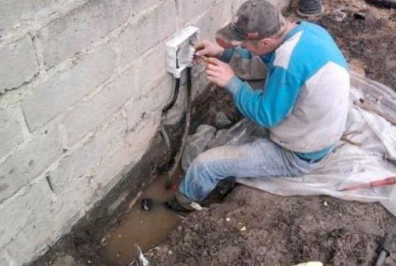
Again… What could possibly go wrong?
Notes:
Brings to mind another appropriate quote

Slide 48

“Two things are infinite: the universe and human stupidity; and I'm not sure about the universe.” ― Albert Einstein
Notes:
And speaking of stupidity…

Slide 49
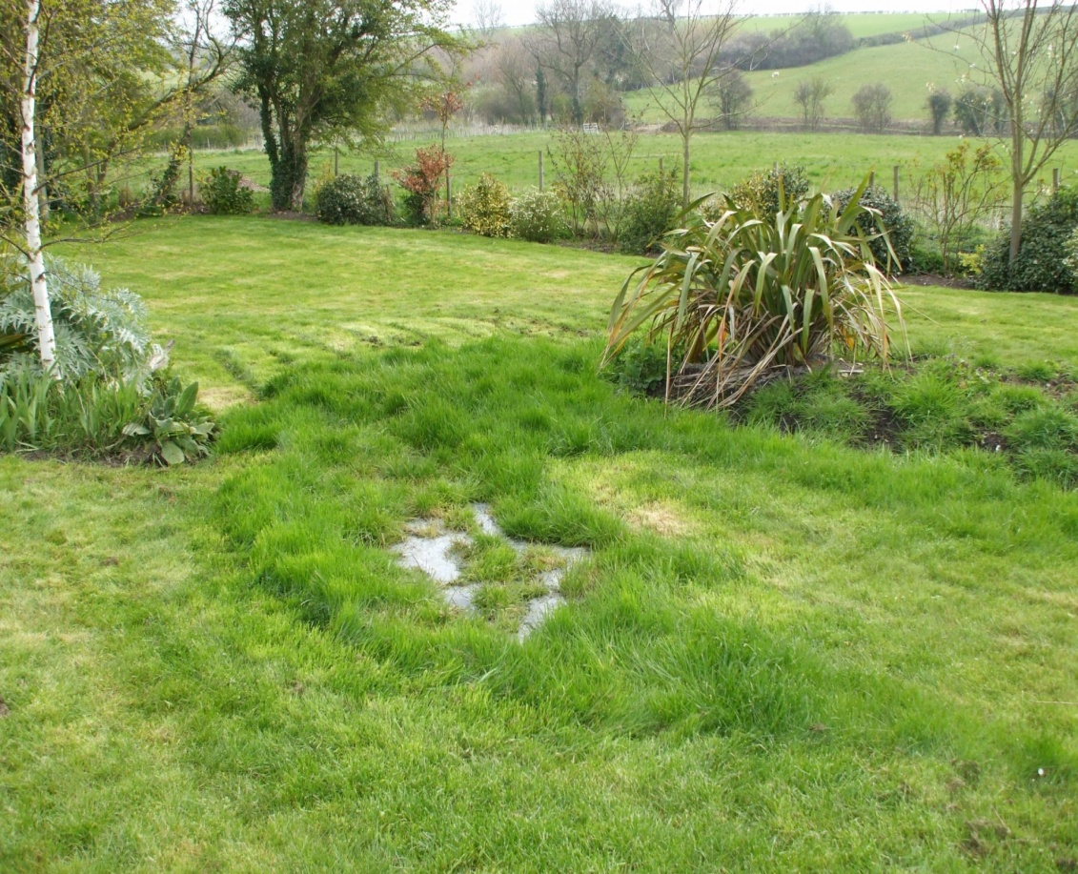
What are the “more obvious” causes of failure?
Excessive Flows
Leaky fixtures
Groundwater infiltration
Improper use
Improper design
Improper installation
High strength waste
BOD; TSS; FOG
This should be identified prior to design

Slide 50
Typical Residential Effluent Concentrations
Parameter System | BOD5 Mg/l | TSS mg/l | Fats, Oils, Grease (FOG) | Total Nitrogen (TN)
Septic Tank Effluent* | 150 -250 (180) | 40 - 140 (80) | 20 - 50 | 60 - 80
With Effluent Filter | 130 Typ. | 30 Typ. | 15 - 20 Typ. | 60 - 80
H.L.T. 5 – 30 5 – 30 80 – 95% >50%
*Increased concentrations, considered “High Strength Waste”

Slide 51
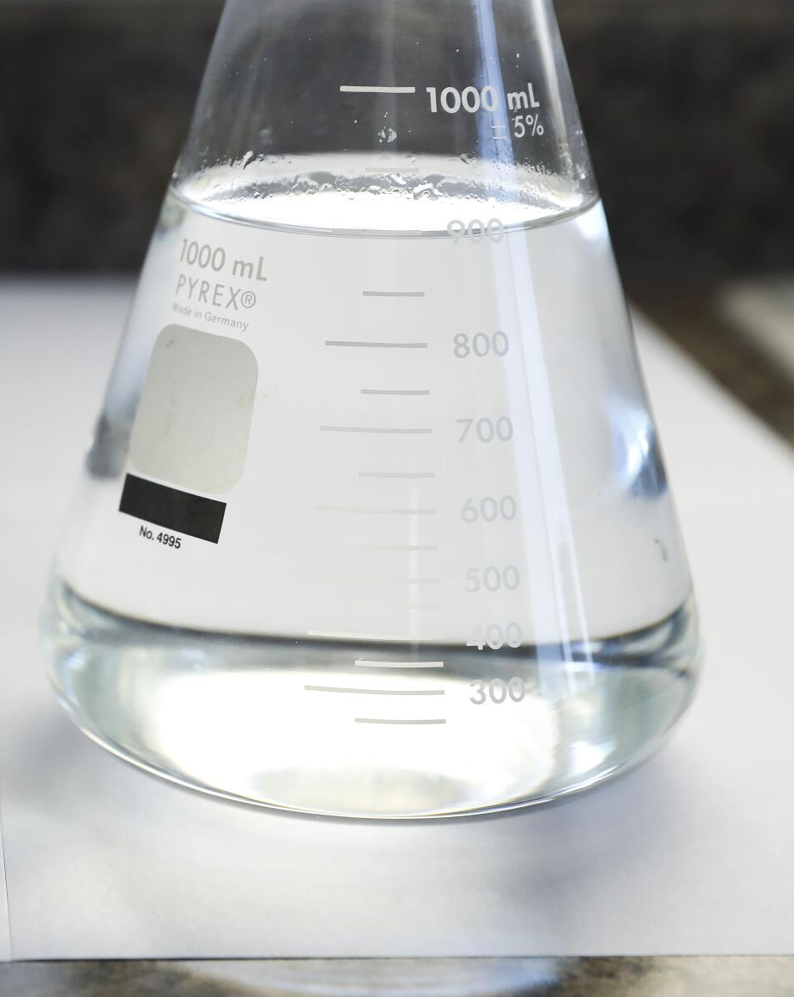
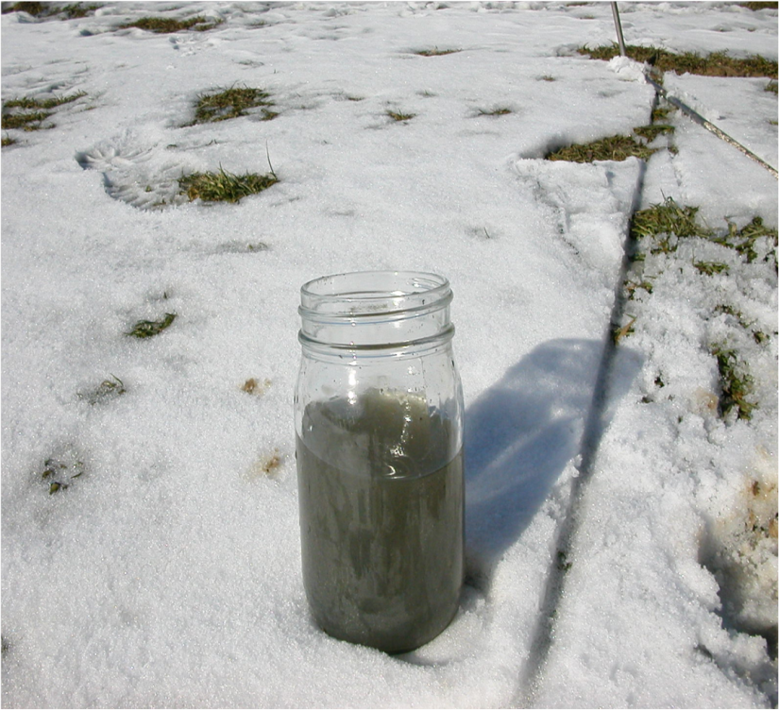
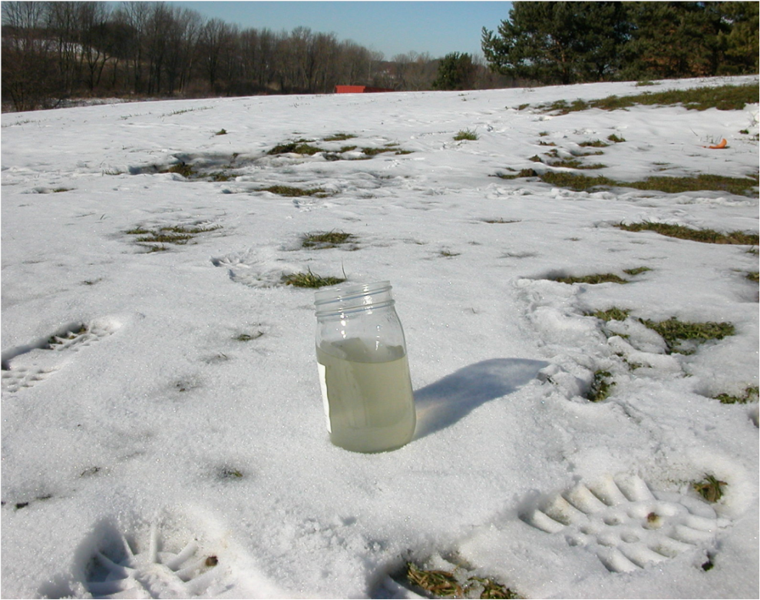
Upset Tank
Std. Septic Tank Effluent
Treated Effluent

Slide 52
High Strength Waste:
Not only in commercial food establishments, but…
Supermarkets: Typical BOD >500mg/l.; up to 2900mg/l.
Schools: Ammonia Nitrogen 4 – 5 times residential WW
Church (Large Kitchen Facilities); Restaurant strength
Vet. Clinics: TSS (hair), Chemicals, Pharmaceuticals
Dog Kennels: Hair, BOD, Nitrogen, Phosphorus > residential
Wineries: BOD (5 – 20K), TSS (up to 2500) Nitrogen (500), Low pH
Micro-breweries: BOD (2,500 – 12K), TSS, High temps, slug loading
Marijuana grow/mfgr. facilities (EPA CLV Injection Well)

Slide 53
Upcoming Slides Reference:
Onsite Installer Magazine; “Online Exclusives” Articles
Authored by:
Sara Heger
Jim Anderson
Dave Gustafson
This is a free publication; sign up!
www.onsiteinstaller.com/magazine

Slide 54
So, what are the “less obvious” causes of failure?
pH
Optimum microbial activity; 6.5 – 7.5 (not as efficient outside range)
High pH (Base: 8 – 12)
Will typically emit a chemical / cleaner odor
Detergents, cleaners, photo labs
Some municipal water supplies raise pH (9+) to reduce microbes
Low pH (Acidic: 0 – 6)
Will typically emit a very acidic odor
High dairy product use; excessive baking / home canning
Nitrification consumes 7.1 mg/l alkalinity (as CaCO3); Low alkalinity
Acidic water supplies
Notes:
low alkalinity makes water's pH unstable and more prone to dropping, alkalinity acts as a buffer to resist pH changes. When alkalinity is low, the water lacks the capacity to neutralize acids, causing the pH to fluctuate easily and become acidic

Slide 55
“Less obvious” causes of failure?
Temperature: (More of an issue w/treatment units and restaurants)
Optimum for microbial activity; 77˚ – 95˚ F
Warm temps:
Bugs more active; oxygen uptake is more rapid; need more “O”
An issue for the removal of FOG in tanks (< 80˚ F)
Cool temps:
Bugs less active <50˚ F; Become dormant, 35˚ – 39˚ F
Significant effect on nitrification; nitrifying bacteria grow slower
Pseudomonas, Micrococcus
Notes:
The waste degrades more quickly at warmer temperatures, so it does not be held in the treatment system as long when it is warm.
The converse is also true: In the winter, oxygen uptake is low and air need not be supplied as fast. However, the waste takes longer to degrade, and therefore needs to stay in the treatment system longer during cold months.
The practical implication of this is that aerobic treatment unit processes should be designed using summer temperatures, and detention tanks should be designed using potential winter temperatures.

Slide 56
“Less obvious” causes of failure?
Laundry:
High water use fixture (second to toilets)
Lint (no known technical studies):
Most is non-biodegradable (synthetic fibers, nylon, polyester); may clog soil interface
Found to be common in effluent from municipal WWTP
Physical filter on the discharge line greatly reduces lint volume

Slide 57
“Less obvious” causes of failure?
Laundry / Detergents:
Typically contain petroleum based surfactants, enzymes, bleaches, fragrances (synthetic petroleum compounds)
Surfactants are typically not a risk to groundwater due to strong soil sorption; they attach to soil particles
Anionic surfactants have poor anaerobic degradability in septic tank possibly causing accelerated accumulation of solids

Slide 58
“Less obvious” causes of failure?
Laundry / Fabric Softeners:
“Quats” are most common softening products
Quats have anti-bacterial qualities
Overuse may affect biological activity in both the septic tank and soil treatment area
Reduce effectiveness of secondary treatment systems
Notes:
Chemical compounds electrically charged causing threads to “stand up”, causing fabric to feel softer;
Quats are harmful in the nitrification process;

Slide 59
“Less obvious” causes of failure?
Assisted Living Facilities
Pharmaceuticals, Detergents, Cleaners, Anti-bacterial
Solids typically low; residents wearing adult diapers
Overuse of all products is real
Excessive use of wet wipes (disposable cloths)
Excessive water use; ~125 gpd/user
Prevents settling in tank
Increase the gpd applied to the soil treatment area
High volume of laundry use; Items previously discussed

Slide 60
“Less obvious” causes of failure?
Dialysis:
Waste products should not be disposed in septic system
Hemodialysis: has a high concentration of sodium and chloride which can alter or kill organisms. May also negatively impact concrete tanks
Peritoneal Dialysis: has a high glucose concentration forming a copolymer that can coat soil peds and distribution laterals
Patients are also told to follow disposal of waste with a full cup of bleach to address viruses and bacteria
Both types negatively effect beneficial microbes
Notes:
Dialysis assists in kidney failure by removing waste and extra fluid from the blood; additional flows of up to 100 gallons/week

Slide 61
“Less obvious” causes of failure?
Pharmaceuticals: (Chemicals of Emerging Concern – CEC’s)
Groundwater issues
Possible long-term environmental and health effects
Research is limited
Trace levels of constituents; typically in ppb
Very difficult to determine the actual level of treatment
Best removal of CEC’s occurs with:
Shallow system profiles (Active biological treatment zone)
Pressure distribution (Unsaturated flow; available oxygen)
Notes:
Wastewater in groundwater can be traced by testing for caffeine

Slide 62
“Less obvious” causes of failure?
RV Waste Disposal:
Formaldehyde (recognized as a probable carcinogen)
At one point, the most widely used chemical; mixed with methyl alcohol; however use is decreasing
Kills / retards bacterial growth; used as industrial disinfectant
Is most toxic to anaerobic, sludge digesting organisms
Strong inhibitor to all micro-organisms
Notes:
blue colored and perfumed

Slide 63
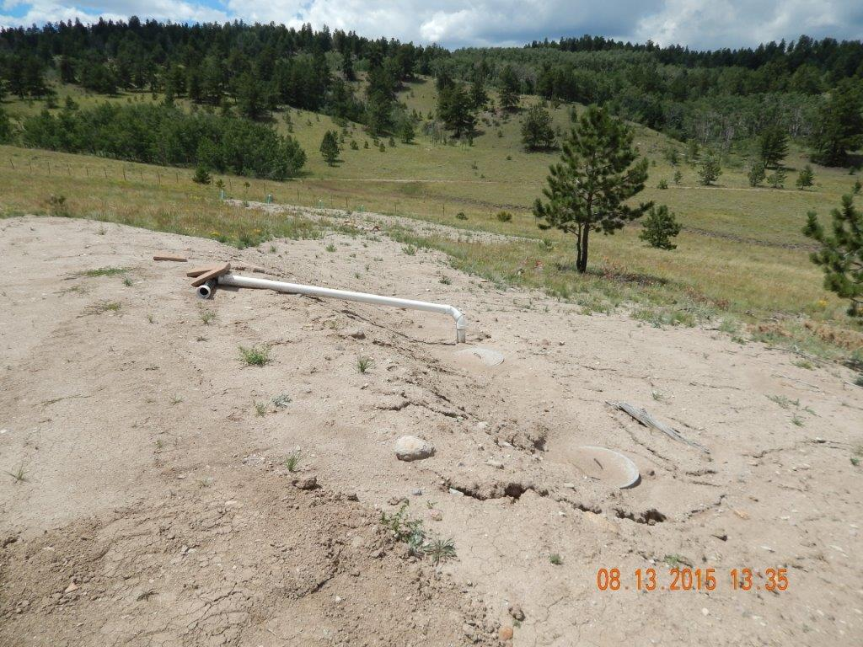
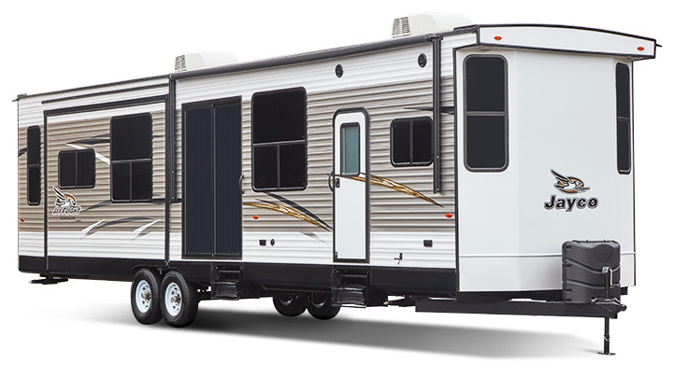
?
STA
Septic Tank

Slide 64
“Less obvious” causes of failure?
Iron Filters:
Used to address taste, staining and accumulation issues
Process: oxidation followed by filtration
Filters are backwashed with 150 – 200 gallons, 1 – 2x/week
Additional solids accumulation in tank; settle out in sludge
150 – 200 gal. creates turbulence in tank
Iron precipitate may clog distribution system piping
Connect to drywell (w/water softener)
Notes:
Oxidation converts soluble contaminants during a chemical reaction to soluble byproducts or insoluble products that can be filtered.
Insoluble iron is converted to soluble iron, then back to insoluble in aerobic env.

Slide 65
“Less obvious” causes of failure?
Grinder Pumps:
Grinds sewage into smaller particles; lifts to tank
How to address grinder pumps
Small dose volume; Deliver effluent to sewer pipe
Increase tank capacity by 500 gal.; multiple compartment
Effluent screen w/alarm required
Inspect tank every 2 – 3 years; depending on pump use
Notes:
Use only for lower level if possible; gravity main floor

Slide 66
“Less obvious” causes of failure?
Tank deterioration:
Hydrogen sulfide gas; produced naturally by anaerobic bacteria. Can be enhanced by high-sulfur water supply
Combined with moisture and air, forms sulfuric acid
White crumbling concrete, or rusty streaks (when it has reached the reinforcing rods)
Is venting to roof stack and within tank clear? Obstructions or belly in sewer line
Root cause of the problem has not yet been defined; studies continue
Safety concerns; top, lids, concrete tees
Notes:
Baffles may decay and fall off; 2nd comp. more prolific; Bowed sewer line preventing gasses access to roof vent

Slide 67
Final Thoughts:
Conduct site evaluation as if you had to design it
Design it as if you had to install it
Install it as if you had to use it
Inspect it as if it belonged to your family
Use it as if you have to pay for the replacement

Slide 68

Parting Thoughts:
Over the years,
I’ve learned that:
People may forget what you said
People may forget what you did
But people will never forget how you treated them

Slide 69

Again, What Could Possibly Go Wrong?

