Slide 1
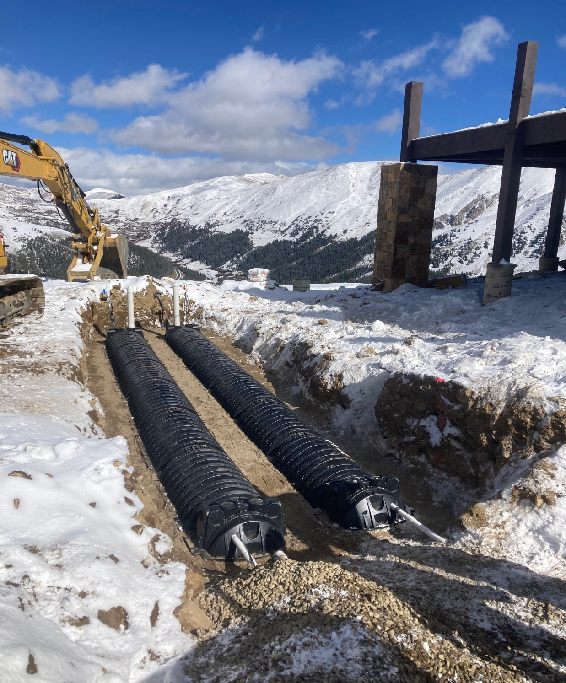
CPOW, 2026
OWTS in Colorado
&
Regulation 43 Update
Steve Prosise, REHS
CDPHE\WQCD,
OWTS Coordinator

Slide 2
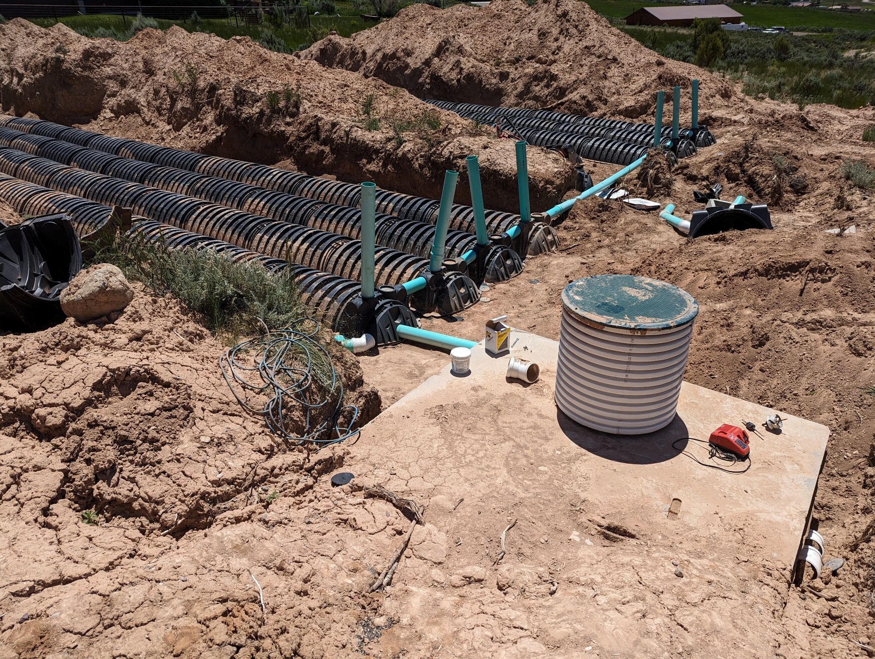
This is why we are here
Notes:
Others much higher….

Slide 3
What is the CDPHE Role for the OWTS Program?
OWTS Coordinator; point of contact for assistance and guidance to local agency regulatory staff, the private sector (engineers, installers, etc.), general public
Develop the state’s OWTS requirements, (Regulation 43)

Slide 4
What is the CDPHE Role for the OWTS Program?
➢ Provide guidance documents and clarification statements to ensure that the OWTS regulations are properly and consistently applied across Colorado
➢ Provide OWTS technology reviews for proprietary products (septic tanks, treatment systems, etc.) for sites ≤ 2,000 GPD

Slide 5
Local Regulatory Agencies
58 local OWTS programs covering all 64 counties;LPHA (Env. Health), Bldg. Dept., Land Use
Must develop local regulations that are at least as stringent as Regulation 43.Within one year of Reg. 43 effective date
Administer all aspects of the OWTS program; permitting, inspections, enforcement, file maintenance, etc.

Slide 6
  CDPHE OWTS Webpage
    Cdphe.Colorado.gov/OWTS
      Local agency OWTS program information
      Product acceptance lists
      Regulation 43 policies and clarifications
      OWTS industry related links
      Guidance documents
Notes:
Policy 6 – OWTS act – Mound docs – Sodic soils – NDDS – Time dose – sand gradation - wildfire

Slide 7
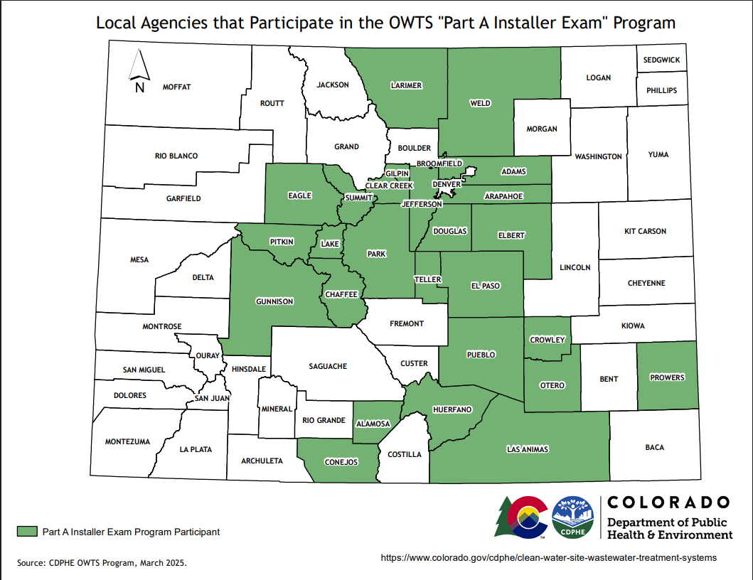

Slide 9
  Guidance documents
    OWTS Act
    Mound system design guidance document
    Mound system design spreadsheet
    Sodic soil guidance
    Timed dosing guidance
    Policy 6; multiple OWTS on one parcel
    NDDS design document (CPOW)

Slide 10
  Guidance documents
    OWTS plan review checklist
    Evaluating sand gradations
    Sand gradation spreadsheet
    PVC pipe; informational document
    Discharges from marijuana facilities
    Power outage – OWTS guidance
    Post wildfire- OWTS guidance
    Post Flood- OWTS guidance

Slide 11
Water Quality Program Mgr. Group
  Currently over 100 members
  Quarterly remote meetings
    Discuss a wide variety of water related topics (majority being OWTS)
  Google group; listserv
  Discuss and publish documents related to specific topics as appropriate
  Has also created several subgroups

Slide 12
  Published documents:
    Transfer of Title program development
    Septage survey
    Part A exam development
    Higher Level Treatment program development
    Sharing of permit forms, etc.

Slide 13
  What else is happening?
  EPA, NAWT, NOWRA were involved in a study regarding septage disposal. Concerns over reduced options nationwide.
      Recently released a whitepaper on this.
  Local Colorado group working to support a piece of legislation that would create a loan/grant program for OWTS major repairs for replacements for low-income residents throughout Colorado.

Slide 14
  What else is happening?
    CPOW has updated the “Design Class” NAWT has updated the “Inspector Class”
    2026 NOWRA Mega-Conference; Westminster CO. (Oct. 25 – 28)

Slide 15
How busy are we; you? Permit trends
  2019: 6105
  2020: 6574
  2021: 7620
  2022: 6880
  2023: 5761 (almost equal to 2017)
  2024: 5601 Down 3%
  2025: 5738 and up 40% HLT permits

Slide 16

Revisions to Regulation 43

Slide 17
  Key edits to Regulation 43
    Definitions
      Limiting layer (Treatment), Groundwater condition, Restrictive layer (Vertical)
      Dry gulch, Water course
    Requiring squirt height testing for pressure distribution systems prior to final approval
    Requiring the identification of “cementation class” - “rupture resistance” in soil profiles
    New req’s. to ensure soil profile test pits are promptly covered
    Engineers must be licensed in Colorado and practicing in their area of expertise.

Slide 18
  Key edits to Regulation 43
    Transfer of Title inspection req’s.
      Identify well locations
      Allowance for LPHA to require sampling(i.e.: nitrates, E. coli, etc.)
      When identified, cesspools must be abandoned
    Flow estimates in Table 6-2
    Property line setback requirement. Allow LHPA to reduce setback to 3’; Local opt-in
    Pipe standards, cleanouts; SCH40 required 5’ either side of tank (inlet/outlet)
    Sewer C/O no longer required within 5’

Slide 19
  Key edits to Regulation 43
    STA sizing req’s.
      Limited reductions for soil type 4A and 5; pressure dosing required
    STA sizing reductions for composting and incinerating toilets( 25% MAX).
    Local TOT and Use Permit programs; Local opt-in
    Preferred sand being discontinued. One definition for “imported treatment sand”
      Gradation test; now every 4 months

Slide 20
  Key edits to Regulation 43
    Major edit to Table 10-1A (Type R soils)
      Edits to “Percent rock and Soil type” identifiers (R-0, R-1, R-2, R-3)
      New categories for “Fractured” (FBR) and “Deteriorated” (DBR) bedrock
        Table 10-1B - LTAR in FBR
        Table 10-1C - “Excavation difficulty”

Slide 21
  Key edits to Regulation 43
    Treatment Level 3ND added
      Allows for disinfection systems to be installed following TL3N (O/M – LPHA oversight program req.)
      One foot vertical separation req. to limiting layer

Slide 22
  Key edits to Regulation 43
    Major edit to Mound system design req’s.
      Varied application rates for imported sand vs. in-situ soil
      Identifying different mound types
        All above grade
        Imported sand both above and below
        Distribution media both above and below

Slide 23
  Key edits to Regulation 43
LPHA may add up to 50 gallons per day per bed when there are provisions for more than 2 people.
Cellular or foam core type piping may not be used in pressurized systems
Bottom of control panels must be at least 30” above grade.
LPHA’s may permit portable chemical toilets
Surcharge $$ amount is recommended to be removed

Slide 24
  REGULATION 43;
    Adopted consolidated redline and submittal documents were sent out in May, 2025.
      Counties and jurisdictions have 12 months from the effective date (June 15, 2025) to adopt local regulations.
      Its is recommended to adopt before busy season.

Slide 25
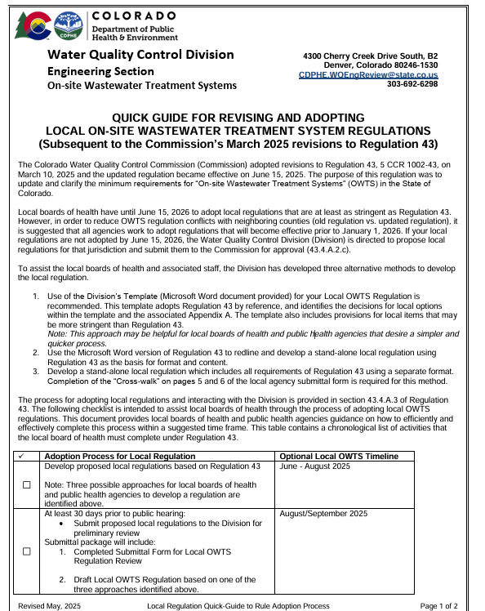

Slide 26
Adoption Process-Option 1
Division’s Template for your Local OWTS Regulation – Recommended.
  Adopts Regulation 43 by reference, and identifies the decisions for local options and the associated Appendix A.
  Note: This approach may be helpful for local boards of health and public health agencies that desire a simpler and quicker process.

Slide 27
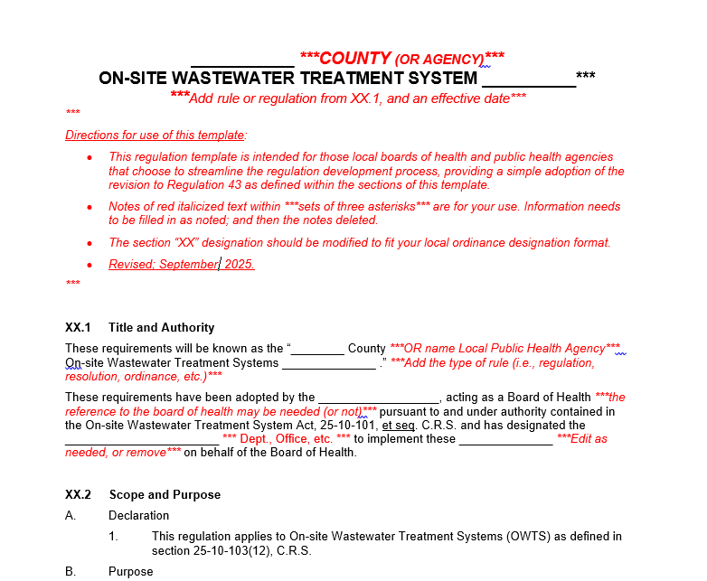
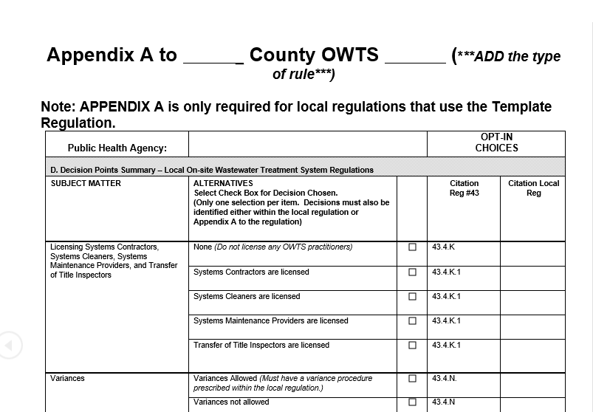
Template and Appendix A

Slide 28
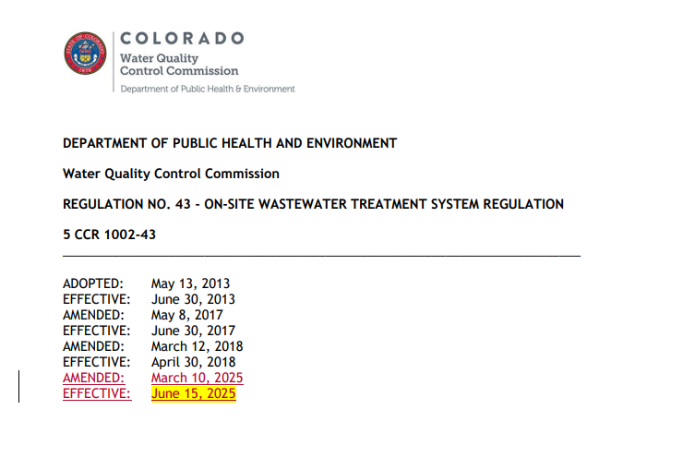
Adoption Process- Option 2
Use the Microsoft Word version of Regulation 43 to redline and develop a stand-alone local regulation using Regulation 43 as the basis for format and content.

Slide 29
Adoption Process – Option 3
Develop a stand-alone local regulation which includes all requirements of Regulation 43 using a separate format. Completion of the “Cross-walk” on pages 5 and 6 of the local agency submittal form is required for this method.

Slide 30
Adoption Process
At least 30 days prior to any public hearing
  submit local draft regulations to the Division for preliminary review
Submittal package will include:
  1. Completed Submittal Form for Local OWTS Regulation Review
  2. Draft Local OWTS Regulation based on one of the three approaches identified above

Slide 31
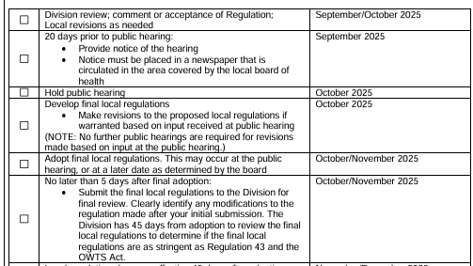
Adoption Process
The Division will issue a Pre adoption comment or Acceptance Letter based on your submittal

Slide 32
Board of Health Adopts Local Regulation
After BOH approval
  Submit approved BOH copy of Regs to CDPHE
  Reg goes into effect 45 days after final adoption unless the department notifies the BOH that
  rules or amendments are not in compliance

Slide 33
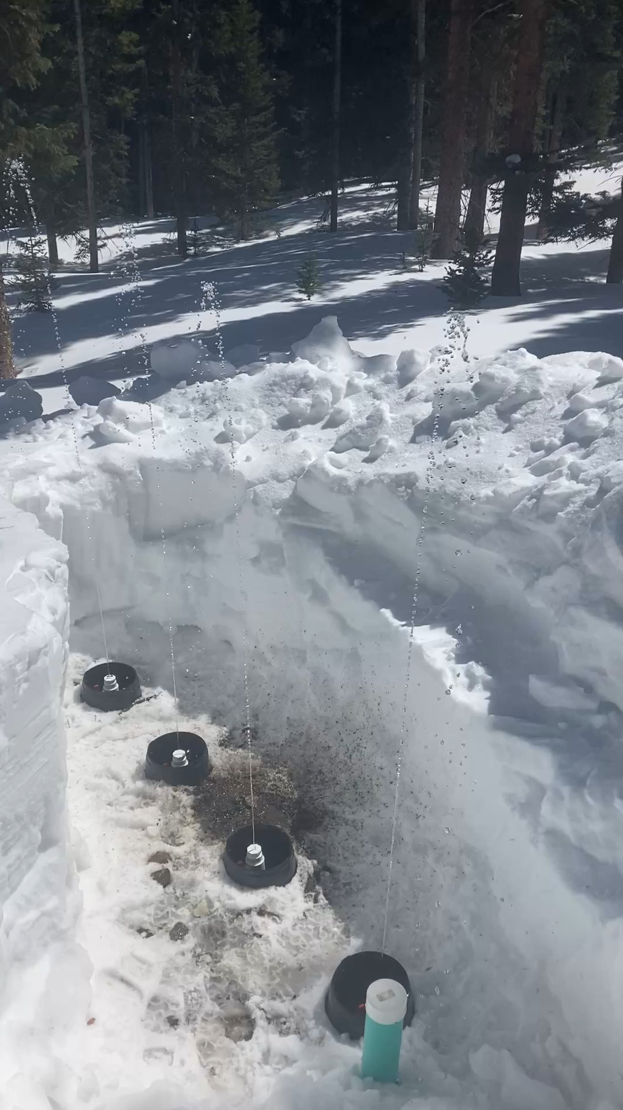
Questions?
“Thank you”
Steve.Prosise@state.co.us
Ph: 303-692-2366

