Slide 1
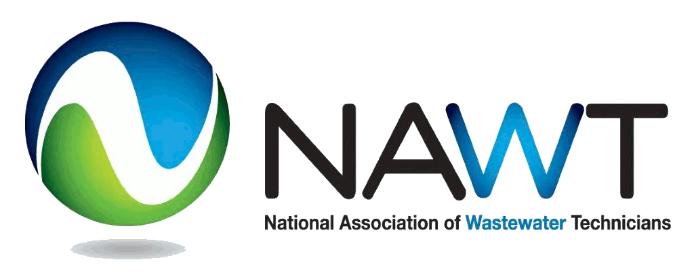
WHAT’S NEW!!
Notes:
1
What is NEW with NAWT

Slide 2
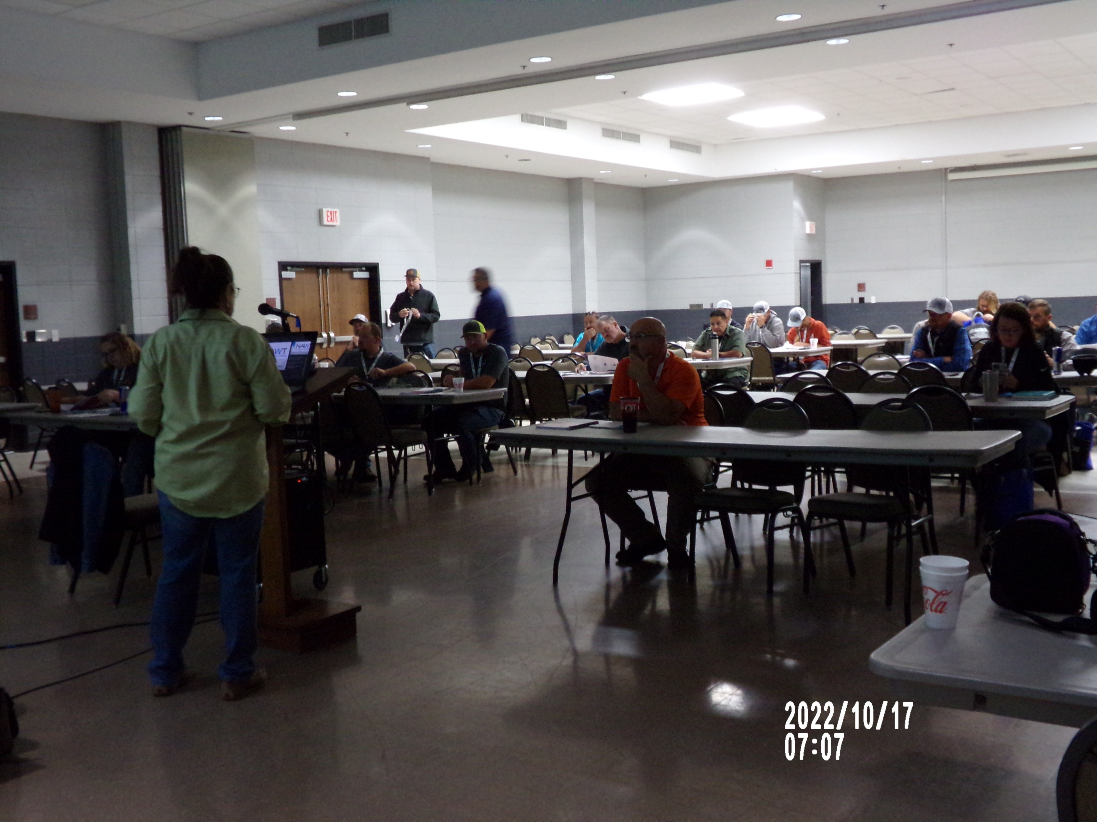
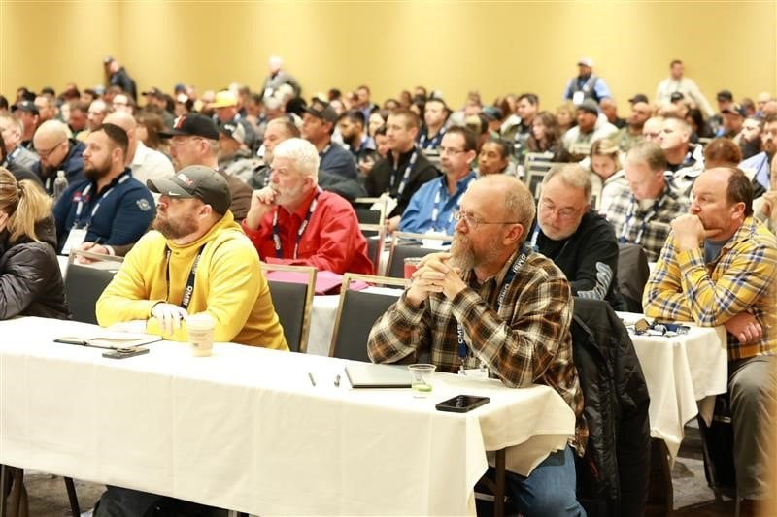
HISTORY
National Association of Wastewater “Transporters”
NAWT Inspection Course
Other NAWT Courses
Technicians
Notes:
NAWT has been around since the 1980’s and started as the association that focused on the pumpers in the industry.
NAWT mission has always been to be a voice for the practitioner in the OWTS industry. But we found that we really represented and became the voice for all practitioners within the industry – **click
We are dedicated to being the voice for practitioners in the industry, the boots on the ground, typically underrepresented, under appreciated folks in our industry.
The NAWT Inspector Training Course came to be through an EPA grant for the purposes of address Time of Sale inspections on OWTS
This set the initial standard at the National Level for OWTS inspections – We have delivered this course across the country and have had participants from other countries take this course because they see the value in the NAWT training, education, and certification.

Slide 3
NAWT OWTS Standards
Development
Manuals
Getting back to the field!!
Notes:
NAWT has recently gone through and updated their flagship training, the NAWT Inspector Training Course to the NAWT OWTS Inspection Standards.
Over the last few years NAWT has asked practitioners what they want to see from NAWT; the answer was a National Standard for Septic Inspections. While the course has always been recognized as the “Standard” there were areas that needed to be tightened up, to be more uniformed – we received comments and input from different regulatory agencies, practitioners, consumers, etc.
We listened, and as of Jan 1, 2026, we have rolled out the NEW NAWT OWTS Inspection Standard Training
NAWT is also currently working on updating our NAWT Installer Training Courses (due out this year) and then will delve into updating our NAWT Operations and Maintenance Course(s). Always with the thought of creating a way for practitioners to get training, education, and certification and not break the bank in the process. And understanding the uniqueness of our practitioners learning styles.
One of the things that NAWT prides itself on with all if its recognizing that each area, region, state may have a slightly different takes on certain processes and procedures and NAWTs goal is to work with the local associations and using the NAWT courses making sure that any local, regional, or state code that needs to be emphasized is included in the presentation and can be added as exam questions specific to that local, region, or state.
Now that we have our updated programs coming out, we are working with different state associations and looking to help them build a similar type of training program that Colorado has successfully done. Keeping the training, relevant, affordable and accessible. We understand practitioners, our demographics. We understand the regulatory sectors need for consistency with inspections and other OWTS sector work.

Slide 4
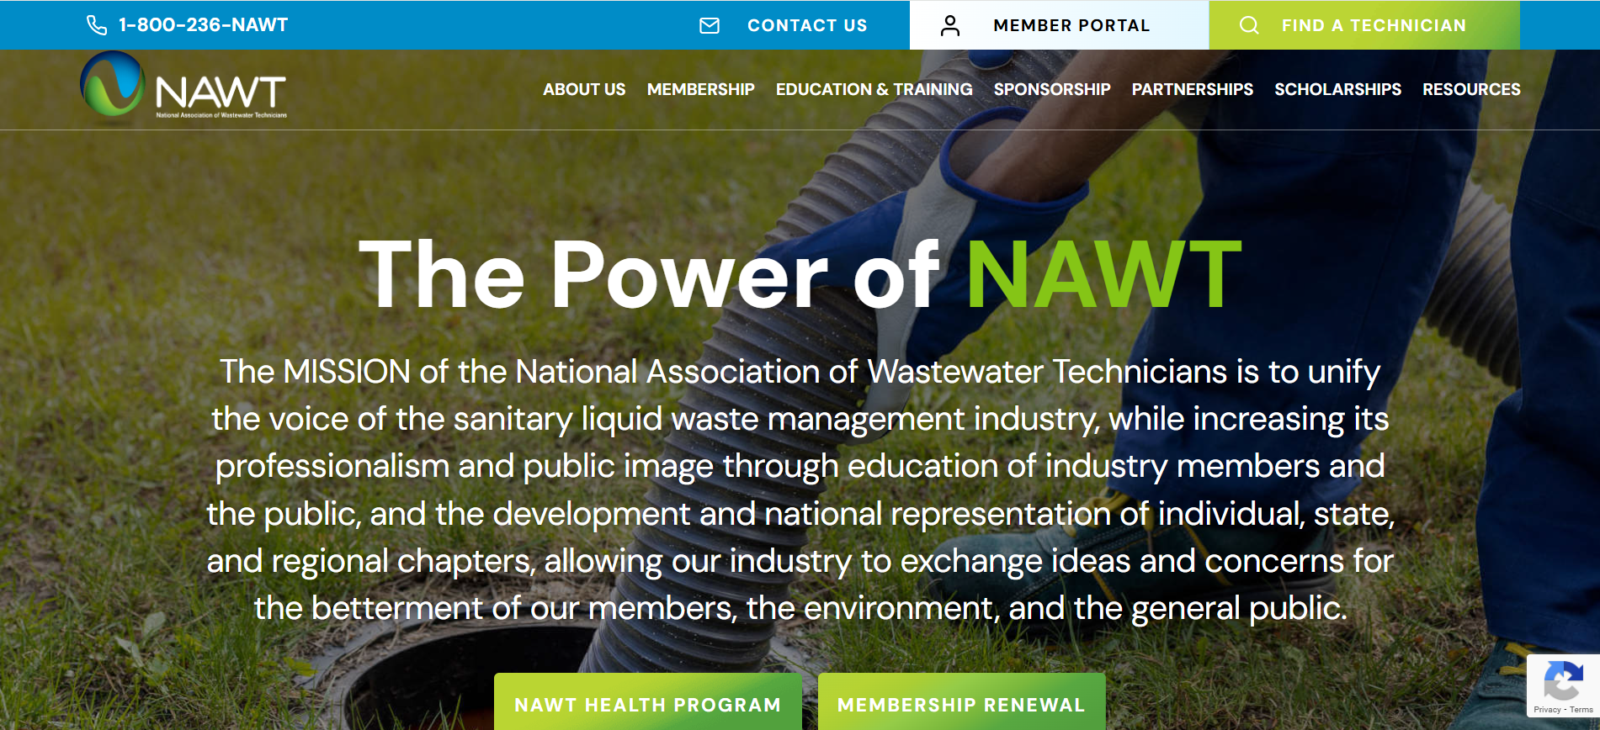
Notes:
The NAWT website has been revamped for a cleaner feel and easier navigation. Technicians now have an online portal where they can access their certifications, update their personal information and see classes they have attended.
As of January 1, 2025, if you hold a NAWT Certification you are a NAWT member – no additional fees, no additional paperwork. You will be a member as long as you have any one of the renewable NAWT certifications and keep it active. With that, we invite you to get more involved. Help us help you. If you have a particular interest, idea, or concern, let us know – we want to be that voice for you. If you are interested in helping work on the training courses, let me know, the more help we have the easier the workload becomes and it helps to make the courses complete and more relevant.
As a member of NAWT, we offer a Health Insurance Benefits program offering competitive pricing for both group and individual health insurance. We encourage you to check it out.
Coming 2027 we will be looking to expand our scholarship opportunities to cover more than just standard college education and training. We will be working to include scholarship opportunities to individuals enrolled in trade schools learning how to operate heavy equipment and opportunities to those new to the industry. Practitioners looking to take the NAWT education and training courses. This group is just getting started. We have been approved to expand the current scholarship program to include these options by Dave Hapchuk who started the scholarship for NAWT. This is going to make taking some of the courses and getting that baseline training, education, & certification for new people in the industry much easier.

Slide 5
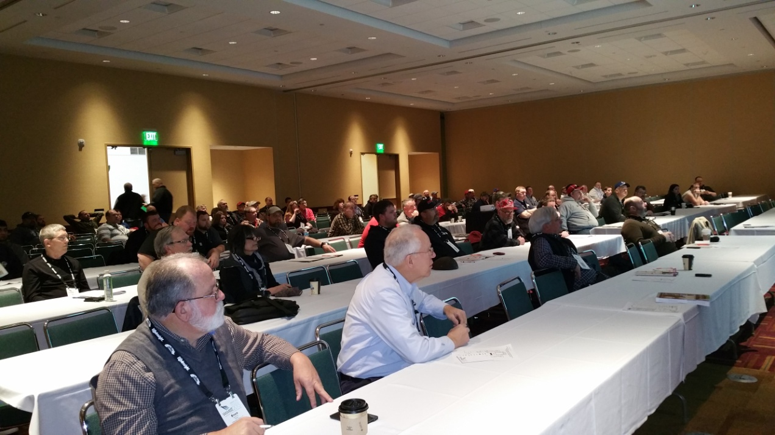
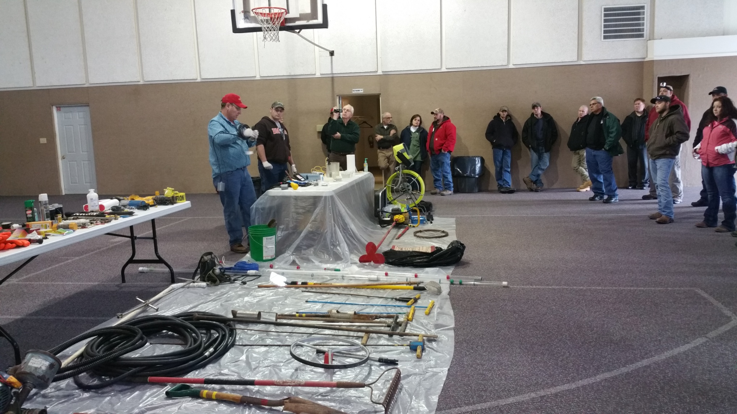
Notes:
NAWT continues to participate in both the WWETT and the Mega Conferences providing tracks targeted for our group, practitioners in the industry to help improve our presence and position in the industry.

Slide 6
THANK YOU!!!

