Slide 1

Onsite Wastewater Treatment System Installation Challenges
Notes:
Welcome to the Colorado Professionals in Onsite Wastewater presentation on site evaluation for onsite wastewater treatment system design.
This presentation will identify the process to evaluation a site for design and construction of an onsite wastewater treatment system.

Slide 2
Alps Inn 38619 Boulder Canyon Drive
Title Transfer inspections indicated that the system was functioning properly.
New owner just need an engineer to write a letter stating that the system was acceptable for the proposed use.
Notes:
New system could be a brand new system or a repair.

Slide 3
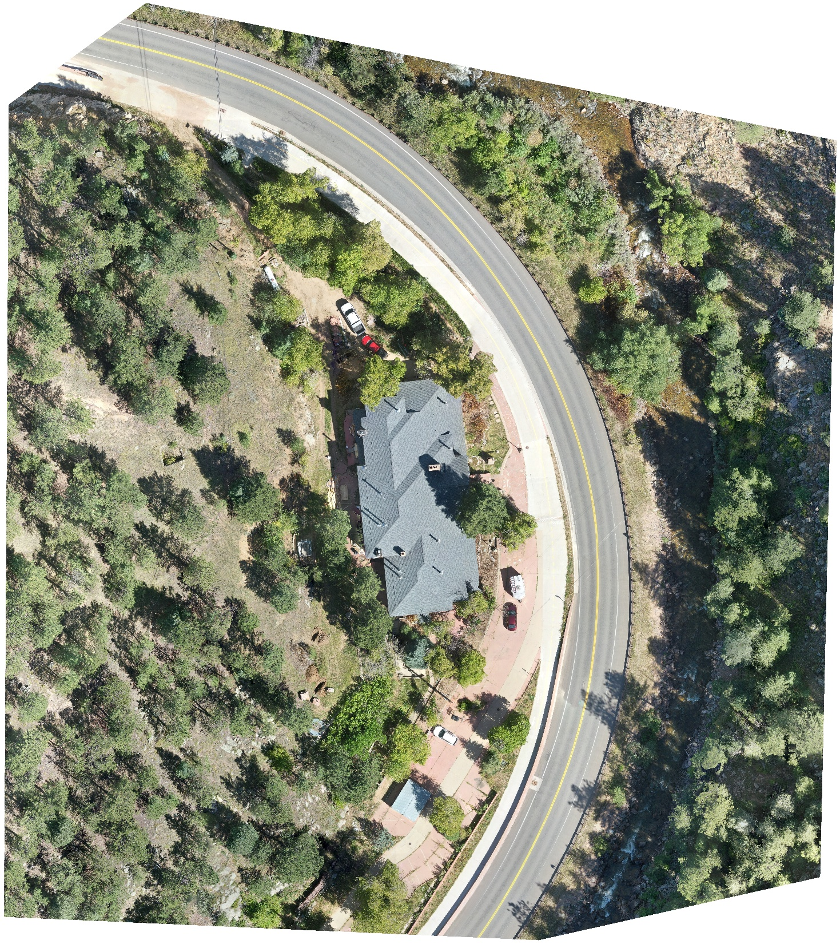
38619 Boulder Canyon Drive

Slide 4
Site
Google Maps
Notes:
Anticipated construction-related issues, if applicable;
An assessment of how known or reasonably foreseeable land use changes are
expected to affect the system performance, including, but not limited to, changes
in drainage patterns, increased impervious surfaces and proximity of new water
supply wells, if applicable; and
A narrative explaining difficulties encountered during the site evaluation,
including but not limited to identifying and interpreting soil and landform features
and how the difficulties were resolved, if applicable.

Slide 5
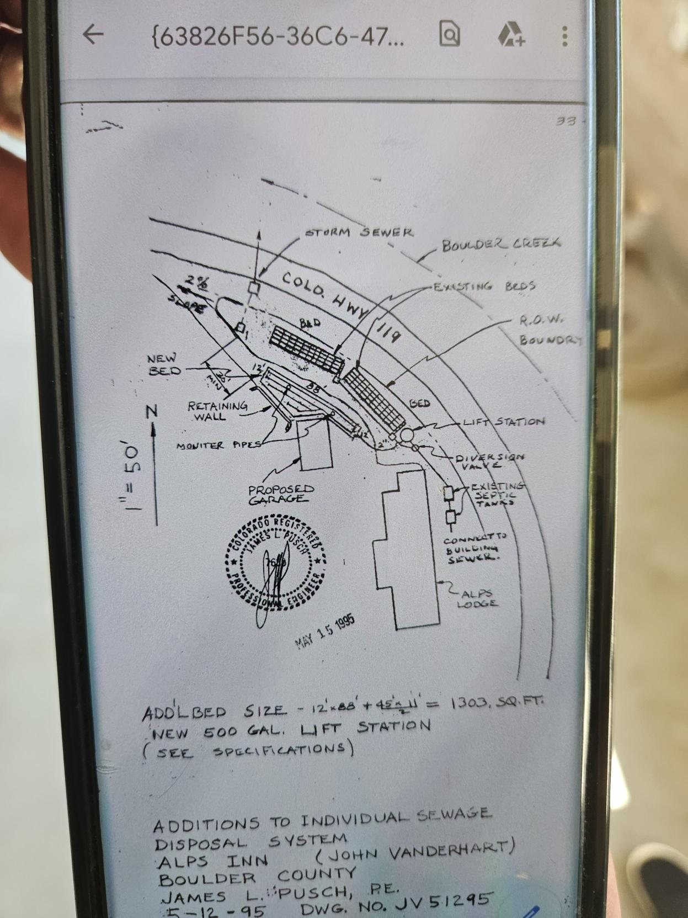
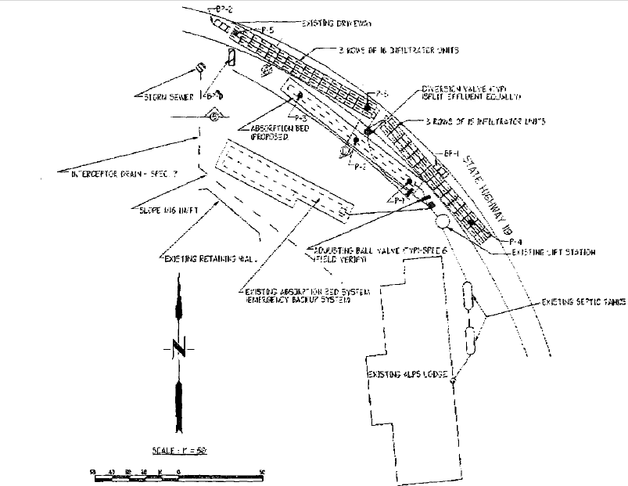

Slide 6
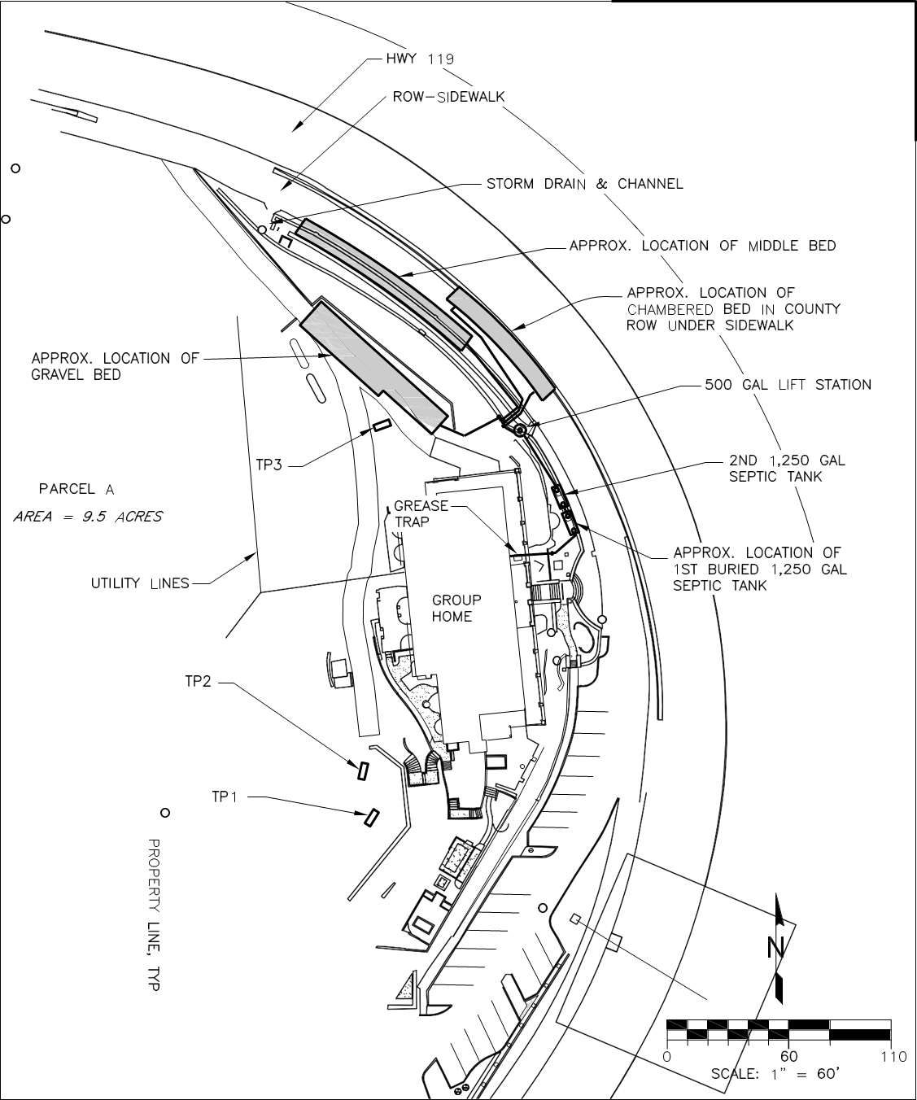
Existing OWTS
Notes:
Anticipated construction-related issues, if applicable;
An assessment of how known or reasonably foreseeable land use changes are
expected to affect the system performance, including, but not limited to, changes
in drainage patterns, increased impervious surfaces and proximity of new water
supply wells, if applicable; and
A narrative explaining difficulties encountered during the site evaluation,
including but not limited to identifying and interpreting soil and landform features
and how the difficulties were resolved, if applicable.

Slide 7
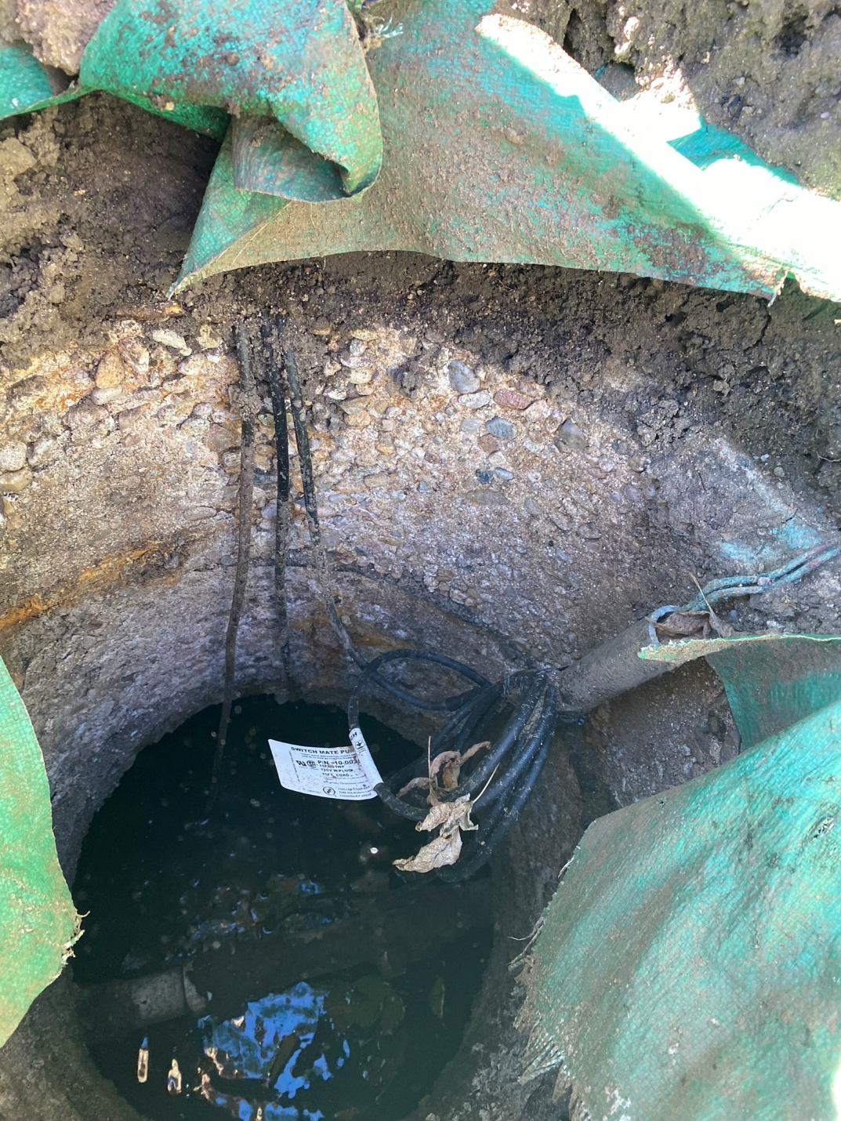
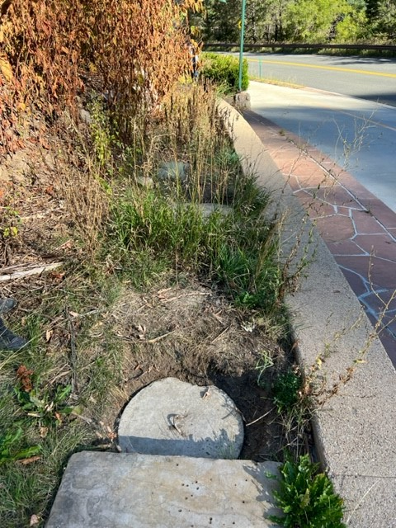
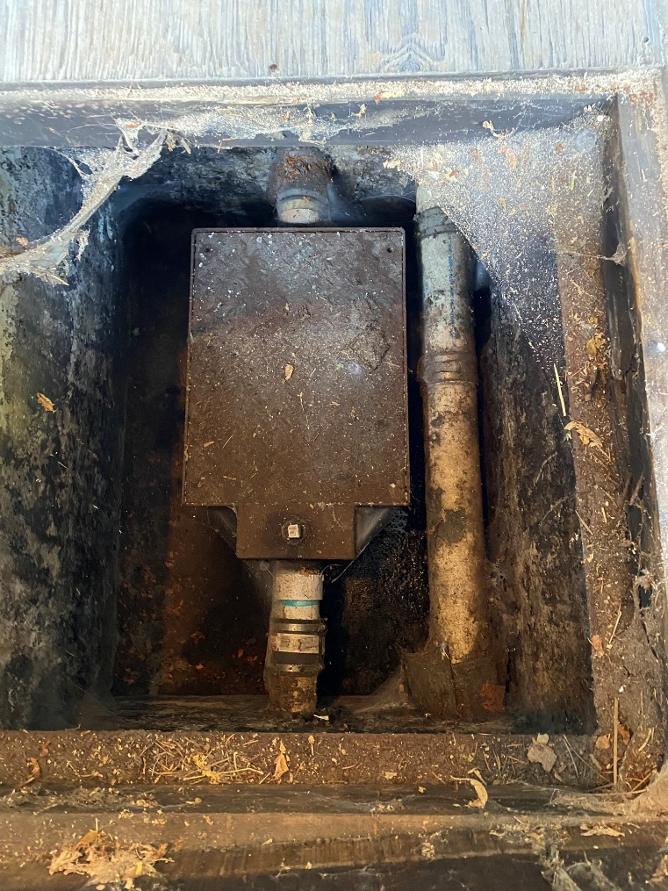
Existing Tanks
Notes:
Anticipated construction-related issues, if applicable;
An assessment of how known or reasonably foreseeable land use changes are
expected to affect the system performance, including, but not limited to, changes
in drainage patterns, increased impervious surfaces and proximity of new water
supply wells, if applicable; and
A narrative explaining difficulties encountered during the site evaluation,
including but not limited to identifying and interpreting soil and landform features
and how the difficulties were resolved, if applicable.

Slide 9
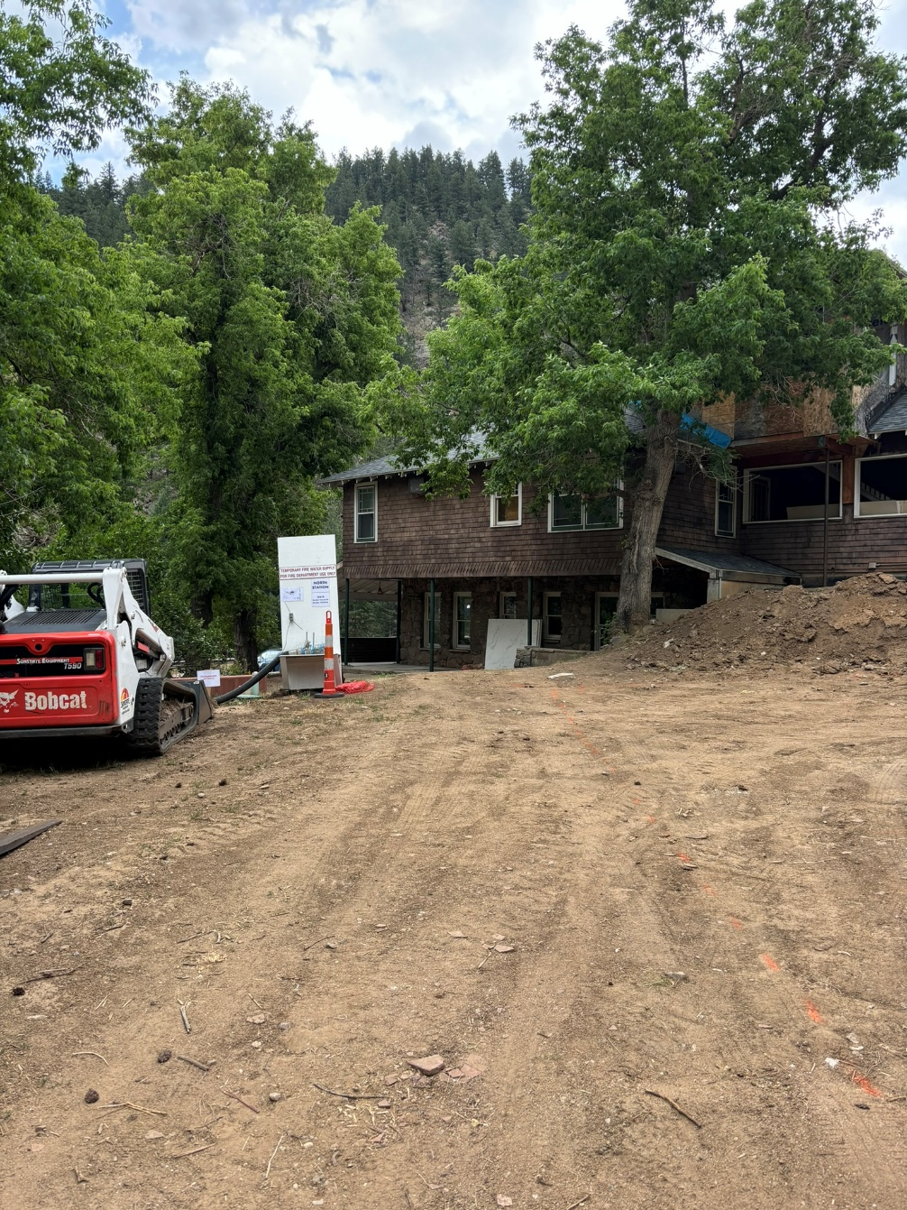
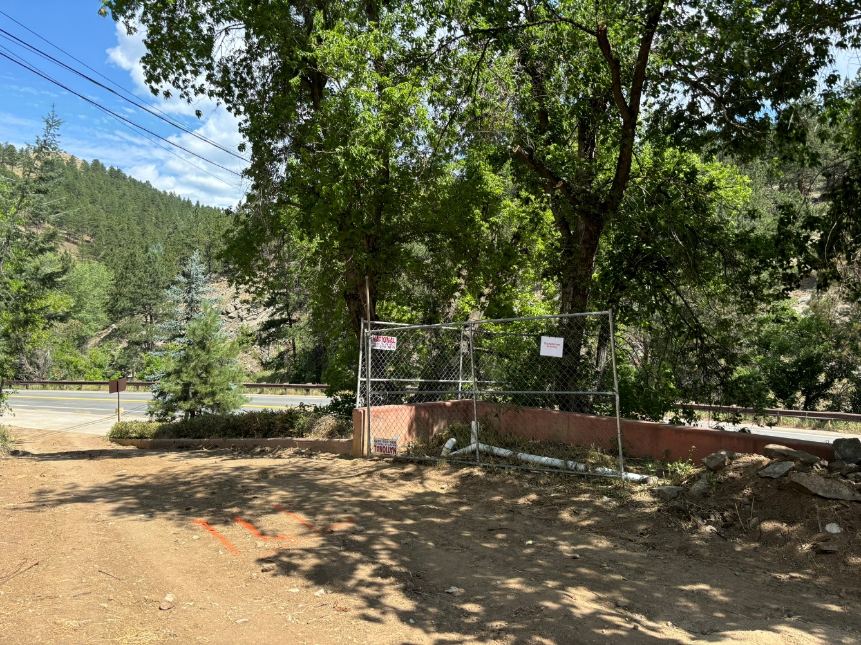
Available Area for STA
Notes:
Anticipated construction-related issues, if applicable;
An assessment of how known or reasonably foreseeable land use changes are
expected to affect the system performance, including, but not limited to, changes
in drainage patterns, increased impervious surfaces and proximity of new water
supply wells, if applicable; and
A narrative explaining difficulties encountered during the site evaluation,
including but not limited to identifying and interpreting soil and landform features
and how the difficulties were resolved, if applicable.

Slide 10
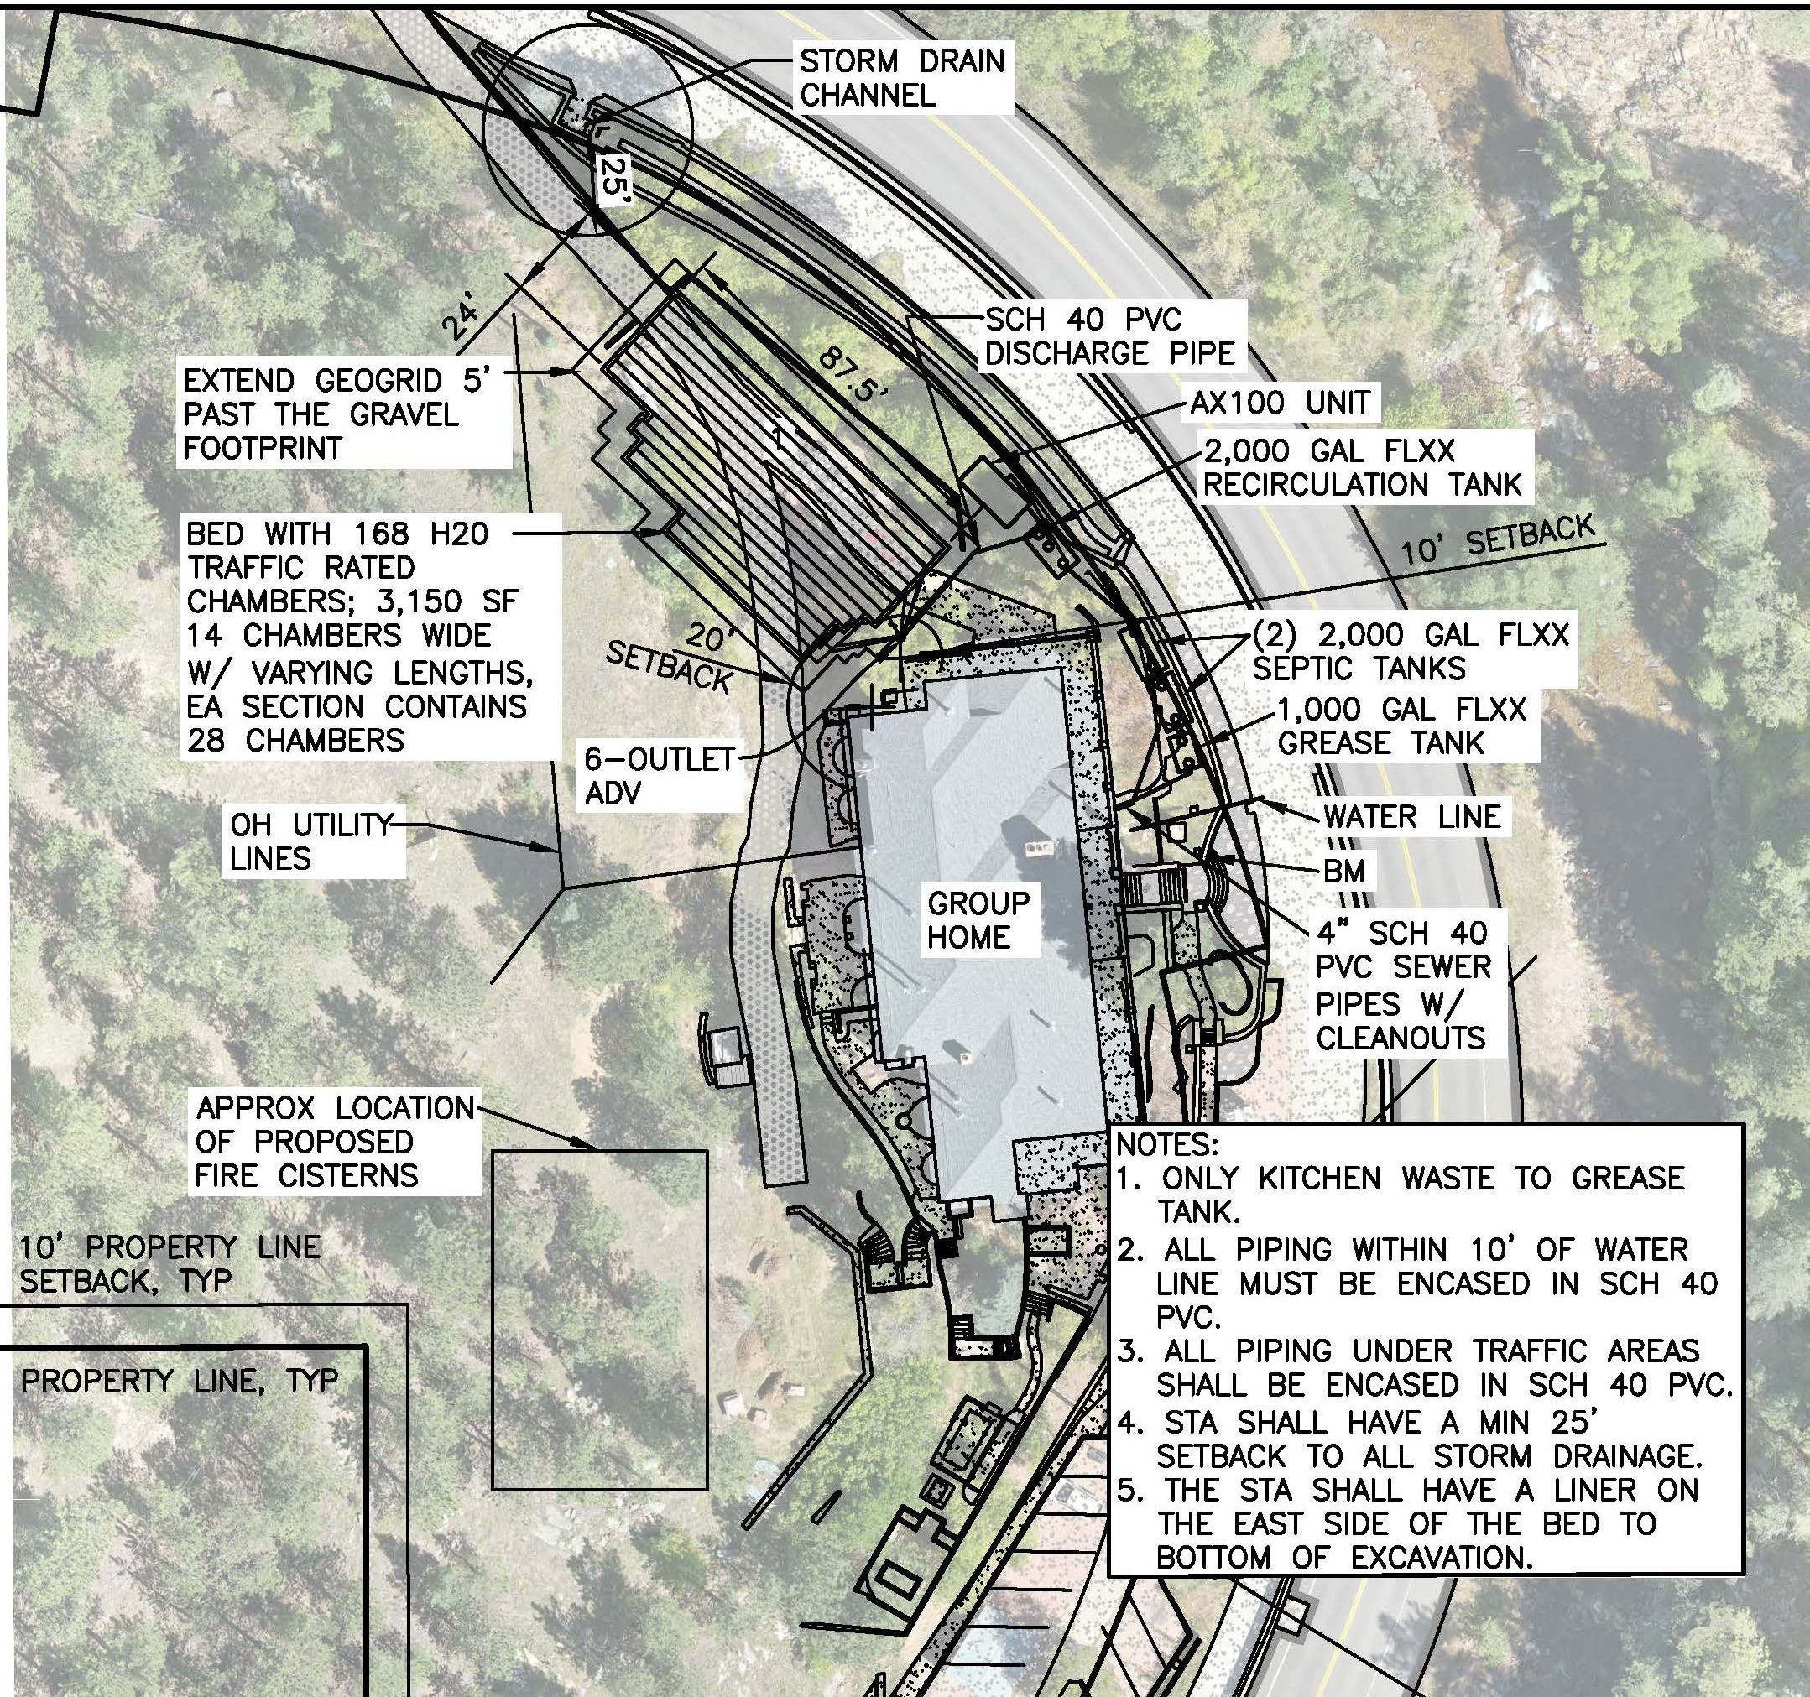
OWTS Layout

Slide 11
Group Home 2,000-GPD
1,000-Gal Grease Interceptor Tank
Two 2,000-Gal Septic Tanks
2,000-Gal Recirculation/Dosing Tank
AdvanTex AX100 Treatment Pod
Sand Filter with H-20 Rated Traffic Rated Chambers

Slide 12
OWTS Construction Challenges
Water Cisterns
CDOT Right of Way
Bike Lane and Road Traffic
Rock Removal
Access for Importing Sand & Gravel

Slide 13
OWTS Layout
Notes:
The cisterns had to be installed prior to the STA so that construction traffic wasn’t crossing the newly constructed STA.

Slide 14
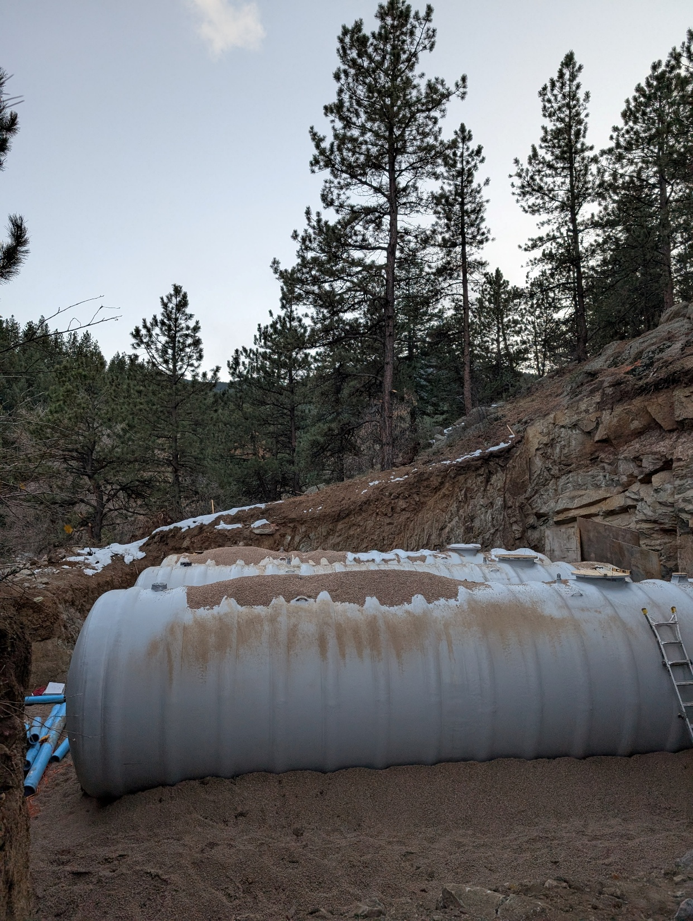
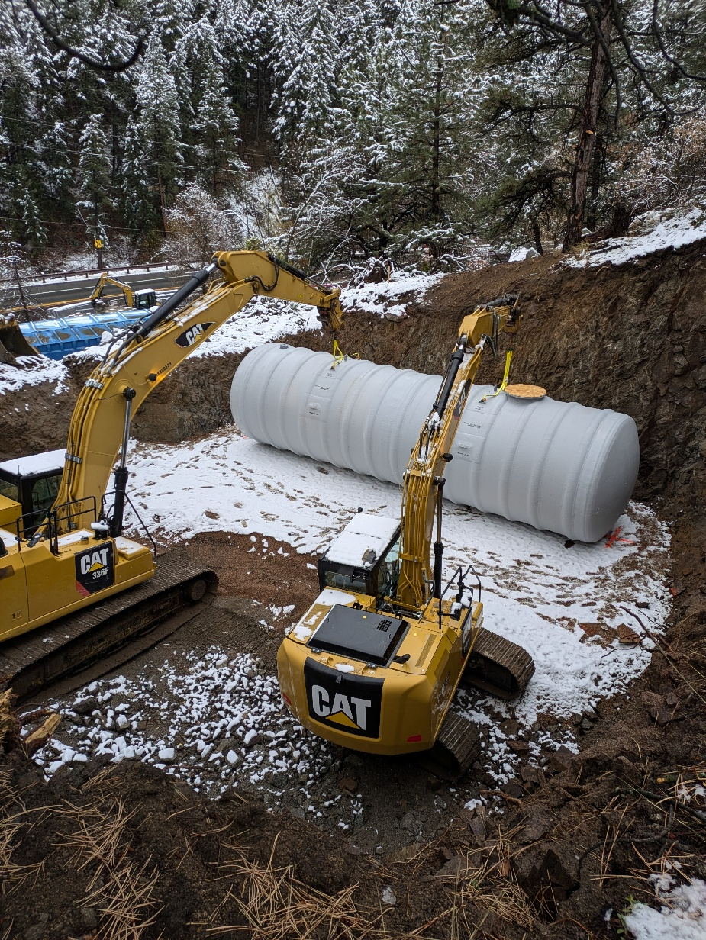
Water Cisterns

Slide 15
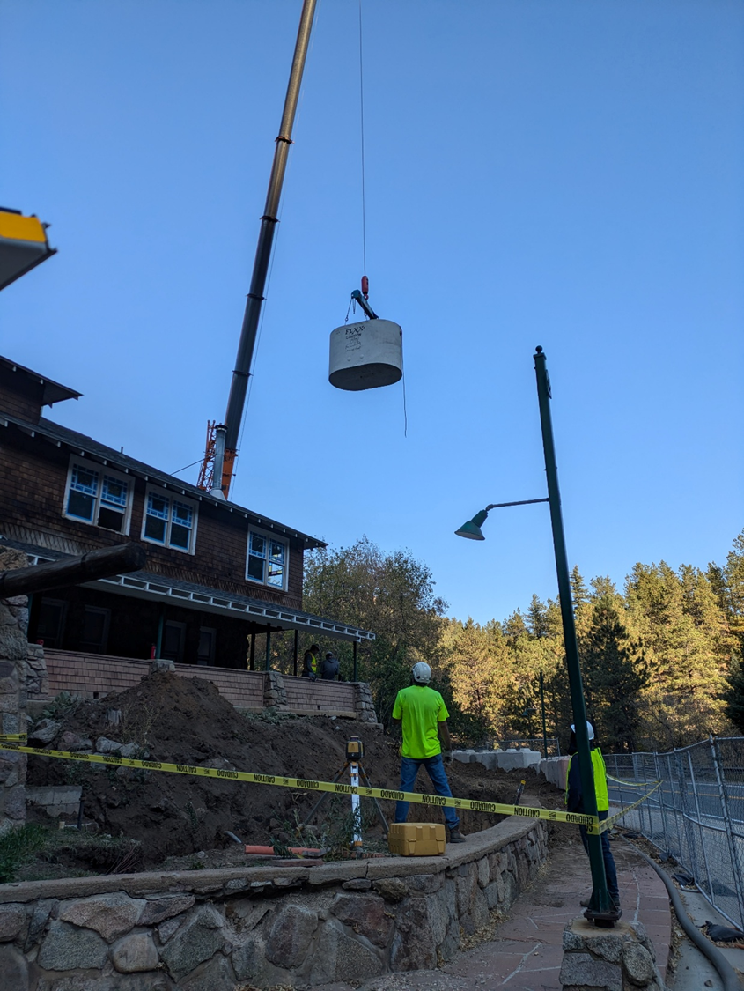
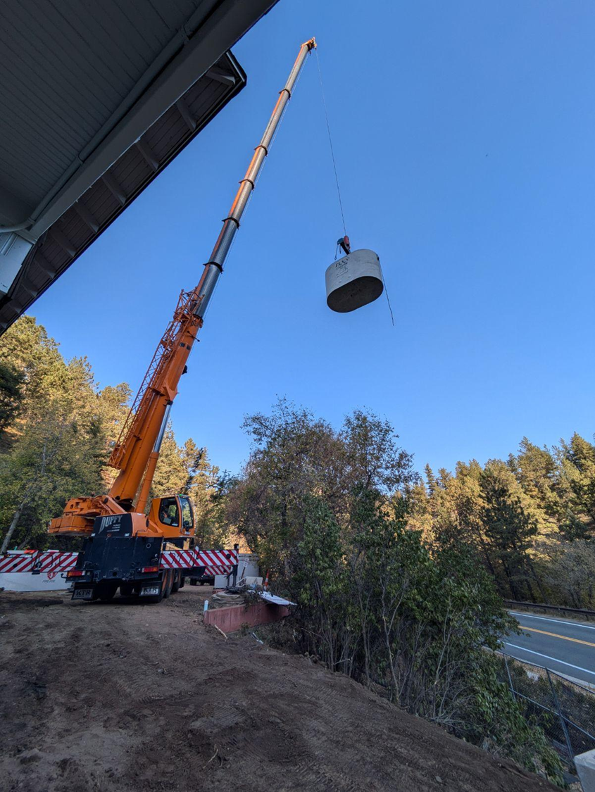
CDOT Right of Way Avoidance

Slide 16
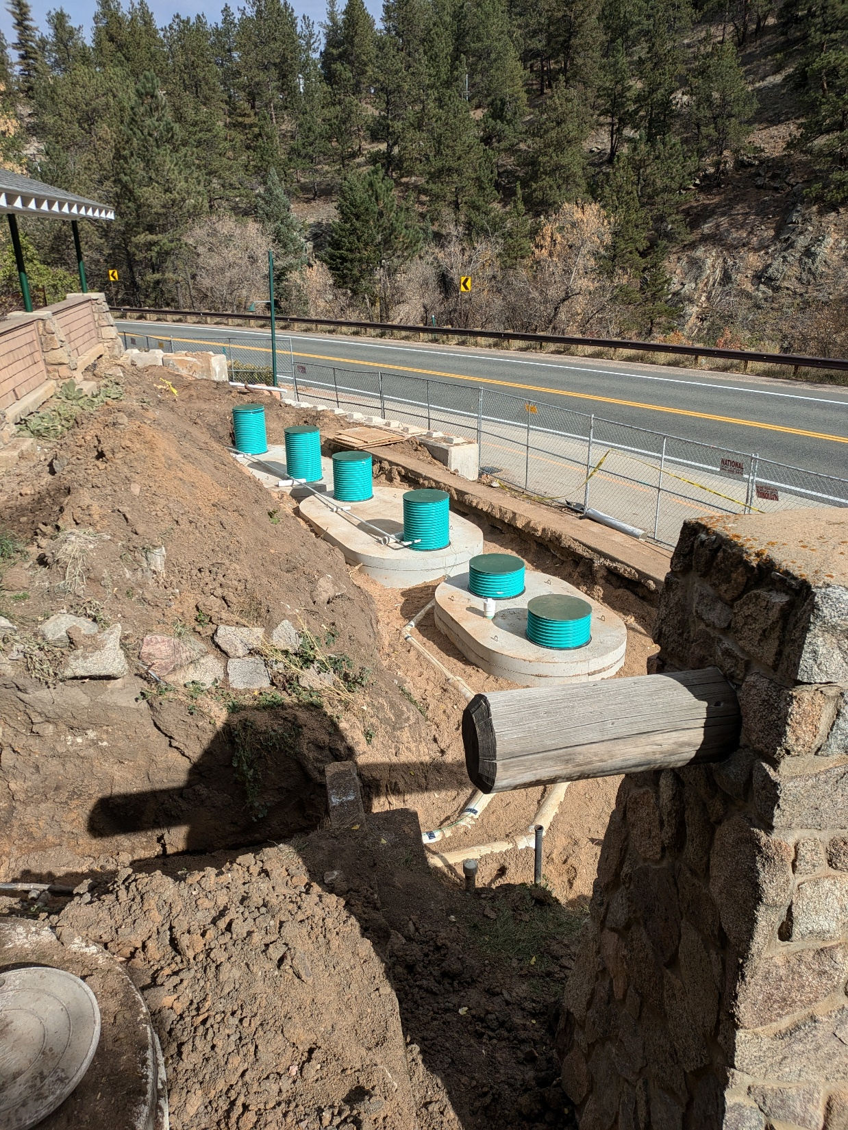
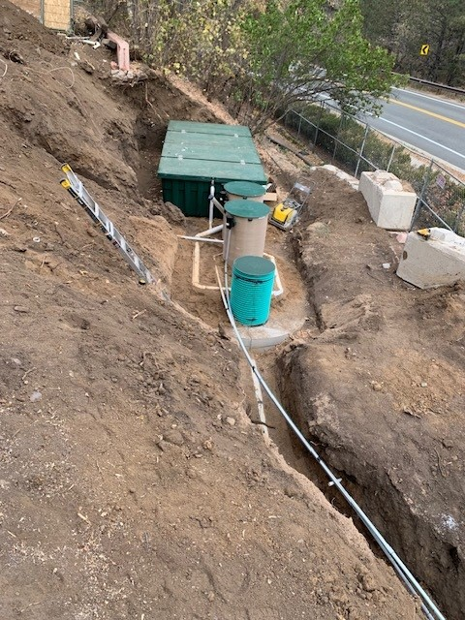

Slide 17
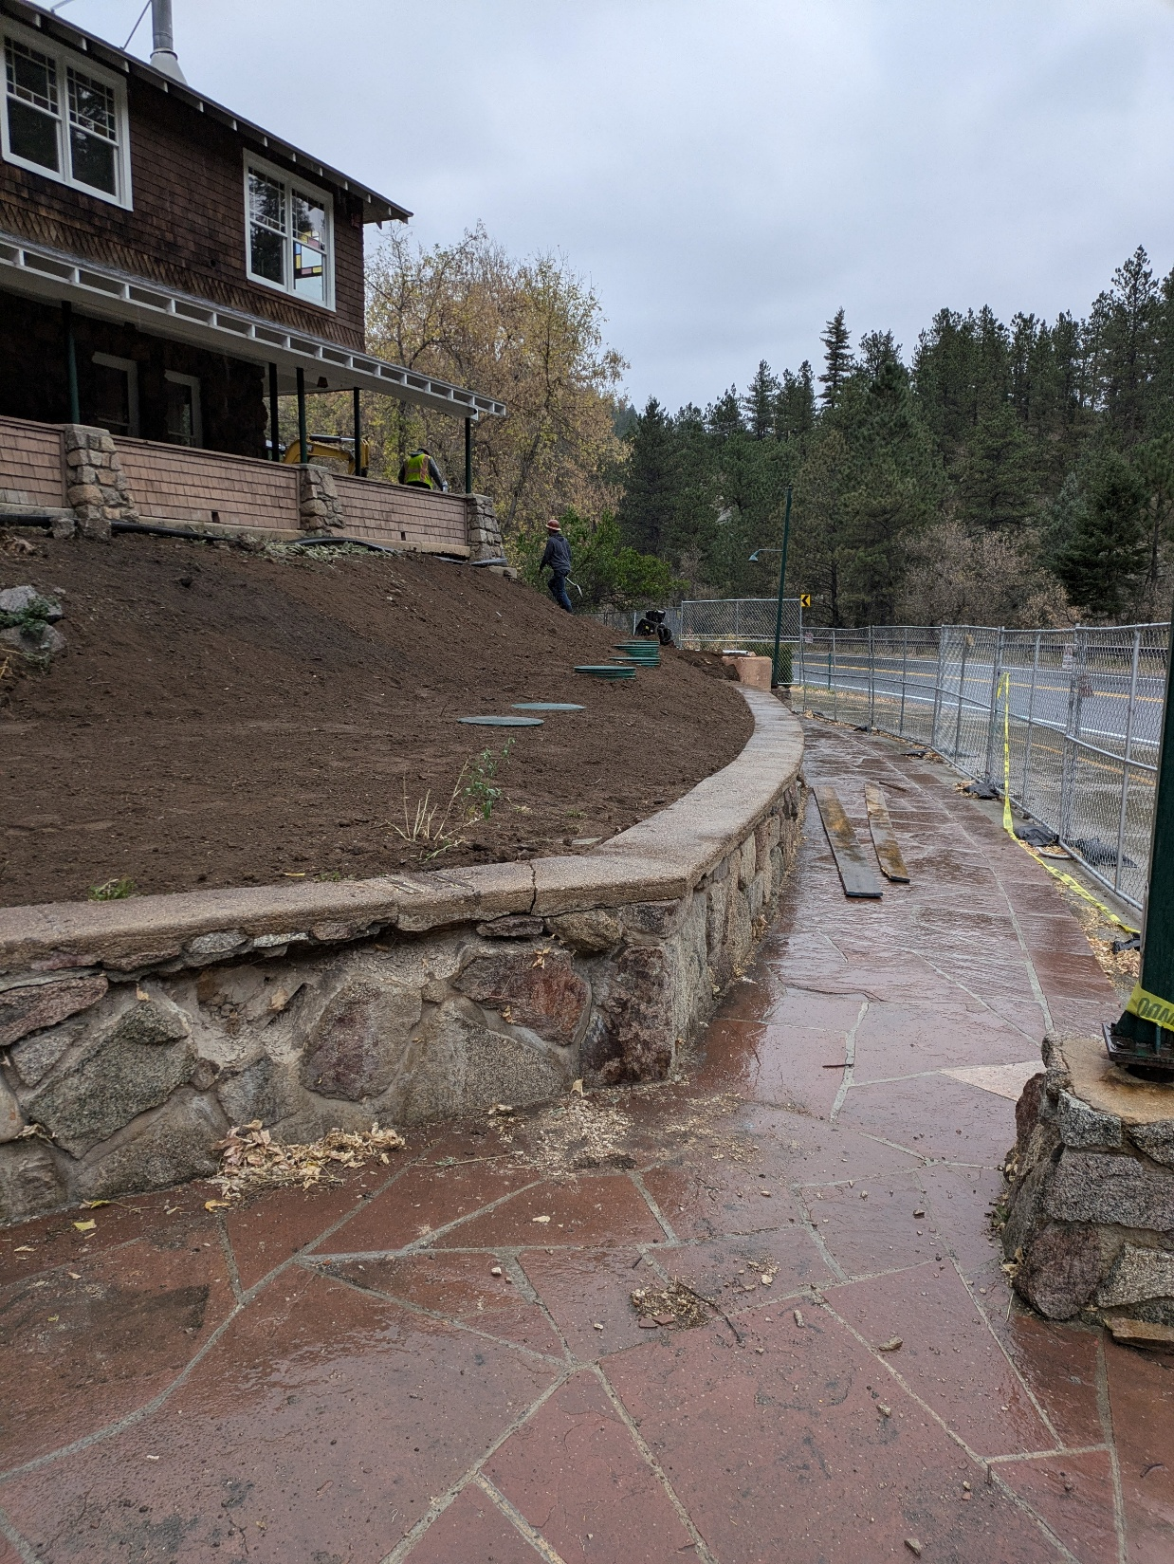
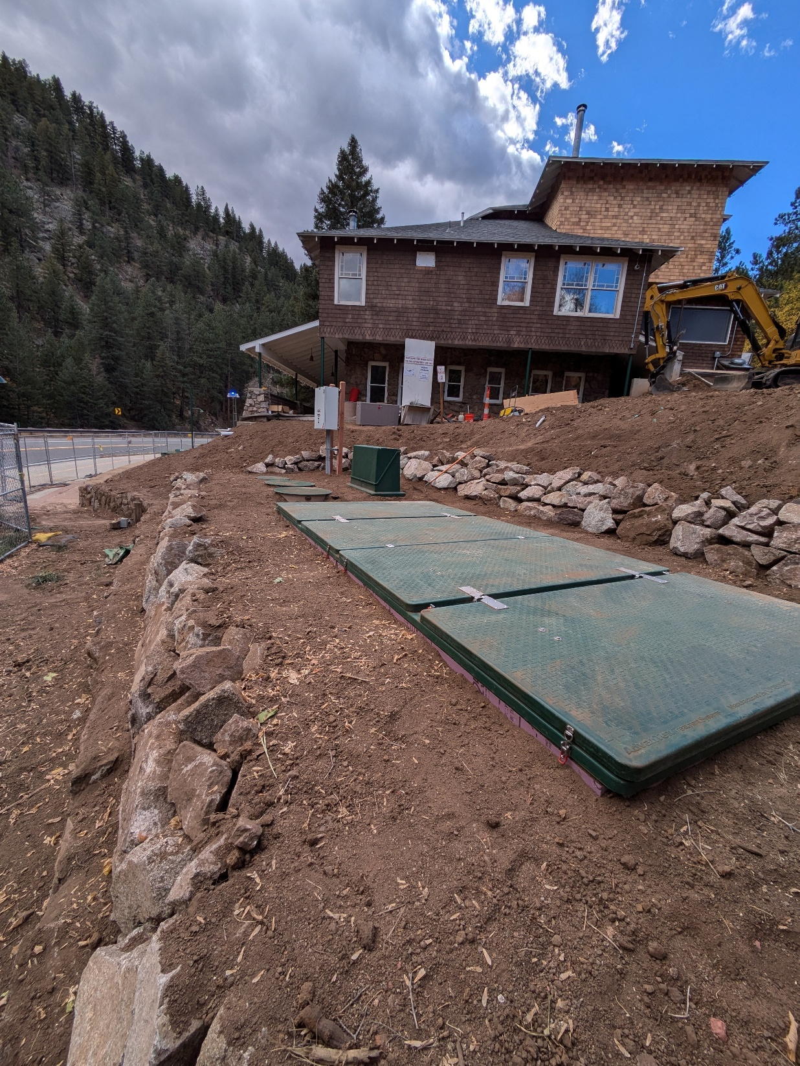
Tanks and Treatment

Slide 18
Access to STA
Notes:
Anticipated construction-related issues, if applicable;
An assessment of how known or reasonably foreseeable land use changes are
expected to affect the system performance, including, but not limited to, changes
in drainage patterns, increased impervious surfaces and proximity of new water
supply wells, if applicable; and
A narrative explaining difficulties encountered during the site evaluation,
including but not limited to identifying and interpreting soil and landform features
and how the difficulties were resolved, if applicable.

Slide 19
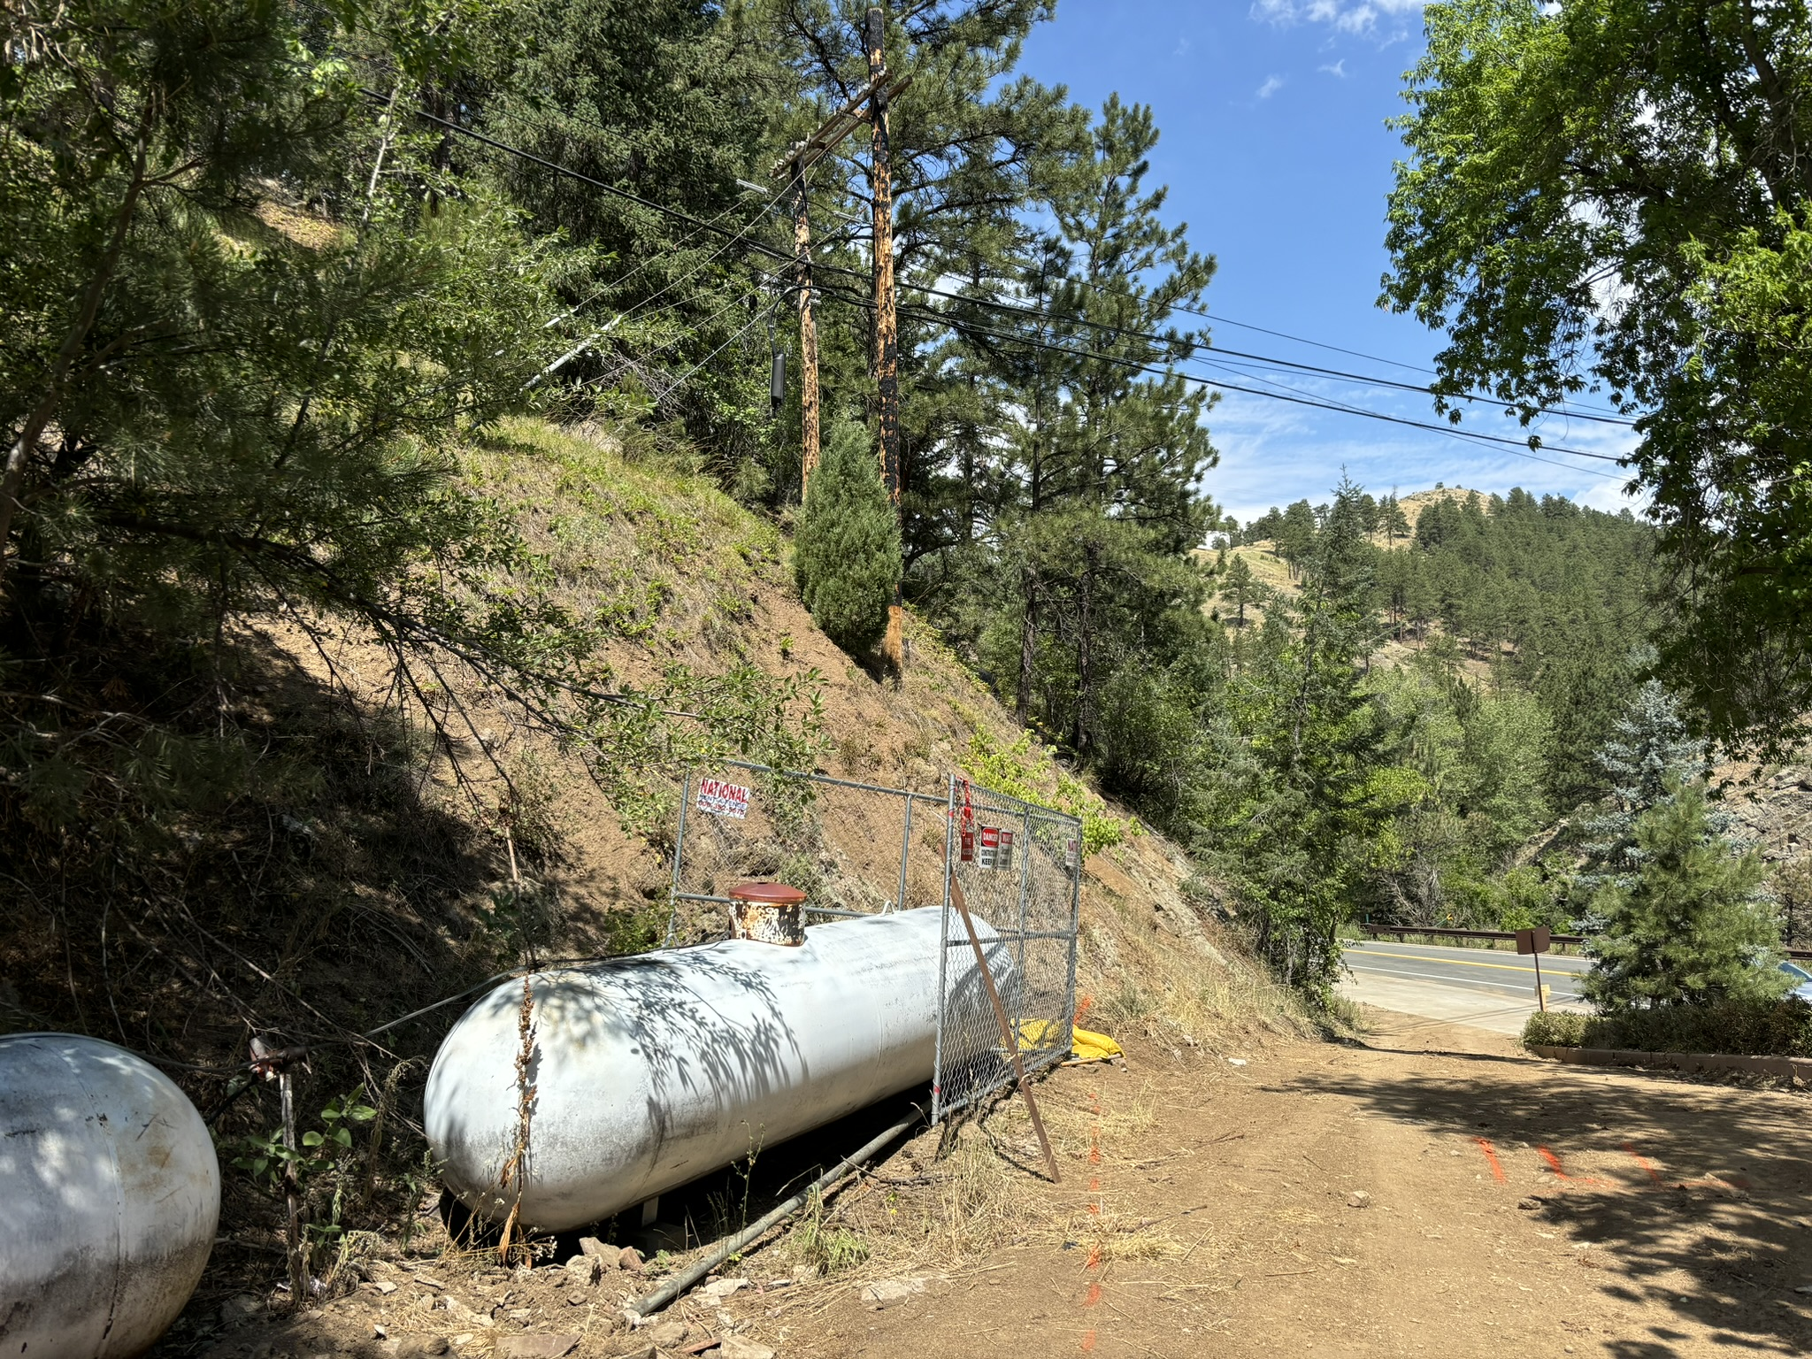

Slide 20
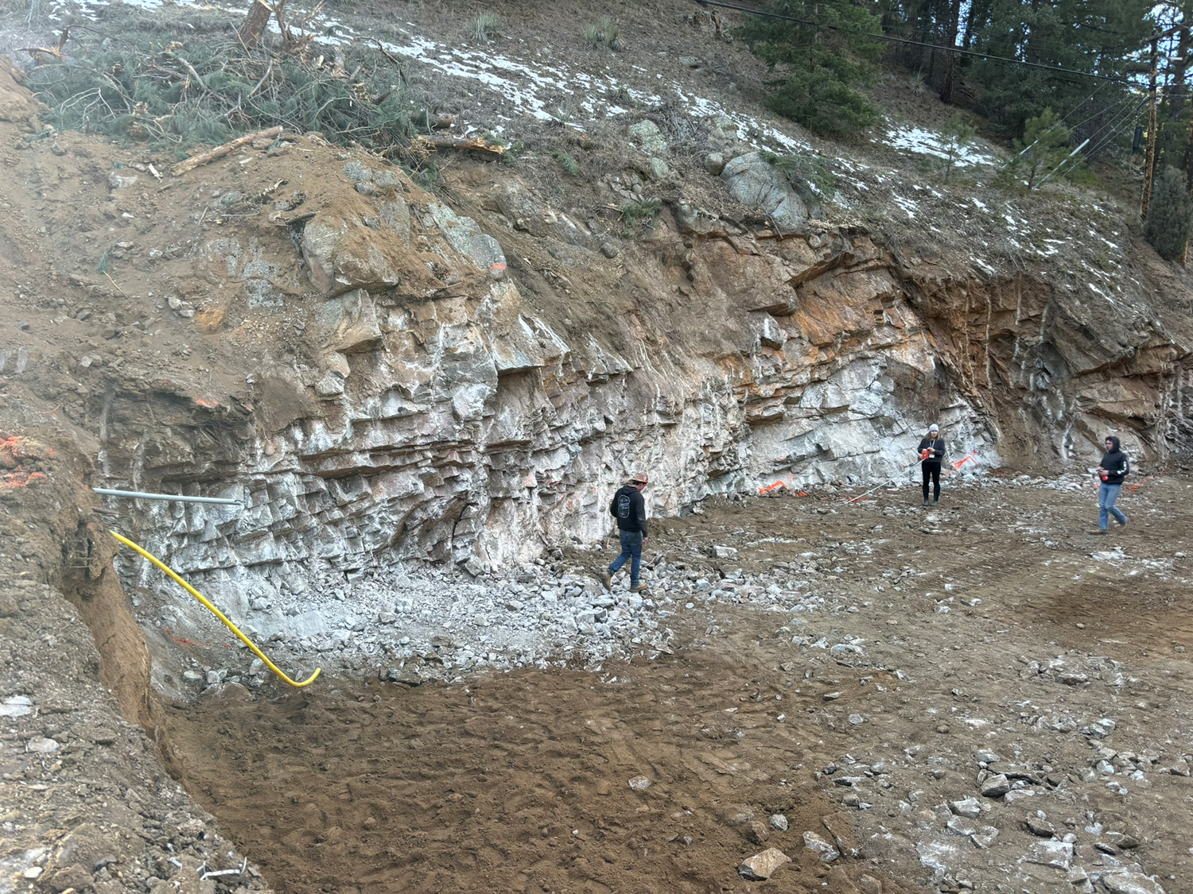
Rock Removal
Notes:
Anticipated construction-related issues, if applicable;
An assessment of how known or reasonably foreseeable land use changes are
expected to affect the system performance, including, but not limited to, changes
in drainage patterns, increased impervious surfaces and proximity of new water
supply wells, if applicable; and
A narrative explaining difficulties encountered during the site evaluation,
including but not limited to identifying and interpreting soil and landform features
and how the difficulties were resolved, if applicable.

Slide 21
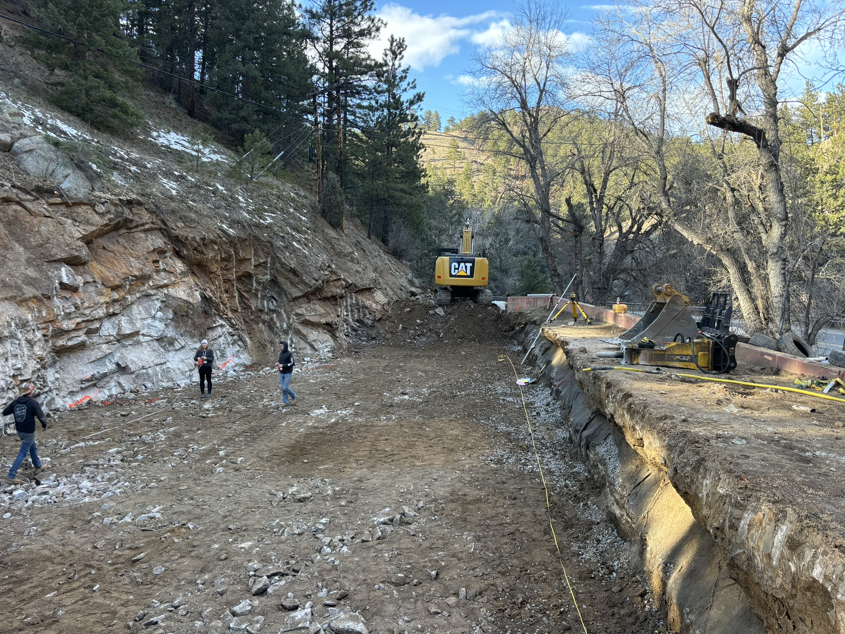

Slide 22
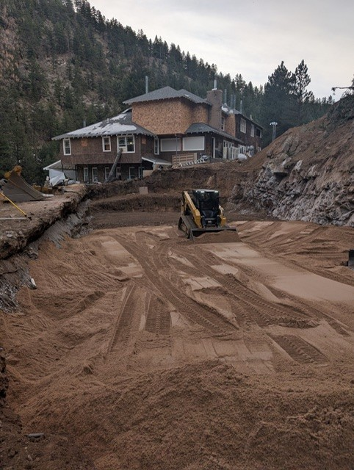
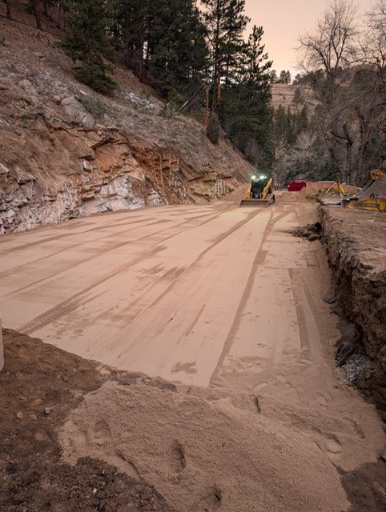
Import Of Material
Notes:
Anticipated construction-related issues, if applicable;
An assessment of how known or reasonably foreseeable land use changes are
expected to affect the system performance, including, but not limited to, changes
in drainage patterns, increased impervious surfaces and proximity of new water
supply wells, if applicable; and
A narrative explaining difficulties encountered during the site evaluation,
including but not limited to identifying and interpreting soil and landform features
and how the difficulties were resolved, if applicable.

Slide 23
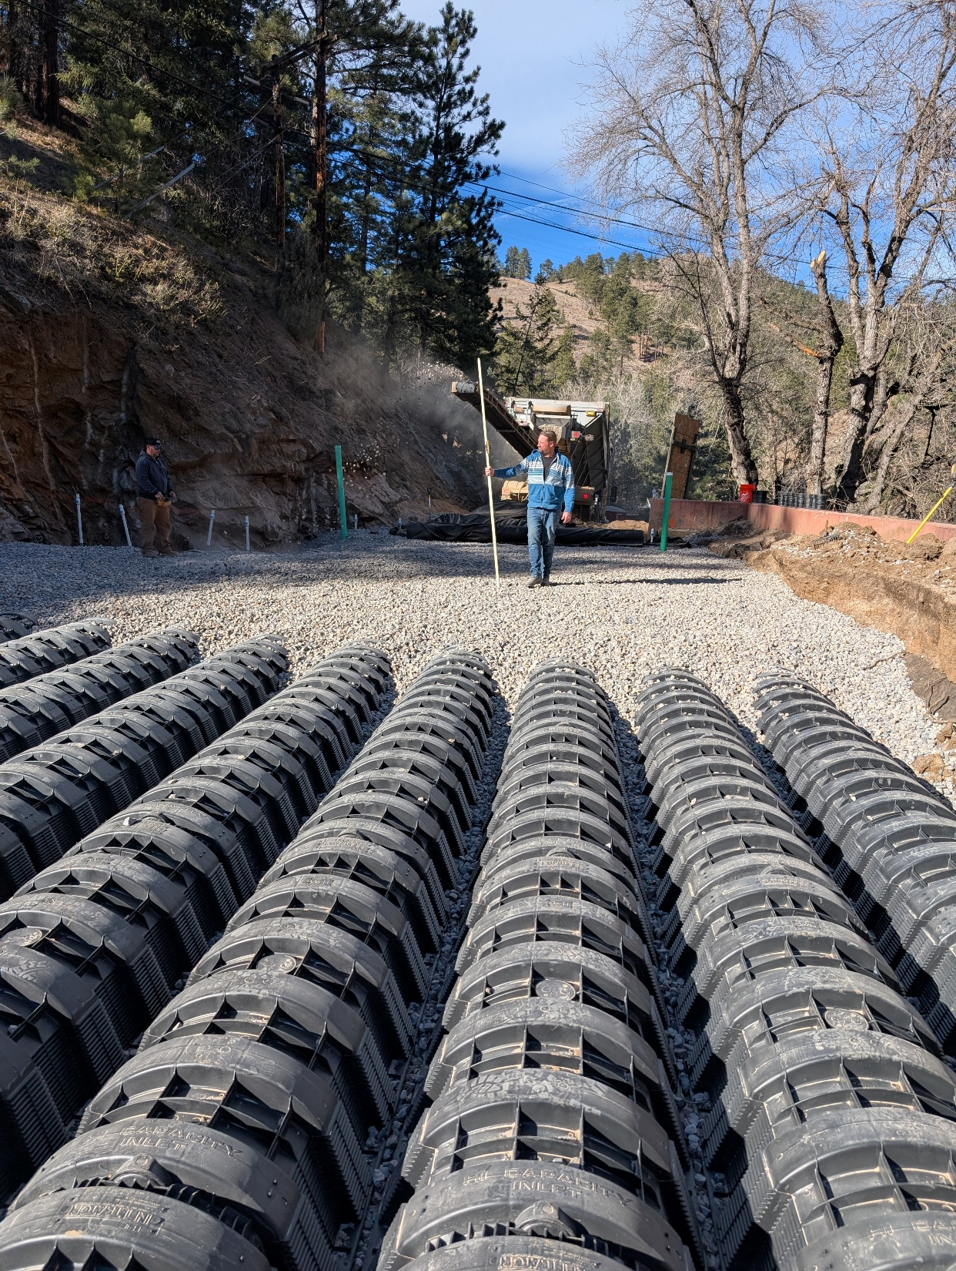
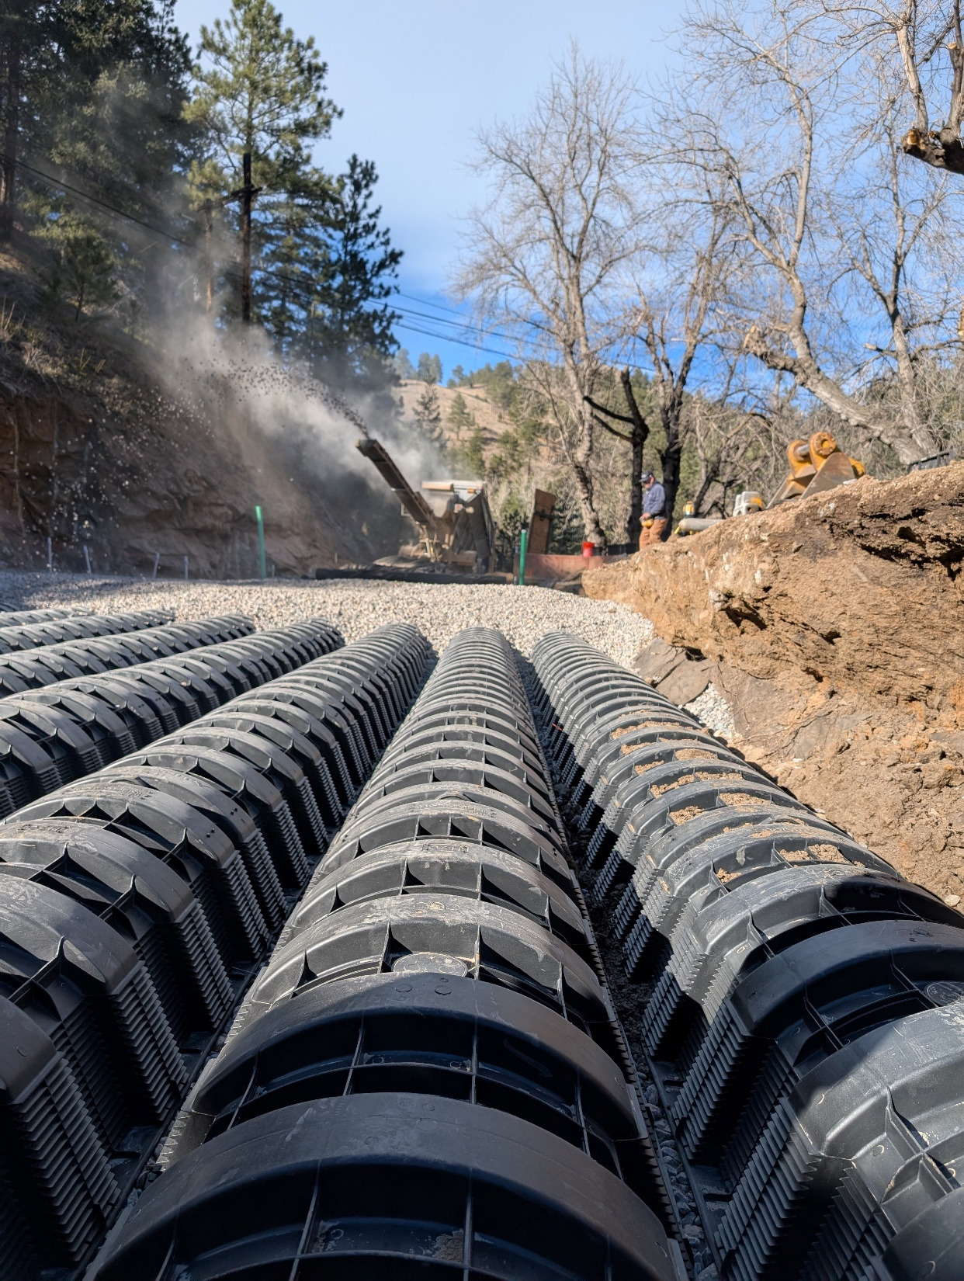

Slide 24
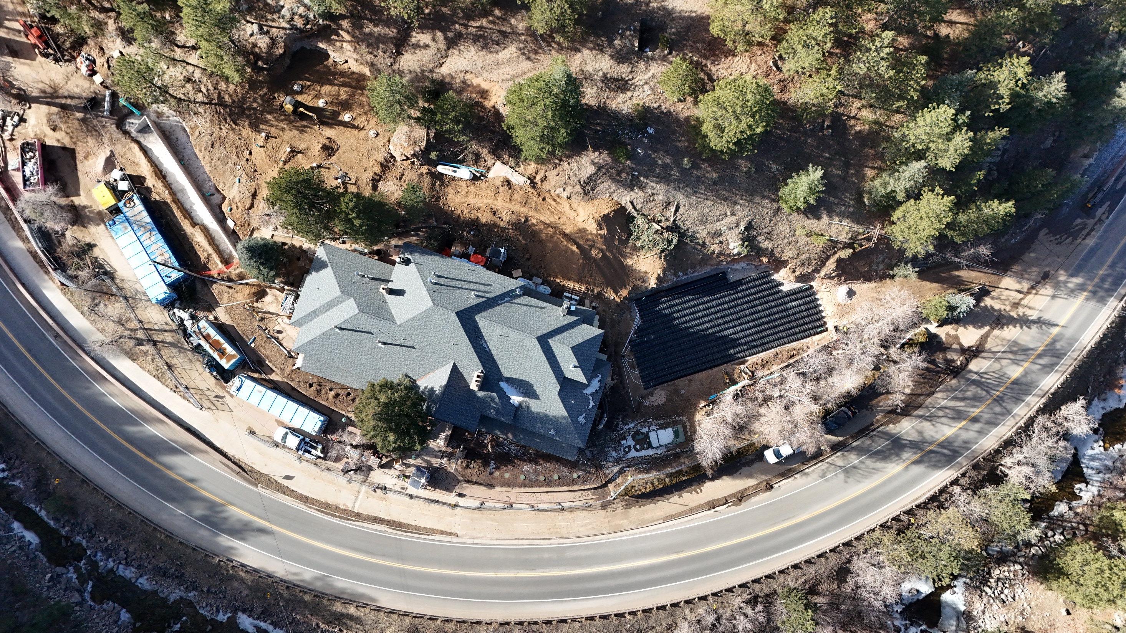
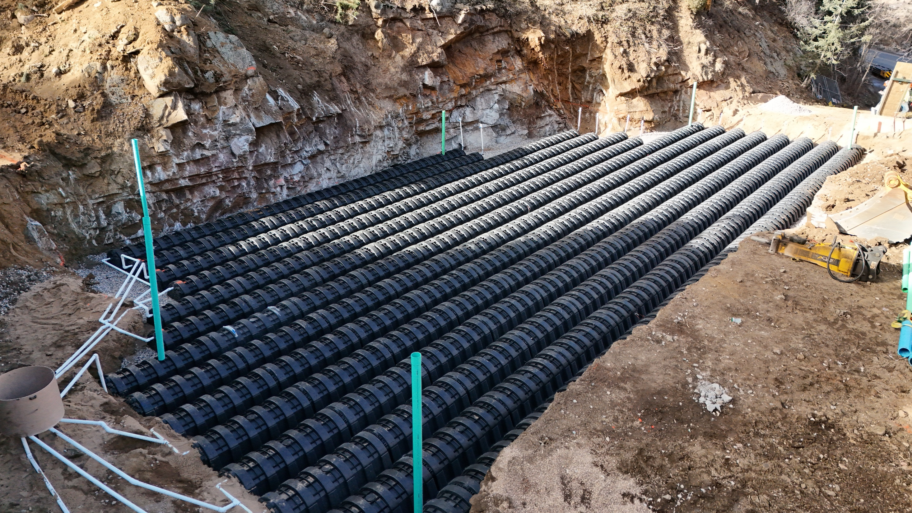
Land Use Changes

Slide 25
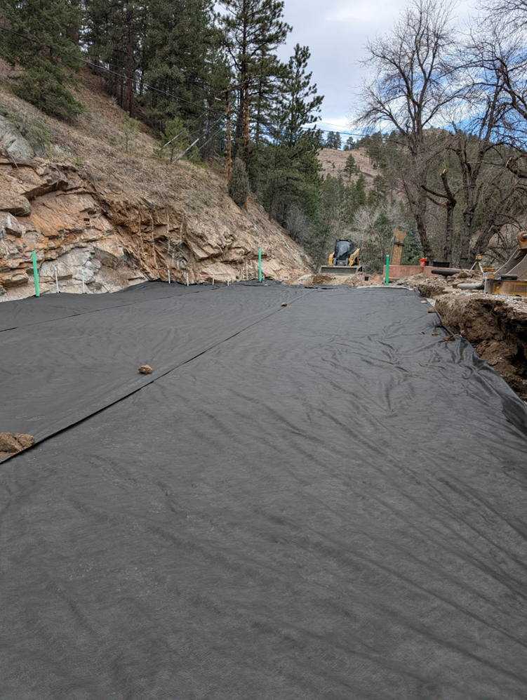
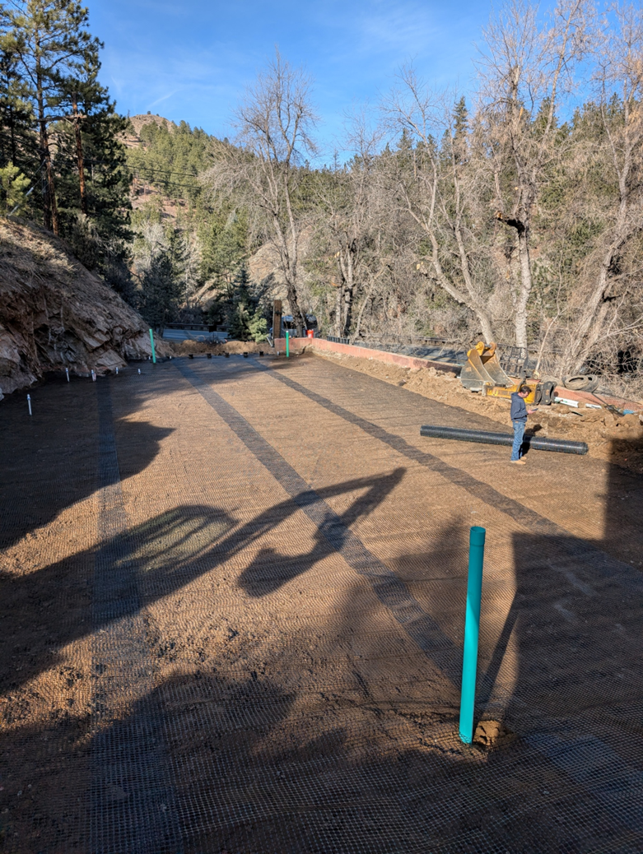
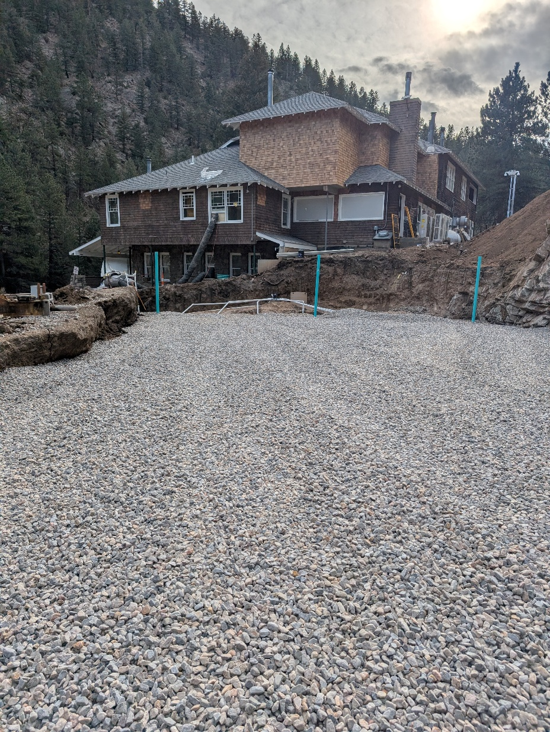

Slide 26
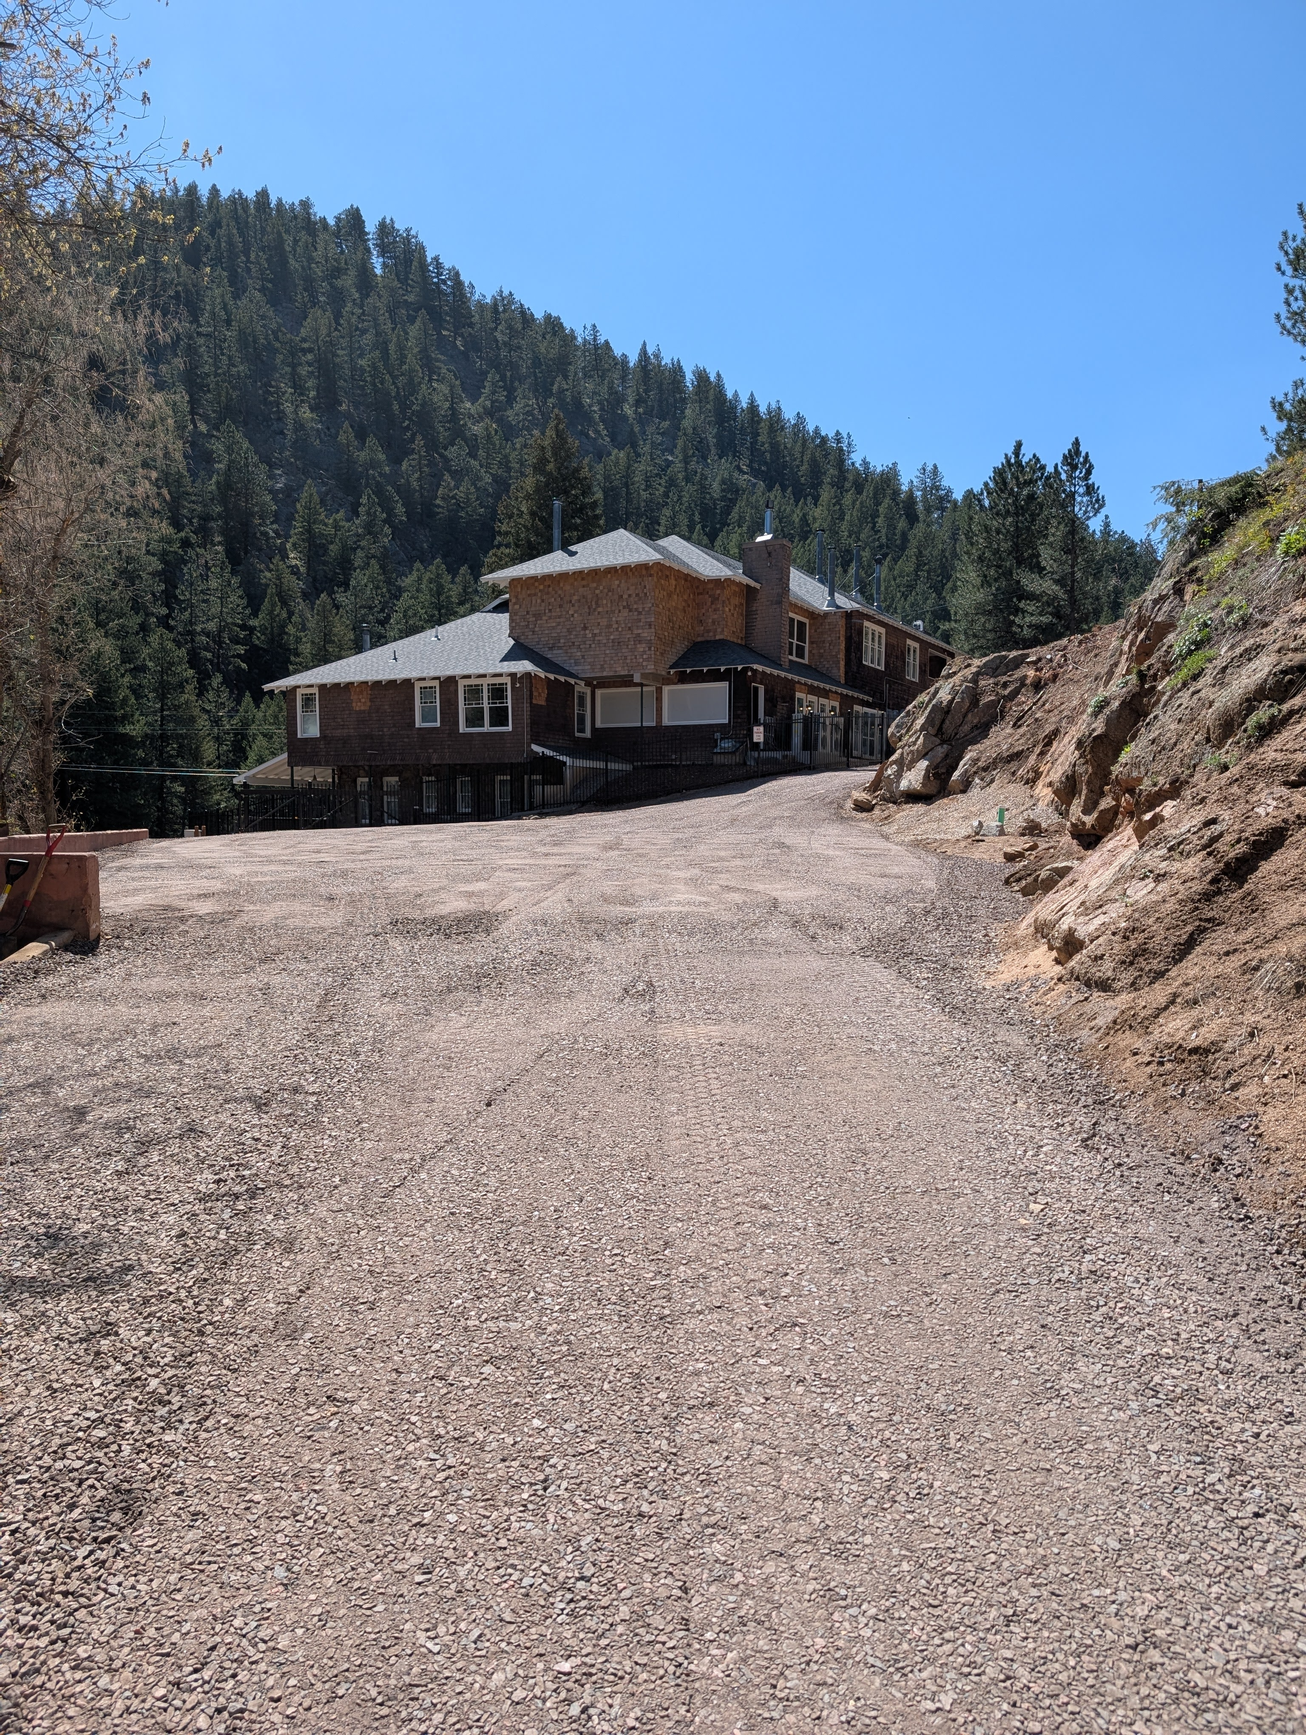
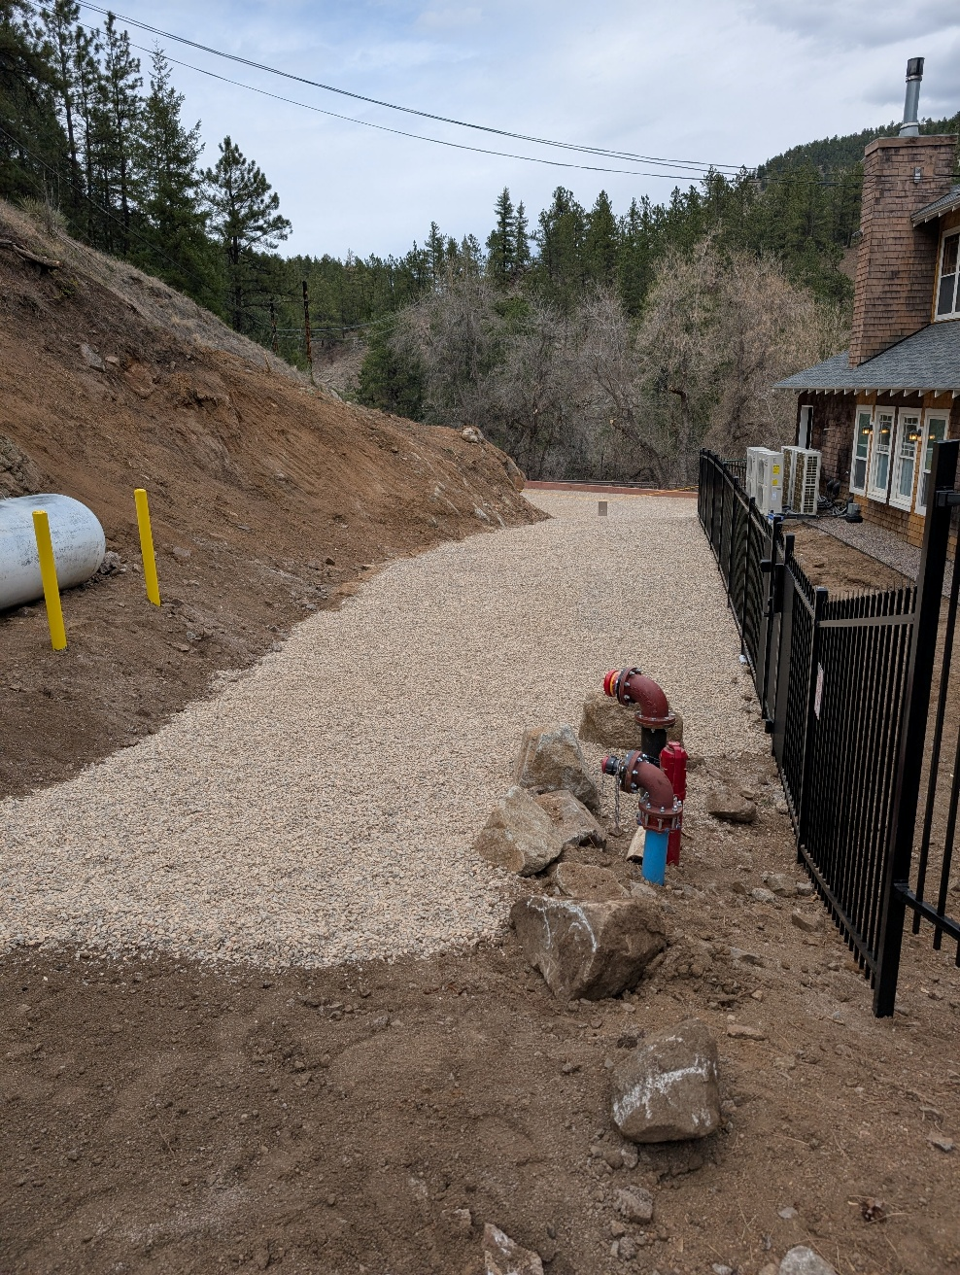
Finished STA Driveway

Slide 27



Church OWC, LLC.
Kate Carney, P.E.
kcarney@cowc.info
720-837-6397
CWS Excavating
Matthew Morgan
matthew@cwsexcavating.com
303-243-2298
Thank You

