Slide 1

Onsite Wastewater Treatment System Installation Challenges

Slide 2
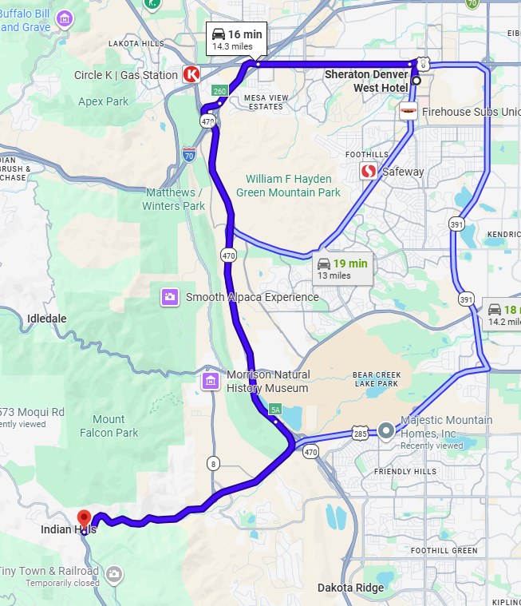
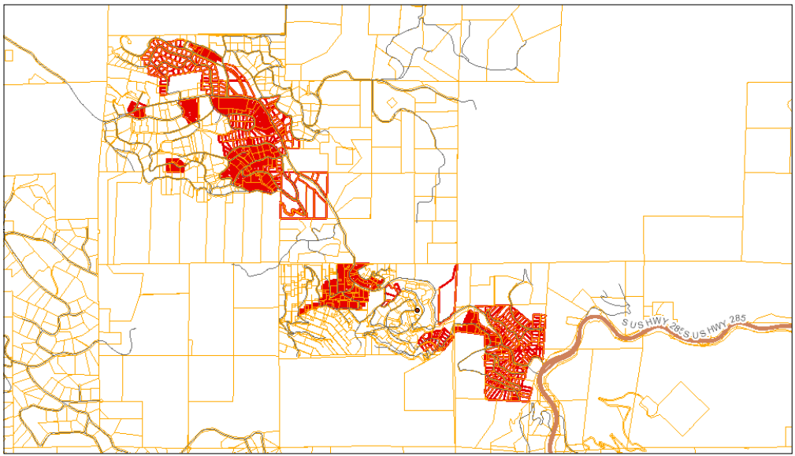
Indian Hills / Parmalee Gulch area
Notes:
Indian Hills / Parmalee Gulch Area is not too far from where the conference is being held. It is an area that has experienced increasingly contaminated ground water over the last century. The properties in red is the prohibition area. These properties are subject to Jefferson County’s OWTS standards for Indian Hills & Parmalee Gulch area 2022

Slide 3
Jefferson County OWTS Regs
Permitting
OWTS Standards for Indian Hills & Parmalee Gulch Area
Net Nitrogen Reduction must be achieved
Repairs on < 2 acres requires TL3N
Annual maintenance required
Notes:
These standards are a subset of Jefferson County’s OWTS regulations. The intent of these standards is prohibit the discharge of additional nitrate from OWTS and decrease the discharge of nitrate.
The county’s research and modeling has found that people can produce 2.7 KgN (kilograms of nitrate)/ person / year
By upgrading an existing TL1 system to TL3N we can reduce the nitrogen loading by over 70%

Slide 4
Indian Hills 23573 Moqui Road 2-bedroom residence OWTS Replacement
Challenges
Clay (type 4 soil)
0.44 acres
Owners want to save trees in yard as much as possible
Owners paying out of pocket
Setbacks to wells
Notes:
It is somewhat rare for this area to have a type 4 soil; however, this property had two 6-7 foot deep test pits that ribboned out to a type 4 clay.
Lot was very small. The area for the new STA was only 50 feet wide
Owners wanted to save trees if possible
Owners are paying out of pocket and prefer to keep capital costs low

Slide 5
Single-family residence 300-GPD New System specs
500-Gal poly tank for first compartment
Norweco Singulair Green 960 with Hydro Kinetic Bio Film Reactor
500-Gal poly discharge tank
Geoflow headworks and 1,000 sq. ft. of Geoflow drip STA
Notes:
We have had feedback from pumping companies that norweco tanks require pumping more often to keep up with the annual maintenance. We saw this as an opportunity to add a 500 gallon tank prior to the treatment unit and this could be compared over time to a similar system that does not have a 500 gallon tank prior
Norweco now provides a TL3N system that adds a Hydro Kinetic Bio Film Reactor to the system. The ongoing costs might be slightly higher than a recirculating media filter; such as the power consumption and the replacement aerators; however the upfront costs are somewhat lower.
500 gallon discharge tank. Colorado requires dosing with higher level treatment.
The area for the STA that we had to work with had some trees and was only 50 feet wide. We needed at least 1,000 sq ft so a bed type STA would have been around 28 – 30 feet long and 30 to 36 feet wide. With the slope of the property it would have required terracing out the backyard and wiping out most of the trees. And possibly some sand for leveling the chambers or sewer rock.
This is why we decided to use drip dispersal.

Slide 6
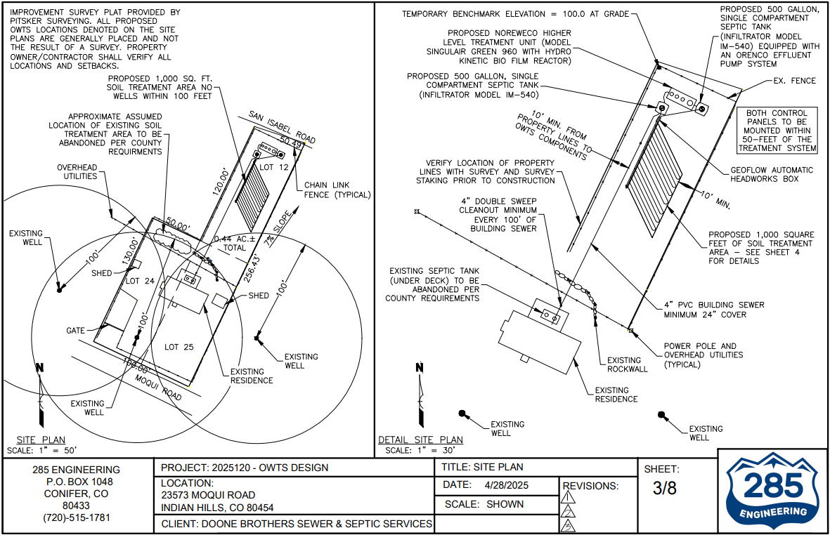
Existing and proposed system

Slide 7
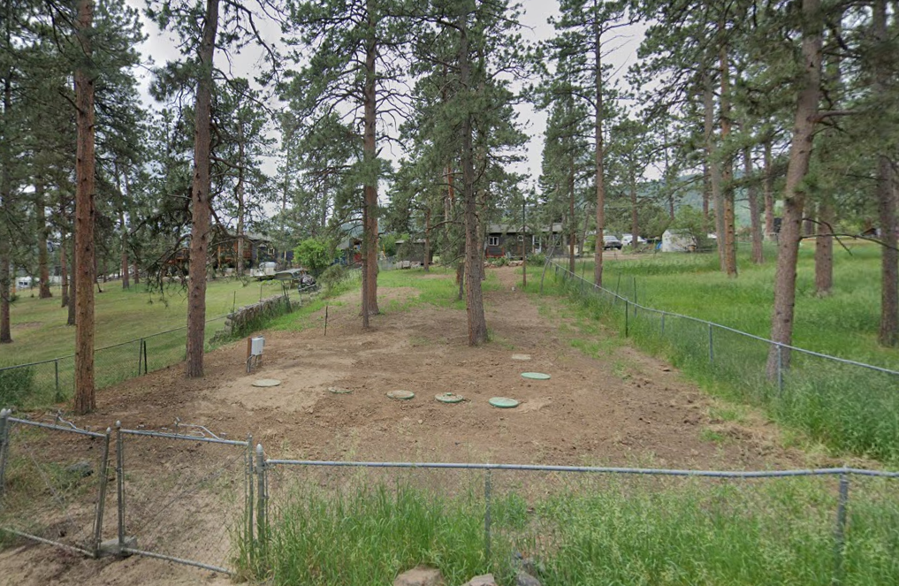
23573 Moqui Road, Indian Hills view from the road
Notes:
View of the trees that were saved. View is from the road looking south.

Slide 8
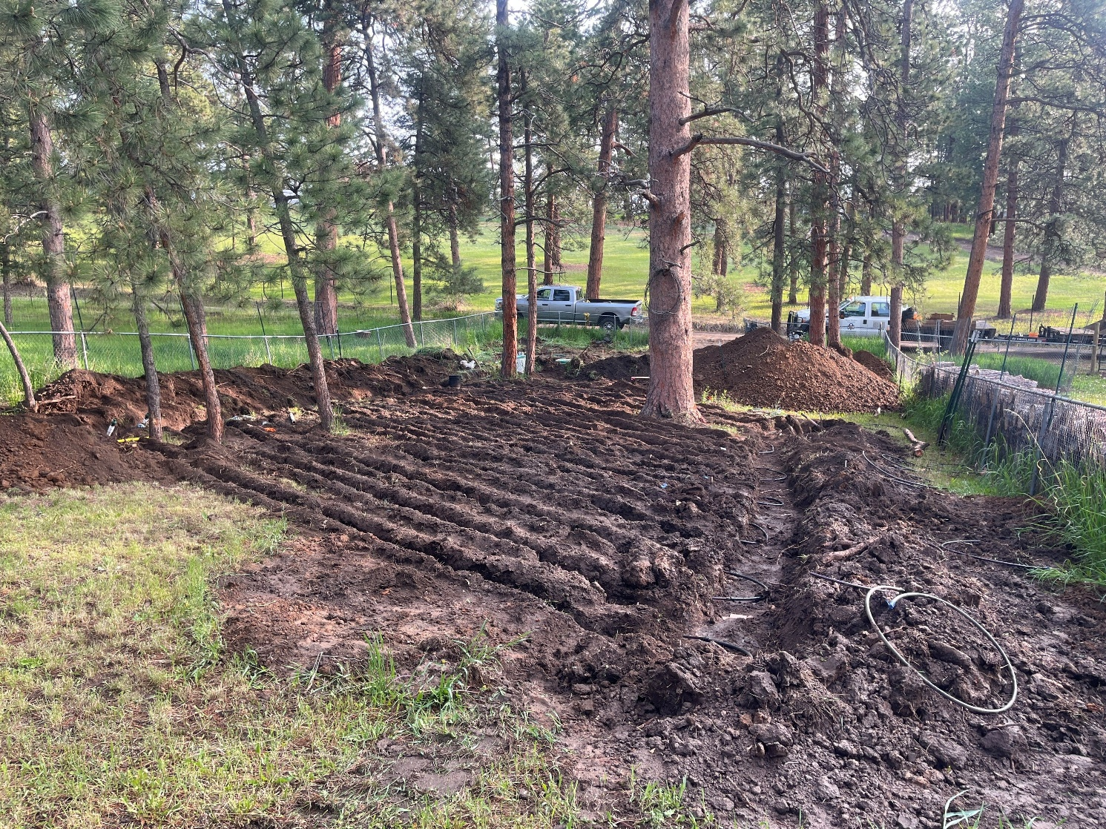
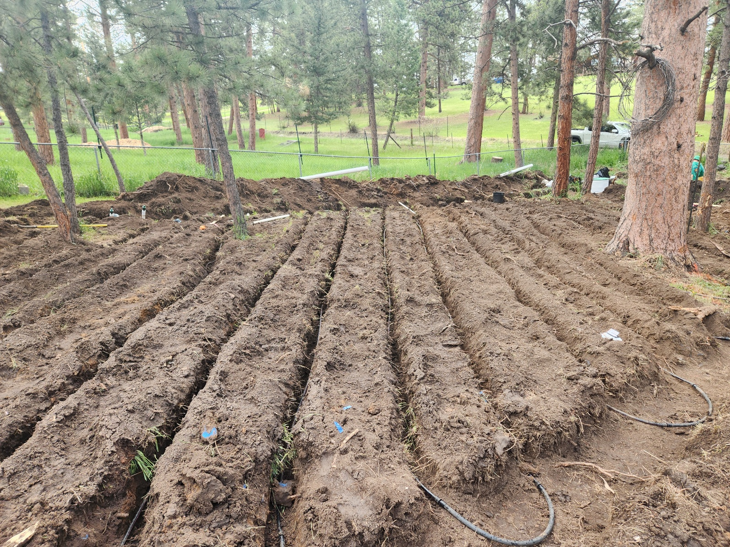
Notes:
Notice the drip tubing is only 10 to 12 inches deep and is capable of being routed around trees with minimal disturbance to the property.

Slide 9
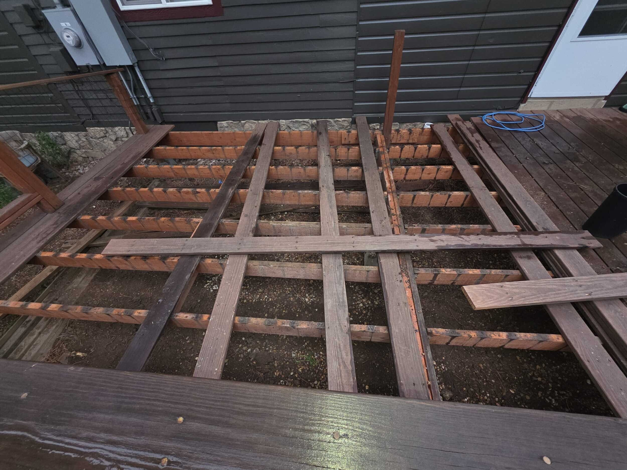
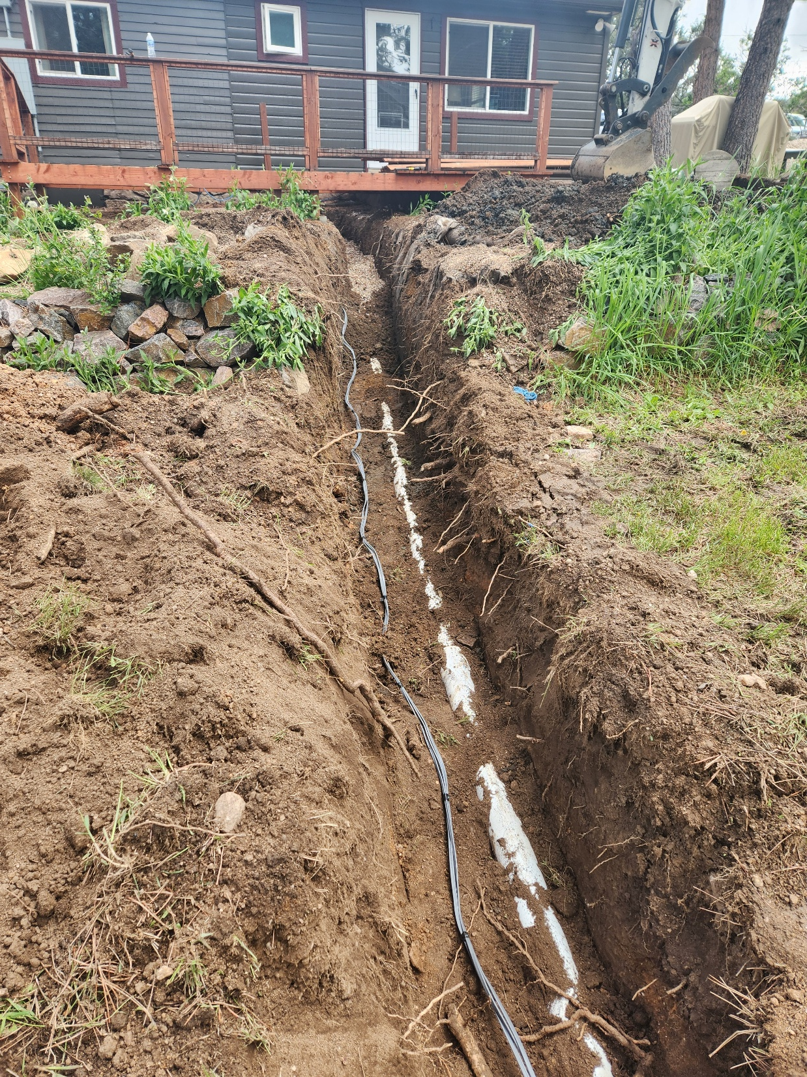
Notes:
Existing septic tank was underneath an existing deck. The tank had to be abandoned, and the building sewer bypassed down to the new tanks.

Slide 10
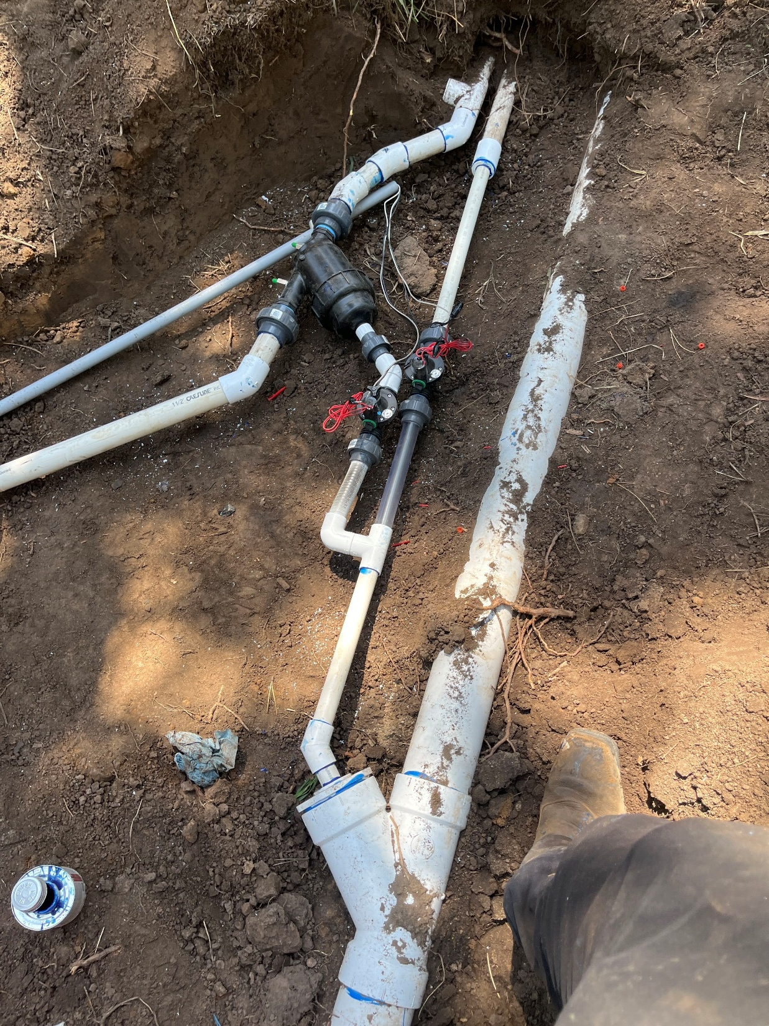
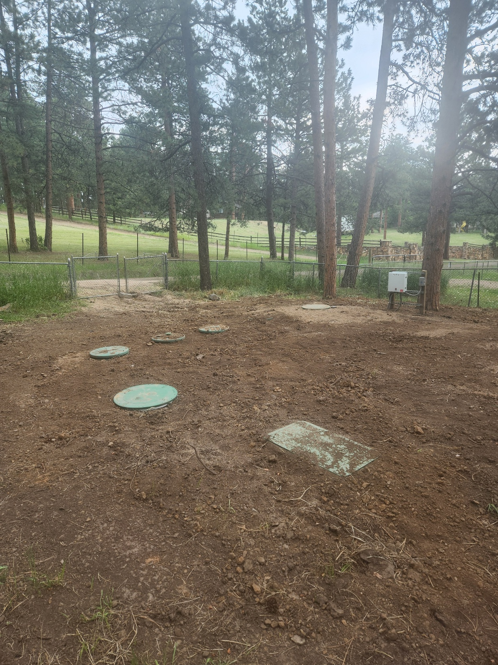
Notes:
Geoflow headworks plumbing and final grade photos

Slide 11
Indian Hills 5702 Santa Clara Road 2-bedroom residence Tank Replacement
Challenges
Indian Hills Prohibition area
Nowhere for an alternate STA that meets 200 foot well setback
Very limited access
0.233 acres
Large deck in the way
Any materials or equipment had to go down over a retaining wall
Setbacks to house, property lines and existing STA
Notes:
This site is also located in the Parmalee gulch prohibition area.
There is no where an alternate STA can be located that meets the 200 foot setback in the future. This means that Jefferson county will require HLT as part of the tank replacement.
All materials and equipment will have to work its way over an old tall retaining wall
Setbacks to house property lines and existing STA will come into play

Slide 12
5702 Santa Clara Road, Indian Hills 300 GPD Tank replacement specs
2 compartment Orenco Meander tank
Concrete was not an option over the retaining wall.
Meander tank is not as long as other tanks
We were able to stack the AX20 pod on top of the tank.
Orenco’s AdvanTex AX20 pod for TL3N
Not enough room to use an AXRT unit
24” diameter pump basin due to limited space
Colorado requires dosing with HLT
Existing soil treatment area to remain in use.
Notes:
We decided to use poly tank. Concrete tank would have required a crane.
The traditional 3 compartment septic tanks are around 13 feet long while the Meander tank if less than 9 feet in diameter.
A traditional 2 compartment tank and an AXRT unit would not fit.

Slide 13
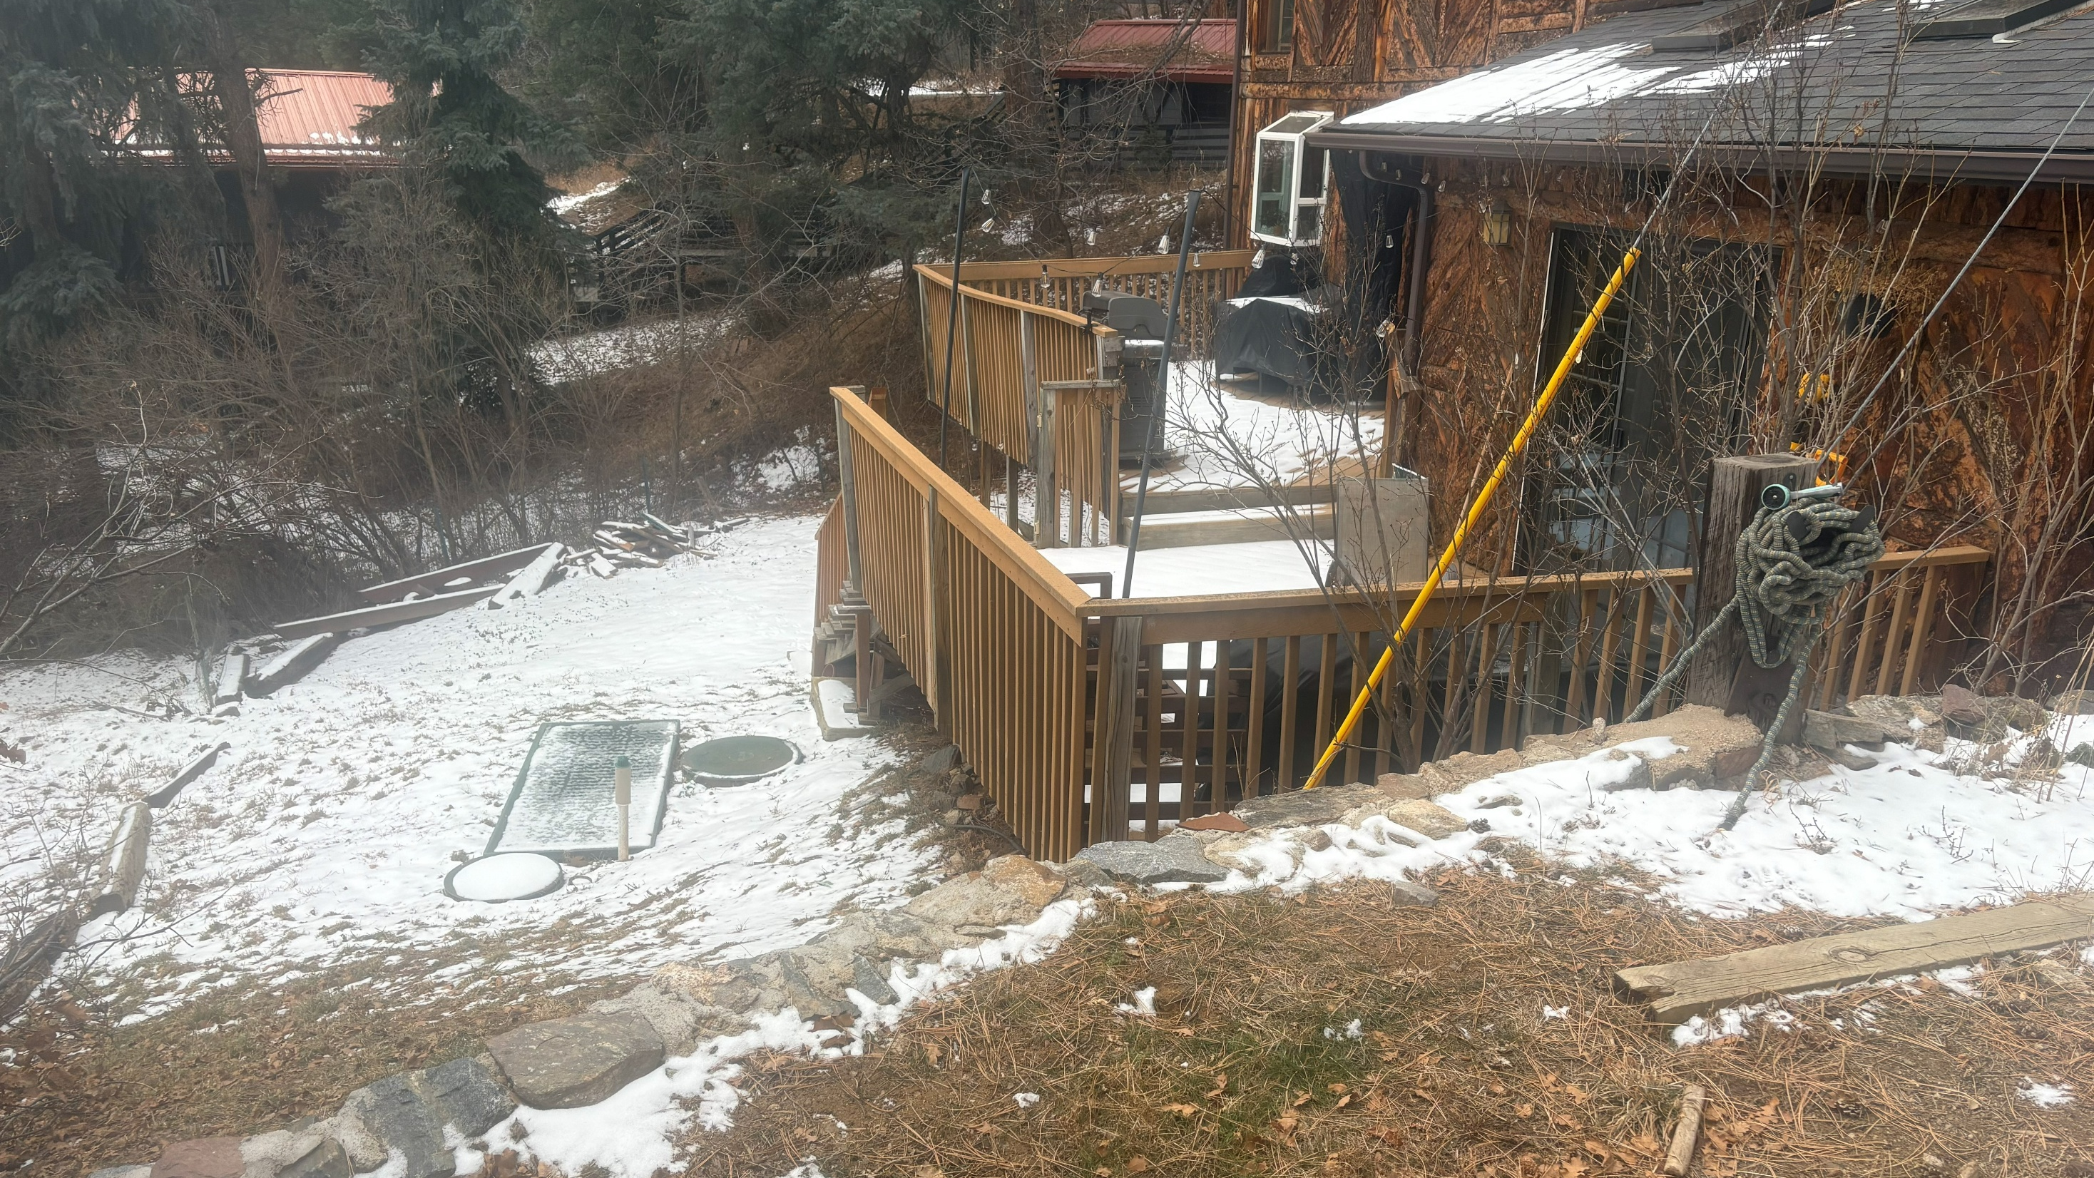
Notes:
View of the retaining wall from up top.

Slide 14
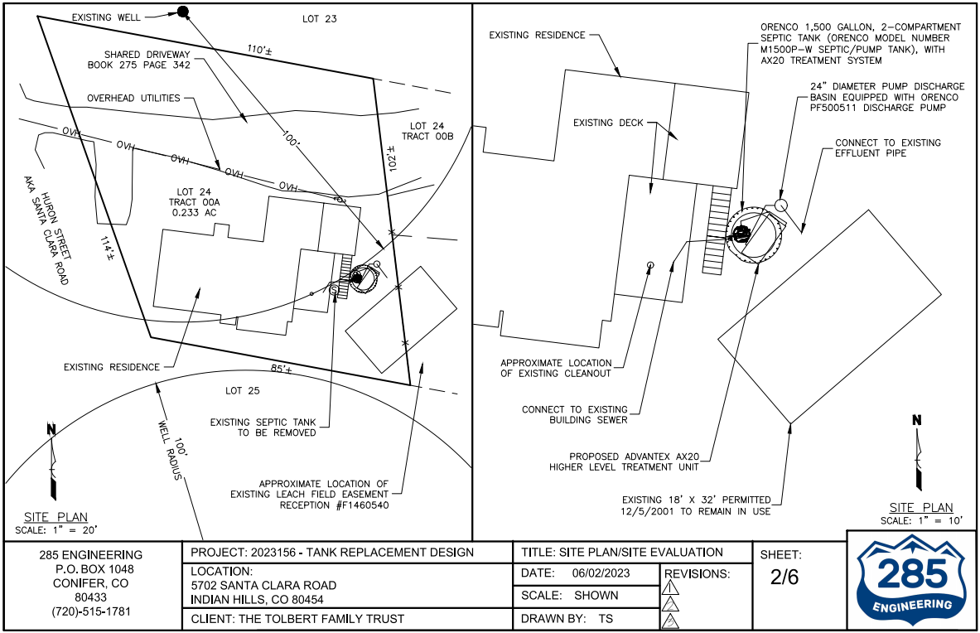
Notes:
Design Site plan

Slide 15
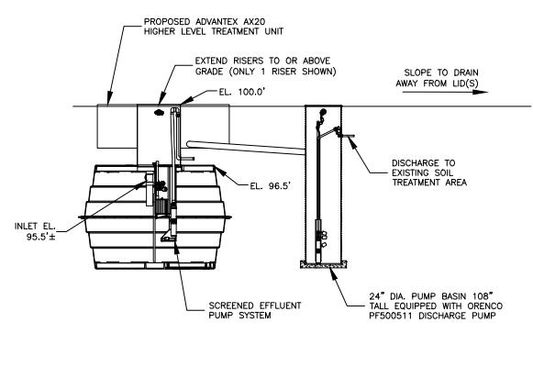
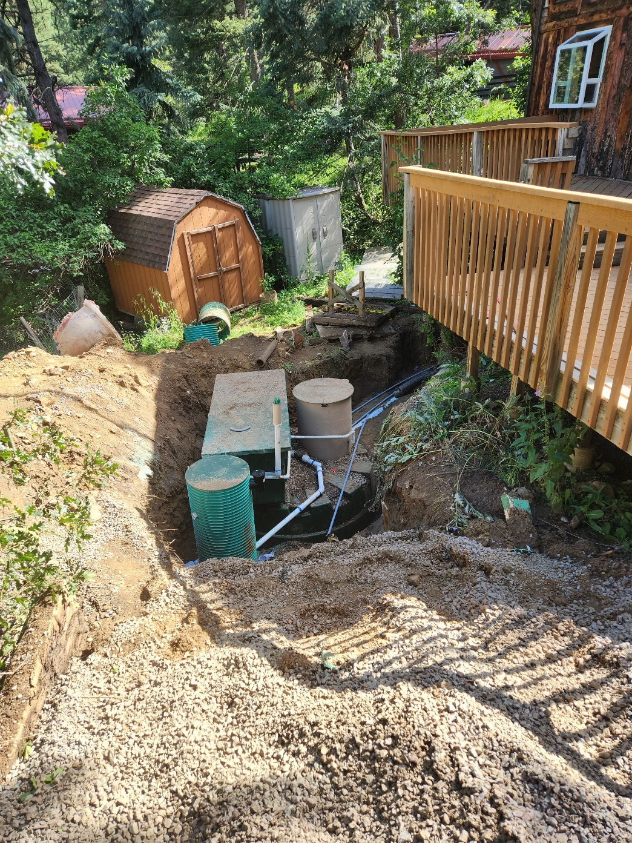
Notes:
Profile and installation photo

Slide 16
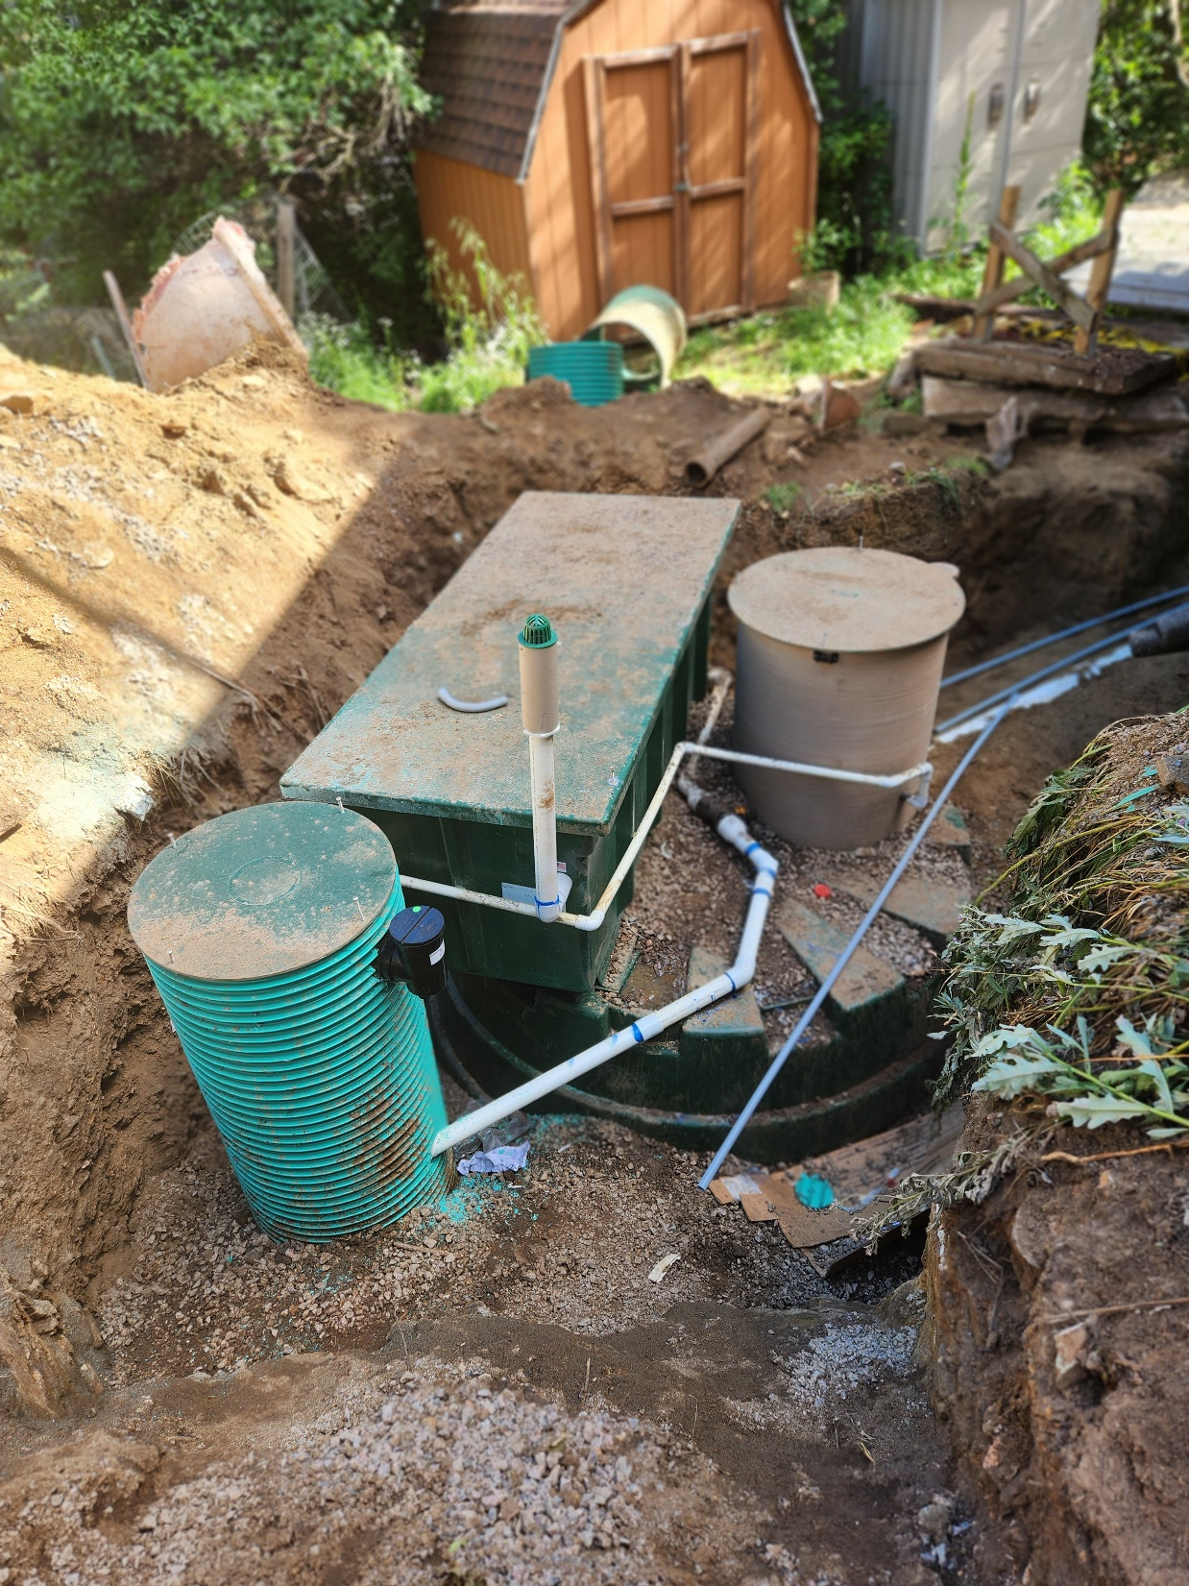
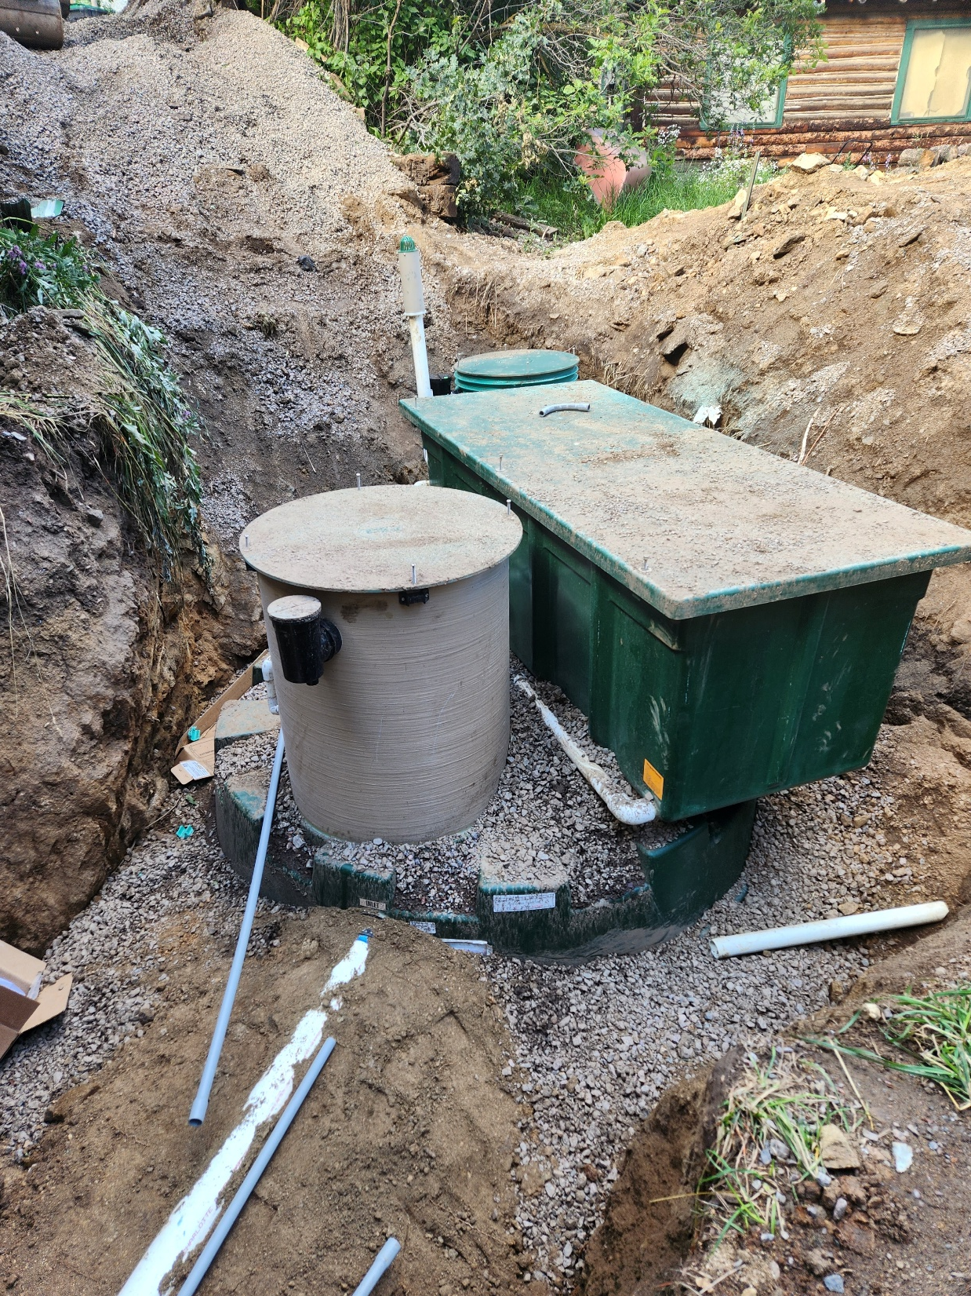
Notes:
Installation Photos

Slide 17
Questions?

Slide 18

Thank You

