Slide 1
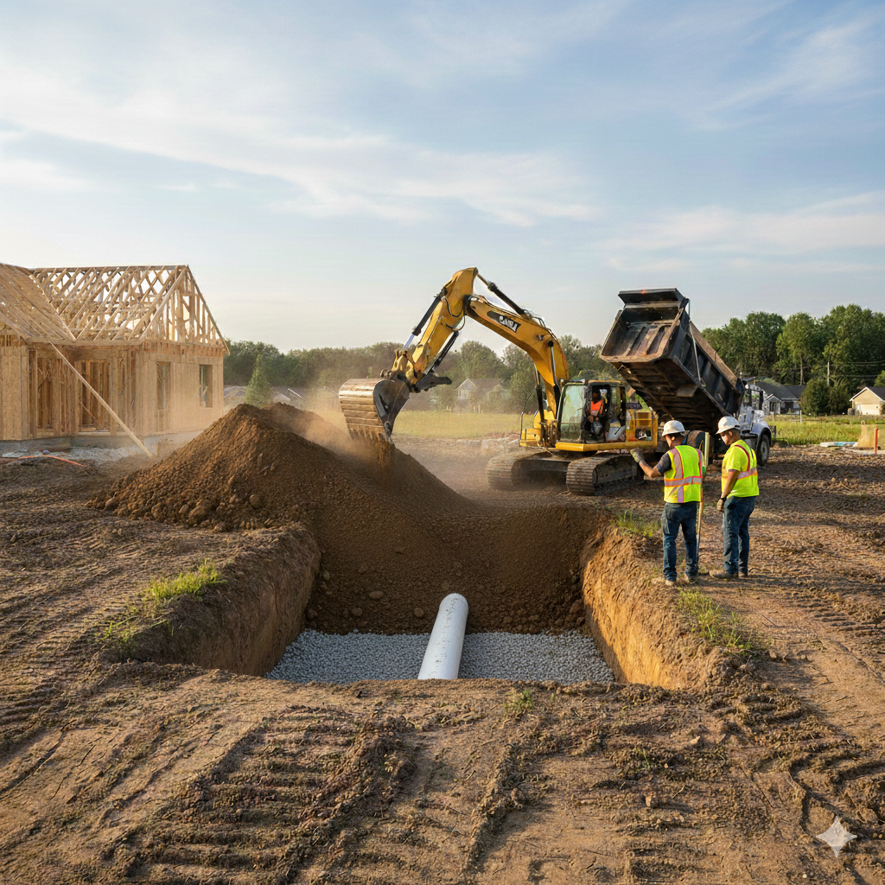
CPOW Conference 2026
Backfilling and Bedding Procedures for Tanks and Pipes from an Engineering Perspective
Pablo Bolaños, PE
XEG (Ximarros Engineering Group)
Notes:
1. The reason why its from an engineering perspective is because I am not an installer, I am an engineer.

Slide 2
Why this presentation?
The industry deserves excellence from all our professions:
  Engineers
  Installers
  Regulators
  Maintenance Providers
  Manufacturers of Proprietary Products
Properly executed projects makes this industry go forward.
Notes:
I'm in the wastewater but also design sewer lines, pressure force mains etc.
Do you know what I heard this year?
Septic Systems pollute groundwater.
From a local engineer for a large municipality in the Denver metro area after an undersized OWTS failed. ”That’s why we prefer that the client bring in big pipe unless there is political pressure to allow a septic system”.
Septic systems are killing manatees.
Lawsuit for a poorly installed system that flooded someone's basement.
I have seen way too many crazy things designed and installed.

Slide 3
Why this presentation?
Engineers
  Hold paramount the safety, health and welfare of the public.
Notes:
NSPE (National Society of Professional Engineers) Code of Ethics.

Slide 4
Why this presentation?
If something doesn’t go according to plan everyone gets thrown in to the blame party, even though it may not be their fault.
Notes:
I have been part of one lawsuit in which a plastic tank lifted up.
A 500-gallon tank lifted while the 1500 gallon perhaps sank.
Even though the installers job was proper compaction and bringing suitable soil the engineer was grouped into the fault.

Slide 5
Problems in the field
A lot of the biggest issues that I have seen out in the field come from backfilling and bedding.
Tanks and pipes are expensive to put in, and more expensive to dig up and move.

Slide 6
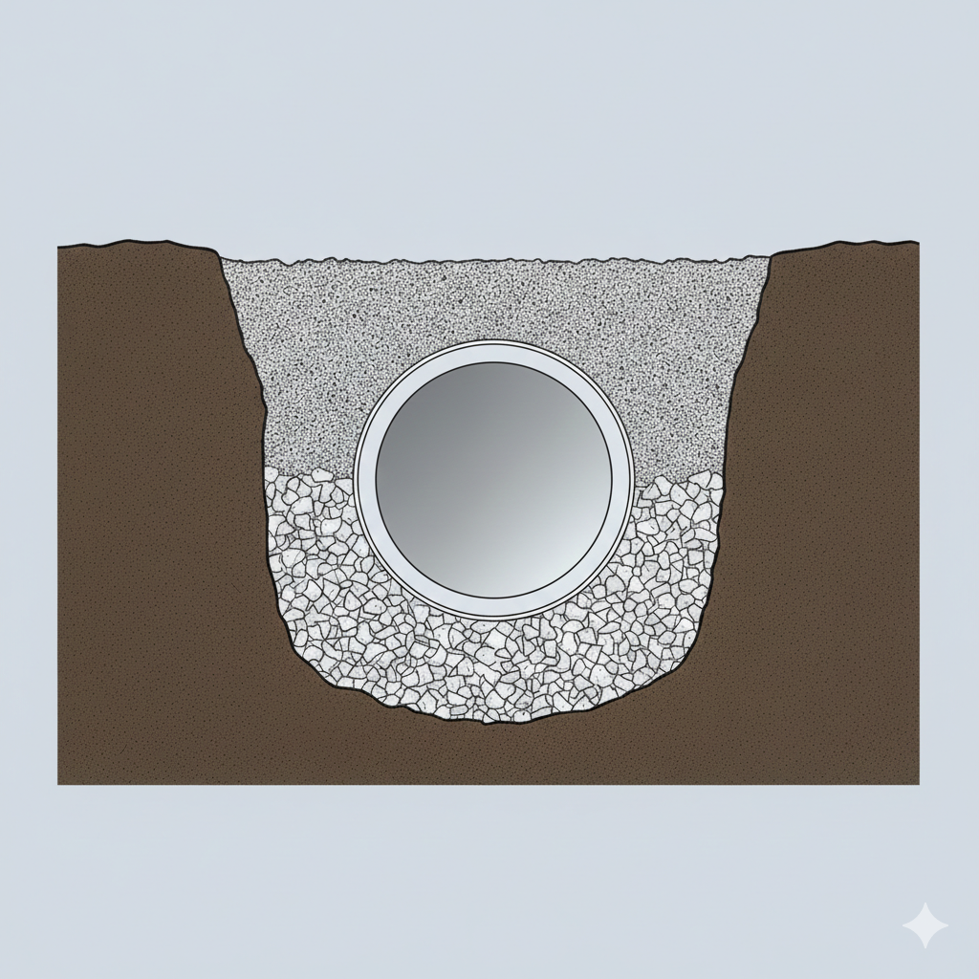
What is bedding?
Very simple, bedding is the bottom of the trench; what the pipe or tank rests on.

Slide 7
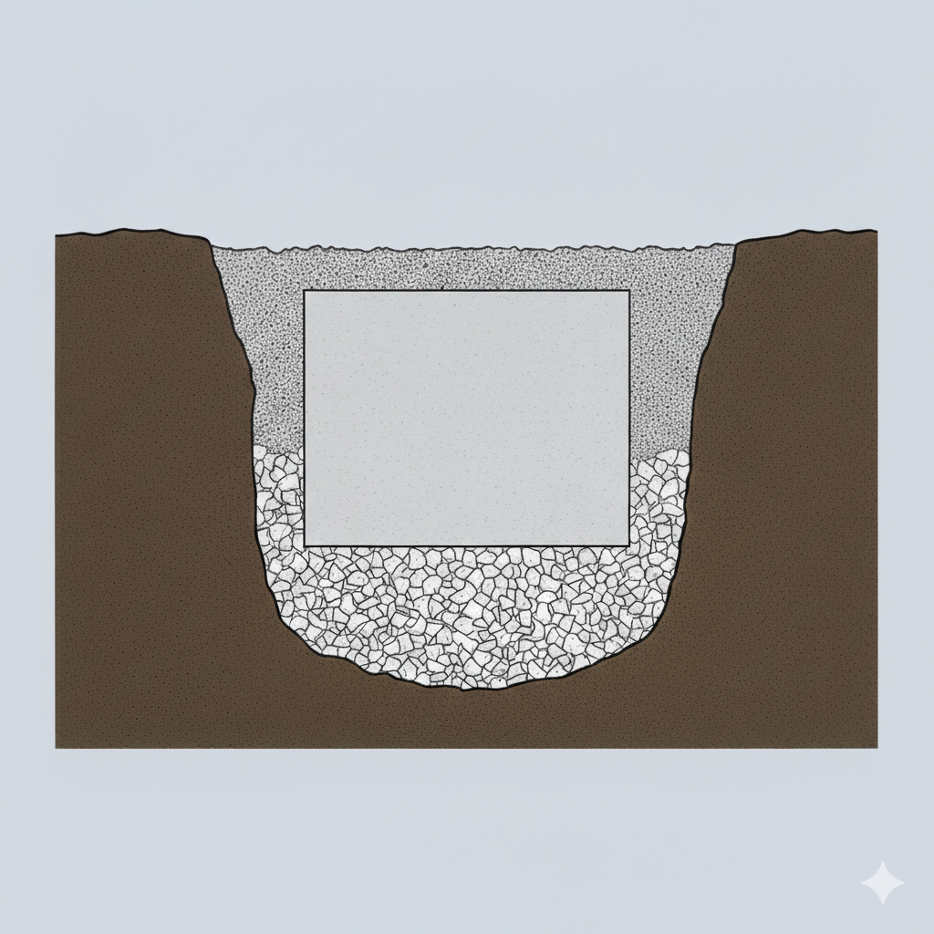
What is backfilling?
Very simple, backfill is the sides of the trench, what the pipe or tank rests on.

Slide 8
Is this rocket science or what?
Very simple, why take the time to talk about it?
Dig up the ground and put the tank and pipes in and dump the dirt back in, right?
Notes:
1. That is why I still cringe when I hear the word homeowner install.

Slide 9
Soils
Some soils can:
  Shrink/swell with moisture changes.
  Move with freeze/thaw cycles.
Notes:
1. If you are in the geotechnical world, you can know that buildings can move.
2. Different types of foundations.
3. Geotechnical Engineers accept that building in a clayey area is a privilege not a right, and there come risks associated with it.
4. If you ever read a geotechnical report, they say usually if you can afford the risk of 1-2” of heave then you use 1’ of structural fill.
5. Any geotechnical engineers in the room?
6. Moving buildings can have enormous risks such as piping breaking. It doesn’t have to be big cracks in the building to notice it.

Slide 10
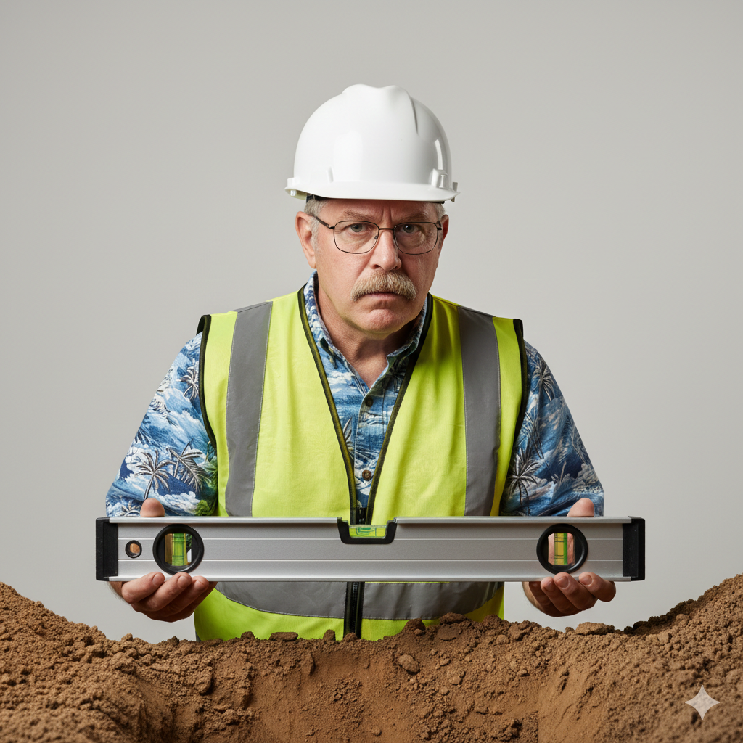

Soils
All the sudden the 1/8” per foot you perfected now ruined.
Notes:
1/8 per foot is 2.5 inches in a 20’ stick of pipe
Water flows by elevation gradient.

Slide 11
Let’s talk about pipes first.
What do the professionals say?
  ASTM D2321
    Standard Practice for Underground Installation of Thermoplastic Pipe for Sewers and Other Gravity-Flow Applications
Notes:
American society of testing and materials.
Please buy these, they are $80 a piece.

Slide 12
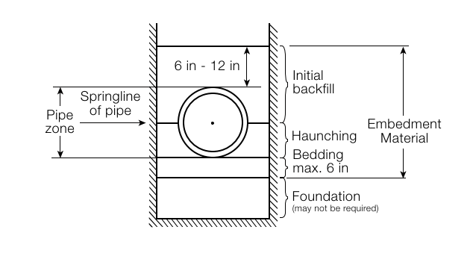
Let’s talk about pipes first.
Gravity Sewer Catalog by JM Eagle
Notes:
Three main ones, bedding, haunching and initial backfill are the most crucial ones when installing a pipe. These three ensure that the pipe wont move.
In Flexible pipes like the ones we use most of the time in septic systems (hdpe pvc) the bedding and the haunching provide lateral support.
A rigid pipe (concrete, cast iron) relies on the inherent strength of the material, it cannot deflect.
A flexible pipe deflects slightly under a load, it pushes against the soil around it, which then pushes back to support the pipe.
Note that after initial haunching it has been seen that settlement may continue for more than 10 years. I’ve been doing this all my life and have never seen anything move.

Slide 13

Let’s talk about pipes first.
Bedding
Gravity Sewer Catalog by JM Eagle
Notes:
Foundation if you have unstable soils.
Generally 6”.
Generally speaking, the bedding can be placed on native soil, that is if that soil is stable. You can conduct several tests to know that.
Well-graded crushed stone is the best. Like #67 AASHTO, which I have here in front.
Well graded crushed stone>well graded gravel>uniformly graded pea gravel.
If you have soil type 1 on site, I say use that. Verify with your engineer.

Slide 14










Let’s talk about pipes first.
Haunching
Gravity Sewer Catalog by JM Eagle
Notes:
The soil placed at the sides of a pipe from the bedding up to the to the spring line of the pipe.
For flexible pipe, the compaction of the huanching material is essential.
You can use a well graded granular material, usually the same as the bedding.
Do not use sand if you have groundwater.

Slide 15











Let’s talk about pipes first.
Initial Backfill
Gravity Sewer Catalog by JM Eagle
Notes:
Final Backfill
Height depends on the material, several jurisdictional authorities show something different.
This is a material that should not need a lot of compaction to avoid damaging the pipe.
That is why a granular material that should fulfill most compaction by being dumped is the best.

Slide 16
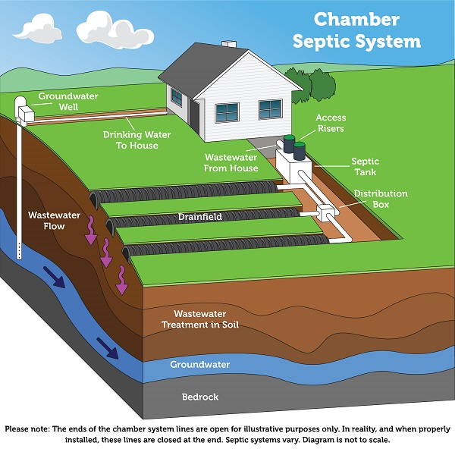
Let’s talk about pipes first.
OWTS 101.
https://www.epa.gov/septic/types-septic-systems#chamber
Notes:
Elevation gradient.
Talk about the why with the first 3 are important
Pipe coming out of the crawlspace
Systems, are shallow susceptible to freeze/thaw.

Slide 17
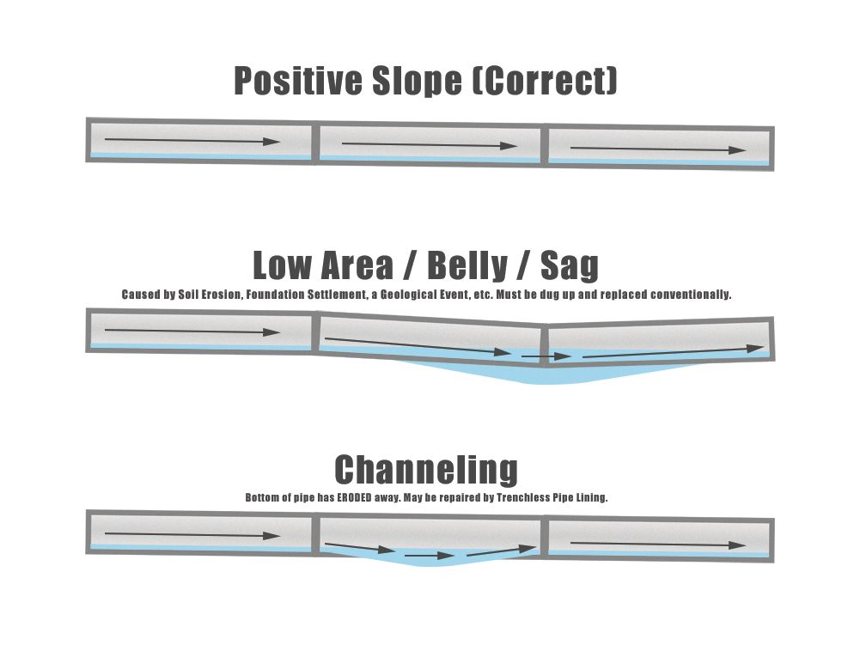
Let’s talk about pipes first.
OWTS 101.
https://pipelt.com/sewer-repair/sewer-line-belly-vs-pipe-channeling/
Notes:
Elevation gradient.
Talk about the why with the first 3 are important
Pipe coming out of the crawlspace
Systems, are shallow susceptible to freeze/thaw.

Slide 18


Let’s talk about pipes first.
Final Backfill
Gravity Sewer Catalog by JM Eagle
Notes:
Final Backfill
Now we’ve shifted over to supporting the pipe and avoiding differential settlement to what's above a pipe
The requirements are different based upon
How much cover to FG?
What kind of traffic we’ll see over it. Is it just landscaping?
It can be more complex but if you have more than 3’ of cover don’t sweat it. You can dump in almost anything back in the trench if its just landscape areas, gravel driveways, etc.
If cover is less than 3’ and traffic will go over the pipe, you have to pay attention.

Slide 19
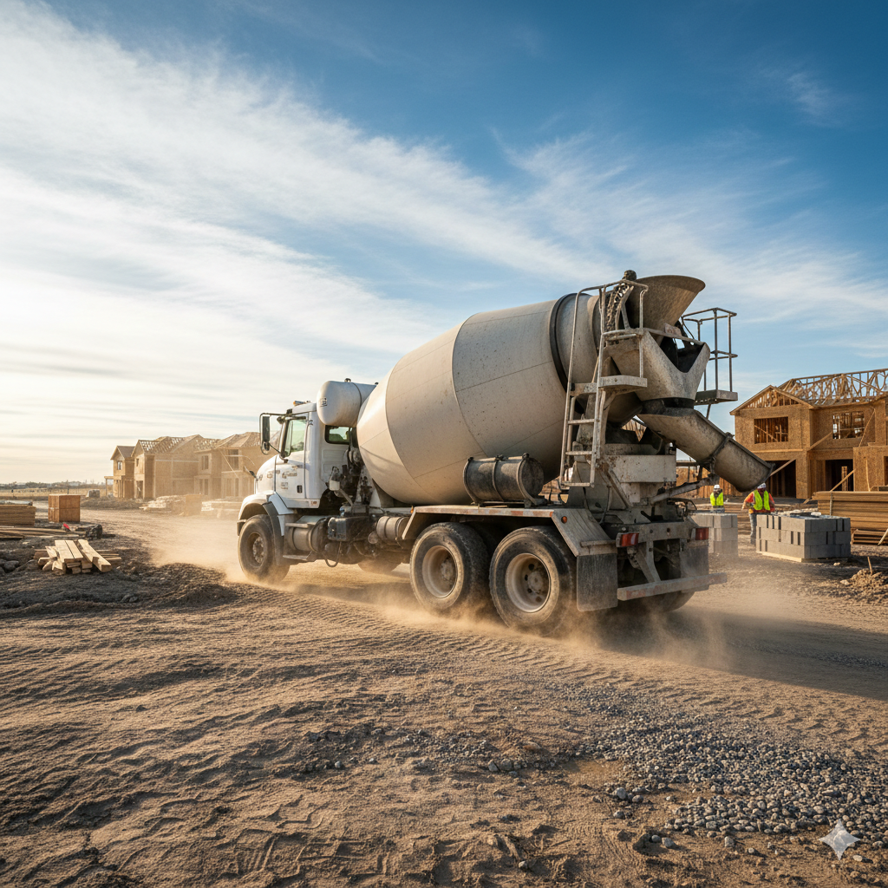
Let’s talk about pipes first.
Notes:
1. The importance of the final backfill has to do with protecting the pipe from deflection of live loads, i.e. A concrete truck the worst-case scenario that could show up on your jobsite. An HS 20 load is a 32,000 lb rear axle limit, or 16,000 lb per tire.

Slide 20
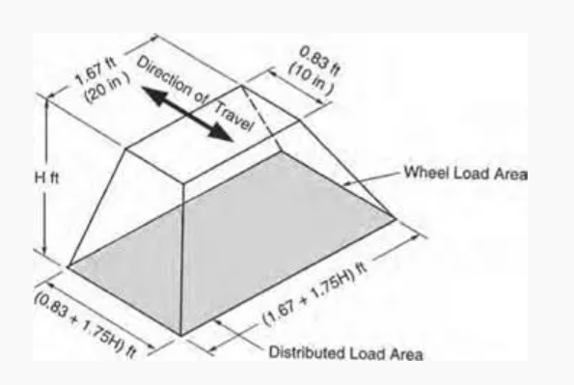
Let’s talk about pipes first.
Photo Credit: https://www.conteches.com/knowledge-center/learn/the-pipe-blog/part-ii-thats-a-load-off-my-mind/
Notes:
Generally, for 4” pipe, we’ll need about 2’ minimum of class one material for a hs20 loading
You can have 36” for class II,III, IV according to ASTM D2321
Generally speaking, if you have concrete you can get away with shallower depths of bury
Asphalt, its flexible pavement and it will impart more load to the ground underneath.
Gravel, the least forgiving.

Slide 21
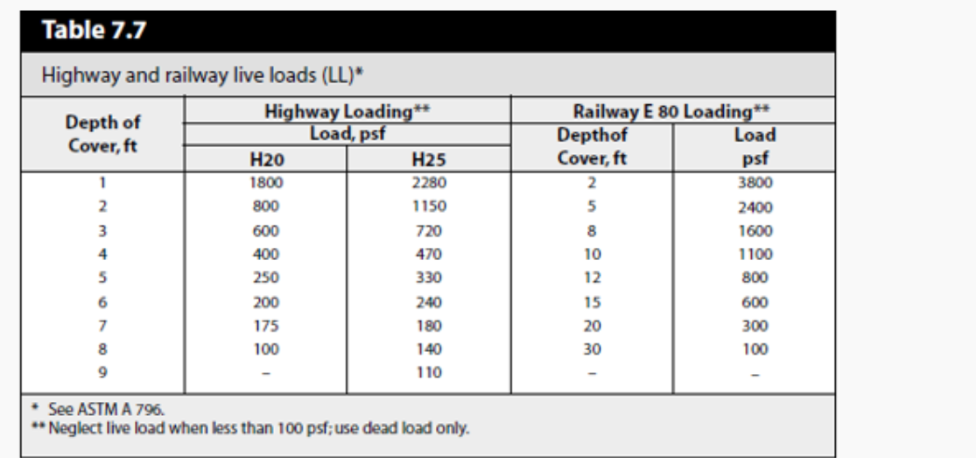
Let’s talk about pipes first.
Photo Credit: https://www.conteches.com/knowledge-center/learn/the-pipe-blog/part-ii-thats-a-load-off-my-mind/
Notes:
Generally, for 4” pipe, we’ll need about 2’ minimum of class one materials for a hs20 loading
You can have 36” for class II,III, IV according to ASTM D2321
Generally speaking, if you have concrete you can get away with shallower depths of bury
Asphalt, its flexible pavement and it will impart more load to the ground underneath.
Gravel, the least forgiving.

Slide 22

Let’s talk about pipes first.
SDR vs SCH
  SDR
    Standard Dimensional Ratio
  SCH
    Schedule
      SCH40
      SCH80
$$SDR=\frac{D_{0}}{t}$$
Photo Credit: https://www.conteches.com/knowledge-center/learn/the-pipe-blog/part-ii-thats-a-load-off-my-mind/
Notes:
Tricky here.
Standard Dimensional Ratio is Do/t.
D0 is averge outside diameter
T is thickness
SDR 35 the outside dieamter of the pipe is 35 times larger than the thickness
SDR 35
46 psi pipe stiffness
115 psi pipe stiffness
Industry standard is not to allow more than 3-5% deflection
Schedule is by service pressure and allowable stress of the material

Slide 23
Let’s talk about pipes first.
  Example
    SDR 35 (46 psi stiffness)
    SCH 40 (foam core) (897 psi)
    SCH40 (solid wall) (897 psi)
  Design Parameters
    Amount of cover = 2’.
    Moderate Compaction. E’= 1,000 psi
Photo Credit: https://www.conteches.com/knowledge-center/learn/the-pipe-blog/part-ii-thats-a-load-off-my-mind/
Notes:
Moderate Compaction
E’ = 1,000 psi Modulus of Soil Reaction.
Examples
Dumped crusher rock
85%—95% proctor density for Class II soils.
Coarse-grained soils with fines less than 12% passing under the #200 sieve.

Slide 24
Let’s talk about pipes first.
  Example
    SDR 35 (46 psi stiffness)
    SCH 40 (foam core) (897 psi)
    SCH40 (solid wall) (897 psi)
  Results
    SDR 35 (3-5% deflection)
    SCH 40 (1% deflection)
Photo Credit: https://www.conteches.com/knowledge-center/learn/the-pipe-blog/part-ii-thats-a-load-off-my-mind/
Notes:
Moderate Compaction
Modulus of Soil Reaction E’ = 1,000 psi
Examples
Dumped crusher rock
85%—95% proctor density for Class II soils.
Coarse-grained soils with fines less than 12% passing under the #200 sieve.

Slide 25
Let’s talk about pipes first.
  Example
    SDR 35 (46 psi stiffness)
    SCH 40 (foam core) (897 psi)
    SCH40 (solid wall) (897 psi)
  Design Parameters
    Amount of cover = 2’.
    High Compaction. E’=3,000 psi
Photo Credit: https://www.conteches.com/knowledge-center/learn/the-pipe-blog/part-ii-thats-a-load-off-my-mind/
Notes:
Moderate Compaction
Modulus of Elasticity E’ = 3,000 psi. Modulus of Soil Reaction.
Examples
Compacted crushed rock, 3,000 psi.
Basically 1 ½” rock minus, washed angular rock.

Slide 26
Let’s talk about pipes first.
  Example
    SDR 35 (46 psi stiffness)
    SCH 40 (foam core) (897 psi)
    SCH40 (solid wall) (897 psi)
  Results
    SDR 35 (1% deflection)
    SCH 40 (0.1% deflection)
Photo Credit: https://www.conteches.com/knowledge-center/learn/the-pipe-blog/part-ii-thats-a-load-off-my-mind/
Notes:
In this scenario, the rock proves as a good foundation for the pipe, distributing the load.
As you can see this can be quite complex, that’s why you as the engineer need to be knowledgeable.
Specially in wastewater systems, where cover limits on the tank cannot exceed 4’ and the infiltrative surface at the STA cannot be deeper than 4’.

Slide 27

Let’s talk about pipes first.
Gravity Sewer Catalog by JM Eagle
Notes:
1. The standard classes are given by ASTM D2321. Buy a copy of this thing please!
2. Holy smokes, this is more complex than my morning Wheaties back of the cereal problem.
3.

Slide 28


Let’s talk about pipes first.
Cannot use
  Organic Soils
  Fine grained soils
    Clay, clay, clay.
Gravity Sewer Catalog by JM Eagle
Notes:
Organic soils probably tough to find in Colorado. The point of this slide is that you and I are not generally geotechnical engineers, and we can’t generally know what types of soils we have. Do we want to spend $2600 on Billys new OWTS replacement on a geotechnical study? Maybe they are conducting a study for the house foundation?
If you are working on a bigger commercial project you’ll probably have access to a geotechnical engineer.
Can use IVA (4A) if the trench is dry and you have to condition to optimum moisture content. You have to bring water :/

Slide 29
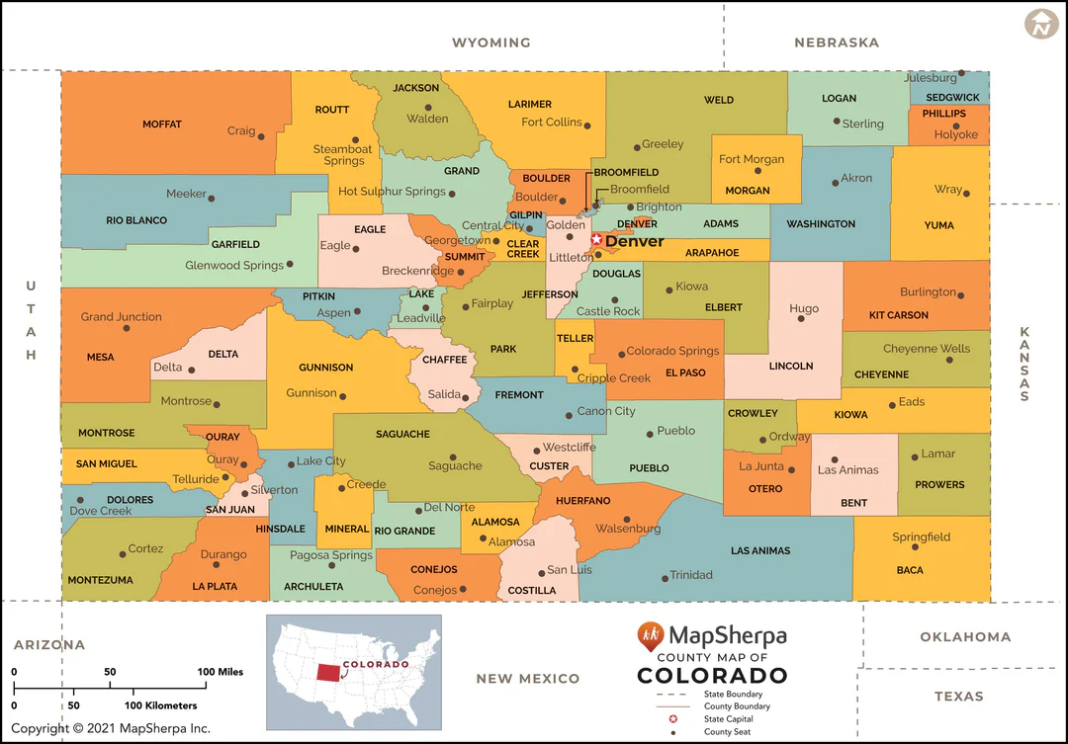
Let’s talk about pipes first.
Notes:
Generally speaking, anything east of the divide has got a good chance of being clayey. I’ve only been in the western slope a couple of times, Rifle, Carbondale and I’ve found clayey soils.

Slide 30
Let’s talk about pipes first.
Ok fine, what can I bring in?
  If you have to bring something you can bring in:
    Crushed Concrete (careful), ASTMD2321
      Obtain a gradation.
    Angular rock (expensive)
    Well Graded Sand
    Angular Squeege Sand
    ¾” coarse aggregate #67 AASHTO.
Notes:
1. Just have to get a gradation like C33 sand, some C33 sand “concrete sand” meets the secondary sand spec, but some does not.
2.

Slide 31

Let’s talk about pipes first.
Notes:
Please don’t be the cheapest bid by putting a tank or pipe in soil that will ruin someone's day.

Slide 32
Speaking of Money
Use short 4-in sewer runs.
Use short 4-in sewer runs to the tank and then use pressure pipe.
How much is this all going to cost?
  30 LF of 4-in pipe with gravel.
    30” trench
    6” bedding, 12” initial backfill, and haunching.
    $400
Notes:
I've seen very long runs, unnecessary cost. Homeowner wants to get it as far away from the house as possible
4.58 cu ft of material per lf of pipe
435 lb of material per LF
For 30 Lf is 6.5 tons, at $50/ ton. $400. To me this is worth it. I’ve seen a contractor who has put in tanks in high groundwater scenarios with manufactured aggregate and has been fine, and then contractors saying it will be fine on native material and lower groundwater, and then tanks move.
Experience says it, the people who sell you this pipe say it, (JM Eagle). What is left for us to enforce this?
Regulators must begin to enforce this.

Slide 33
Let’s talk about pipes first.
Conclusion
  Pay attention to pipes that have less than 3’ of cover.
  Pay attention to proper haunching with the right materials.
Notes:
If you have less than 3’ of cover you may need the whole trench to be roadbase and non-native material.
Frost also gets driven down by driveways, the frost heave can make a belly in a pipe.

Slide 34
Let’s talk about tanks now.
Three main types of tanks.
  HDPE (plastic).
  Concrete
  Fiberglass

Slide 35
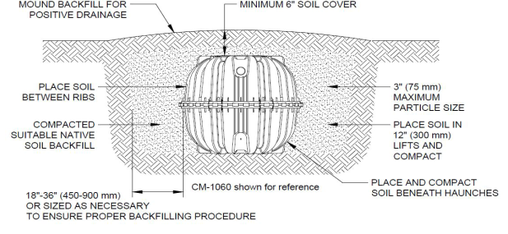
Let’s talk about tanks now.
HDPE
Notes:
I'm showing infiltrators specification here. It’s the tank I'm most familiar with, there is Roth, poly pocket, home depot special and others in the approved product list I'm sure.
Note that you have to over ex the hole by 18” to 36”
No rocket science here.

Slide 36
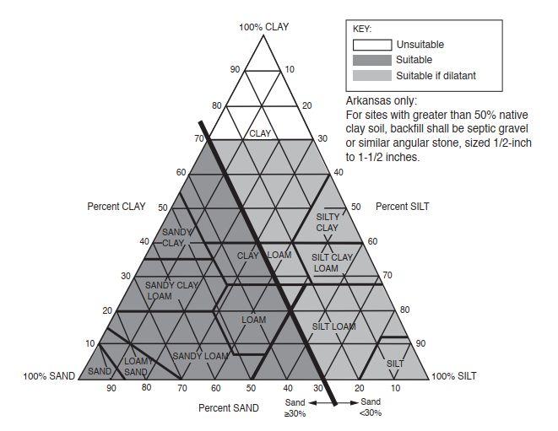
Let’s talk about tanks now.
HDPE
Notes:
1. Generally speaking you cannot backfill with any soil that is a 3, 3A, 4, 4A. By the way these instructions come in the tank when you buy it.
This is for 0.5-2’ of bury depth
Ask Eric and Dennis about dilatant.

Slide 37
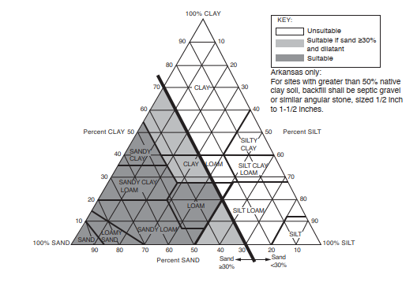
Let’s talk about tanks now.
HDPE
Notes:
This is for 2-4’ of bury depth.
The soil is less forgiving, note that the unshaded is unsuitable.
How will you know how much soil will end up on top of the tank?
If I am in your shoes as a designer, unless I have a soil type 1 from 0-8’ I’m not using the native soil. Even a silt loam which is a 2 or 2A is unsuitable.
It probably has to do with lateral forces exerted on the tank to compromise its integrity.

Slide 38
Let’s talk about tanks now.
Notes:
What can go wrong?
Soils with fines can absorb moisture and swell. Pushes on the tank laterally and compromises the midseam here. Freeze/thaw cycles can also push against the tanks.
It can also warp the risers as the soil pushes against them. Ribbed risers, concrete ones or culverts are more forgiving. Yes, you need to bring granular material all the way to the risers.
No pea gravel or rounded stone – use angular / road base material / Sand per infiltrator

Slide 39
Concrete Tank
Concrete
  ASTM C891. Standard Practice for the Installation of Underground Precast Concrete Utility Structures.
    What does it say?
      Use 4-6 ” of granular material under the tank.
      Do not backfill with expansive material.
    Haunching is critical
Notes:
Tank settlement and uplift will ruin a contractor and a homeowners day
A bad pump you can fix, electrical problem, you can fix. If you have to lift out a tank and reset it you are going to bankrupt your business. Do not take that risk.

Slide 40
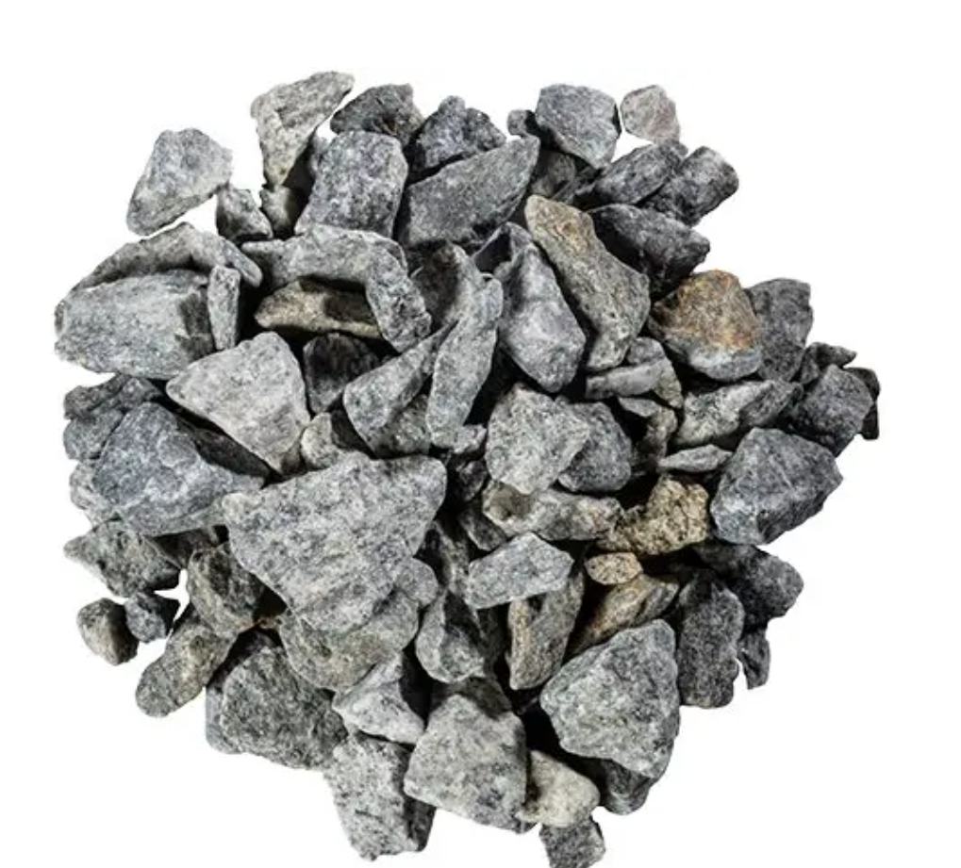
Granular Materials
ASTM D2321
  Class I
    Class IA
      Angular, crushed stone or rock. Contain no fines
    Class IB
      Stone and sand mixtures.
Notes:
What is a granular material?
Class I, Class II and Class III of the ASTM D2321
Class I is probably not good for plastic tank, it could puncture the tank?
Eric, Dennis?
Class IB
Up to 50% passing the No 4, 1/5” particle size
Class IB could be used in preventing migration of fines into the gravel.

Slide 41
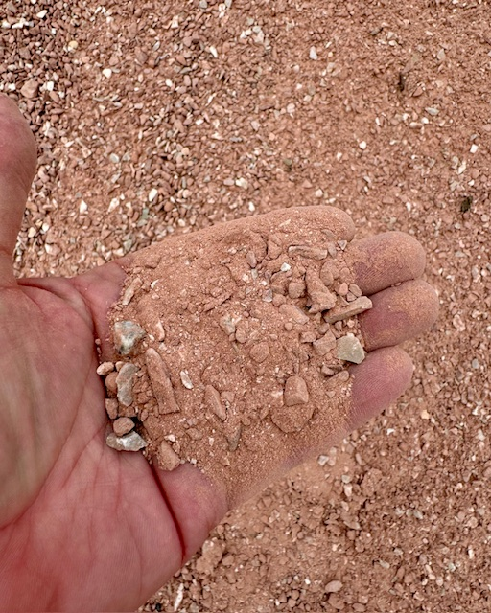
Granular Materials
ASTM D2321
  Class II
    GW Well graded gravel
    GP Poorly graded gravel
    SW Well graded sand
    SP Poorly graded sand
Notes:
. Well-Graded Soil
A well-graded soil contains a wide variety of particle sizes (from large gravel to fine sand). Because there are many different sizes, the smaller particles fill the voids (gaps) between the larger ones.
Engineering Properties:
High Density: More solids per cubic inch.
High Shear Strength: The interlocking grains make it harder for the soil to slide or shift.
Low Permeability: Water has a harder time traveling through the tiny, filled-in gaps.
Best For: Structural fill, road bases, and embankments.
2. Poorly Graded Soil
A poorly graded soil is "uniform"—the particles are mostly the same size. Because they are all roughly the same, they don't pack together tightly, leaving large gaps (voids) between them.
Engineering Properties:
Low Density: More air/water space between particles.
High Permeability: Water flows through it easily (like marbles in a jar).
Lower Stability: Without small particles to lock the big ones in place, it can shift more easily under weight.
Best For: Drainage systems, French drains, and filter blankets.
Symbol (USCS): Usually denoted with a P (e.g., GP for Poorly Graded Gravel).

Slide 42
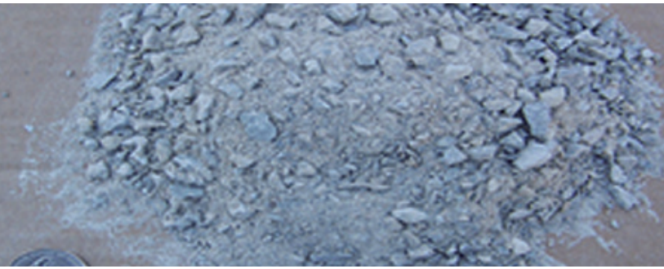
Granular Materials
ASTM D2321
  Class III
    GM Silty Gravel
    GC Clayey Gravels
    SM Silty Sands
    SC Clayey sands
Notes:
What is a granular material?
Class I, Class II and Class III of the ASTM D2321
We touched on it briefly but its

Slide 43
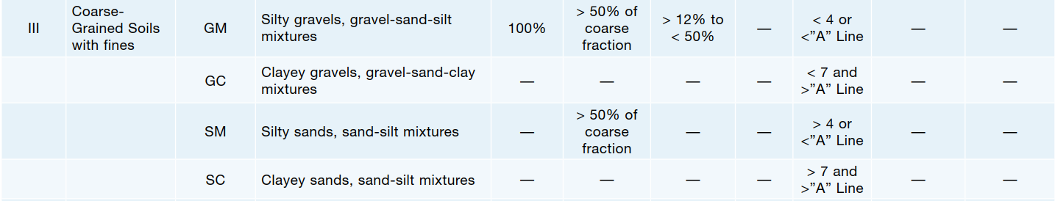
Granular Materials
ASTM D2321
  Class III
Notes:
Class III
Note that there are Atterberg limits, for this one. There is a liquid limit for these. The liquid limit has to be evaluated. Soil has little shear strength at this liquid limit. Cannot support structures, pipes, etc.
Anyway, this is stuff most wastewater engineers are not going to be able to tell you, you’ll need a geotechnical engineer.
If you pay for a $2,500 study, and you could have just bought aggregate with that money. so it doesn’t make sense to me.

Slide 44
Granular Materials
AASHTO #67 ¾” Gravel
¾”Class 6 Roadbase
Well-Graded Sand
Angular Squeegee Sand
Notes:
Display the different types of materials.
FYI, if you go to the store and ask ASTM type I, they are going to look at you funny.
I got these from my local site one supply in Castle Rock for free. Here is their shout out, they didn’t let me pay.

Slide 45
Groundwater
  ASTM D2321, Class IA
    Avoid this one in high groundwater conditions, it can turn into a French drain.
    Use Class IB or II.
Notes:
I have a sample upfront for you to see.

Slide 46
Groundwater
  Water can do bad things.
    Move drainage away from tanks.
    Use a French drain around the tank that daylights into the foundation drain system.
    Use geotextile fabric to allow water to get through, but prevent migration of fines
Notes:
Move drainage away from tanks
A lot of buildings have foundation drains that have a sump pump, specially homes with basements.
Connect to those to remove water as needed moisture.
If there is groundwater you will need anchoring as well, but that does not mean that if you anchor you can use poor soils for bedding and backfilling. I have seen this.

Slide 47
What are regulatory agencies saying?
Reg 43.9.6D
  Schedule 40 ASTM D3034 is preferred
All system piping, except for distribution laterals within the soil treatment area, must be bedded with select material before final inspection by the local public health agency. Select bedding material must consist of loose, granular material, free from stones, clods, frozen soil, or other deleterious material. Select material may consist of on-site job-excavated or imported material. Bedding material must be mechanically compacted to support piping.
Notes:
If your engineer is unable to give you information about what type of soils you should be backfilling with consult your local jurisdiction

Slide 48
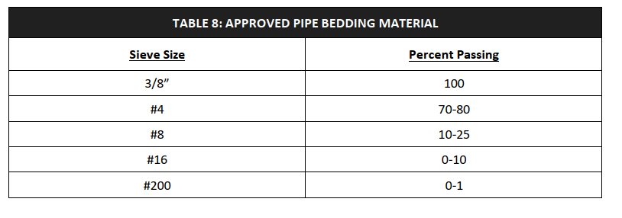
What are regulatory agencies saying?
Douglas County
Notes:
Douglas County has a gradation, this looks like some kind of squeegee.
The county that I work out of.

Slide 49
Striving for Excellence
  Your story
  Questions?
Notes:
Now you will probably tell me of you are an engineer:
1. I don’t have time for this stuff, specially on single family systems. Charge more, we need to elevate this industry and avoid a race to the bottom. It starts with the engineer.
Now you will probably tell me of you are an installer:
1. I don’t have money for this installation, specially on single family systems. Charge more, and explain to the client the risk. Do you want to go dig something up later?

Slide 50
References
ASCE Manuals and Reports Engineering Practice No.60. WEF Manual of Practice No. FD-5, 2nd edition
JM Eagle Gravity Sewer Catalog
https://www.conteches.com/knowledge-center/learn/the-pipe-blog/part-ii-thats-a-load-off-my-mind/
https://bedrocklandscapingmaterial.com/product/colorado-red-breeze/
ADS, Classes of Embedment and Backfill Materials
5 CCR 1002-43
https://www.epa.gov/septic/types-septic-systems#chamber
https://pipelt.com/sewer-repair/sewer-line-belly-vs-pipe-channeling/

