Slide 1


Case studies of Challenging waste streams Dr. Sara Heger sfheger@gmail.com
Notes:
Author: Sara Heger

Slide 2
What makes wastewater challenging?
High Strength
Hard to Treat
Food service
Food preperation
Alcohol
Dairy
Sugar
Toilet flushing primarily
In-home business/hobbies
Cleaning chemicals
Sanitizers
Anti-bacterial
Quats
Emulsifiers
Medicines

Slide 3
Facilities Likely to Have HSW and/or Challenging Waste Streams
Restaurants/Bars/Taverns
Supermarkets/Grocery Stores
Convenience Stores/Mini-Marts
Schools
Churches
Mini-Malls
Golf Courses
Beauty Shops/Salons
Child Care Centers
Resorts/Camps/Retreats
Inns/Lodges/Bed and Breakfast
Vacation home rentals
Visitor Centers/Concessions
Carwashes
Health Care Facilities

Slide 4
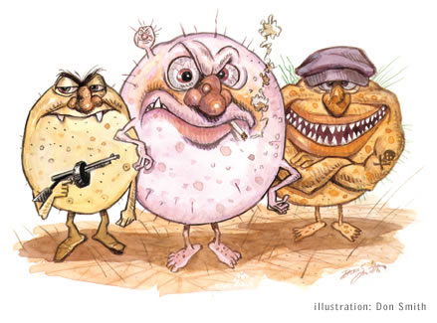
Bacteria – The public May Not Like Them
But we need these guys
bacteria and fungi are the workhorses of wastewater treatment
they prefer their carbon source to be non-toxic

Slide 5
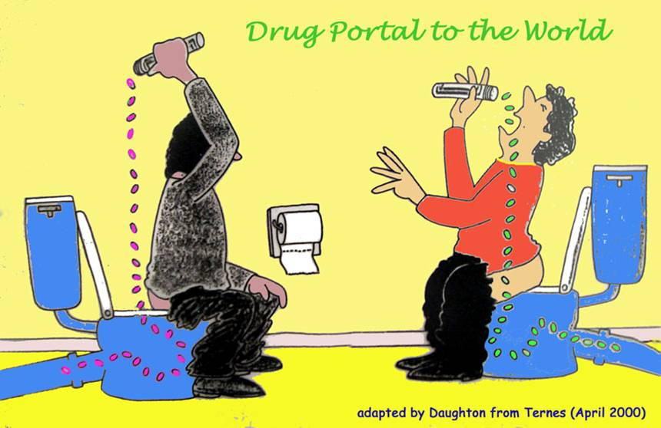
They are Exposed to Everything we Put Down the Drain
The good news
Most waste organic compounds can be degraded by the microbes
in the septic tank
in the soil
The bad news
there are plenty of organic compounds that will kill them

Slide 6
Antibiotics and Similar Meds
Antibiotics are not selective in which bacteria are killed
While antibiotics help a patient by killing harmful bacteria, the medicine often kills good bacteria also
Recommendations: Use them only when needed, dispose of unused ones properly (Do NOT flush)

Slide 7

Chemotherapy
Two risks:
Septic systems
Human health

Slide 8
Chemotherapy
Some forms of chemotherapy are called cytotoxins
Cytotoxic drugs can be used to destroy tumors, boost the outcomes of surgery or radiotherapy, reduce metastases and alleviate cancer symptoms
27 chemotherapy drugs have been identified with a high risk to the impact human health at low doses

Slide 9
Chemotherapy
Approximately 85% are immediately sent home after a treatment
Courses of treatment are generally given at 3 – 4 week intervals
In the 2-3 days after treatment relatively high amounts of the cytotoxin in urine, feces, vomit, and sweat

Slide 10
Risk to septic Systems
Many of the drugs used for chemotherapy could damage the bacteria in a septic system
Due to being immune compromised use of sanitizer/ antibacterial is high in homes undergoing chemo
Lack of dilution in septic system is challenging

Slide 11
Management options with medicine impacts – Short Term
Single short-term doses will cause a small impact but system will likely recover
Example – antibiotic for bacterial infection
Pumping the tank will help

Slide 12
Management options with medicine impacts - Long Term
Long term low doses may impact system but will depend on amount, duration, other inputs
Example – acne medication
Monitor system
Long term high dose will very likely kill off the system and cause clogging of filters, pretreatment units and the soil
Example – daily infusion of antibiotic for micro-bacteria lung infection, chemo, etc.
Use system as a holding tank or get a port-a-potty

Slide 13
Completed research projects
Water softening salt use and impacts
Kidney dialysis
State park wastewater
Coffee, soda, and distillery wastewater characteristics
Flammable waste trap waste both solids and liquids (not covered today)
Home health care facilities

Slide 14


The problem with salt
Most commonly used salts contain chloride, which is toxic to aquatic life
To protect aquatic life, the EPA set a chronic water quality standard for chloride at 230 mg/L
This is equivalent to 1 teaspoon salt in 5 gallons water
x

Slide 15
Soft water
Hard water
Water softening process
Hard water enters the softener
The softener resin attracts hard water minerals and removes them from the water
Softened water is delivered to the house
Resin
SALT

Slide 16
When the resin is full of hard water minerals, the resin is regenerated
Brine enters the softener
The brine removes water hardness from the resin through ion exchange
Hard water minerals and chloride from the brine are discharged to a drain
The resin is ready for the next softening cycle
To drain
Brine

Slide 17
Water softener impacts to Septic Systems
Debate exists about impacts
It is a fact that water softener brine regeneration discharges change the consistency and chemistry of the wastewater stream
Studies with septic tanks have shown that the high concentration of salt introduced by slugs of backwash brine cause salt stratification in the tank, which inhibits the ability of solids and FOG to stratify

Slide 18
Water softener impacts
Sodium concentrations greater than 3,500 mg/L have been reported to inhibit anaerobic digestion
Chloride concentrations greater than 180 mg/L have an inhibitory effect upon nitrifying microorganisms
Chloride concentration in regenerate can reach into the 10,000 mg/L range, with sodium in the 6,000 mg/L range

Slide 19
Water softener impacts
Manufacturers void warranties
Many manufacturers of wastewater treatment systems have clauses in their warranties voiding the warranties if water softener backwash brine is discharged to the treatment system

Slide 20
Water softener discharge options
Replace old units to reduce discharge amount and concentration
Route out of system:
Separate drainfield/rock pit
Surface

Slide 21
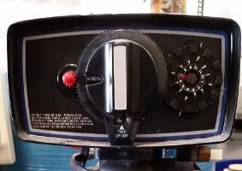
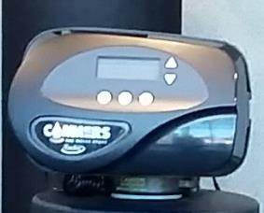
If using an ion exchange softener:
Check to see if it uses a timer or on-demand controller - Look for an efficiency rating of 4000 grains/lb. salt or higher
Upgrade to on-demand
Reduces salt use by 26 – 60%
Reduces water use by 25 – 40%
Old timer controller
Demand-initiated controller
Notes:
Look at your water softener or manual for the softener. Check if it uses a timer to recharge or if it measures water use and recharges based on water use.
A timer or time clock controller is set to recharge every XX days based on an estimate of water use.
An on-demand controller uses a meter to measure actual water use and recharges based on that use. Switching to an on-demand softener will reduce salt use by about 30%.

Slide 22
Make sure softener is sized correctly
Purchase through a water conditioning professional
If you are a do-it-yourselfer, learn what size is needed based on your household:
Water hardness
Water use
Notes:
A softener that is too small or too large is inefficient. The softener should be set based on the hardness of your water supply and your household water use. Those purchased at big-box stores are set for national average values, which may not be close to what you need. Working with a water quality professional will help you find the correct sized softener for your household and correct settings for your water use.

Slide 23

Kidney Dialysis and Septic system Impacts

Slide 24

Kidney failure
Kidney disease affects an estimated 36 million people in the U.S
14% of the adult population; more than 1 in 7 adults
Over 800,0000 Americans have kidney failure, and needed dialysis or a kidney transplant to survive
Dialysis is a treatment for kidney failure that removes waste and extra fluid from the blood, using a filter
Home dialysis is increasing every year
Notes:
At the end of 2021, 14.1% of all patients undergoing dialysis performed dialysis at home. The percentage of patients performing home dialysis increased approximately 45% between 2011 and 2021.

Slide 25
Potential Dialysis impacts
Depends on the type
Each session is from 3-8 hours typically using around 25-100 gallons per week
Post-dialysis effluent can have a high concentration of sodium and chloride (over 3,000 mg/l for both)
Can alter, kill, or to cause unwanted and incorrect organism overgrowth in the septic tank and downstream
Can negatively impact concrete

Slide 26
Potential Dialysis impacts
Effluent can have a high glucose content – 7,000 – 20,000 mg/L
The high glucose content of effluent can promote the formation of a co-polymer that can coat the surface of the soil and can block the lateral lines

Slide 27
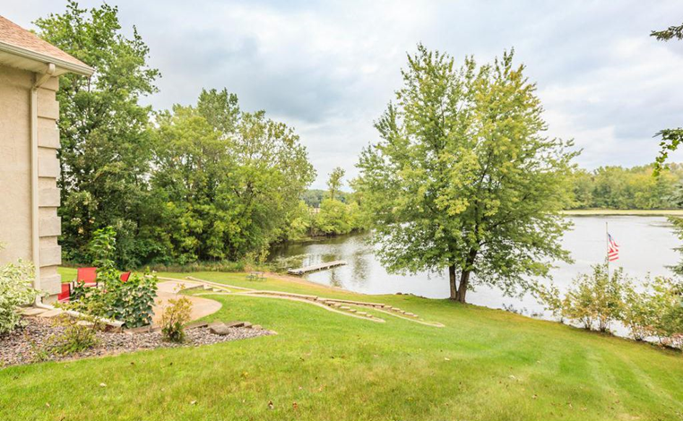
Dialysis Case Study
Does home hemodialysis affect the function of a septic tank?
Field samples, from the homeowner’s septic tank, were taken and tested for TSS, BOD, P, TKN, sodium and chloride
A site assessment was performed to ensure the system was working properly
Notes:
OSTP assessed a residential septic system in Minnesota owned by a patient undergoing home hemodialysis treatment for kidney failure to evaluate the wastewater being generated by the household and determine whether the composition of this wastewater has the potential to affect the function of the septic system.
ONE site was assessed, ONE round of samples taken. This study needs more data, more sampling events.

Slide 28
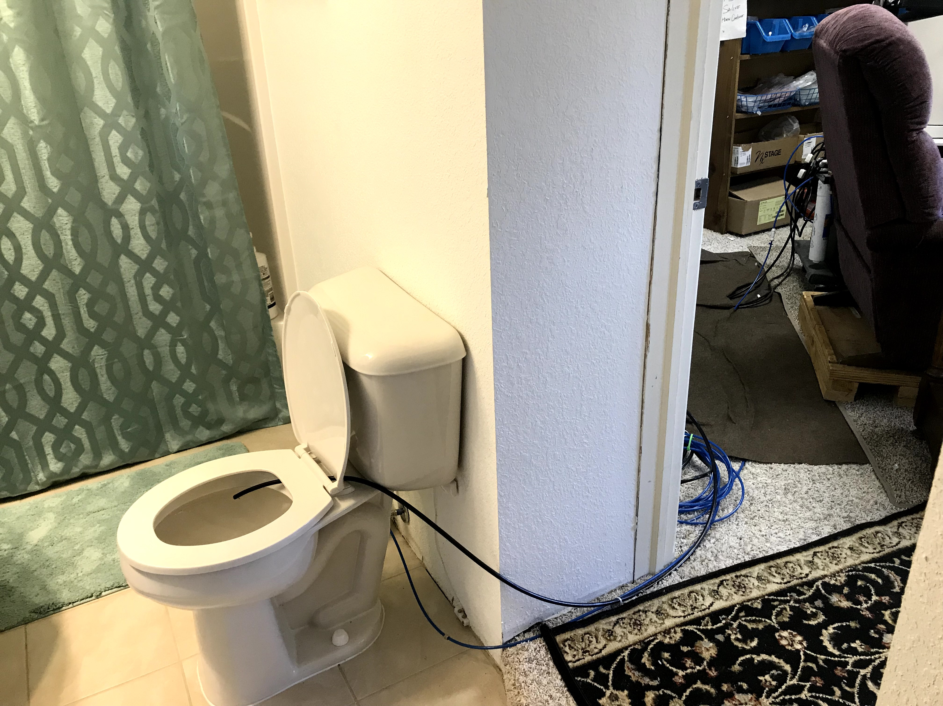
Home uses hemodialysis Their dialysis machine into their home plumbing system
Notes:
Photos: the homeowner’s home hemodialysis machine and showing how the machine is plumbed right to the toilet.
The two wastewater streams produced by home hemodialysis are reverse osmosis reject water and a post-dialysis effluent called dialysate, in this system the two streams are combined at the output point.
Fresh dialysis solution has a high concentration of sodium and chloride and because of this, the dialysate dialysis solution is also high in sodium and chloride. If a patient is discharging this waste to their septic system, these high concentrations have the potential to negatively affect the function of the system.
The reverse osmosis water is not harmful to a septic system because it is considered clean.
The only concern would be that, depending on a patient’s treatment plan and schedule, a septic system may
not be designed for the additional flow.

Slide 29
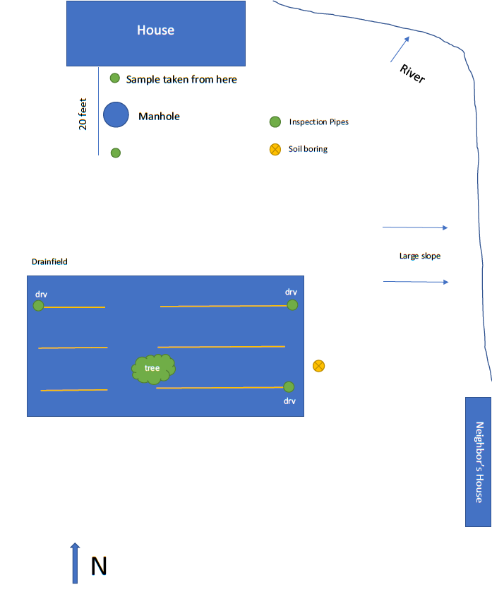
Site Assessment
Septic System
1,500 gallon septic tank
Wastewater flows via gravity to rock trenches
The system is sized appropriately for the number of bedrooms and soil conditions
Demand-based water softener in operation
Inspected in 2017 → 36 inches to the limiting condition according to the Minnesota state code
Notes:
To note: The system froze in January of 2018 likely due to a very shallow septic tank depth. The shallow depth of this tank in cold Minnesota temperatures can be unfavorable for fostering natural bacteria
growth. It was estimated that in early April of 2018 the septic tank was cleaned. The homeowner started dialysis at home in May of 2018.

Slide 30
Results
Parameter | Septic Tank Effluent (mg/L) | Typical Residential (mg/L)
BOD | 198 | 170
TSS | 142 | 60
Bacteria | LOTS | LOTS
Nitrogen | 132 | 60
Phosphorus | 7.3 | 8
Sodium | 742 | 50 *
Chloride | 1250 | 20*
* Without a water softener
Notes:
Total Kjeldahl Nitrogen - Higher than normal concentrations
Explanation: Urine is the most common cause of nitrogen in septic effluent. Other causes of high nitrogen can be undigested food and certain household cleaners.
Recommendation to Homeowner: Do not dispose of any undigested food into the system. Evaluate all cleaners and remove those that contain ammonia or nitrogen.
BOD- Within a normal range
Explanation: BOD measures waste strength. Although, levels here are within a normal range it is still higher than expected for two people residing in the home. This could be a result of higher glucose levels from the dialysate entering the system.
Recommendation to Homeowner: For now, continue discharging dialysate to the system.
TSS- Higher than normal concentrations
Explanation: Measures waste strength and solids in the effluent after tank settling.
Recommendation to Homeowner: Add an effluent screen to the outlet of the septic tank. Do not dispose of any undigested food into the system.
Sodium and chloride- Higher than normal concentrations
Explanation: Higher concentrations of sodium and chloride could be caused by discharging dialysate to the system and running the water softener.
Recommendation to Homeowner: For now, continue discharging dialysate to the system.
With regard to the water softener, consider:
· having it adjusted to regenerate less frequently,
· not running the discharge to the septic system, or
· discontinue use.

Slide 31
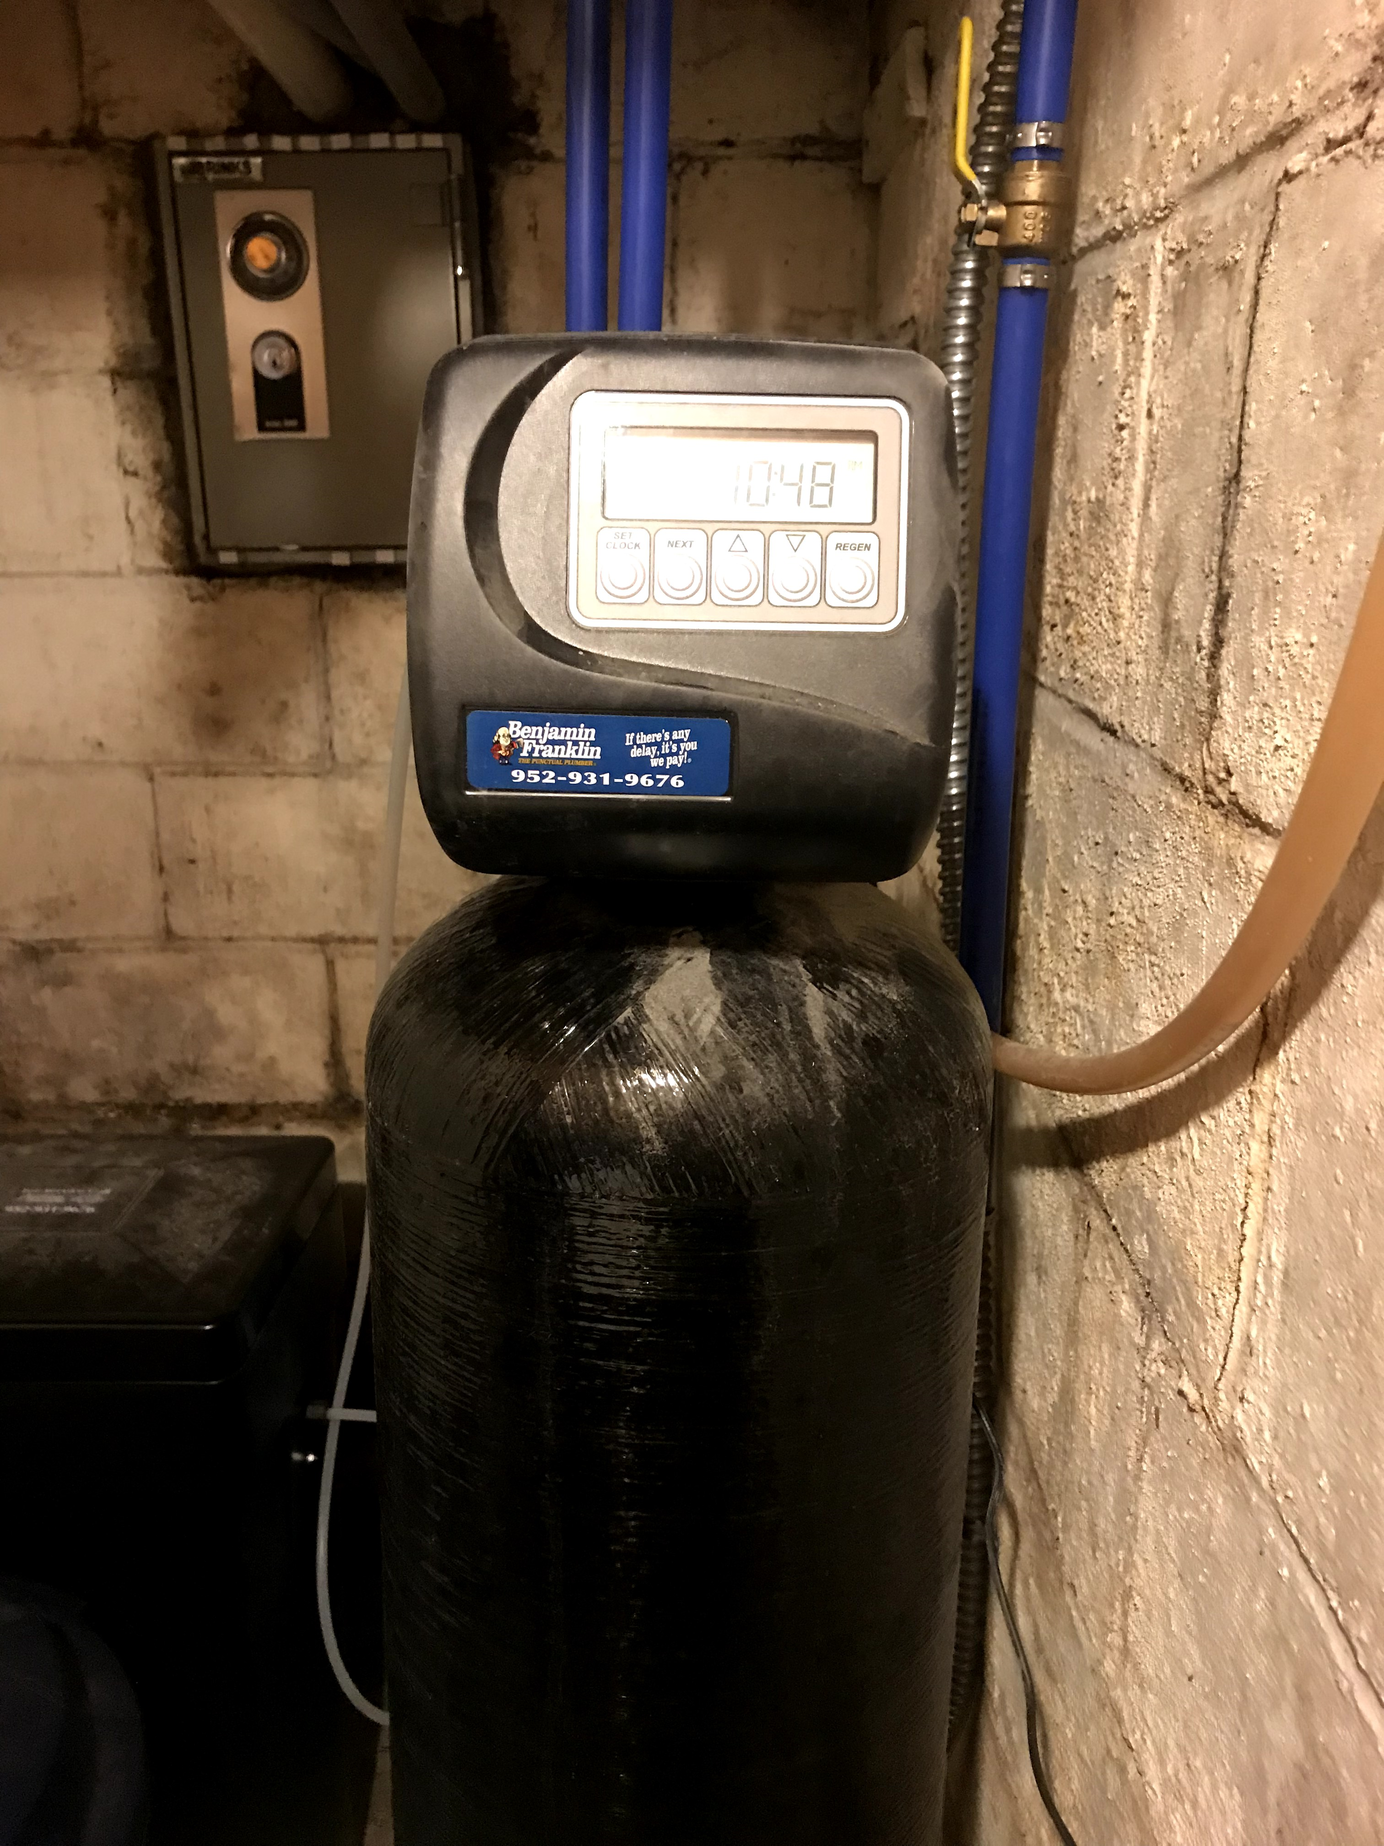
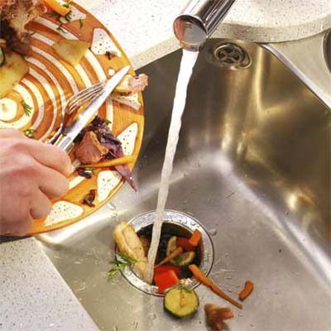
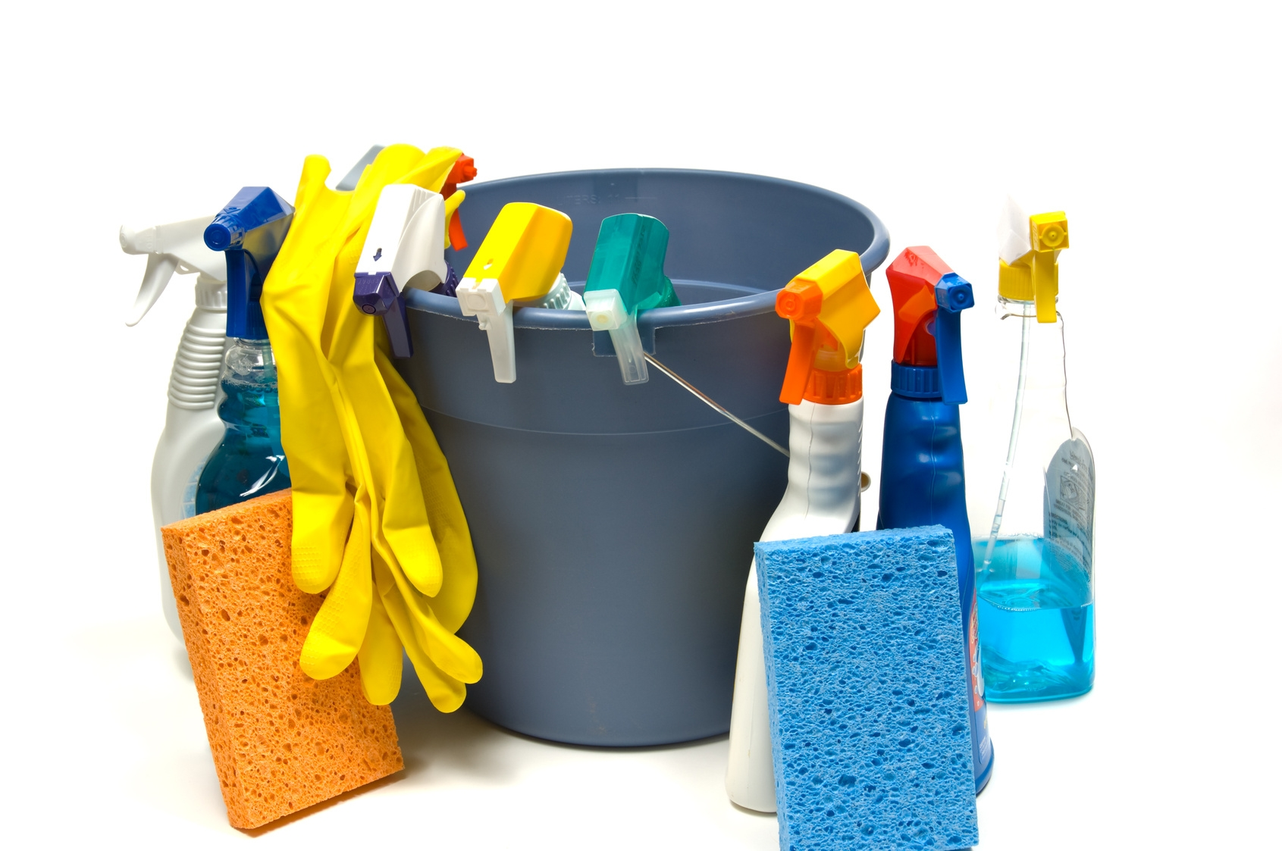
General Recommendations – can it not be plumbed in?
There needs to be more data collected to observe contaminant concentrations
Notes:
If you know that one of your clients is using a home hemodialysis machine- you can make the following general recommendations:
Get the water softener checked.
· having it adjusted to regenerate less frequently,
· not running the discharge to the septic system, or
· discontinue use.
Discontinue use of the garbage disposal if there is one.
Eliminate cleaning products with ammonia (except for cleaning the hemodialysis machine).

Slide 32
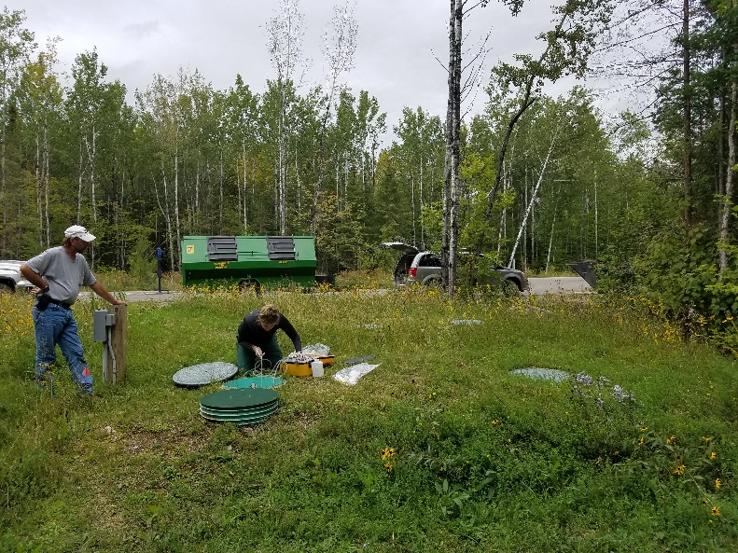

Case Study: Campground shower Houses and RV Dump stations

Slide 33
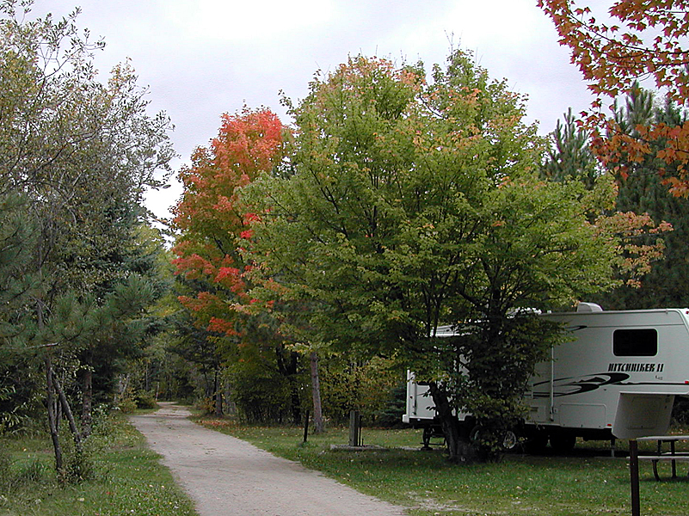
Park 1 Project Synopsis
The purpose of this project was to provide an evaluation of the wastewater stream:
Recreational vehicle (RV) dump station
Campground bathroom
Existing pond system failing
Sampled septic tank effluent (STE) from the two sources
Notes:
Park A currently treats all their wastewater using a centralized wastewater treatment pond and vault toilets.
The pond is not meeting the requirements of its state permit and therefore the DNR is having a new wastewater treatment system designed.
The purpose of this assessment was to produce a summary of the wastewater stream from the RV dump station and campground bathroom at the park.

Slide 34
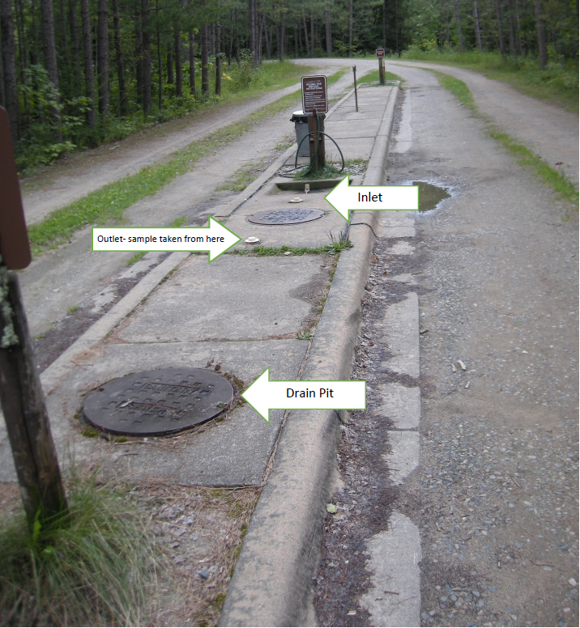
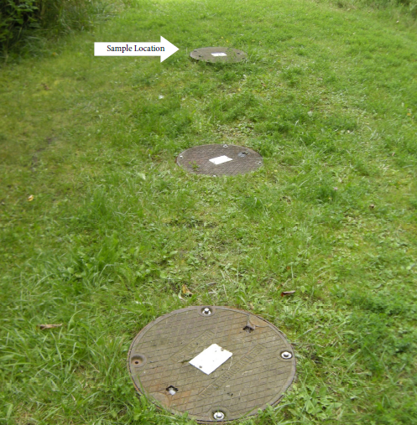
Sampling Locations
RV Dumping Station
Campground Bathrooms
Notes:
The outlet inspection port was opened and wastewater samples were obtained.
There was 5 feet of wastewater in the tank and about 28 inches of sludge at the bottom.
According to the DNR this tank was last pumped in the fall of 2017.

Slide 35
Results – park 1
Parameter | RV Dump Station STE | Bathroom STE | Typical
BOD | 1280 | 195 | 170
TSS | 230 | 74 | 60
Nitrogen | 769 | 135 | 60
Phosphorous | 56 | 18 | 10

Slide 36
Results
The waste stream is not typical domestic-strength waste
Before a new system is designed, more wastewater contaminant data should be collected and flow rate data for the park analyzed as well
Notes:
It is likely, in order to properly treat this wastewater, the new design must include a secondary treatment unit to reduce the RV waste and potentially the nitrogen from the shower house.
The range of parameters tested in this report should be repeated monthly during the summer months of 2020 park operation.

Slide 37
Solution
System was sampled again
Advanced treatment system was designed for dump station with an aerobic treatment unit
RV treated wastewater is combined with shower house STE
Mound systems were installed for final treatment and dispersal

Slide 38
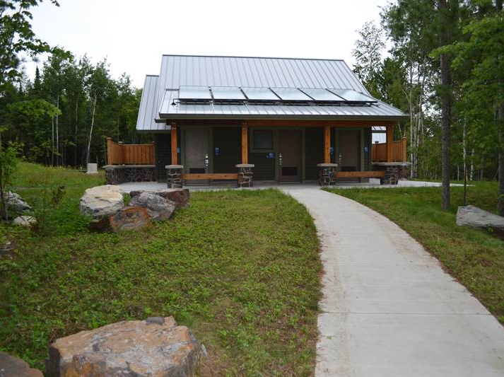
Park 2 Project Synopsis
The purpose was to evaluate the new septic systems with secondary treatment units at a:
RV dumping station
Campground shower house
Provide recommendations to the DNR on how to move forward with the management of these systems

Slide 39
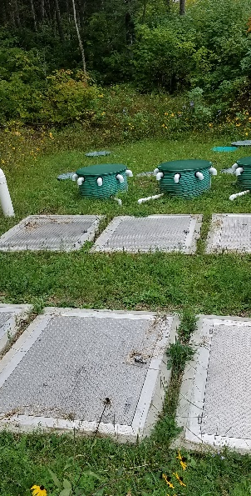
RV Dumping Station
Designed for 1,800 gal/day
Secondary treatment unit:
Two 4,200 gallon Nibbler tanks.
Each holds one 10-pod pretreatment unit
Samples Taken from:
Flow equalization tank for the Nibbler
Lift station to analyze treatment achieved by the Nibbler
Sludge and scum were measured as well
Notes:
6,000 gal septic tank, 4,000 gallon surge tank, 2000 gallon clarifier tank, 2000 gallon surge tank
There is a sludge return pump in the clarifier tank which on a monthly basis is manually operated to return sludge to the septic tank.
Sampling Background
• At the inlet of the first septic tank there was 5 feet of wastewater, 2 feet of sludge and 3 inches of scum at the top.
• The second tank (flow equalization tank for the Nibbler)) was where the samples were drawn from. This tank had about 4 feet of water, 4 inches of sludge and no scum but a light film on top.
• The lift station which doses the mounds was where the second samples were drawn from to analyze the treatment achieved by the Nibbler. This tank had only about 2 to 3 inches of sludge.

Slide 40
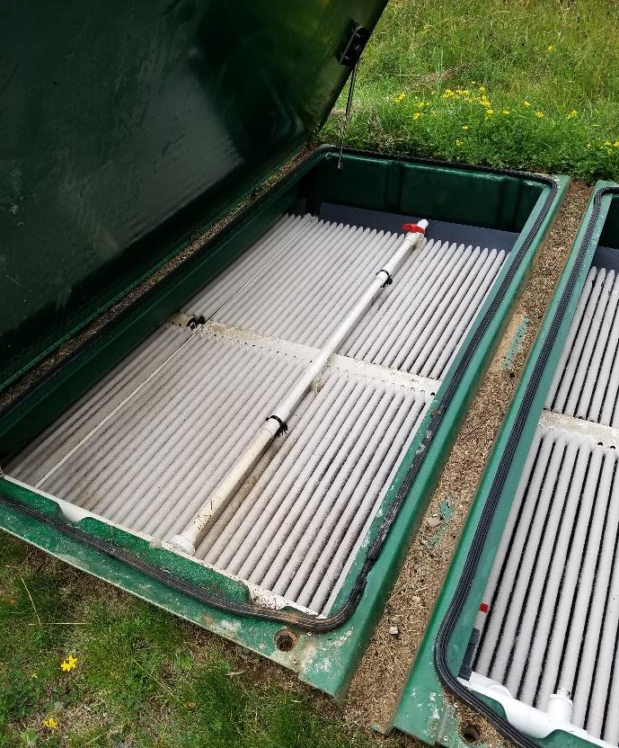
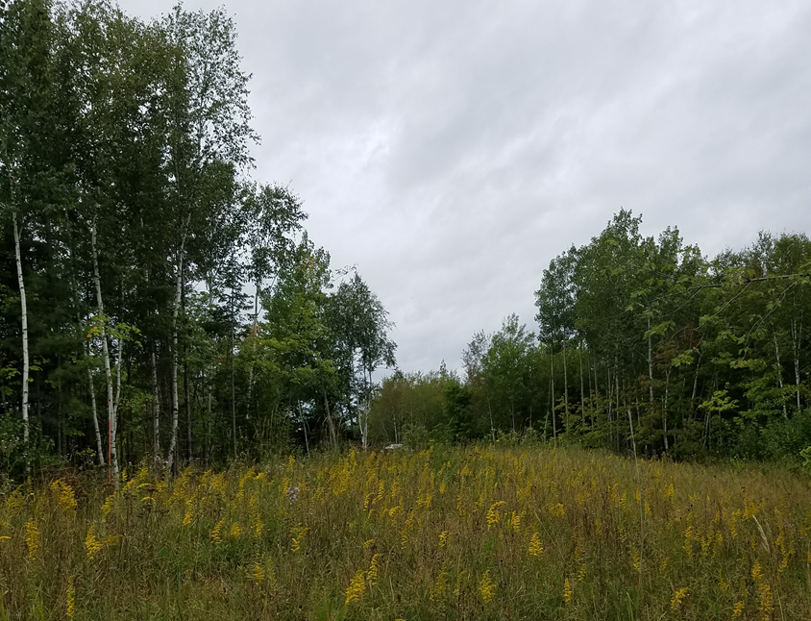
Campground Shower house
Designed for 1,900 gallons per day
Advantex AX-100 recirculating secondary treatment unit
Wastewater is directed to two mounds
Samples Taken from:
Outlet of the septic tank.
Lift station, to understand the treatment achieved by the Advantex
Sludge and scum were measured as well
Notes:
1,085 gallons per day to Mound #1 and 815 gallons per day to Mound #2.
The system has three tanks: a 6,000 gallon septic tank, a 4,000 gallon pump tank and a 2,000 gallon recirculation tank.
• Samples were drawn from the outlet of the septic tank from where there was 5 feet of water, 18 inches of sludge and less than 1 inch of scum.
• The inlet of the tank was observed to have about 5 feet of liquid depth, 3 feet of sludge and about 4 inches of scum.
• In the recirculation tank in the middle, 3 feet of liquid depth and about 6 inches of sludge was observed.
• Samples were drawn from the lift station to understand the treatment achieved by the Advantex pre-treatment system. This tank had about 4 feet of liquid depth and 2 inches of sludge.
All tanks were pumped in the fall of 2017.

Slide 41
Results - RV Dumping Station
Parameter | STE | Post Nibbler | % Reduction
BOD | 1530 | <20 | 99
TSS | 92 | 15 | 84
Nitrogen | 757 | 273 | 84
Phosphorus | 86 | 32 | 62
Fecal coliform | TNTC | 74 | 99.9+
Notes:
The RV dump station wastewater contaminant findings (Table 2) show that this wastewater sample is very concentrated compared to typical domestic effluent.
The Nibbler pre-treatment unit is working well, reducing the BOD by more than 99% and TSS by 84%.
The incoming nitrogen and phosphorous concentrations are being reduced but there may be an opportunity for further treatment.

Slide 42
Results – Campground Showerhouse
Parameter | STE | Post Advantex | % Reduction
BOD | 213 | 7 | 97
TSS | 60 | <10 | >83
Nitrogen | 139 | 21 | 85
Phosphorus | 26 | 28 | -
Fecal coliform | TNTC | 74 | 99.9+
Notes:
The total nitrogen and phosphorus levels in the septic tank are double domestic strength due to the high amount of toilet flushing.
The Advantex is performing well in terms of BOD, TSS and Fecal Coliform.
The nitrogen reduction is at 85% during our sampling.

Slide 43
Recommendations
1. Septic tanks at both locations need to be pumped.
2. Time-dosed control panel on sludge return pump at RV Dumping Station to improve nitrogen treatment.
3. Hire a certified service provider.
4. Gather and analyze flow data to gain a better understanding of how the systems are working compared to how much use they are getting.
Notes:
1. Septic tanks at both locations need to be pumped.
2. To improve nitrogen treatment at the RV Dumping Station, the sludge return pump should be changed to be controlled with a time-dosed control panel (currently operated manually). Flow data will be needed to set the panel.
3. MPCA certified service provider be hired to manage and maintain these systems to ensure they are consistently evaluated and operating properly

Slide 44
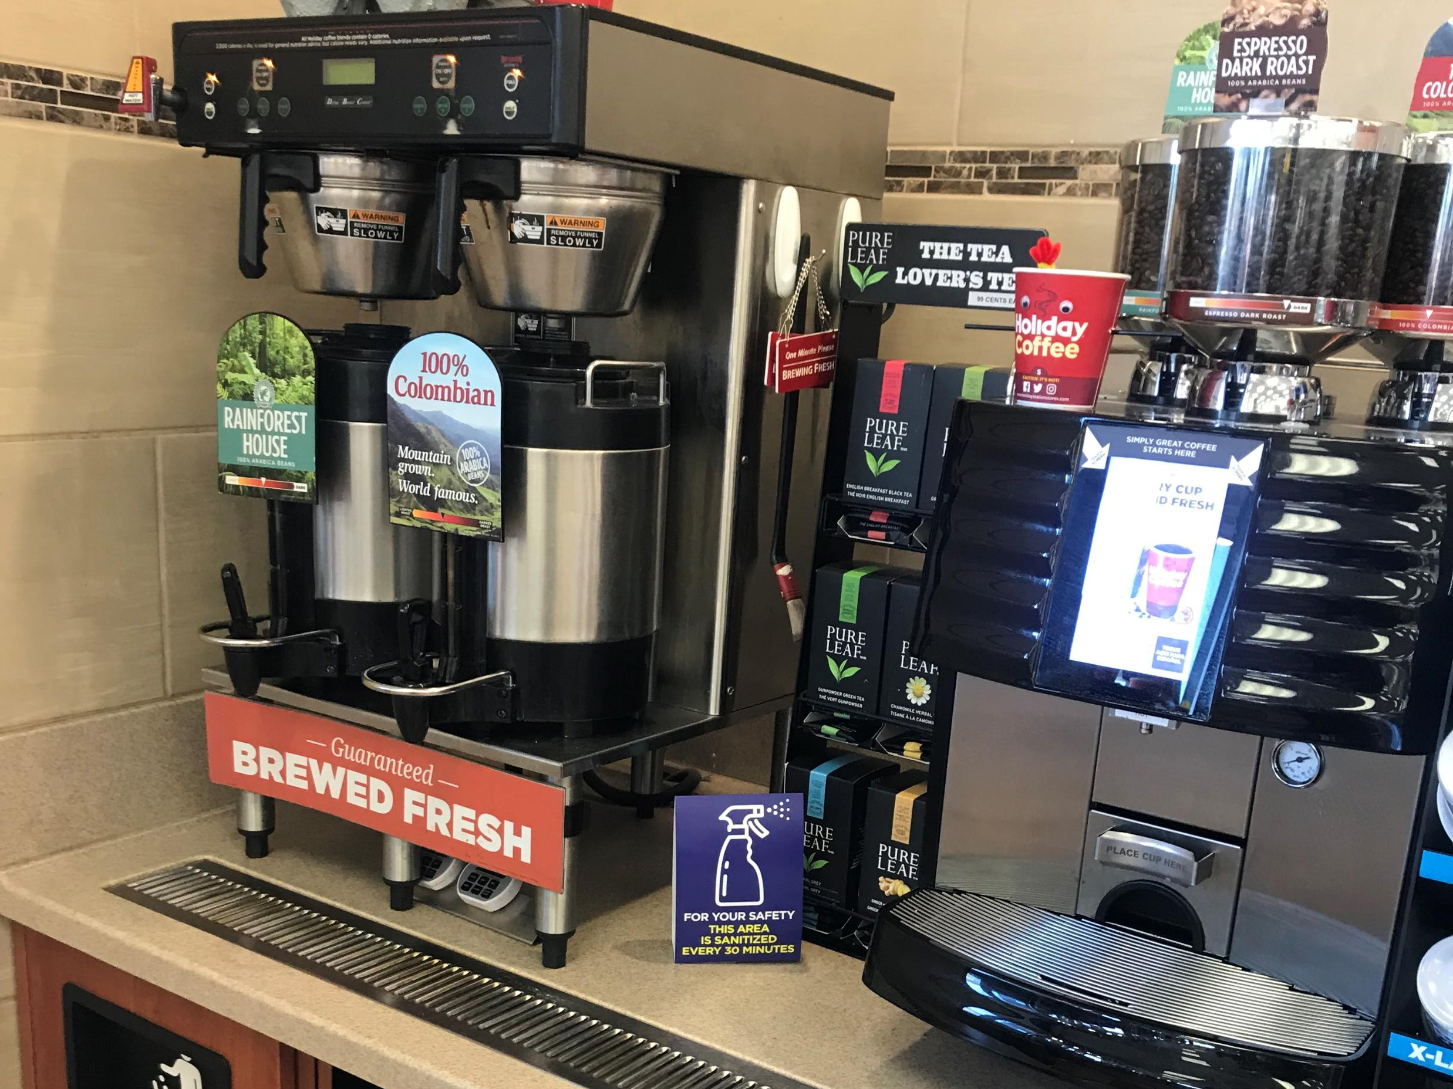
Wastewater characteristics analysis of coffee, soda and Spirit products

Slide 45
Beverage impacts at convenience stores and food establishments
Considerable amounts of liquid beverages is discharged to septic systems
What is the impact of coffee, soda and spirits on wastewater levels?
Five different types of product were used for this study:
black coffee
iced coffee
coffee with a sweetened creamer
coffee with regular half and half added
coke (regular)
Vodka, whisky, rum

Slide 46
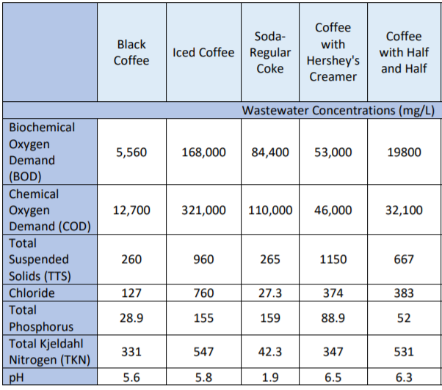
results

Slide 47
What’s in Booze? Straight alcohol lab test results
Parameter | Stoli Vodka | Jack Daniels Whisky | Captain Morgan Rum
pH | 6.6 | 4.1 | 4.5
TSS (mg/L) | 6.5 | 6.3 | 6.3
BOD (mg/L) | 380,000 | 470,000 | 420,000
Total Nitrogen (mg/L) | 125 | 131 | 126

Slide 48
recommendations
Characterize the facility to determine what will be going down the drain
CIDWT forms for Analyzing Wastewater Treatment Systems for High Strength Waste and Hydraulic Loading
http://cidwt.org/awtschecklists.html
Discuss with the facility owner/manager if changes can be made to the equipment or management practices to reduce the amount of beverage waste entering the system
During design or management for all existing facilities, several samples should be taken and analyzed, as the influent levels are likely to be variable

Slide 49
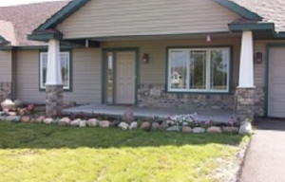
Case study: home health care facilities

Slide 50
Background
6 homes owned by same individual had reported various issues with their septic system operation and performance, including:
surface discharge of wastewater and
premature system failure
The systems evaluated are conventional systems with septic tanks followed by in-ground soil treatment areas or mound systems
Septic tanks pumped annually

Slide 51
Methods
Water Usage - staff who work in the facilities collected daily water meter readings over 5 months
Onsite Practices and Behaviors
Staff provided feedback and assisted in completing a survey
Provided inventories for each site listing all pharmaceuticals and personal care products used in the facilities

Slide 52
Results – Water usage
Site | Flow, gpd
 | Mean Ave. Recorded | 70% of Design | Design
A. Maple View | 321 ± 13 | 525 | 750
B. Shady Lane | 462 ± 6 | 420 | 600
C. Woods | 326 ± 22 | 420 | 600
D. Jocelyn | 630 ± 19 | 525 | 750
E. Upland | 521 ± 6 | 840 | 600/1200
F. Meadows | 491 ± 23 | 525 | 750

Slide 53
BOD₅ data
Site | BOD₅, mg/L
 | Mean | Min. | Max.
A. Maple View | 143 ± 31.0 | 80.8 | 166
B. Shady Lane | 129 ± 12.4 | 110 | 147
C. Woods | 193 ± 34.2 | 159 | 235
D. Jocelyn | 144 ± 41.5 | 93.4 | 195
E. Upland | 182 ± 49.9 | 119 | 244
F. Meadows | 132 ± 64.9 | 48.7 | 191
G. Control Site | 64 ± 30.7 | 38.6 | 114

Slide 54
TSS data and analysis
Site | TSS, mg/L
 | Mean Ave. | Min. | Max.
A. Maple View | 46.5 ± 2.7 | 44.1 | 51.0
B. Shady Lane | 38.9 ± 16.9 | 20.5 | 67.4
C. Woods | 39.6 ± 8.7 | 28.2 | 54.5
D. Jocelyn | 48.6 ± 10.5 | 36.7 | 65.3
E. Upland | 51.1 ± 18.7 | 31.9 | 84.7
F. Meadows | 24.7 ± 6.3 | 17.5 | 32.0
G. Control Site | 40.3 ± 24.4 | 17.3 | 71.8
All sites had TSS concentrations within the standard range*
Lint filters and effluent screens recommended

Slide 55
Additional recommendation
Some of the existing systems are not up to basic standards
Effluent screens and alarms should be added
New systems or those being upgraded should time dosing and incorporate secondary treatment prior to soil treatment to mediate:
flow,
waste strength, and
CECs

Slide 56
More information
See our website at: septic.umn.edu/research
sfheger@gmail.com

