Slide 2

Old File Follies What One Comes Across When Trying to Update Septic System Records
Diana Rashash, PhD CPH EI, Sr Water Quality Specialist Arapahoe County Public Health
Notes:
This was truly an educational and entertaining process that deserves the “Old File Follies” title. I read - and saw - some of the darndest things.

Slide 3






Agenda
1
Project Overview
2
Methods and Steps
3
Roadblocks
4
Resources and Relationships
5
Results and Lessons Learned
6
Q&A
Notes:
This presentation will take you through the process that I used to update the Arapahoe County Public Health septic system records.

Slide 4

Project Overview
1
ACPH formed January 1, 2023
Question to answer:
What was the status of the septic systems in ACPH’s files?
Historical records from TriCounty Health
6,457 system addresses in Health Space
Unknown number not in Health Space
Files dated back to 1948
Notes:
Arapahoe County Public Health opened its doors in January 2023, when TriCounty Health Department dissolved. I came onboard in October 2023. One project given to me was to go through the septic system records and determine if there were systems that no longer existed. There were 6,457 system addresses in Health Space (the software system used to track permits and inspections), plus an unknown number of old files that weren’t in HS. Many of the files were from the 50s-90s. The earliest was from 1948.

Slide 5

Methods and Steps
Septic system status choices:
Still in use
Demolished/gone
Belonged to a different county
Can’t locate
Collect or locate sanitation district maps
Roughly 32 sanitation districts!!
Establish contacts with the districts
Google Maps & County Assessor’s website
Create Excel spreadsheet & update Health Space
2
Notes:
First, we chose system status categories: “still in use”, “demolished/gone” (through either from redevelopment or connection to sewer), “belonged to another county” (we gave them back the file), and “can’t locate”. This involved locating each of the systems. To do this, the sanitation district maps were very useful, especially since we have so many districts in Arapahoe County. These maps were used in conjunction with Google Maps and the County Assessor’s website to locate individual parcels. The Assessor’s website was VERY useful in identifying property addresses and parcels that no longer existed. Attempts were made to find the current or correct addresses for the systems. Addresses were entered in an Excel spreadsheet and sorted by sanitation district. Lists of “true” addresses were sent to the district contacts and the request was made to confirm if the address had been connected to sewer. After a district replied, the spreadsheet and Health Space were both updated. It was a very iterative process. Most frustrating were the “can’t locate” sites. These had insufficient information to determine the current address.

Slide 6
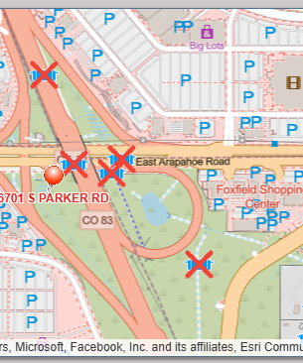
Methods and Steps
2
https://gis.arapahoegov.com/septicSearch/
Notes:
Some systems were definitely easy to say that they no longer existed – such as those under roadways, apartment complexes, and shopping centers. They were my “low hanging fruit”. To “inactivate” the sites on the publicly available septic system lookup map, the permits were toggled “inactive” in Health Space, which connected to the lookup map. The septic system lookup webpage now permits viewers to select “Include Inactive Permits”, which appear with the red X. If the box is not selected, those systems do not appear on the map.

Slide 7

Roadblocks
Address issues
House number changes
Road name changes
Incomplete addresses
Address no longer exists
Re-platted developments
Very poorly documented systems
DIAGRAMS!
3
Notes:
There were numerous roadblocks to identifying system location. For “address does not exist” situations, it had to be determined if it was because the house numbers changed, the road name changed (sometimes both!), it was an incomplete address (I loved when there were “lot, block, & subdivision” notations!), or if the site was truly gone due to either demolition or redevelopment. In a few cases, permits had been obtained by a developer for several parcels, then another developer bought the properties and added them to their development. The re-platting changed the lots, subdivision, and address information. In one instance, the new developer connected to sewer, so the permitted systems were never actually installed. Often, happiness was finding one file among a street full of address files that contained lot and subdivision information or a parcel map.

Slide 8
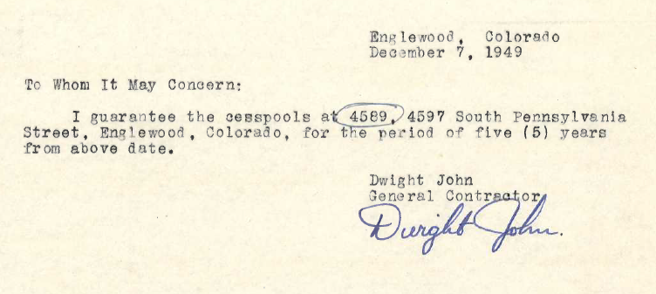
Roadblocks
3
Notes:
The “file follies” part comes into play with files such as this one. This page was the ONLY item in the file! For situations like this, the process was to use various maps to determine if the sites may have been demolished (became roads, shopping centers, or apartment complexes). If not, they were added to the list of addresses sent to the sanitation districts to determine if they had connected to sewer. At times when the property number no longer existed (for example the 4589 address), the list was sent with several addresses above and below that number that do exist. If they all came back as “connected to sewer” – great. If one came back as “not connected”, the assumption was that that was the new address number. Luckily, I never got back information that more were not connected than I was asking about.

Slide 9
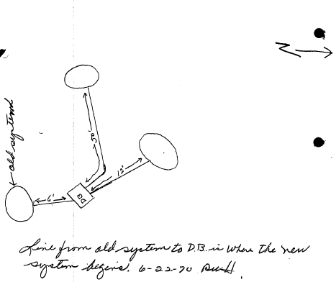
Roadblocks
3
Notes:
When addresses were incomplete or inaccurate, the majority of the drawings did NOT have sufficient information to try to locate the property.

Slide 10
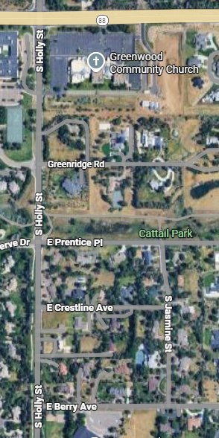
Roadblocks
3
Notes:
Some files had no address; just an intersection – in this case, “Osmer & Jasmine”. Sorry, the “JA” didn’t show up well. For this file, there was no address number and Osmer no longer existed. The property was located using both the drawing on the upper left corner of the form and various maps, which let me discover that the road was now E Crestline Ave. The Assessor’s parcel map let me add complete addresses to the list – in this case a row of address numbers - to send to the respective sanitation district.

Slide 11
Roadblocks
“The address does not exist!”
3
https://columbinegenealogy.com/wp-content/uploads/2013/04/Littleton_1961_Address_Changes_v.4_OLD-NEW-1.pdf
Notes:
I had a stack of files for systems in Littleton in the “can’t locate” pile. Either the street name or the number no longer existed. These were all from prior to 1961. While searching online, I found information about an address update that occurred to bring addresses in line with the Denver name and number system. Further searching located a document with the address changes. I considered this the “fun sleuthing” part of the project. Actually, it was likely a combination of “frustration and fun sleuthing”. I have to say that it was a true “Eureka!” moment when I came across this document! There is still a stack of “can’t locate” files, but it is somewhat smaller.

Slide 12

Resources and Relationships
Maps and screens
Google Maps
County Assessor’s website
ACPH septic lookup website
Excel spreadsheet
Update Health Space after confirmation
Sanitation district contacts!!!!
4
Notes:
Having multiple maps and screens open at the same time was not uncommon. After getting confirmation from a sanitation district that a site had connected to sewer, the HS entry would be updated to “inactive” it. To do this, the sanitation district contacts were vital. Arapahoe has roughly 32 sanitation districts. Some are served by the same “parent” entity or service. Figuring that out took a bit of work. As the project progressed – and I kept sending them lists of addresses – I made sure to thank them for the information that they were providing.

Slide 13

Results and Lessons Learned
1765 systems inactivated
Some sites had multiple permits (install, repair, use, etc.)
67 systems as “can’t locate”
Now adding GPS info to tank location
Different sanitation districts provide different information:
“Yes”, “No”,…date of connection!
Be nice to your contacts!
5
Notes:
So far, we are at 1,765 inactivated system addresses. There were actually many more permits that were inactivated due to different permit types, such as install, use, and repair that may serve the same property. There are still 67 systems that I haven’t been able to find. This has prompted us to add the GPS location of the septic tank during final inspection of new systems or repairs. Some sanitation districts replied with just “yes” or “no” responses to “is this address on sewer?”. Others provided the date that the sewer connection was made. I know that I mentioned it in the previous slide; however, it bears repeating: be nice to your contacts!

Slide 14
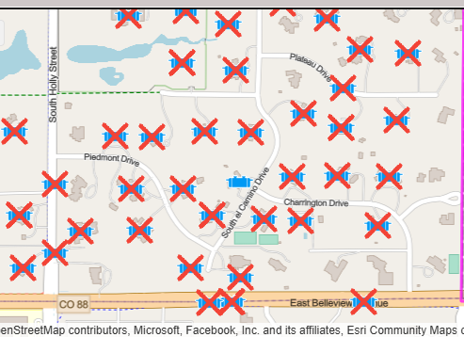
Results and Lessons Learned
5
Notes:
Has this project been worth it and useful? In a word, YES! The updated maps are great and really let you see where sewer has expanded. It also lets you see where that lone – confirmed – septic system holdout is located. Prior to this project and the updated mapping visualization, it would have been impossible to tell at a glance that the lone site was surrounded by sewer. It’s safe to say that its days are numbered.

Slide 15

Q & A
Feel free to contact me at:
drashash@arapahoegov.com
6

